Slide 1



Social movements and collaborative climate adaption: the case of Campo do Bomba, in Duque de Caxias-RJ- Brazil
Ana Lucia Britto, Thêmis Aragão, Jorge Nassar Fleury
Urbanism Program – Federal University of Rio de Janeiro
ana.britto@fau.ufrj.br

Slide 2
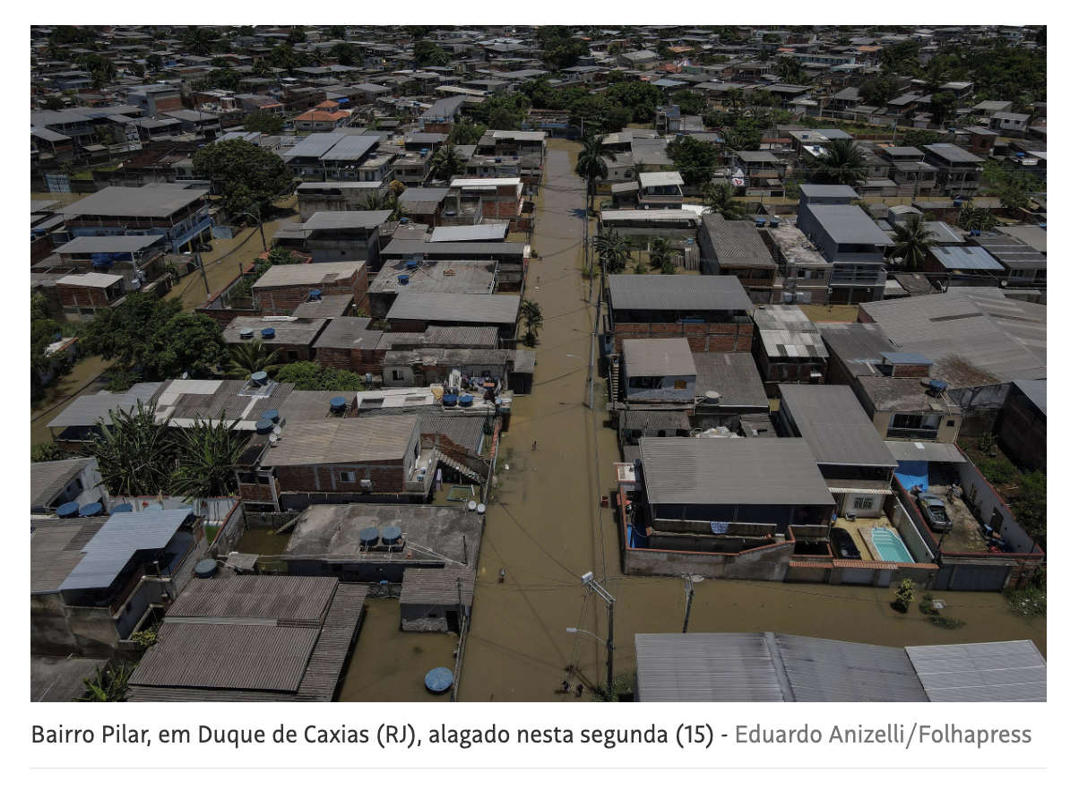
Context: Climate Governance in Brazil and in peripheral municipalities of Rio de Janeiro Metropolitan Region
Between January 2013 and December 2024, 95% were affected by different climate disasters ( most of them by floods)
Most municipalities lack of institutional capacity and adaptation plans
Rio de Janeiro Metropolitan Area (RMRJ) has twenty-two municipalities and only two of them have a Climate Change Mitigation and Adaptation Plan.
The paper aims to discuss social participation in climate adaptation projects/actions and the possibilities of collective adaptation (Wannewitz and Garschagen, 2023) in vulnerable communities.
Duque de Caxias January 2024

Slide 3
The study area: Duque de Caxias municipality
808,161 inhabitants; about 30% of the population living below the poverty
45% of households are in high-risk of floods susceptibility
Outdated urban development master plan (2006)
Informal settlements in fragile areas
Absence of adaptation plan
A municipal government that prioritizes the pursuit of economic growth over environmental preservation and climate risk adaptation or mitigation.
Active local social movements with a history of struggles for environmental justice and the right to housing.
Alliances with academics from Federal University of Rio de Janeiro
Discuss Holland (2017) proposal concerning the importance of alliances built by vulnerable or marginalized communities to enhance their capacity to be politically capable of shaping adaptation decisions ( such as alliances with media or academics)

Slide 4
Context of the study: Campo do Bomba environmental conflict
A conflict between municipal government and local social movements about de the use of a natural protected area in São Bento, Duque de Caxias, named Campo do Bomba
Bomba was part of a much larger environmentally protected area called APA São Bento, which belongs to the Federal Government
Municipal government project: transform the area into a private logistic zone
Bomba is floodplain (i.e., a 'sponge' area) absorbing water and minimizing the effects of floods in surrounding areas
Floods tend to worsen in the context of climate change.
Social movements articulated in FORAS (Fórum de Articulação da Sociedade Civil ): preserve the protected natural area and giving it a public use (a public park) arguing its importance in an adaption strategy

Slide 5
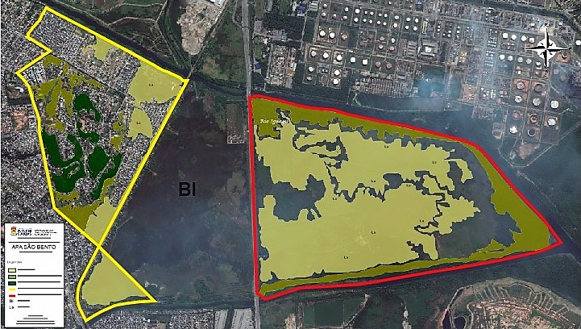
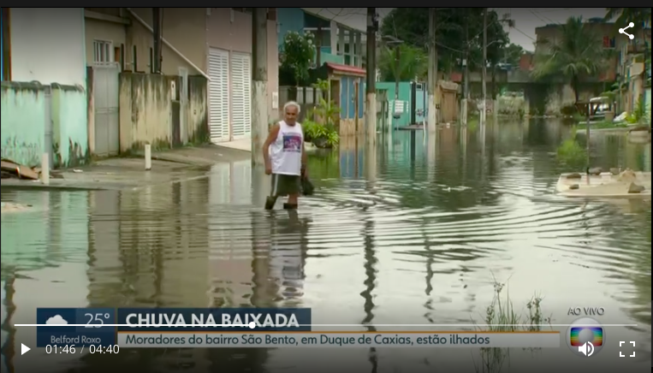
Campo do Bomba area

Slide 6
Social movement actions
3 public hearings and online seminars with academics and residents, during the pandemic period.
Mobilization on social media and formal media ( local news broadcast; press media)
Articulation with Rio de Janeiro state deputies: draft bill transforming the area in a state park
Articulation with Urbanism Program of Federal University of Rio Janeiro: A landscape studio with master students and members of social movements that produces a preliminary urban design proposal for a sponge park ( conceptual approach and reference projects were WSUD an Sponge City /Yu Kongjian, Turenscape)
Combines: academic research and community-based planning
Goals: flood control, ecological preservation, nature-based solutions, public leisure space

Slide 7
Lessons learned: public participation and possibilities of collective adaptation
Beyond mere opposition, to a municipal project, Duque de Caxias social movements strive to propose alternative projects to official initiatives, where climate adaptation becomes a crucial aspect.
To achieve this, strategic alliances are formed to provide the projects with technical, political and broad social support.
It is within these alliances and the articulation built in the territory that the concept of collective adaptation lies.

Slide 8
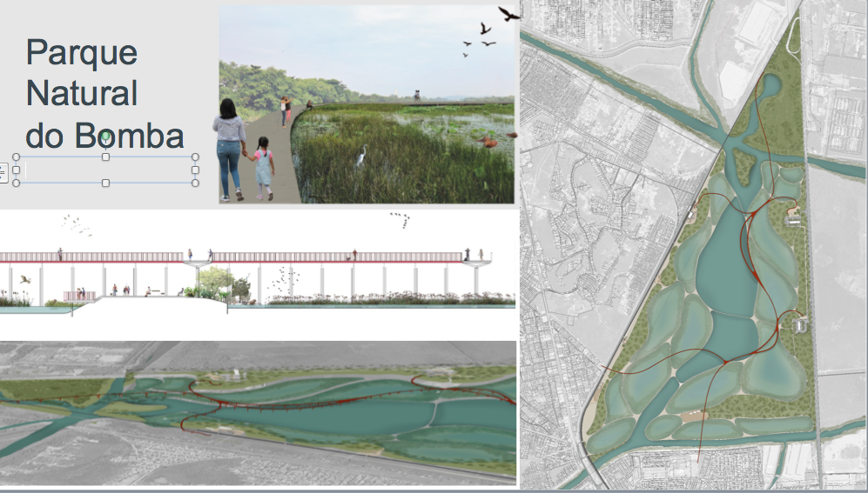
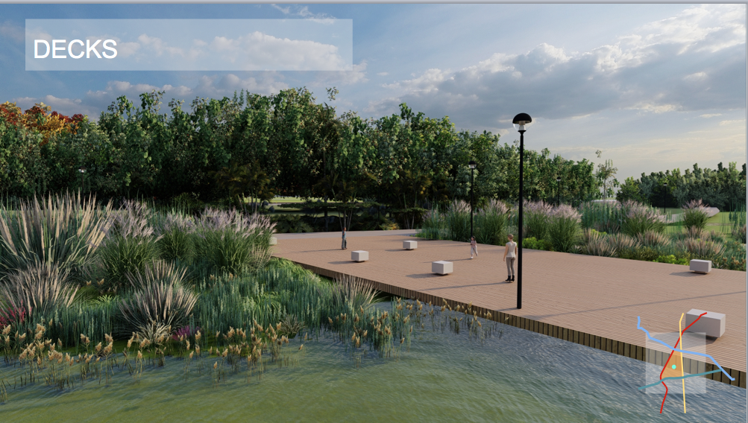

Slide 9
Thank you!

