Slide 1
‘15-Minute City’ in Turkey: A Framework for Sustainable Urban Planning and Governance in Mid-Sized Turkish Cities
Presenter: Emine Yetiskul,
Department of City and Regional Planning
Middle East Technical University, Turkey
Paper by: Emine Yetiskul (METU, Turkey) and Metin Senbil (Gazi University, Turkey).

Slide 2
What is 15-Minute City (Chrono-Urbanism)?
The 15-minute city is an urban planning model where residents can meet most of their daily needs—such as work, education, healthcare, shopping, and recreation—within a 15-minute walk or bike ride from their homes. It promotes compact, mixed-use neighborhoods, reduces dependency on private vehicles, and fosters local living, sustainability, and social equity.
Earlier/similar variants: Compact city, Transit Oriented Development
Notes:
The 15-minute city builds upon foundational ideas from earlier urban models such as the Compact City and Transit-Oriented Development (TOD). These models share core principles like high-density, mixed-use development, and the prioritization of non-motorized and public transport. However, the 15-minute city distinguishes itself through its temporal framing—emphasizing access to essential services within a 15-minute walk or bike ride—shifting focus from just spatial planning to the quality and proximity of urban life.

Slide 3
Basic Principles of 15-Minute City are…
Proximity: Services and amenities within reach.
Diversity: Mixed-use development and social inclusivity.
Density: Optimized urban form for walkability and efficiency.
Ubiquity: Equitable distribution of urban functions.
Participation: Community-led planning and local governance.
Notes:
Proximity: At the heart of the 15-Minute City is the principle that essential services—like housing, work, healthcare, education, shopping, and leisure—should be accessible within a 15-minute walk or bike ride. This shifts the focus from high-speed, long-distance mobility to local access and quality of life. Diversity: The city should include a variety of functions, housing types, and social groups within each neighborhood. Mixed-use development ensures that people can live, work, and relax in the same area, promoting vibrancy, inclusiveness, and economic resilience. Density: A balanced and efficient urban density supports walkability, local services, and public transport viability. It's not about high-rise buildings, but about compact and connected urban forms that reduce travel needs and support neighborhood cohesion. Ubiquity: Urban amenities and opportunities should be equitably distributed across all parts of the city—not just in privileged neighborhoods. Territorial equity means every community has access to the same quality of public space, infrastructure, and services. Participation: Communities should play a central role in shaping their neighborhoods. The 15-minute city calls for inclusive, participatory planning and decentralized governance, empowering residents to make decisions that affect their local environments. Together, these principles foster human-scale urbanism, reduce car dependency, strengthen local economies, and build cities that are more resilient, healthy, and inclusive.

Slide 4
International Examples of 15-Minute City
Paris, France
Lead Visionary: Carlos Moreno
Peculiarity: Paris is the birthplace of the modern 15-minute city model. Under Mayor Anne Hidalgo, the city has aggressively pursued policies to reduce car use, increase bike lanes, convert streets into pedestrian zones, and decentralize services.
Unique Feature: Repurposing schoolyards as public parks on weekends and after hours; strong investment in cycling infrastructure and neighborhood-level planning.
Melbourne, Australia
Concept: “20-Minute Neighborhoods”
Peculiarity: Focus on ensuring all essential services are within a 20-minute round trip by foot, bike, or public transport.
Unique Feature: Emphasis on health equity, integrating urban planning with public health goals.
Portland, USA
Program: Complete Neighborhoods
Peculiarity: Long-term focus on transit-oriented development (TOD) and reducing single-car usage.
Unique Feature: Combines the 15-minute city ethos with zoning reform to support affordable, mixed-use development and pedestrian access.
Shanghai, China
Approach: Dense, mixed-use “Urban Villages”
Peculiarity: Naturally formed high-density neighborhoods where work, home, and recreation are tightly integrated.
Unique Feature: Supports aging populations through design that promotes walkability, social interaction, and access to health.
Barcelona, Spain
Concept: Superblocks
Peculiarity: Large urban blocks are redesigned to prioritize pedestrias, limit traffic, and provide green space.
Unique Feature: Creation of people-centric public spaces within each superblock, reflecting strong community engagement.
Metropolitan cities
Notes:
Paris is the birthplace of the modern 15-minute city, propelled by Anne Hidalgo’s administration and visionary urbanist Carlos Moreno, the city has pedestrianized over 500 streets, converted schoolyards into public parks, and created pocket green zones to bring daily amenities—schools, shops, cafés—within walking or cycling distance Notably, Paris enforces local retail policy that subsidizes small businesses, ensuring mixed-use vibrancy and social mix in every arrondissement. This is a highly decentralized, neighborhood-based transformation, with about 50 district-level “mini 15-minute cities” already in place. Despite some backlash abroad, the policy enjoys broad local support and has made Paris synonymous with chrono-urbanism and polycentric cities.
Melbourne’s Plan Melbourne 2017–2050 embraces the concept as “20-minute neighbourhoods,” built around six pillars: safe, connected streets; local economic vitality; access to services; climate resilience; public spaces; and supporting housing density. Mapping initiatives show service access (GPs, childcare, pharmacies) within an approximate 20-minute walk, identifying equity gaps across suburban regions. The strategy also emphasizes active transport and climate adaptation, aiming to align with UN Sustainable Development Goals through walkable, resilient urban design.
Portland pioneered the Complete Neighborhoods initiative in 2009, aiming to ensure 90% of residents live within a 20-minute walk of essential amenities as part of its 30-year Portland Plan. The city now recognizes 21 “neighborhood centers,” each containing about 2,500 households and defined by mixed-use, small main streets. Community-led planning ensures these centers evolve organically, valuing local input and identity over top-down mandates.
Shanghai’s 2016 Master Plan institutionalized 15-minute community life circles, mandating that all residences in centers housing 50,000–100,000 people should access basic services (shops, clinics, green spaces) on foot within 15 minutes. Evaluations of Shanghai neighbourhoods show a strong correlation between population density and facility access, though disparities persist in certain "high-low" areas. Health research further emphasizes walkable local environments as crucial for cognitive health and social capital among older adults.
Barcelona’s Superblocks (Superilles) retrofit 3×3 block grids (~400 × 400 m) into pedestrian-first zones with slowed traffic (10 km/h), greenery, recreational spaces, and social interaction points citychangers.org+4urbandesignlab.in+4citiespeoplelove.co+4. Over 500 Superblocks are planned by 2030 citychangers.org. Public health studies report reduced noise, pollution, and enhanced social cohesion, though benefits vary and require long-term stewardship emerald.com+2reasonstobecheerful.world+2sciencedirect.com+2. The initiative exemplifies inclusive urban design that reclaims street space and strengthens neighborhood identity.
All cities share a temporal accessibility focus—bringing essential services within a 15–20 minute walk or cycle.
Paris and Barcelona advance localized interventions with strong central-local coordination.
Melbourne and Portland emphasize planning frameworks and mapping tools for equitable delivery.
Shanghai embeds 15-minute planning directly in statutory urban design standards.
Community engagement is vital across all cases—Paris’s neighborhood shops, Melbourne’s localized mapping, Portland's citizen-led centers, and Barcelona's Superblocks reinforce the participatory principle

Slide 5
International Examples of 15-Minute City
Pontevedra, Spain (≈83,000)
Pedestrian-first transformation: Since 1999, the historic center has been largely car-free, supported by extensive pedestrianization, low-speed zones, and expanded public spaces
Metrominuto network: Time-based pedestrian maps illustrating walking distances to key destinations encourage active mobility
Results & recognition: With 65 % of trips now made on foot, improved air quality, and international awards, Pontevedra shows how small cities can pivot sharply toward walkability.
Sennestadt (Bielefeld), Germany (≈21,000)
Organic planning origins: Designed in the 1950s as a green, integrated garden suburb with walkable access to parks, schools, shops, and public spaces .
Modern revitalization: Recent urban renewal projects, led by community engagement, have strengthened connectivity, green corridors, and local identity, echoing 15-minute city ideals
Toowoomba, Australia (≈140,000)
‘Safe Active Street’ pilot: Introduced low-speed, bike-friendly street design to encourage active travel in a traditionally car-centric context theguardian.com.
Cultural obstacle & community tension: Mixed public reaction illustrates the need for local engagement and tailored 15-minute interventions in mid-sized settings .
Cedar Rapids & Iowa City, USA (≈130,000)
Exploratory planning initiatives: Local planners and universities investigating 15-minute city frameworks, including context-appropriate active transport and service proximity
City | Key Feature | Impact and Relevance
Pontevedra | Comprehensive pedestrian zone + Metrominuto maps | High walkability, economic vitality, safety
Sennestadt | Organic, green neighborhood design since 1950s | Walkable suburbs, climate-conscious renewal
Toowoomba | Active-street pilot in car-centric suburb | Behavioral shift toward sustainable mobility
Iowa & Cedar Rapids | Community-engaged planning workshops | Institutional readiness for proximity-based planning
Notes:
Pontevedra, Spain (≈83,000 inhabitants) Pontevedra stands as a living example of proximity-based transformation. Since 1999, the city center has been systematically pedestrianized—over 300,000 m² in its first month—with traffic slowed to 30 km/h and many streets fully. The introduction of Metrominuto, a metro-style pedestrian map launched in 2011, visually communicates that key destinations are accessible on foot, encouraging active movement. The city reclaimed 1.3 million m² for pedestrians, reduced CO₂ emissions by 67 %, and halted traffic fatalities since 2011. Coupled with bans on large shopping malls, Pontevedra's shift has revitalized its local economy, increased foot-traffic to small businesses, enhanced public health, and catalyzed a human-centric urban renaissance.
Sennestadt (Bielefeld district), Germany (≈21,000) Developed in the 1950s with an organic suburban design by Hans Bernhard Reichow, Sennestadt was planned around green corridors (“Grünes Kreuz”) linking residential streets, schools, shops, and parks. The design embedded mixed-use facilities within walking distance, nurturing self-contained local communities while integrating housing with green landscapes. Since 2006, the district has engaged in systematic renewal focused on public space improvements, climate adaptation, and participatory planning . With residents actively shaping public realm upgrades, Sennestadt demonstrates how a mid-sized city can sustain and modernize its 15‑minute neighborhood concept over decades.
Toowoomba, Australia (≈140,000) In a bold step toward active transport, Toowoomba launched Australia’s first “Safe Active Street” on Pierce Street in 2024. Featuring a 30 km/h limit, bike-prioritized lanes, and shared space design, the project seeks to shift car dependency in a conservative, peri-urban setting While public transit remains underdeveloped, this pilot aims to reduce obesity, pollution, and car-centric habits by encouraging everyday cycling and walking. Despite tensions around change, the initiative reflects a targeted strategy to embed 15-minute principles in suburban Australian contexts.
Cedar Rapids & Iowa City, USA (≈130,000 combined) Research-driven initiatives in Eastern Iowa have applied 15-minute city frameworks to suburban-American settings. Workshops led by Tippie College at the University of Iowa and local planners have engaged residents in identifying neighborhood needs and mapping access to everyday services. The City of Iowa City’s 2023 Strategic Plan includes a clear vision for compact, diverse neighborhoods offering essential services within 15 minutes by foot or bike. These early-stage efforts underscore a data-informed, participatory route to delivering equitable access and resilience in mid-sized American cities.

Slide 6
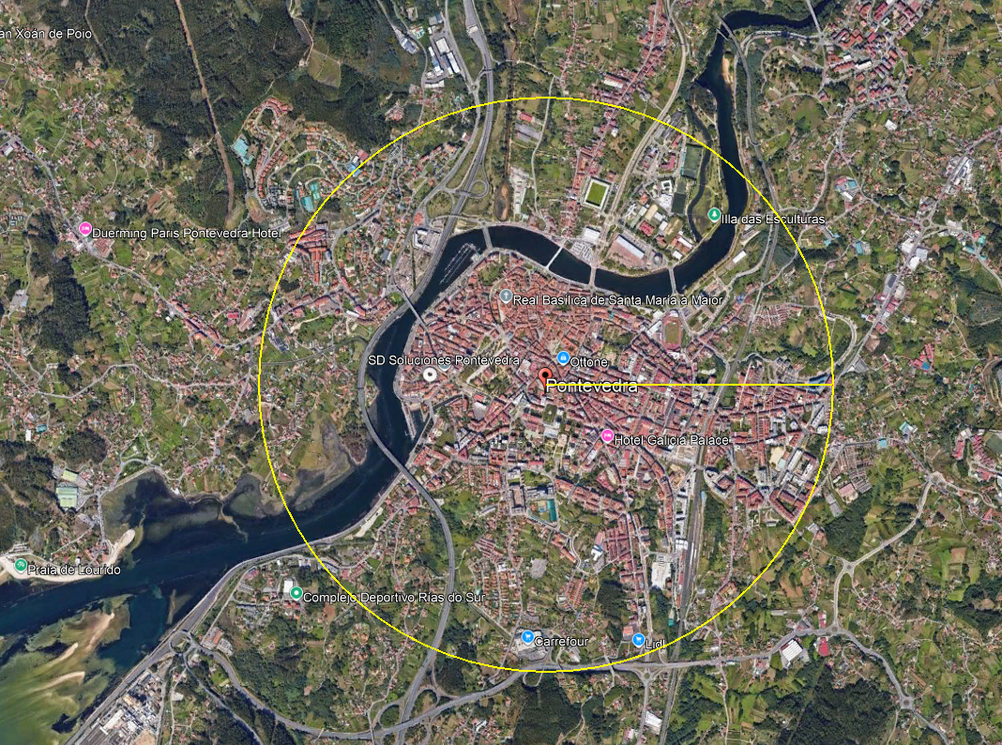
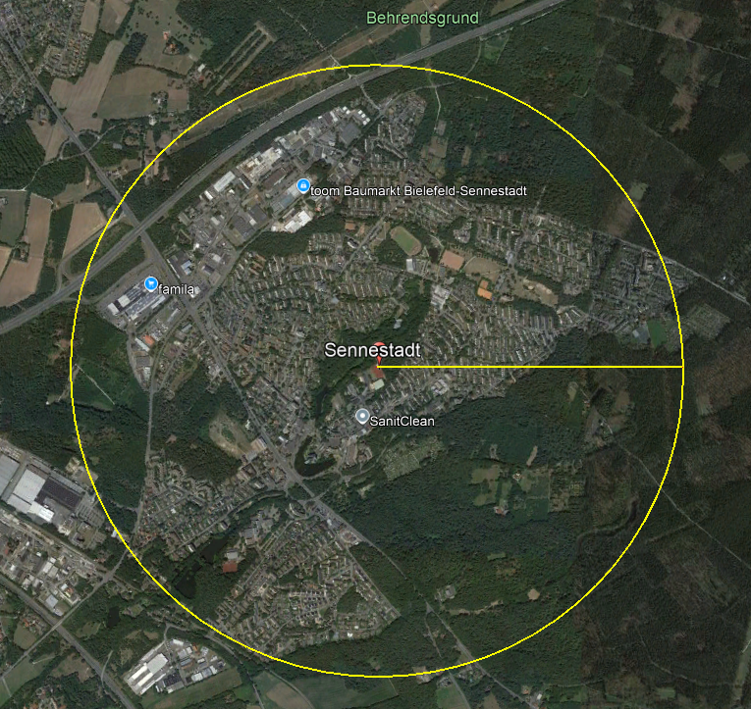
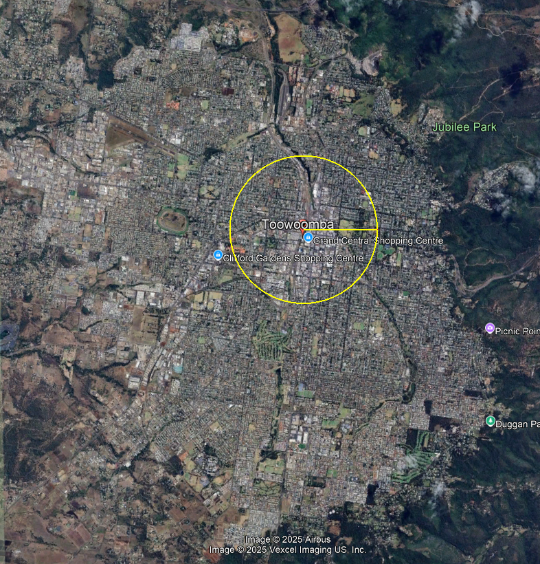
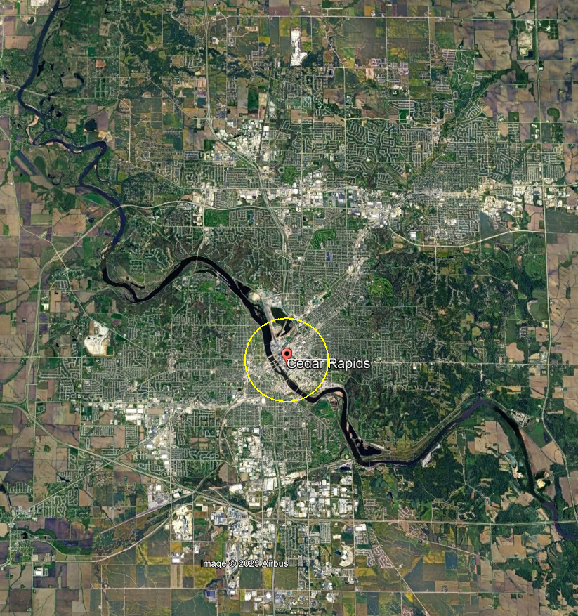
Pontevedra (Spain) (~19,000)
Sennestadt (Germany)
(~21,000)
Toowoomba (Australia)
Cedar Rapids (USA)

Slide 7
Mid-sized cities in Turkey
Plenty of them
Mostly 3-km Radius
Surrounded by fertile lands
Under fast-motorization stress
Currently sprawling
Notes:
1. Plenty of Them
Turkey is home to over 650 mid-sized municipalities with populations exceeding 10,000. These urban centers serve as regional hubs for economic, social, and administrative functions. Their manageable size and scale provide fertile ground for implementing proximity-based urban models like the 15-minute city. With decentralized densities and defined urban cores, these cities offer a unique opportunity to operationalize compact, inclusive, and sustainable urban living.
2. Mostly 3-km Radius Built Areas
Many mid-sized cities in Turkey exhibit a built-up form within a 3-kilometer radius, making them inherently suited for 15-minute walkability and bikeability. Despite this spatial advantage, current planning practices often fail to leverage this scale for accessibility-focused development. Instead of embracing proximity planning, these cities have historically relied on outdated, expansionist master plans that overlook the potential of self-sufficient neighborhoods and service-rich local hubs.
3. Surrounded by Fertile Lands
These cities are often embedded within agriculturally rich geographies—valleys, deltas, and high plains—where fertile lands are a strategic natural asset. However, unchecked urban sprawl and peripheral development threaten these vital ecosystems. Implementing a 15-minute city approach can help preserve these agricultural zones by reinforcing compact development boundaries and directing growth inward, rather than outward onto productive lands.
4. Under Fast-Motorization Stress
Although car ownership in Turkey remains below European saturation levels, the rate of motorization is accelerating rapidly in mid-sized cities. The expansion of low-density, auto-dependent neighborhoods, along with weak public transit infrastructure, fosters unsustainable mobility patterns. The 15-minute city strategy counters this by prioritizing non-motorized and collective transport options, reducing dependence on private cars and mitigating congestion, emissions, and land consumption.
5. Currently Sprawling
Urban sprawl in Turkish mid-sized cities continues largely unchecked, driven by speculative real estate practices, administrative leniency in land-use changes, and flawed population projections. This spatial spread undermines efforts toward climate adaptation, public service efficiency, and social cohesion. A shift toward the 15-minute city paradigm can redirect attention to the inner fabric of cities—retrofitting existing neighborhoods, reinvesting in local infrastructure, and establishing policy frameworks that promote densification, mixed use, and inclusive mobility.
Therefore…
Mid-sized cities in Turkey sit at a crossroads: they can either continue sprawling into fertile hinterlands or recalibrate their planning systems toward compactness, accessibility, and resilience. The 15-minute city approach offers a coherent and locally adaptable strategy to reverse current unsustainable trends and shape a more equitable, healthy, and future-ready urban Turkey.

Slide 8
Urban settlement pattern in Turkey
Megalopolis (Istanbul and environs; more than one metropolitan areas; multiple districts)
Metropolitan areas (multiple districts of greater municipalities)
Provincial centers (single district; called «merkez» in Turkish)
Districts

Slide 9
Key problematic of Mid-Size Cities
Rapid motorization, outdated urban plans, and poor public transit undermine the potential for sustainable, walkable environments in Turkish mid-sized cities.
Urban Settlement Areas (USA) in Turkey are often over-dimensioned due to inflated population projections. A reframing is needed to align with compact, walkable cities.
Turkey's urban governance is highly centralized. Local governments lack flexibility, financial tools, and authority for neighborhood-scale planning interventions.
Notes:
Turkish mid-sized cities face a set of entrenched structural problems that hinder their transition to sustainable, walkable urban forms aligned with the 15-minute city vision.
1. Rapid Motorization, Outdated Plans, and Poor Transit Infrastructure
Many of these cities are undergoing rapid motorization without the necessary transit alternatives or updated planning frameworks. Legacy urban plans, often designed for growth-centric, expansionist visions, no longer reflect demographic realities or environmental constraints. As private car use accelerates, public transportation systems remain underdeveloped, inefficient, and disconnected, undermining the feasibility of proximity-based mobility. The resulting urban form is increasingly fragmented and auto-dependent, eroding walkability and neighborhood cohesion.
2. Over-Dimensioned Urban Settlement Areas (USAs)
Urban Settlement Areas, as defined by upper-level plans like the Territorial Plan, are typically oversized due to outdated population projections that fail to account for Turkey’s slowing and aging demographic trends. These projections often lead to sprawling development patterns, encouraging low-density housing, land speculation, and the loss of fertile agricultural land. To reverse this trajectory, a reframing of USAs is essential—one that is grounded in compact growth principles and calibrated to realistic demographic and spatial needs.
3. Centralized Urban Governance and Limited Local Authority
Urban planning in Turkey remains highly centralized, with key legal and technical documents drafted at the national level. Local governments, particularly in mid-sized cities, are left with little flexibility or institutional capacity to develop context-sensitive plans. They lack both the legal mandate and financial tools to initiate neighborhood-scale interventions. As a result, transformative planning ideals like the 15-minute city struggle to find local expression. Without devolved authority, urban reforms risk being generic and ineffective, failing to reflect the needs, aspirations, and specificities of individual communities.

Slide 10
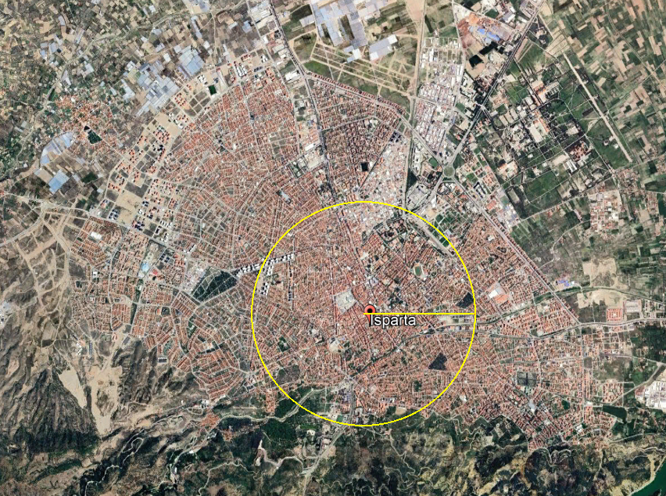
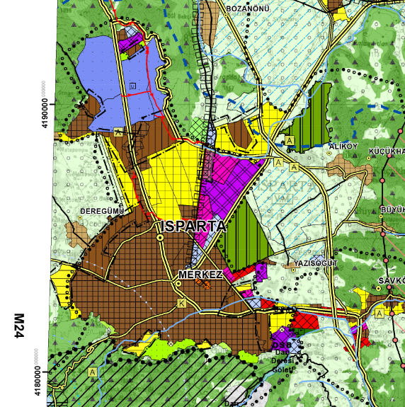
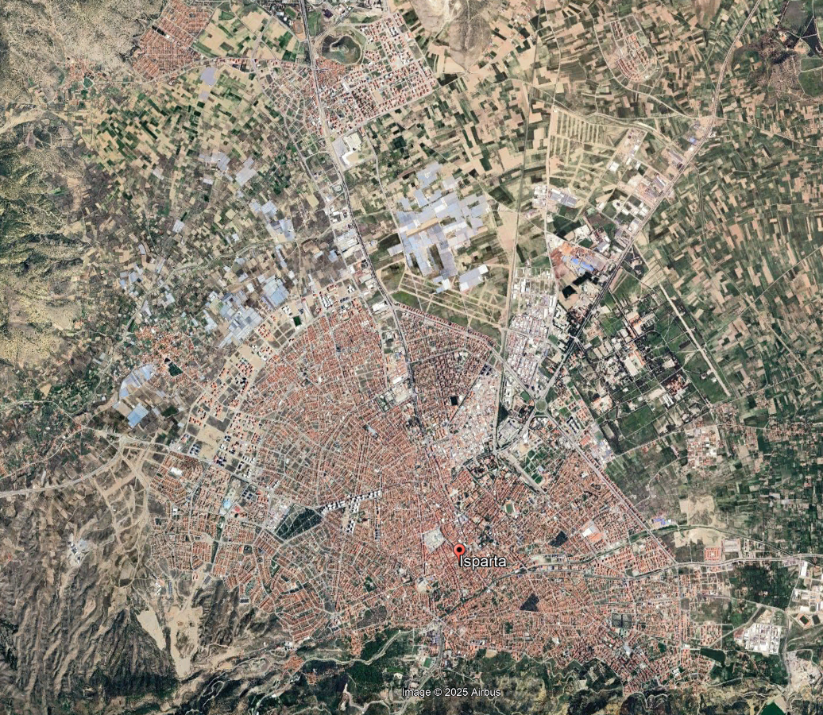

Isparta (a provinvial center; pop@2024: 277,797)
1.5 km radius
3.0 km radius

Slide 11
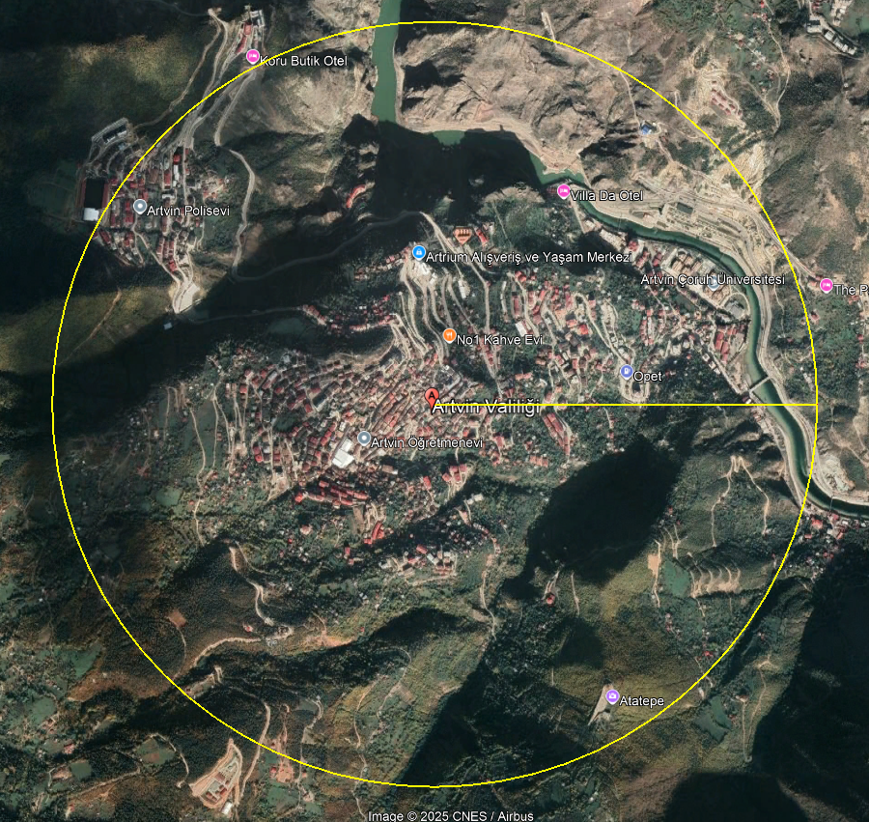
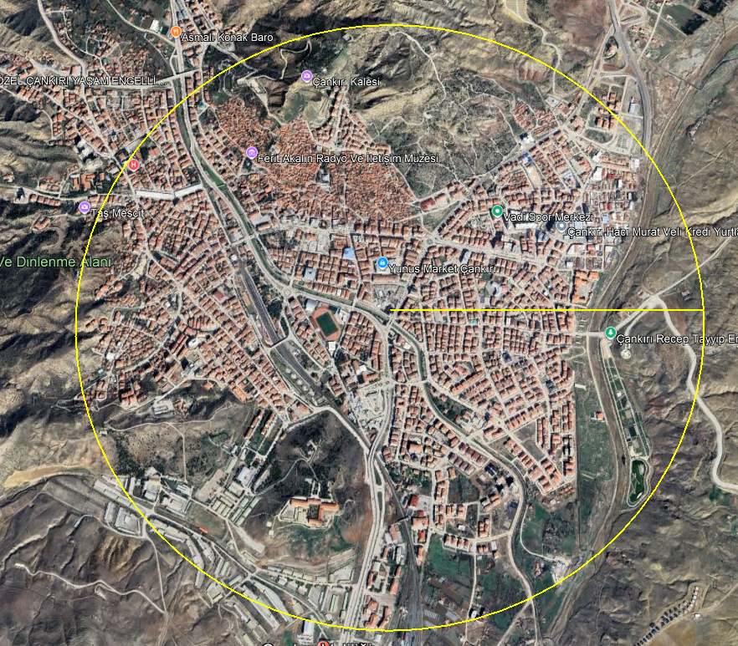
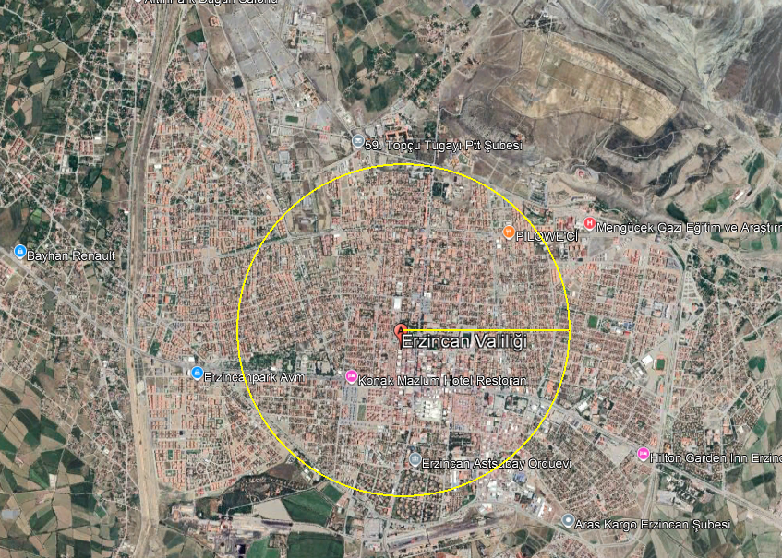
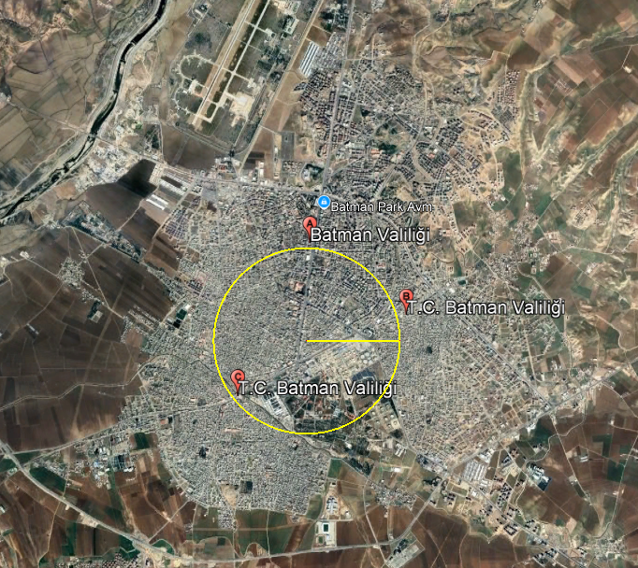
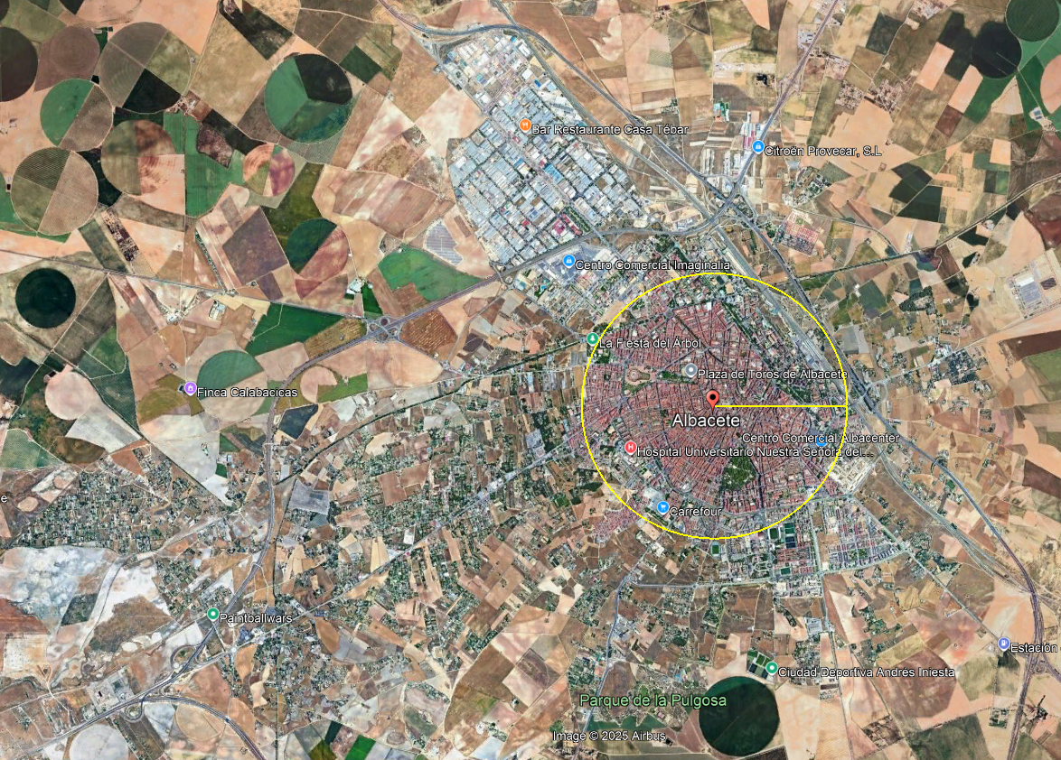
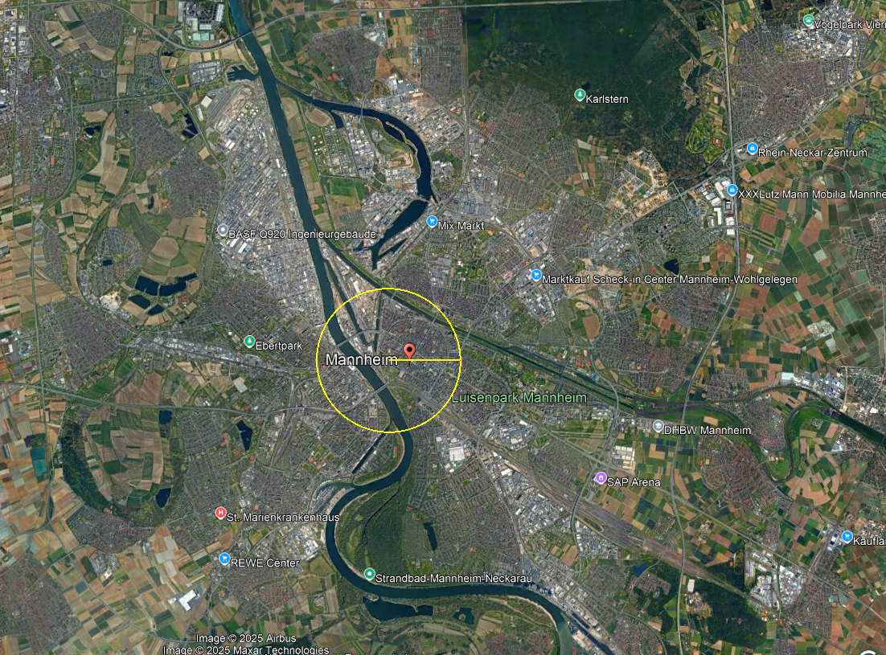
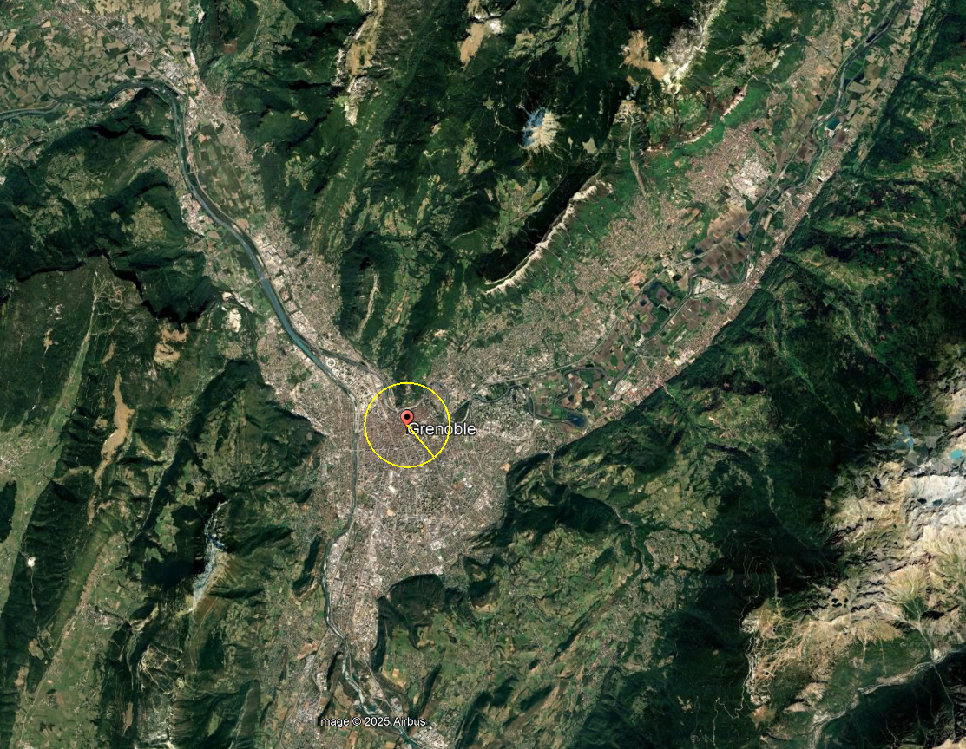
Provincial Centers
Artvin (2024 Pop: 36,071)
Çankırı (2024 Pop: 98,972)
Erzincan (2024 Pop: 168,093)
Batman (2024 Pop: 506,322)
Albecete (2024 Pop: 169,716)
Mannheim(Ger) (2020 Pop: ~332K)
Grenoble (Fr) (2020 Pop: ~528K)

Slide 12
(15-Minute City) Planning Paradigm for Mid-Sized Cities in Turkey: the way forward I
The 15-minute city model offers a path toward climate-responsive, equitable, and resilient urban systems, particularly relevant in Turkey's post-urbanization phase.
Transforming mid-sized Turkish cities requires rethinking planning institutions, legal frameworks, and governance to deliver inclusive, functional, and vibrant neighborhoods.
Calls for flexible planning tools, updated legislation, compulsory areal plans, and inclusion of 15-minute city metrics in regulatory frameworks.
Notes:
The 15-minute city model offers a path toward climate-responsive, equitable, and resilient urban systems, particularly relevant in Turkey's post-urbanization phase.
As Turkey experiences stagnating urban population growth and faces the challenges of an aging demographic, the 15-minute city presents a future-proof planning paradigm. By emphasizing local access to essential services within a short walk or bike ride, it addresses environmental concerns, enhances community cohesion, and reduces dependence on private vehicles. This model supports Turkey’s need to shift from expansion-oriented urbanism to retrofitting and revitalizing existing urban areas in a sustainable and socially just manner.
Transforming mid-sized Turkish cities requires rethinking planning institutions, legal frameworks, and governance to deliver inclusive, functional, and vibrant neighborhoods.
Mid-sized cities often lack institutional capacity and legal flexibility for neighborhood-scale interventions. Achieving the 15-minute city requires updated governance structures that empower municipalities, strengthen participatory planning processes, and facilitate integrated action across housing, mobility, public space, and infrastructure. This transformation demands moving away from centrally imposed plans toward localized, adaptive, and responsive planning tools.
Calls for flexible planning tools, updated legislation, compulsory areal plans, and inclusion of 15-minute city metrics in regulatory frameworks.
To operationalize the 15-minute city, urban planning must adopt enforceable areal plans based on walkability, mixed-use development, and spatial equity. Legislation must mandate compact growth boundaries, require inclusive urban design standards, and assign city planners with neighborhood-specific responsibilities. Including 15-minute city indicators—such as access to services, mobility diversity, and social infrastructure—within regulatory frameworks ensures that transformation efforts are measurable, accountable, and aligned with long-term sustainability goals.
Ask ChatGPT

Slide 13
(15-Minute City) Planning Paradigm for Mid-Sized Cities in Turkey: the way forward II
Neighborhoods should be semi-autonomous planning zones with access to education, healthcare, green areas, markets, and social facilities within 15 minutes.
Proposal to assign city planners per 10,000 residents and per additional 25,000 increment to ensure localized planning capacity and accountability.
Mid-sized cities must prioritize retrofitting existing urban fabric over expansion, focusing on pedestrian-friendly design, mixed-use zoning, and efficient transit access.
New planning tools should integrate infrastructure, land readjustment, urban design, and social inclusion strategies to create holistic urban environments.
Community engagement and participatory planning must be central, empowering residents in decision-making and fostering democratic local governance.
Notes:
To fully harness the transformative potential of the 15-minute city model in Turkey's mid-sized cities, urban neighborhoods must be redefined as semi-autonomous, functional planning units. These zones should guarantee access to education, healthcare, daily goods, recreation, and social services within a 15-minute walk or bike ride. This shift emphasizes the spatial justice and socio-spatial cohesion necessary to counteract decades of car-dependent and mono-functional development. Planning at this scale reintroduces human-centered design principles, restores community life, and enhances urban resilience in the face of climate, health, and economic crises.
To implement such localized strategies effectively, institutional capacity must be strengthened. A clear policy should assign a dedicated city planner for every 10,000 residents, with an additional planner for each 25,000 increment. This framework ensures professional oversight and encourages a more responsive, neighborhood-level planning approach. Rather than merely supporting growth, planners must be tasked with sustaining and revitalizing existing urban environments through targeted interventions, performance-based design, and inclusive decision-making practices.
Mid-sized cities, in particular, must reverse the current trajectory of horizontal expansion. Most have inherited oversized Urban Settlement Areas (USA) designed for unrealistic population projections from earlier urbanization periods. These zones now lie underutilized or fragmented. Instead of encouraging further growth outward, these cities should focus on retrofitting their existing urban form. Retrofitting includes reorganizing plot structures, enhancing pedestrian and cycling infrastructure, integrating land-use functions, and ensuring connectivity through a high-quality public transport system. Such interventions reduce environmental impact while fostering more socially vibrant and economically productive neighborhoods.
Achieving these outcomes requires new planning instruments. Conventional regulatory tools in Turkey remain rigid, fragmented, and disconnected from on-the-ground realities. A new generation of planning instruments must be introduced—ones that combine infrastructure renewal, equitable land readjustment, green public spaces, and urban design principles. These tools should also incorporate social inclusion strategies, ensuring vulnerable groups such as the elderly, women, and children are central to neighborhood transformation. They must allow planners to engage in iterative and adaptive planning processes, respond to local conditions, and manage interdependencies across sectors.
Finally, community engagement and participatory governance must be institutionalized. Without the active involvement of residents, any spatial intervention risks being top-down and unsustainable. Municipalities should establish participatory mechanisms—from neighborhood planning councils to digital platforms—that empower communities to co-produce urban plans. Engaging citizens enhances the democratic legitimacy of planning decisions, reinforces trust in institutions, and encourages behavioral change toward sustainable mobility and lifestyle practices.
As Marquet et al. (2024) emphasizes, such participation is not a procedural formality but a vital ingredient in creating inclusive and accountable urban environments.
Marquet, O., Anguelovski, I., Nello-Deakin, S., & Honey-Rosés, J. (2024). Decoding the 15-Minute City Debate: Conspiracies, Backlash, and Dissent in Planning for Proximity. Journal of the American Planning Association, 91(1), 117–125. https://doi.org/10.1080/01944363.2024.2346596
Lastly, the 15-minute city planning paradigm for Turkey’s mid-sized cities is not simply a technical vision of spatial proximity, but a holistic model that integrates legal reform, institutional redesign, design innovation, and civic empowerment. It calls for a complete restructuring of how urban neighborhoods are conceived, governed, and experienced—placing people, rather than vehicles or growth projections, at the center of planning practice.

Slide 14
Thank you very much

