Slide 1
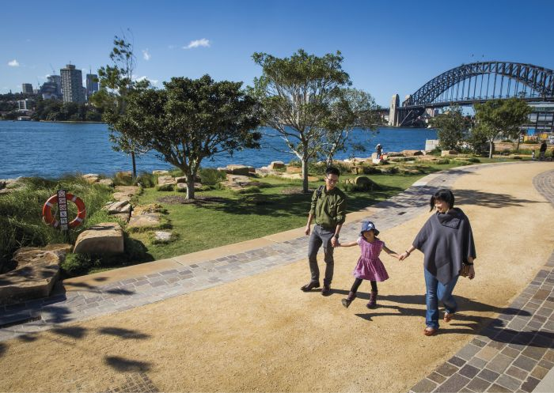
Contextual factors for Active Transport Infrastructure​
Presenter: Sara Haider (PhD Candidate)
Supervisors: Prof. John Nelson, Dr Jennifer Kent, and Prof. Sotiris Vardoulakis

Slide 2
Why Active Travel?
Transport is a need
Low Mode Share
Infrastructure
Transport is essential for connecting people to places and others.
Despite recognised benefits and government policies, active travel remains low.
Identify where effective behaviour change will occur and the type of infrastructure most conducive to this change.
Global Agenda
Behavioural Factors
Effective Design
On the global agenda, 4 sustainability goals:
Promoting health (SDG 3)
Resilient Infrastructure (SDG 9)
Sustainable Human Settlements (SDG 11)
Climate Change (SDG 13)
Geographical location shapes travel behaviour needs in terms of utilitarian, psychological and social factors
Context driven infrastructure features that respond to localized travel needs

Slide 3
Context? People – Place – Time
Demographics (Census 2021)
Age
Gender
Country of Birth
Vehicles in Household
Mortgage and Income
People
Natural Environment
(Bureau of Meteorology)
Temperature
Rainfall
Topography
Active Travel Context
Built Environment
(Transport Authority)
Existing Bike Network
Speed Limit Zones
Bus Routes/Train Network
Streetlights
Travel Time (Trip Planner)
Proximity to destinations
Comparative Travel Time
Journey to Work
Place
Travel Time

Slide 4
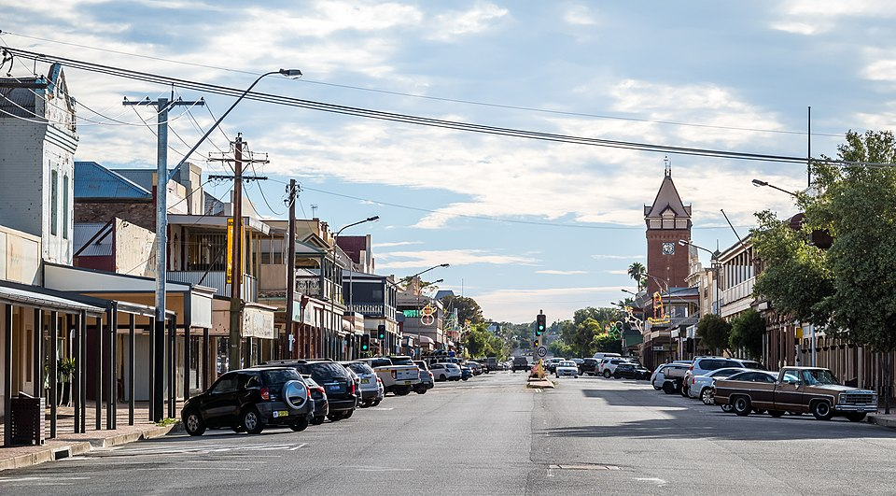
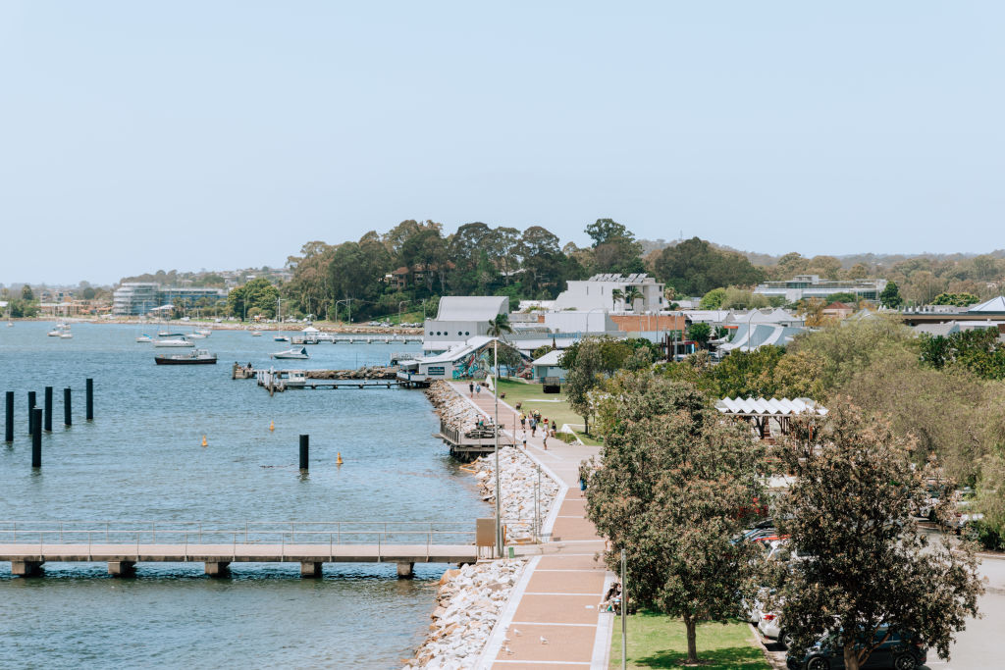
Context… in New South Wales
Broken Hill – Inland mining town
Batemans Bay – Coastal town

Slide 5
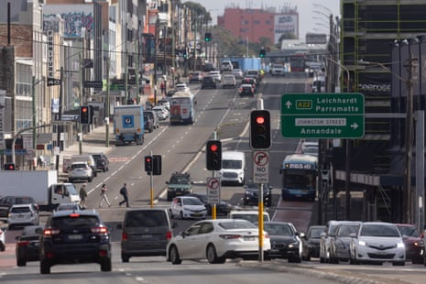
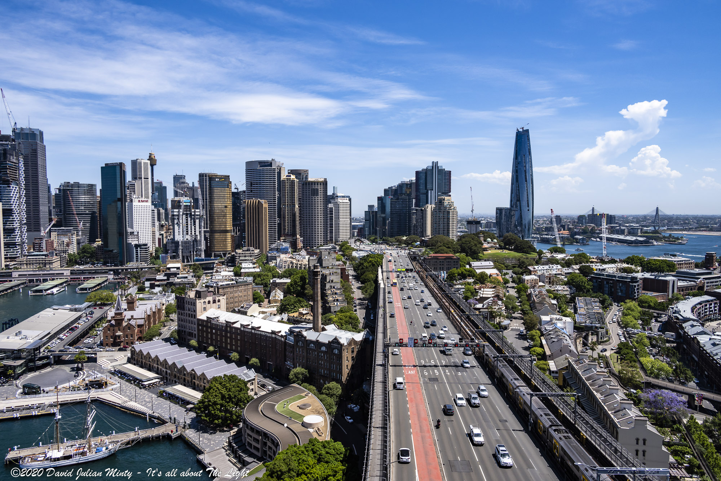
Context… in New South Wales
Sydney Suburban Road
Sydney CBD

Slide 6
Methodology
DATA STANDARDISATION
K-MEANS CLUSTERING
SPATIAL COMPILATION
PEOPLE DATA
PLACE DATA
TRAVEL TIME DATA
(SECONDARY SOURCES)
PRINCIPAL COMPONENT ANALYSIS
TYPOLOGY ASSIGNMENT
FEATURE ASSIGNMENT TO SA2 ZONES
Normalization (Z-SCORE)
FEATURE SELECTION

Slide 7
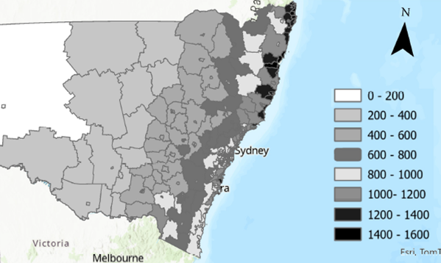
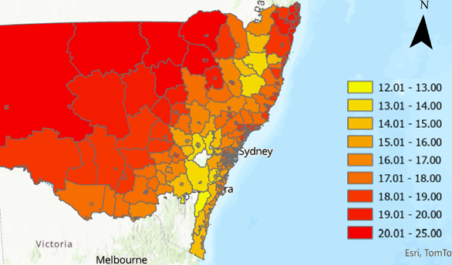
Context – Place
Rainfall intensity across the state (SOURCE)
Temperature intensity across the state (SOURCE)

Slide 8
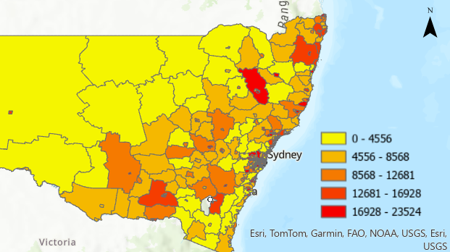
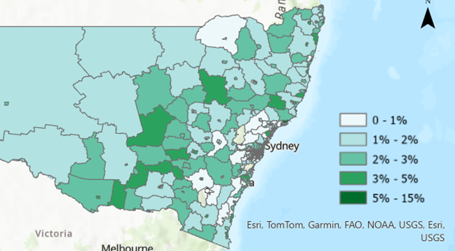
Context – People
Population distribution across the state (SOURCE)
Percentage of elderly across the state (SOURCE)

Slide 9
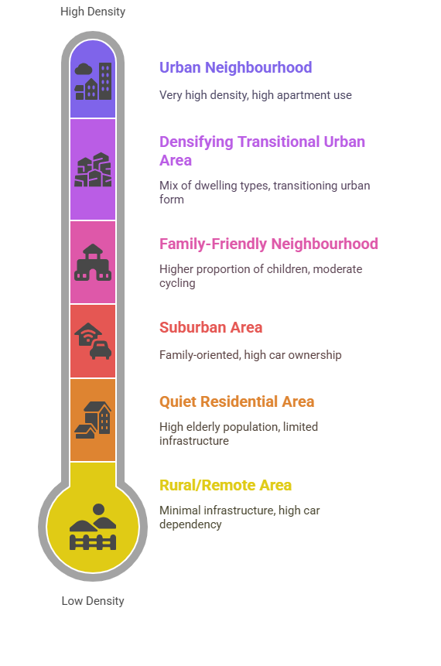
Findings
4%
High walkability, low car ownership, moderate cycling access
7%
Increasing apartments, in-fill development and transport solutions
3%
Parks and schools, high car ownership, emerging cycle infrastructure
41%
High car ownership and transport infrastructure mostly tailored to cars
28%
Limited cycling infrastructure, some public transport, inland or coastal
16%
High reliance on cars, long distances to services, minimal public/active transport

Slide 10
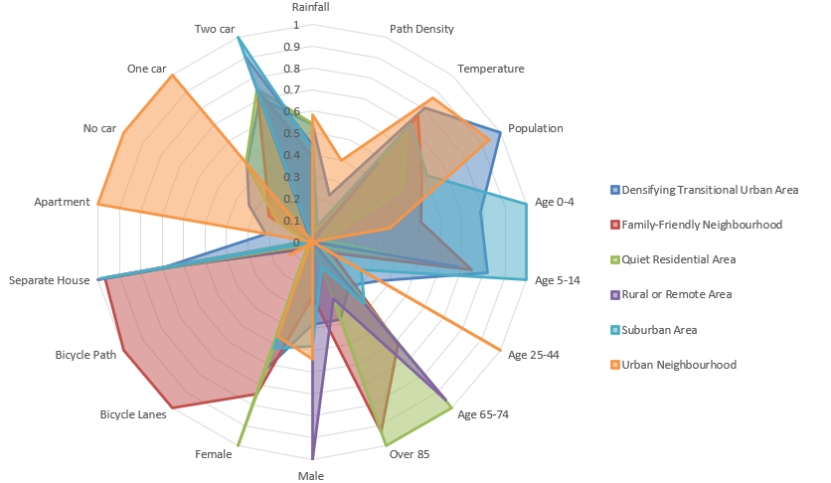
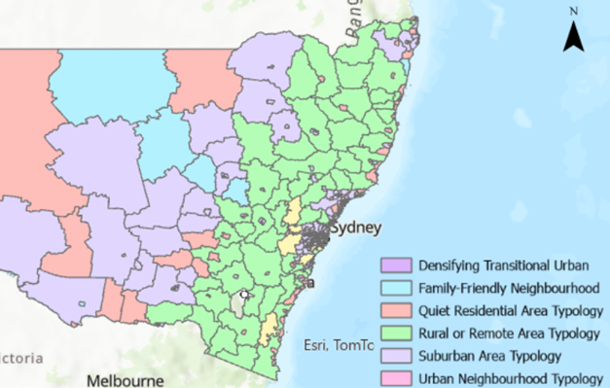
Features of Typologies
Radar Chart showing the most dominant factors influencing the typology
Spatial distribution of typologies across the state

Slide 11
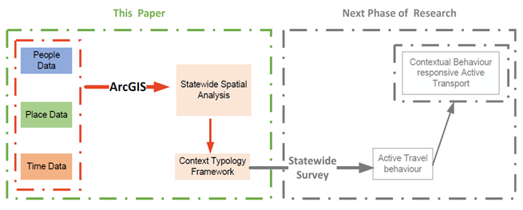
Context into Design – Next Steps

Slide 12
Context - Behaviour - Infrastructure
Context and Behavioural Factors
Utilitarian
Behavioural Factors
Psycho-social
Behavioural Factors
Utilitarian and Infrastructure
Psycho-social and Infrastructure

Slide 13
Thank you! Sara Haider s.haider@sydney.edu.au Institute of Transport and Logistics Studies University of Sydney, Australia

Slide 14
Findings
Typology | SA2 Zone Counts | Dominant Features | Findings
Urban Neighbourhood | 15 | Very high density, high apartment use, young adult population | Population Density: Very high (>4,000/km²) Demographic: Young adults (25–39 years) Housing: Predominantly apartments Transport: High walkability, moderate cycling access, low car ownership Examples: Surry Hills, Ultimo, Newtown
Suburban Area | 148 | Moderate density, family-oriented, high car ownership | Population: Balanced age profile Transport: High car ownership (typically 2 per household), car-oriented infrastructure Cycling Infrastructure: Limited but present Examples: Campbelltown, Blacktown, Liverpool
Family-Friendly Neighbourhood | 11 | Higher proportion of children, moderate cycling provision | Demographic: Higher proportion of children (5–14 years) Amenities: Parks, schools, family-oriented facilities Transport: Balanced car ownership, emerging cycling infrastructure Examples: Outer Newcastle suburbs, Goulburn
Quiet Residential Area | 104 | High elderly population, low-density, limited infrastructure | Demographic: High proportion of elderly residents Density & Housing: Low density, modest housing Transport: Limited cycling infrastructure, high reliance on vehicles Examples: Older suburbs, scenic/hilly regional towns
Rural or Remote Area | 62 | Very low density, long travel distances, low infrastructure | Population Density: Very low Infrastructure: Minimal public/active transport, separate houses Transport: High car dependency, long distance to services Examples: Inland and coastal rural NSW zones
Densifying Transitional Urban Area | 25 | High density, mix of dwelling types, transitioning urban form | Development Stage: Undergoing urban renewal/infill Population: Moderate-to-high density; mix of young adults and families Housing: Increasing apartment presence Infrastructure: Mixed/variable; reflects transition in planning Examples: Inner and middle ring suburbs in transition

