Slide 1
#749 Impact of Multi-Station Aggregate Hub Redevelopment on Surrounding Urban Areas-A Case Study of London’s King’s Cross
Yufei Qu, Yuying Zhu, Xiaoxi Zhang, Chuan Wang*
School of Architecture, Southeast University
chuanwang@seu.edu.cn

Slide 2
Impact of Multi-Station Aggregate Hub Redevelopment on Surrounding Urban Areas -A Case Study of London’s King’s Cross
1
Introduction
2
Research Methods
2.1 Case: King’s Cross, London
2.2 Data Sources: Documents and Spatial Data
Multi-Station Aggregation Hub and
Regional Impact in King’s Cross
2.3 Analytical Methods: Integration of Qualitative and Quantitative Approaches
3
3.1 Aggregation Development of Transport Hubs
3.2 Evolution of the Transport Network
3.3 Functional Vitality Transformation
3.4 Intensity of Spatial Development
4
Spatial Renewal Methods in King’s Cross Area
4.1 Brownfield Redevelopment Mode
4.2 Demolition-Reconstruction Mode
4.3 Functional Retrofitting Mode
5
Discussion and Conclusions
References
4.4 Upward Addition and Perimeter Expansion Models
6
School of Architecture, Southeast University | chuanwang@seu.edu.cn

Slide 3
Impact of Multi-Station Aggregate Hub Redevelopment on Surrounding Urban Areas -A Case Study of London’s King’s Cross
1 Introduction
ABSTRACT
2 Research Methods
3 Multi-Station Aggregation Hub and Regional Impact in King’s Cross
Multi-station aggregation hubs – interconnected transport nodes in high-intensity urban areas – significantly influence metropolitan growth, yet systematic research on their regional development impacts remains limited. This study examines London’s King’s Cross–St Pancras hub redevelopment using spatiotemporal data (1996–2023). Three analytical zones (Core zone, Central Impact Zone and Wider Impact Zone) were established to assess transport networks, functional vitality, and development intensity via GIS and qualitative methods. Findings indicate a 25:11:8 ratio of renewed building areas across zones, with development intensity strongly correlated to hub proximity. The core zone saw significant growth in consumer/service-oriented POIs, evolving into a mixed-use creative hub. Insights are provided for redeveloping similar hubs in high-density cities, particularly China.
4 Spatial Renewal Methods in King’s Cross Area
5 Discussion and Conclusions
6 References
School of Architecture, Southeast University | chuanwang@seu.edu.cn

Slide 4
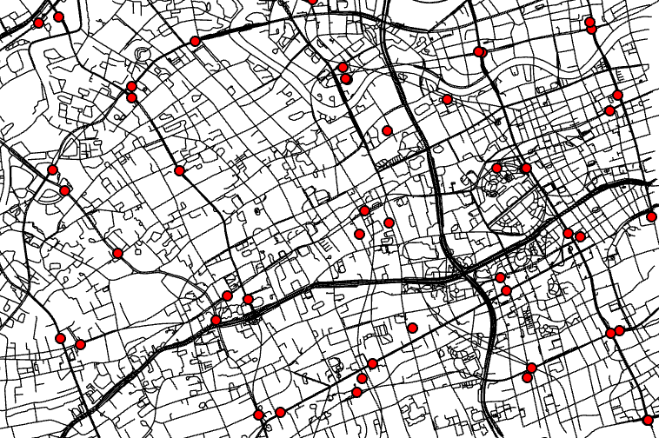
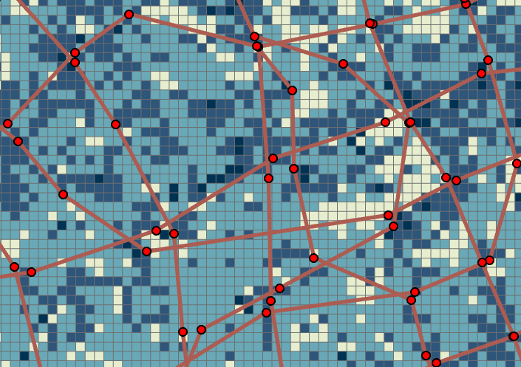
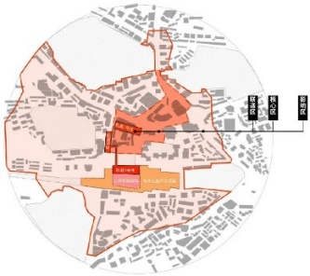
Impact of Multi-Station Aggregate Hub Redevelopment on Surrounding Urban Areas -A Case Study of London’s King’s Cross
ABSTRACT
1 Introduction
Urban rail transit multi-site aggregation lots generally satisfy four attributes at the same time:
Transportation - there is a strong transportation connection between the stations;
Distance - within a certain spatial distance;
Function -There is a strong public correlation between the stations and the lot, as well as between the functional elements within the lot;
Space - the spatial elements within the lot have an orderly, clear, detailed and rich organizational order.
2 Research Methods
3 Multi-Station Aggregation Hub and Regional Impact in King’s Cross
Multi-site Aggregate Lot Boundary Identification and Typing
1. Initial screening of multi-site lots based on site density
(“distance” factor, nuclear density analysis)
4 Spatial Renewal Methods in King’s Cross Area
2、Analysis of the morphology of multi-site lot aggregation characteristics
[Transportation (accessibility), density (road network density, intersection density, public space density, population density, building density and height or number of floors), function (functional mix)]
5 Discussion and Conclusions
6 References
3、Aggregate lot boundary identification
Boundary delineation based on aggregated feature attenuation
School of Architecture, Southeast University | chuanwang@seu.edu.cn

Slide 5
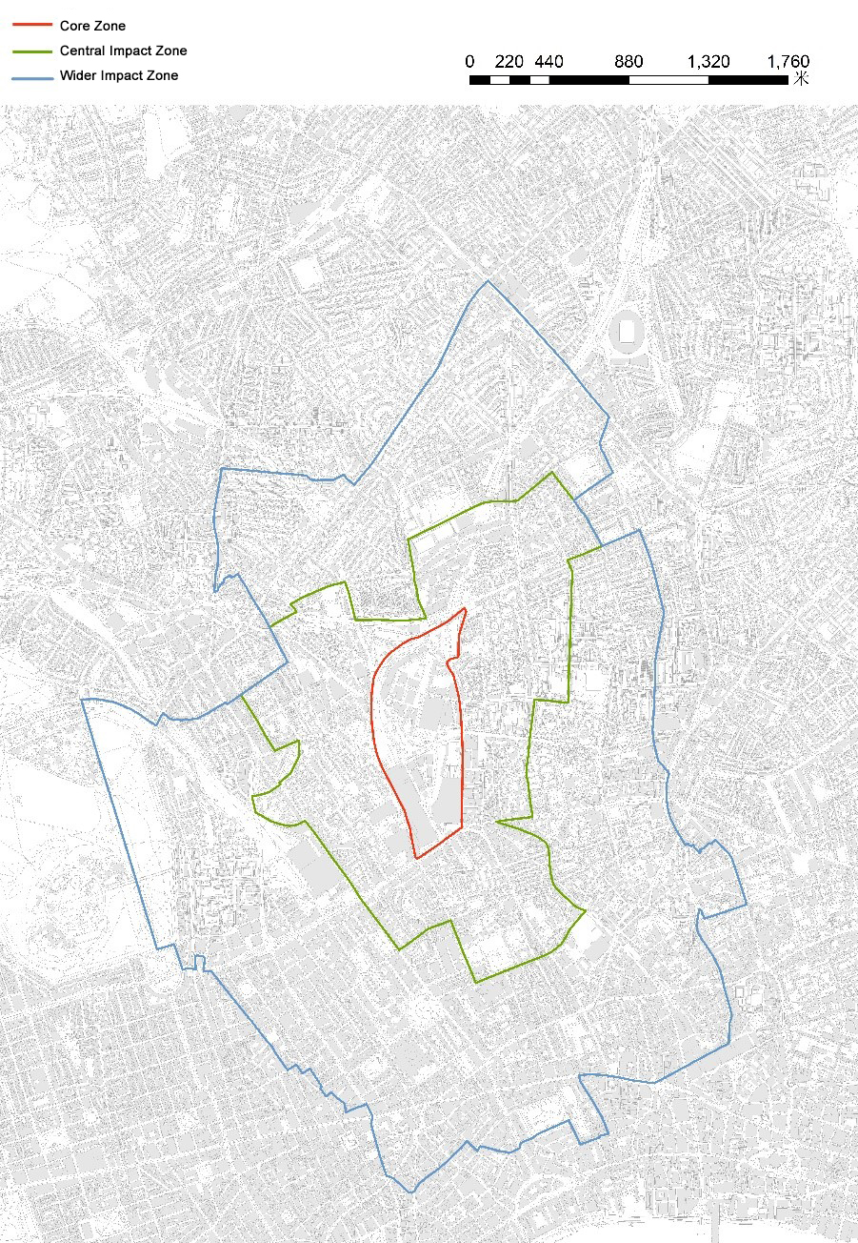
Impact of Multi-Station Aggregate Hub Redevelopment on Surrounding Urban Areas -A Case Study of London’s King’s Cross
1 Introduction
Research Methods
2 Research Methods
Figure 1: Three Analytical Zones of King’s Cross
2.1 Case: King’s Cross, London
3 Multi-Station Aggregation Hub and Regional Impact in King’s Cross
2.2 Documentary Data,
this included historical records of the area, planning and design proposals from developers and urban designers, relevant planning documents published on the official websites of the Camden and Islington local authorities, progress reports on the King’s Cross core zone (2008–2024) published by KCCLP on its official website, and a 2017 construction evaluation report for the core and impact zones by Regeneris Consulting (Regeneris Consulting, 2017). For spatial and statistical data, the study acquired: Ordnance Survey datasets (2007–2023): Built-environment typology maps, building height data, and Points of Interest (POIs); Transport for London (https://tfl.gov.uk): Ridership statistics for stations (2007–2017); UK Office for National Statistics (www.ons.gov.uk): Census data (2001, 2011, 2021) at the Output Area (OA) level, with each OA typically covering 40–250 households.
4 Spatial Renewal Methods in King’s Cross Area
5 Discussion and Conclusions
6 References
2.3 Analytical Methods-
Integration of Qualitative and Quantitative Approaches
School of Architecture, Southeast University | chuanwang@seu.edu.cn

Slide 6
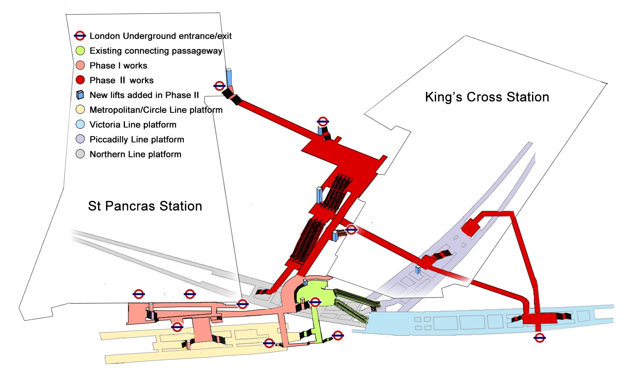
Impact of Multi-Station Aggregate Hub Redevelopment on Surrounding Urban Areas -A Case Study of London’s King’s Cross
1 Introduction
3.1 Aggregation Development of Transport Hubs
2 Research Methods
3 Multi-Station Aggregation Hub and Regional Impact in King’s Cross
4 Spatial Renewal Methods in King’s Cross Area
5 Discussion and Conclusions
6 References
Figure 2: Schematic Diagram of the Multi-Station Aggregation Project at King’s Cross
School of Architecture, Southeast University | chuanwang@seu.edu.cn

Slide 7
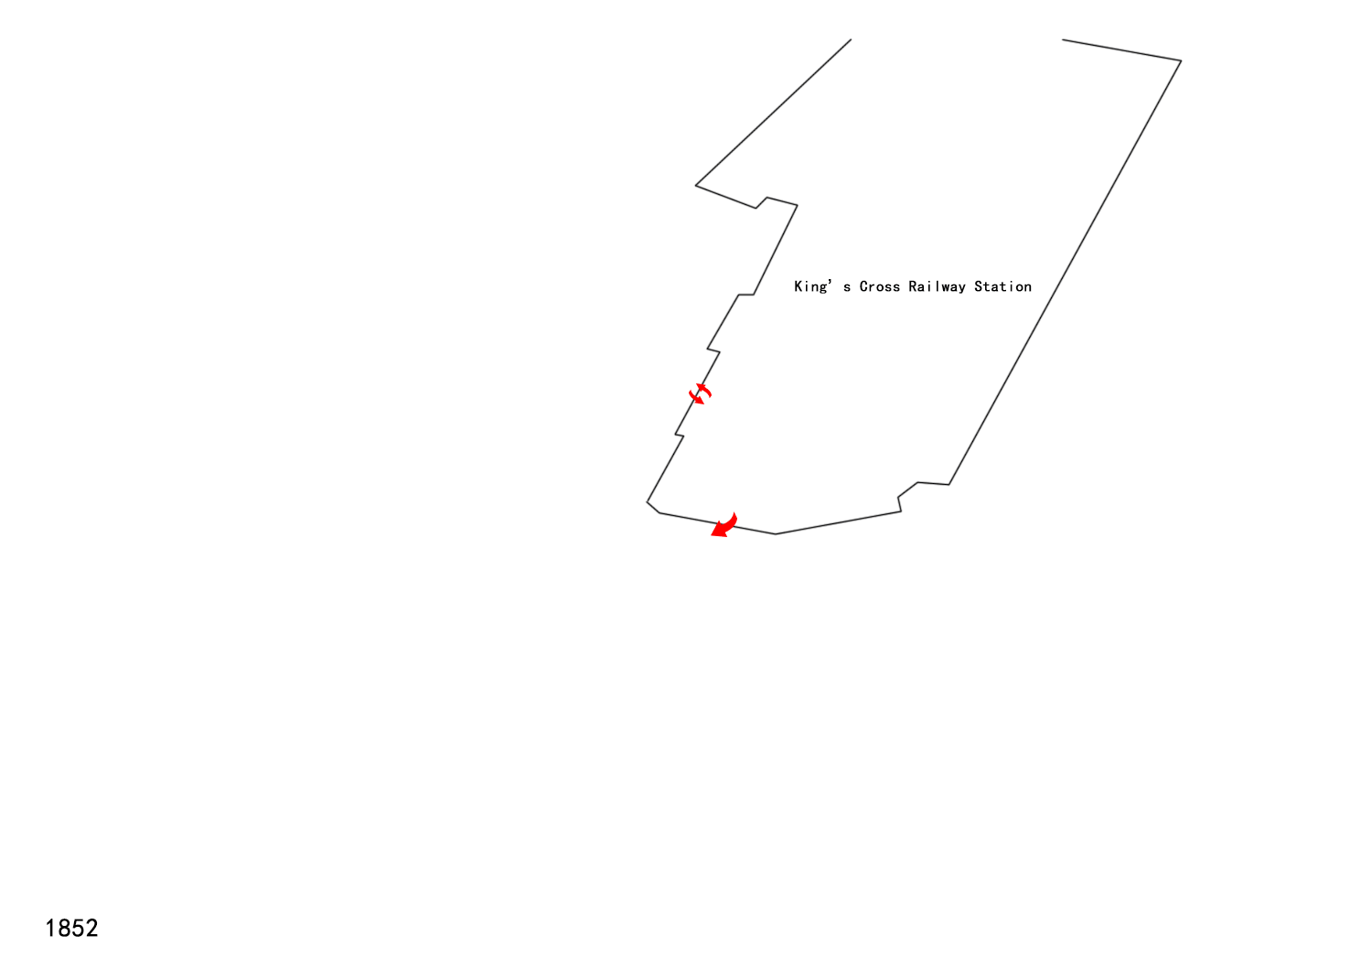
Impact of Multi-Station Aggregate Hub Redevelopment on Surrounding Urban Areas -A Case Study of London’s King’s Cross
1 Introduction
3.1 Aggregation Development of Transport Hubs
2 Research Methods
3 Multi-Station Aggregation Hub and Regional Impact in King’s Cross
4 Spatial Renewal Methods in King’s Cross Area
5 Discussion and Conclusions
6 References
King's Cross Station from its inception to the turn-of-the-century development of polymerization
School of Architecture, Southeast University | chuanwang@seu.edu.cn

Slide 8
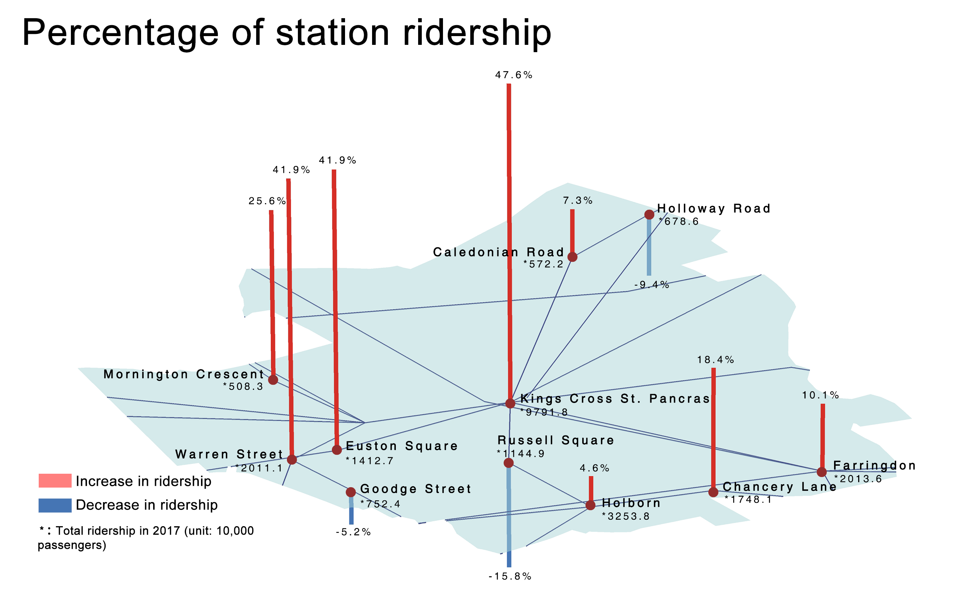
Impact of Multi-Station Aggregate Hub Redevelopment on Surrounding Urban Areas -A Case Study of London’s King’s Cross
1 Introduction
3.1 Aggregation Development of Transport Hubs
2 Research Methods
3 Multi-Station Aggregation Hub and Regional Impact in King’s Cross
4 Spatial Renewal Methods in King’s Cross Area
5 Discussion and Conclusions
6 References
Figure 3: Annual Ridership Changes at King’s Cross Stations (2007–2017)
School of Architecture, Southeast University | chuanwang@seu.edu.cn

Slide 9
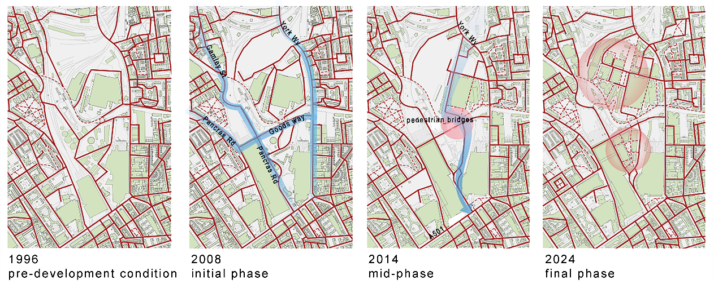
Impact of Multi-Station Aggregate Hub Redevelopment on Surrounding Urban Areas -A Case Study of London’s King’s Cross
1 Introduction
3.2 Evolution of the Transport Network
2 Research Methods
3 Multi-Station Aggregation Hub and Regional Impact in King’s Cross
4 Spatial Renewal Methods in King’s Cross Area
5 Discussion and Conclusions
6 References
Figure 4: Road network evolution in the core zone (1996–2024)
School of Architecture, Southeast University | chuanwang@seu.edu.cn

Slide 10
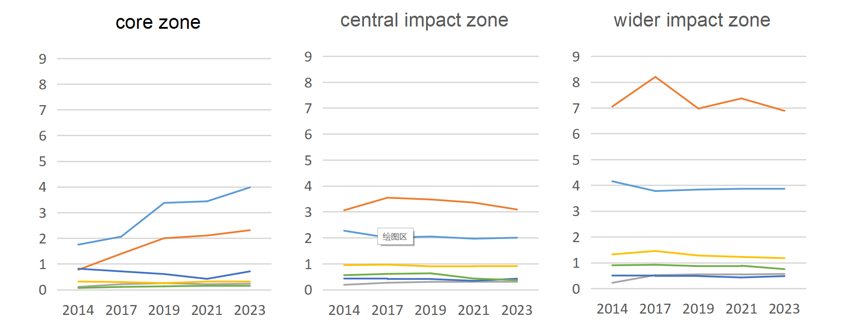
Impact of Multi-Station Aggregate Hub Redevelopment on Surrounding Urban Areas -A Case Study of London’s King’s Cross
1 Introduction
3.3 Functional Vitality Transformation
2 Research Methods
3 Multi-Station Aggregation Hub and Regional Impact in King’s Cross
4 Spatial Renewal Methods in King’s Cross Area
5 Discussion and Conclusions
6 References
Figure 5: Changes in POI density per hectare across zones (2014–2023)
School of Architecture, Southeast University | chuanwang@seu.edu.cn

Slide 11
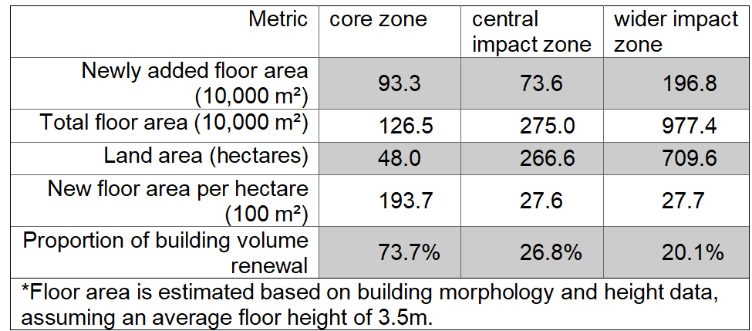
Impact of Multi-Station Aggregate Hub Redevelopment on Surrounding Urban Areas -A Case Study of London’s King’s Cross
1 Introduction
3.4 Intensity of Spatial Development
2 Research Methods
3 Multi-Station Aggregation Hub and Regional Impact in King’s Cross
4 Spatial Renewal Methods in King’s Cross Area
5 Discussion and Conclusions
6 References
Table 1: Spatial Development Metrics Across Zones (1996–2023)
School of Architecture, Southeast University | chuanwang@seu.edu.cn

Slide 12
Impact of Multi-Station Aggregate Hub Redevelopment on Surrounding Urban Areas -A Case Study of London’s King’s Cross
1 Introduction
3.4 Intensity of Spatial Development
2 Research Methods
3 Multi-Station Aggregation Hub and Regional Impact in King’s Cross
4 Spatial Renewal Methods in King’s Cross Area
5 Discussion and Conclusions
6 References
School of Architecture, Southeast University | chuanwang@seu.edu.cn

Slide 13
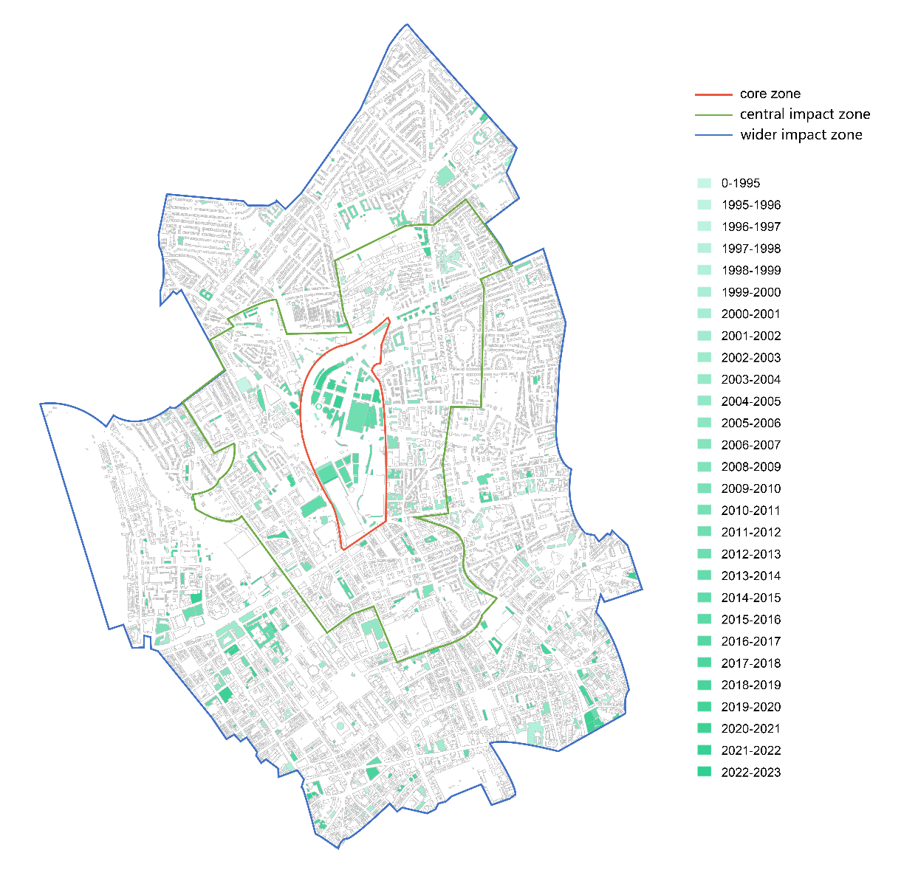
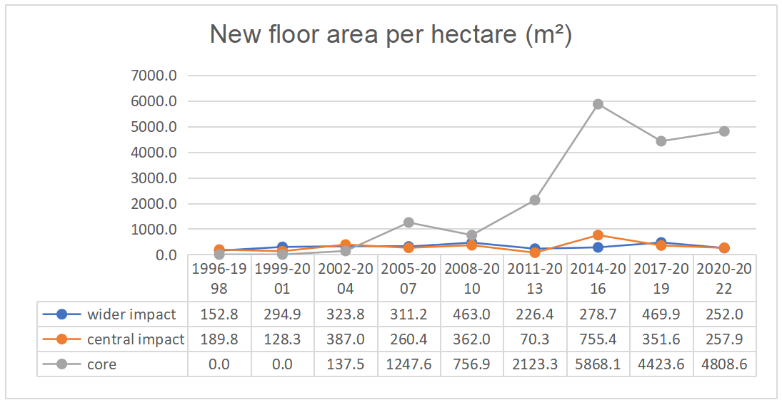
Impact of Multi-Station Aggregate Hub Redevelopment on Surrounding Urban Areas -A Case Study of London’s King’s Cross
1 Introduction
3.4 Intensity of Spatial Development
2 Research Methods
3 Multi-Station Aggregation Hub and Regional Impact in King’s Cross
4 Spatial Renewal Methods in King’s Cross Area
5 Discussion and Conclusions
6 References
Figure 6: Spatial distribution and comparative metrics of redeveloped buildings (1996–2022)
School of Architecture, Southeast University | chuanwang@seu.edu.cn

Slide 14
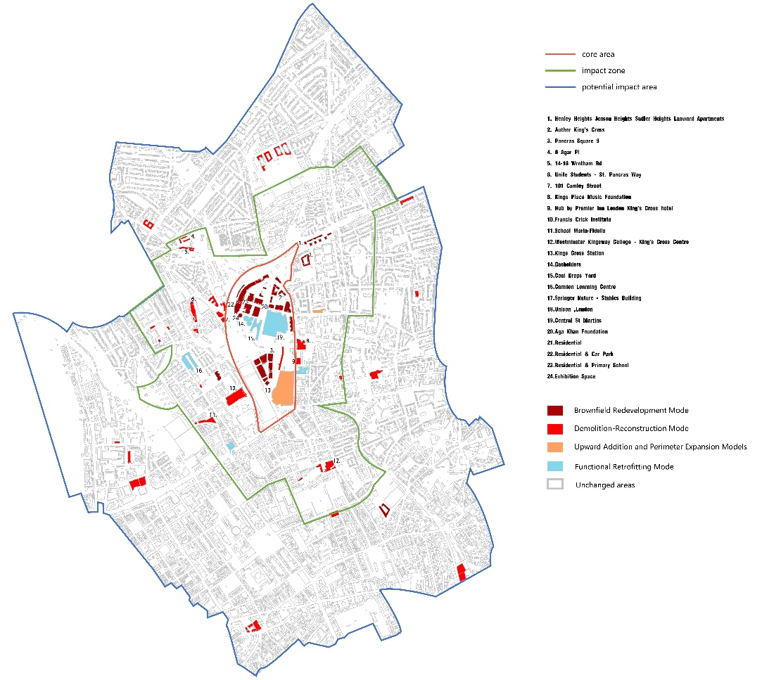
Impact of Multi-Station Aggregate Hub Redevelopment on Surrounding Urban Areas -A Case Study of London’s King’s Cross
1 Introduction
Spatial Renewal Methods in King’s Cross Area
2 Research Methods
3 Multi-Station Aggregation Hub and Regional Impact in King’s Cross
Brownfield Redevelopment Mode
Demolition-Reconstruction Mode
Functional Retrofitting Mode
Upward Addition and Perimeter Expansion Models
4 Spatial Renewal Methods in King’s Cross Area
5 Discussion and Conclusions
6 References
Figure 7: Distribution of the four development patterns
in the King's Cross area
School of Architecture, Southeast University | chuanwang@seu.edu.cn

Slide 15
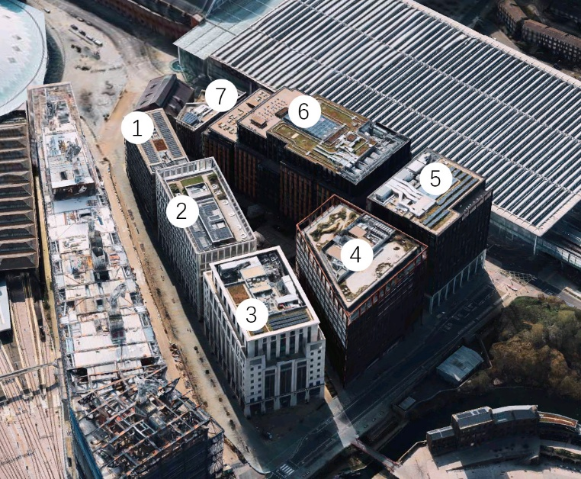
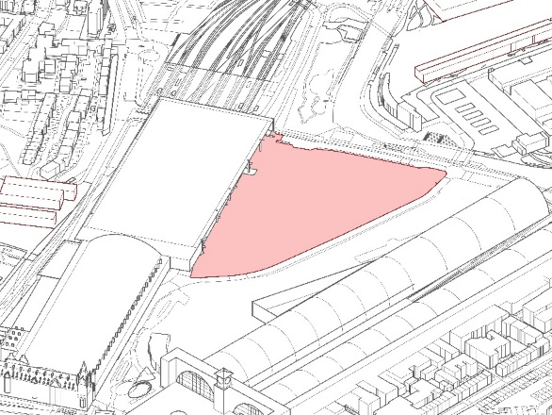
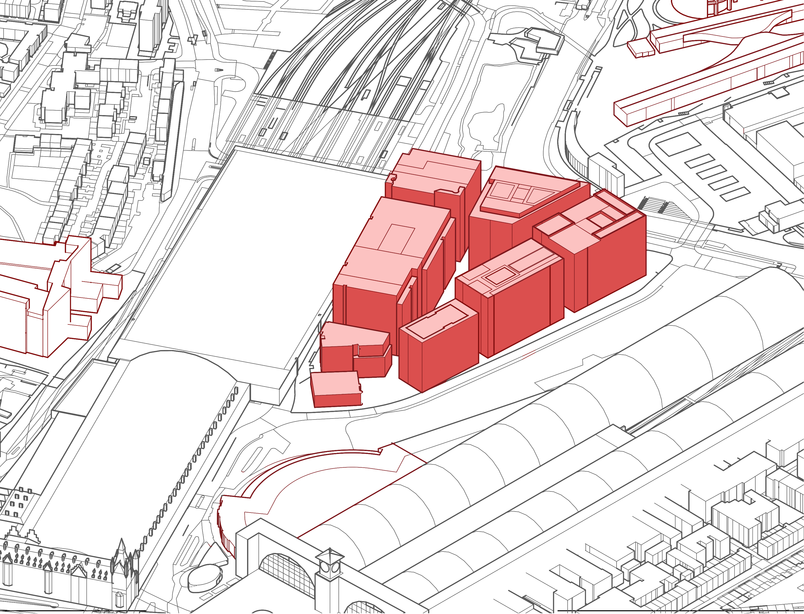
Impact of Multi-Station Aggregate Hub Redevelopment on Surrounding Urban Areas -A Case Study of London’s King’s Cross
1 Introduction
4.1 Brownfield Redevelopment Mode
2 Research Methods
3 Multi-Station Aggregation Hub and Regional Impact in King’s Cross
4 Spatial Renewal Methods in King’s Cross Area
5 Discussion and Conclusions
6 References
Aerial view of Pancras Square (Source: Apple 3D Maps)
Before-and-after comparison of Pancras Square
School of Architecture, Southeast University | chuanwang@seu.edu.cn

Slide 16
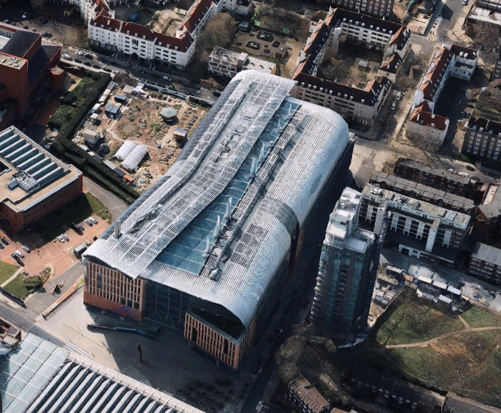
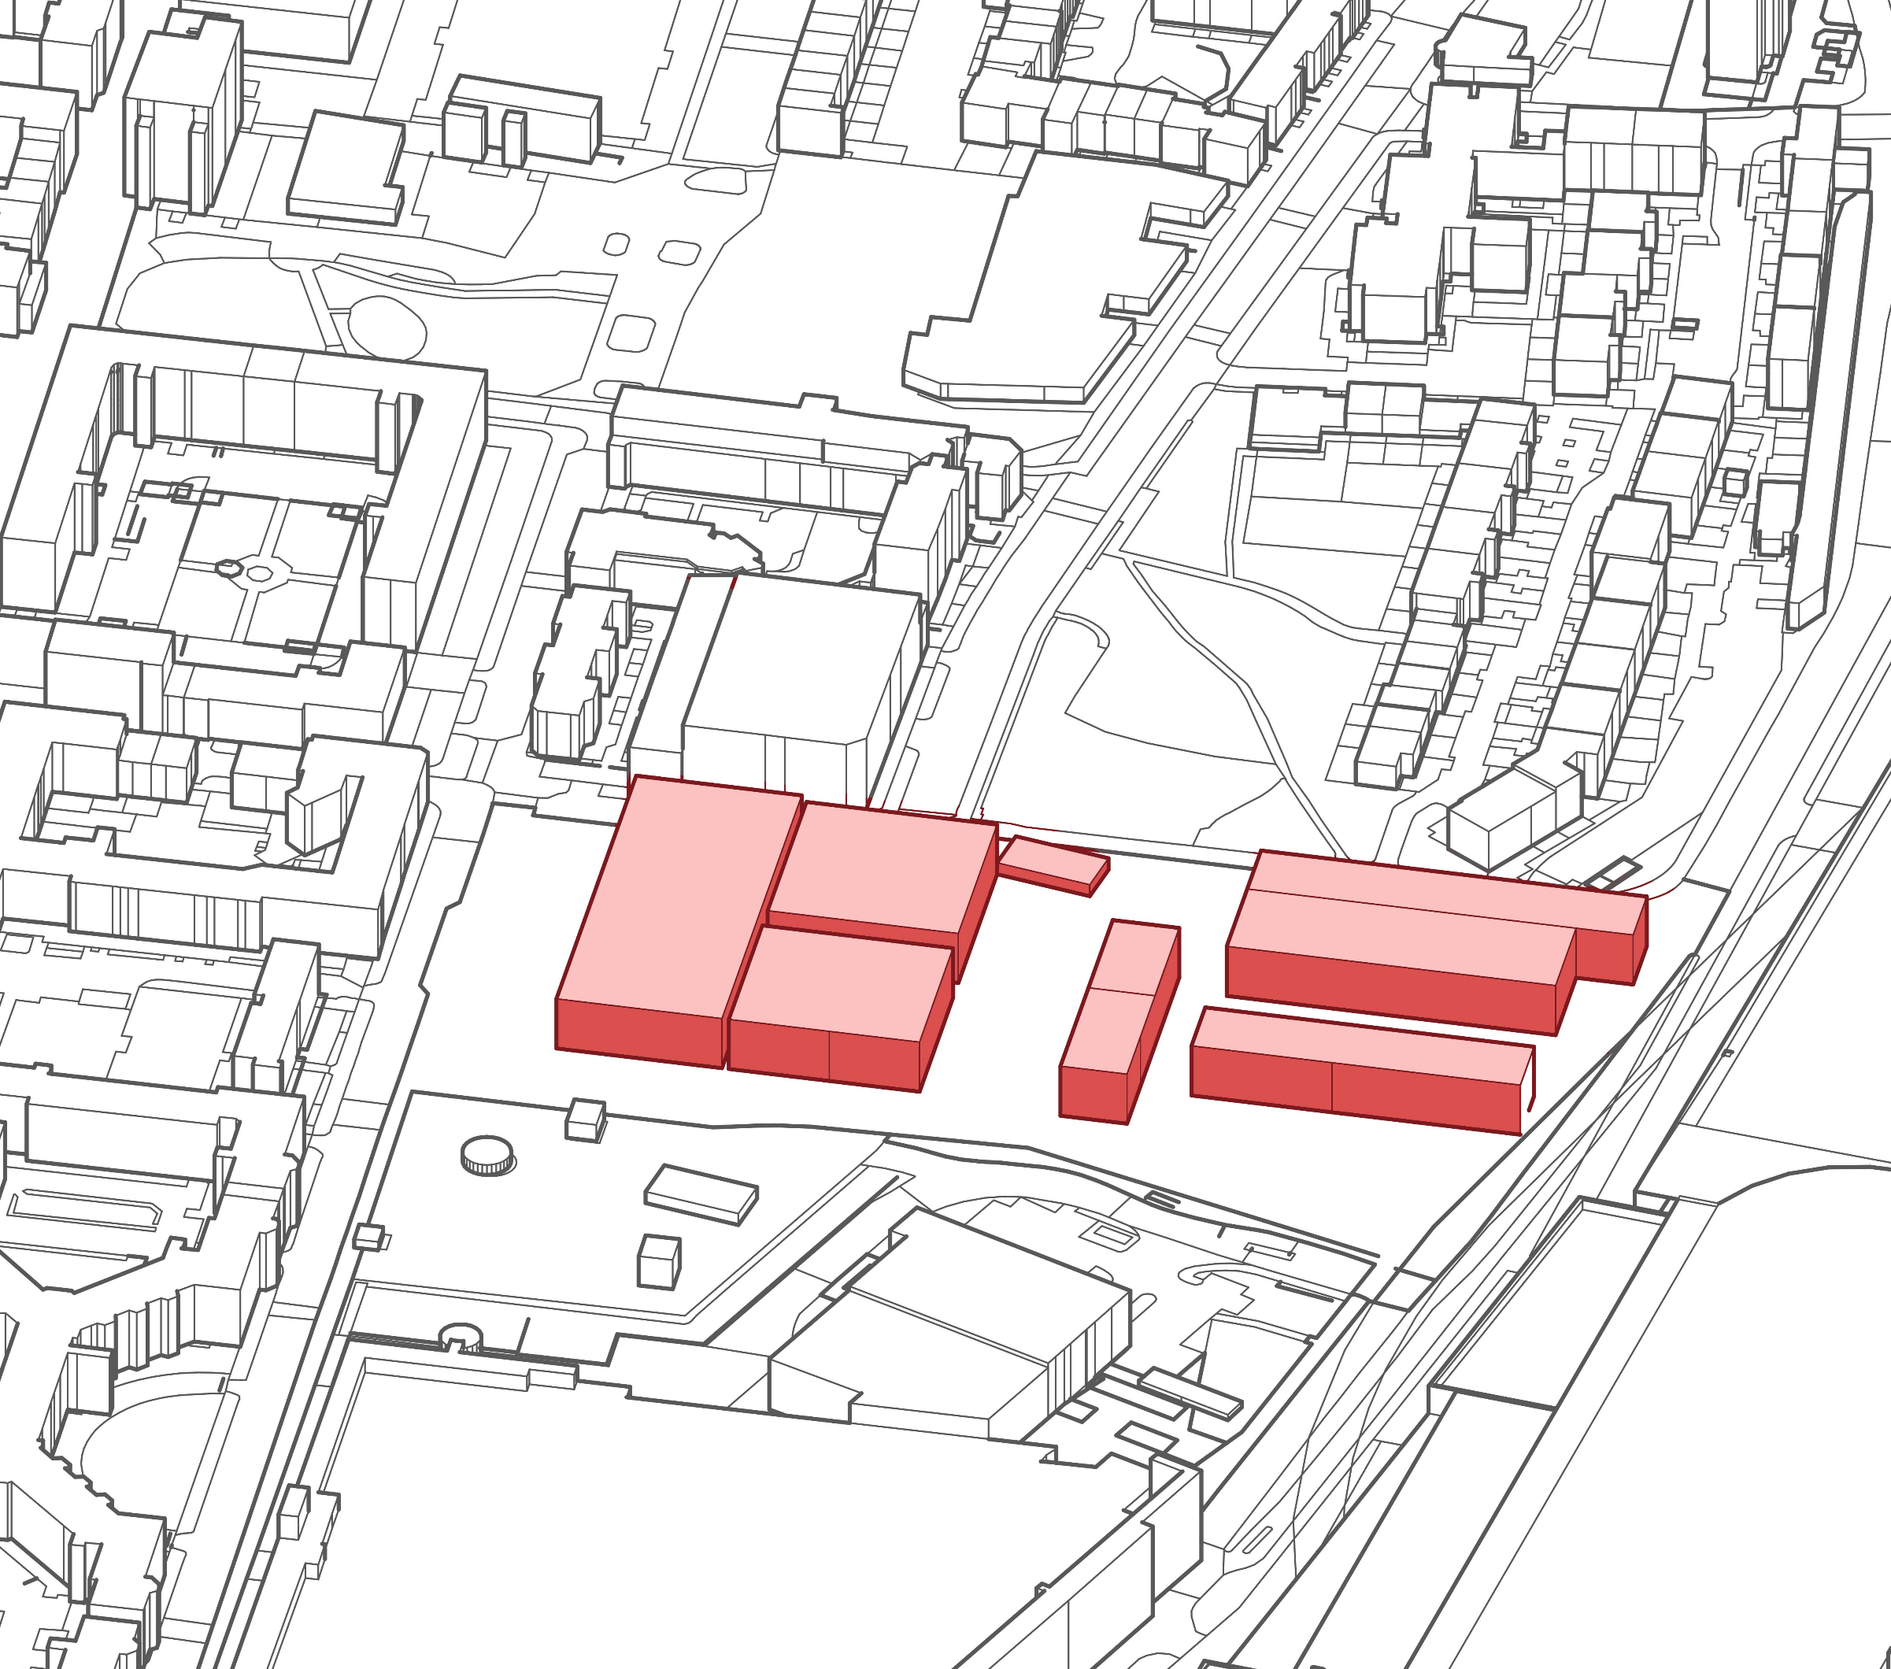
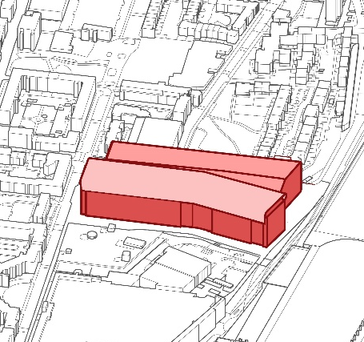
Impact of Multi-Station Aggregate Hub Redevelopment on Surrounding Urban Areas -A Case Study of London’s King’s Cross
1 Introduction
4.2 Demolition-Reconstruction Mode
2 Research Methods
3 Multi-Station Aggregation Hub and Regional Impact in King’s Cross
4 Spatial Renewal Methods in King’s Cross Area
5 Discussion and Conclusions
6 References
Aerial view of the Francis Crick Institute (Source: Apple 3D Maps)
School of Architecture, Southeast University | chuanwang@seu.edu.cn

Slide 17
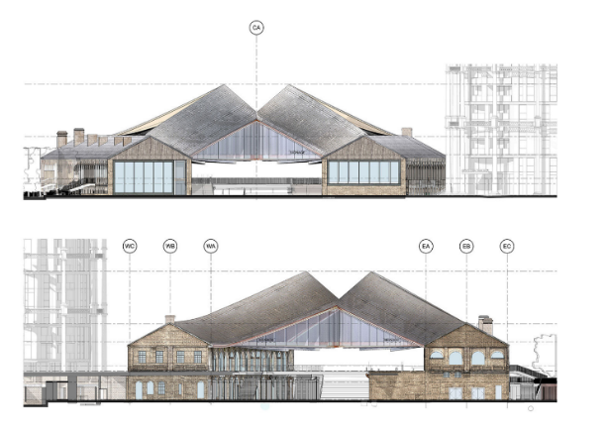
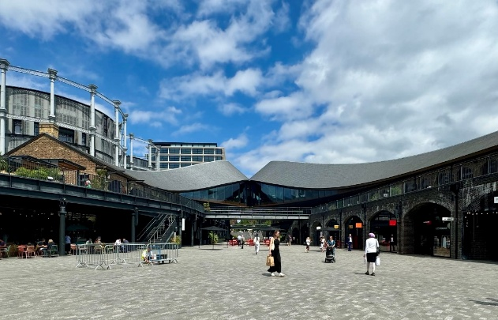
Impact of Multi-Station Aggregate Hub Redevelopment on Surrounding Urban Areas -A Case Study of London’s King’s Cross
1 Introduction
4.3 Functional Retrofitting Mode
2 Research Methods
3 Multi-Station Aggregation Hub and Regional Impact in King’s Cross
4 Spatial Renewal Methods in King’s Cross Area
5 Discussion and Conclusions
6 References
Figure 12: Coal Drop Plaza Elevation and Existing Conditions
School of Architecture, Southeast University | chuanwang@seu.edu.cn

Slide 18
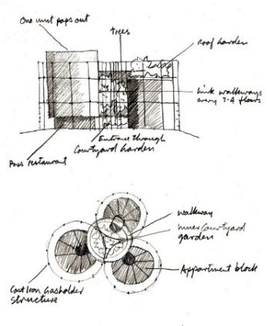
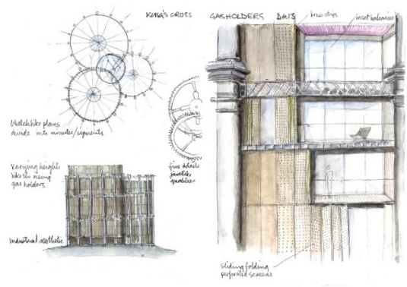
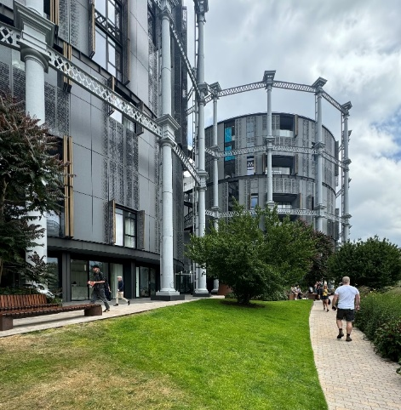
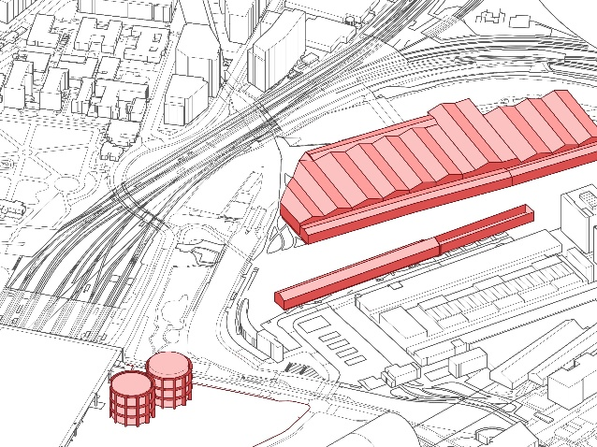
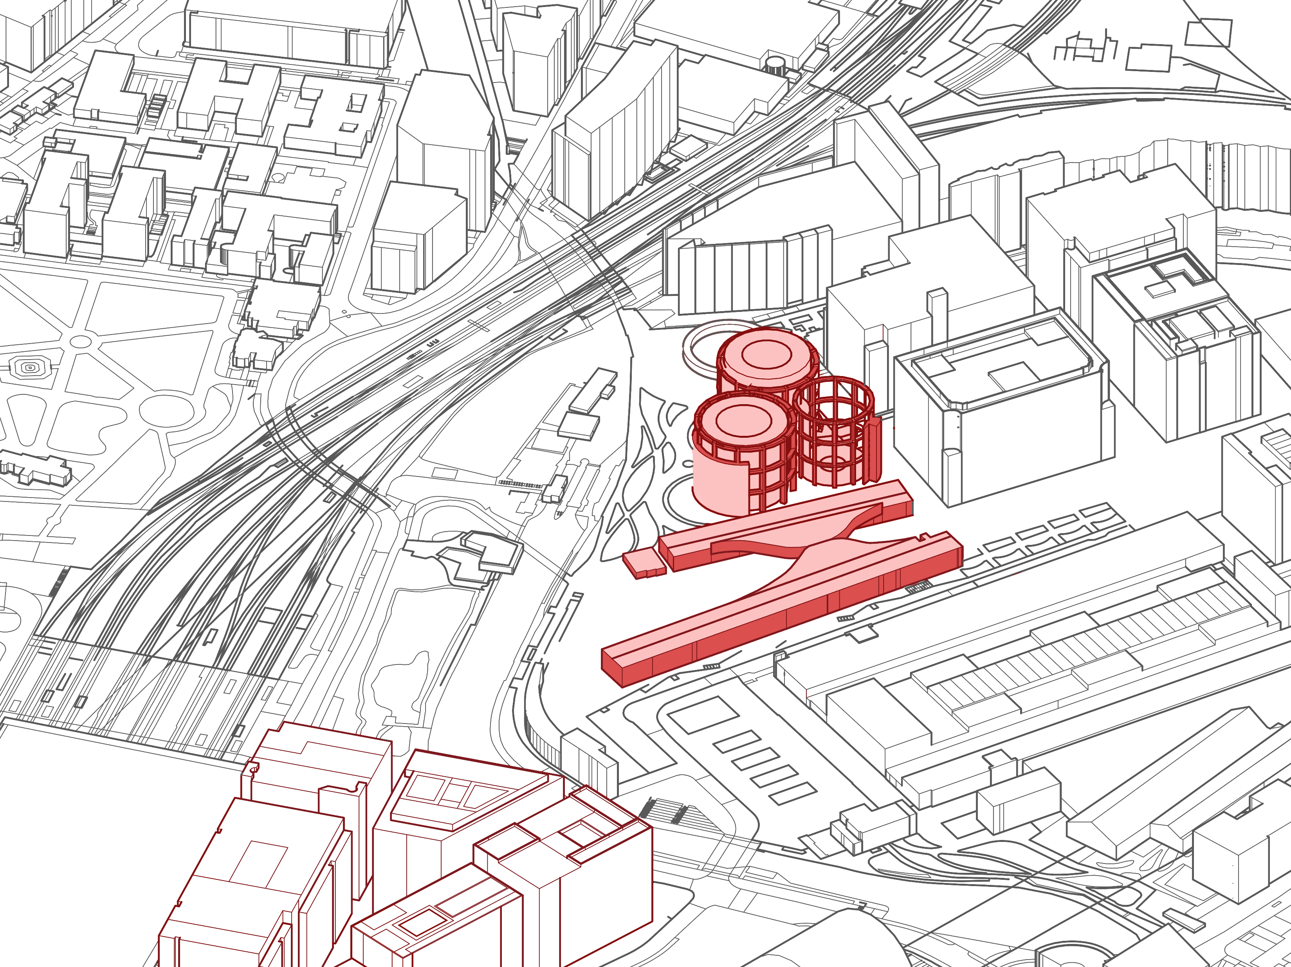
Impact of Multi-Station Aggregate Hub Redevelopment on Surrounding Urban Areas -A Case Study of London’s King’s Cross
1 Introduction
4.3 Functional Retrofitting Mode
2 Research Methods
3 Multi-Station Aggregation Hub and Regional Impact in King’s Cross
4 Spatial Renewal Methods in King’s Cross Area
Triplex Gas Storage Tank Design Analysis Diagram and Current Status
5 Discussion and Conclusions
6 References
Comparison of Triplex Gas Storage Tank and Coal Drop Plaza before and after construction
School of Architecture, Southeast University | chuanwang@seu.edu.cn

Slide 19
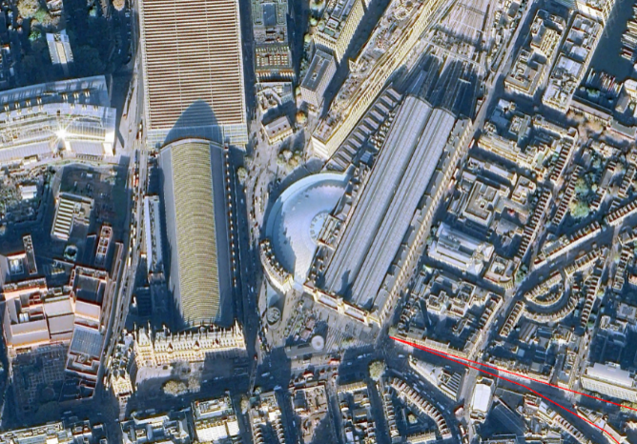
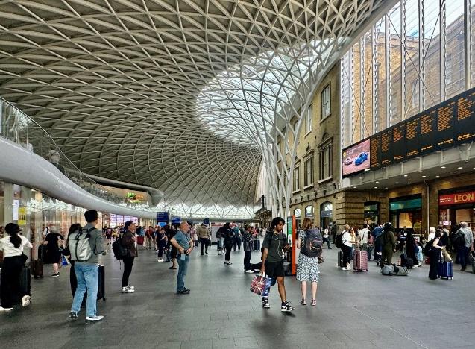
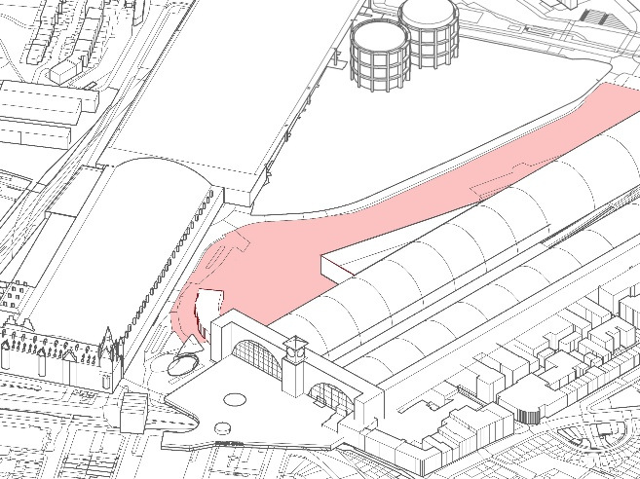
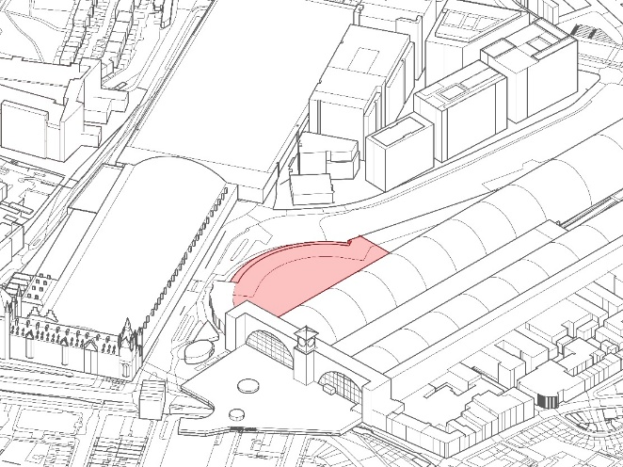
Impact of Multi-Station Aggregate Hub Redevelopment on Surrounding Urban Areas -A Case Study of London’s King’s Cross
1 Introduction
4.4 Upward Addition and Perimeter Expansion Models
2 Research Methods
3 Multi-Station Aggregation Hub and Regional Impact in King’s Cross
4 Spatial Renewal Methods in King’s Cross Area
Aerial view of the new Western Ticket Hall and human eye viewpoints
5 Discussion and Conclusions
6 References
Comparison of the New Western Ticket Hall before and after its completion
School of Architecture, Southeast University | chuanwang@seu.edu.cn

Slide 20
Impact of Multi-Station Aggregate Hub Redevelopment on Surrounding Urban Areas -A Case Study of London’s King’s Cross
1 Introduction
Discussion and Conclusions
2 Research Methods
The redevelopment of King’s Cross demonstrates that the aggregation of transport hubs—through the expansion of rail networks and integration of existing stations—creates efficient connectivity, driving increased passenger flows and stimulating demand for complementary functions and spatial provisions.
3 Multi-Station Aggregation Hub and Regional Impact in King’s Cross
Proximity to the multi-station hub strongly correlates with development intensity. From 1996 to 2023, 25: 11: 8 of new floor area per hectare was added in the core, central impact, and wider impact zones, respectively.
4 Spatial Renewal Methods in King’s Cross Area
It is foreseeable that with continuous advancements in transportation technology, the reduced demand for ancillary transport infrastructure and increased functional integration will enable sophisticated mixed-use design to unlock greater development potential in urban multi-hub aggregation zones.
5 Discussion and Conclusions
6 References
School of Architecture, Southeast University | chuanwang@seu.edu.cn

Slide 21
Impact of Multi-Station Aggregate Hub Redevelopment on Surrounding Urban Areas -A Case Study of London’s King’s Cross
1 Introduction
References
Allies and Morrison Architects (2007) King’s Cross Central Urban Design Statement. [Online] Available at: https://www.alliesandmorrison.com/projects/kings-cross [Accessed: 12 January 2019].
Bessant, G. T. (2004) King's Cross underground station, London: an overview. Proceedings of the Institution of Civil Engineers - Transport, 157(4), pp.211–220.
Cao, Z. (2022) Integrating station area development with rail transit networks: lessons from Japan Railway in Tokyo. Urban Rail Transit, 8(3), pp.167–174.
Chen, E. and Zhuang, Y. (2022) 力量博弈与要素组织——乌德勒支站城融合发展研究. 建筑师, (03), pp.52–60.
Chen, J. (2018) 穿城铁路地下化更新三例. 工业建筑, 48(11), pp.197–200+167.
Chu, D. and Su, H. (2024) 投射：移动性触发下的建筑学时空要素. 建筑师, (05), pp.6–13.
Chu, D. and Wei, S. (2017) 轨道交通站点影响域的界定与应用——兼议城市设计发展及其空间基础. 建筑学报, (02), pp.16–21.
Desjardins, X., Maulat, J. and Sykes, O. (2014) Linking rail and urban development: reflections on French and British experience. The Town Planning Review, 85(2), pp.143–153.
Fennell, D. (1989) King's Cross Fire (Fennell Report). [Online] Available at: https://api.parliament.uk/historic-hansard/commons/1989/apr/12/kings-cross-fire-fennell-report [Accessed: 16 June 2024].
Islington Council (2023) Islington Local Plan: Strategic and Development Management Policies. In: Islington Planning Policy Team. [Online] Available at: https://www.islington.gov.uk/planning/planning-policy/islington-local-plan.
Kidokoro, T. (2020) Transit Oriented Development (TOD) policies and station area development in Asian cities. IOP Conference Series: Earth and Environmental Science, 532(1), 012001.
Li, T., Shi, Y. and Fu, W. (2015) TOD概念的发展及其中国化. 国际城市规划, 30(03), pp.72–77.
Li, X., Cao, Y., Zhao, X. and Zhai, J. (2024) “双碳目标下的建筑城市一体化与立体化关键技术研究”项目概述. 世界建筑, (10), pp.10–14.
2 Research Methods
3 Multi-Station Aggregation Hub and Regional Impact in King’s Cross
4 Spatial Renewal Methods in King’s Cross Area
5 Discussion and Conclusions
6 References
School of Architecture, Southeast University | chuanwang@seu.edu.cn

Slide 22
Impact of Multi-Station Aggregate Hub Redevelopment on Surrounding Urban Areas -A Case Study of London’s King’s Cross
1 Introduction
References
Regeneris Consulting (2017) The Economic and Social Story of Kings Cross. [Online] Available at: https://relatedargent.co.uk/media/The-Economic-and-Social-Story-of-Kings-Cross.pdf [Accessed: 16 June 2024].
Yang, B. (2021) 多轨道站点关联下城市中心区空间布局研究. Unpublished doctoral dissertation.
Zhu, Y. and Wang, H. (2022) 等时效应下轨道交通站点三维影响域界定方法初探. 建筑学报, (10), pp.80–85.
2 Research Methods
3 Multi-Station Aggregation Hub and Regional Impact in King’s Cross
4 Spatial Renewal Methods in King’s Cross Area
5 Discussion and Conclusions
6 References
School of Architecture, Southeast University | chuanwang@seu.edu.cn

Slide 23
Thanks for listening！ #749 Impact of Multi-Station Aggregate Hub Redevelopment on Surrounding Urban Areas-A Case Study of London’s King’s Cross
Yufei Qu, Yuying Zhu, Xiaoxi Zhang, Chuan Wang*
School of Architecture, Southeast University
chuanwang@seu.edu.cn

