Slide 1
EXAMINING THE EFFECTS OF SHORT-TERM RENTAL REGULATIONS: THE INS AND OUTS OF ISTANBUL
Basak OZEN, Master Student, Department of Architecture, Gebze Technical University, TURKEY (bozen2023@gtu.edu.tr)
Dr. Dicle KIZILDERE, Assistant Professor, Department of Architecture, Gebze Technical University, TURKEY (diclekizildere@gtu.edu.tr)
Notes:
Hello everyone. My name is Basak Ozen, and I am a master's student at Gebze Technical University in Turkey. It is with great pleasure that I am here today to present the findings of a research study that was conducted in collaboration with my master thesis advisor Dr. Dicle Kızıldere The presentation is entitled "EXAMINING THE EFFECTS OF SHORT-TERM RENTAL REGULATIONS: THE INS AND OUTS OF ISTANBUL."

Slide 2
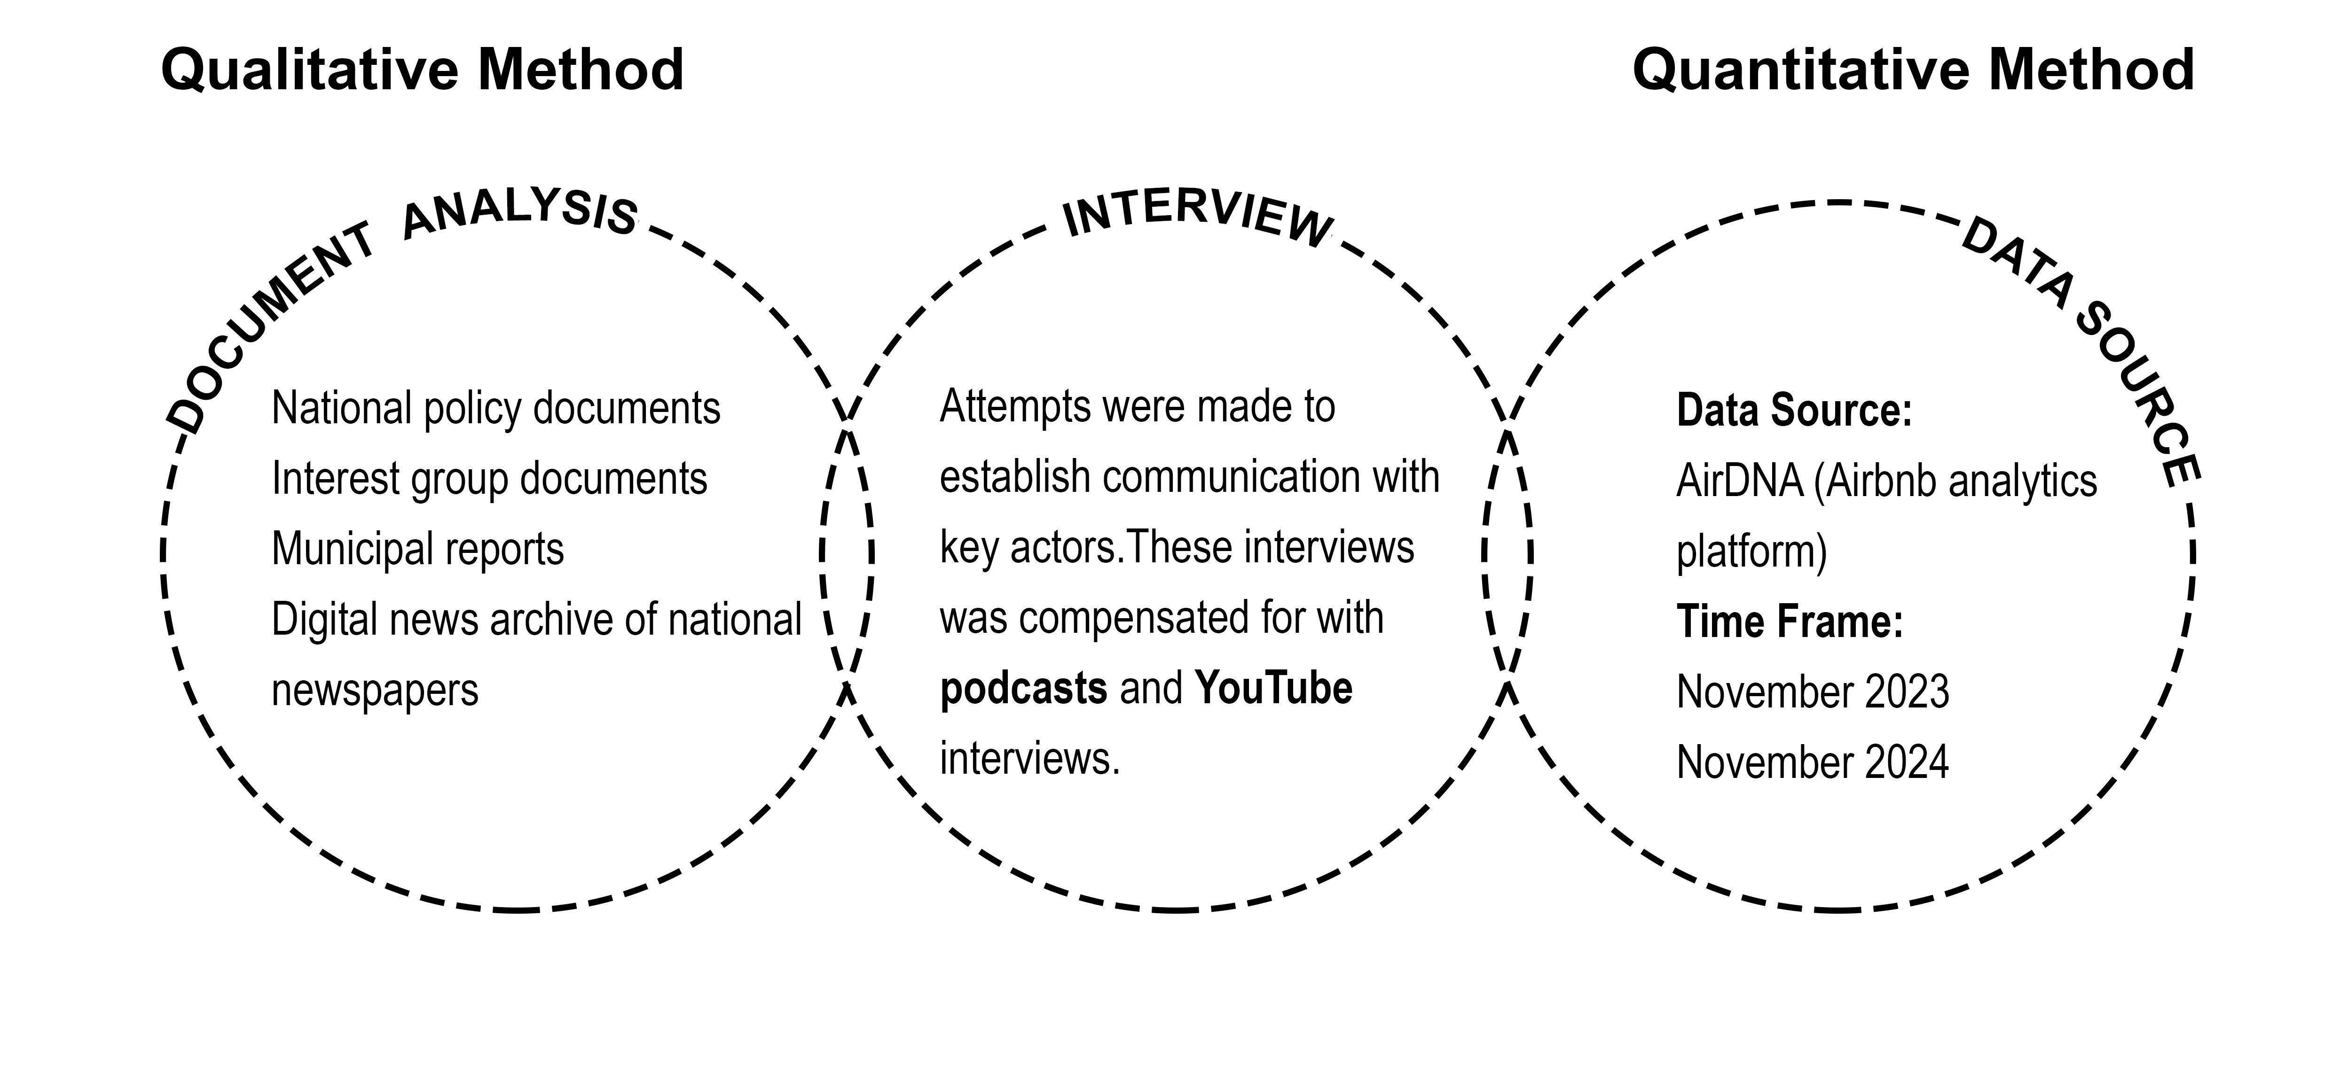
EXAMINING THE EFFECTS OF SHORT-TERM RENTAL REGULATIONS: THE INS AND OUTS OF ISTANBUL
The short-term rental (STR) regulation in Istanbul;
its background,
its local characteristics and complexities,
and its preliminary
results in the field.
Notes:
This study focuses on the process of regulating short-term rentals in Istanbul. First, we will look at the background and context of short-term rentals (STRs), then examine the unique local features of the regulatory environment, and finally discuss the initial impacts observed in the field.
We used a combination of qualitative and quantitative research.

Slide 3
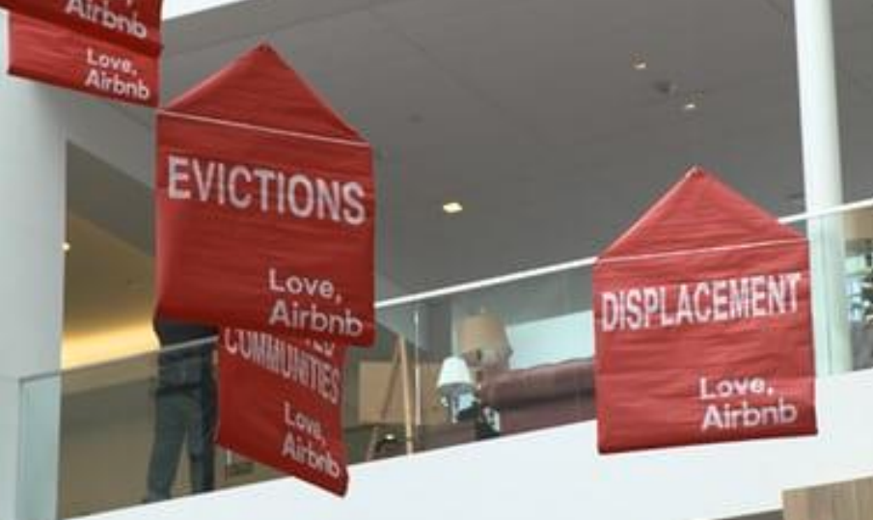
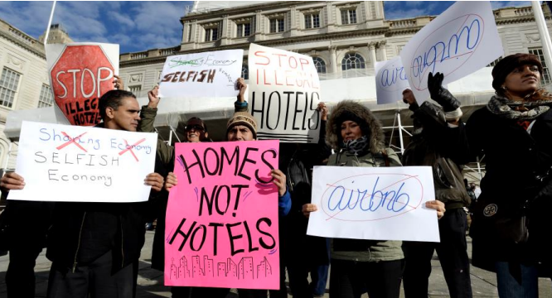
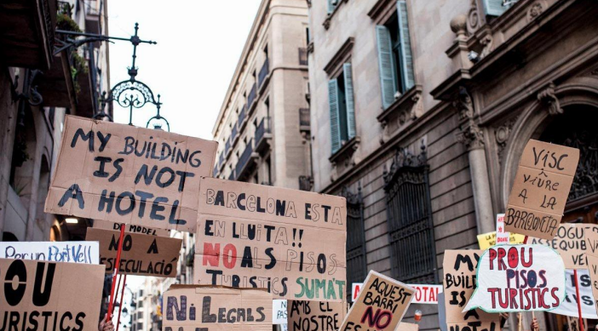
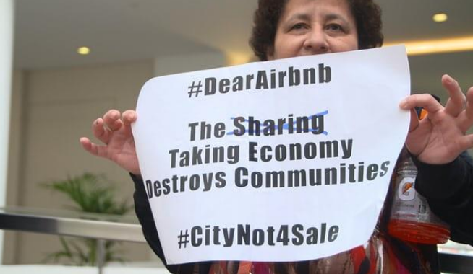
The short-term rental (STR) market ‘Airbnb’
220 +
countries and regions with Airbnb listings
150 K +
cities and towns with active Airbnb listings
8 Milyon +
Active listings worldwide
Notes:
First, let's examine the global context.
Airbnb has grown rapidly and become a major player in the short-term rental market.
The sharing economy is the basis of this venture, which connects locals and travellers, and it has become a global business with implications for housing, the economy and city life.

Slide 4
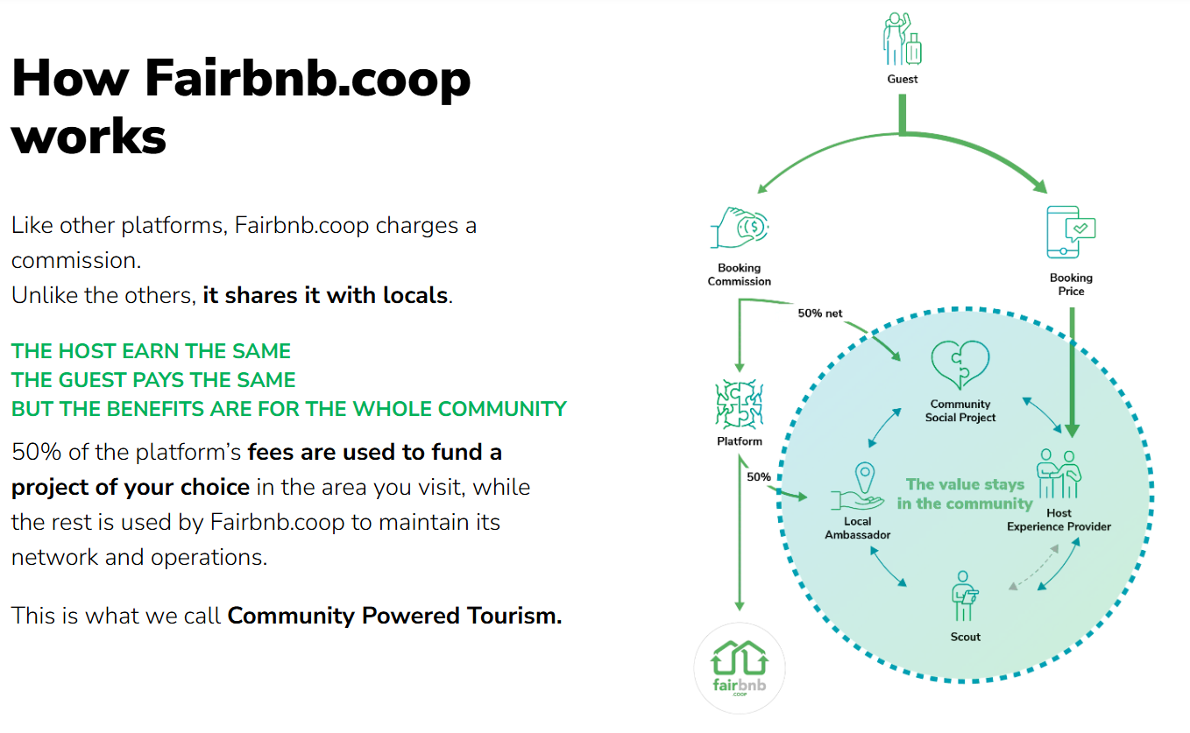
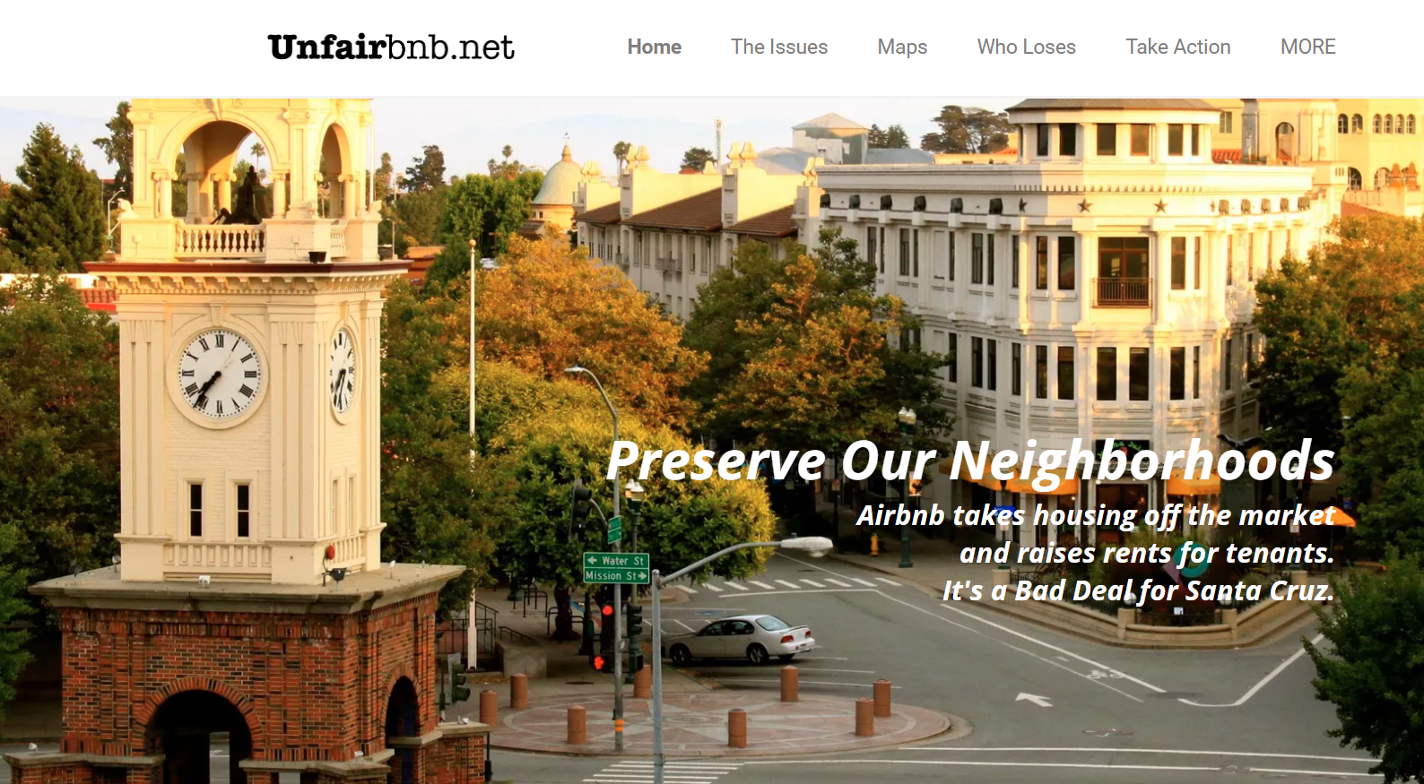
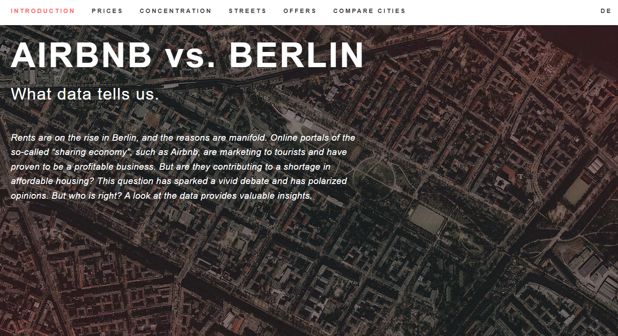
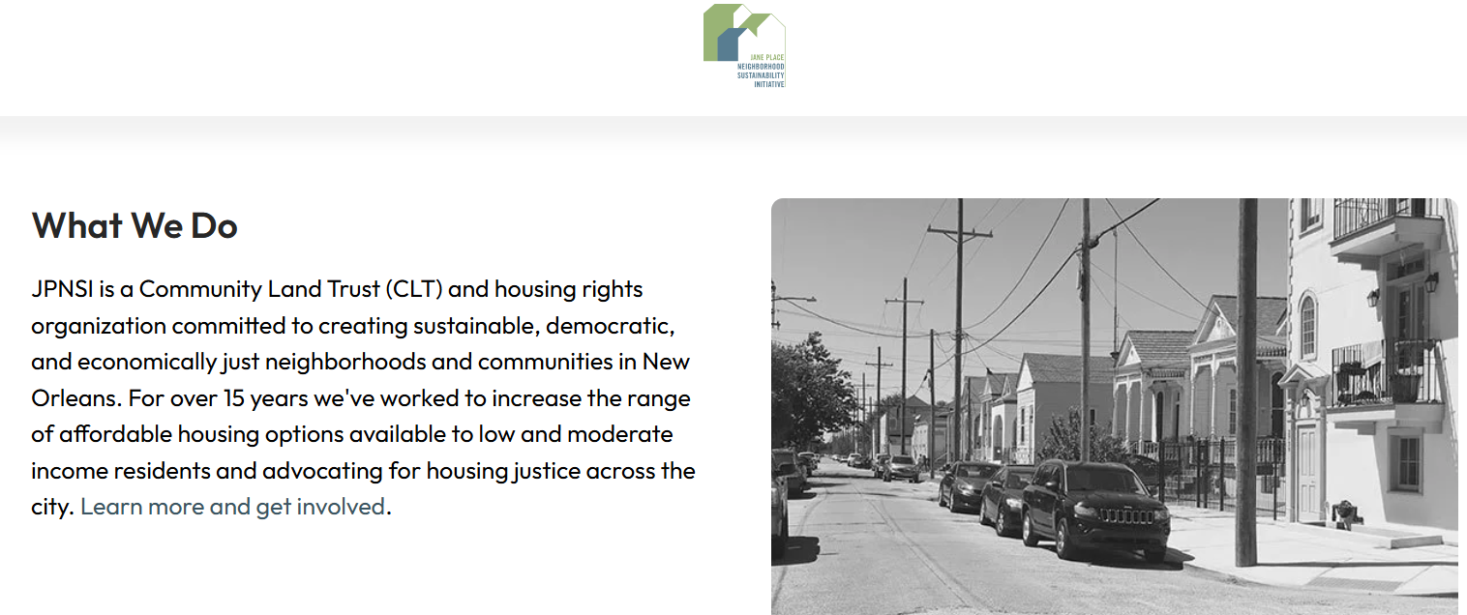
The short-term rental (STR) market ‘Airbnb’
Unfairbnb
Airbnb vs Berlin
Fairbnb
JPNSI
InsideAirbnb
Notes:
In addition to the academic discourse, there has been a notable rise in public activism concerning the impact of Airbnb.
Groups such as InsideAirbnb and Fairbnb advocate for greater transparency and community-centred alternatives, reflecting mounting concerns regarding the impact of urban disruption.

Slide 5
Regulating Strs: Narratives and Approaches
Perspectives
 | Positive | Negative
Actors | Service providers ‘Airbnb’ , Sharing Economy | Neighbourhood associations, Urban movements, Grassroots campaigns, Hotel and hospitality industry's
medium for social exchange and sustainability "Belong Anywhere," "Live like a local"
redistribution of income derived from tourism,
the promotion of local enterprises,
the encouragement of sustainable resource utilisation and the facilitation of meaningful social connection between hosts and guests
daily disturbances such as; noise, unruly behaviour, waste management, traffic and damaged shared spaces
speculative rental market
removal of homes from the housing marke 'Airbnbisation’
displacement of residents and tenants
housing affordability
unfair competition
Notes:
Stakeholders have different views on STRs.
Supporters, including service providers and sharing economy advocates, emphasise the ways in which STRs help to distribute tourism income, support local businesses and encourage social connections between hosts and guests.
In contrast, critics point to rising rents, a reduction in the housing supply, gentrification and daily nuisances.This tension is at the heart of the regulatory challenge.

Slide 6
Regulating Strs: Narratives and Approaches
Challenges
The dichotomy between positive and negative realities on the ground, presence of actors with conflicting interests
FULL BAN |  |  |  |  |  |  | LAISSEZ-FAIRE
Anaheim | Barcelona | New Orleans | New York | San Francisco | Paris | Denver | London
Full ban whole city | One listing per property owner | One party of guests per unit | Only one listing per address | Maximum 90 unhosted nights | Max. 4 months a year (otherwise registration as business required) | - | Max. 90 nights renting per year
Start phasing out existing STRs January 2018 | Hygiene, contact details provided for neighbors | Insurance, safety and emergency precautions, contact details, trash and noise info, no nuisance | Permanent resident needs to be present during rental period in multifamily dwellings | Permanent residents only, safety precautions provided | - | With primary residence only, safety precautions provided | -
Nieuwland and Van Melik (2020), Cassell and Deutsch (2023)
Results
Lose revenue generated from taxation and tourist spending, social backlash, informal market for STRs
Notes:
Cities around the world have responded to short-term rentals (STRs) in a variety of ways.
In some cities, such as London, limited regulations are in place, while in others, including Barcelona and New Orleans, strict bans are enforced.
While these approaches aim to protect residents and preserve the housing supply, they also present challenges, including income loss and an increase in illegal, unregulated rentals.

Slide 7
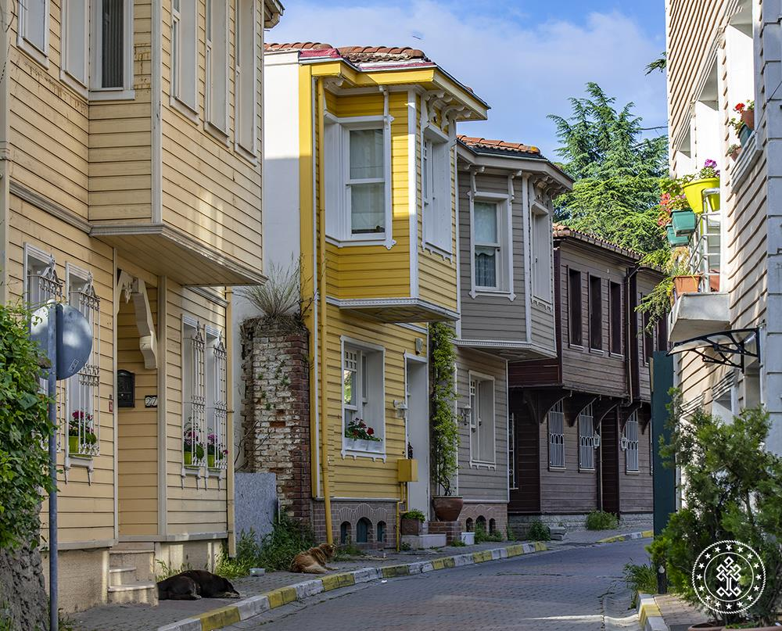
The Genesises of STRs in Istanbul
Cultural Heritage
Spirituality
Cruise tourism
Historical
Gastronomy
Shopping
Entertainment
Education
Healthcare tourism
Notes:
Now let’s focus on Istanbul.
Istanbul's many attractions, from historical sites to entertainment, make it a popular destination for millions of tourists.
This tourism-fuelled economy has created a demand for a variety of accommodation options, particularly short-term rentals.
Airbnb has expanded rapidly in this context, offering more flexible options that appeal to both domestic and international travellers.

Slide 8
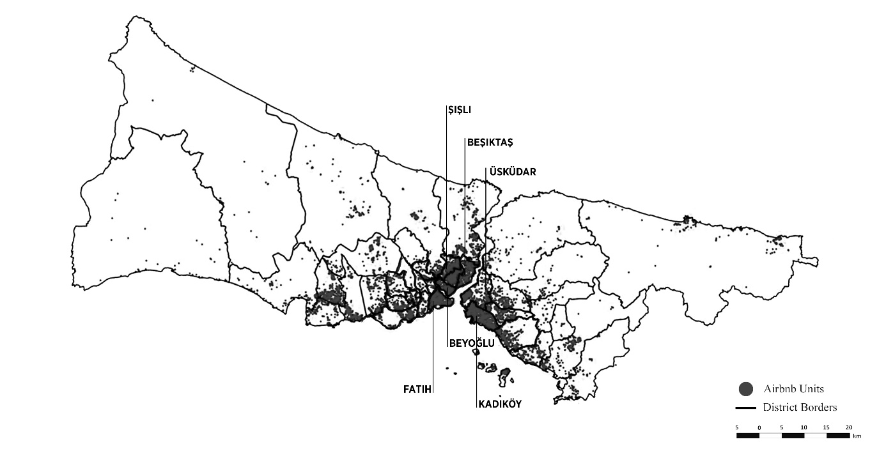
The Genesises of STRs in Istanbul
Notes:
Airbnb listings in Istanbul have grown rapidly— nearly thirty thousand (30.000) units.
However, these listings are heavily concentrated in certain districts like Beyoğlu, Şişli, Kadıköy, Fatih, and Beşiktaş.
We also observe a shift from individual hosts to commercial operators, indicating the professionalisation of STRs.
This trend raises concerns about housing commodification, reducing the availability of long-term rentals for local residents.

Slide 9
The Genesises of STRs in Istanbul
NEGATIVE | IPA (2023) | Airbnb density, long-term rental issues
 | Terry Kim (2023) | Airbnb ↑ → Rent ↑
 | Kasım Zoto (TÜROB) | Neighborhood identity loss, rent ↑
 | Uzgören (2018) | Gentrification
 | Markoç (2019) | Security, noise, parking, theft, rent ↑
 | Minister Mehmet Nuri Ersoy | Need for STR regulation, residential → commercial use, identity loss, security concerns
POSITIVE | Platform Urbanism Supporters | Alternative to hotels, local experience, urban benefits
 | Hosts | 50,000 jobs opportunities, economic investment by hosts
Notes:
Several local studies and official reports have evaluated the impact of STRs in Istanbul. They highlight issues like rising rents, gentrification, neighborhood identity loss, and increased security risks. On the other hand, supporters of platform urbanism and hosts argue that STRs offer economic opportunities and job creation. So, Istanbul reflects a broader global debate between economic growth and social sustainability.

Slide 10
The Genesises of STRs in Istanbul
“The legislation in Turkey is being shaped in a similar way to that seen in the rest of the world. We anticipate that the legislative arrangements will be finalised by the end of the year. They will facilitate a registered economy. However, we wish to clarify that our position on daily houses is not adversarial. We are simply advocating for certification and alignment with global standards. Otherwise, this is also a form of tourism. There is a significant global demand for this, and we believe there is an opportunity to capitalise on it.”
Law on the Rental of Residential Properties for Tourism Purposes and Amendments to Certain Laws
No. 7464, January 1, 2024.
Mehmet Nuri Ersoy, Minister of Culture and Tourism of the Republic of Turkey
Notes:
Turkey introduced Law No. 7464 (seven thousand four hundred sixty-four) in January 2024 (two thousand twenty-four) to regulate short-term rentals.
Rather than banning STRs, the law aims to incorporate them into a legal and accountable framework, as reflected in global trends.

Slide 11
The AIRBNB Law
Regulation | Purpose/Effect | Gaps/Difficulties
Inclusion of rentals of 100 days or less within the scope of regulation | Ensuring the availability of residential units for long-term rentals
Licensing and registration by the Ministry of Culture and Tourism | Ensuring accountability and preventing illegal activities
Renting units registered as residential properties in the land registry | Urban management and planning | The existence of properties that are residential but are registered in the land registry as houses, warehouses, fields, etc.
Rental only by homeowners or companies registered with a travel association agency | Reducing numbers to ease tourism pressure | Elimination of sub-renters
25% limit on the number of documents to be issued in the same building under the same name | Preventing residential blocks from being operated as hotels in order to protect residential areas | Exemption of high-quality housing from this restriction
Consent of property owners | Protecting the rights of neighbourhood residents, reducing tourism pressure | Exemption of high-quality housing from this requirement Lack of right to be heard for tenants residing in the apartment
The requirement for dwellings to meet the specified minimum conditions | Creating equal competitive conditions, ensuring standards and quality service
Tax obligation | Ensuring equal competitive conditions with the hotel sector, generating economic benefits | The lack of a clear definition in the law regarding how tax obligations will be determined
Identification requirement | Securing public safety
Requirement to display a sign belonging to the ministry at the entrance to the residence | Ensuring accountability and preventing illegal activities
Notes:
The law has brought in a series of rules to certify homes rented for tourism, record and tax income, prevent unregistered income, improve security by sharing guest information, and create a safe and fair working environment.
However, there are some gaps, such as confusion in land registry records and uncertainty around tax rates.

Slide 12
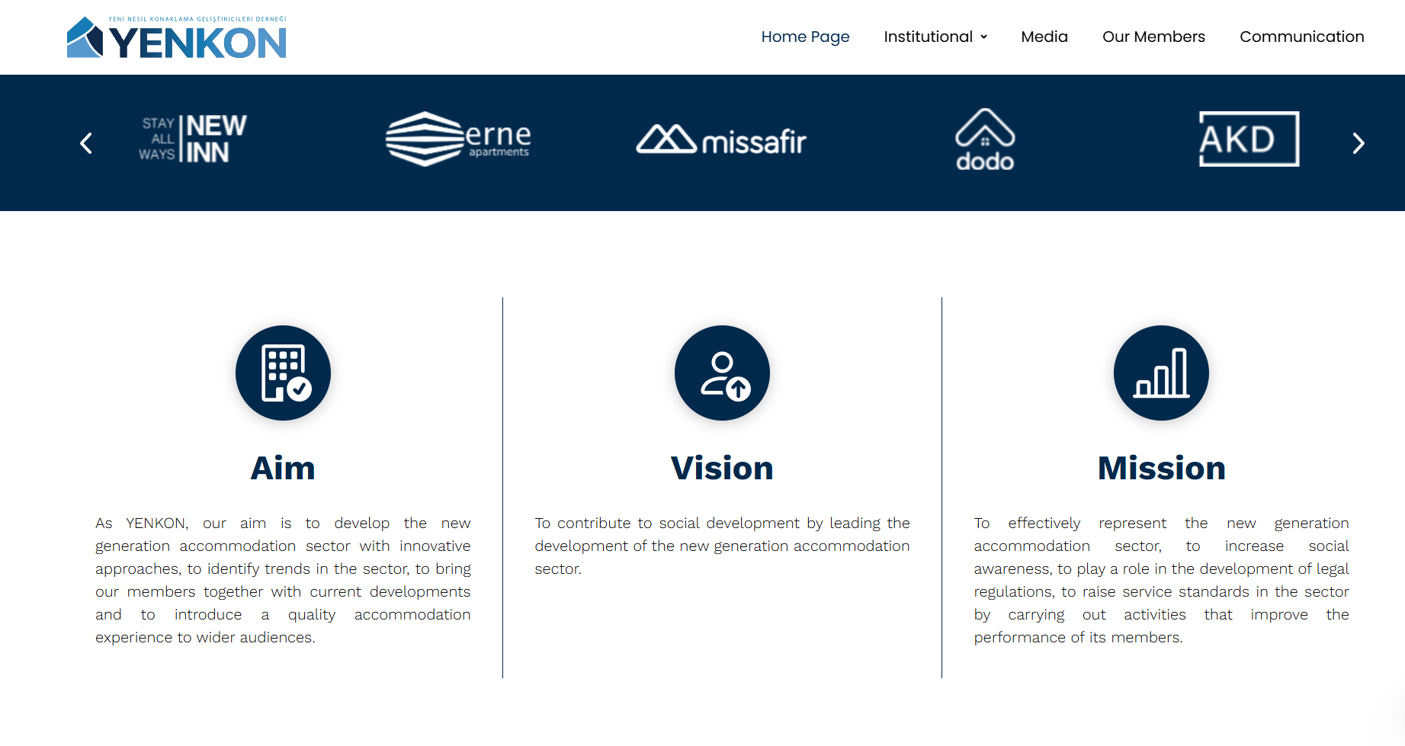
The AIRBNB Law
Notes:
After the law passed, different groups started to organise.
TURKOB was founded to defend hosts' rights, arguing the law was too restrictive.
YENKON, a group of brokerage companies, wanted to work with the government to support legalisation and establish corporate identity.
Both groups had difficulties in communicating with decision-makers. This shows a lack of inclusive policy-making.

Slide 13
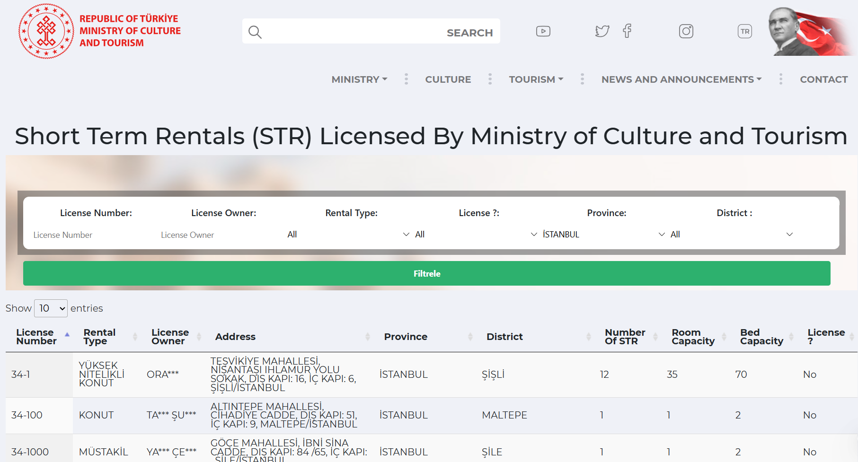
The AIRBNB Law
Notes:
The government has begun imposing fines on those who do not comply with the regulations.
Airbnb and Booking have agreed to list only licensed rental properties.
However, as there is currently no verification system in place, some listings still contain fake licence numbers.
Guests can check licence numbers on the Ministry of Culture and Tourism's website.

Slide 14
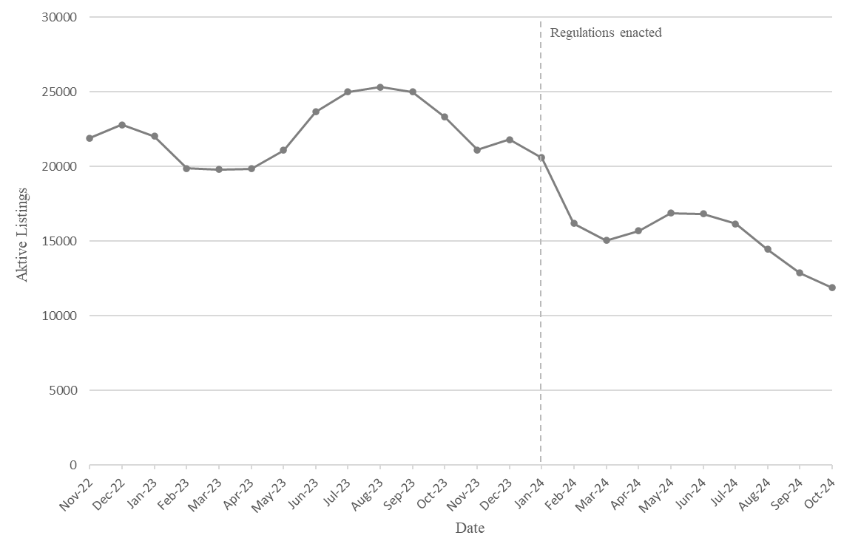
In the Aftermath of AIRBNB Law
Following the legal regulations, there has been a significant decrease in the number of active Airbnb listings in Istanbul. This decrease, together with new requirements such as the requirement to be a property owner and to obtain the approval of the building occupants, is considered a kind of decommodification in the market; however, the long-term effects of the regulations are still unclear.
Notes:
The new regulations have led to a significant decrease in Airbnb listings.
The new requirements, including owning the property and getting neighbour approval, have created barriers for many hosts.
This could be a sign of housing becoming less "decommodified", but it's too early to know the long-term effects.

Slide 15
In the Aftermath of AIRBNB Law
The decline in the number of Airbnb units disrupted the supply-demand balance, causing prices to increase by approximately 17%.
Notes:
Notably, despite a decline in the number of listings, there has been an increase in average daily rental prices.
This phenomenon is likely attributable to a disruption in the equilibrium between supply and demand.

Slide 16
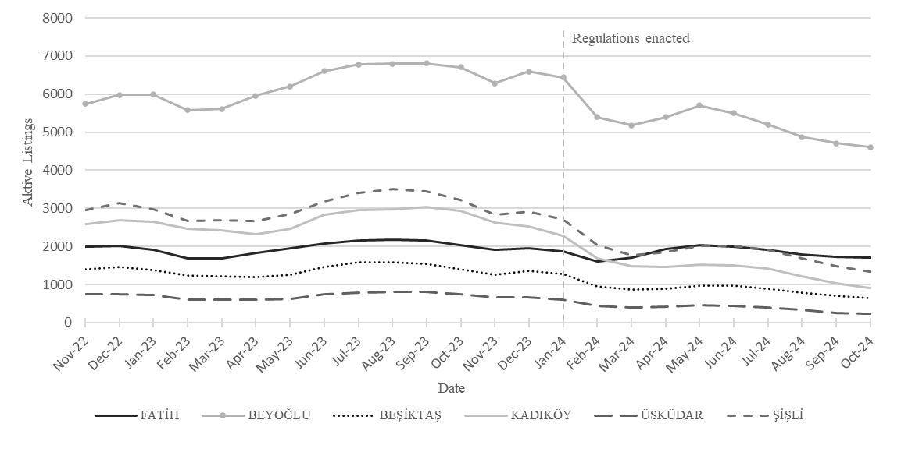
In the Aftermath of AIRBNB Law
While most neighborhoods have seen a decrease in Airbnb listings, Fatih has been a notable exception, increasing despite the regulations. Although this suggests that regulations are effective in the short term, the increase in Fatih requires further empirical research due to the insufficient available data.
Notes:
Most districts saw a fall in listings, but Fatih saw an increase.
This suggests that regulatory measures work differently in different neighbourhoods.
Local social dynamics, enforcement limitations and housing structures may be the reason, but more research is needed.

Slide 17
DISCUSSION
Criticism of centralisation: The STR regulation in Istanbul is highly centralised, with decision-making power delegated to the Ministry of Culture and Tourism. The fact that some districts are more populous than European cities makes it necessary for regulations to be tailored to regional differences. However, the views of local authorities have not been taken into account, resulting in limited effectiveness in practice.
Legal Enforcement Challenges: Supervision and enforcement have been left solely to the Ministry of Culture and Tourism, whose limited human resources have weakened its enforcement capacity. In addition, the limited agreement with platforms has been insufficient to prevent illegal practices.
Notes:
The STR regulation in Turkey is highly centralized under the Ministry of Culture and Tourism.
Local governments, despite overseeing neighborhoods larger than many European cities, have been involved in shaping this policy.
This top-down model may reduce effectiveness because it does not take local differences and needs into account.

Slide 18
DISCUSSION
Lack of participation: The Airbnb community, host associations, the hotel sector and professional companies were not involved in the process. During this process, associations such as TURKOB and YENKON emerged to contribute to the regulation.
Conflicts of interest: While the hotel sector supported the regulation, the Airbnb community demanded regulated flexibility instead of strict restrictions. The regulation, enacted without participation, has created conflict rather than cooperation.
Future uncertainty: The Ministry has stated that this regulation is only the first phase. However, the exclusion of stakeholders such as local governments and tenants raises questions about the inclusivity of future policymaking.
Notes:
Another key issue is lack of participation.
The Airbnb community, professional hosts, and hotel associations were not part of the regulatory process.
This led to conflicts of interest—while hotels supported the new law, hosts asked for more flexible, not stricter rules.
Excluding important stakeholders has reduced the cooperative potential of the policy, and future phases remain uncertain in terms of governance and inclusivity.

Slide 19
Thank you!
Notes:
In conclusion, Istanbul's experience highlights global trends and local complexities.
The recently implemented legislation constitutes a notable preliminary measure; however, its long-term efficacy is reliant upon the principles of inclusive governance, the efficacy of enforcement mechanisms, and the adaptation to local contexts.
I would like to express my gratitude for your consideration.

