Slide 1
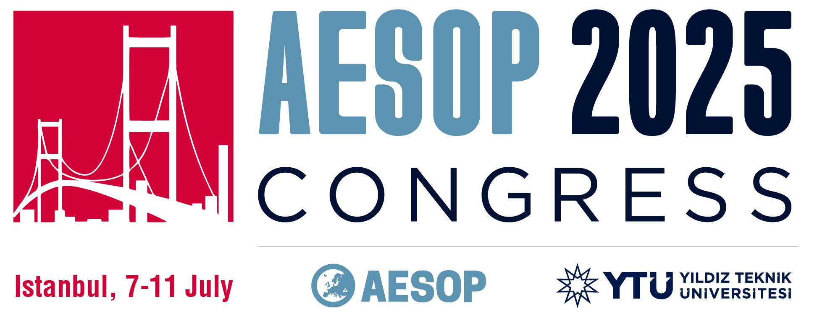
Modern, Restorative, Sustainable? Examining Neo-colonial Urbanism and Commons in the Global South
Cecilia Mercedes Quevedo
Instituto de Estudios en Comunicación, Expresión y Tecnologías (CONICET) - Universidad Nacional de Córdoba, Argentina
cecilia.quevedo@unc.edu.ar
Ailen Suyai Pereyra
Universidad Nacional de Córdoba, Argentina - Bauhaus Universität Weimar, Germany
ailen.suyai.pereyra@unc.edu.ar

Slide 2
Neo-colonial urbanism: the logic of value and the commons in the context of a global socio-ecological crisis
From a critical perspective, we examine three urban planning initiatives proposed by the state as transformative interventions. The cases analysed in Argentina are:
a) the modernisation narrative in the Güemes neighbourhood in Córdoba;
b) the historical reparation narrative in the Toba neighbourhood in Resistencia;
c) the environmentalisation narrative in the Ecobarrio in Villa María.
Our theoretical starting point is organised around three analytical perspectives:
Anselm Jappe's critique of the value associated with urban planning;
Erik Swyngedouw's urban political ecology;
Álvaro Sevilla-Buitrago's perspective on the production of urban commons.

Slide 3
The urban planning of intermediate cities and their neighbourhoods
Intermediate city | Córdoba | Resistencia | Villa María
Neighbourhoood | Güemes | Toba | Ecobarrio
Type of settlement | Traditional neighbourhood | Traditional neighbourhood | Shanty town
Type of intervention | ‘Paseo Güemes’: refurbish and valorisation of a prison facility with infrastructure “green” | ‘Project of integral urban intervention of the Gran Toba Area’: demolition and housing and urban renewal | ‘Ecobarrio’ Project: socio-urban integration of a low-income neighbourhood with environmentally friendly infrastructure

Slide 4
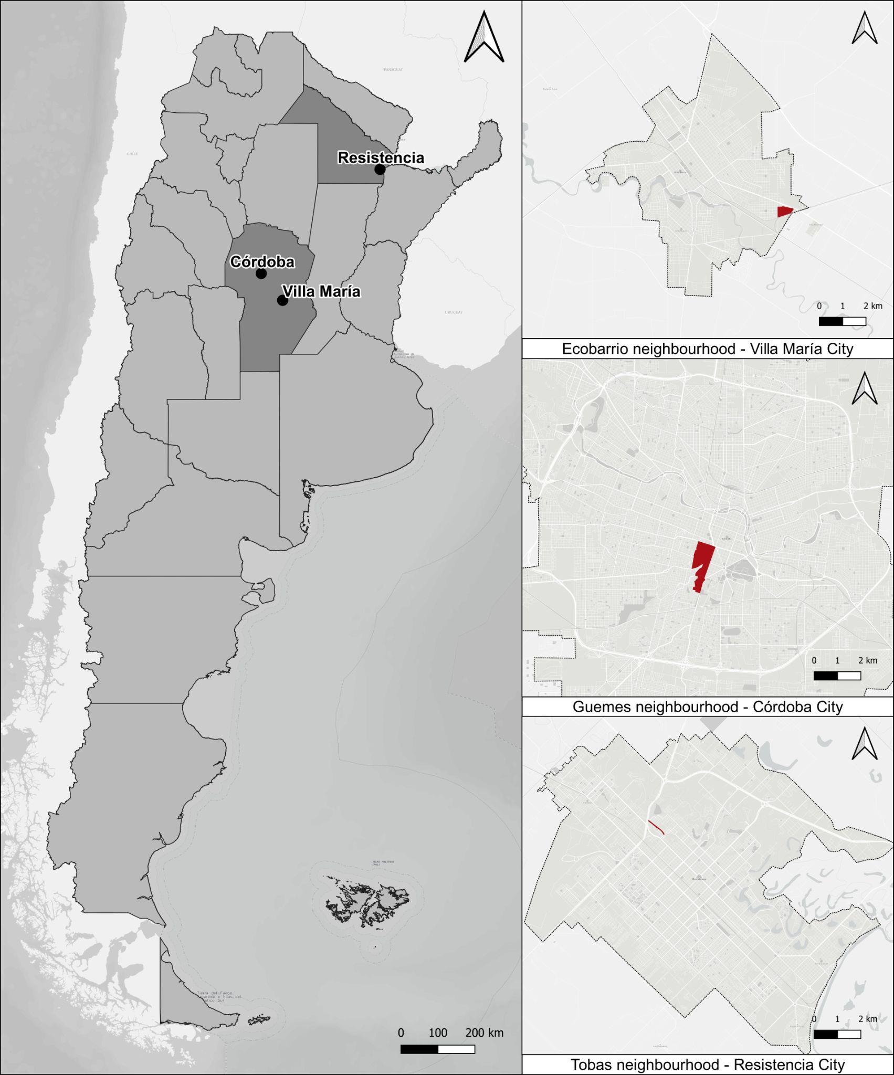
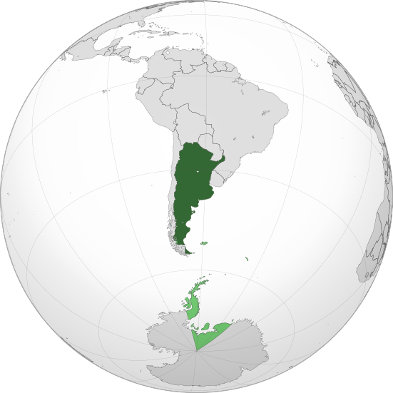
The urban planning of intermediate cities and their neighbourhoods
Currently, models of touristification promoted by actors at different levels are present in all three cities:
'Córdoba, provincial capital of urban art';
'Resistencia, national capital of sculptures'; and
'Villa María, city of learning'.

Slide 5
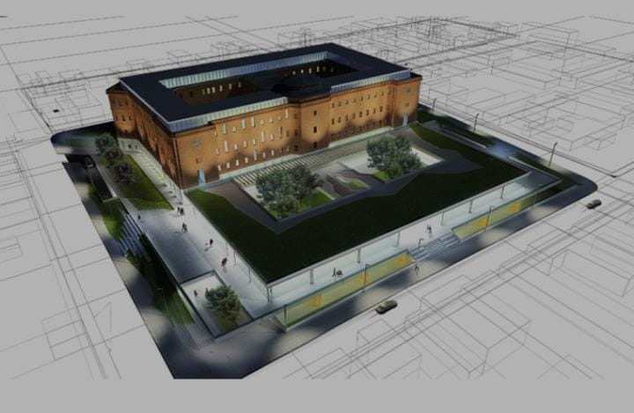
1. The modernisation of Güemes neighbourhood, Córdoba city
“A closed walkway surrounded by perimeter fences for added security. It is located where the previous escape-prevention walls were, and it surrounds the entire premises. We have planted trees and landscaped the area. There are four entrances, where access guards and additional police personnel will be stationed," said Grahovac (La Nueva Mañana, 10/03/2023).
“The brand new space is equipped with street furniture, including drinking fountains, litter bins, and bike racks. In addition, recycling stations with e-bikes have been set up. This type of initiative contributes to what is known as green infrastructure, which is understood as a synergistic and interconnected network that promotes the resilience of ecosystems and the overall well-being of communities" (Córdoba government press, 2023).

Slide 6
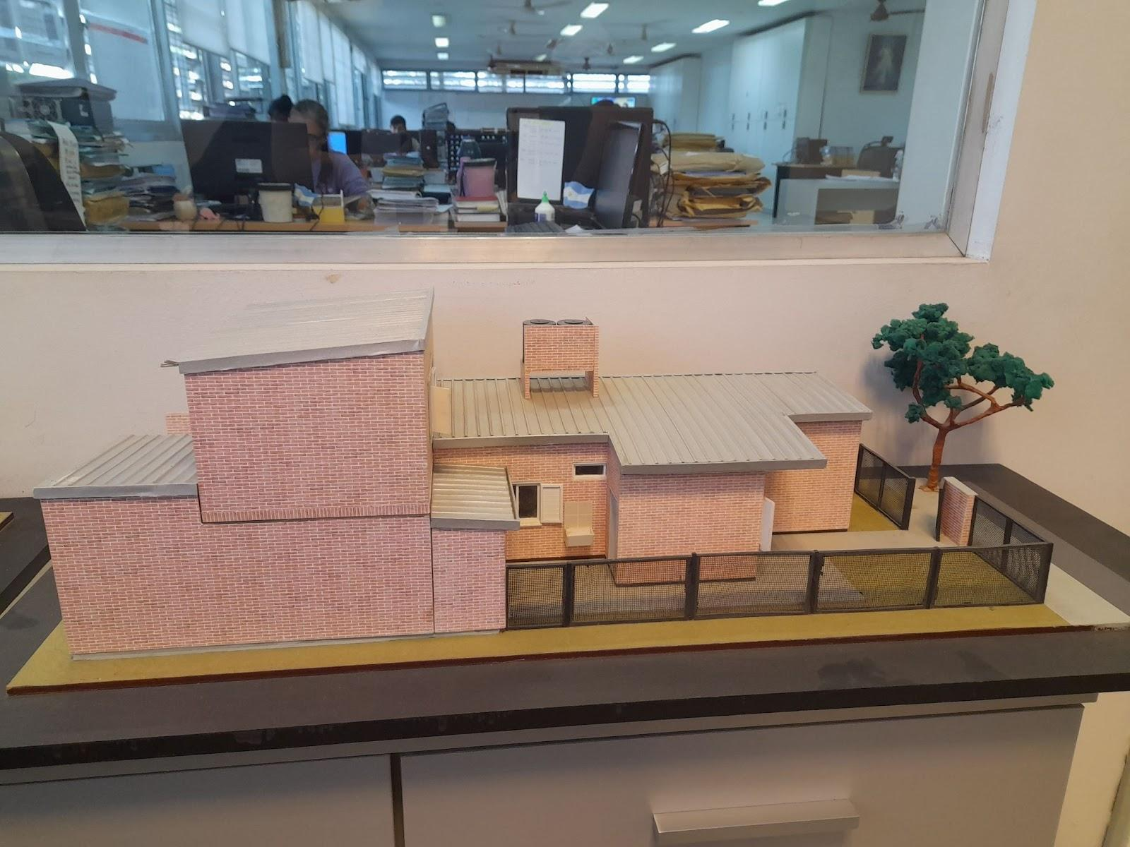
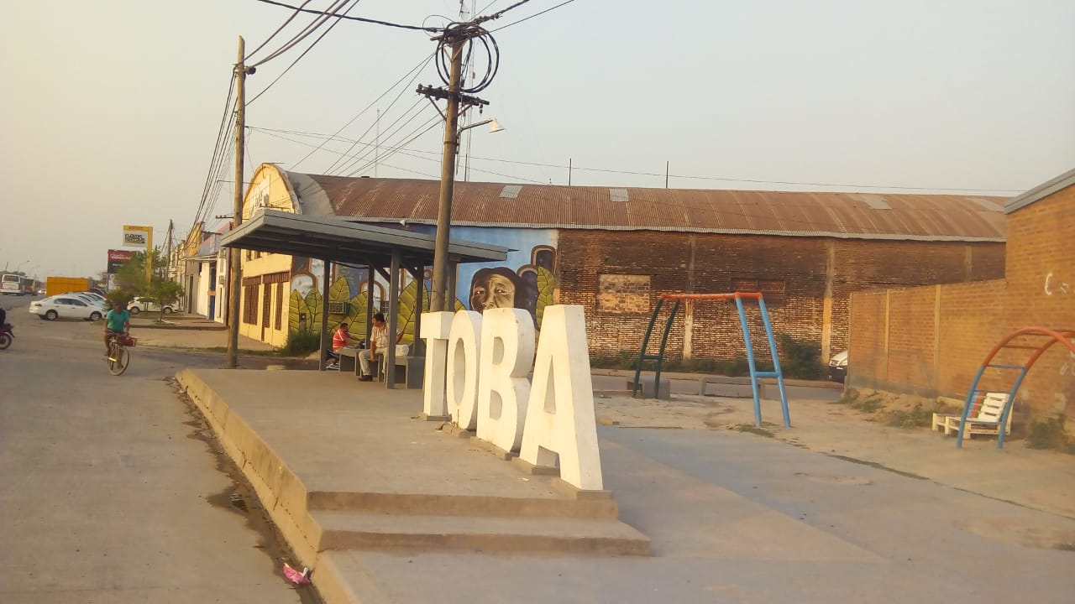
2. Historical reparation in Toba neighbourhood, Resistencia city
“Today, it's not just about providing housing; it's about continuing to expand rights and carrying out historical reparations for indigenous communities” (Solo Chaco, 08/10/2021).
“We signed a first agreement with the aim of being able to develop activities in different parts of the province linked to green and environmental infrastructure, as well as the renovation of squares, the creation of urban green spaces and obviously everything related to habitat through cleaning and environmental sanitation (...) This would improve the quality of life of families in the Area Gran Toba (...)” (Tag Newspaper, 16/03/2021).

Slide 7
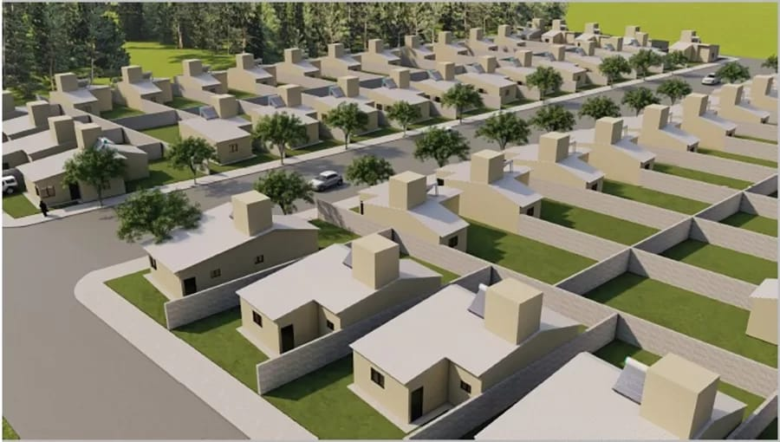
3. Environmental sustainability in the Ecobarrio, Villa María city
“In addition to the houses, the site will have a large green space of more than 10 hectares, which will function as a green lung for the area, with the presence of forests and native species, providing a natural and healthy environment for residents" (La Voz del Interior, 03/07/2023).
“The guidelines of the sustainable model that, once constructed, will seek to reduce energy consumption through the installation of water heaters and solar panels, polyurethane insulated roofing, cross ventilation, bioclimatic design in the implementation of soil and green walls” (Región Objetivo, 13/11/2023).
“There is a trial that has not yet reached a verdict, so the current administration has decided to return the land before it goes any further” (Villa María Vivo, 23/01/2025).

Slide 8
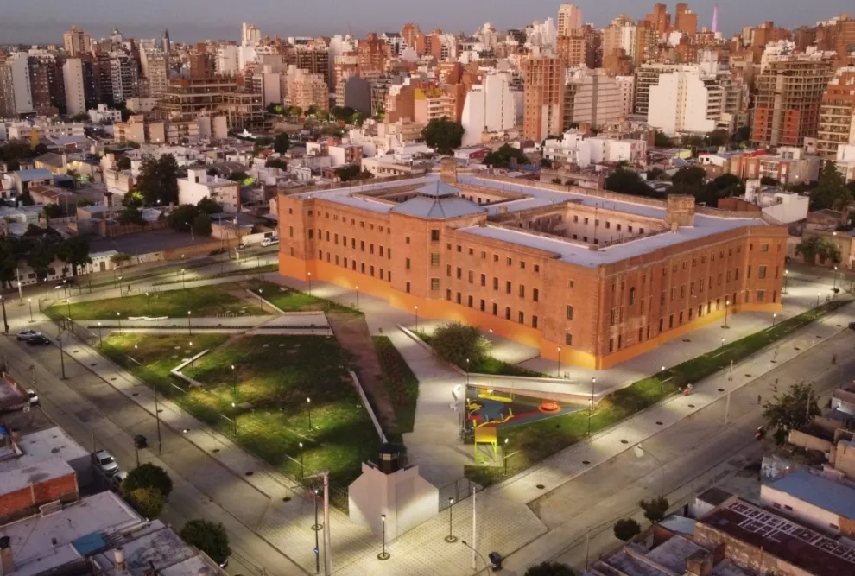
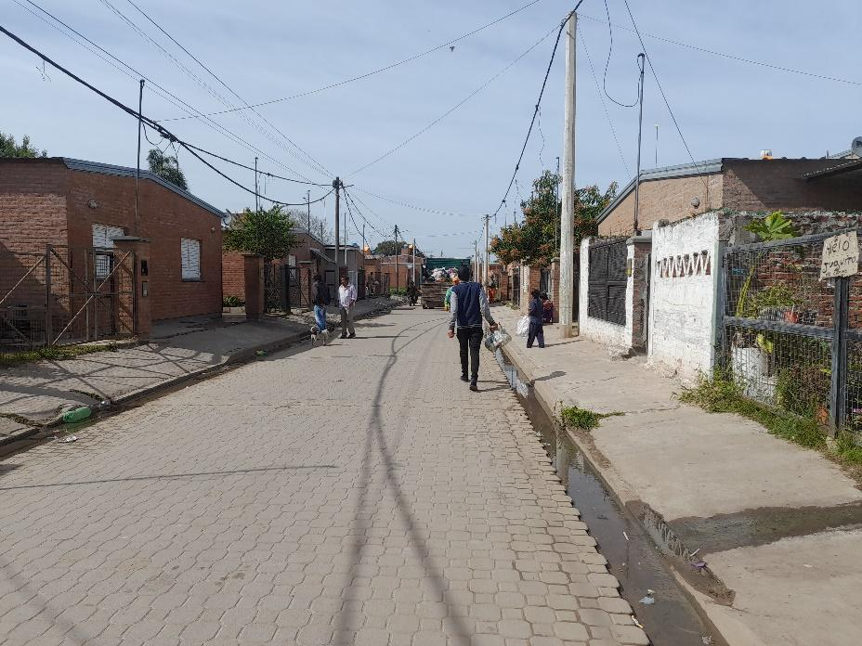
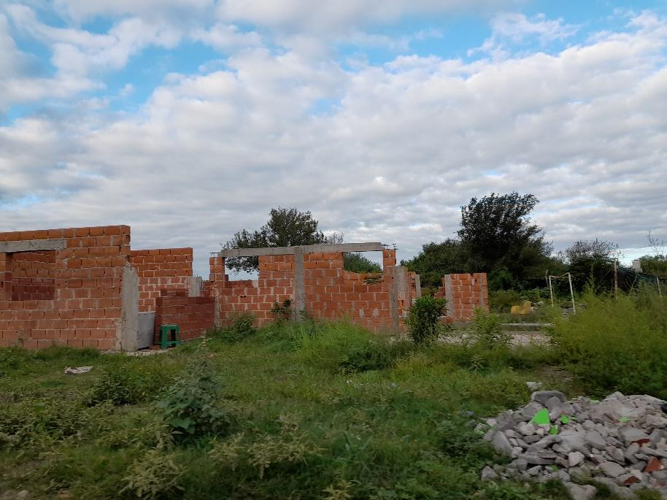
The production of the commons in intermediate cities
In Güemes neighbourhood, residents contest the prison's refunctionalisation by distancing themselves from the site. The logic of value implies pacifying conflict and constructing a homogeneous and abstract social order. The area is promoted for tourists and celebrated in advertising campaigns, yet it remains uninhabited by locals.
In Toba neighbourhood, indigenous Qom women who produce handicrafts have been organising themselves for several years to sustain production and marketing spaces for these crafts. Since the destruction of their workshop when the neighbourhood was remodelled for the second time, they have been campaigning for the construction of a new site at the entrance to the neighbourhood where they can display and sell their products.
In the Ecobarrio, the night watchman, who lived opposite the unfinished construction site, organised a 'soup kitchen' with his wife to feed poor families in the neighbourhood. The economic conditions of these families have worsened considerably since the works were interrupted.

Slide 9
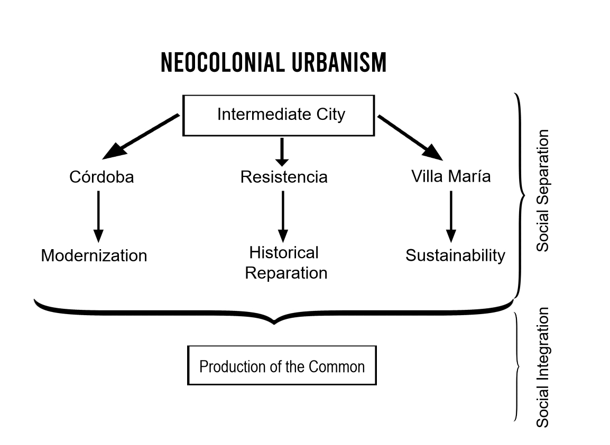
Conclusions
Intermediate cities in the Global South, such as Córdoba, Resistencia and Villa María in Argentina, have undergone profound urban transformations in recent decades.
These transformations are driven by the logic of capitalism and the prioritisation of value production.
This dynamic is embedded in the logic of social conflict and is manifested in the inability of certain urban policies to promote social integration.
This generates increasingly segregated and fragmented neighbourhoods.
The logic of value tends to pacify conflict and construct society as something homogeneous and abstract, subjugating common goods and converting them into assets with exchange value.
In this complex scenario, communalisation practices and urban struggles emerge as potentially transformative and integrative forces in response to the advance of neo-colonial urbanism in intermediate cities in the Global South.

Slide 10
Thank you!
Cecilia Mercedes Quevedo
Instituto de Estudios en Comunicación, Expresión y Tecnologías (CONICET) - Universidad Nacional de Córdoba, Argentina
cecilia.quevedo@unc.edu.ar

