Slide 1
Mapping community perspectives for co-designing
regional sustainability transitions
Authors: Anca Ioana Forgaci & Verena Balz, TU Delft
Contributors: Nohemi Ramirez Aranda &
Alexander Wandl, TU Delft
8 July 2025, AESOP Congress Istanbul

Slide 2
What do communities expect and hope
regarding sustainability transitions?
And how can we map these futures for policy co-design?

Slide 3
The DUST context
Least Engaged Communities (LECs)
youth, miners, women, rural communities
4 Case-study Regions
Norrbotten (SE), Stara Zagora (BG), Lusatia (DE), Katowice (PL)
Regional Futures Literacy Labs (RFLLs)
4 workshops
Community co-designed policy recommendations
Notes:
4 case-study regions facing energy trasition from coal and engaged in.a process of sustainaibility transition.

Slide 4
The DUST context
Futures: preferred (hopes, dreams), probable — drawing on UNESCO Future Literacy Lab (Miller, 2007; Miller, 2015; UNESCO et al., 2023)
Territorial capital, rooted in policy (OECD, 2015), recognized for its value in regional design (Orsi et. al., 2022) describes physical and non-physical values of a specific region.

Slide 5
Method for mapping the community perspective
Data collection:
Transcripts from RFLLs workshops
Data analysis:
Thematic narrative
Combined inductive deductive
CAQDAS Atlas.ti
Conceptual frames:
TC categories: Built Environment, Infrastructure, Natural, Economic, Cultural, Human, Social, X
Futures: preferred and probable
Notes:
Adopted, combined, used;
Deductive part, based on two conceptual frameworks

Slide 6
Coding system
Present TC
Memories
Built Environment
Preferred futures
Time dim. & futures
Probable Futures
Deductive
TC categories
Infrastructure
Natural
Social
Cultural
Human
Economic
X
Inductive
Codes:
TC sub-aspects
Categories:
TC aspects
Themes:
TC clusters
Quotes, Norrbotten transcript: ”Community will be key, we’ll farm together, build houses together.”
Community
Small rental houses
Small scale farming
Automated farming
Green technologies
Open land
Flexibility
Reduced motivation
Convenience
Improved collaboration
Limited Face-to-Face Interaction
Self-paced Learning
Preferred futures
Social
Community & social relations
Built environment
Housing
Economic TC
Farming
Territorial capitals highly grounded in LECs futures.
Narrative construction across TC categories
“Housing projects will focus on communities, building own small rental houses.”
“small scale farming protects open land…future automated farming, technology will allows us to pursue the things we really want.”
Inductive coding exemplification based on diagram from Kyngäs et. Al. 2019

Slide 7
Analytical visualisations
Present TC
Memories
Built Environment
Preferred futures
Time dim. & futures
Probable Futures
Deductive
TC categories
Infrastructure
Natural
Social
Cultural
Human
Economic
X
Inductive
Codes:
TC sub-aspects
Categories:
TC aspects
Themes:
TC clusters
Quotes Norrbotten transcript: ”Community will be key, we’ll farm together, build houses together.”
Community
Small rental houses
Small scale farming
Automated farming
Green technologies
Open land
Flexibility
Reduced motivation
Convenience
Improved collaboration
Limited Face-to-Face Interaction
Self-paced Learning
Preferred futures
Social
Community & social relations
Built environment
Housing
Economic TC
Farming
1 Co-occurance tables
Territorial capitals highly grounded in LECs futures.
Narrative construction across TC categories
“Housing projects will focus on communities, building own small rental houses.”
“small scale farming protects open land…future automated farming, technology will allows us to pursue the things we really want.”
2 Sankey
with quotes
3 TC clusters
Inductive coding exemplification based on diagram from Kyngäs et. Al. 2019
Notes:
after the coding process was complete
we used 3 types of analytical visualisations to further interpret the results.
further exemplified

Slide 8
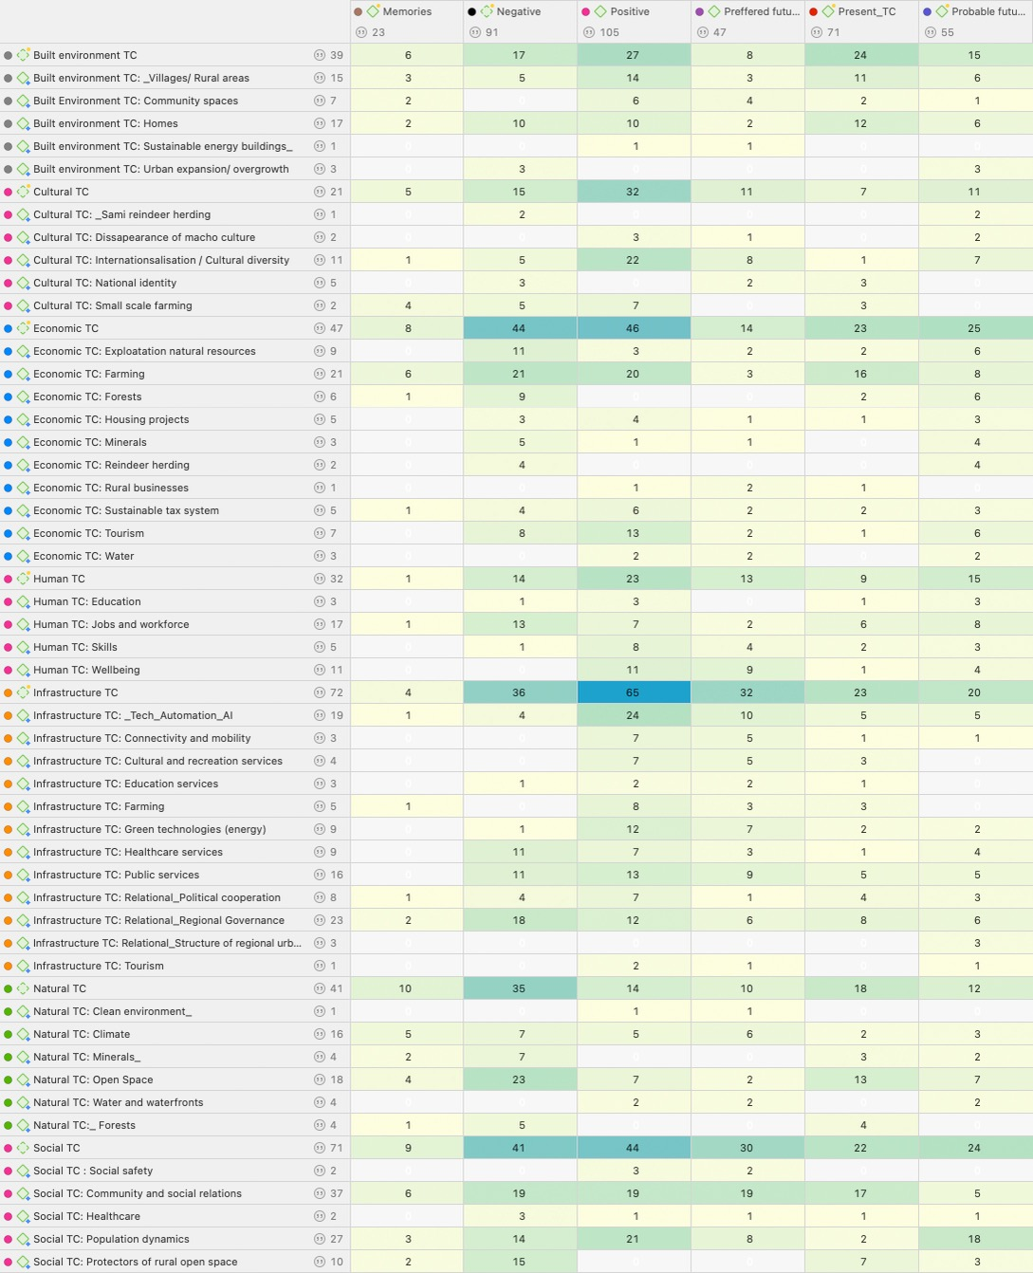
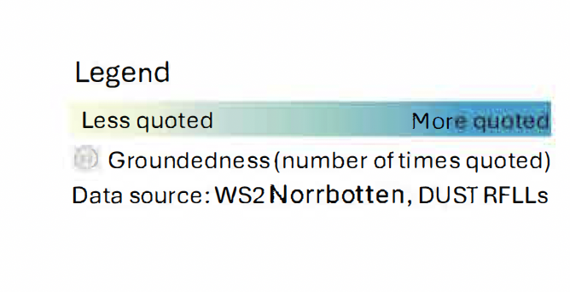
What were the most discussed TC aspects in Norrbotten?

Slide 9
What were the most discussed TC aspects in Norrbotten?

Slide 10
What do rural communities in Norrbotten dream about their future region?
Notes:
For that, we used Sankey diagrams with quotes
Which shows the distribution of preffered futures across TC categories, containing a systematic selection of representative quotes for the most grounded TC aspects from each TC category.
Dreams and wishes are about:
a circular tax system in the region, “contributors instead of burden”:
multigenerational living;
“In the future community will be key. We’ll farm together, build houses together.”

Slide 11
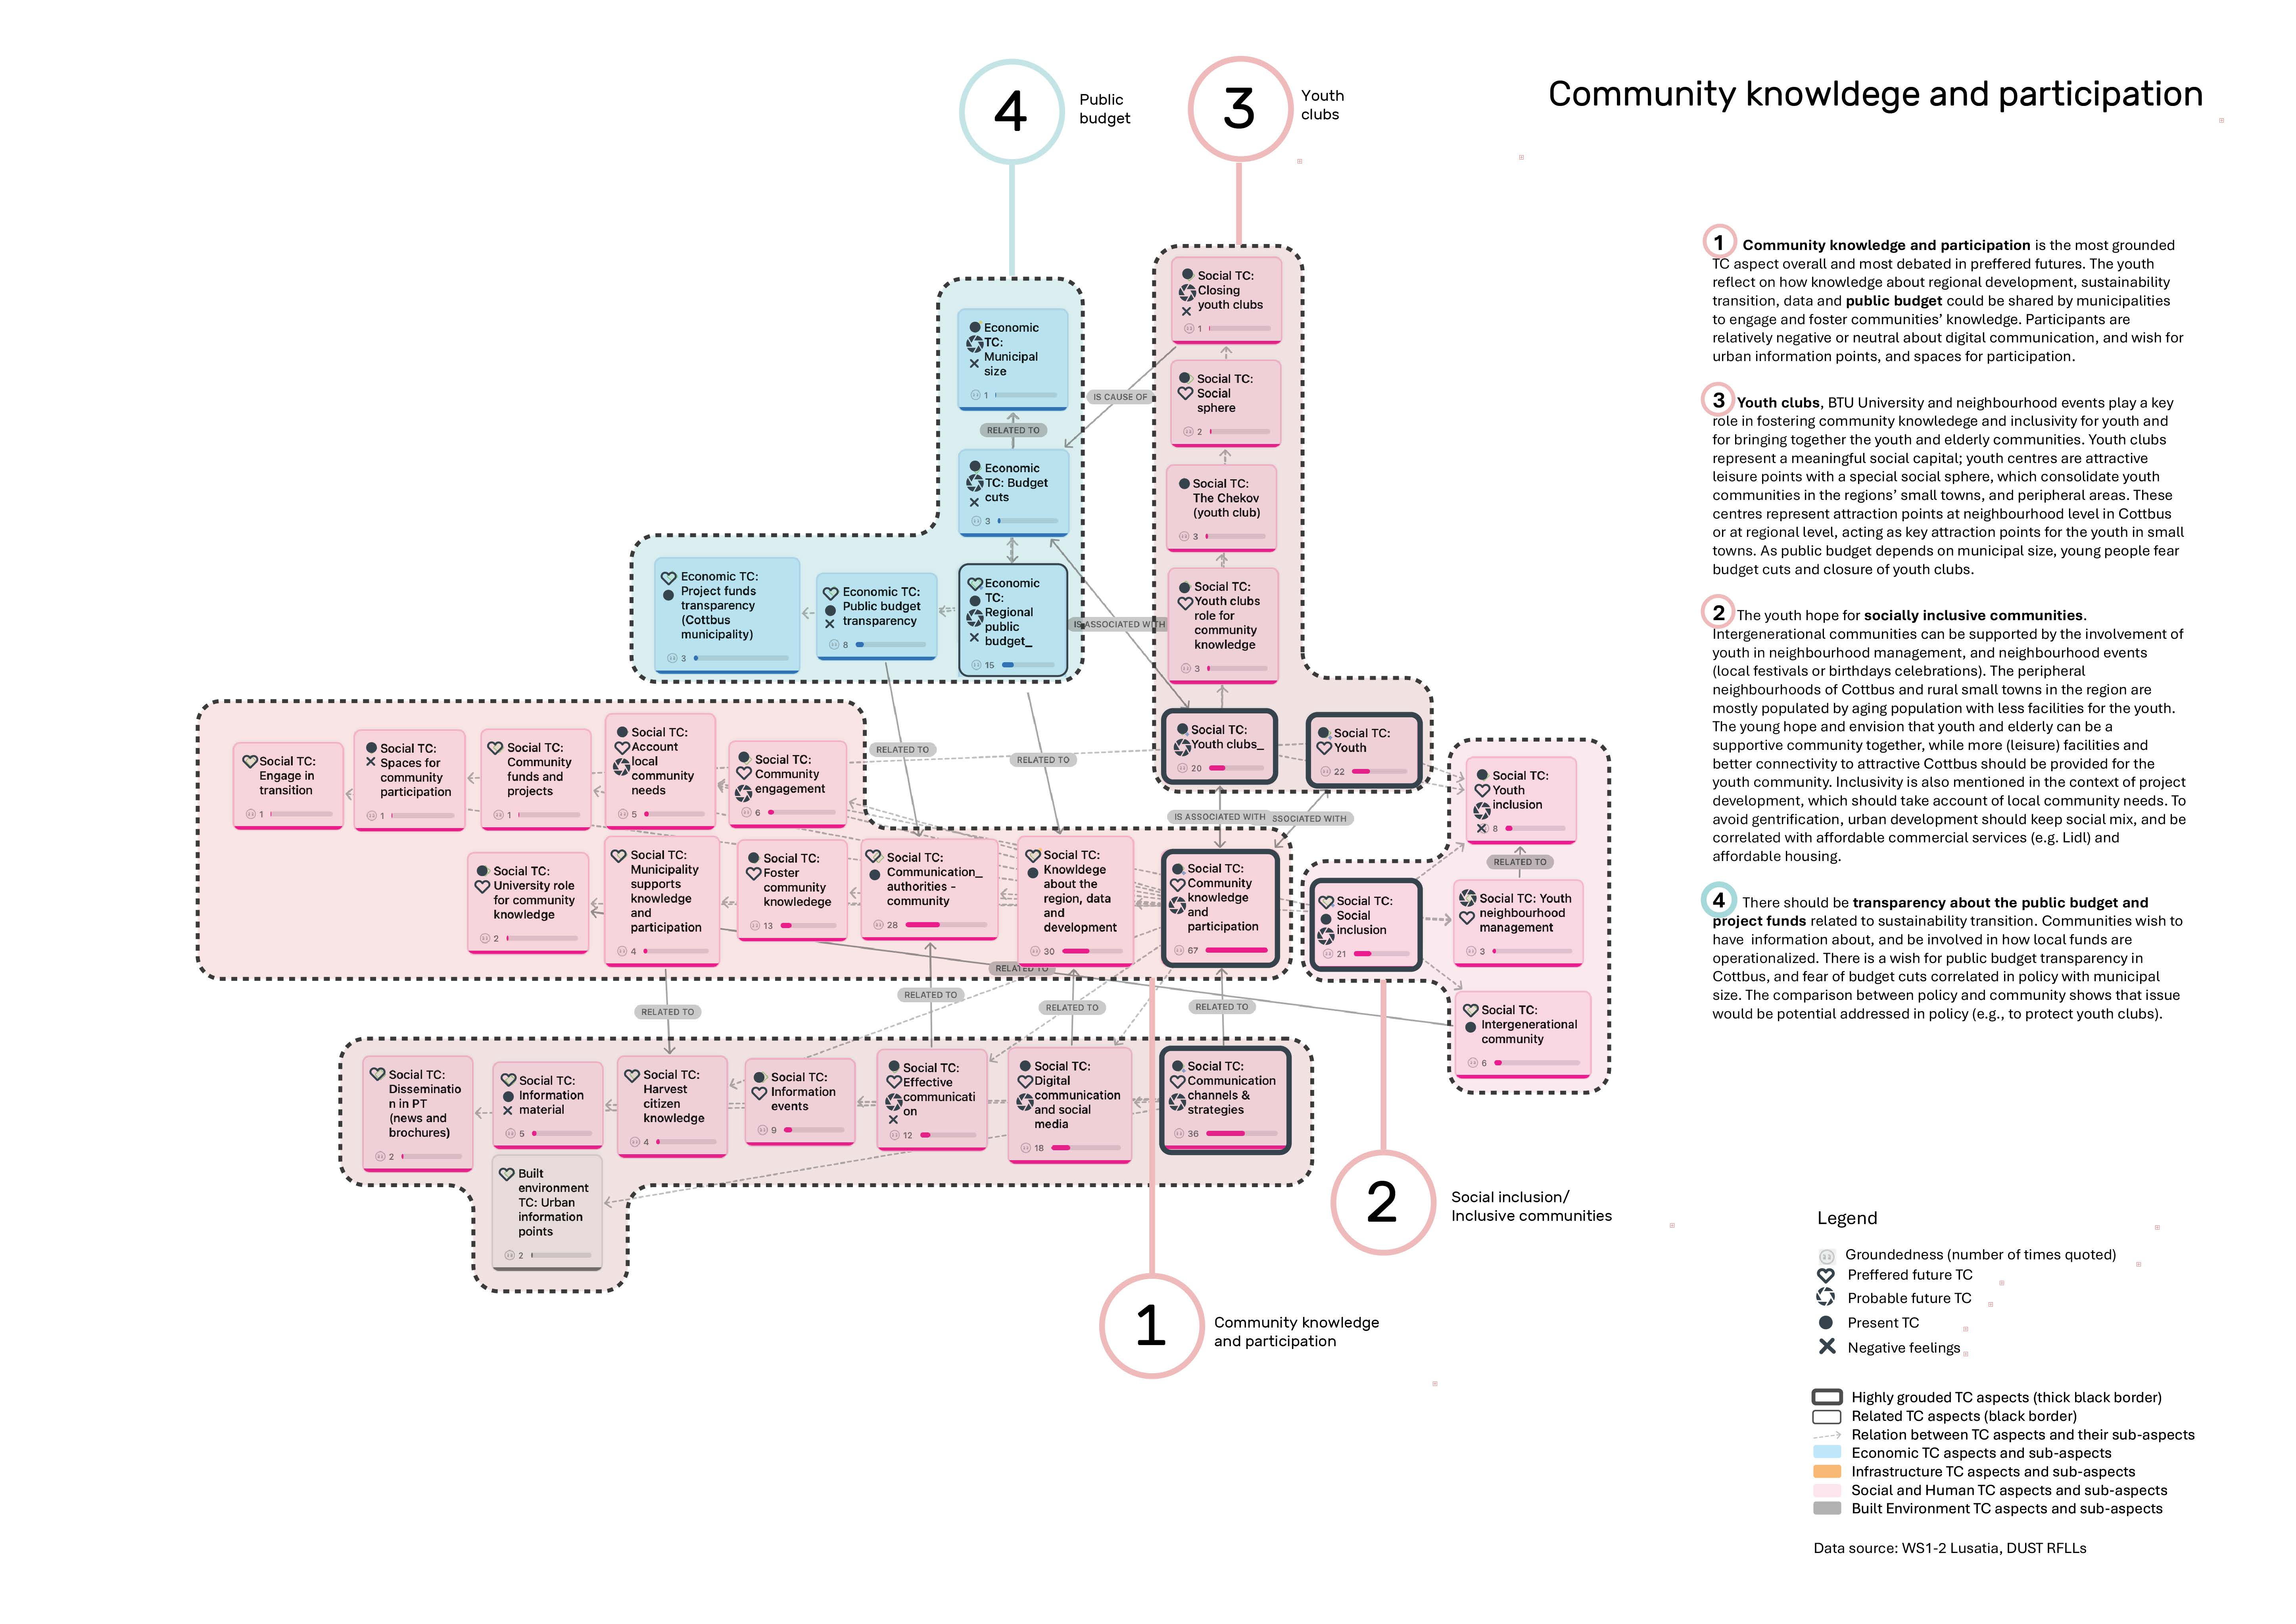
TC clusters: regional values from community perspectives
Notes:
The third type of diagram, the TC clusters was based on further co-occurance analyses between the most grounded TC capitals
, reconstruct community narratives in a diagramatic way.
TC clusters:
1. offered a layered perpection of the TC aspects from general and abstract (in center) to specific and detailed towards the edges, with each line unfolding a specific topic. Information
Legend information is assigned to each TC aspect or sub-aspect
2. Offered a systemic perspectives, revealing relations, in this case, across social and economic capitals.

Slide 12
TC clusters: regional values from community perspectives
Notes:
For example, in the case of Lusatia: community knowledge is related to both youth clubs regional public budget transparency. The closure of youth clubs is related to regional budget distribution depending on municipal size.

Slide 13
TC clusters: regional values from community perspectives
Notes:
Or in the case of Norrbotten, Communities regard ‘Future small scale farming and farmers as protectors of the open space – a cultural and natural valuable feature of the region. For that to happen, technology and automation can preserve small scale farming practices

Slide 14
TC clusters: regional values from community perspectives
Notes:
Overall, we see that the clusters provide a portrait of the discussion across the different case studies and LECs, depending on what and how was discussed, the clusters took different shapes,

Slide 15
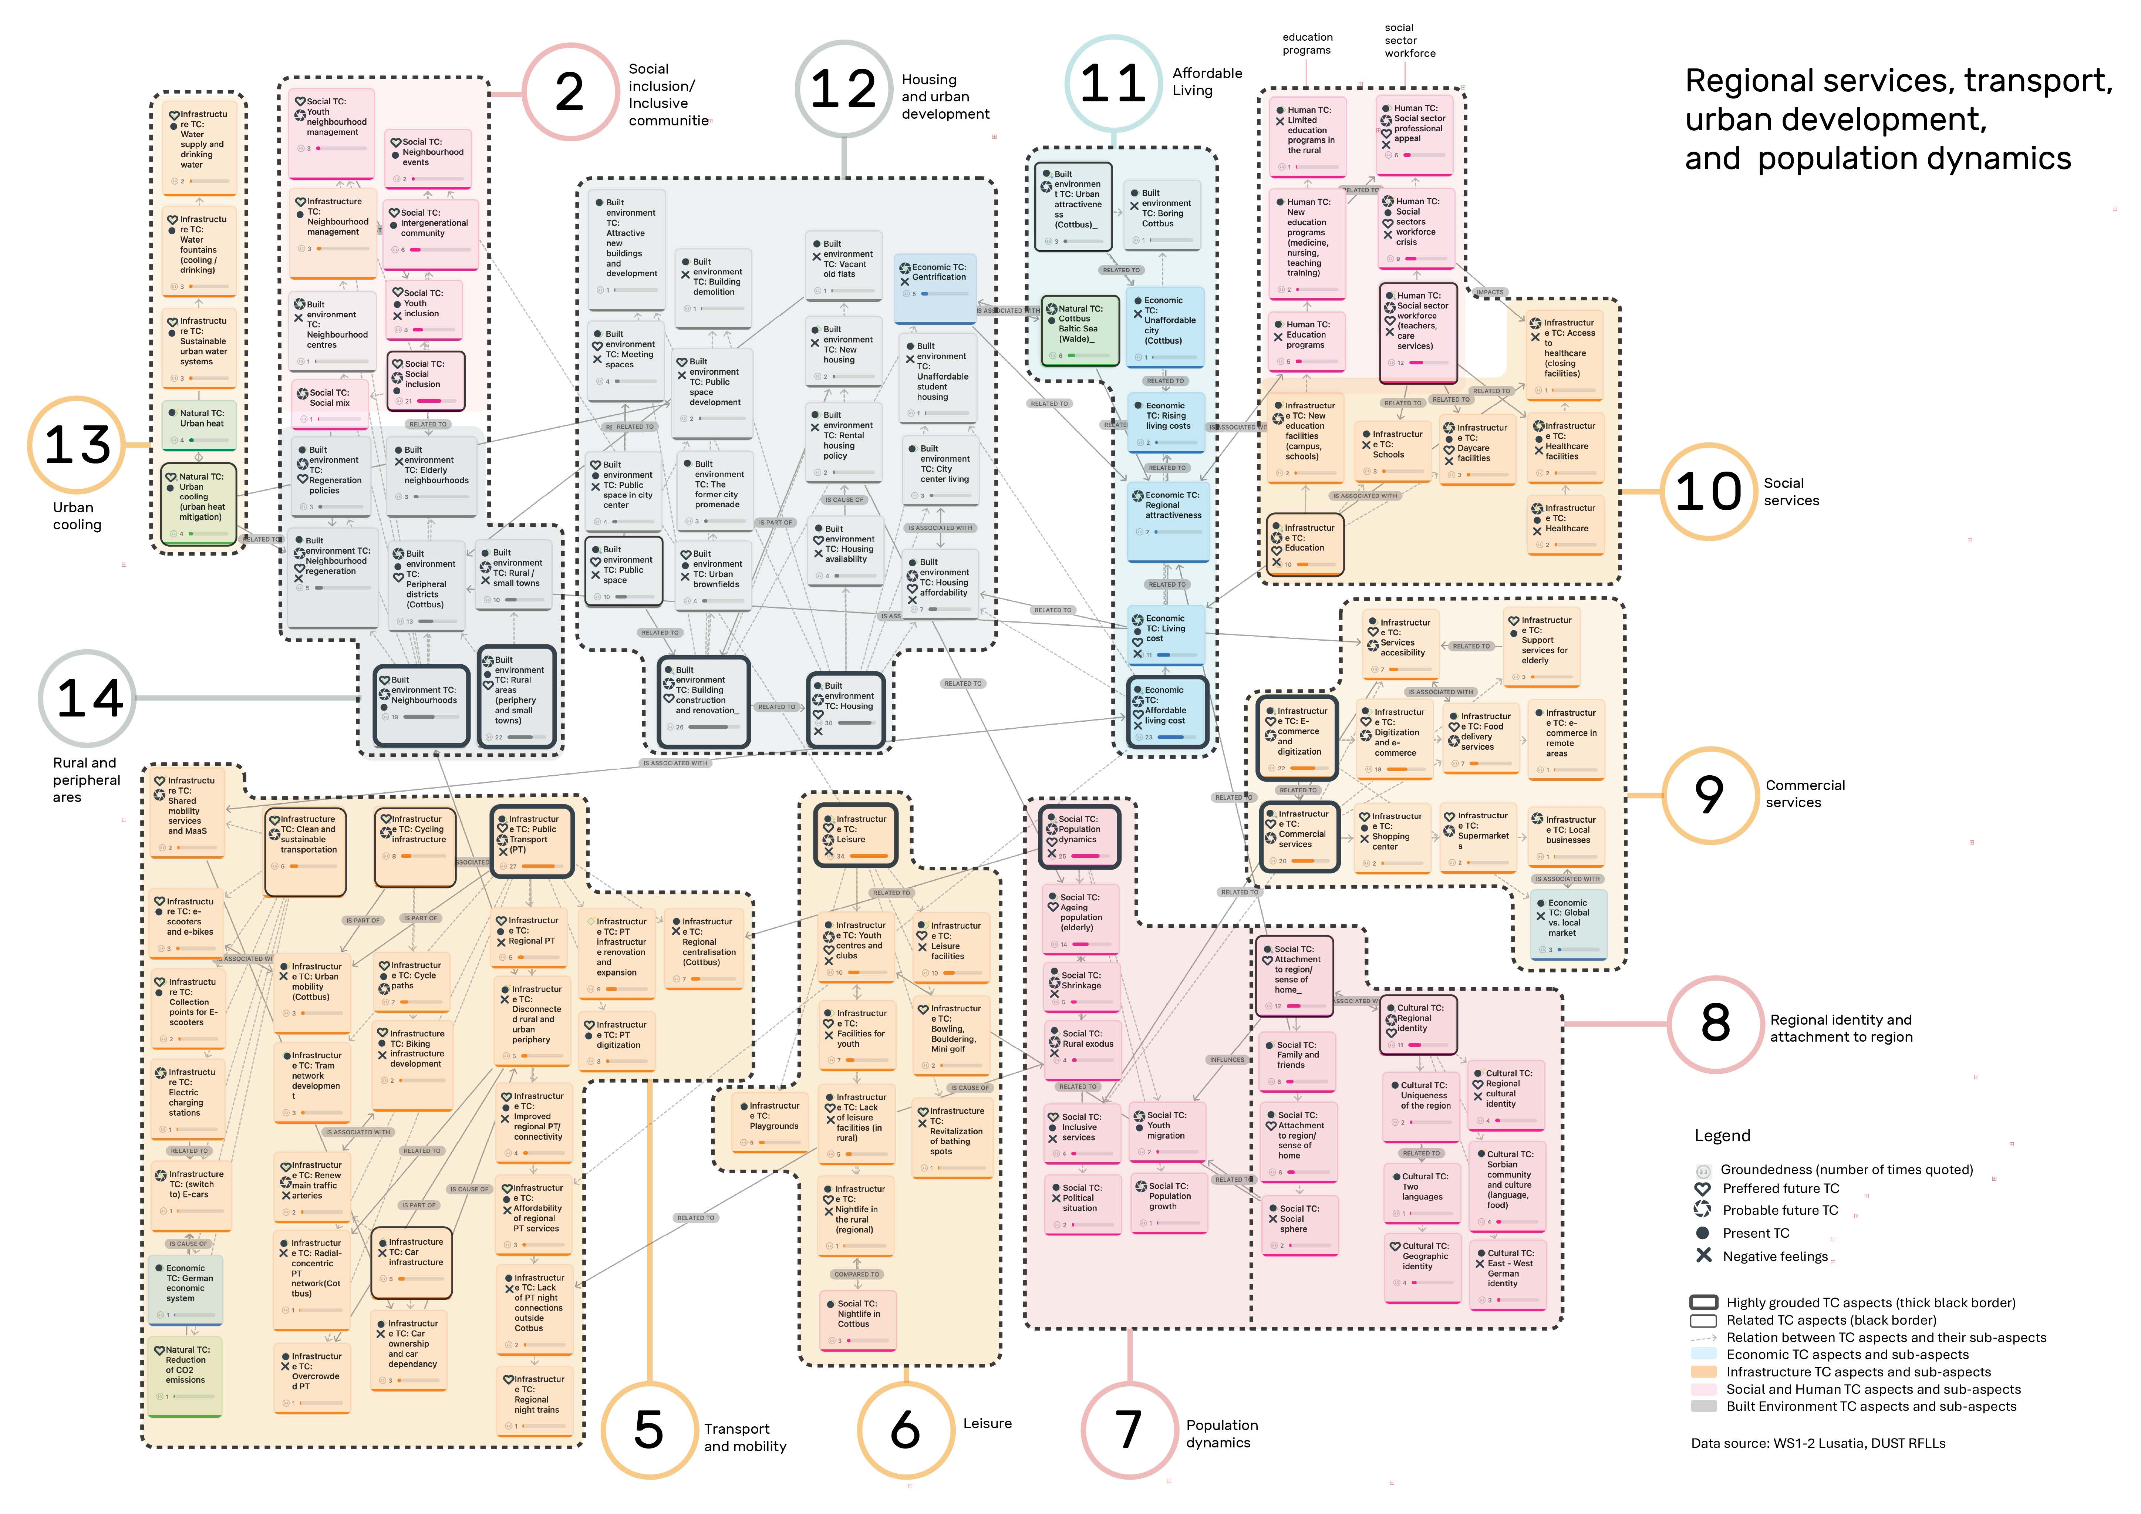
TC clusters: regional values from community perspectives
Notes:
There was a different number of TC clusters in each case. They had different configurations and colours. revealing the uniqueness of community narratives in each case.
For example, this cluster shows that topics were discussed one by one; in the background we see the web of key global connections drawn by participants in the discussion.

Slide 16
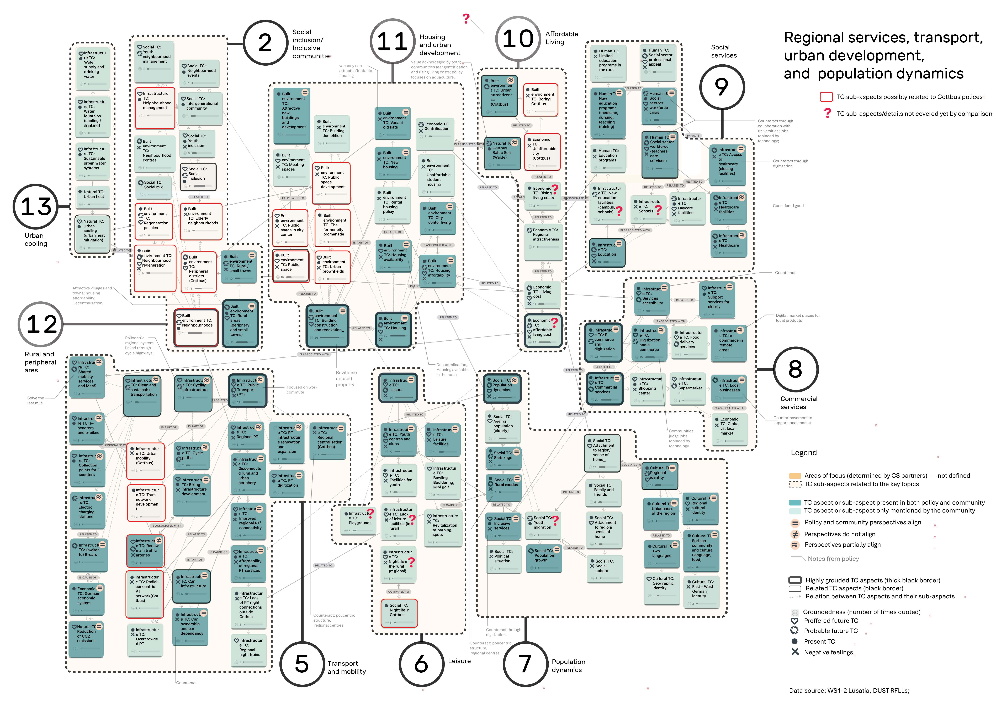
How do LECs’ futures compare to policy?
Notes:
The clusters offered a base for comparison with policy.
Dark blue indicates the common ground between policy and community perspectives with a degree of interpretation: if perspectives aling, differ, partially align or oppose. Light blue indicates TC present only in the com. perspective.

Slide 17
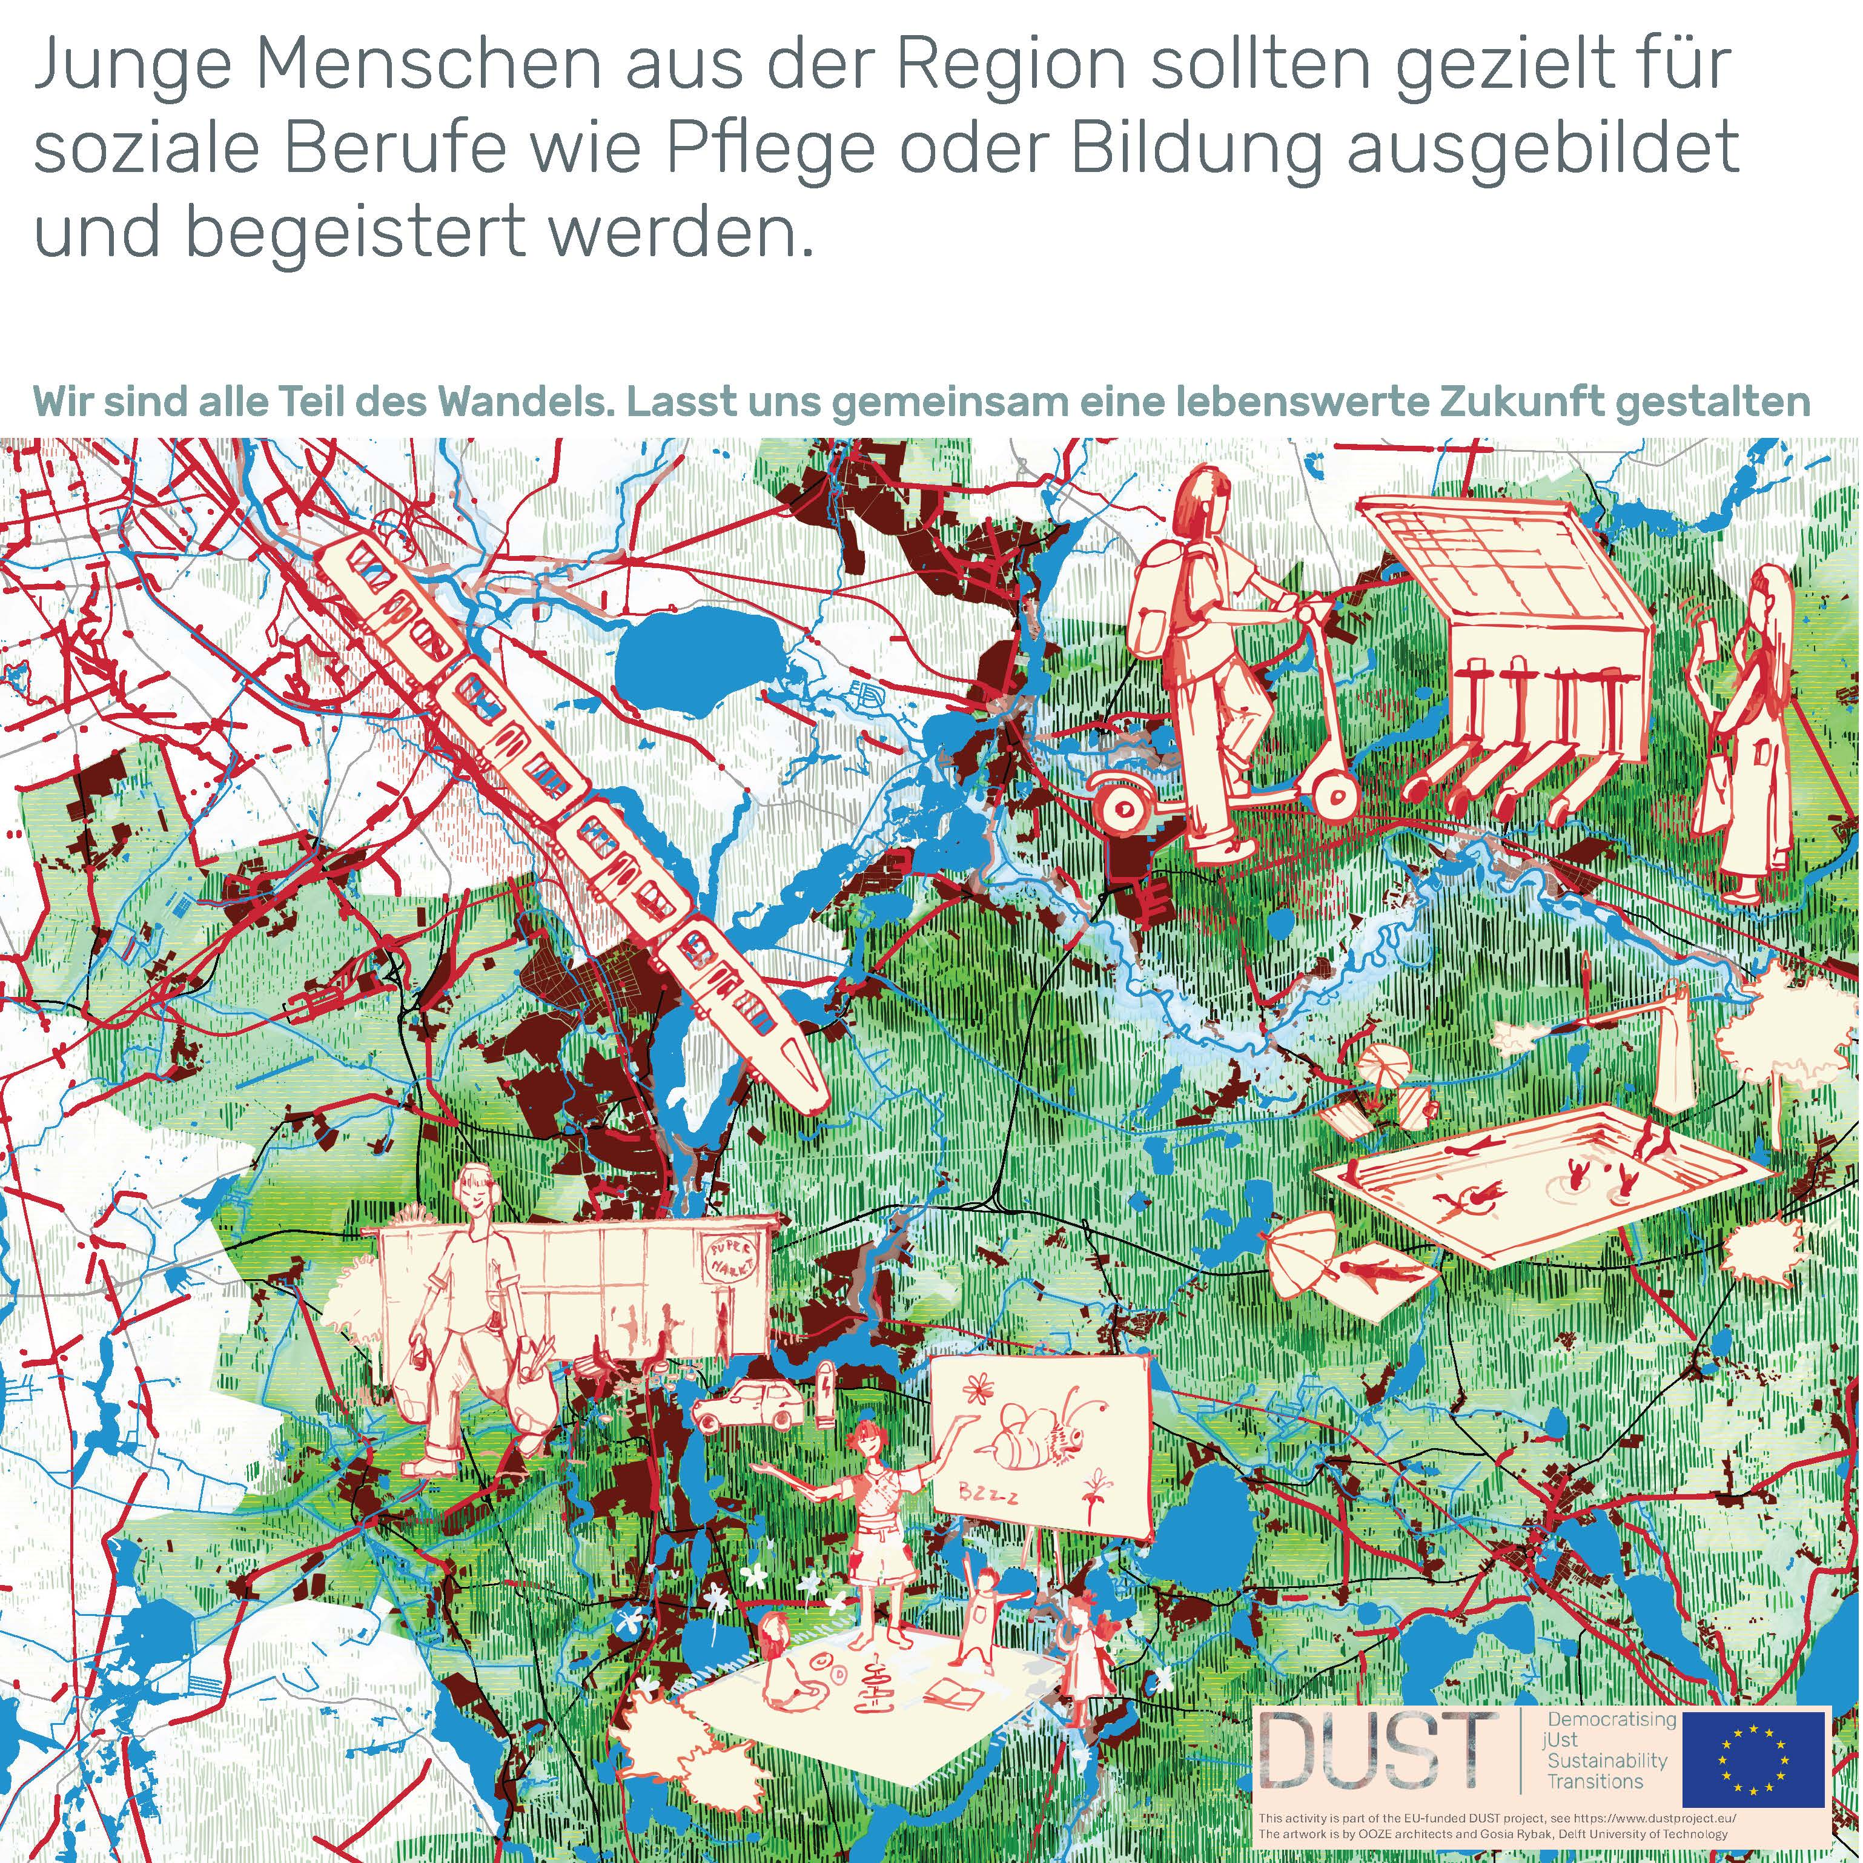
Notes:
we used These analyses to formulate policy seed Staments (SS) based on community perspectives of the transition; and to inform regional design illustrations, depicting regional futures from the community perspective; comparing these futures with the policy imagined impact.

Slide 18
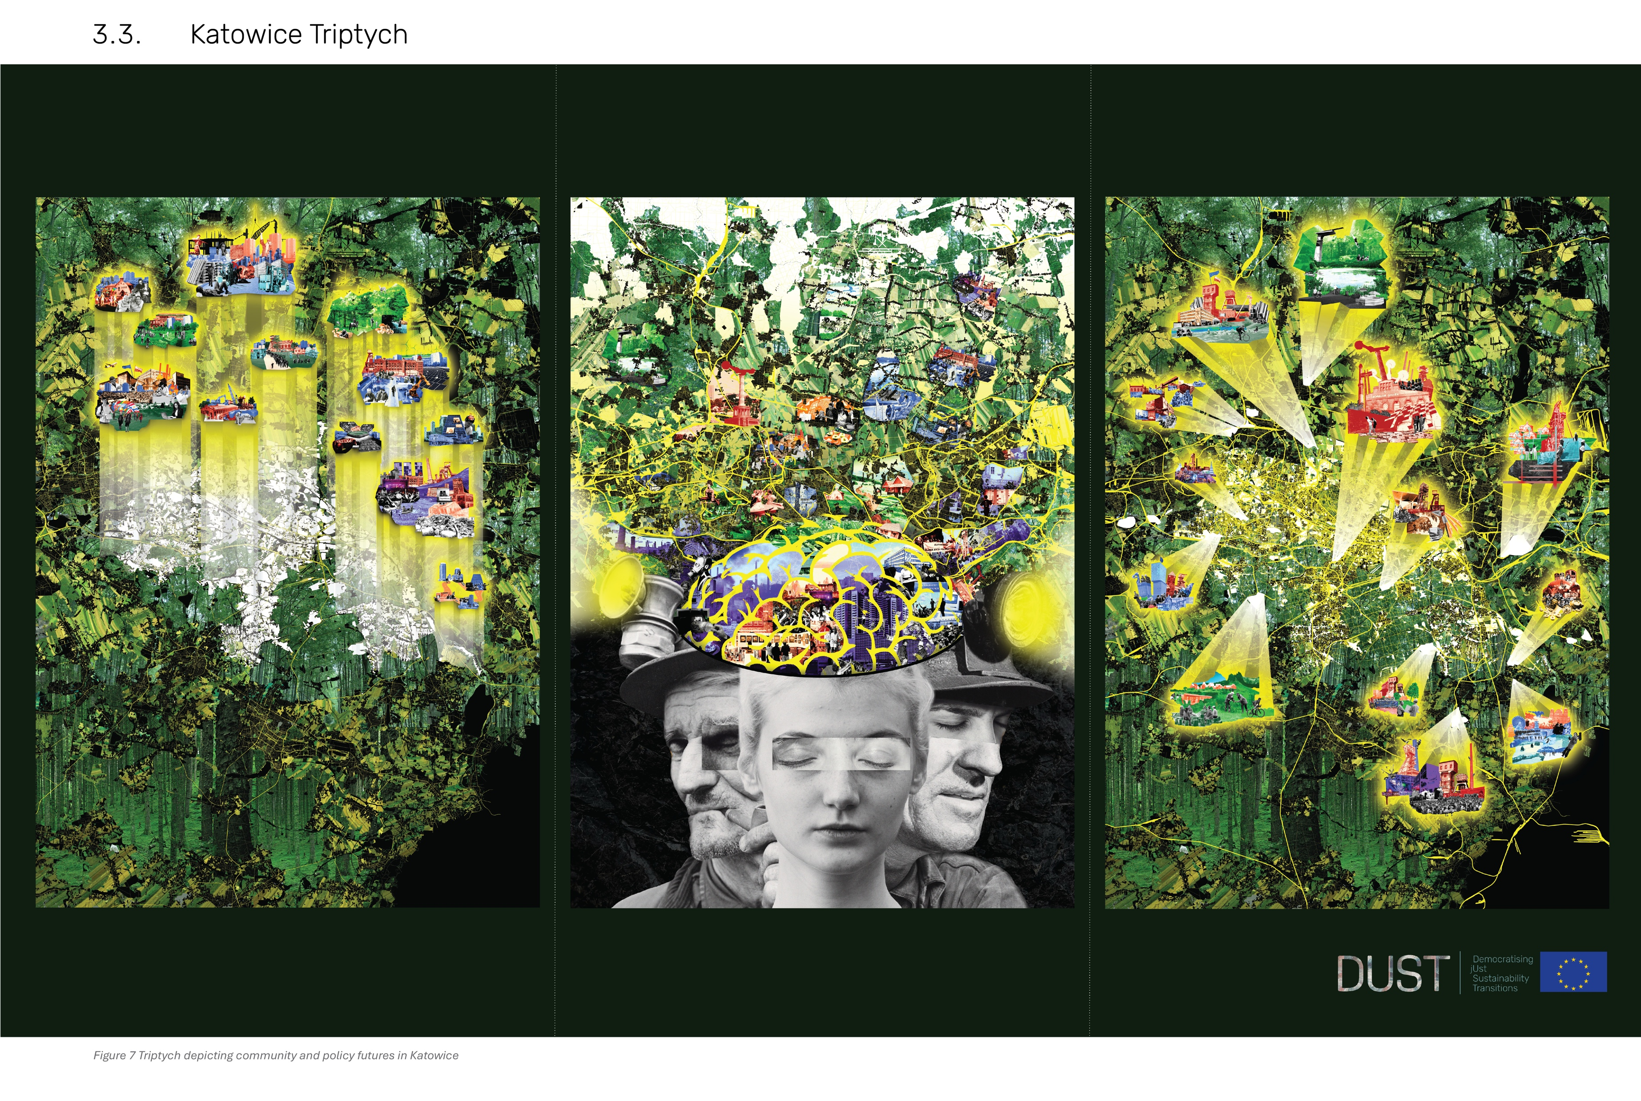
Illustration by OOZE architects and Małgorzata Rybak (TU Delft)
Notes:
The policy and community future futures were juxtaposed and reframed in a tryptich format.
Example of regional design illustration from Katowice, combining policy and community futures.

Slide 19
Contribution and discussion
Further demonstrates the value of the TC concept and use of ‘futures’ for regional policy co-design (by successfully mapping and comparing policy and community perspectives).
Contributes to overcoming the challenge of combining inductive and deductive approaches.
Integrates different levels of information: from in-depth and detailed to general and abstract.
Offers a systemic perspective: demonstrates the value of integrated approaches and reveals specific relations across TC categories.
Proposes a nuanced TC categorization based on community perspectives (TC X).
Studies community perspectives at different time scales.
The three types of analytical visualizations can effectively capture community perspectives, potentially becoming a decision support tool for place-based policy making.
Notes:
reflection on the contribution and points for discussion
visual controbution; data visualisation was a challenge, turning complex and layered data into comhensive information.; such qualitative analyses are usually enquired by the researcher, and stay in their computer; not used as a instrument for collaborative reflection.
- to what extent were the futures imagined by community regenerative? When /in which context did this happen?
Regenerative futures identified via the TC clusters from each case:
(1) Katowice: re-use of mines infrastructure for future energy systems, using their depths for geothermal energy;
(2) Norrbotten:
(1) circular tax systems for large industrial companies in rural Norrbotten;
(2) local small scale farming as a cultural practice to protect open land, and the value of green technology and automation support these local food system in the future.
(3) Lusatia: (1) enhance youth knowledge and include them in participation processes at neighbourhood and regional level; the role of youth clubs in this process.
(2) rethinking rural-urban accessibility from the youth perspective; (3) rethink service availability, diversity and quality (recreation, health, commercial) in old neighbourhoods and remote rural municipalities;
(3) Rethink budget allocation system for small municipilaties, which puts at risk current assests (youth clubs as a Social TC).

Slide 20
References
Organisation for Economic Co‑operation and Development. (2015, November 19). OECD guidelines on corporate governance of state‑owned enterprises: 2015 edition (OECD Publishing, Paris). https://doi.org/10.1787/9789264244160-en
Orsi, F., Cavaco, C., & Gil, J. (2022). From territorial capital to regional design: A multidimensional model for territorial analysis and scenario evaluation. Planning Practice & Research. Advance online publication. https://doi.org/10.1080/02697459.2022.2120490
Miller, R. (2007). Futures literacy: A hybrid strategic scenario method. Futures, 39(4), 341–362. https://doi.org/10.1016/j.futures.2006.12.001
Miller, R. (2015). Learning, the future, and complexity: An essay on the emergence of futures literacy. European Journal of Education, 50(4), 513–523. https://doi.org/10.1111/ejed.12157
UNESCO, Prince Mohammad bin Fahd University (Saudi Arabia)., & Center for Futuristic Studies. (2023). Futures literacy laboratory playbook: An essentials guide for co-designing a lab to explore how and why we anticipate—UNESCO Digital Library. https://unesdoc.unesco.org/ark:/48223/pf0000385485

Slide 21
Find out more about DUST here!

Slide 22
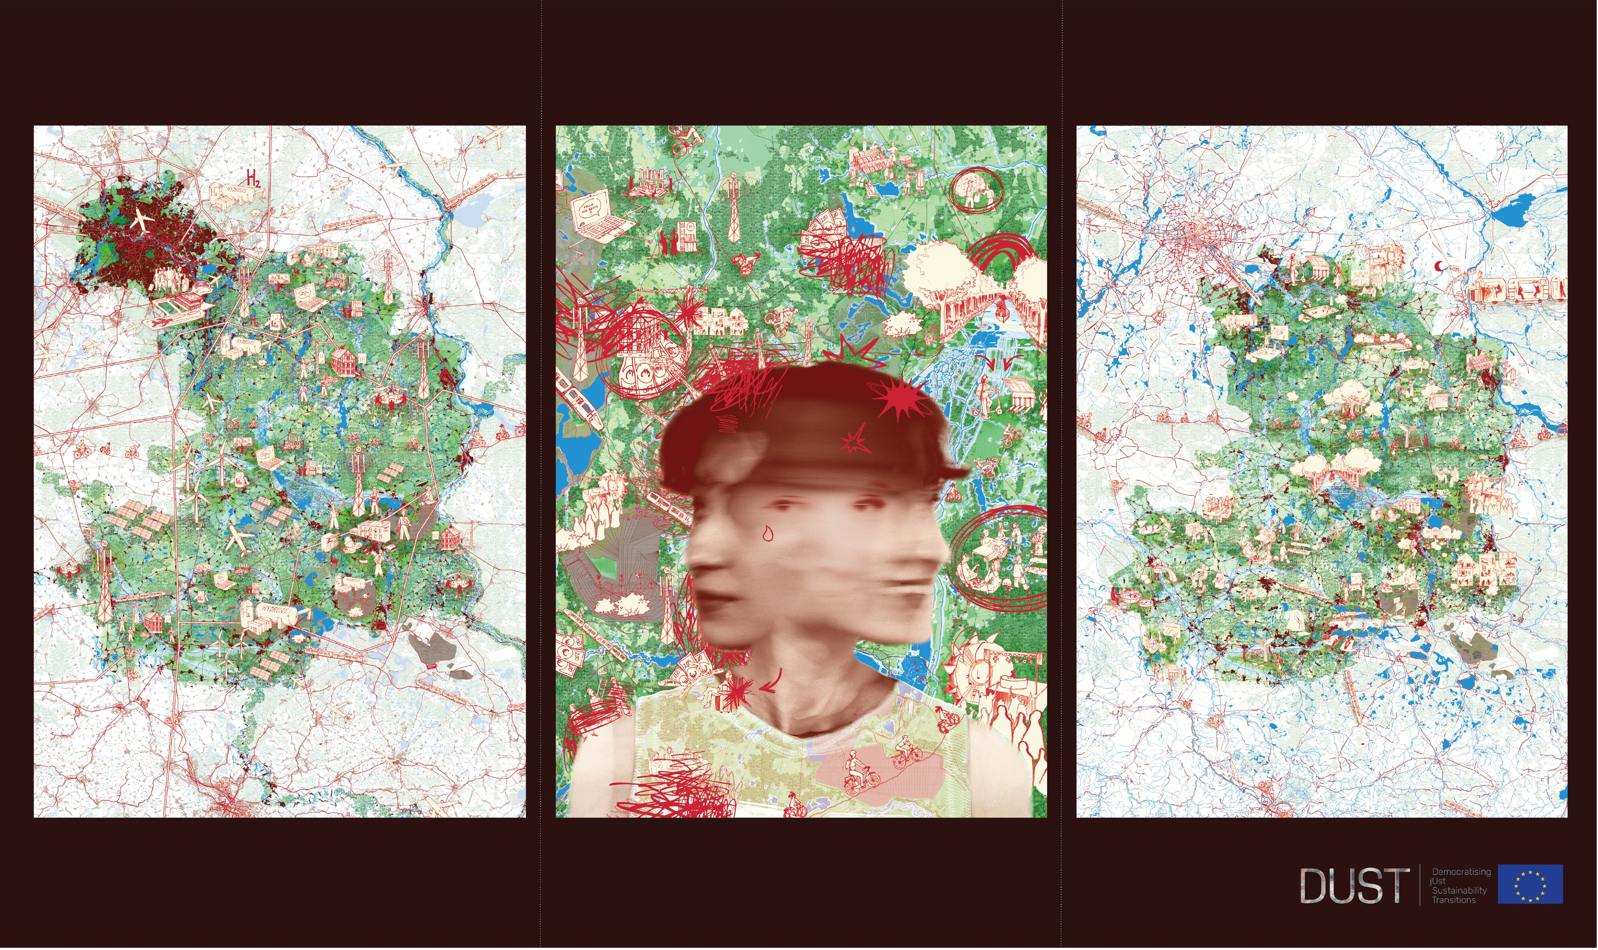
Illustration by OOZE architects and Małgorzata Rybak (TU Delft)
Notes:
To this point, findings were used to co-create policy seed statements and illustrate the community perspective in comparison to policy futures
Both using tekst and image to be compared with policy.
Based on findings we Formulated policy Seed Staments (SS) and evidence-based regional design images.

Slide 23
Cross case overview
Norrbotten
3 TC clusters
47 Preffered Futures
55 Probable Futures
(25 – 19) Tangible Probable futures
(20 - 18) Intangible Preffered futures
Most grounded TCs: Community & social relations, Technology & Automation, Farming , (Aspects of) Population dynamics, Regional governance;
Lusatia
2 TC clusters
62 Preffered Futures
51 Probable Futures
(33 – 29) Intangible Probable futures
(33 – 24) Intangible Preffered futures
Most grounded TCs: Community knowledge and participation; Youth; Youth Clubs; Leisure facilities; Public transport;
Katowice
5 TC clusters
182 Preffered Futures
221 Probable Futures
(110 – 88) Intangible Probable futures
(108 – 64) Intangible Preffered futures
Most grounded TCs: Economic vision beyond mining; Investors & investment; Education programs; Industrial heritage; New construction & development;
Stara Zagora
3 TC clusters
45 Preffered Futures
28 Probable Futures
(19 - 9) Intangible Probable futures
(26 - 24) Tangible Preffered futures
Most grounded TCs: Education facilities & Education; Sports & culture facilities; Future work culture; Economic transition;

