Slide 1

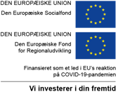

Understanding the role of water data space imaginaries in shaping the twin (green and digital) transition for the water multiverse
Chiara Farné Fratini & Peter Steen Mikkelsen
DTU Sustain, Department of Environmental and Resource Engineering
Technical University of Denmark
AESOP, July 7th, 2025

Slide 2
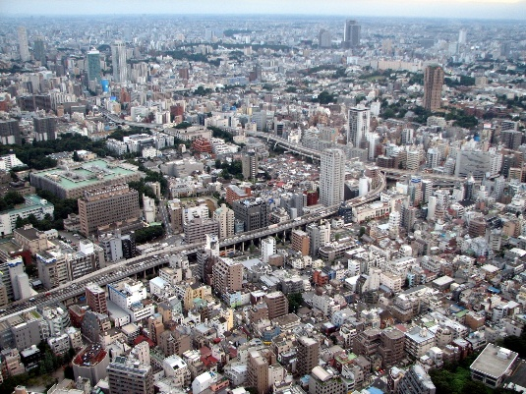
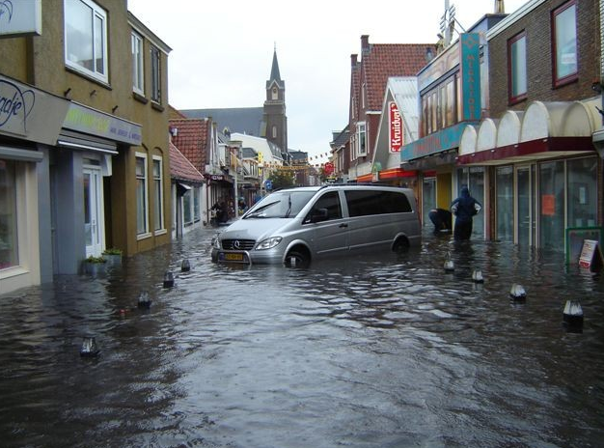
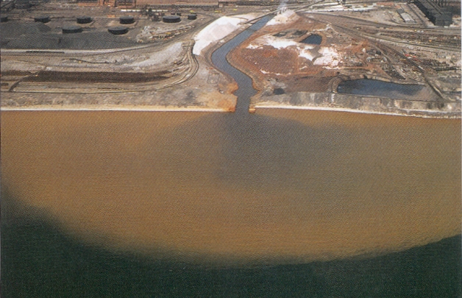
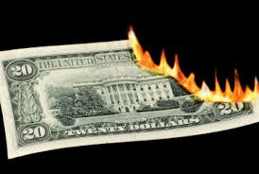
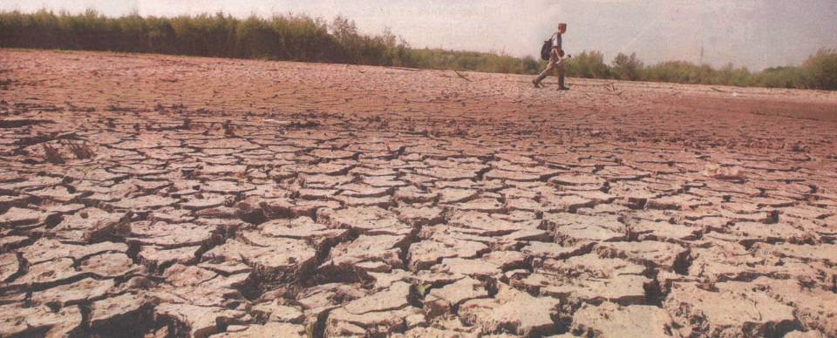
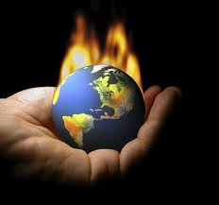
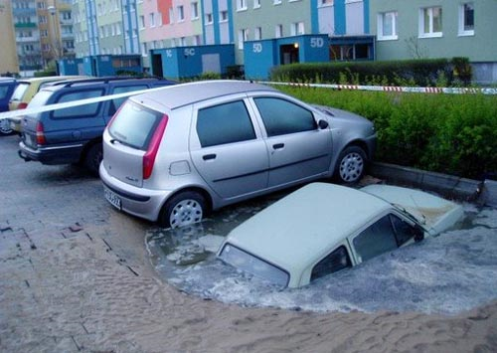
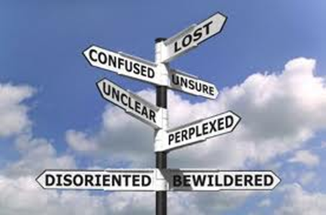
Transitioning into the “Anthropocene”
Transgressed Planetary Boundaries
  Climate change
  Disrupted biochemical flows
  Biosphere disintegration
  Land-system changes
Societal challenge in the context of uncertain scenarios
  Social inequalities
  Social fragmentation
  Knowledge institutions loosing authority
  Political instabilities
  Re-emergence of Nationalisms and Extremisms
Notes:
Urban challenges most of all influenced by the increasing urbanization of the world population, which in the last century have drastically increased from 10% to 50% and that is expected to increase even further in the future.
In particular, urban utilities have been identified as an empirical theme of growing relevance in the field of sustainable transition (Bulkeley et al., 2011; Markard et al., 2012). On one hand, expectations on water utility services are changing as networked infrastructure are discovered to be critical in improving urban living and protect the natural environment at the same time (Kaika and Swyngedouw, 2000; Monstad, 2009). On the other hand, market oriented management approaches,influenced by the neoliberal paradigm, are drastically changing socio-technical priorities of utility management (Graham and Marvin, 2001). As a consequence, it becomes fundamental to develop better descriptions of the double interrelations of the on-going restructuring of both infrastructure networks and cities (Hodson and Marvin, 2006).

Slide 3
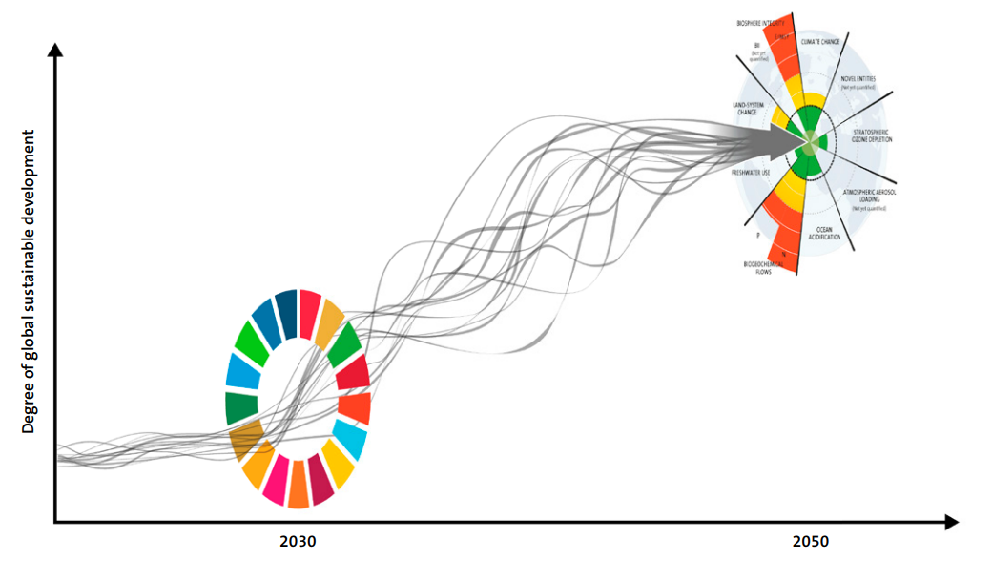
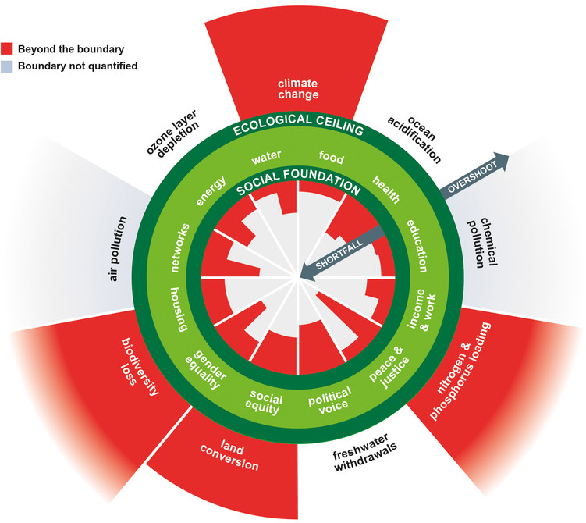
A complex path to Sustainability
Report to the Club of Rome (2018) “Achieving the Sustainable Development Goals within Planetary Boundaries”:
  “Agenda 2030 and conventional growth incompatible!”
  There are recognized conflicts in between the social and ecological SDGs
  Calls for a ”Smart Transformation” – fundamental changes in consumption patterns and socio-economic models for redistribute resources while retracting into safe planetary boundaries (with Biosphere integrity and Bio-Physical Flows being the most critical)
  Sustainability transformations requires science to undertake integrated perspectives and transdisciplinary approaches
Kate Raworth (2017), “Doughnut Economics: Seven Ways to Think Like a 21st-Century Economist”
  “Today’s economy is divisive and degenerative by default. Tomorrow’s economy must be distributive and regenerative by design.”
  There is a need of redesigning sectors , systems and institutions while transforming discourses, practices and identities
  Such a redesign process need to be inclusive and collaborative
Notes:
Professor Katherine Richardson - Leader of Sustainability Science Centre

Slide 4
Critical Infrastructures and Regional Sustainability Transitions
Critical infrastructures are key focus of Transition Studies: resistant to change but great potentials for contributing to the acceleration of broader societal transformations.
Critical Infrastructures ideal study objects to develop strategic and innovative approaches for sustainability transitions across silos in between systemic and place-based dynamics
Whole system change approach: the focus on singular technological innovation is not enough!
Silo and disciplinary perspectives have potential for important externalities and lock-ins: need of trandisciplinarity and multiple systems approach
Social and Professional Practices are key: a focus on transformational capacity building is necessary!
The role of Geographies and Places in Sustainability Transitions are crucial still largely un-reflected
Critical studies on knowledge co-production across disciplines, cultures, sectors and scales are underrepresented in Transitions Studies (implications on transition justice)
The role of the Digital or Smart Transformation for Sustainability Transitions in Critical Infrastructures is largely understudied!

Slide 5
Cumulative socio-political drivers
Increasing diversity of actors and level of collaboration
Supply access
and security
Public health
protection
Socio-economic
sustainability
Social amenity,
environmental
protection
Limits on
natural resources
and materials,
social equity
Intergenerational
equity, resilience,
sense of belonging,
environmental/social
justice
Requiring knowledge and experimentations for shared learnings to re-design system and places
Green Transition
Livability
Circularity
Supply
Risk
Smart Transition
Adaptive and multifunctional infrastructures,
transdisciplinary design for biosphere regeneration,
reinforcing cultural identity
Diverse, fit-for-purpose renewable sources, maintainance, reuse, redistribute, recycle, share
Radical transformation of business models, planning/management practices and governance structures (beyond sectorial perspectives)
Distribution
of resources for livelihood and sustenance
Prevent and
mitigate health/safety
hazards
Pollution
management,
comfort
and beauty
Create new
opportunities
for growth
Service delivery functions

Slide 6
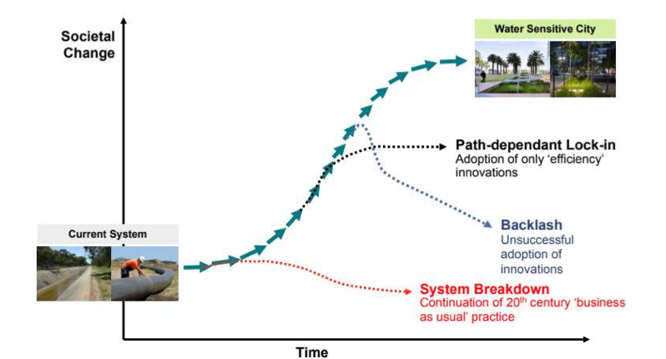
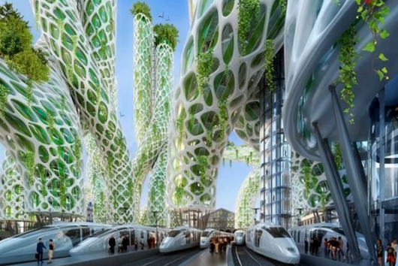
Smart transformations as part of an integrated regional strategy
Smart Transformation
Practices
Institutions
Policy
Organizations
Business Models

Slide 7

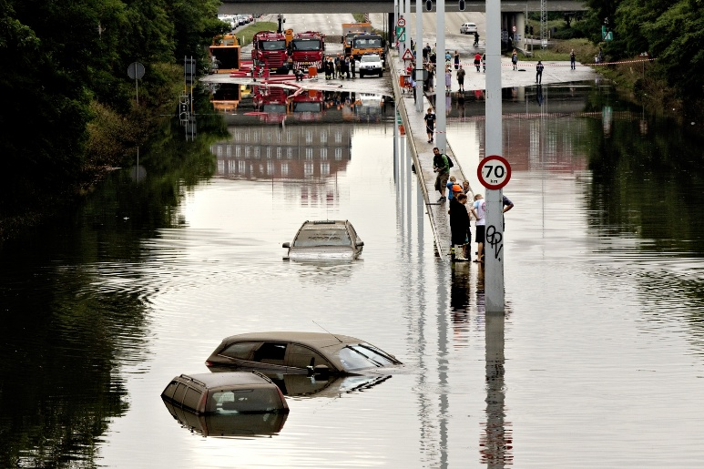
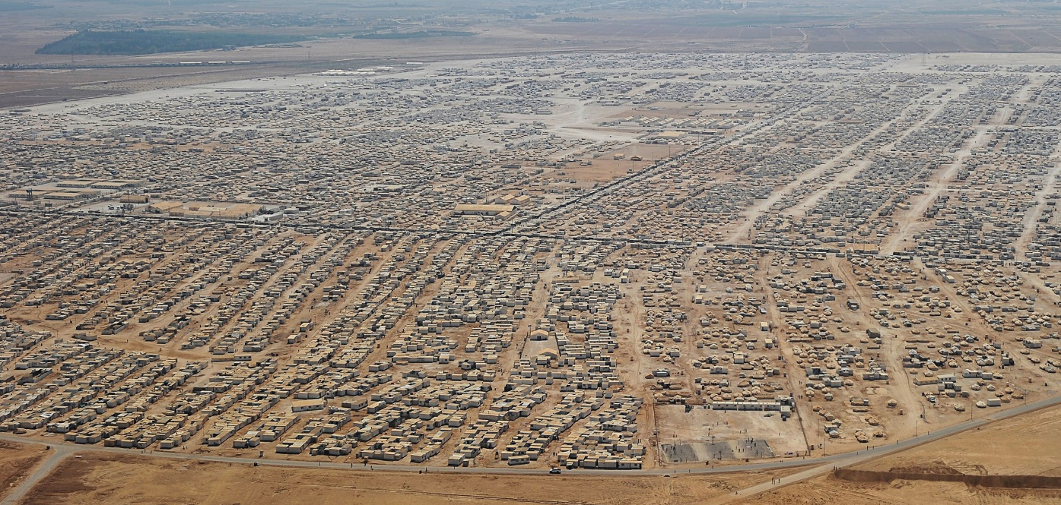
How do we go from grand and interrelated socio-ecological challenges…

Slide 8

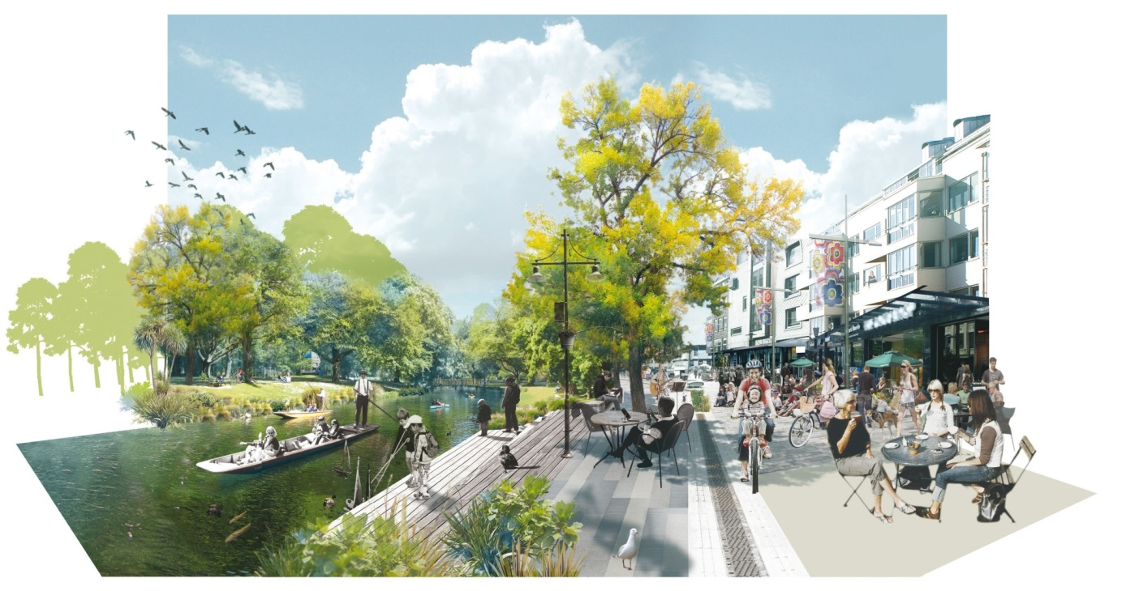

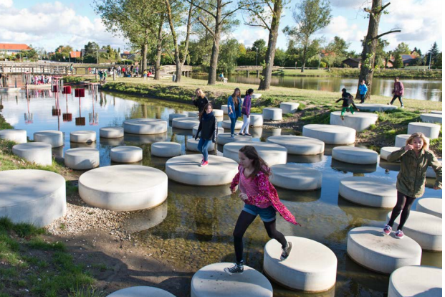
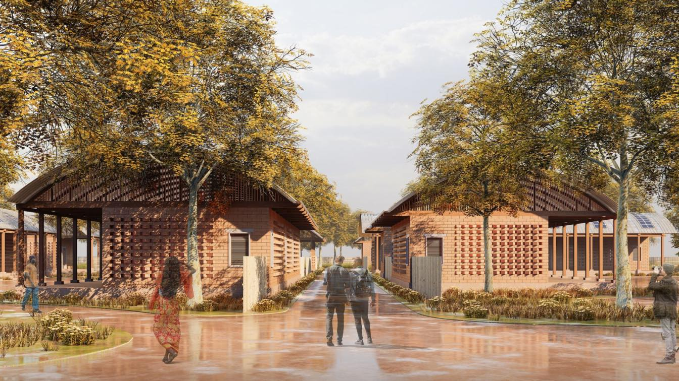
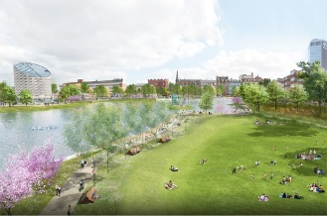
…to smart solutions for sustainability transition?
It is complex!

Slide 9
To tackle complexity,
we just need knowledge-based, holistic and collaborative policy and planning processes!!!
Yes but….
what and whose knowledge?

Slide 10

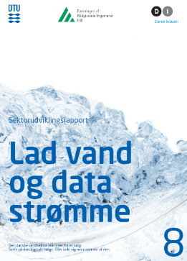
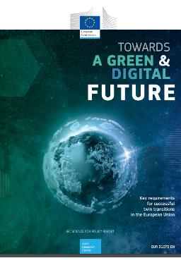
The promises of the Digital Transition…
- More effective governance
- More innovation
- Less fragmentation
- Supporting Sustainability Transition
  BUT…what are the challenges?
    Social disruptions and polarization
Increasing inequality
Security risks
          Mis- and disinformation
Presented at Christianborg
25th marts 2019
EC Joint Research Centre, 2022

Slide 11
The EU Data Strategy– enabling data-driven prosperity in EU
Europe is at the heart of a digital revolution affecting almost every domain of the economy, policies and citizens' lifestyles in general.
Data is an essential resource for the green economy, competitiveness, innovation, job creation and societal progress; therefore, it is important to ensure that the digital transition will be sustainable and beneficial for all (Otto, ten Hompel, and Wrobel 2022)
Despite the exponential growth of data produced and the value potential they bear for society and the economy, the use of this data is suboptimal and therefore its value is not exploited. Three critical reasons:
    Lack of trust between data providers and data users
    Regulatory and technical issues around reuse of public sector data and around collecting data for the common good
    Limited accessibility and availability of data
Notes:
The acceleration of the digital transformation makes data the most significant resource for our future.
Being able to access, use, and combine data is the key to prosperity and innovation in Europe and worldwide.
Understanding how to manage and safeguard people’s sovereignty over their own data is and will be vital for creating trust and confidence among actors in the data economy and therefore in the acceleration of digital transitions within and across sectors and scales

Slide 12
European Data Strategy: Why needed?
Low trust in data sharing
Issues around reuse of public sector data and collecting data for the common good
Technical obstacles to data reuse
DRIVERS
Limited data sharing despite its economic and social potentials
PROBLEM
Lack of cross-border data driven innovation, products and services
Dependency on third countries
Consolidation of dominant market actors’ power
Full economic and societal value is not unlocked
CONSEQUENCES
Brain drain of professionals, researchers and companies
Data intermediation services from dominant firms
Lack of competing offers and harms to consumers
Unfulfilled potential for innovation and technology development
Insufficient offer of data-based services and products
Less job creation: stagnation of data economy
SMEs not engaged in data sharing due to transaction costs
Internal market not fully developed and economy of scale not achieved
No EU-wide data-driven products, services and research available
Data and AI R&D move abroad where rules are less
Notes:
The OECD states that ‘one of the most frequently cited barriers to data sharing and reuse is the lack of common standards, or the proliferation of incompatible standards’. This is confirmed by the 2020 public consultation, where 91.5% of the respondents agreed that standardisation is necessary to improve interoperability and ultimately data reuse across sectors. Some 91.1% of respondents agreed that future standardisation activities need to better address the use of data across sectors of the economy or domains of society.

Slide 13
EU Data Spaces - 3 key socio economic goals
EU competitive advantage/sovereignty in the digital transformation over its non-European competitors (i.e. US, CN):
  Estimated ‘Cost of Non-Europe’ in digital transformation equal to € 315 billions already in 2021 (€1.3 trillions by 2033)
  Inherent business model logic of Non-EU platforms challenge EU democratic values
  To build a fair and sustainable data economy for Europe, driven by EU companies
Promoting EU democratic values of the EU Single Market (e.g. social justice, data protection and privacy) by:
  supporting growth and gains for SMEs,
  ensuring cybersecurity for institutions and citizens,
  protecting users, ensuring equal access to data to all individuals and organizations in EU.
Contributing to the Green Transition (societal-, climate- and environment- related challenges)
    Making data available and improving the way in which data is used, leading to better policies for the European Green Deal.
    The EU proposes green transformation measures for the environmental footprint of the ICT sector

Slide 14
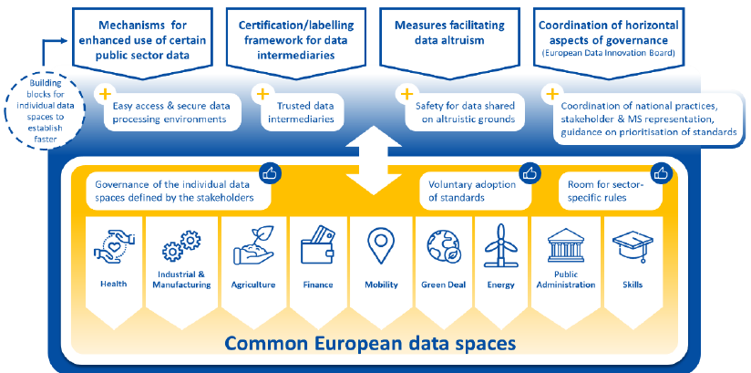
The EU Data Strategy – an horizontal approach
The EU Data Strategy proposes an overarching framework encompassing horizontal measures for all common European data spaces: sector-specific rules, governance mechanisms and standards where relevant, using a collaborative approach (European Commission 2020b)
“The objective is not to create the common European data spaces by law, but to enhance their development by strengthening trust in data sharing and in data intermediaries” (EC 2020b, p.3)
9 sectors were selected as the most critical for the green and digital transition.
Water not identified as an independent sector but as part of the Green Deal Data Space
Notes:
References
European Commission, 2020b. “Accompanying the Document Proposal for a REGULATION OF THE EUROPEAN PARLIAMENT AND OF THE COUNCIL on European Data Governance (Data Governance Act).” European Union: European Commission. Brussels. https://eur-lex.europa.eu/legal-content/EN/TXT/?uri=CELEX:52020SC0295

Slide 15
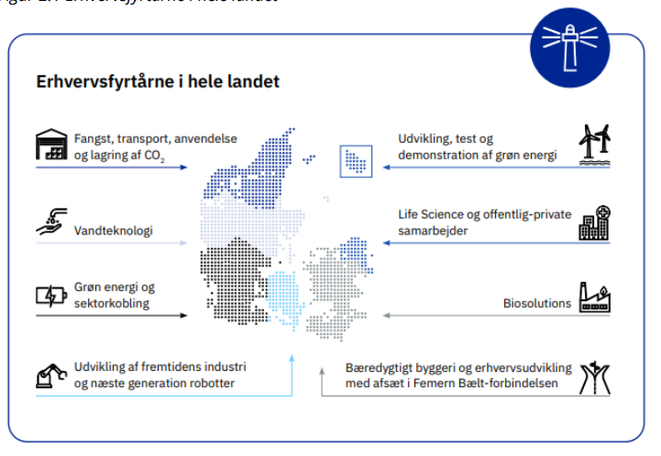
The Water Data Space Project
Funded by REACT EU as part of the “Region Midt Erhvervsfyrtårn for Vandteknologi” initiative,
Regional initiative aimed at the competitive advantage of the Danish water sector to act and support the digital transformation in Europe and beyond, thus, creating important opportunities for the export of Danish technologies and expertise.
The “Water Data Space” project investigates the potentials for data spaces to facilitate the complex task of collecting, organizing and displaying data from multiple data sources, so that it is possible for a large diversity of actors to develop new knowledge and business models for digital and green water transitions
P.S. Mikkelsen & C. Fratini, DTU Sustain; J. Hansen, Systematic;
H. Dissing, Danmarks Miljøportal; K.B. Kjær & T. Dalkvist, DHI;
M. Levring & M.K.S Ahm, Aarhus Vand; U. Sparre & C.F. Simonsen, Water Valley Denmark

Slide 16

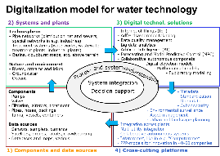
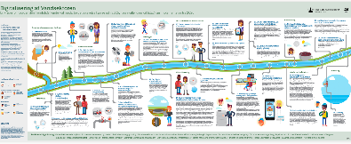


Background for the Digital Water Transition in DK
The Growth Team's recommendations and the Government’s Digitalization Strategy 2022 – Vision 6
Concrete initiatives to contribute to the green transition, e.g., by putting water data into play. With better data on where water is and where it is moving, we can better protect ourselves against the weather events we will face in the future.
A circular databank is being established to collect and make accessible data on waste and materials, so that companies and public authorities can streamline their material consumption and minimize waste.
A utility digitization program will drive development toward a coherent green utility sector that better utilizes resources and infrastructure across value chains and types of utilities.
DTU Sektorudviklingsrapport, marts 2019
Miljøstyrelsen, December 2019

Slide 17
Research design
Two interrelated phenomena worth investigating:
“The digital water transition in Denmark” to better understand its dynamics in terms of opportunities, challenges and direction.
“The development of water data spaces in Denmark” to better understand what are the opportunities and challenges for these to contribute to the Digital and Green (Twin) water transition in Denmark and beyond.
The 2nd phenomenon is the central one so we have identified cases of water data space ecosystems at different development stages and context
We expect that knowledge on the 2nd phenomenon will inform the 1st

Slide 18
The Digital Transition of the water sector in DK (overarching phenomenon)
CASE STUDY A:
Water Data Space Project
CASE STUDY B:
Miljøportalen – an advanced portal with environmental data from the state (government), municipalities and regions. Is it or could it be considered a Data Space?
Use-case 1:
Automated reporting to the utility secretariat
Use-case 2:
Detention Pond Analytics - Giber Å
Use-case 3
EHS Source Tracking Analytics
CASE STUDY C:
Water Living Lab Project

Slide 19

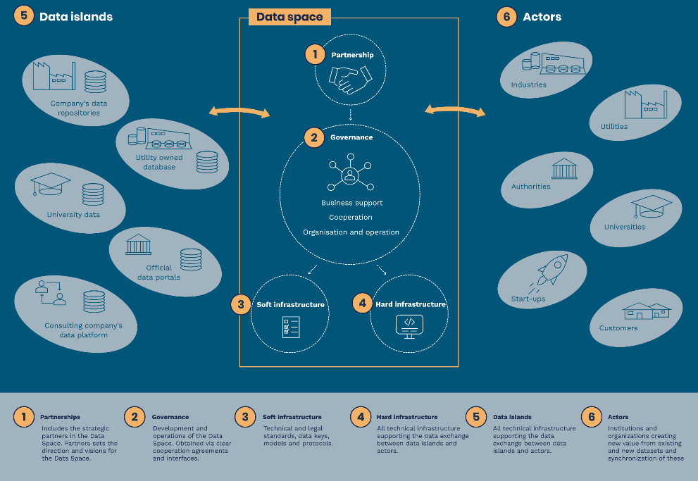
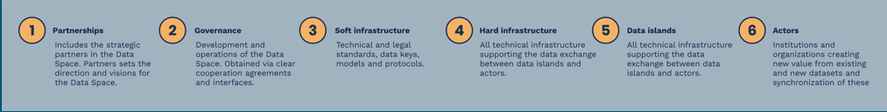

Slide 20
Case study research
Data collection in each case was based on:
  Participant observations at workshops and meetings
  Literature review encompassing academic literature, national and international policy documents and official web-sites
  Collaborative Stakeholder Analysis (CSA)
  Semi-structure interviews with key actors within the project
Exploring the epistemic politics of Water Data Spaces – i.e. the politics related to the processes of knowledge creation, knowledge flows and mode of doings – understanding how specific framing, material arrangements and governance settings enable the stabilization of sociotechnical imaginaries.

Slide 21
Theoretical framework for the analysis
Knowledge co-production (Jasanoff, 2004) - concerned with the emergence of hybrid phenomena as well as with the processes making them visible, understandable, measurable, governable (Voss and Freeman, 2016)
Two strands of co-production studies (Pfister, 2016): 1) “constitutive” studies, exploring how new phenomena come into being and get stabilized and 2) “interactional” studies, unfolding the controversies and transformations arising within established political and epistemic orders, especially when their boundaries and qualities are being reimagined and renegotiated.
Four elements that contribute to sustaining social order morally, ontologically, politically, and symbolically: identities, discourse, institutions, and representations.
Socio-technical imaginaries : “collectively held, institutionally stabilized and publically performed visions of desirable futures, animated by shared understanding of forms of social life and social order attainable through, and supportive of, advances in science and technology”
Pathways to Sustainability - analytical and normative tools to help us reflecting on governance arrangements and critically assess them in terms of social and environmental justice asking what kinds of institutions and interactions are needed to help shape desirable urban transformations.
Notes:
Immaginari socio-tecnici: ”immaginari collettivi e condivisi, istituzionalmente stabilizzate e in grado di contribuire alla creazione di scenari desiderabili futuri, animati dalla comprensione condivisa di forme di vita sociale e di ordine sociale ottenibili attraverso e di supporto ai progressi della scienza e della tecnologia"
Esplorando le politiche epistemiche - cioè quelle politiche legata ai processi di creazione della conoscenza, flussi di conoscenza e modalità di azione – alla base delle strutture di governance – quindi tali da facilitare la stabilizzazione degli immaginari sociotecnici.

Slide 22
 | Actors | Who are they? | Description
International actors | European Commission and Parliament | DG Environment, DG Research and Innovation, DG Informatics, DG JRC, … | Regulator (Parliament is legislator), also providing strategic push and knowledge regarding data governance and data space ecosystems. There are several directorates, which each play different roles wrt. policy related to digital transformation, as well as the Joint Research Centre and the European Environment Agency (EEA, located in Copenhagen). The Parliament and the EC are not always perfectly aligned. DTU’s conceptual note, Part 1 (Jan 2023) provides some insight.
 | International (Non-EU) Tech Companies | Microsoft, Google, Amazon, Alibaba, … | Contribute with hardware, software and design principles for the development of data spaces. Some are big international players providing de-facto technology standards and platforms. The EC wants to reduce the influence and market share of these actors.
 | International Data Space organisations | International Data Space Association, GAIA-X, Frauenhofer Institute. Nordic Institute for Interoperability Solutions (NIIS) | Several Data Space initiatives are ongoing at EU level, involving a large network of actors. SMV’s are supposed to have special condition’s. The water sector does not (yet) appear as a separate entity, and Danish participation is not (yet) formalised. Alexandra Insituttet’s report om Data Spaces (Jan 2023) provides some insight.
Knoweldge institutions | Universities and other reserarech/education institutes | DTU, AU, AAU, VIA | Contribute with in depth knowledge on both technological and governance innovation. They can also act as facilitators of change and innovation across actor categories. Universities in particular have own innovation ecosystem and startup activities, and access to mobilise qualified workforce (students).
 | GTS (Godkendte Teknologiske Serviceinstitutter) | Alexandra, DHI, TI, FORCE | Contribute with in-depth knowledge on both technological and governance innovation. They can also act as facilitators of change and innovation across actor categories. GTS often also have a business-support or/and commercial profile and therefore have market interests in the digital transition.
 | Governmental research institutions | DMI, GEUS | Both are public bodies with roles defined by law. Have a mix of different roles, with both similarities and differences. Roles including authority, research, guidance/consultancy to government, teaching (to some extent), operators of monitoring and modelling systems, and providers of open data to the benefit of the general public including SMEs.
Private companies | Water Technology Companies (Large) | Grundfos, Kamstrup, AVK, Danfoss, … | Founding members of WVDK. Interested in increased Danish export of Danish water technology (including digital). Have own large innovation activities, and increasingly own digital platforms. Not involved with Miljøportalen.
 | Tech companies (national) | Systematic, DHI | Contribute with software platforms and design principles for the development of data spaces. To some extent international players providing de-facto technology standards and software systems. The EC wants to increase the influence and market share of these actors.
 | Consultancy companies (Large) | Rambøll, Niras, COWI, WSP Krüger, Envidan, DHI, Frontmatec | Data users, data providers but also data space developers (each company has different strategies wrt. digitalization). They might be protective of their knowledge and data. Some are multi-sector consultancies (1st line), whereas others are more specialized (in water or food, 2nd line). Some (Krüger) also act as construction actor and water technology supplier.
 | Wastewater discharging industries/organisations | Production companies, car washes, waste deposits, hospitals | Industries with industrial production that have a high water use and discharge of pollutants. Relevant specifically in relation to how water use and discharge in industries are regulated. Their business model and operation can potentially be impacted by regulation and by public insights into their environmental performance through digitilisation and sharing of data. Hospitals discharge specific pollutants and are also responsible for individual discharges at the household level (depending on treatment)
 | Acredited labs for sampling/analysis | Eurofins, ALS, Højvang | Companies in charge of environmental sampling and analysis of concentrations of specific pollutants
 | SMEs and Startups | DRYP/Tech Instrumentering/Envco Logistics – all Use case 2 SCALGO, APX10, Unisense Envir., Aquarden, Innovation Lab ... (more) | Many, with very different focus/products and busyness models. Some are spinouts from universities, still maintaining close links, and some have utility companies as partial owner. Crucial actors establishing the water data space ecosystem, due to REACT funding requirements. SMEs can push new technologies into the market, and can be both data owners, - holders, - distributors, - consumers, and - end-users.
Utility service providers | Water Utilities | Aarhus Vand (Steering Committee of WDS project) HOFOR, VCS, Herning Vand (Reference group of WDS project) | Water Utilities are quite different in size, capacity and strategy, and this will affect the role they can have in the Water Data Space ecosystem. They are the key user of the data space and therefore key actors in the ecosystem. Aarhus Vand is the only utility directly involved as a core partner in the WDS project; HOFOR, VCS and Herning Vand are part of the “Reference group” where regular meetings take place in relation to use cases. Other utilities are involved in public meetings from time to time. Not involved with Miljøportalen.
 | Danmarks Miljøportal (Miljøportalen) | Separate unit, owned by Government, the municipalities, and the regions | Has expertise and ideas on how to design the water data space and its ecosystem. Focus on data related to the environment, so far only little focus on data owned/produced by utility companies (e.g. emission data in PULS, but not data from “inside the fence”). Can be considered a ”supplier of data” much in the same way as other publically owned utility companies are suppliers of services or goods. Can be considered a ”data dissemination service” within an environmental data space ecosystyem (Fig 5 in the Alexandra report from Jan 2023).
Users/ citizens | Water costumers and citizens | … | They need to be kept informed as they might both become data producers and/or users
 | Students and Entrepreneurs | … | They are an important source of new ideas and potential data producers and/or users
Public authorities (nationally) | Municipalities (98 in total) | The 98 municipalities are local environmental authorities | Owners of the (water) utility companies. Have important influence on the local environmental targets and the service goals the water utilities have to fulfill, through the board of the utilities. Influence on spatial and industrial planning at municipal level. Aarhus Municipality and Lemvig Municipality are both core actors in the Erhvervsfyrtårn for vandteknologi project. Several are actively involved with Miljøportalen.
 | Regions (5 in total) | Midtjylland, Nordjylland, Syddanmark, Hovedstaden, Sjælland | Role and relation to this project is not clear. The Fyrtårn is in Region Midtjylland. The national/regional/local setup of “erhvervsfremmesystemet” and what this means to the WDS project is currently not well understood and agreed among actors. Regions are owners of public hospitals.
 | Danish Ministry of Environment (Miljøministeriet) | Ministry | Has important influence of environmental policies and regulations. Portfolio of responsibility changes over the years (was earlier part of the Ministry of Environment and Food). Responsibility for the water sector is currently shared with the “Danish Ministry of Climate, Energy and Utilities”, and the “Ministry of Industry, Business and Financial Affairs”.
 | Ministry of Digital Government and Gender Equality (MDGGE) | New ministry formed 15/12-2022 | New ministry, and new minister (Marie Bjerre, V), formed by the new (December-2022) Danish government (A, V, M). We don’t know yet exactly how it will develop. We assume it will be regulative entity for data security and management in Denmark.
 | Other ministries | Ministry of Climate, Energy and Utilties (MCEU); Ministry of Industry, Business and Financial Affairs (IBFA); Ministry of Food, Agriculture and Fisheries (MFAF); Ministry of Transport (MT) | The first two have direct influence on water policy and reguation, the third and fourth have indirect influence (as several other ministries)
 | Miljøstyrelsen & Naturstyrelsen | Agencies under the Environment Ministry | Can be facilitator of changes in service goals and also have interest on water data that deal with environmental regulation.
 | Other agencies | Digitaliseringsstyrelsen; The Danish Road Directorate (Vejdirektoratet); Landbrugsstyrelsen; Energistyrelsen | Agencies under MDGGE, MT, MFAF & MCEU. Interest in water data that can support regulations within their resort area.
 | Forsyningssekretariatet (Utility Secretariat) | Officially called ”Vandtilsynet”. Unit under the Konkurrence- og Forbrugerstyrelse. | In charge of the efficiency requirements and assessments of water utilities. Interested on water data related to these requirements.
Interest organisations | Water Valley Denmark | Ofice in Aarhus, private interest organisation | Is a key interest organization driving the Water Data Space project. Founded by a range of (mainly large) private water technology companies and utility companies.
 | CLEAN | Offices thoughout DK, has 5 focus areas + internationalisation | The (national) cluster organization in environmental technology, managing the Erhvervsfyrtårn for vandteknologi. Has important knowledge and data on SMEs in the field of water technology. Has both national and international focus, digitalization is a cross-cutting activity, across five thematic focus areas
 | Erhvervsfyrtårn for vandteknologi | Styregruppe consisting of: CLEAN, WVDK, Klimatorium, Aarhus Kommune, Aarhus Universitet, VIA, Lemvig Kommune, Region Midtjylland, Erhvervshus Midtjylland | Currently, a project og one year duration (May 2022 – August 2023) with finding from REACT. Currently an application for 2nd round REACT-funding is being prepared. It is currently unclear how the local-regional-national focus will be.
 | DANVA, Danske Vandværker | National Danish (private) interest organisations of public and private water utility companies | DANVA’s target group is principle all Danish water utilities, however many small drinking water utilities are organised under Danske Vandværker. Both are active in the political domain. DANVA also has substantial professional development and conference activities (annual conference, nordic conferences, IWA2022), as well as dissemination activities, and appeals to membership also beyonf utility companies.
 | Kommunernes Landsforening (KL) and Danske Regioner | Private interest organisations KL represents the 98 municipal councils, and Danske Regioner represents the 5 regions | KL covers a wide range of resort areas (employment, integration, culture and spare time, business development, children and youth, the social area, health and the elderly, technology and environment, and climate); Dansk Regioner’s mandate is more narrow (health and hospitals, regional development including environment and resources)
 | DI Vand, Dansk Miljøteknologi | Member organisations | DI Vand is one among ~100 membership organisations under DI (Confederation of Danish industry), which are less formally embedded in DI than the ”branchefælleeskaber” such as DI Digital, DI Byggeri or DI Energi. Overall goals are to (1) increase exports, (2) increase R&D, and (3) strengthen DK and EU framwork conditions. Dansk Miljøteknologi is a specialised organisation of technology companies (water/waste).
 | NGOs | Naturfredningsforeningen, Danmarks Lystfiskerforbund | Interest in protecting the environment, and thus in public data about potential pollution sources andfthe status of the environment. May influence the process about issuing discharge permits.
CSA at the ”Project level” (Case Study A), updated by DTU 22/8-23 (including info from Use Case 3 & Case Study B)

Slide 23
 |  | Focused on water utility companies
 |  |  |  | Focused on environmental authorities and the public
Actor categories | Actors | Use Case 1 Automated reporting | Case Study C Water Living Lab | Use Case 2 Detention Pond Analytics | Use Case 3 EHS Source Track. Analyt. | Case Study B Miljøportalen
International actors | European Commission and Parliament |  | X | X | X | X
 | International (Non-EU) Tech Companies |  | X | X |  | X
 | International Data Space organisations |  | X | X |  | X
Knowledge institutions | Universities and other research/education institutes | X | X | X | X | X
 | GTS (Godkendte Teknologiske Serviceinstitutter) | X | X | X | X | X
 | Governmental research institutions (DMI, GEUS) |  | X |  |  | X
Private companies | Water Technology Companies (Large) |  | X
 | Tech companies (national) | X | X | X | X | X
 | Consultancy companies (Large) |  | X | X | X | X
 | Wastewater discharging industries/organisations |  |  |  | X
 | Acredited labs for sampling/analysis |  |  |  | X
 | SMEs and Startups | X | X | X | X | X
Utility service providers | Water Utilities | X | X | X | X
 | Danmarks Miljøportal (Miljøportalen) |  |  | X | X | X
Users/ citizens | Water costumers and citizens | X |  |  |  | X
 | Students and Entrepreneurs |  |  |  |  | X
Public authorities (nationally) | Municipalities (98 in total) |  | X | X | X | X
 | Regions (5 in total) |  | X |  | X | X
 | Danish Ministry of Environment (Miljøministeriet) |  | X | X | X | X
 | Ministry of Digital Government and Gender Equality |  | X |  |  | X
 | Other ministries |  |  |  |  | X
 | Miljøstyrelsen & Naturstyrelsen | X | X | X | X | X
 | Other agencies | X |  |  |  | X
 | Forsyningssekretariatet (Utility Secretariat) | X
Interest organisations | Water Valley Denmark | X | X | X | X | X
 | CLEAN |  | X | X
 | Erhvervsfyrtårn for vandteknologi |  | X | X
 | DANVA, Danske Vandværker | X | X |  | X | X
 | Kommunernes Landsforening (KL) and Danske Regioner |  |  |  |  | X
 | DI Vand, Dansk Miljøteknologi |  | X |  | X | X
 | NGOs |  |  |  | X

Slide 24
Preliminary conclusions: multiverse transition pathways
The digital water transition is advancing through multiverse pathways due to the following reasons:
  Extreme fragmentation across water utilities: 1) different size and human capacities; 2)different data standardization; 3)different priorities; 4)different level/type of collaboration with companies, local and national authorities
  There is a clear lack of common data standardization (different in the health sector where standards are set up at EU level)
  Water utilities do not see value in sharing data with other utilities. It costs money to make data sharable and there is no clear understanding on how that can support their work as it would be a new practice.
  There is no common regulations, practices or infrastructures for governing data sharing
  It might be problematic that the EU do not see water as a strategic sector in digitalization. There is need to make some lobbying in this direction if we want authorities and/or utilities to prioritize the creation of a water data space and to allocate funding to realize it.
  If things will not change in this direction, there is no incentive for water utilities and the water industries to share data – this will delay innovation for the digital and green transitions
  Denmark is a small country and is already upfront in the digital transition. There is a need for common regulations, data standardizations and infrastructure for data sharing within and across the sectors to achieve the competitive advantage of the Danish Water Sector that the EU is aiming at.
Notes:
Miljøportalen has already a large experience in doing that in other fields and it started to develop infrastructures for data sharing in relation to specific water areas (e.g. wastewater and surface water).

Slide 25
Preliminary Conclusions: governing water data spaces
A data space is not a data repository, but a digital ecosystem of actors and technologies. A water data space should be organized through a specific infrastructure which makes data, which are placed in different places and owned by different actors, visible and accessible.
A data space should be clearly regulated to enable fair (but not necessarily free) data sharing practices across the large variety of actors involved in the design, operation, planning, development and innovation of water systems.
A data space should be managed by an intermediary actor with both IT capabilities and an official mandate to govern the data sharing infrastructure.
There could be more than one intermediaries but common data standardization and regulation for data sharing should still be enforced or incetivized.
There is a need for setting up common data standardization nationally or at EU level – but in that case funding will have to be allocated for realizing that
It is not possible to understand fully the value creation of data sharing until you actually start sharing data

Slide 26
Governance challenges regarding the Twin Water Transitions in between systemic and place-making dynamics
Policymakers rely too much on businesses to drive the implementation, therefore, preferring to use affordable experiments and business incentives
the role of citizens and communities are generally valued but there appears to be a mismatch in how these stakeholders are involved in shaping Digital and Green Regional Futures; too much emphasis is, rather, placed on major stakeholders and on sectorial approaches.
if implemented poorly, the twin transition can lose credibility and be reduced to buzzwords or greenwashing
‘Durable’ transformational journeys require engagement with place-making dynamics rather than trying to contain them in discrete and sectorial framings – which is e.g. currently the case in Danish green policies (Fratini and Jensen, 2017).
Require a better understanding of the relation between goal-oriented ‘durable’ journey and the extent of diversification coming from place-making practices

