Slide 1
Establishing the foundations for a
Transnational Network of Integrated Planning Labs
Preliminary efforts and insights
Yannis Paraskevopoulos, Stefanos Tsigdinos, Ioannis Chatziioannou, Dionisia Koutsi, Sofia Tsadari, Efthimios Bakogiannis & Thanos Vlastos
Yannis Paraskevopoulos Department of Geography and Regional Planning, National Technical University of Athens parask.yannis@gmail.com
37th AESOP Annual Congress, Yildiz Technical University, Istanbul, July 9, 2025

Slide 2
Time to integrate planning!
Mobility
Urbanism
Participatory planning
Evidence-based planning

Slide 3
What is InPlaLabs project? Towards establishing an Integrated Planning Network
InPlaLabs aspires to develop a Transnational Network of multi-stakeholder Integrated Planning Labs for knowledge co-creation on people-centric planning.
Integrated Planning as a 3-fold framework:
# Discipline-based integration➛ urbanism, mobility, evidence-based, participatory, analytics
# Method-based integration➛ quantitative, qualitative, participatory
# Role-based integration➛ urban education and research, urban practice, urban policy

Slide 4
Visions and objectives
Towards establishing an Integrated Planning Network
◐ InPlaLabs envisions becoming a network of (diverse) “labs” working locally and internationally on people-centric integrated planning
&
◑ InPlaLabs aspires to advance HED ecosystem knowledge for promoting truly integrated planning
Systemic transnational collaboration between different Labs
Inclusive and participatory approach in the Network’s activities
Knowledge co-creation between various planning actors
Upskilling planning
actors on people-centric integrated
planning
Cultivating an Integrated planning culture
A long-term hub bringing together different stakeholders

Slide 5
Meet the initiators of our Network
Academia + Practitioners!

Slide 6
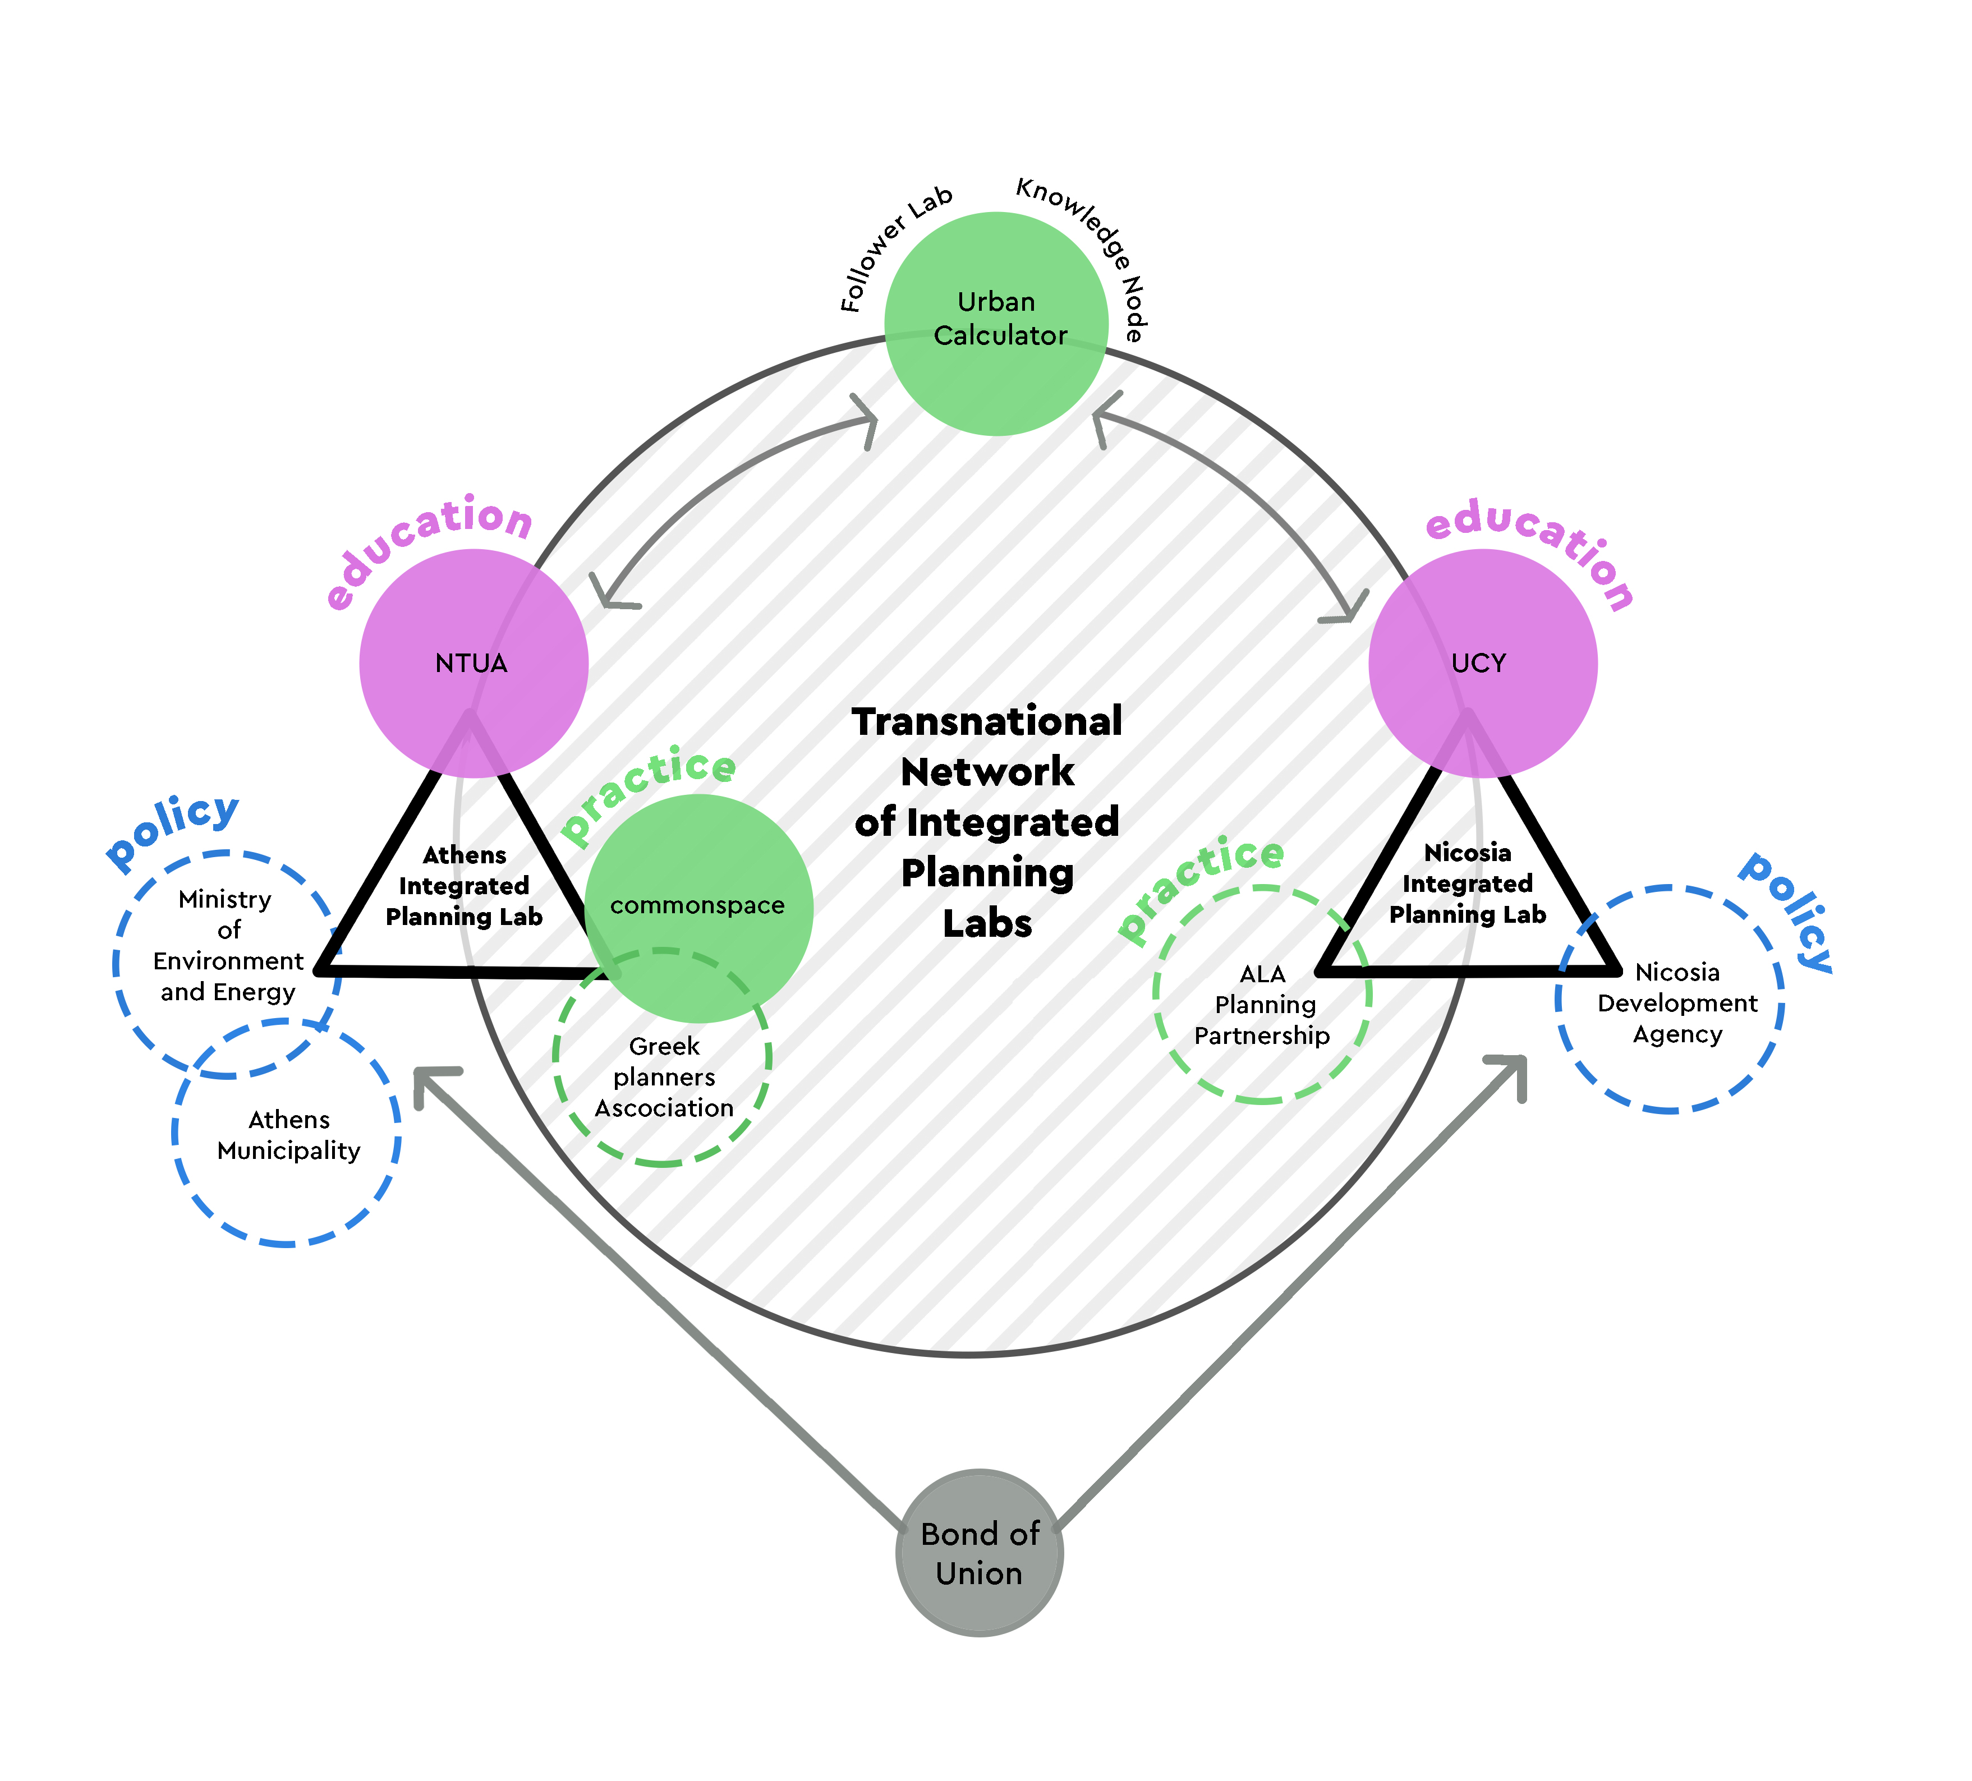
Initial Network structure With our Associated Partners

Slide 7
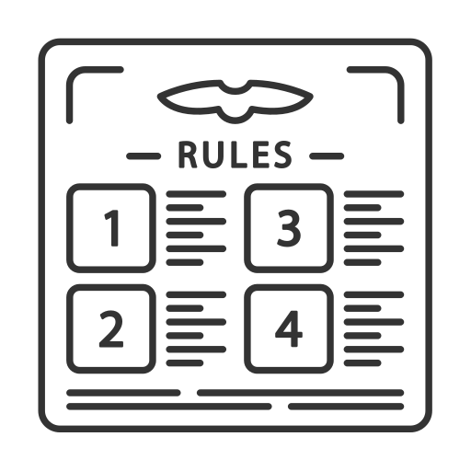
Foundations of the network!
Charter
Knowledge Hub
Participatory guide

Slide 8
Foundations of the network!
Charter
Knowledge Hub
Participatory guide

Slide 9
InPlaLabs Network Charter Establishing the identity and the operation of the network
A “charter” indicates the terms governing the operation of an organisation or association (Enjolras, 2008)
Clarity of purpose and vision
Guidance for actions
Member rights and duties
Transparency
Legal recognition
Sustainability and continuity
Credibility and trust

Slide 10
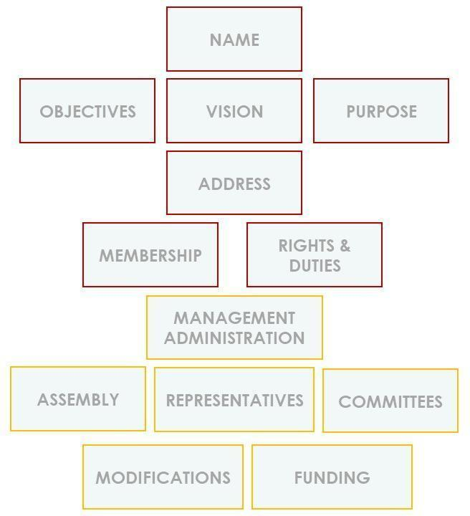
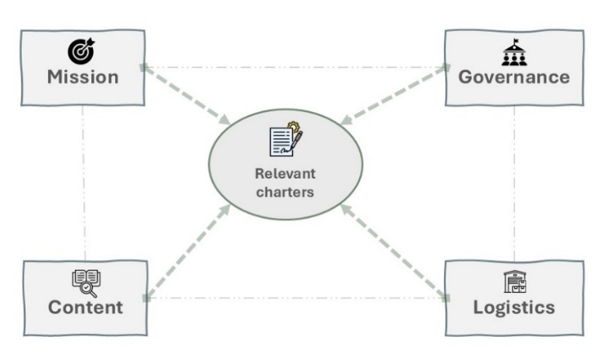
Charter Establishing the identity and the operation of the network
Key terms: a) Integrated planning and b) network
InPlaLabs Charter delineates the conceptual and organisational model of the Network
Charters are very essential for Organisations!
Done!
TBD
Scoping review was utilised → 20 Charters were examined!
Charter sections
Notes:
AESOP Charter was reviewed as well as:\
AGILE
Walk21
IFLA Europe (International Federation of Landscape Architects IFLA-Europe)
European Association of Geographers EUROGEO
International Seminar on Urban Form ISUF
International Sociological Association ISA
International Council for Local Environmental Initiatives ICLEI

Slide 11
Foundations of the network!
Charter
Knowledge Hub
Participatory guide

Slide 12
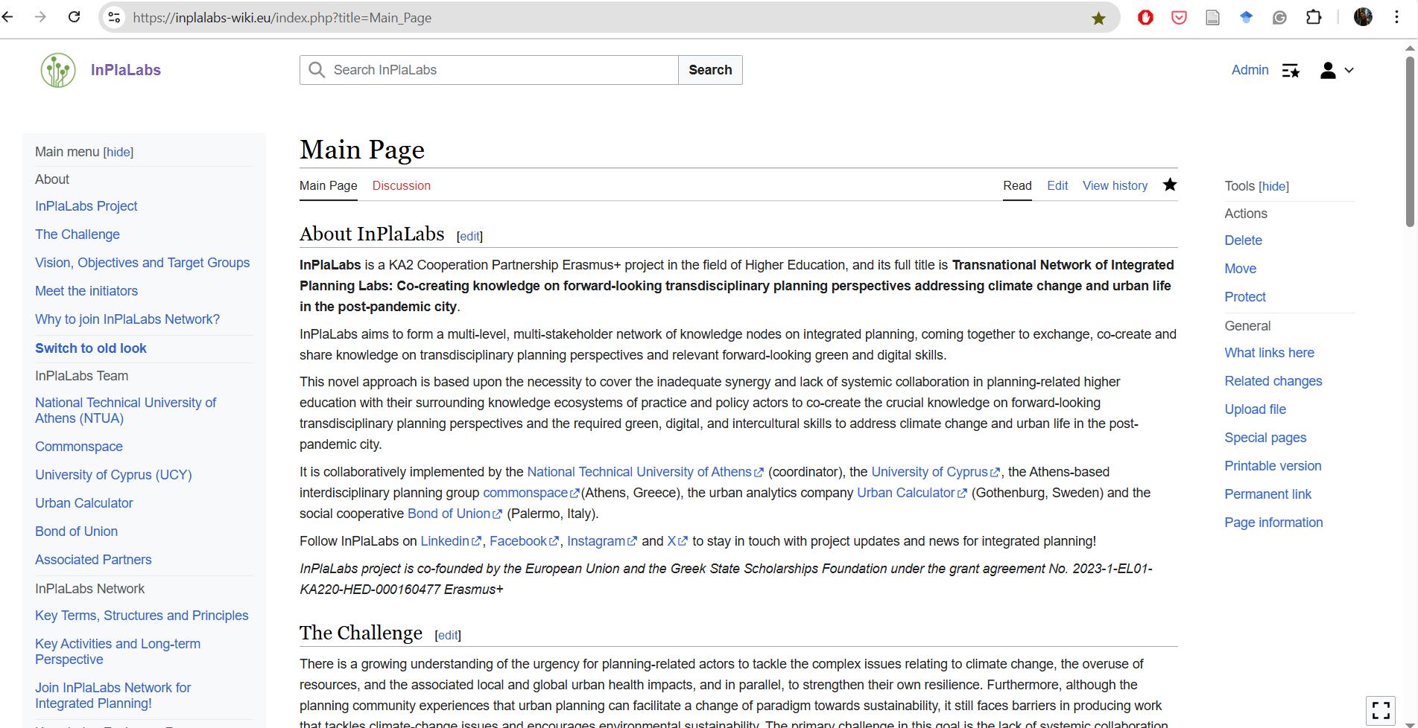
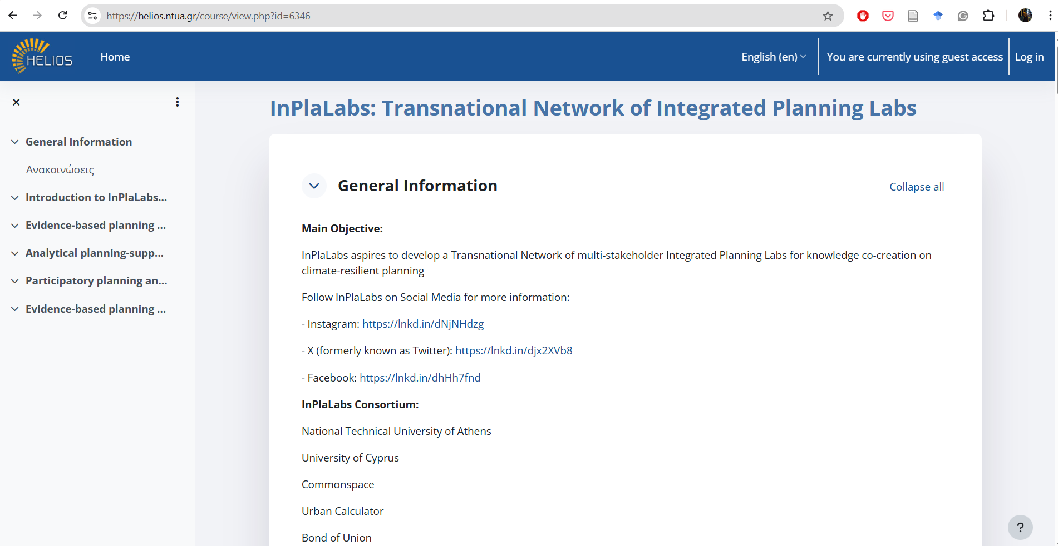
Virtual Knowledge Hub Dedicated Wiki + Open Learning Platform
InPlaLabs Virtual Knowledge Hub consists of an InPlaLabs-dedicated Wiki and an Open Learning Platform
We use this two-fold approach to:
inclusively facilitate the different needs of all prospective members of the network
provide a variety of routes for InPlaLabs to successfully reach its diverse target audiences
We aim to utilise:
open science principles and participatory action learning approaches → To reach the research and civic society actors
Conventional Open Learning Platform → To reach the Higher Education ecosystem

Slide 13
Foundations of the network!
Charter
Knowledge Hub
Participatory guide

Slide 14
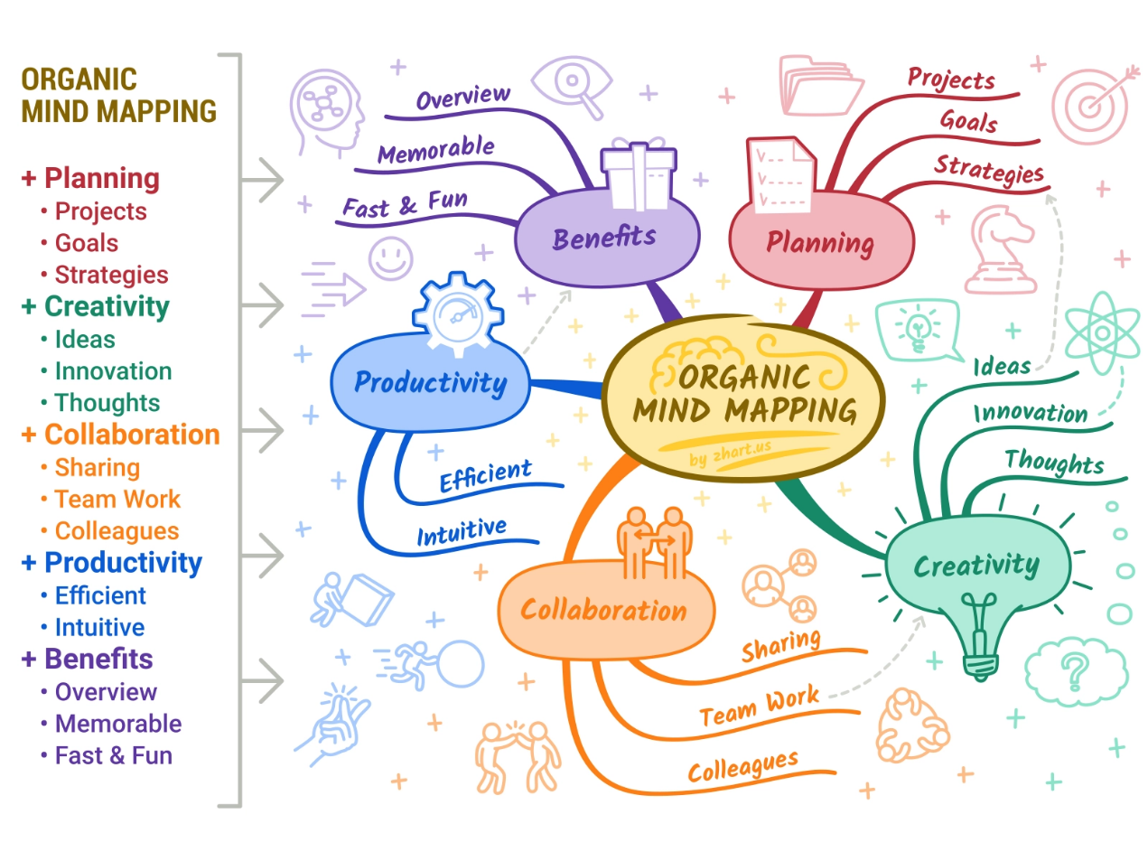
Participatory Guide InPlaLabs Participatory Action Learning and Research Strategy
InPlaLabs Participatory Action Learning and Research Strategy horizontally runs all Network’s structures to ensure inclusion and democratic participation in all its activities
It consists of guidelines, facilitation material and resources ensuring:
Systemic transnational collaboration between the Network’s Nodes
Inclusive and participatory approach during the Network’s activities
Mind Map example. Source: Guthrie, (2024)

Slide 15
Key Insights – Concluding Remarks
Integrated planning should be promoted both in research and practice - Bringing different actors, methods and disciplines together
A network addressing Integrated Planning is now absent
Networking people is a constant process. This initiative is the beginning for a broader endeavour
InPlaLabs network has laid its foundations: Charter, Knowledge Hub and Participatory Guide
The articulated Charter could function as a prototype for similar initiatives in the future
Refinement is desirable through co-creation workshops; future evaluation would be also beneficial
Let’s organise!
100++ members have joined

Slide 16
Thank you!
Yannis Paraskevopoulos National Technical University of Athens parask.yannis@gmail.com

Slide 17
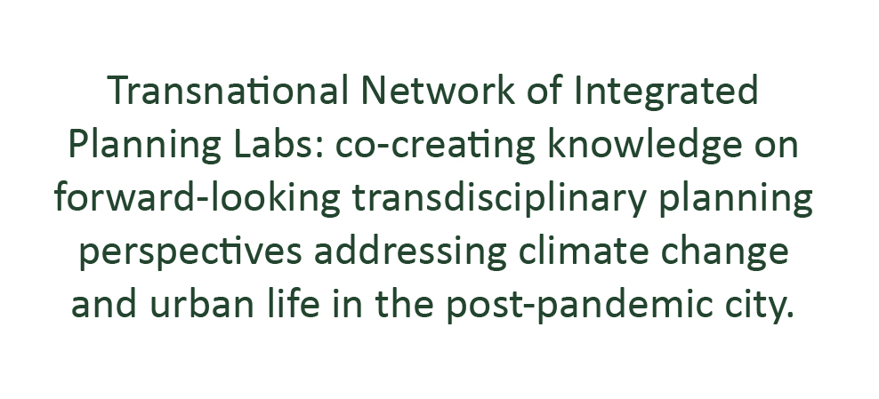
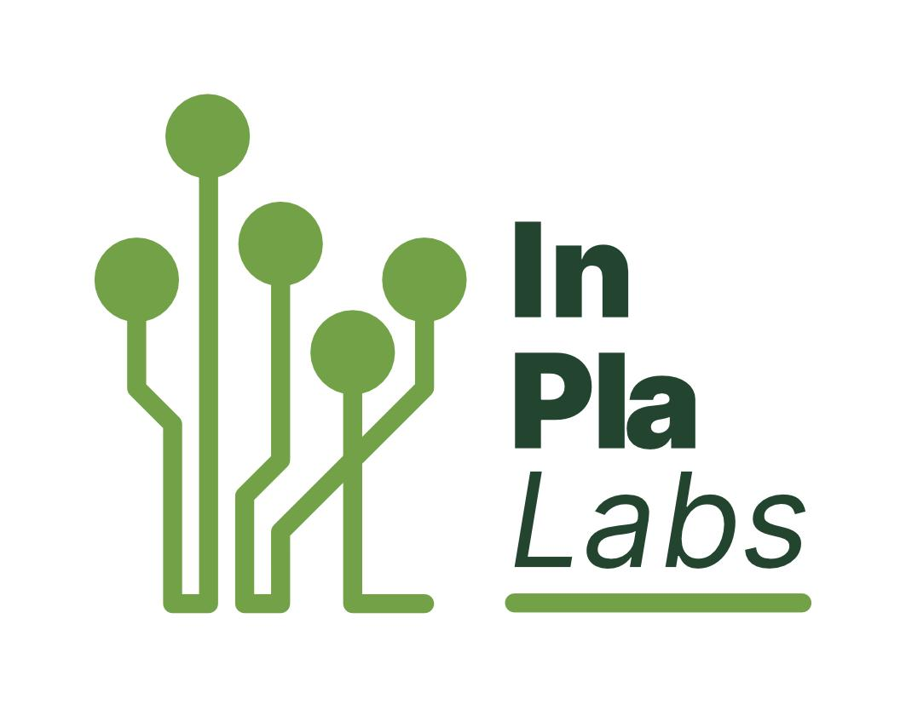
Interested in integrated planning?... …Join our network!

Slide 18
InPlaLabs mini-courses Piloting a network activity > Co-creating and Sharing knowledge
InPlaLabs Theoretical Framework
InPlaLabs Methodological Resources
InPlaLabs Technical Toolkit
Participatory Planning and Design Methods: History, theory and practice.
Evidence-based planning and design: Background, methods and tools
Integrating centrality and accessibility analysis into urban design at early stages
Analytical planning-support approaches for integrated urbanism-mobility planning
Co-creation!

