Slide 1
Gamifying Participatory Design
A Digital Platform for Urban Renewal in Gangxia Urban Village, Shenzhen
Yangyang PAN
School of Design, Hong Kong Polytechnic University

Slide 2
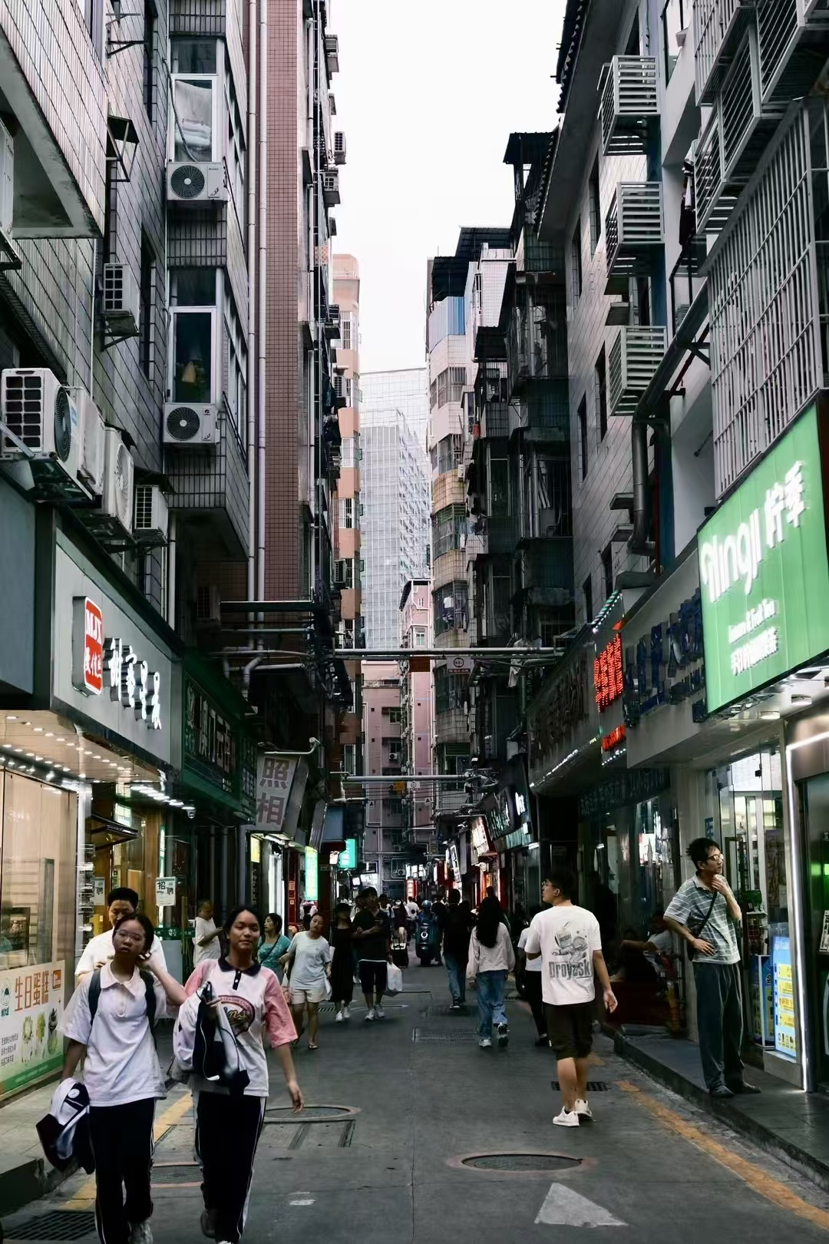
Introduction
RESEARCH BACKGROUND
Rapid urbanization in China
Gangxia
growth of informal "urban villages"
spatial marginality, fragmented governance
(Hao et al., 2011; Lin et al., 2014).
(Wu, 2016).
PROBLEM CONTEXT
Limited
Traditional top-down planning
community participation
digital
institutional exclusion
social tension & inefficiency
Current situation of Gangxia (Author's photograph)

Slide 3
Research Objective
Shen Zhen
gamification
Digital Participatory Design (DPD)
participation
migrants
planning
Community Engagement
Urban Villages
Digital Divide
Inclusion

Slide 4
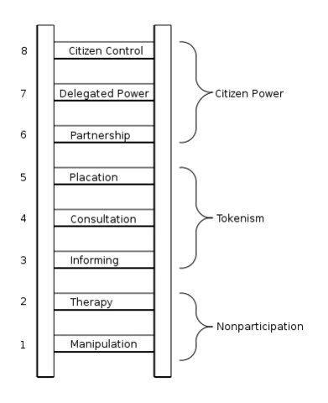
Theoretical Framework
Arnstein's Ladder(Arnstein, 1969)
Planning in urban villages
=
more symbolic than substantive
Digital Participatory Design (DPD)
+
Urban Villages

Slide 5
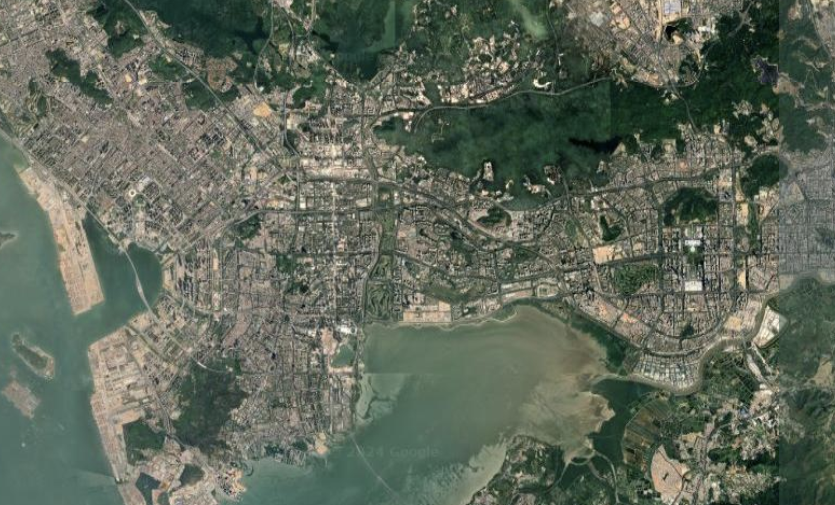
Case Study – Gangxia Village
Location | Completion time | Area(km2) | Social structure | Population density | Main economic activity | Technology access degree
Futian District | 1980s | About 0.8 | Mainly migrant workers, low-income groups, residents are relatively simple | Hight, dense commercial and residential areas | Take-out delivery, catering, retail and other small-scale businesses | Limited, low technology access and usage

Slide 6
Methodology
40 semi-structured interviews:
Modes: Purposive & snowball sampling
Migrant tenants (15)
Trust
Accessibility
Thematic coding:
Participation Fatigue
Local landlords (15)
Fairness
Government officials (10)

Slide 7
Interview Findings
Migrant tenants
Cautious but open to simple, rewarding tools
Local landlords
Concerned about digital transparency and profit risk
Government officials
Supportive, but wary of misinformation overload
Multi-role account system
Gamified feedback
Real-time authority response
Mobile-first, low-barrier UI

Slide 8
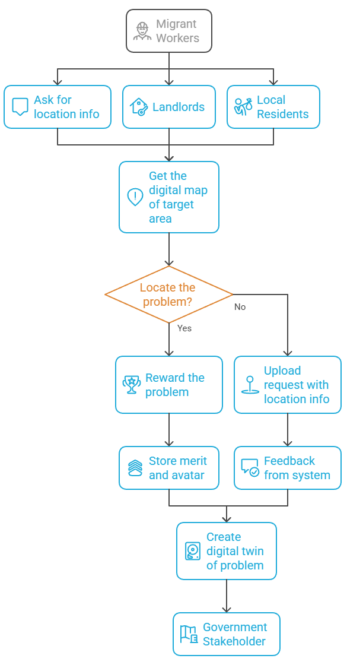
System Workflow
User reports local issue via app
System geo-tags & verifies data (AI + rule-based filters)
Users gain reward points & visual badges
Government receives input → responds via platform
Feedback loop visualized in digital twin model

Slide 9
System Requirements
Functional Requirements | Non-Functional Requirements
F1. Multi-role account system | N1. Cross-device accessibility
F2. Gamified feedback mechanism | N2. Scalable to other urban villages
F3. Issue reporting & suggestions | N3. Privacy and consent safeguards
F4. Real-time government feedback | N4. Low learning curve (usability)
F5. Community voting feature | N5. Cultural localization & multilingual UI
F6. Mobile-friendly interface | N6. Offline caching & low-bandwidth compatibility

Slide 10
Disscusion
Migrant tenants
usability, reward, recognition
Local landlords
property rights, info risk
Government officials
efficiency, data noise

Slide 11
Conclusion
Input
Migrants: low digital literacy
Landlords: risk-aware
Officials: efficiency-driven
Platform
Trust mechanisms
Feedback loop
Adaptivity
Output
Inclusive Decision-Making
Transparent Policy Adjustments
Sustainable Urban Development

Slide 12
Thank you!

