Slide 1
Using Social Media Big Data and ChatGPT for Identifying Counter-urbanisation Hot Spots in China
Jian Chen
J.Chen115@newcastle.ac.uk
Supervisors & co-authors:
Menelaos Gkartzios, Guy Garrod
AESOP Track 11 | EMERGING TECHNOLOGIES
Centre for Rural Economy, SNES
Notes:
Track 11 | EMERGING TECHNOLOGIES – ‘the state of the art in the methodologies and the practice of New Technologies in Planning’
Background – main PhD project – selection of cases in China – lack of data source – social media data – ‘big data’ – AI methods (concerns, procedures) – results – reflection: limitations & advantages

Slide 2
Year 2
PhD in Agriculture and Rural Development
Main Project:
How Can Counter-urbanisation Support Rural Community?
A Comparative Case Study
Between Scotland and China
Today’s paper [in progress]:
Using Social Media Big Data and ChatGPT for Identifying Counter-urbanisation Hot Spots in China
LINK ME

Slide 3
CONTENTS
Counter-urbanisation
Big Data & ChatGPT
Limitations & Advantages

Slide 4
Counter-urbanisation

Slide 5
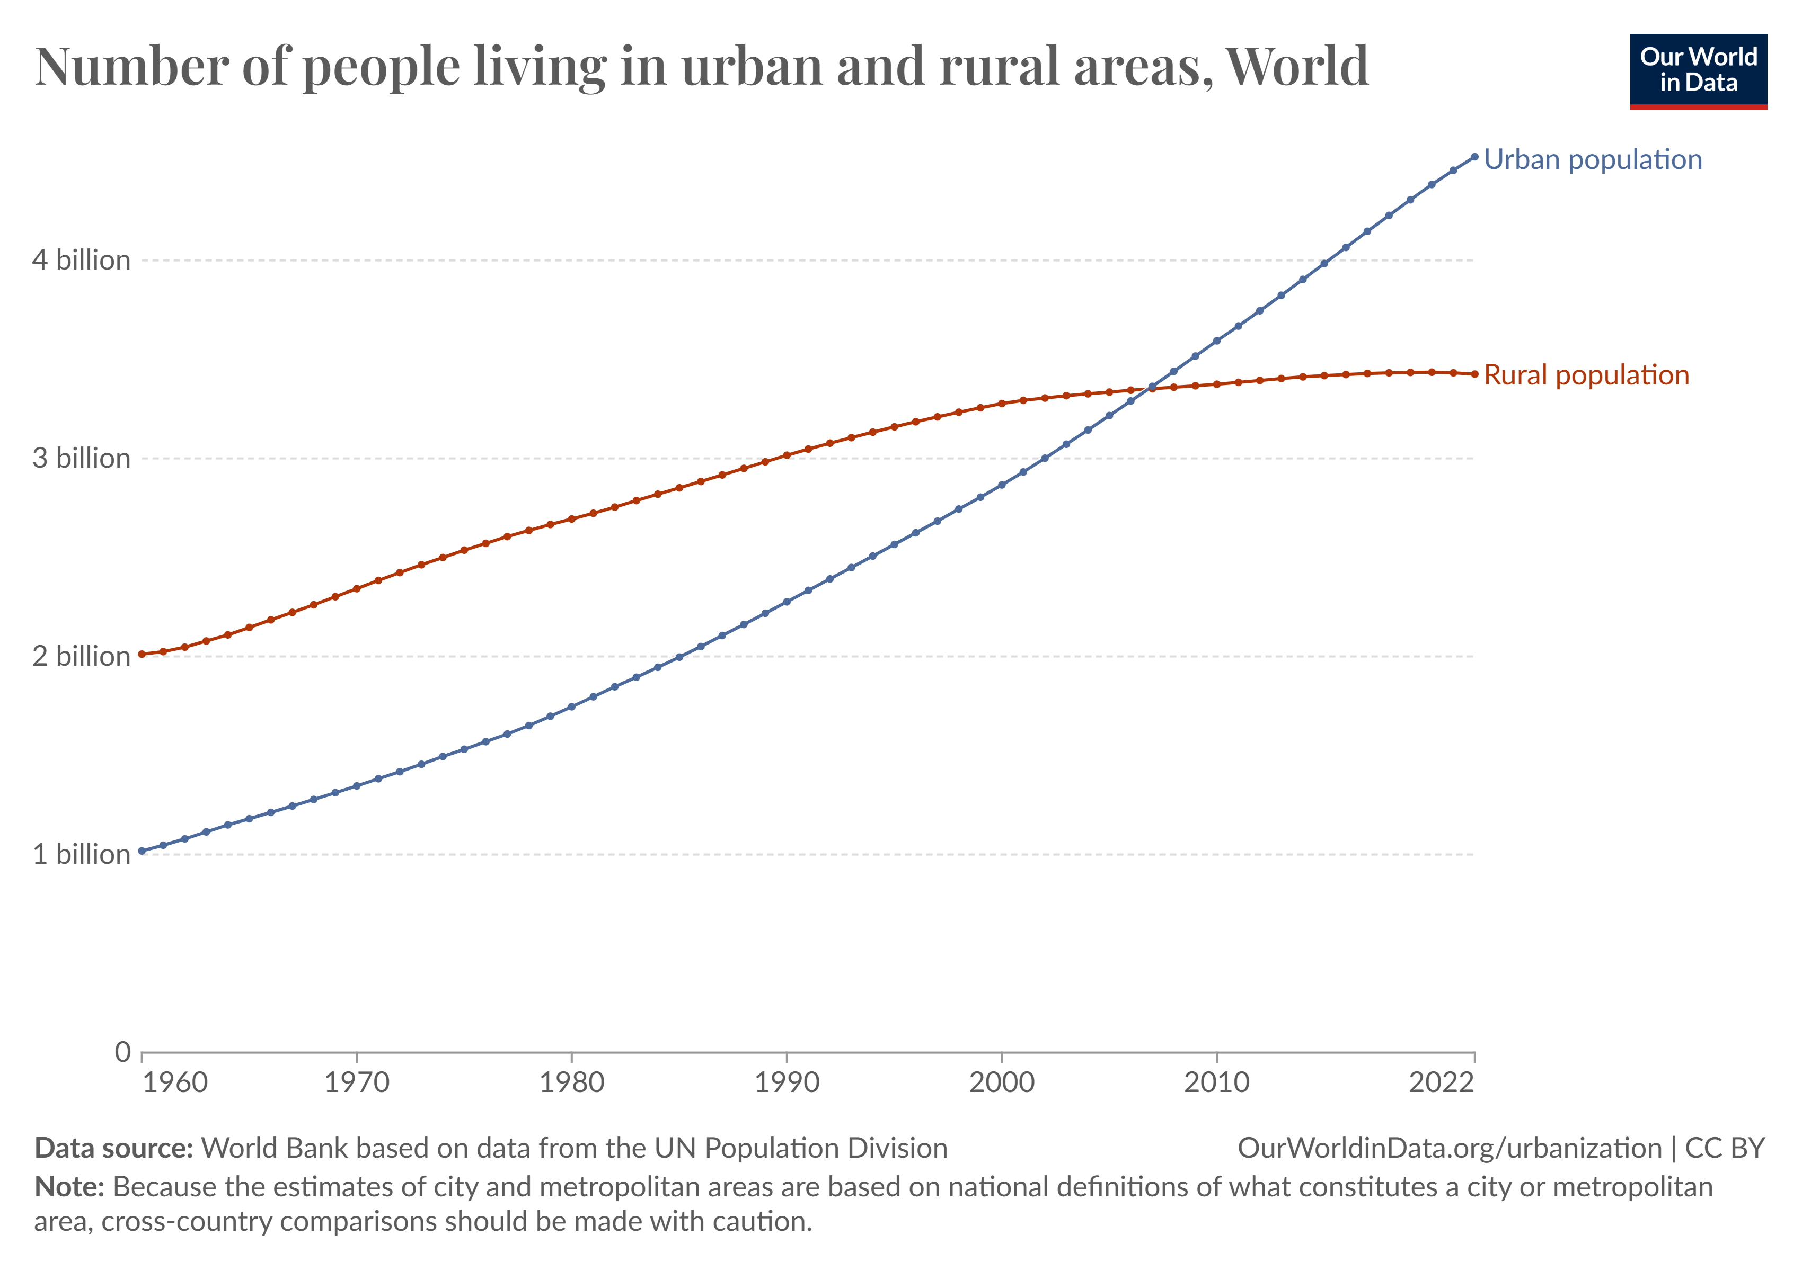
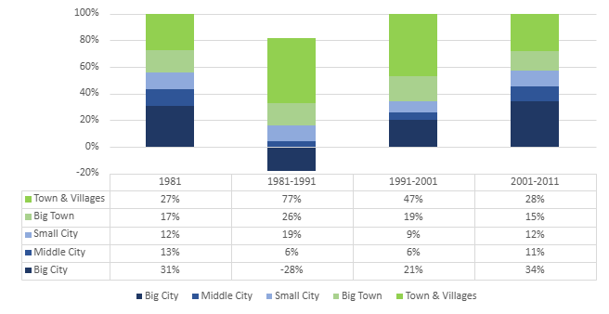
Urbanisation & Counter-urbanisation
Human settlement ←→ Social labour and distribution
City & Countryside ←→ Agriculture – Industry – Information Society – ?
‘Today, some 56% of the world’s population – 4.4 billion inhabitants – live in cities.’ (World Bank Group)
The countryside has become the preferred place of residence for an increasing number of people, especially in developing areas.
https://assets.publishing.service.gov.uk/government/uploads/system/uploads/attachment_data/file/321814/14-802-people-in-cities-numbers.pdf
Counter-urbanisation in the UK

Slide 6
Urbanisation & Counter-urbanisation
Inequality within urbanisation process
Rural IN-Flows
Rural OUT-Migration
……
Population
Funding
Technology
Knowledge
……
Depopulation
Underinvestment
Lack of services
Urbanisation
COUNTER
Urbanisation

Slide 7
Rural Inflows: A CHANCE for underdeveloped countryside
with potential risks e.g. gentrification & displacement
Monitoring the progress!

Slide 8
Big Data & ChatGPT

Slide 9
Counter-urbanisation in China
Lack of statistical data
Restrictions on rural property ownership by outsiders, who mostly rent properties from individual rural residents
no formal record
Counterurbanisation case studies in literature
Basemap: Google Map

Slide 10
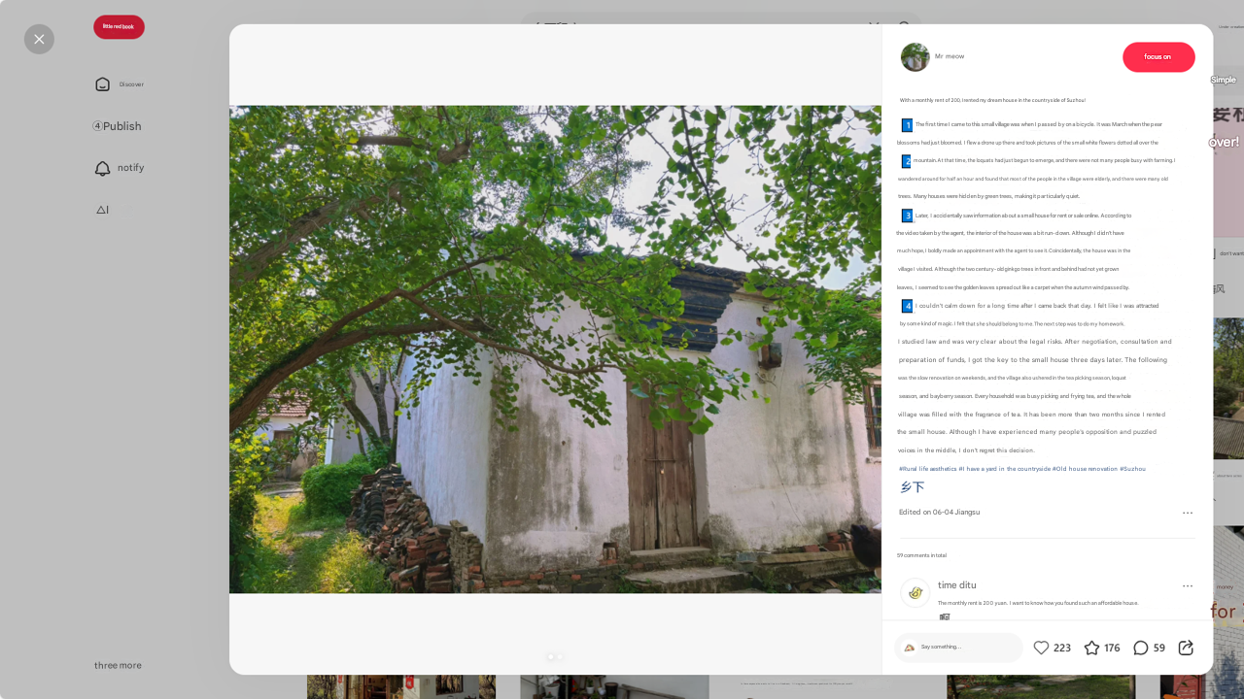
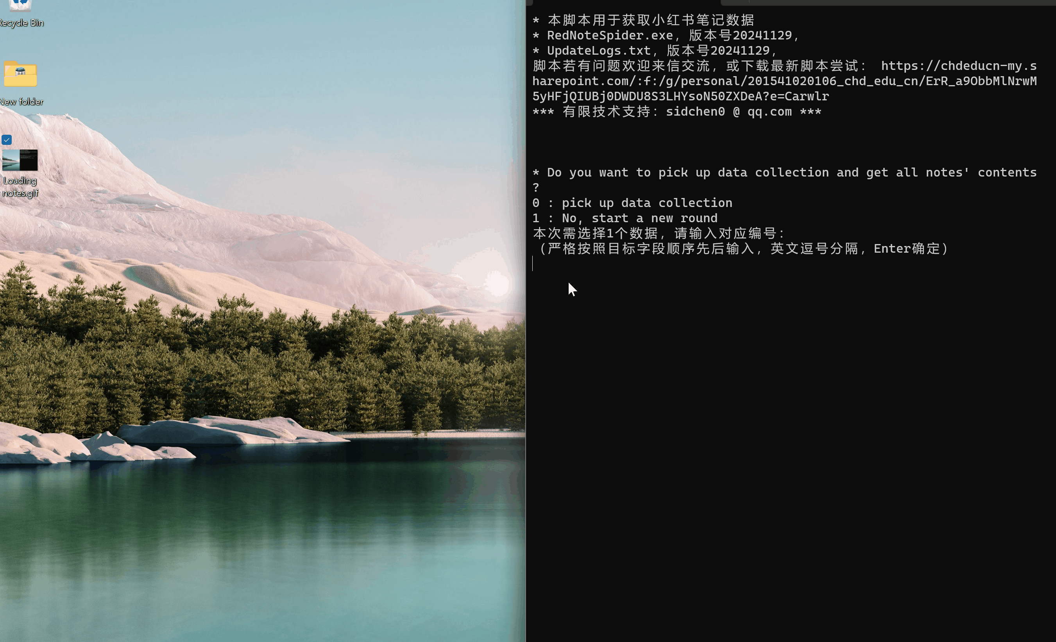
A Chinese social media platform like Instagram where specific users share their experience renting houses in rural areas or moving back to home villages
A web crawler was developed to collect all these ‘big data’
following the anti-crawler restrictions of RedNote platform
Title
Details:
Rural relocation
House renting
House refurbishment
Rural life
Difficulties
Satisfactions
……
RedNote
Post Date & IP
Comments & Replies

Slide 11
AI-based processing methods
668 relevant posts requiring at least half a month labouring coding work by HUMAN

Slide 12
AI-based processing methods
Provided 4-step scripts for Batch API in ChatGPT
4
Clicks
£
5

Slide 13
AI-based processing methods
Data Cleaning
Criteria | Method | Processed /posts | Remain /posts (668)
Not in China | Human (post IP) ChatGPT (content) | 16 (excluded) | 652
Not relevant | ChatGPT Human (occassionaly) | 189 (excluded) 35 (excluded) | 463 428
House location | Unspecified house location (e.g. ‘村子(a village)’, ‘县城 (a county)’, ‘老家(hometown)’ Unclear house location (e.g. only has town or village name) | 175 (update) | 428
Occasional corrections | Human (after ChatGPT): Blank poster type update (14) Poster type (8) Employment status (5) | 27 (updated) | 428
Rural incomers: tenants, tenants (subletting), returnees | Human (after ChatGPT): filtered by poster types merged posts by the same poster | 66 (returnees) 142 (tenants) 28 (merged into 14) | 208 (posters) 222 (posts)
Mapping rural incomers: tenants, tenants (subletting), returnees | Human (after ChatGPT): excluded posts without location information, categorised the precision of house location into three levels | 58 (excluded) 26 (Province level) 74 (City level) 50 (Village level) | 150 (posters)

Slide 14
AI-based processing methods
Geocoding
Mapping
Rough Address
Coordinates
ArcGIS Pro
Navigation provider GaoDe Map API
Create XY points

Slide 15
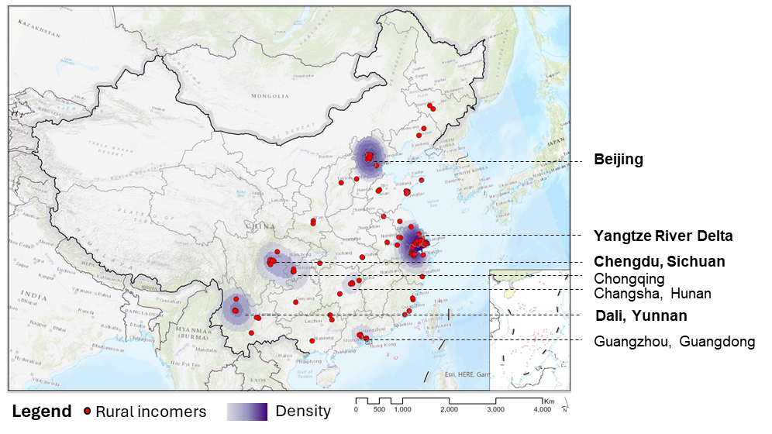
Analysis results
Counter-urbanisation hot spots and General records

Slide 16
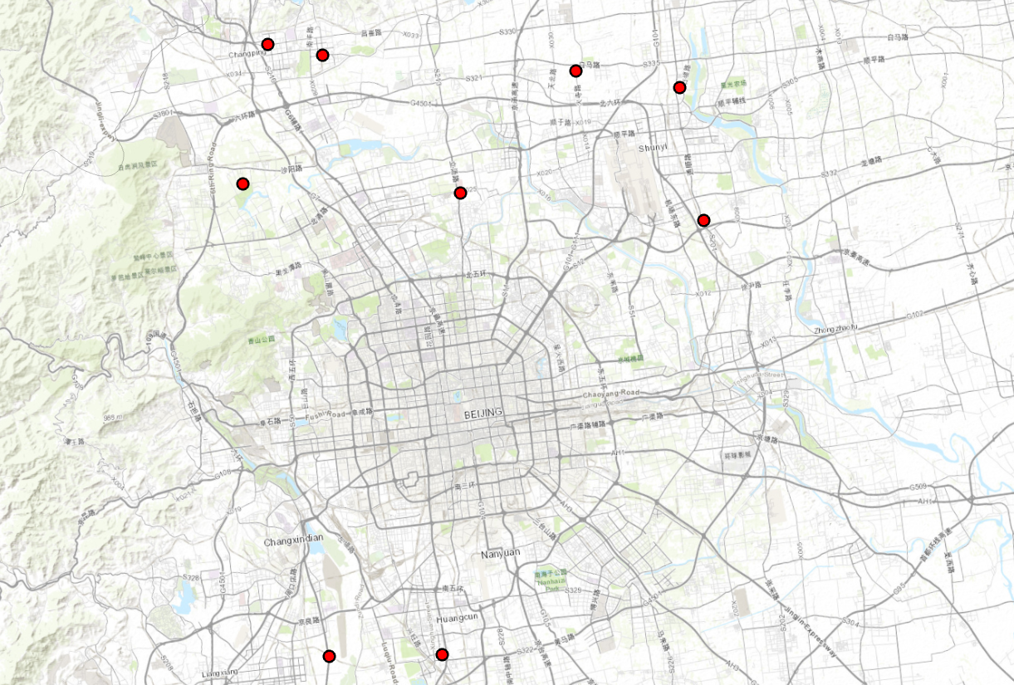
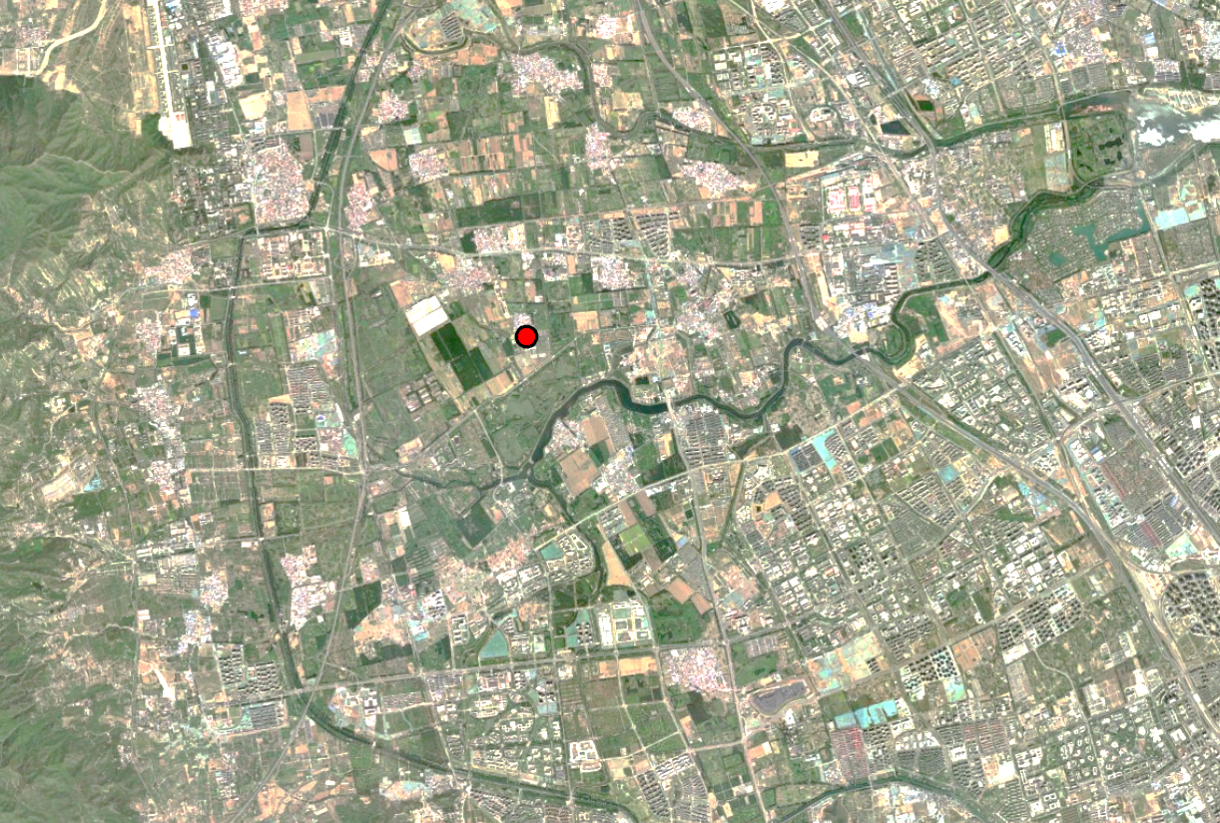
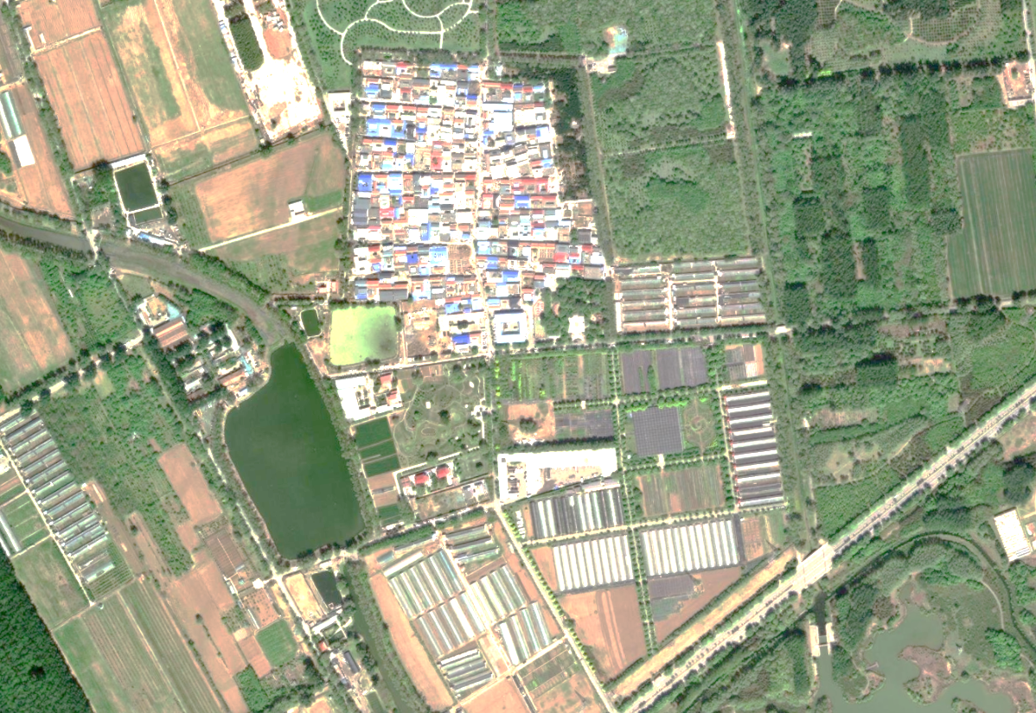
Analysis results
Specific cases
Beijing
Case ID 538
Case ID 538
The tenant had lived in a small rural house with two bedrooms for two years and commuted to work by a 40-minute drive. This individual was very satisfied with the comfortable and convenient life there. One wonderful moment was ‘enjoying sunshine at the yard, getting a cup of coffee, feeling the bleeze, listening to the birdcall or music, and petting the dog’.

Slide 17
Limitations & Advantages
Data: ethics & limitations
AI method
Credibility
Simplicity
Efficiency

Slide 18
Ethics: Public data? Depends!
Data collected
Saved:
posters’ username (all pseudonyms)
profile URL
postdate and post IP (provinces – the first-level administrative division in China, if available)
posts’ title
content and hashtags
comments replied by the poster
Extracted:
general location (such as village name or city district)
tenancy conditions
personal emotions
marriage status
employment status

Slide 19
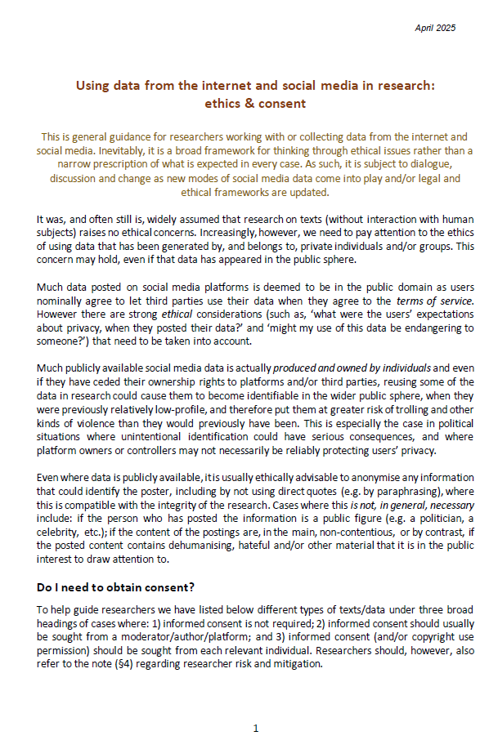
Ethics: Public data? Depends!
Data from PUBLIC domain (social media)
Ethical considerations, such as:
Only accessible to a certain group of people?
Such as only RedNote users here (require log-in to ‘crawl’ data)
What were the users’ expectations about privacy, when they posted their data?
←→ professional reviewers, politicians, etc.
Reference: LONDON SCHOOL OF ECONOMICS AND POLITICAL SCIENCE. 2025. Using data from the internet and social media in research: Ethics & consent [Online]. Available: https://info.lse.ac.uk/staff/divisions/research-and-innovation/research/Assets/Documents/PDF/ethics-Using-internet-and-Social-media-data.pdf [Accessed 05-21 2025].
Might my use of this data be endangering to someone?
←→any potential detriment to the government/party/company/group/individual – e.g. Hate speech/ death threats/ sexual harassment

Slide 20
Ethics: Anonymisation
Data from PUBLIC domain (social media)
Anonymisation
Ethical considerations
NOT personally identifiable for text quotation (rephrasing)
avoid citation of photos (traceable)

Slide 21
Data limitations: Big data
Certain group’s lens
Cannot compare quantitatively
General hot spots and specific cases
……
Not full information for each social media post
Mostly only positive and negative parts of information

Slide 22
AI-based Methods
Credibility
Simplicity
Efficiency
Question1:
whether AI methods can produce similar results without the demanding process by human?
Question2:
whether the time savings and simplicity of using AI methods worth the effort?

Slide 23
AI-based Methods
Occasional Cleaning
Credibility
Data Cleaning
Thematical Cleaning
85%
Raw ChatGPT
Outputs
…

Slide 24
AI-based Methods
Conclusion
Efficiency
10 min
For raw result
Cleaning
50%
Human work
…

Slide 25
AI-based Methods
Well packaged .EXE
Simplicity
5
£
Provided Scripts
4
Clicks
…

Slide 26
All comments welcomed!
LINK ME
General enquiry, Cooperation,
Expanding network, etc.
Jian Chen
J.Chen115@ncl.ac.uk
Year 2, PhD in Agriculture and Rural Development
Main Project:
How Can Counter-urbanisation Support Rural Community? A Comparative Case Study
Between Scotland and China

