Slide 1
Effectiveness of Public-Private Sector Collaboration in Regenerating Historic Industrial Brownfield Sites
Author: Alexander Petrov (PhD candidate, year 2) Supervisory team: Dr Olivier Sykes, Dr Tatiana Moreira de Souza

Slide 2
Professional route:
Academia
( )
Industry
Year
2005
2010
2015
2020
2025

Slide 3
Research question:
How do negotiation dynamics between public and private actors in the regeneration of historic industrial brownfield sites vary across different real estate markets, with a focus on the negotiation actor-level categories of Trust, Risk, Interest, and Power?

Slide 4
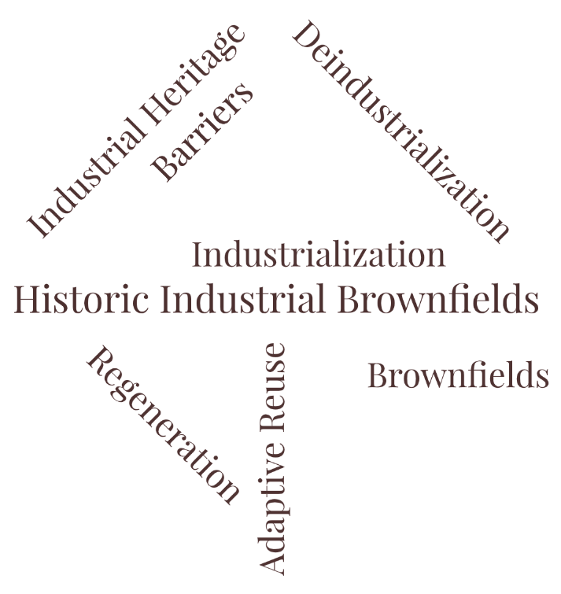
Regeneration of Historic Industrial Brownfields
- disused for original purposes tangible remains of past industrial activities, that might be under protection due to their cultural and historic value and that have the potential to be repurposed to new functions

Slide 5
Negotiation dynamics between public and private sectors during Preapplication and Application stages are shaped by market buoyancy and expressed through four key categories: Trust, Risk, Interest, and Power (TRIP)
Negotiations
Public Sector
Private Sector
Regeneration
T
r
u
s
t
P
o
w
e
r
R
i
s
k
I
n
t
e
r
e
s
t

Slide 6
Negotiations
Negotiations
Public Sector
Private Sector
Regeneration
T
r
u
s
t
P
o
w
e
r
R
i
s
k
I
n
t
e
r
e
s
t
Position

Slide 7
Negotiations
Negotiations
Public Sector
Private Sector
Regeneration
T
r
u
s
t
P
o
w
e
r
R
i
s
k
I
n
t
e
r
e
s
t
TRIP = Position

Slide 8
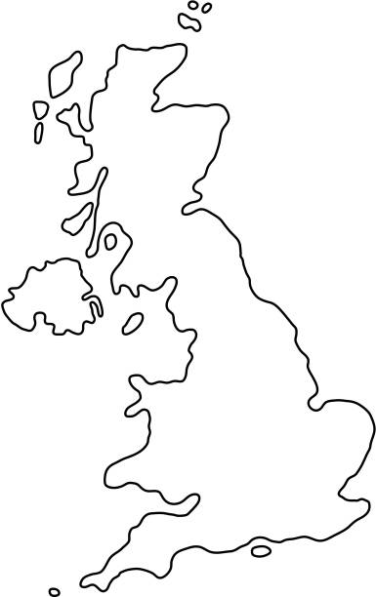
Methodology
Qualitative research:
Official documents analysis
Case studies in:
London – high market buoyancy
Liverpool - low market buoyancy
Semi-structured interviews with key stakeholders from both public and private sectors
Liverpool
1
2
3
Current policies analysis
Interviews with private sector stakeholders
Interviews with public sector stakeholders
London

Slide 9
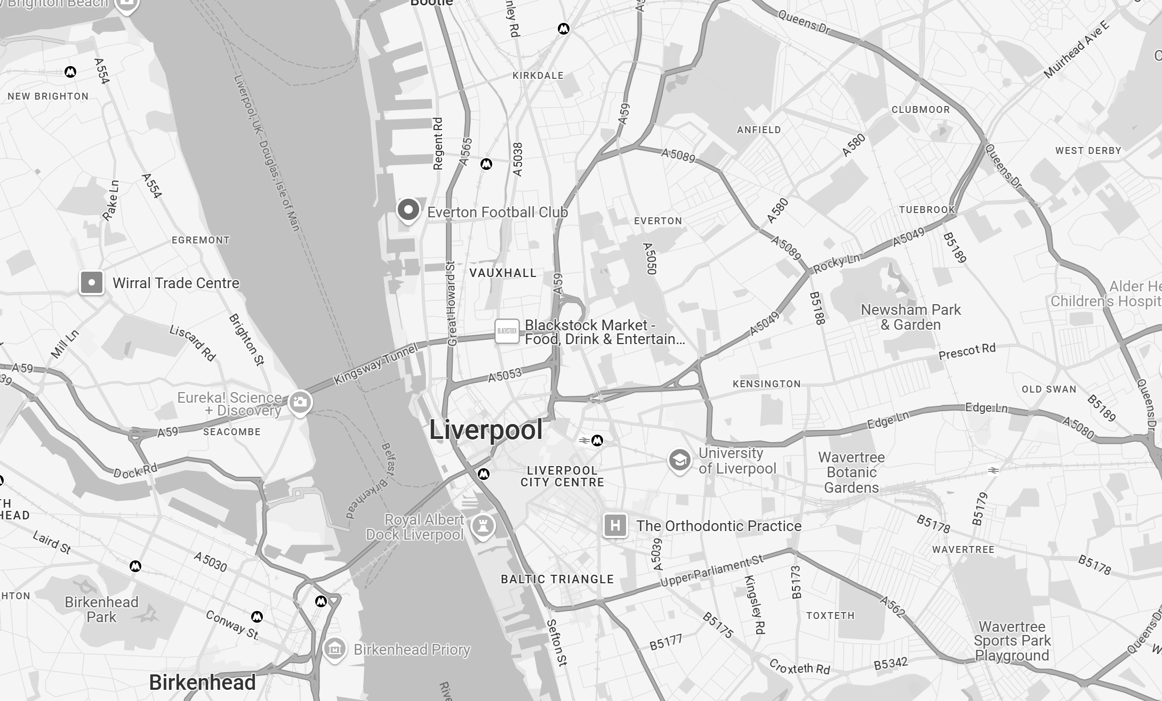
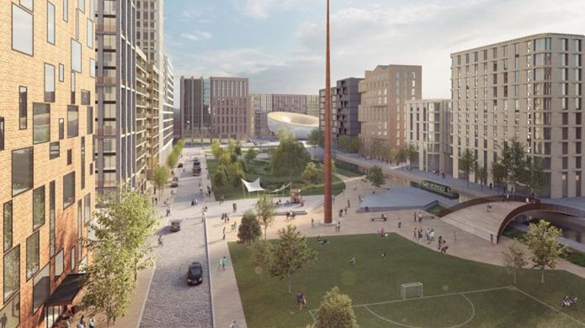
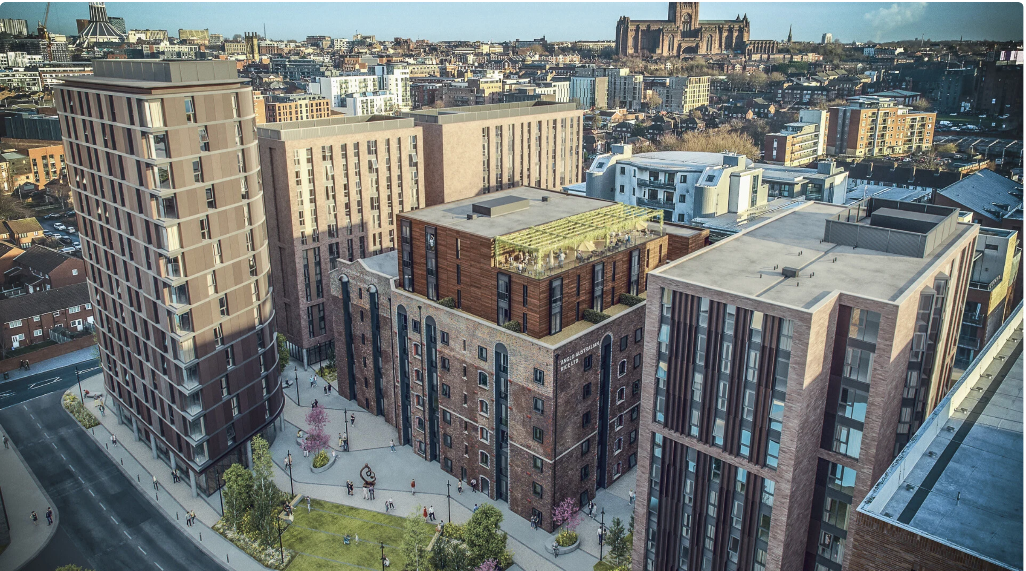
Liverpool Waters
Heap Mills

Slide 10
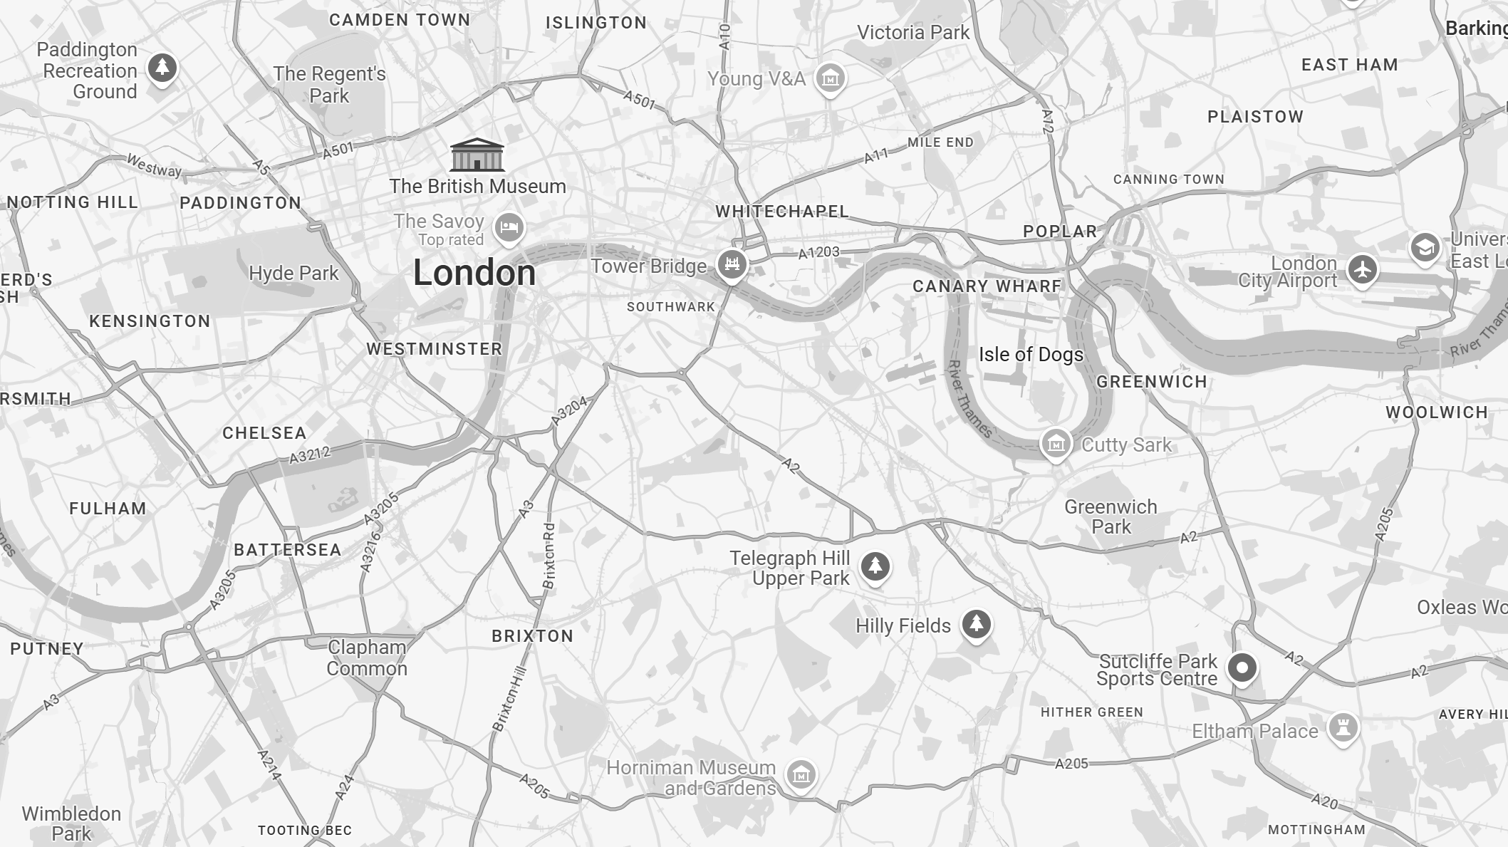
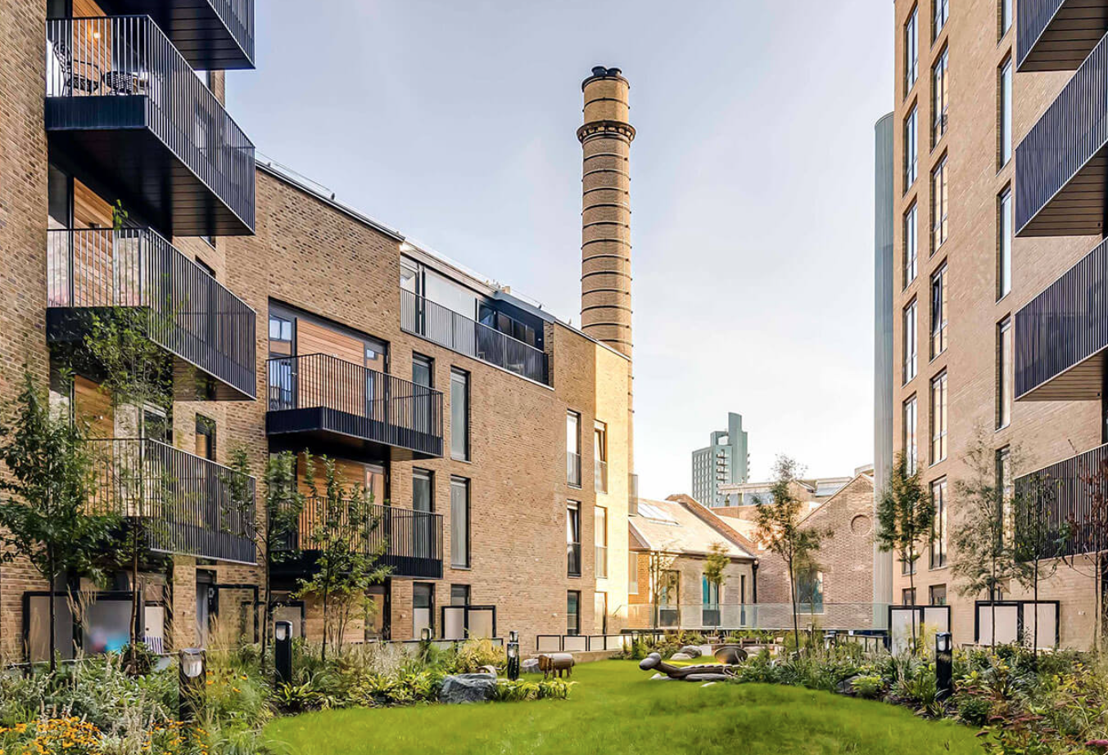
Silvertown
The Ram Quarter

Slide 11
Data Сollection. Questionnaire Highlights
Section 1: Project and respondent background
Section 2: Core negotiation categories (Trust, Risk, Interest, Power)
Each assessed via:
Self-assessment
e.g., What were the main risks you considered during the negotiation?
Perception of the other side
e.g., What risks do you think the other party was concerned about?
Each rated on a 1 (Very low) → 5 (Very high) scale
Section 3: Reflections
Satisfaction with negotiation outcome
Confidence in understanding how the other side viewed key negotiation categories
Suggestions for improving mutual understanding

Slide 12
Analytical Approach
Qualitative Analysis:
How actors interpret each concept in practice
Typical sources of misunderstanding
Suggestions for improving negotiation outcomes
Quantitative Analysis:
Comparative Perceptions — Public vs Private
Market Context Effects
Cross-Perception Gaps — Self vs Other vs “Actual”
Outcome Satisfaction — Which categories predict satisfaction
Guess vs Reality: Accuracy of Understanding the Opposing View

Slide 13
Next Steps:
Receiving your feedback
Finalizing participant recruitment
Beginning interviews this summer
Aiming for preliminary analysis by autumn 2025

Slide 14
Contact details:
www.linkedin.com/in/aap777
Alexander.Petrov@liverpool.ac.uk

Slide 15
Case studies:
Project | Developer | City | Size (ha) | № of resi units | Type of industry | Listed heritage | Completion dates | Real estate sectors
Central Docks & Clarence Docks | Peel | Liverpool | ≈25 | 6 800 | Shipping, Warehousing | Grade II | 2034 | residential, commercial, leisure, and retail
Silvertown | Lendlease | London | ≈25 | 6 500 | Shipping, Warehousing and others | Grade II | 2032 | residential, commercial, and cultural sectors
Heap Mills | Legacie | Liverpool | n/a | 620 | Food Manufacturing | Grade II | 2025 | residential, leisure, and commercial
The Ram Quarte | Greenland Group | London | 3.2 | 713 | Brewery | Grade II | 2027 | residential, retail, leisure

