Slide 1
A Capital-Based Assessment of the Livelihood Vulnerability of Syrian Refugees
Lale Görgülü & Menelaos Gkartzios
Affiliation: İzmir Institute of Technology
Email: lalegorgulu@iyte.edu.tr menelaosgkartzios@iyte.edu.tr

Slide 2
Content of the Presentation
Introduction
Purpose and Scope of the Study
Data and Methods
3.1. Study Area
Findings
Discussion and Conclusion
References

Slide 3
Introduction
Refugee livelihoods have attracted attention because of their connection to global changes in climate, economics and society. Human disasters and mass migrations highlight the vulnerability of refugees' livelihoods. The 2030 United Nations Sustainable Development Goals adopt a livelihoods approach that emphasises people's abilities to adapt and their assets. A sustainable livelihood can preserve resources and capital assets in challenging environments.
This study derived from a part of the author's master's thesis entitled [Livelihood Vulnerability Assessment of Syrian Refugees in Basmane, İzmir].

Slide 4
Introduction
According to the United Nations High Commissioner for Refugees (UNHCR), Türkiye has approximately 3 million Syrian refugees, making it the world's largest host country (UNHCR, 2025). This is contrary to the principles of United Nations Sustainable Development Goal 10 (i.e., Reducing inequality within and among countries) and the related item 10.7.4 (i.e., Proportion of the population who are refugees by country of origin). It also leads to an imbalance in the distribution and reproduction of livelihood capitals and a deterioration in the interrelationship between capitals. Consequently, threats to livelihood sustainability result in livelihood vulnerability.
This migration from Syria defined by the Syrian Crisis by the United Nations High Commissioner for Refugees (UNHCR) due to its rapidity and scale.

Slide 5
Purpose and Scope of the Study
The study aims to assess the livelihood vulnerability of Syrian refugees based on a capital framework by creating a Livelihood Vulnerability Index (LVI) and LVI-IPCC vulnerability dimensions (exposure, vulnerability and adaptive capacity) determined by Intergovernmental Panel on Climate Change (IPCC) to capture socio-economic problems, the presence or absence of diverse forms of capitals, and problems of organisation or balance among these capital types.
The study contributes to the existing literature by addressing an existing gap in research on livelihood vulnerability assessments at the household level for Syrian refugees in Türkiye.

Slide 6
Purpose and Scope of the Study
The research questions are as following:
What is the level of LVI of Syrian refugees, and what type of capitals make it more or less vulnerable?
What dimension of vulnerability is more effective on vulnerability?
How should planning strategies regulate the distribution and reproduction of capitals in refugee-dense areas?

Slide 7
Data and Methods
A mixed method was employed by including both qualitative and quantitative analyses to maximise the reliability of the research.
The capital-based livelihood approach is based on five types of capital: human, social, financial, physical and natural.
Syrian refugees were selected as a vulnerable group.
LVI results will be explored through the analysis of qualitative data obtained through interviews with both Syrian refugees and NGOs working with refugees.

Slide 8
Data and Methods
The capital-based livelihood vulnerability approach allows the incorporation of context-specific and community-specific variables associated with Syrian refugees who are defined as a vulnerable group.
Household Survey
In-depth Interwiew with both Syrian Refugees and NGOs
Creating LVI and LVI-IPCC

Slide 9
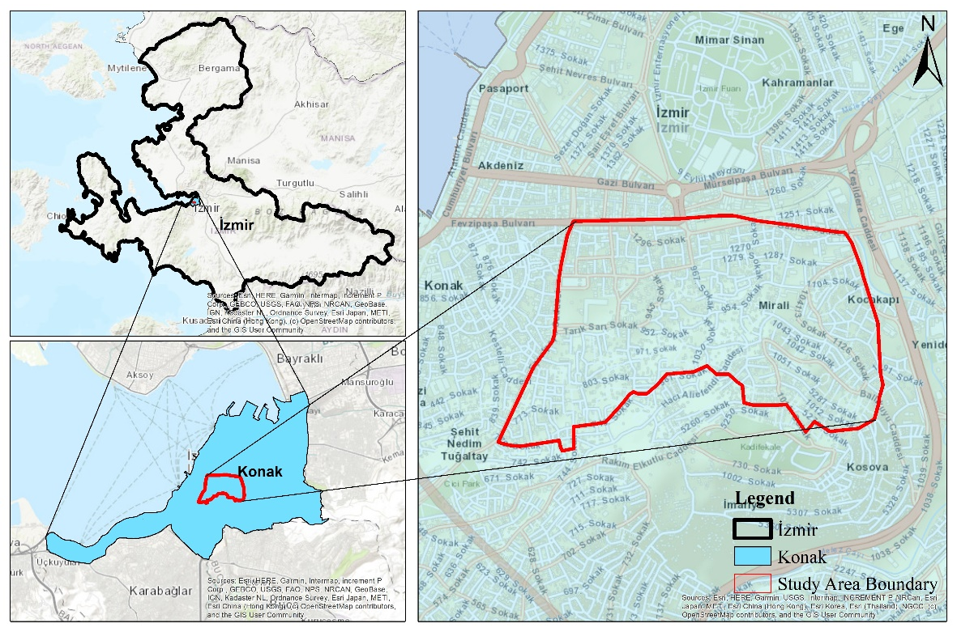
Data and Methods → Study Area
The Basmane region of the Konak district of the İzmir province was selected as the study area within the scope of this study (Figure 1). İzmir's strategic location as a transit point to Europe, particularly within the European Union, has attracted migrants (Vesek and Suğur, 2021).
Figure 1: Location of the Study Area

Slide 10
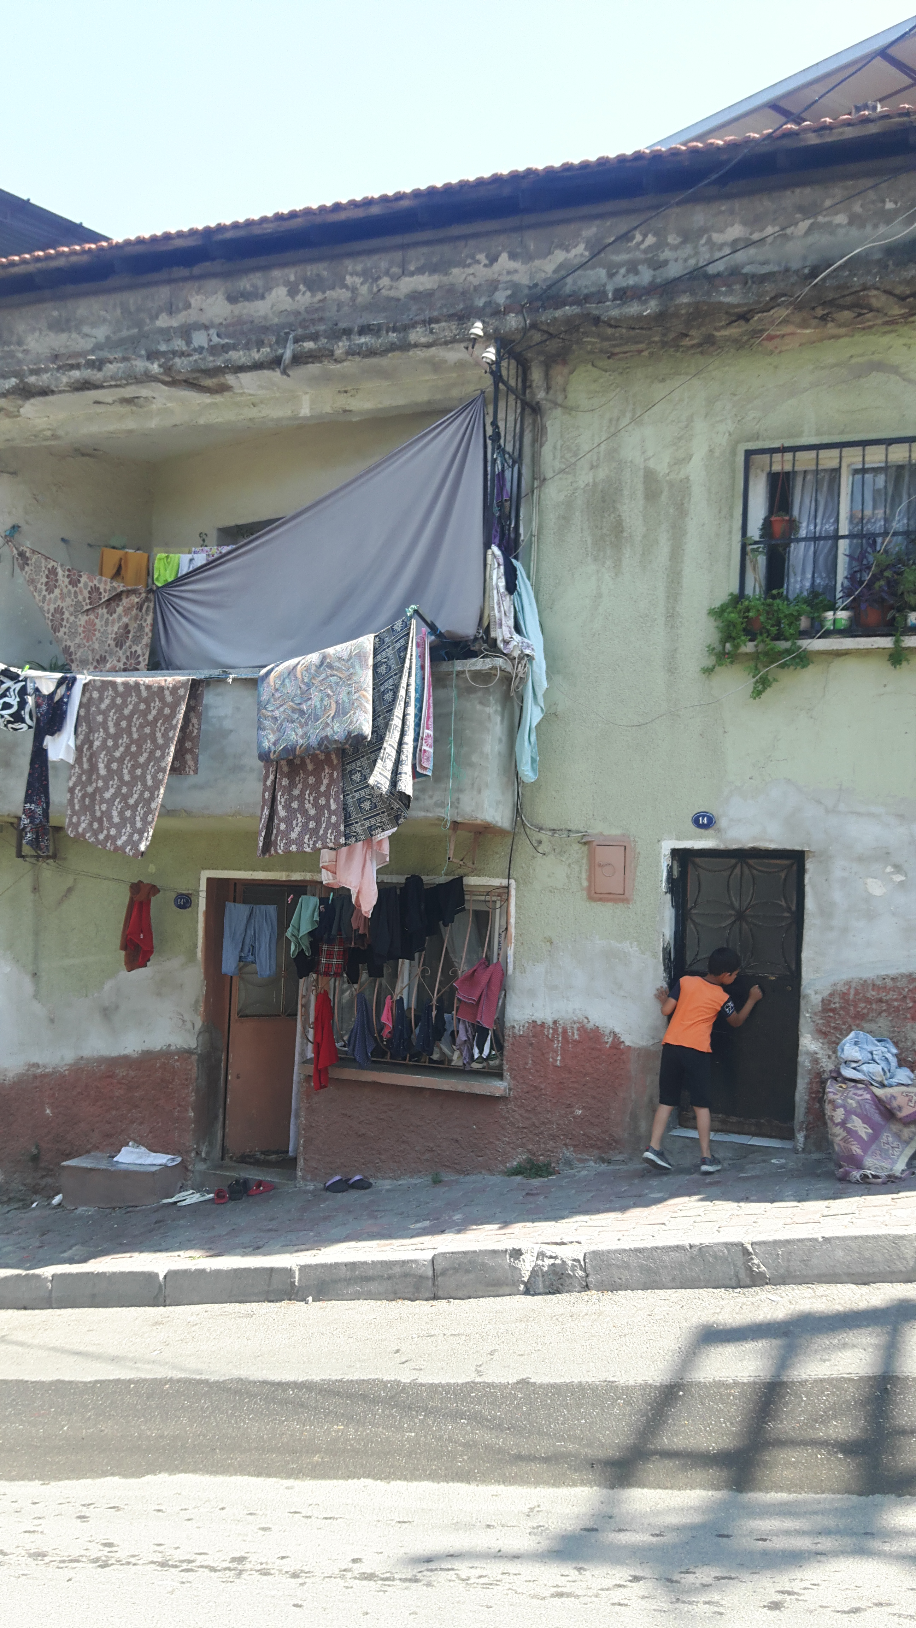
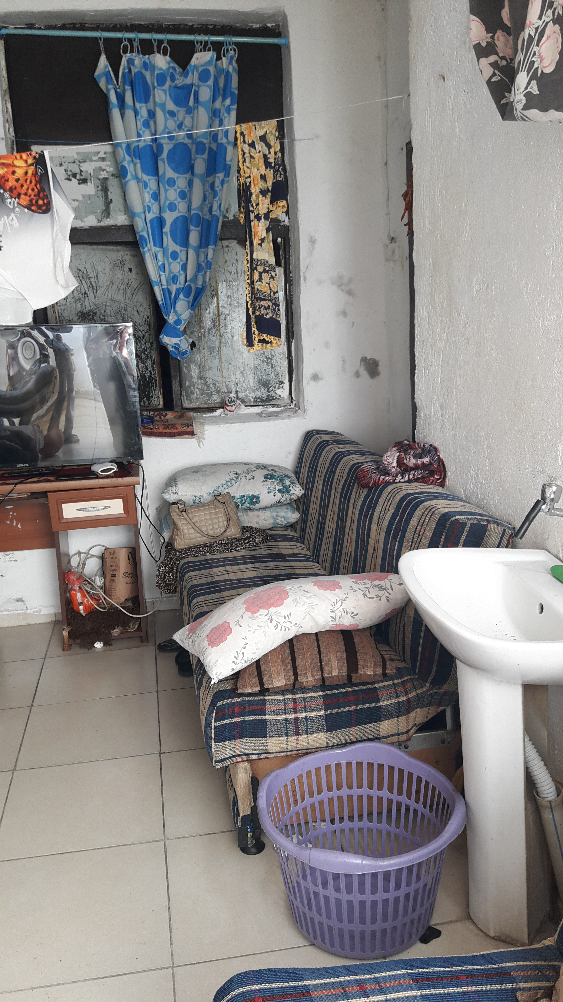
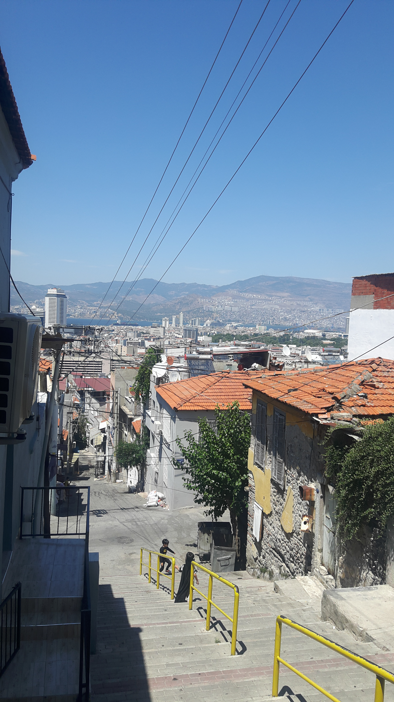
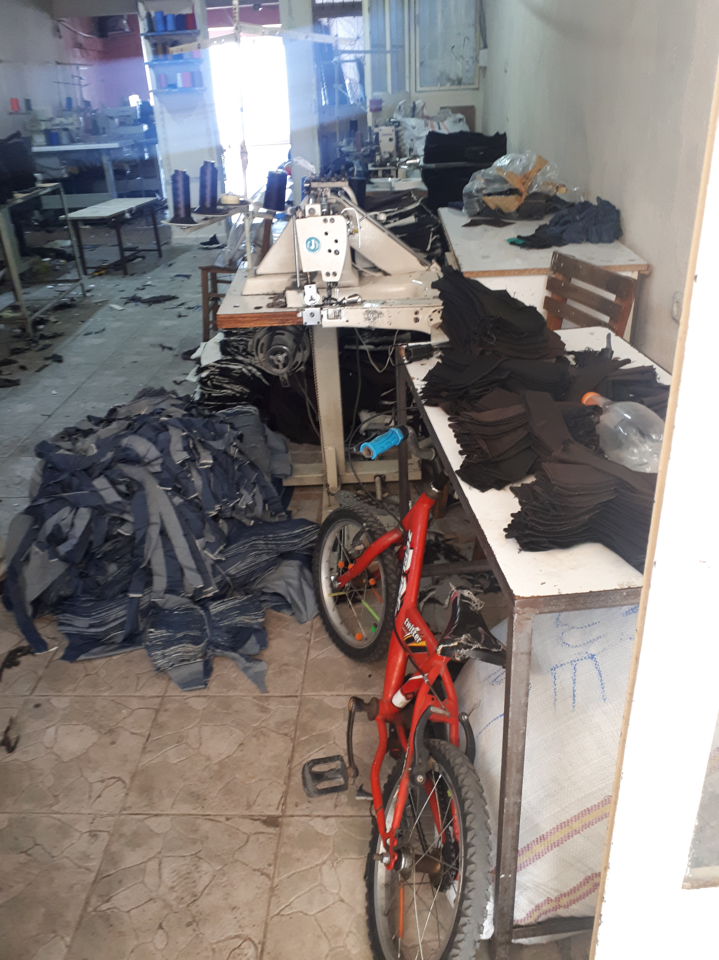
Data and Methods → Study Area
The study area, which is already a slum, has experienced an increase in inequalities and scarcity of resources due to an imbalance in the types of capital belonging to the host community and vulnerable groups including Syrian refugees, and the sharing of capitals among them.

Slide 11
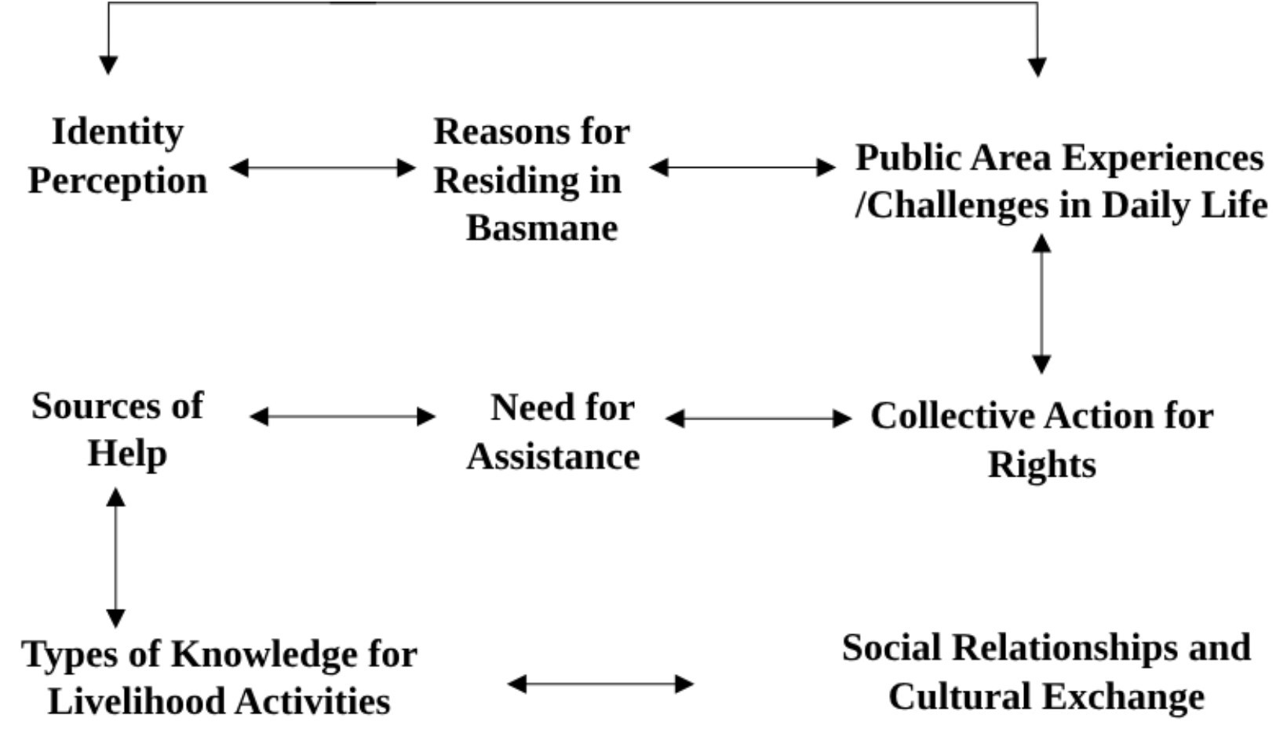
Findings
Conceptual Framework of Interview with NGOs
Conceptual Framework of Interview with Syrian Refugees

Slide 12
Findings
Livelihood Capitals | Exposure | Sensitivity |  | Adaptive Capacity
Human Capital | 0.44 |  | 0.21 | 0.41
Physical Capital | 0.65 |  | 0.32 | 0.48
Financial Capital | 0.58 |  | 0.55 | 0.39
Social Capital | 0.23 |  |  | 0.51
Natural Capital | 0.48 |  |  | 0.22
Overall | 0.50 |  | 0.31 | 0.44

Slide 13
Findings
Livelihood Capitals | LVI-Capital based* | LVI-IPCC
Human Capital | 0.39 | 0.01
Physical Capital | 0.50 | 0.06
Financial Capital | 0.59 | 0.10
Social Capital | 0.46 | -0.29
Natural Capital | 0.51 | 0.26
Overall | 0.48 | 0.02
Reference range* | 0 < LVI < 0.60
Reference range | -1 < LVI-IPCC < 1

Slide 14
Discussion and Conclusion
The findings show that Syrian refugees have highly vulnerable level of LVI, with a value of 0.48, and their vulnerability based on financial capital is the highest, while human capital is the least. Also, they are Overall LVI-IPCC is 0.02, and it means moderate livelihood vulnerability. These results point out high livelihood vulnerability in the study area compared to similar index studies in the literature (Pandey et al. 2017; Zhang and Fang, 2020; Adu et al., 2018).
Considering vulnerability dimensions, exposure is more effective contributing factor to livelihood vulnerability. Adaptive capacity of Syrian refugees is weak due to mainly indicators' values of housing ownership, education, livelihood strategies, socio-economic status and minority/language.

Slide 15
Discussion and Conclusion
In terms of capital specific assessment, physical and natural capital reflect high exposure level of Syrian refugees, while social, human and financial capitals reflect Syrians' capabilities and sensitivities.
NGOs emphasised that financial and social capital are the most effective capitals for livelihood vulnerability of Syrian refugees.
According to interviews and field observations, they have to take risks due to lack of capital and are highly vulnerable to physical hazards. Urban planning strategies should take a referans context and community spesific problems in the study area to sustain balance among livelihood capital types.

Slide 16
References
Zhang, Chenjia and Fang, Yiping (2020) Application of capital-based approach in the measurement of livelihood sustainability: A case study from the Koshi River basin community in Nepal. Ecological Indicators, 116, 106474. https://doi.org/10.1016/j.ecolind.2020.106474
United Nations High Commissioner for Refugees (UNHCR) (2025) Syria situation. Available at: https://data.unhcr.org/en/situations/syria (Accessed: 12 February 2025).
Pandey, Rajiv, Jha, Shashidhar K., Alatalo, Juha M., Archie, Kelli M. and Gupta, Ajay K. (2017) Sustainable livelihood framework-based indicators for assessing climate change vulnerability and adaptation for Himalayan communities. Ecological Indicators, 79, pp. 338–346. https://doi.org/10.1016/j.ecolind.2017.03.047
Adu, Derick T., John K. M. Kuwornu, Henry Anim-Somuah and Nophea Sasaki (2018) Application of livelihood vulnerability index in assessing smallholder maize farming households' vulnerability to climate change in Brong-Ahafo region of Ghana. The Kasetsart Journal Social Sciences 39, 22-32. https://doi.org/10.1016/J.KJSS.2017.06.009
Vesek, Sait and Suğur, Nadir (2021) Urban life experiences of Syrians in Turkey: The case of Gaziantep and Izmir (in Turkish). İnsan ve Toplum, 11 (1), 169–207. https://doi.org/10.12658/M0512

Slide 17
Thank you!

