Slide 1
Which development role for civic organisations? Insights from Sicily, Southern Italy
Laura Saija (Università degli Studi di Catania)
Co-authors:
Giusy Pappalardo (Universitat Autonoma Barcelona)
Giulia Li Destri Nicosia (Università di Roma La Sapienza)

Slide 2
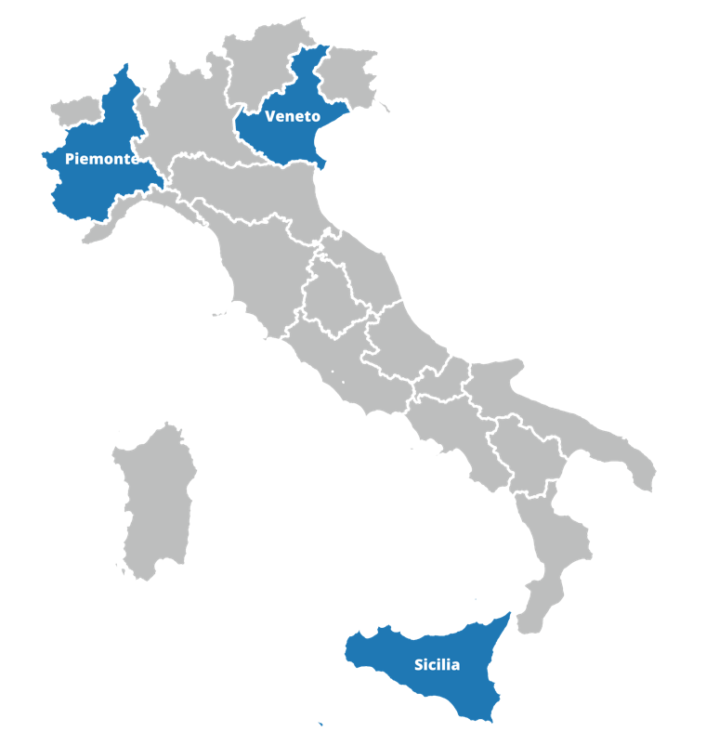
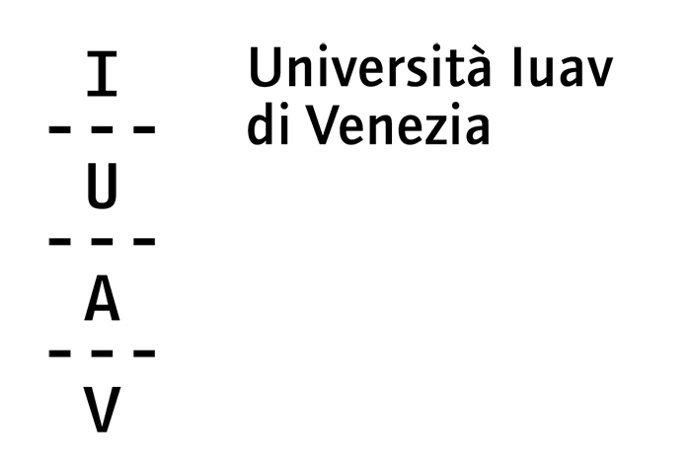
PRIN PNRR 2022 RESISTING - Reconnecting Social Innovation with Institutions in Urban Planning
How do ‘social innovators’ impact institutions?

Slide 3
ROUNDTABLE 06 – WED 4:30-6PM – E1-08
LEARNING THROUGH INSTITUTING. IMPACTS OF CIVIC ACTION ON INSTITUTIONS AND THE POTENTIAL FOR THE PRODUCTION OF PUBLIC VALUE IN PLANNING
Organizers
Elena Ostanel, University Iuav of Venice Giusy Pappalardo, Universitat Autónoma de Barcelona Nadia Caruso, Politecnico di Torino
Contributors
Pablo Sendra, The Bartlett School of Planning Laura Saija, University of Catania Laura Lieto, University of Naples Alessandro Balducci, Politecnico di Milano Massimo Bricocoli, Politecnico di Milano Loris Servillo, Politecnico di Torino Giulia Li Destri Nicosia, University of Catania Chandrima Mukhopadhyay, UN-Habitat India Eva Álvarez de Andrés, Universidad Politécnica de Madrid Angela Barbanente, Politecnico di Bari

Slide 4
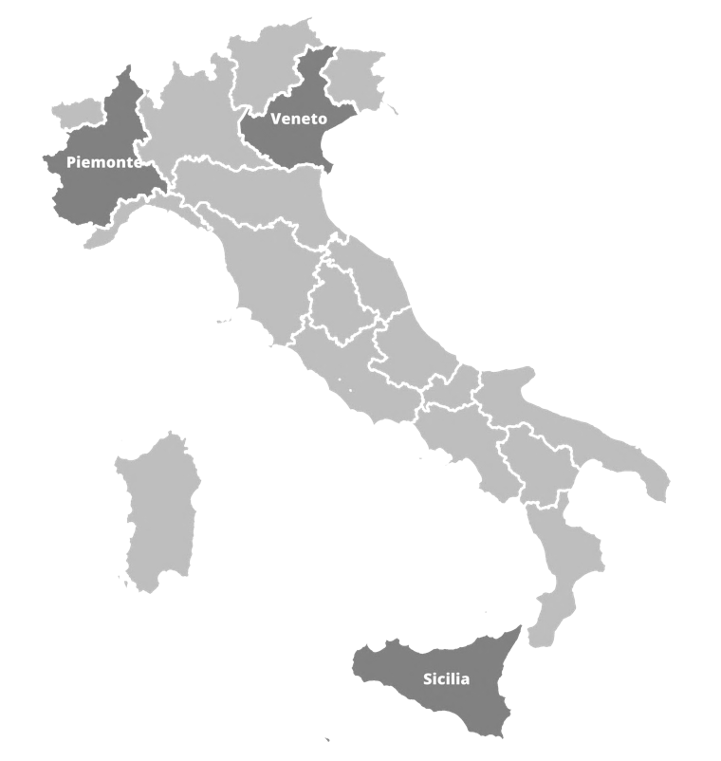
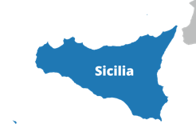
PRIN PNRR 2022 RESISTING - Reconnecting Social Innovation with Institutions in Urban Planning
How do ‘social innovators’ impact institutions?

Slide 5
«…in four decades of planning we went from
a credo in a centralized, benevolent state which was assumed to have a far-sighted and comprehensive vision of the public good
to the present welter of a triumphant market economy driven by global competition, an emasculated national state in retreat, a plethora of social movements vying for our attention and support, and a burgeoning sector of voluntary organizations competing fiercely among themselves for private and public resources that are becoming ever more scarce»
Friedmann J., 1998

Slide 6
RELATIONSHIP?
PUBLIC AUTHORITIES
CIVIL SOCIETY
dialogue
Collaboration
Conflict
Resistance
Autonomy
Guerrilla Planning
(Goodman 1971)
Antagonistic autonomy
(Hardt, Negri 2009)
Communicative Planning
(Innes 1995)
Collaborative co-production
(Ostrom 1990, Albrecht 2013)
Advocacy planning
(Davidoff 1962)
Collaborative Planning
(Healey 1997)
Agonistic co-production
(Purcell 2008, Miraftab 2009, Watson 2014)
Resistance and economic self-organization
(origins of CDCs and CLTs, Gibson-Graham, etc.)

Slide 7
RELATIONSHIP?
CIVIL SOCIETY
PUBLIC AUTHORITIES
CIVIL SOCIETY
“Recognizing that civil society is contested territory in both theory and reality is the first step in rescuing a potentially powerful set of ideas from the conceptual confusion that threatens to submerge them”
(Friedmann 2011)

Slide 8
What are the traits of a civic organization that can really ‘make a difference’ in a certain locality (i.e. has a meaningful and positive impact on development trajectories)?

Slide 9
We are in search for the
INSTITUTING CIVICS
Theory
Practice

Slide 10
We are in search for the
INSTITUTING CIVICS
Theory
Practice

Slide 11
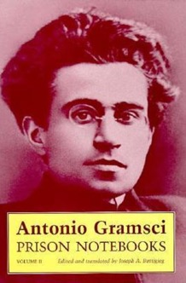
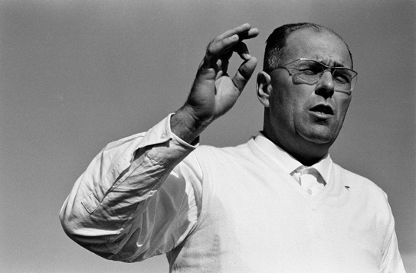
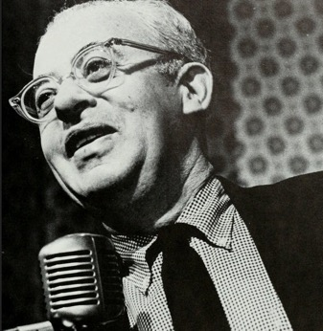
Theoretical framework
Civil society is where counter-hegemony can be culturally developed in order to subvert dominant power structures (norms and institutions)
The need to engage powerless people in a process of learning through experience, action and change…
… some call it ‘organizing’
Dolci
(1924-97)
… we need to search for INSTITUTING FORCES =
political ‘forces’ not merely contesting what exists…
but seeking to generate new forms of collective life capable of renewing institutions through shared practices and democratic processes
2023
Alinsky
(1909-1982)

Slide 12
We are in search for the
INSTITUTING CIVICS
Theory
Practice

Slide 13
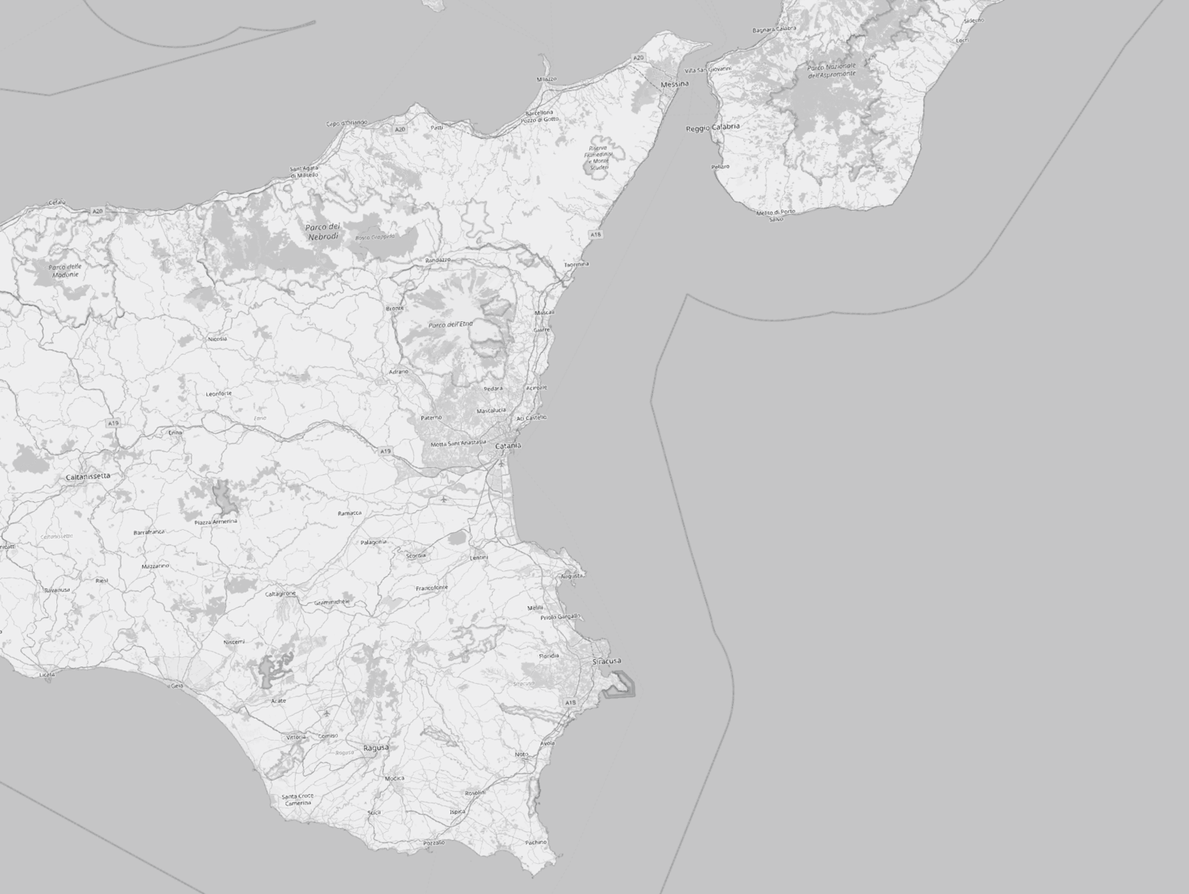
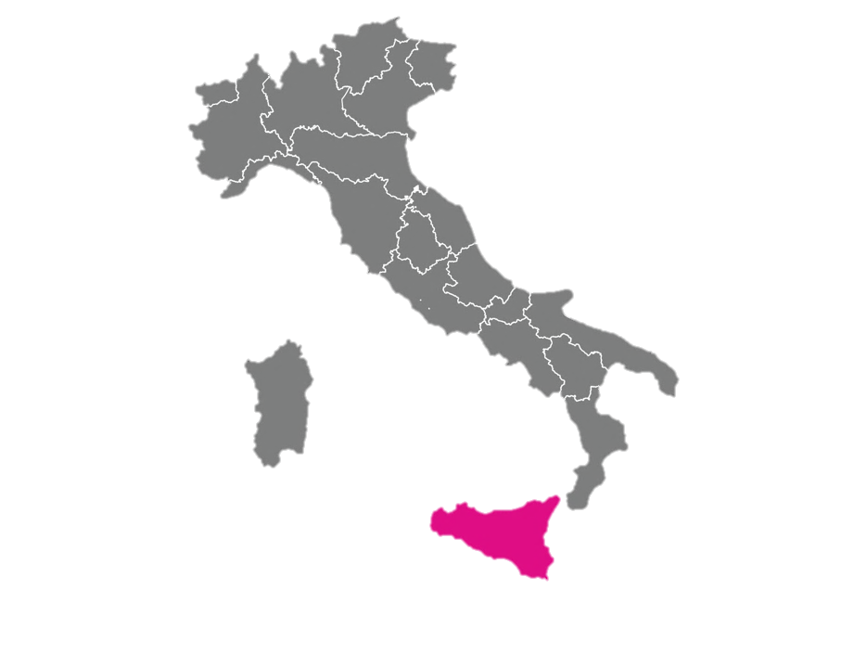
LabPEAT
Laboratory forspatial Environmental Planning and Ecological Design

Slide 14
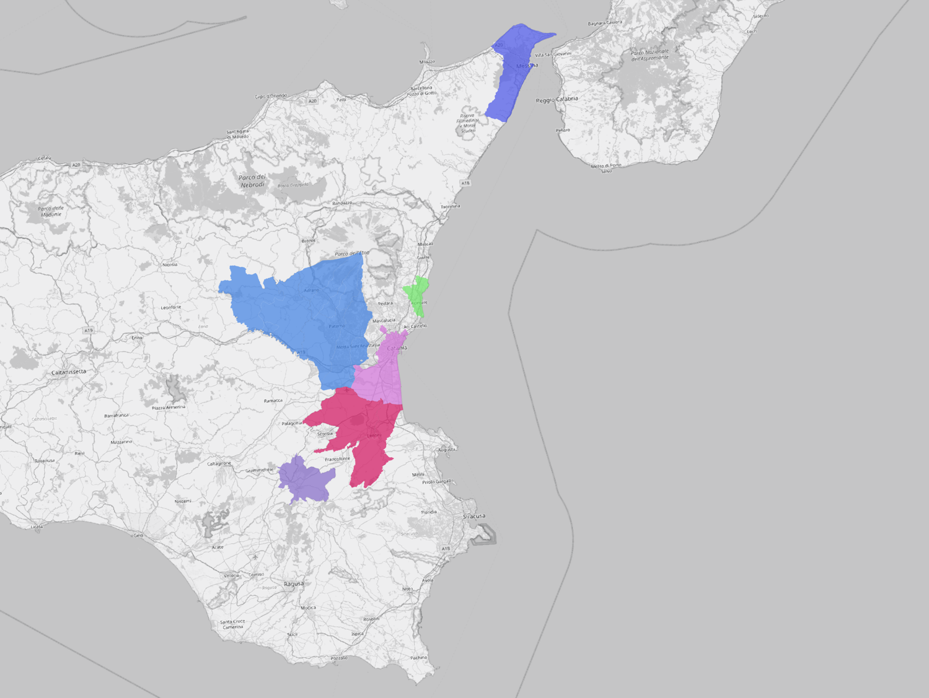
2004-2025 LabPEAT’s action-research partnerships
Messina
Valle del Simeto
Acireale
Catania
Lentini
Vizzini

Slide 15
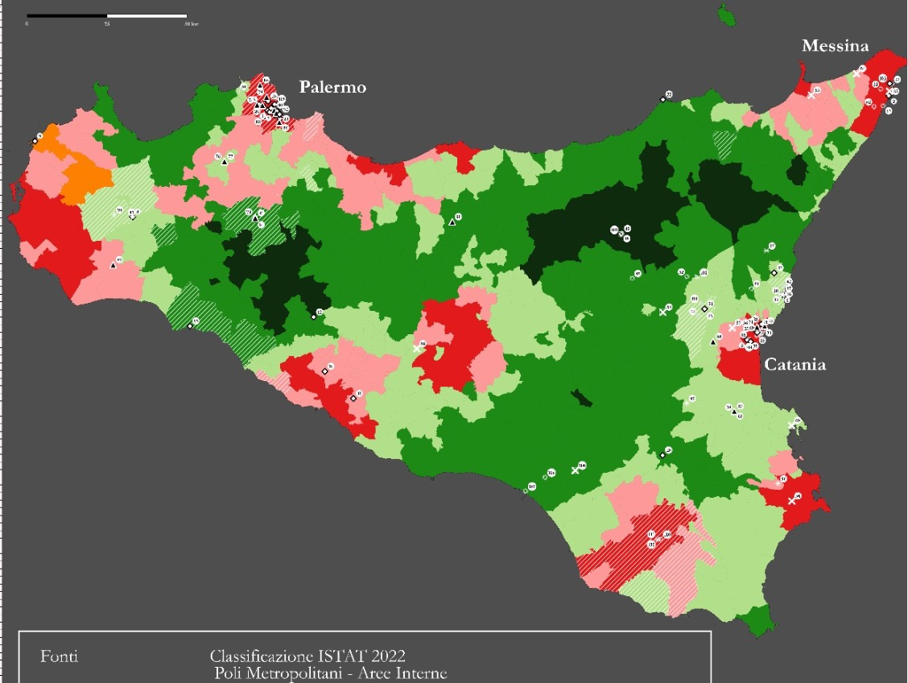
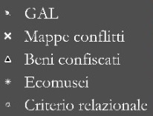
Civic organization
EU funded Local Action Group
Metro Area
Inner Area
Literature
Entrusted with mafia-confiscated property
Ecomusem
Municipalities recognizing ‘shared governance’ agreements
Snow-ball effect

Slide 16
In-depth ‘look’ at 26 organizations in Eastern Sicily
ID | PROJECT, ACTION, INITIATIVE | TYPE OF RELATIOSHIP WITH STATE AND/OR LOCAL AUTHORITIES (CONFLICT-COLLAB) | ESTERNALIZZAZIONE/COPRODUZIONE/INTERAZIONE DEBOLE | YEAR OF BIRTH | PARTNERSHIPS/ NETWORKS

Slide 17
In-depth ‘look’ at 26 organizations in Eastern Sicily
ID | PROJECT, ACTION, INITIATIVE | TYPE OF RELATIOSHIP WITH STATE AND/OR LOCAL AUTHORITIES (CONFLICT-COLLAB) | ESTERNALIZZAZIONE/COPRODUZIONE/INTERAZIONE DEBOLE | YEAR OF BIRTH | PARTNERSHIPS/ NETWORKS
10 In-depth interviews

Slide 18
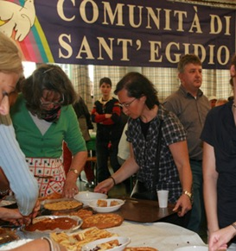
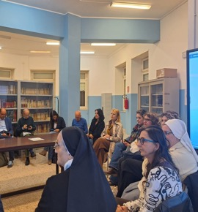
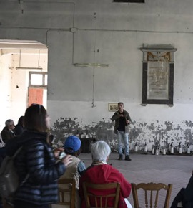
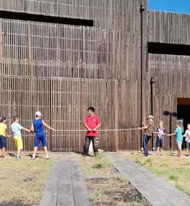
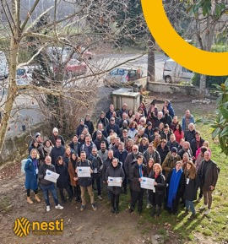
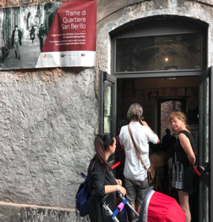
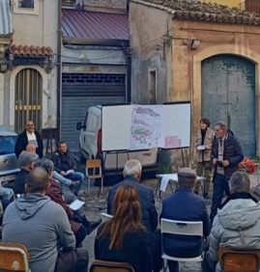
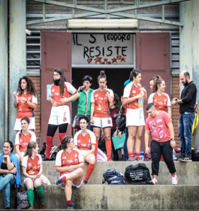
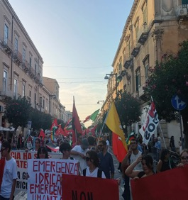
REPRESENTATIVE sample, based on:
Geography (Metro historic center, peripheral neighborhood, inner area)
Time (long-term Vs brand new)
Funding sources (state, regional, private, no funding)
Types (non-profits, grassroots, social enterprises, church-based)

Slide 19
Theory
Practice
PRELIMINARY FINDINGS

Slide 20
An instituting civic organization:

Slide 21
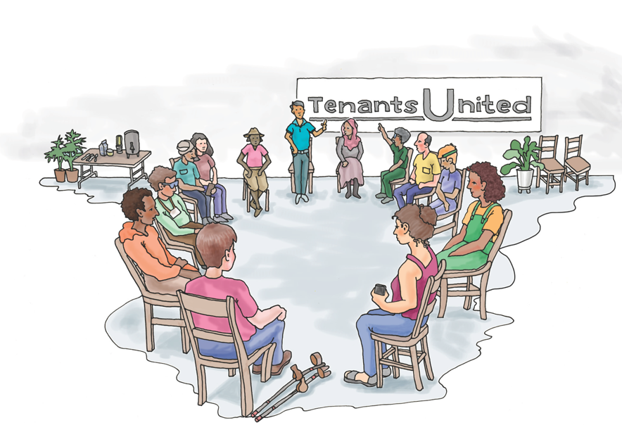
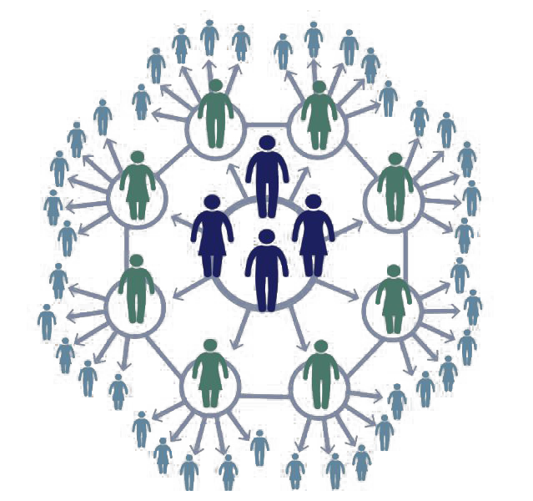
An instituting civic organization:
Collects, organizes, and expresses demands that are REPRESENTATIVE of a COLLECTIVE

Slide 22
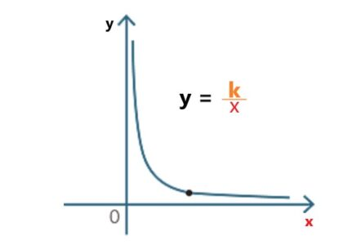
An instituting civic organization:
Collects, organizes, and expresses demands that are REPRESENTATIVE of a COLLECTIVE
our research suggests…
Social representativeness
effectiveness

Slide 23
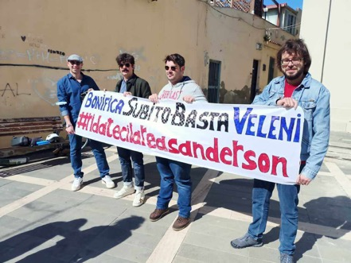
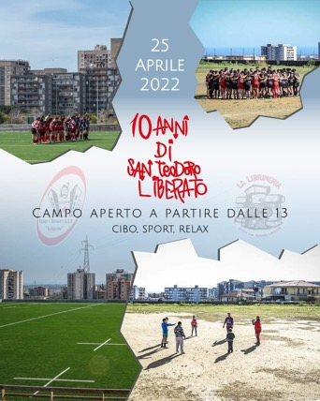
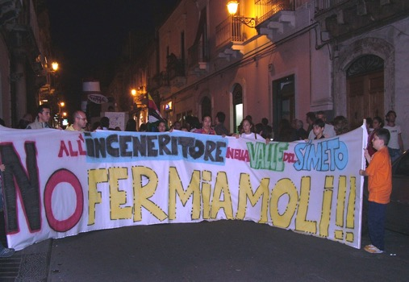
An instituting civic organization:
Collects, organizes, and expresses demands that are REPRESENTATIVE of a COLLECTIVE
PUSHES AUTHORITIES out of their ‘institutional business as usual’
Moving across the
whole spectrum!

Slide 24
An instituting civic organization:
Collects, organizes, and expresses demands that are REPRESENTATIVE of a COLLECTIVE
PUSHES AUTHORITIES out of their ‘institutional business as usual’
Formalization, ability to secure funding
effectiveness

Slide 25
An instituting civic organization:
Collects, organizes, and expresses demands that are REPRESENTATIVE of a COLLECTIVE
PUSH AUTHORITIES out of their ‘institutional business as usual’
Lasts [sustain a) and b) overtime]

Slide 26
An instituting civic organization:
Collects, organizes, and expresses demands that are REPRESENTATIVE of a COLLECTIVE
PUSH AUTHORITIES out of their ‘institutional business as usual’
Last [sustain a) and b) overtime] Our research suggests… …those who last a) and b) do not apply…
SOMETHING ELSE

Slide 27
Is this a sign of a ‘changing time’
?

Slide 28
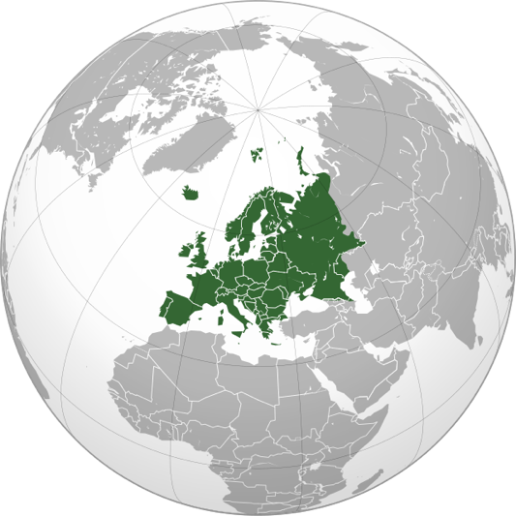
FINAL REMARKS
MORE RESEARCH NEEDED...
To go beyond a regional study
Using the ‘instituting’ theoretical framework to make useful distinctions!
Focus how to act within civil society, to make it one of the source of effective actions for better world

Slide 29
THANK YOU!
laura.saija@unict.it
Main references
Li Destri Nicosia, G., & Saija, L. (2025). Planning as an instituting process. Overcoming Agamben’s despair using Esposito’s political ontology. Planning Theory, 24(1), 3-20. https://doi.org/10.1177/14730952231209755
Saija, L., & Nicosia Li Destri G. (2024). Per un approccio istituente-organizzativo all’interpretazione della relazione tra istituzioni e società civile: riflessioni dai quartieri ERP di Catania. Tracce urbane. Rivista italiana transdisciplinare di studi urbani, 12(16), 251-274. https://rosa.uniroma1.it/rosa03/tracce_urbane/article/view/18871
Pappalardo, G., & Saija, L. (2024). An instituting-organisational framework for the interpretation of urban commoning. Lessons from a neighbourhood park. Contesti. Città, territori, progetti, (1), 18-39. file:///Users/laurasaija/Downloads/FirenzeUniversityPress_Contesti_20250706132836.pdf

