Slide 1

Exploring the genuine flavours of Tehran's cafes: a postmodern destination for tourism
Maryam Farash Khiabani
PhD. In Urbanism, University of Art, Tehran, Iran
Maryamkhiabani86@gmail.com
Notes:
Iranian hospitality

Slide 2
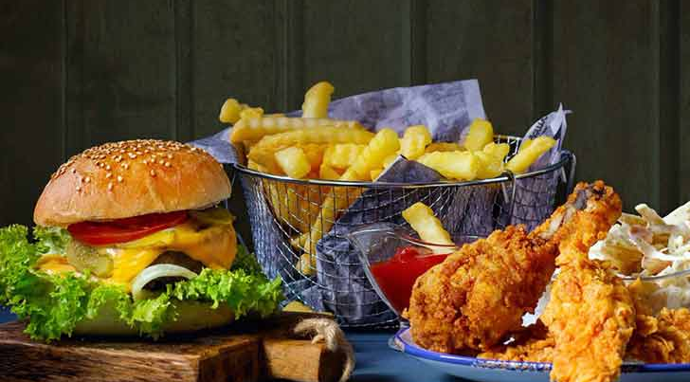
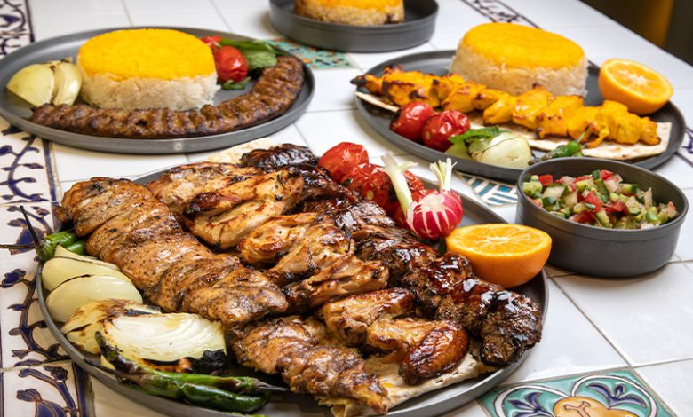
Introduction
Food occupies a central place in our lives & local communities, cultural identities, and daily life. The use of regional and natural ingredients, distinct cooking styles, and even the choice of cutlery are central to this culinary tradition.
Overshadowing traditional local cuisine by fast food and western restaurants, or even Iranian conventional restaurants
In response, some communities are striving to reconnect with their culinary roots by reimagining traditional styles and creating welcoming spaces for diverse groups
Notes:
international brands and cooking methods, particularly fast food, have become increasingly prevalent even in small towns worldwide.

Slide 3
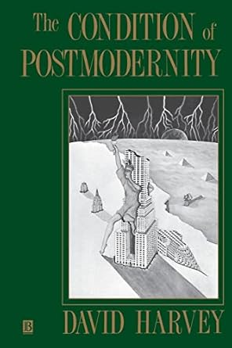
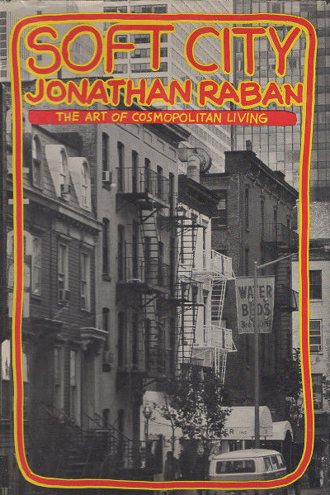
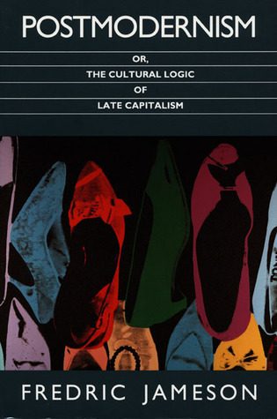
The Era of Diversity: Postmodernism
Postmodernism is a set of conditions that currently influence all aspects of contemporary life, and whether we like it or not, it will continue to have this impact.
One of the primary characteristics of postmodern urbanism is contextualism, which encompasses historical, physical, social, and public culture, in contrast to modern urbanism, which relies on a break from the past.
An open approach to different cultures, embracing pluralism, relativity, and diversity
Notes:
All of the above have come about in the era of diversity
In terms of tourism, postmodern tourism is another term that warrants specific research.
In this study, the emphasis is on “postmodernism” as a “condition” and its impact on tourism destinations, approaches and the “cultural turn”, as cultural scholars have mentioned and not precisely on “postmodern tourism” as a specific term.

Slide 4
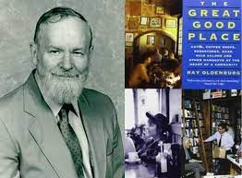
Third place
While people in a bustling city spend time commuting and are occupied with work, there are some welcoming places which open their doors to visitors, catering to the desires of both citizens and newcomers alike.
As urban sociologist Ray Oldenburg described, these places are “the great good place”, the third place.
He describes seven features for the third place, which include the following items:
As a Leveller, 2. Conversation is the primary activity.
3. Accessibility and accommodation. 4. The regulars.
5. A low profile. 6. The mood is playful.
& 7. A home away from home.
Notes:
We have a term Which has come from these situation
This is a place that is generally inclusive and open to the public, with no official criteria for exclusive membership. People often select their companions, friends, and acquaintances from those who are socially akin to their class. The finest characteristic of a third place is conversation. Lively, exciting, and engaging talk, accompanied by smiles, winks, handshakes, pats on the back, and various gestures, serves as an initial indicator of the joy of being in a third place. This enthusiasm is maintained and sustained through enjoyable and entertaining conversations.

Slide 5
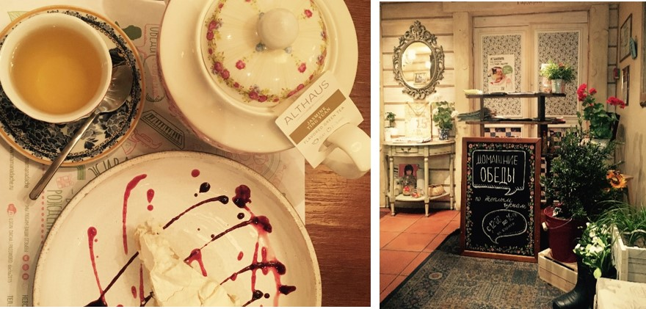
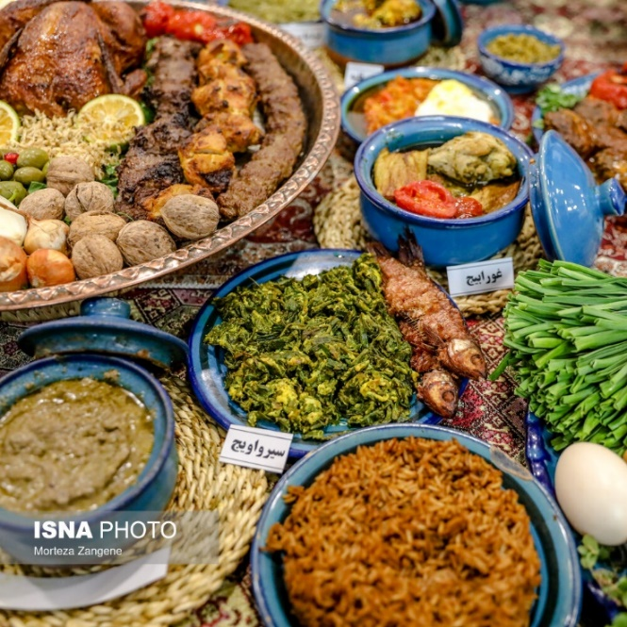
Tourism & Gastronomy
From east to west, numerous efforts are made to create a positive impression for patrons as they enter, even if they are merely visiting for a meal.
A sample of a home café in Moscow, serving traditional foods and desserts with homely cutlery and décor (photo from the author’s archive)
An example of gastronomy and tourism in Rasht, Iran. Creative City of Gastronomy by UNESCO since 2015
Notes:
This experience is realised when all elements align—from the physical environment to the tastes and aromas, the hosts' behaviour, and the lasting memories formed in that space. That is why every detail matters here: the designs, plates, cutlery—everything, as if one is a guest in a thoughtfully prepared welcoming home

Slide 6
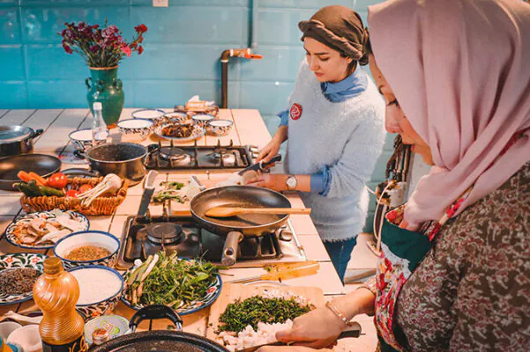
Tourism & Gastronomy
Gastronomy tourism centres on travel experiences focused on food and related activities.
Encompasses authentic, traditional, and innovative culinary experiences, including visits to local producers, attending food festivals, and participation in cooking courses.
When Considering gastronomy as a tourist attraction, it is not solely about the dishes served, but also about the place itself and, of course the hosts.
Notes:
Here we can see the close connection between the new trend in gastronomy & tourism & third place

Slide 7
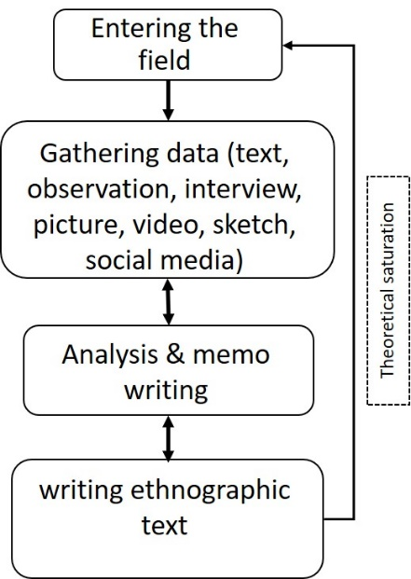
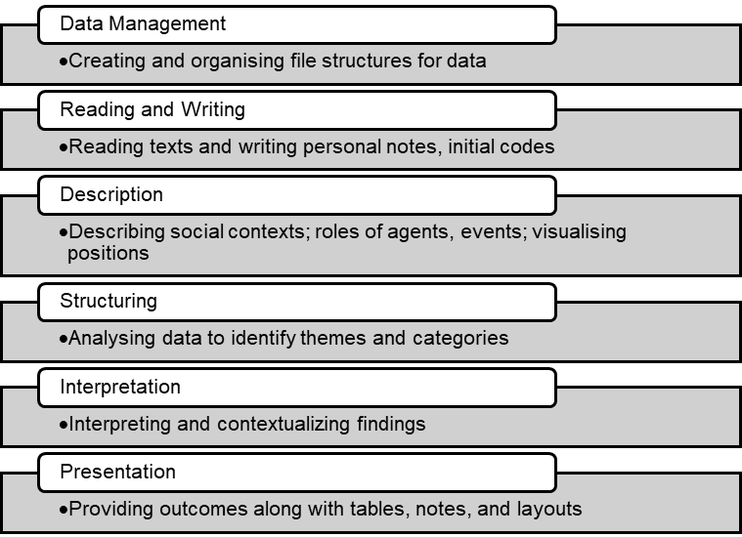
Methodology and background
Observations & 22 semi-structured, in-depth interviews were conducted
The process of applying the ethnographic approach
Data analysis and presentation based on the ethnographic research
Notes:
In the next step

Slide 8
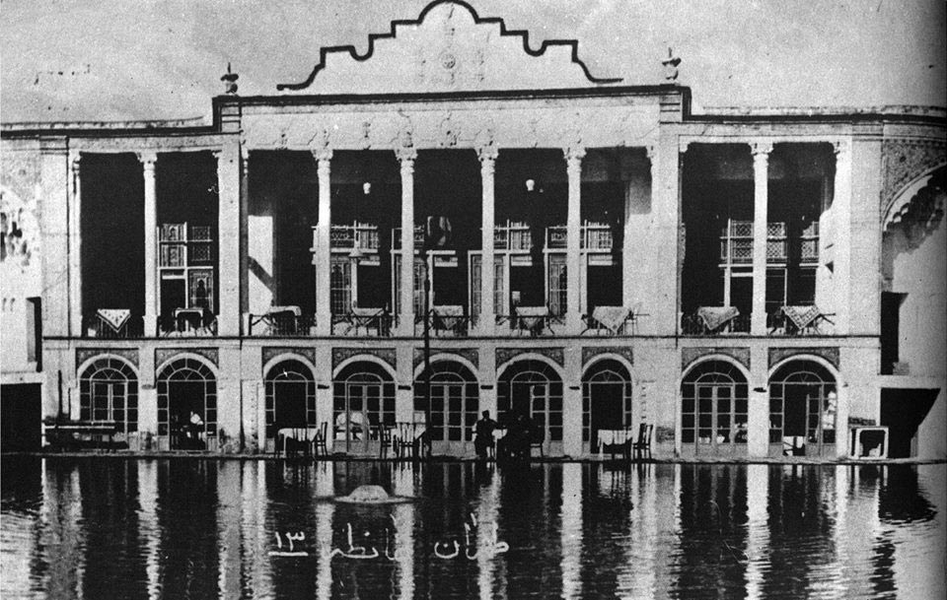
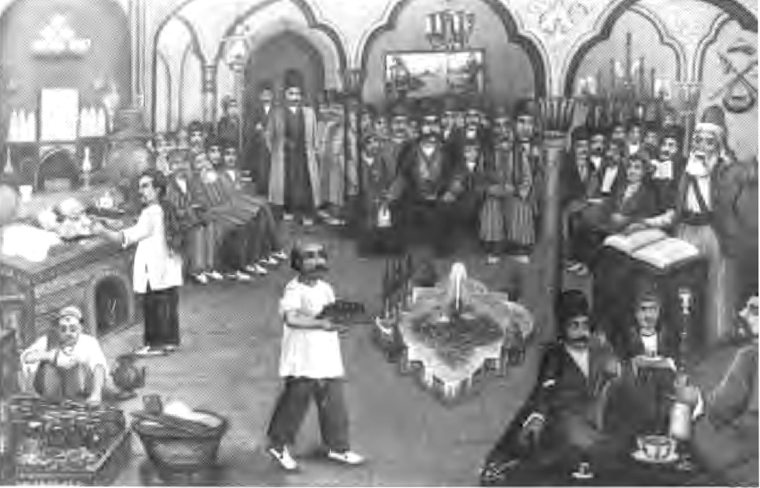
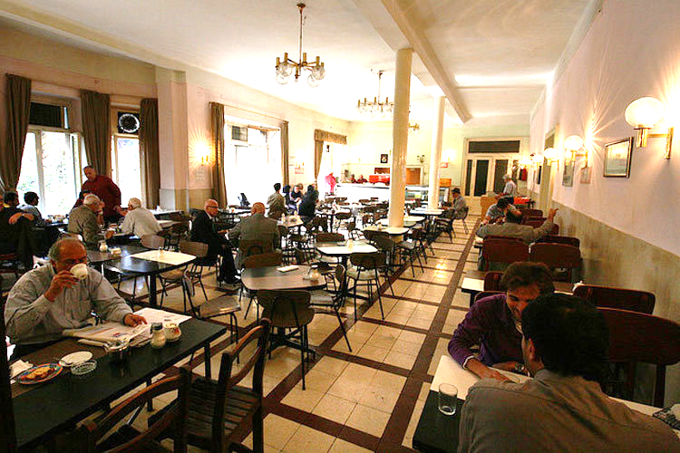
Tehran’s cafes
Sangtarashha coffee house
Loghanteh Café, the symbol of an Iranian modern Café, was located in the central district of Tehran during the Pahlavi period, as documented by the author from the Loghanteh Café Museum's archives in Tehran.
Naderi Café
Notes:
Some of these pictures show how these cafes came about …
Here you can see the picture of …
There are just two cafes remaining from the past era , one of the, is Naderi cafe

Slide 9
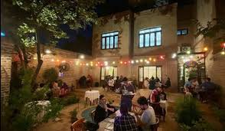
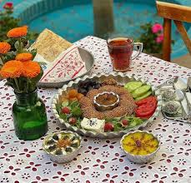
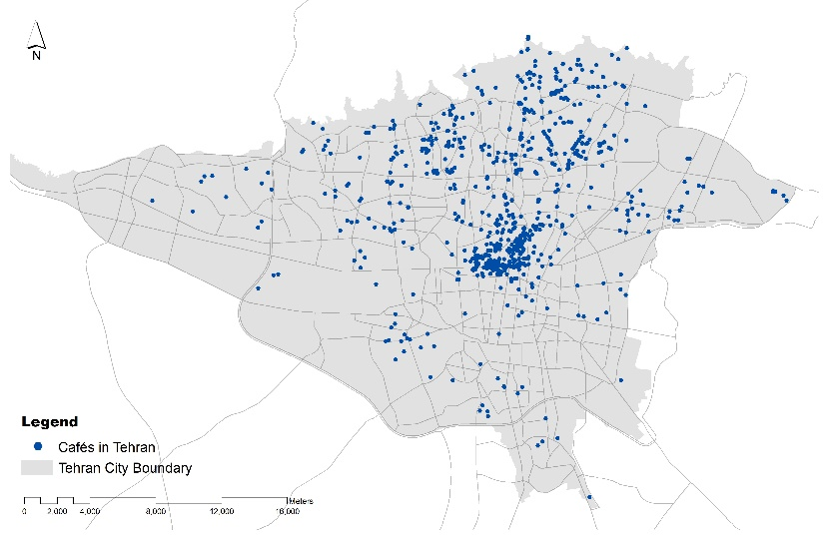
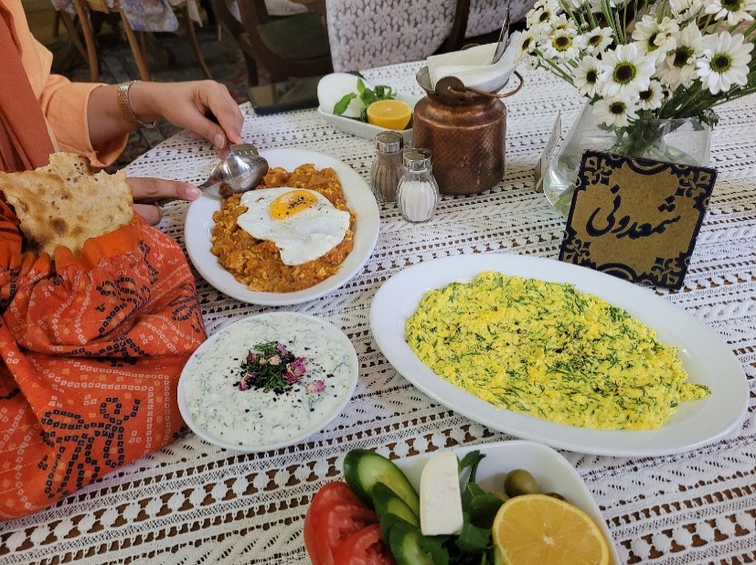
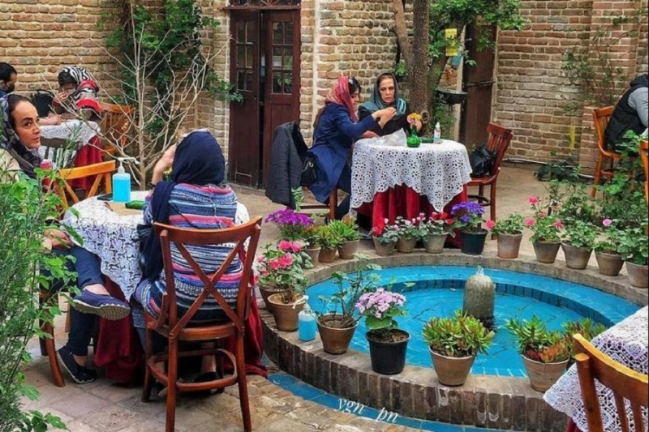
Tehran’s cafes
The expansion of cafés in Tehran in 2024 (Farash Khiabani & Goldar, 2024)
The traditional foods in a nice setting
concentrated in the city centre
Notes:
Which serve the traditional foods

Slide 10
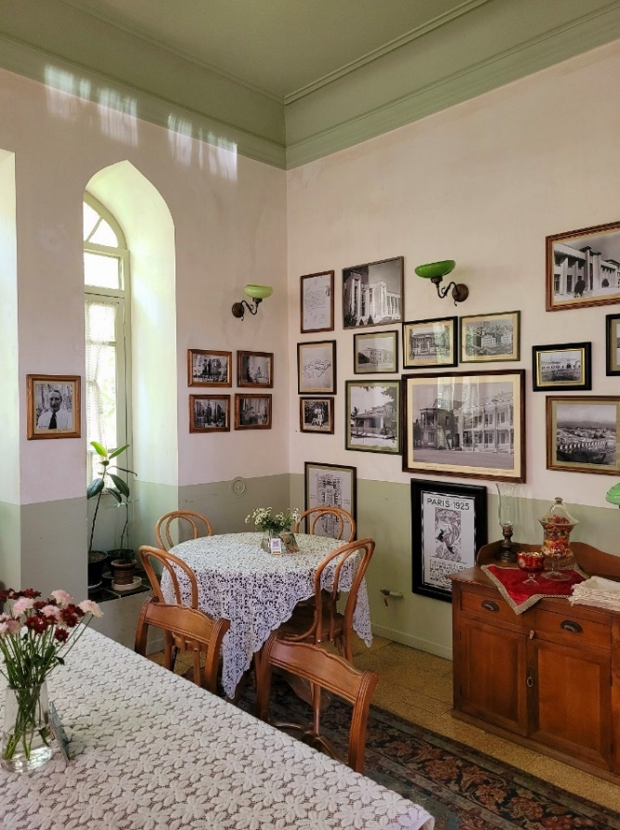
Tehran’s cafes
An interview with a 35-year-old woman:
“Whenever I have free time between tasks and I don’t have enough time to go home, my best option is to go to a café, where I can enjoy a nice drink or meal and read a book.
The cosy atmosphere of my chosen café makes it less formal than a restaurant. I love the aroma of coffee, traditional food, and the rows of books around me.
Those who frequent the café are typically seeking culture, a sense of familiarity, and a friendly atmosphere. This space is my hangout spot. I have come to feel a strong connection with the people here, and the music adds to the attraction too; it is very calming.

Slide 11
Discussion
A sample of the coding process
  The ethnographic text
Notes:
Aesthetic: It is very pleasant on the eye
Or you are surrounded by beauty in every aspect, from the furniture chosen to the lighting to the colour used, to stained glass
Aesthetic beauty of the place

Slide 12
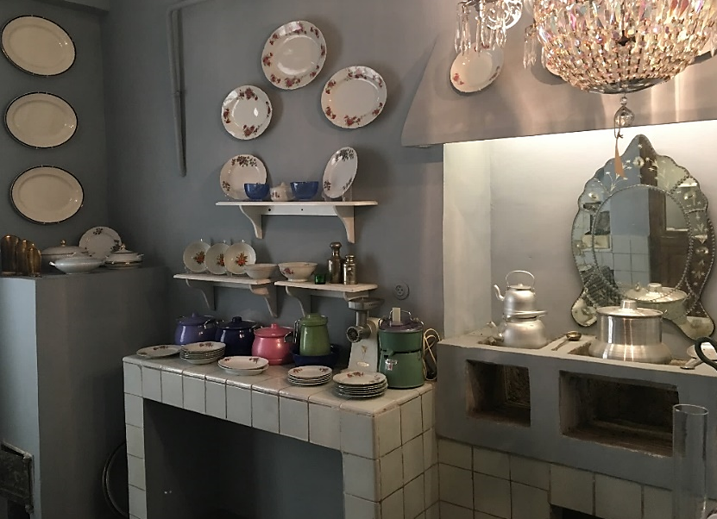
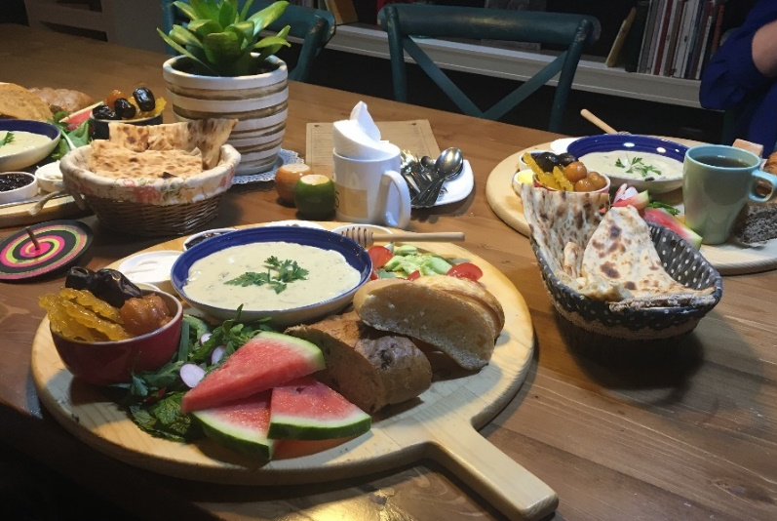
Discussion
One of the key features of the third place examined is the potential for dialogue and interaction within these environments. Cafés lead the way in this aspect. Many of the dishes served in these cafés showcase authentic recipes from various Iranian regions, often presented in traditional settings.
The collection of traditional kitchen items in Khaneye 1308 Café in Tehran
Persian Eftar in a café, special foods for Ramadan (Sangak bread, cheese, date, zoorbia bamie, soup and a cup of tea)
Notes:
For breaking their fast

Slide 13
Conclusion
For many, these cafés evoke a sense of nostalgia, reminding them of the traditional Iranian image of old brick houses surrounded by gardens filled with fresh food and beverages. For newer generations, they symbolise a sense of meaning, identity and belonging to a setting that contrasts with their previous environments.
The establishments in historic Tehran serve a crucial function as tourist attractions, having evolved to accommodate contemporary demands in culinary offerings and cuisine. This adaptability not only enhances the cultural landscape but also fosters an environment that is both vibrant and inviting. By blending innovation with authenticity, these venues create a rich and immersive experience for visitors, to be at home away from home, thereby contributing significantly to the city's unique cultural identity.

Slide 14
Thank you!

