Slide 1
The Spatial Dynamics of Cafés as Everyday Urban Spaces
: Exploring Socialscapes through Streetscapes
Gyuna Hwang
Ph.D Candidate
Department of Urban Planning & Engineering
Hanyang University
Jina Park
Professor
Department of Urban Planning & Engineering
Hanyang University

Slide 2
Contents
The Spatial Dynamics of Cafés as Everyday Urban Spaces: Exploring Socialscapes through Streetscapes
Introduction
Literature Review
Methodology
Results
Conclusion

Slide 3
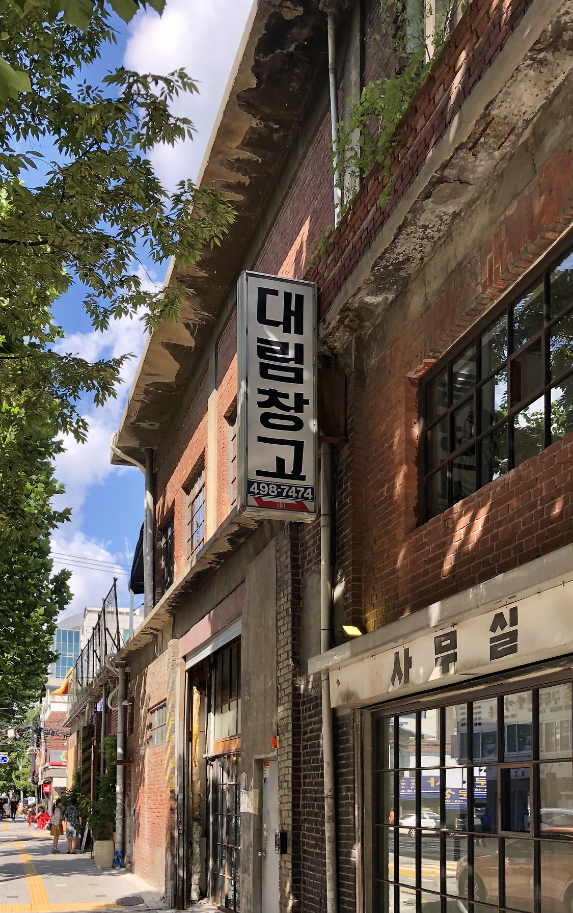
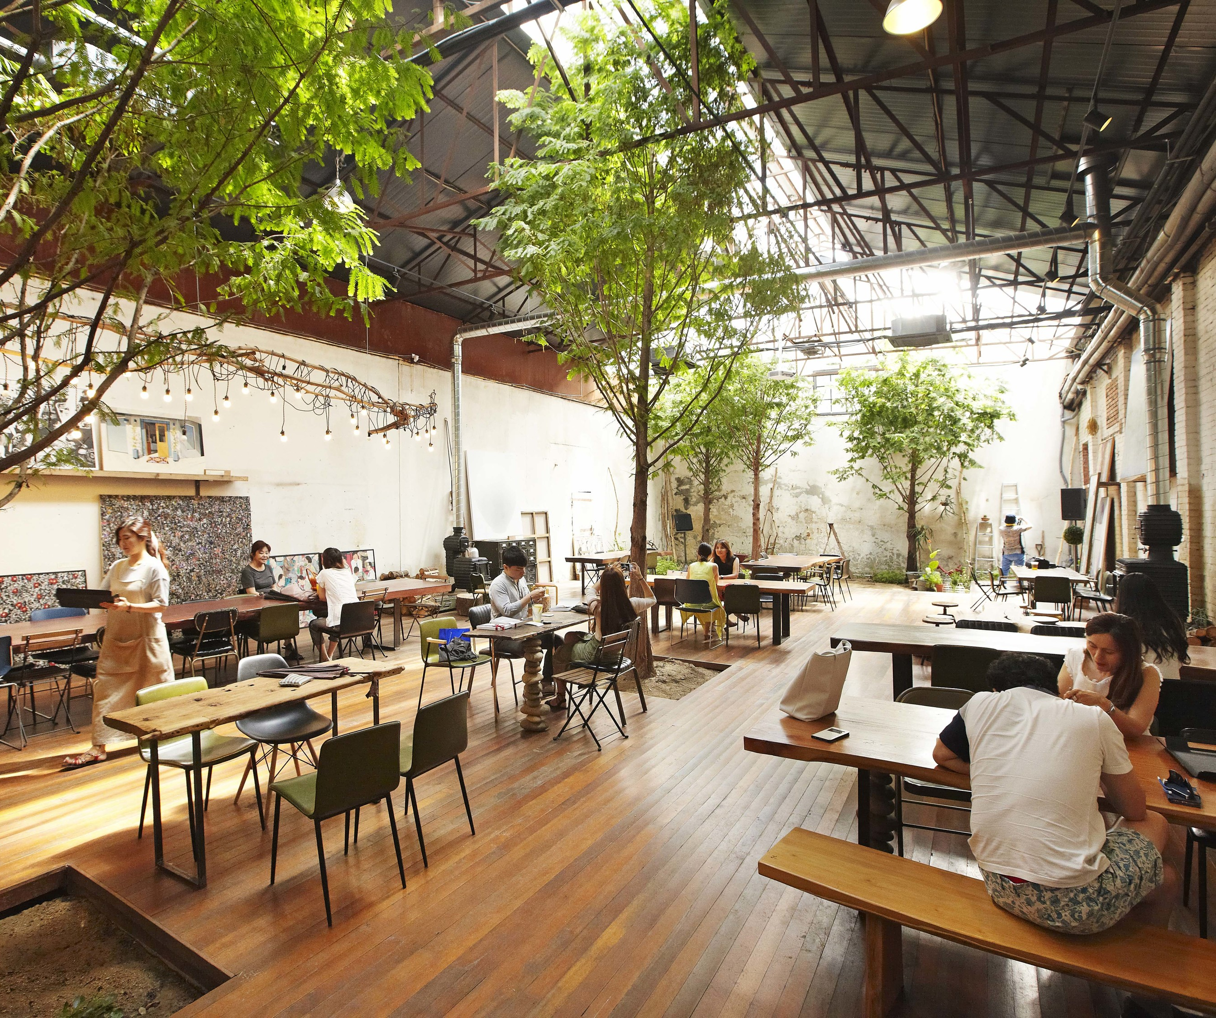
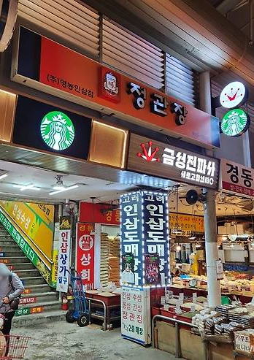
Introduction
The Spatial Dynamics of Cafés as Everyday Urban Spaces: Exploring Socialscapes through Streetscapes
Background
Modern consumer culture has shifted from purchasing products to experiencing places.
Alongside this shift, location-based information disseminated through social media facilitates indirect engagement with place (Yuksel et al., 2016), thereby reshaping spatial preferences.
As a result, cafés and previously overlooked areas have started to gain attention from consumers.

Slide 4
Introduction
The Spatial Dynamics of Cafés as Everyday Urban Spaces: Exploring Socialscapes through Streetscapes
Background
In South Korea, cafés have increasingly made location decisions in favour of residential neighbourhoods with relatively lower rents, facilitated by improved access to location-based information.
Between 2010 and 2019, the number of cafés in Seoul doubled, leading the formation of new commercial spaces within the city through rapid proliferation and high locational flexibility.
Cafés have evolved into everyday social spaces that enrich public life and reflect personal identity through spatial experience.
Their location decisions are increasingly influenced by the perceptual and physical qualities of surrounding streetscapes, which shape how pedestrians experience and evaluate place.
Such streetscape elements play a critical role in enhancing the spatial attractiveness of café locations.

Slide 5
Introduction
The Spatial Dynamics of Cafés as Everyday Urban Spaces: Exploring Socialscapes through Streetscapes
Research Gap
Traditional retail location theories and previous studies emphasize accessibility, land price, and agglomeration.
These models cannot fully explain recent café openings in alleyways and less accessible areas.
New cafés are emerging in small-scale, locally situated spaces that offer sensory and experiential appeal.
Consumers are increasingly drawn to places that feel unique, not just those that are physically accessible.
Accordingly, examining the influence of streetscape and walkability on café location decisions is essential to understanding the evolving dynamics of urban retail geography.
Research Objective
To fill this gap, this study examines the spatial dynamics of café location shifts in an area where traditional and emerging retail districts coexist, and analyses the influence of streetscape and walkability.
Furthermore, it aims to assess the limitations of traditional theories in explaining café location decisions and to explore the evolving role of cafés in urban space.

Slide 6
Literature Review
The Spatial Dynamics of Cafés as Everyday Urban Spaces: Exploring Socialscapes through Streetscapes
Central-place theory (Christaller, 1933) | Retail stores are assumed to be regularly distributed to minimise travel distance for consumers, with hierarchical central places offering different levels of goods and services.
Central-place theory (Lösch, 1938) | Location decisions are driven by retailers’ pursuit of profit maximisation, often resulting in relocation to peripheral areas in response to market competition.
Movement-economic theory (Hillier, 1997) | Retail location patterns can be explained through the relationship between urban structure and movement, as street networks generate flows that attract commercial activity.
Rent gap theory (Smith, 1979) | Commercialisation tends to occur where rent gaps emerge, as lower land values attract retailers even in areas with comparable accessibility.
Consumption-based theory (Ley, 1997) | When artists move into low-rent areas, they foster a consumption culture centred on aesthetic value.
Servicescape (Bitner, 1992) | The servicescape includes both the interior and exterior of a facility, as well as its surroundings, allowing consumers to indirectly perceive service quality and product value, even prior to direct service engagement.

Slide 7
Literature Review
The Spatial Dynamics of Cafés as Everyday Urban Spaces: Exploring Socialscapes through Streetscapes
Traditional retail location theories assume that retailers make location decisions that minimise transportation costs for consumers while maximising proximity to both competing and complementary stores.
Today, retail locations are increasingly chosen by consumers based not only on convenience but also on the unique characteristics of a district and the physical environment and atmosphere surrounding the store.
Walkable streets provide positive sensory stimuli, contributing to more enjoyable and satisfying service experiences (Koo et al., 2023).
By analysing new patterns in café locations, this study contributes to understanding not only the spatial transformation of retail districts and urban form, but also the socio-cultural shifts driven by experiential consumption.

Slide 8
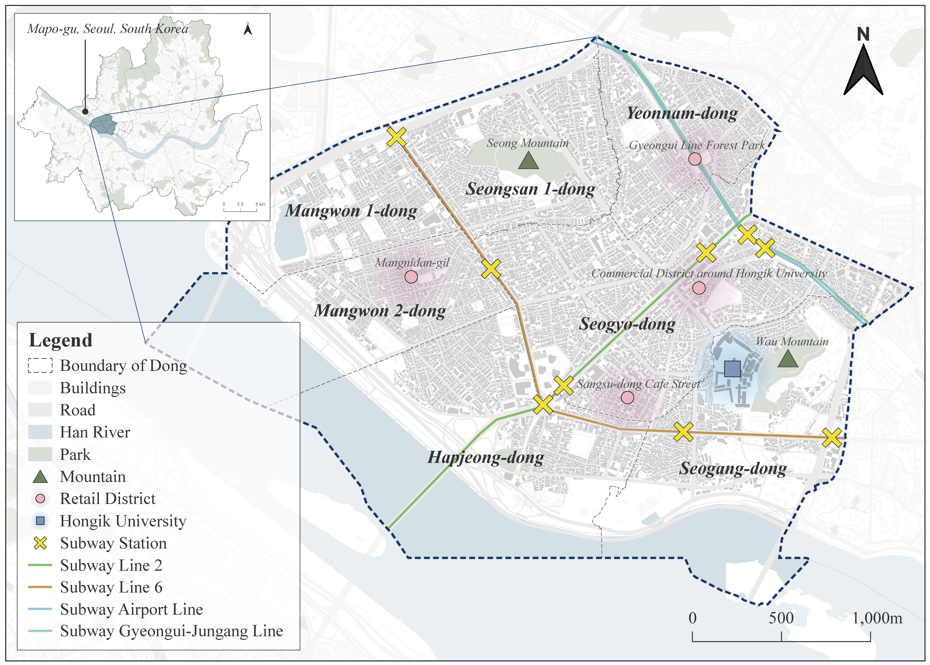
Methodology
The Spatial Dynamics of Cafés as Everyday Urban Spaces: Exploring Socialscapes through Streetscapes
Study Area
Hongdae retail district
Area : 8.15 km²
7 administrative districts (dong)
One of the major commercial centres in Seoul
6 subway stations along 4 lines
Human-scale streetscapes
Mixture of residential and commercial zones
*The term ‘Hongdae’ refers to the area surrounding Hongik University, which has developed into a retail centre around the campus.

Slide 9
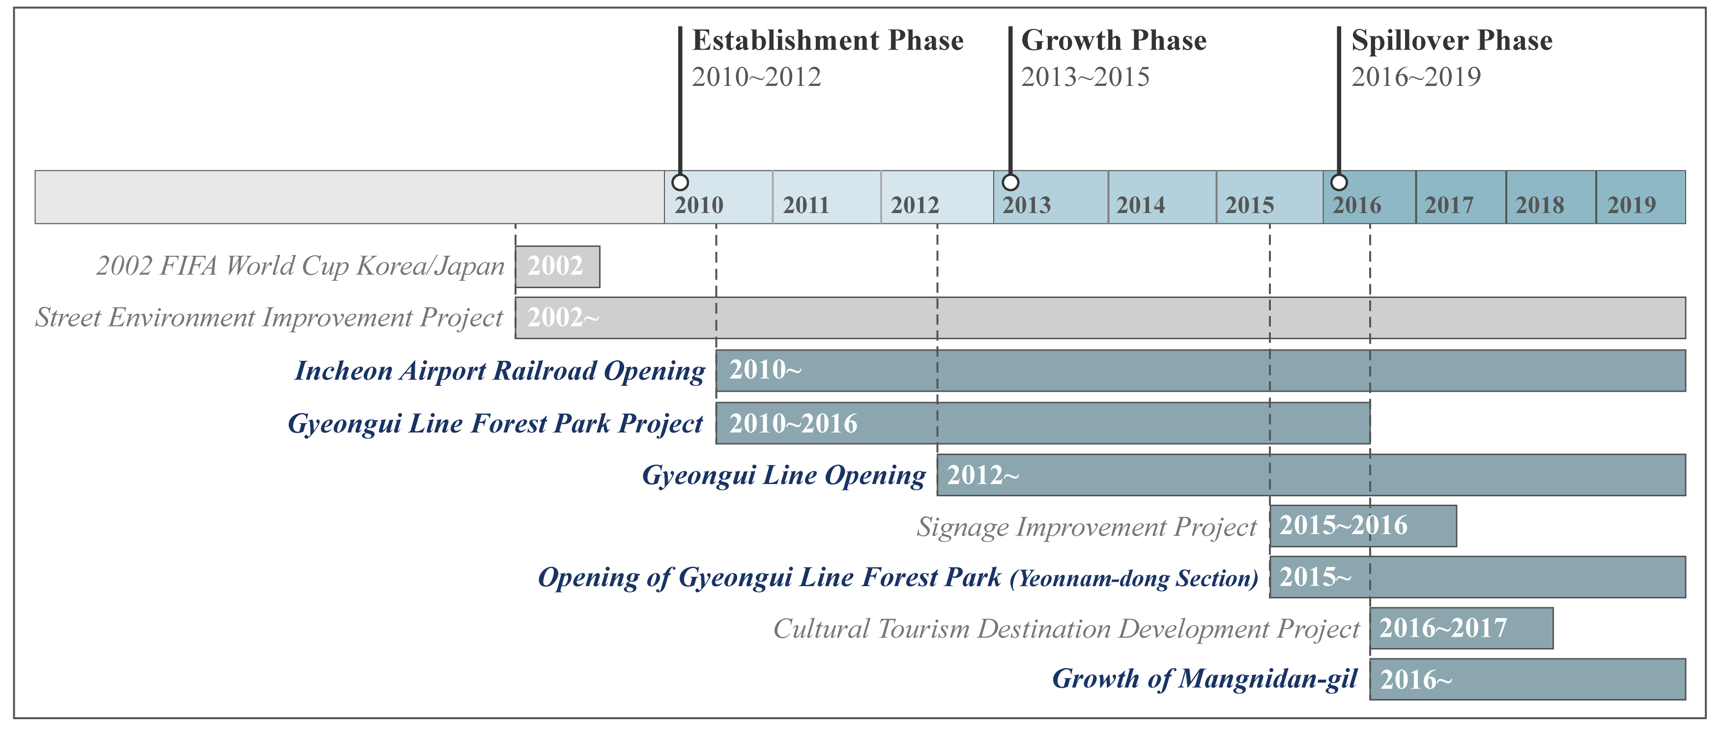
Methodology
The Spatial Dynamics of Cafés as Everyday Urban Spaces: Exploring Socialscapes through Streetscapes
Definition of Analysis Periods
Based on the evolution of the Hongdae retail district, the study defines three distinct analytical phases.
Establishment Phase (2010–2012) : Initial café clustering near Hongik University
Growth Phase (2013–2015) : Spatial expansion from the commercial centre into surrounding areas
Spillover Phase (2016–2019) : Diffusion into alleyways beyond major boulevards
The Hongdae began to take shape in 1955 with the establishment of the College of Fine Arts at Hongik University and gradually evolved into a culturally significant street.
In 2012, the opening of new subway line (Gyeongui–Jungang Line) improved accessibility from other cities.
In 2015, the ‘Gyeongui Line Forest Park’ was completed and the ‘Beautiful Signage Street Project’ was implemented.

Slide 10
Methodology
The Spatial Dynamics of Cafés as Everyday Urban Spaces: Exploring Socialscapes through Streetscapes
Research Framework
Cafés
(Newly opened)
① Location Pattern Analysis
Traditional Location factors
(Competitiveness, Demographics …)
Walkability factors
(Accessibility, Betweenness …)
Urban Network Analysis
② Location Decision Analysis
Visual streetscape factors
(Enclosure, Openness, Greenness …)
Semantic Segmentation
Perceptual streetscape factors
(Safe, Lively, Beautiful)
Perception Modelling
Streetscape

Slide 11
Methodology
–
The Spatial Dynamics of Cafés as Everyday Urban Spaces: Exploring Socialscapes through Streetscapes
Variable
Dependent Variable
Independent Variable
Binary variable (SGIS)
Newly opened (2010–2019)
Café (KSSC 56221, 56229)
Walkability characteristics (MOLIT)
Subway accessibility
Park accessibility
Betweenness
Road width
Streetscape characteristics (NSV)
Visual attributes
Perceptual attributes
Control variables
Competitiveness (SGIS)
Built environments (MOLIT, SODP)
Demographics (SGIS)
*Store opening was operationally defined as the appearance of a café in year t that did not exist in year t–1.

Slide 12
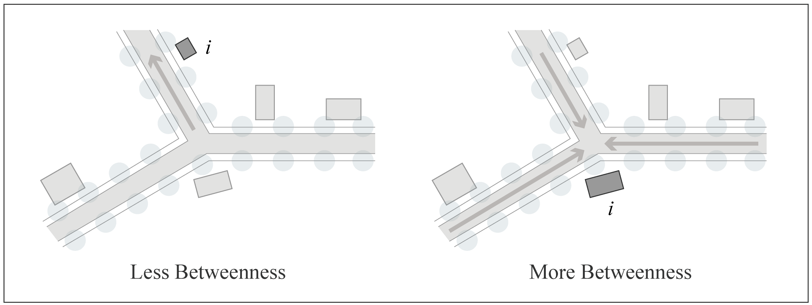
Methodology
The Spatial Dynamics of Cafés as Everyday Urban Spaces: Exploring Socialscapes through Streetscapes
Variable
Urban Network Analysis (UNA)
Network-based spatial analysis method
Street network data from 2019
We were implemented using Rhinoceros 3D.
Walkability Characteristics
Gravity Index
Network radius = 600m
Distance decay 0.00217 (Handy & Niemeier, 1997)
Proximity to subway station exits and parks
$Gravity{[i]}^{r}=\sum_{j∈G−i;d[i,j]≤r}{W{[j]}^{α}/e^{β∗d[i,j]}}$
Betweenness
Full network of buildings
Weighted by volume
Proxy for estimating pedestrian flow
$Betweenness{[i]}^{r,dr}=\sum_{j,k∈G−i;d\left[j,k\right]≤r∗dr}{(n_{jk}\left[i\right]/n_{jk})W[j]}$
Example of betweenness (Adapted from Sevtsuk, 2014)
*Given that urban structures such as roads and buildings tend to evolve gradually over long periods (Casali & Heinimann, 2019),
it was assumed that the spatial configuration remained relatively stable during the analysis period.

Slide 13
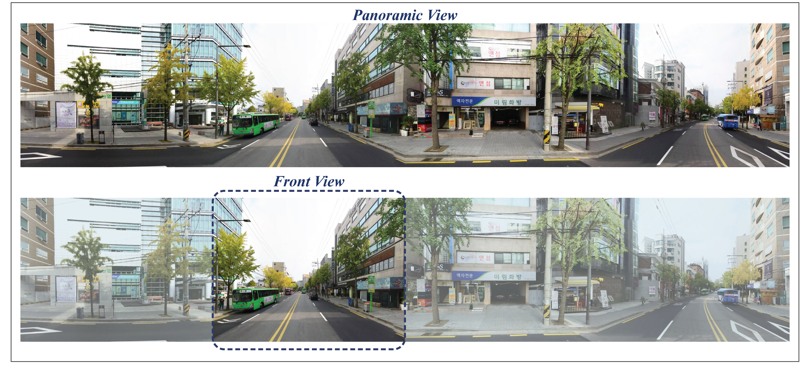
Methodology
The Spatial Dynamics of Cafés as Everyday Urban Spaces: Exploring Socialscapes through Streetscapes
Variable
Naver Street View (NSV) panoramic 360˚ images
Generating points at 20 metre intervals along the street network in Hongdae retail district
Visual attributes, full panoramic images were used to assess the overall street environment.
Perceptual attributes, only the front-facing portions of the panoramic images were extracted, as these reflect the visual field most relevant to pedestrians and were used as input for streetscape perception modelling.
Total of 21,101 panoramic images in 2010, 2014–2015, and 2016–2017 by phases
NSV data for 2013 were not available, as imagery for that year was not provided by the platform.
2015 and 2017 images were included to supplement spatial gaps left by incomplete coverage in earlier years.
*Each variable was calculated as the average value of images within a 100 metre radius, in order to reflect the contextual streetscape characteristics of the surrounding area.

Slide 14
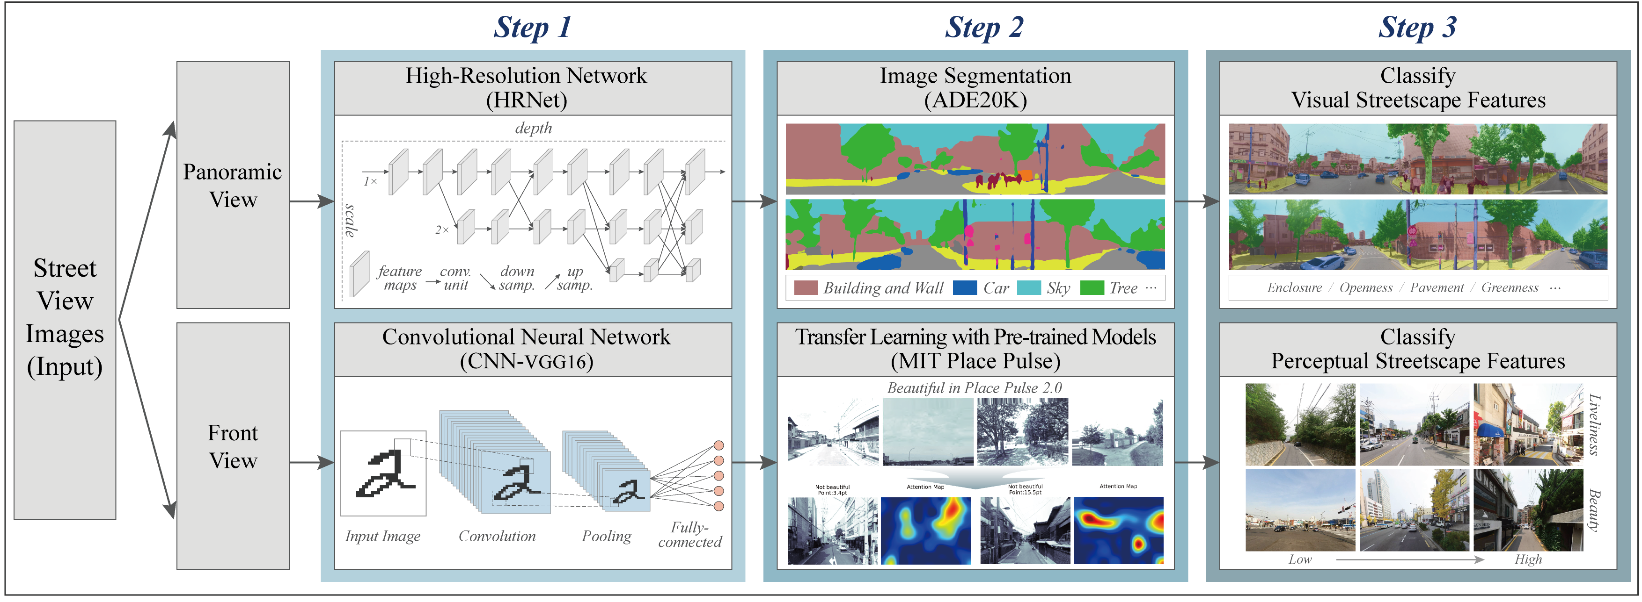
Methodology
The Spatial Dynamics of Cafés as Everyday Urban Spaces: Exploring Socialscapes through Streetscapes
Variable
Streetscape - Visual Attributes
Streetscape – Perceptual Attributes
Calculated by deep learning model (HRNet) which is trained with ADE20K semantic segmentation dataset
Enclosure, Openness, Pavement, Greenness
Estimated by CNN-based deep learning model (VGG16) which is trained with MIT Place Pulse dataset
Safe, Lively, Beautiful
$$Enclosure= \frac{building pixels+wall pixels}{road pixels}$$
$$Openness= \frac{sky pixels}{total pixels}$$
$$Pavement= \frac{sidewalk pixels}{road pixels}$$
$$Greenness= \frac{tree pixels+grass pixels+plant pixels}{total pixels}$$
*From the Place Pulse dataset, we extracted three positive perceptual dimensions—Safe, Lively, and Beautiful—as quantifiable street scores for each image. Other perceptual labels were excluded to ensure objectivity and reliability.

Slide 15
Methodology
The Spatial Dynamics of Cafés as Everyday Urban Spaces: Exploring Socialscapes through Streetscapes
Variable
Variable |  |  |  | Description of variables | Source
Dependent variable |  |  | Open | Binary variable indicating whether a café newly opened (1=Yes; 0=No) | SGIS
Independent variable | Walkability characteristics |  | Subway | Spatial accessibility to subway entrance in the radius (gravity, r=600m) | MOLIT
 |  |  | Park | Spatial accessibility to park in the radius (gravity, r=600m)
 |  |  | Betweenness | Connectivity between all buildings in the radius (r=n, weighted by volume)
 |  |  | Road width | Width of the road adjacent to the building (m)
 | Streetscape characteristics | Visual attributes | Enclosure | Average ratio of building and wall area to road in the radius (r=100m) | NSV
 |  |  | Openness | Average ratio of sky area to road in the radius (r=100m)
 |  |  | Pavement | Average ratio of sidewalk area to road in the radius (r=100m)
 |  |  | Greenness | Average ratio of tree, grass, and plant area in the radius (r=100m)
 |  | Perceptual attributes | Safe | Average perceived safety of streetscape in the radius (r=100m)
 |  |  | Lively | Average perceived liveliness of streetscape in the radius (r=100m)
 |  |  | Beautiful | Average perceived beauty of streetscape in the radius (r=100m)
Control variable | Competitive characteristics |  | Occupied | Binary variable indicating whether the café was already occupied in the previous year (1=Yes; 0=No) | SGIS
 |  |  | Agglomeration | Spatial proximity to other operating cafés in the radius (gravity, r=100m)
 | Built environment characteristics |  | Building footprint | Footprint area of the building (m²) | MOLIT
 |  |  | Building height | Height of the building (m²)
 |  |  | Parcel area | Area of the land parcel (m²)
 |  |  | Land price | Average land price during the analysis period (won) | SODP
 | Demographic characteristics |  | Residents | Residential population density in the census district | SGIS
 |  |  | Millennials | Number of millennials (aged 20–39) in the census district
 |  |  | Employees | Number of workers in the census district

Slide 16
Methodology
The Spatial Dynamics of Cafés as Everyday Urban Spaces: Exploring Socialscapes through Streetscapes
Research Methods
Kernel density estimation (KDE)
Point pattern analysis method
Non-parametric technique that estimates the probability density of point distributions
Effective for spatial visualisation clusters of point features
Binary logistic regression
One of the simplest probabilistic modelling techniques
Accommodate non-linear relationships
Estimate the probability of event’s occurrence
$logit P=\ln\left(\frac{p}{1−p}\right)=β_{0}+β_{1}x_{1}+⋯+β_{n}x_{n} (n=1,2,3…)$
($\frac{p}{1−p}$ : odds, $β_{n}$ : coefficient, $x_{n}$ : independent variables)
If $β_{n}$is negative, OR < 1, indicating that an increase in $x_{n}$decreases the odds.
Location Pattern Analysis
Location Decision Analysis

Slide 17
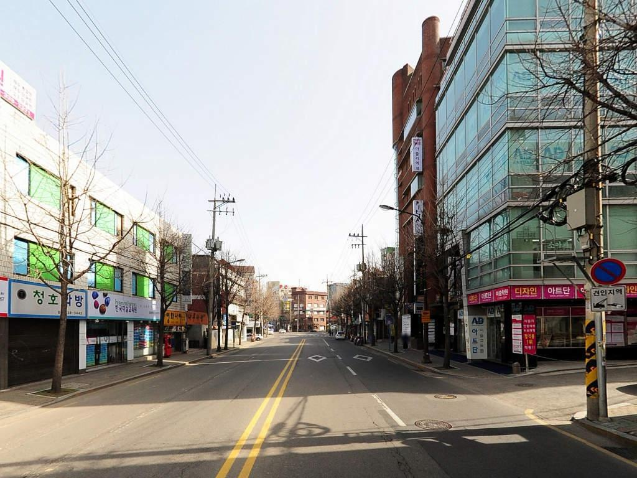
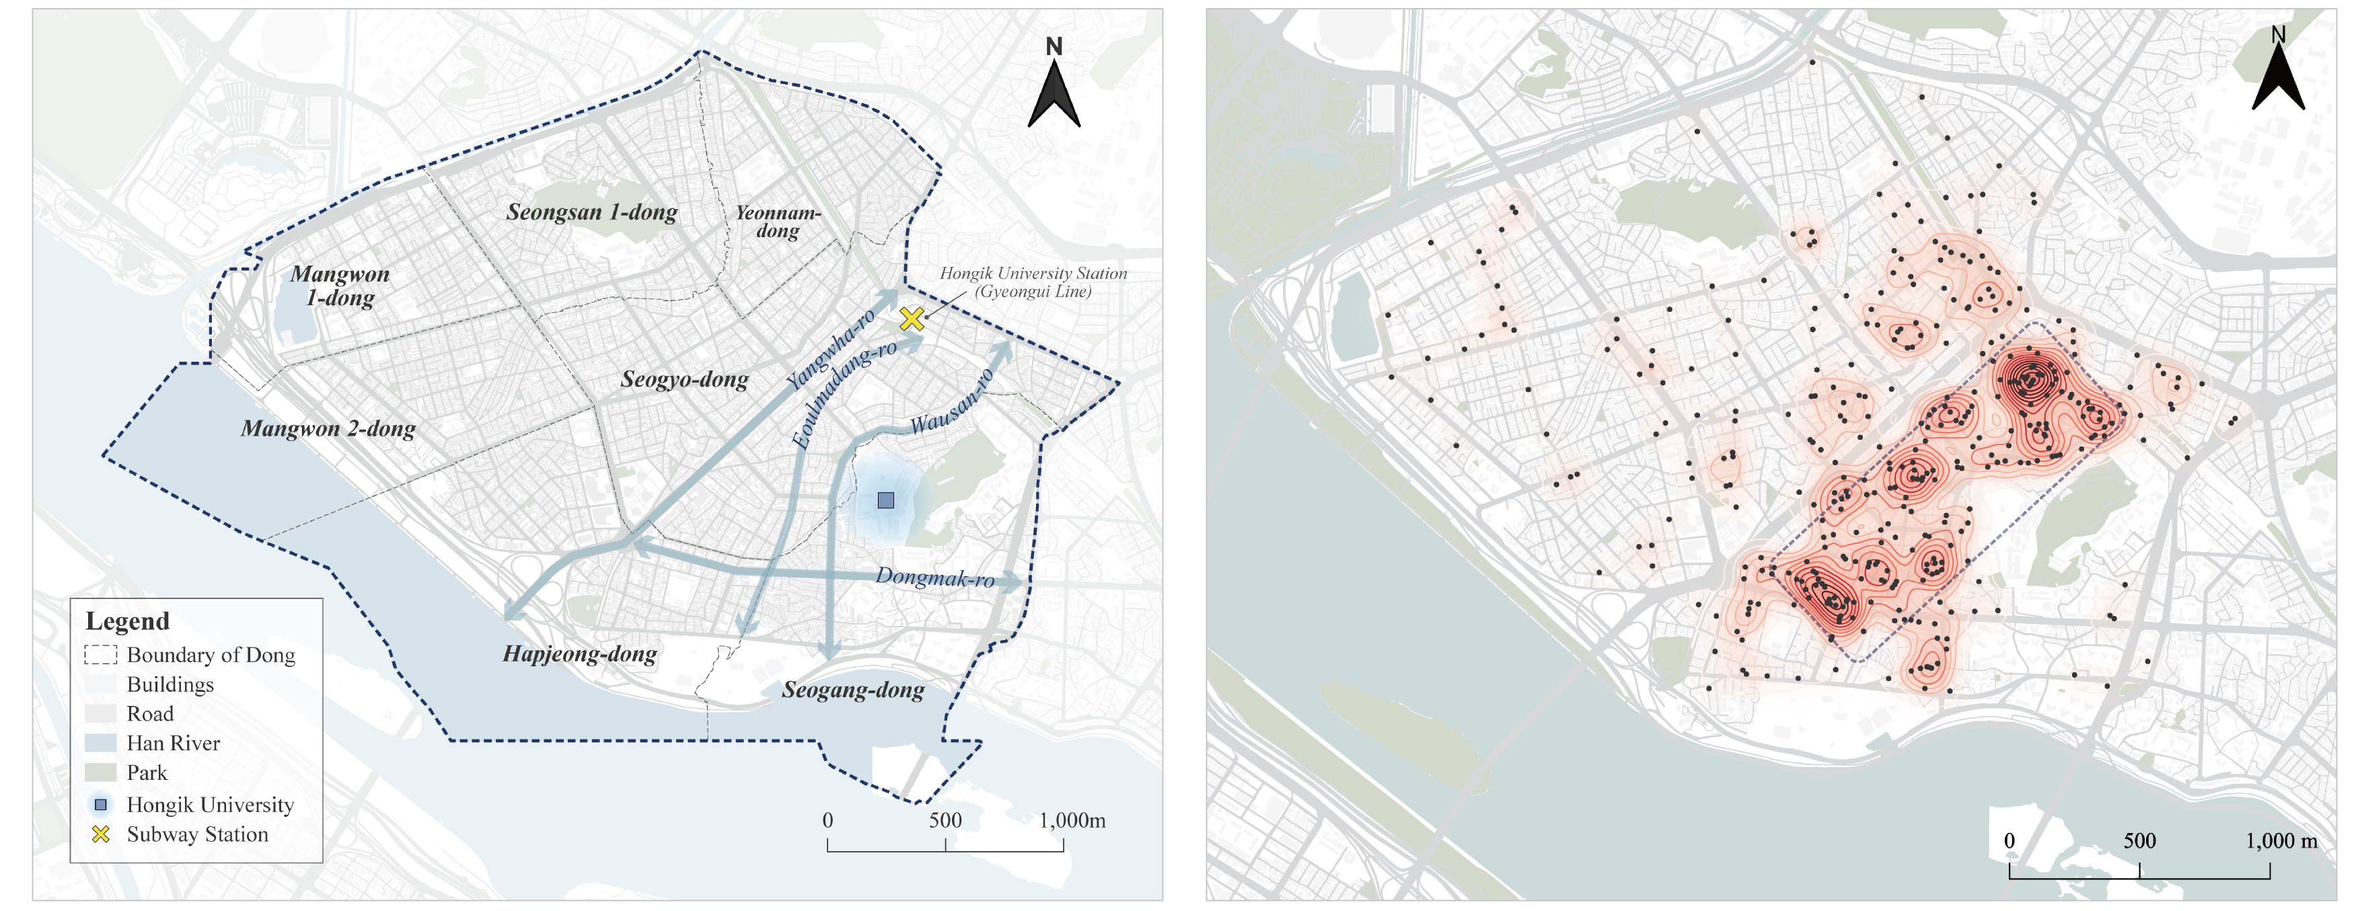
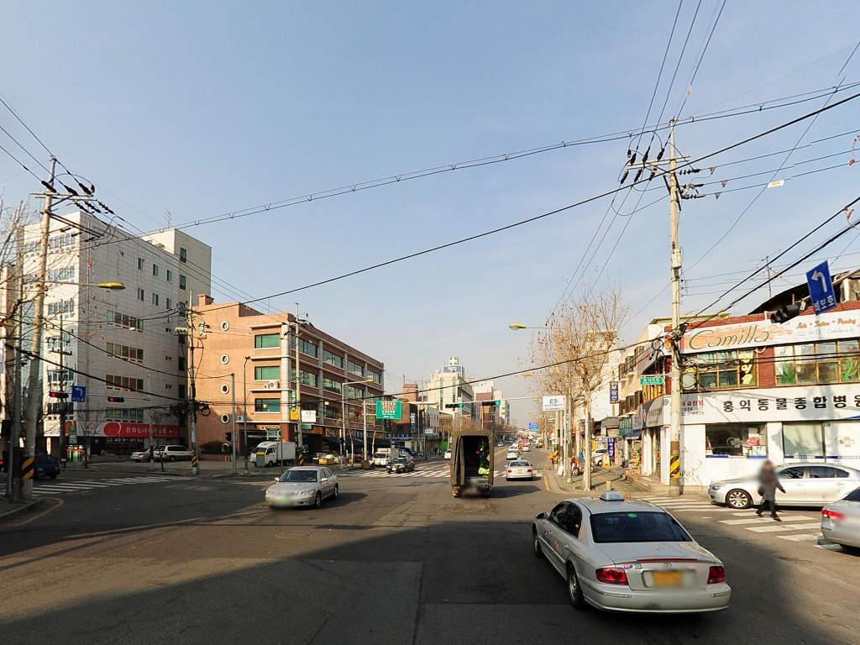
Results
The Spatial Dynamics of Cafés as Everyday Urban Spaces: Exploring Socialscapes through Streetscapes
Location Patterns in Establishment Phase
Concentration within the established commercial centre
Around Hongik University and Hongdae station
Clustered High street and boulevards (Yanghwa-ro, Dongmak-ro …)
Wausan-ro
Dongmak-ro

Slide 18
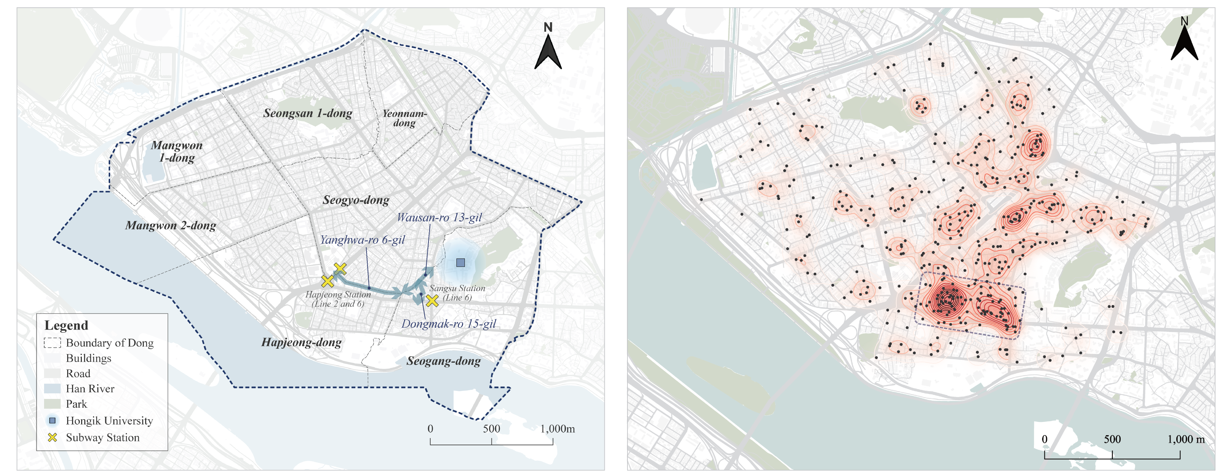
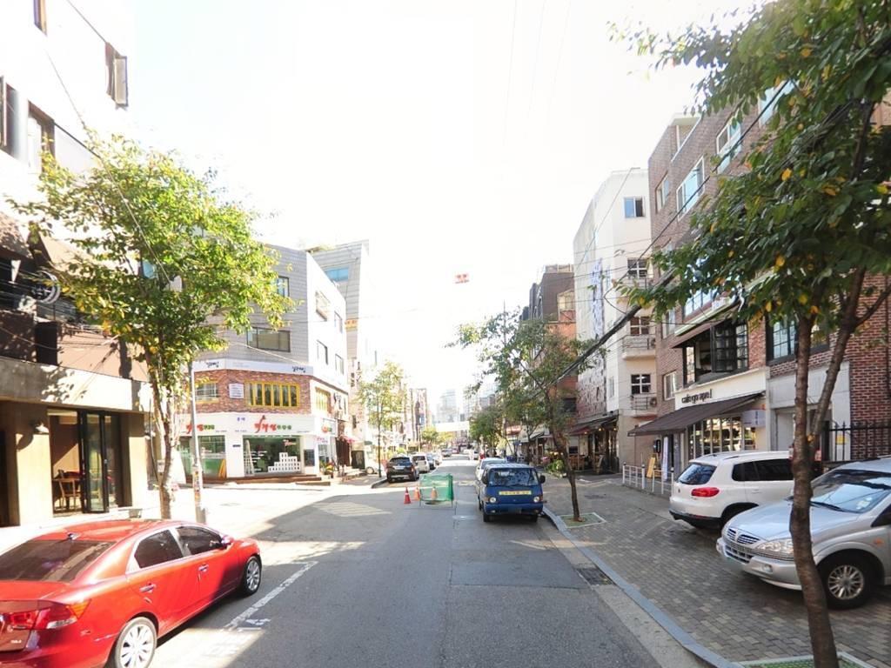
Results
The Spatial Dynamics of Cafés as Everyday Urban Spaces: Exploring Socialscapes through Streetscapes
Location Patterns in Growth Phase
Expansion into side streets adjacent to major boulevards
Around Hapjeong station and Sangsu station
Located roughly one block away from major boulevards (Yangwha-ro 6-gil, Dongmak-ro 15-gil …)
Yanghwa-ro 6-gil

Slide 19
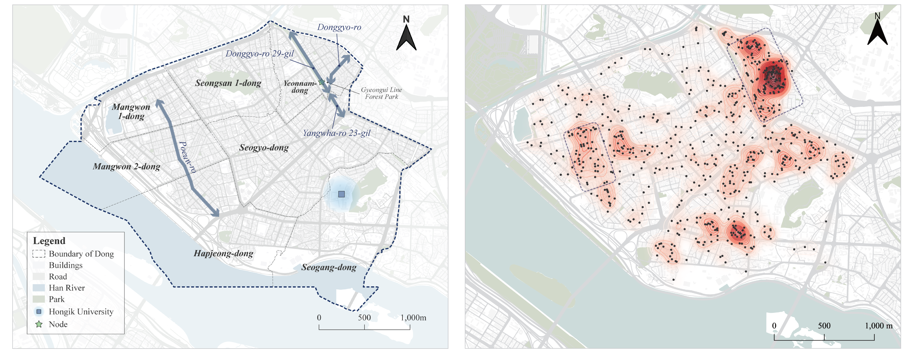
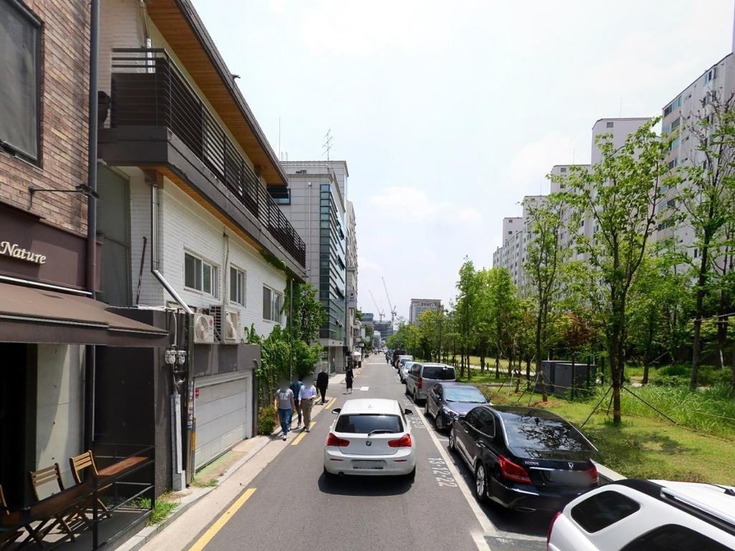
Results
The Spatial Dynamics of Cafés as Everyday Urban Spaces: Exploring Socialscapes through Streetscapes
Location Patterns in Spillover Phase
Diffusion into alleyways deeper within residential area
Around Gyeongui Line Forest Park
Extended beyond boulevards and into inner-block alleyways (Donggyo-ro, Donggyo-ro 29-gil, Yangwha-ro 23-gil …)
Yanghwa-ro 23-gil

Slide 20
Results
The Spatial Dynamics of Cafés as Everyday Urban Spaces: Exploring Socialscapes through Streetscapes
Descriptive Statistics
 | Model 1 |  | Model 2 |  | Model 3
Variables | Mean | S.D. | Mean | S.D. | Mean | S.D. | Obs
Open | 0.03 | 0.17 | 0.03 | 0.18 | 0.05 | 0.22 | 13,439
Subway (gravity, 600m) | 0.93 | 1.08 | 1.13 | 1.25 | 1.13 | 1.25
Park (gravity, 600m) | 1.14 | 0.47 | 1.14 | 0.47 | 1.14 | 0.47
Betweenness (weight=building volume, r=n, log) | 11.97 | 1.16 | 11.97 | 1.16 | 11.97 | 1.16
Road width | 6.06 | 4.46 | 6.06 | 4.46 | 6.06 | 4.46
Enclosure (r=100m) | 838.96 | 564.68 | 742.79 | 287.71 | 835.18 | 299.62
Openness (r=100m) | 17.99 | 3.97 | 16.10 | 3.49 | 15.28 | 3.32
Pavement (r=100m) | 26.00 | 24.45 | 25.43 | 8.54 | 26.05 | 8.35
Greenness (r=100m) | 7.19 | 4.43 | 10.23 | 5.31 | 9.80 | 4.94
Safe (r=100m) | 0.26 | 0.09 | 0.40 | 0.11 | 0.38 | 0.09
Lively (r=100m) | 0.74 | 0.10 | 0.80 | 0.08 | 0.81 | 0.07
Beautiful (r=100m) | 0.16 | 0.07 | 0.23 | 0.09 | 0.22 | 0.08
Occupied | 0.03 | 0.16 | 0.05 | 0.21 | 0.06 | 0.24
Agglomeration (gravity, r=100m) | 0.87 | 1.78 | 1.42 | 2.29 | 1.88 | 2.37
Building footprint (log) | 4.69 | 0.55 | 4.69 | 0.55 | 4.69 | 0.55
Building height (log) | 2.43 | 0.55 | 2.43 | 0.55 | 2.43 | 0.55
Parcel area | 14.84 | 0.36 | 15.00 | 0.37 | 15.37 | 0.36
Land price (log) | 269.86 | 601.76 | 269.86 | 601.76 | 269.86 | 601.76
Residents | 11.06 | 0.72 | 10.97 | 0.76 | 10.94 | 0.79
Millennials | 71.33 | 46.58 | 58.27 | 25.31 | 60.21 | 27.88
Employees | 6.26 | 1.78 | 6.34 | 1.81 | 6.60 | 1.70
*Note: Model 1 corresponds to the Establishment Phase, Model 2 to the Growth Phase, and Model 3 to the Spillover Phase.

Slide 21
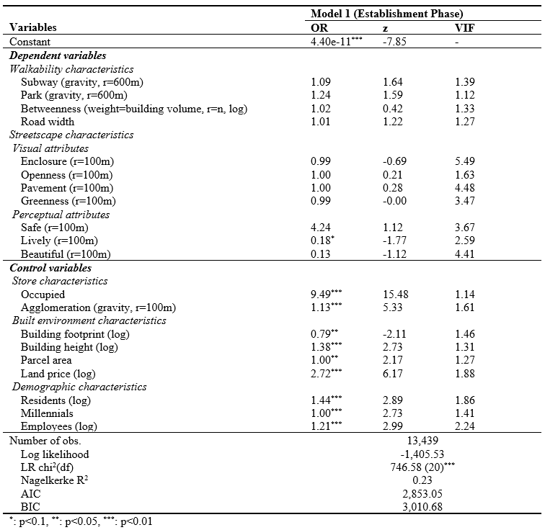
Results
The Spatial Dynamics of Cafés as Everyday Urban Spaces: Exploring Socialscapes through Streetscapes
Café Location (Model 1)
Newly opened café in the Establishment Phase
Cafés tend to locate on less lively streets (lower liveliness)
Prefer occupied buildings, agglomerated areas, and locations with higher land prices
Favour compact building forms (small footprint, taller height)
More likely to appear in areas with larger resident populations, millennials, and employees
*R² values in logistic regression tend to be relatively low and vary depending on the distribution of the dependent variable
(Cohen et al., 2009).

Slide 22
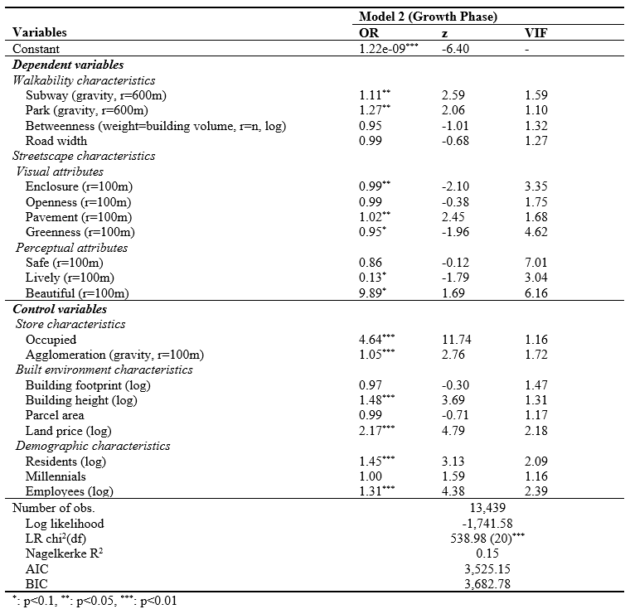
Results
The Spatial Dynamics of Cafés as Everyday Urban Spaces: Exploring Socialscapes through Streetscapes
Café Location (Model 2)
Newly opened café in the Growth Phase
Cafés tend to locate on aesthetic streets (higher beauty, lower liveliness)
Prefer walkable environments (wider pavements, higher enclosure)
Prefer accessible locations (subway stations, parks)
Favour occupied buildings, agglomerated areas, and sites with higher land prices
More likely to appear in areas with taller buildings, more residents, and more employees
*R² values in logistic regression tend to be relatively low and vary depending on the distribution of the dependent variable
(Cohen et al., 2009).

Slide 23
Results
The Spatial Dynamics of Cafés as Everyday Urban Spaces: Exploring Socialscapes through Streetscapes
Café Location (Model 3)
Newly opened café in Spillover Phase
Cafés tend to locate on lively streets (higher liveliness)
Prefer environments with high pedestrian activity and high street vitality (higher enclosure, higher openness, narrower pavements)
Less preference for accessible locations (subway stations)
Favour occupied buildings, agglomerated areas, and sites with higher land prices
More likely to appear in areas with taller buildings, more residents, and more employees
*R² values in logistic regression tend to be relatively low and vary depending on the distribution of the dependent variable
(Cohen et al., 2009).

Slide 24
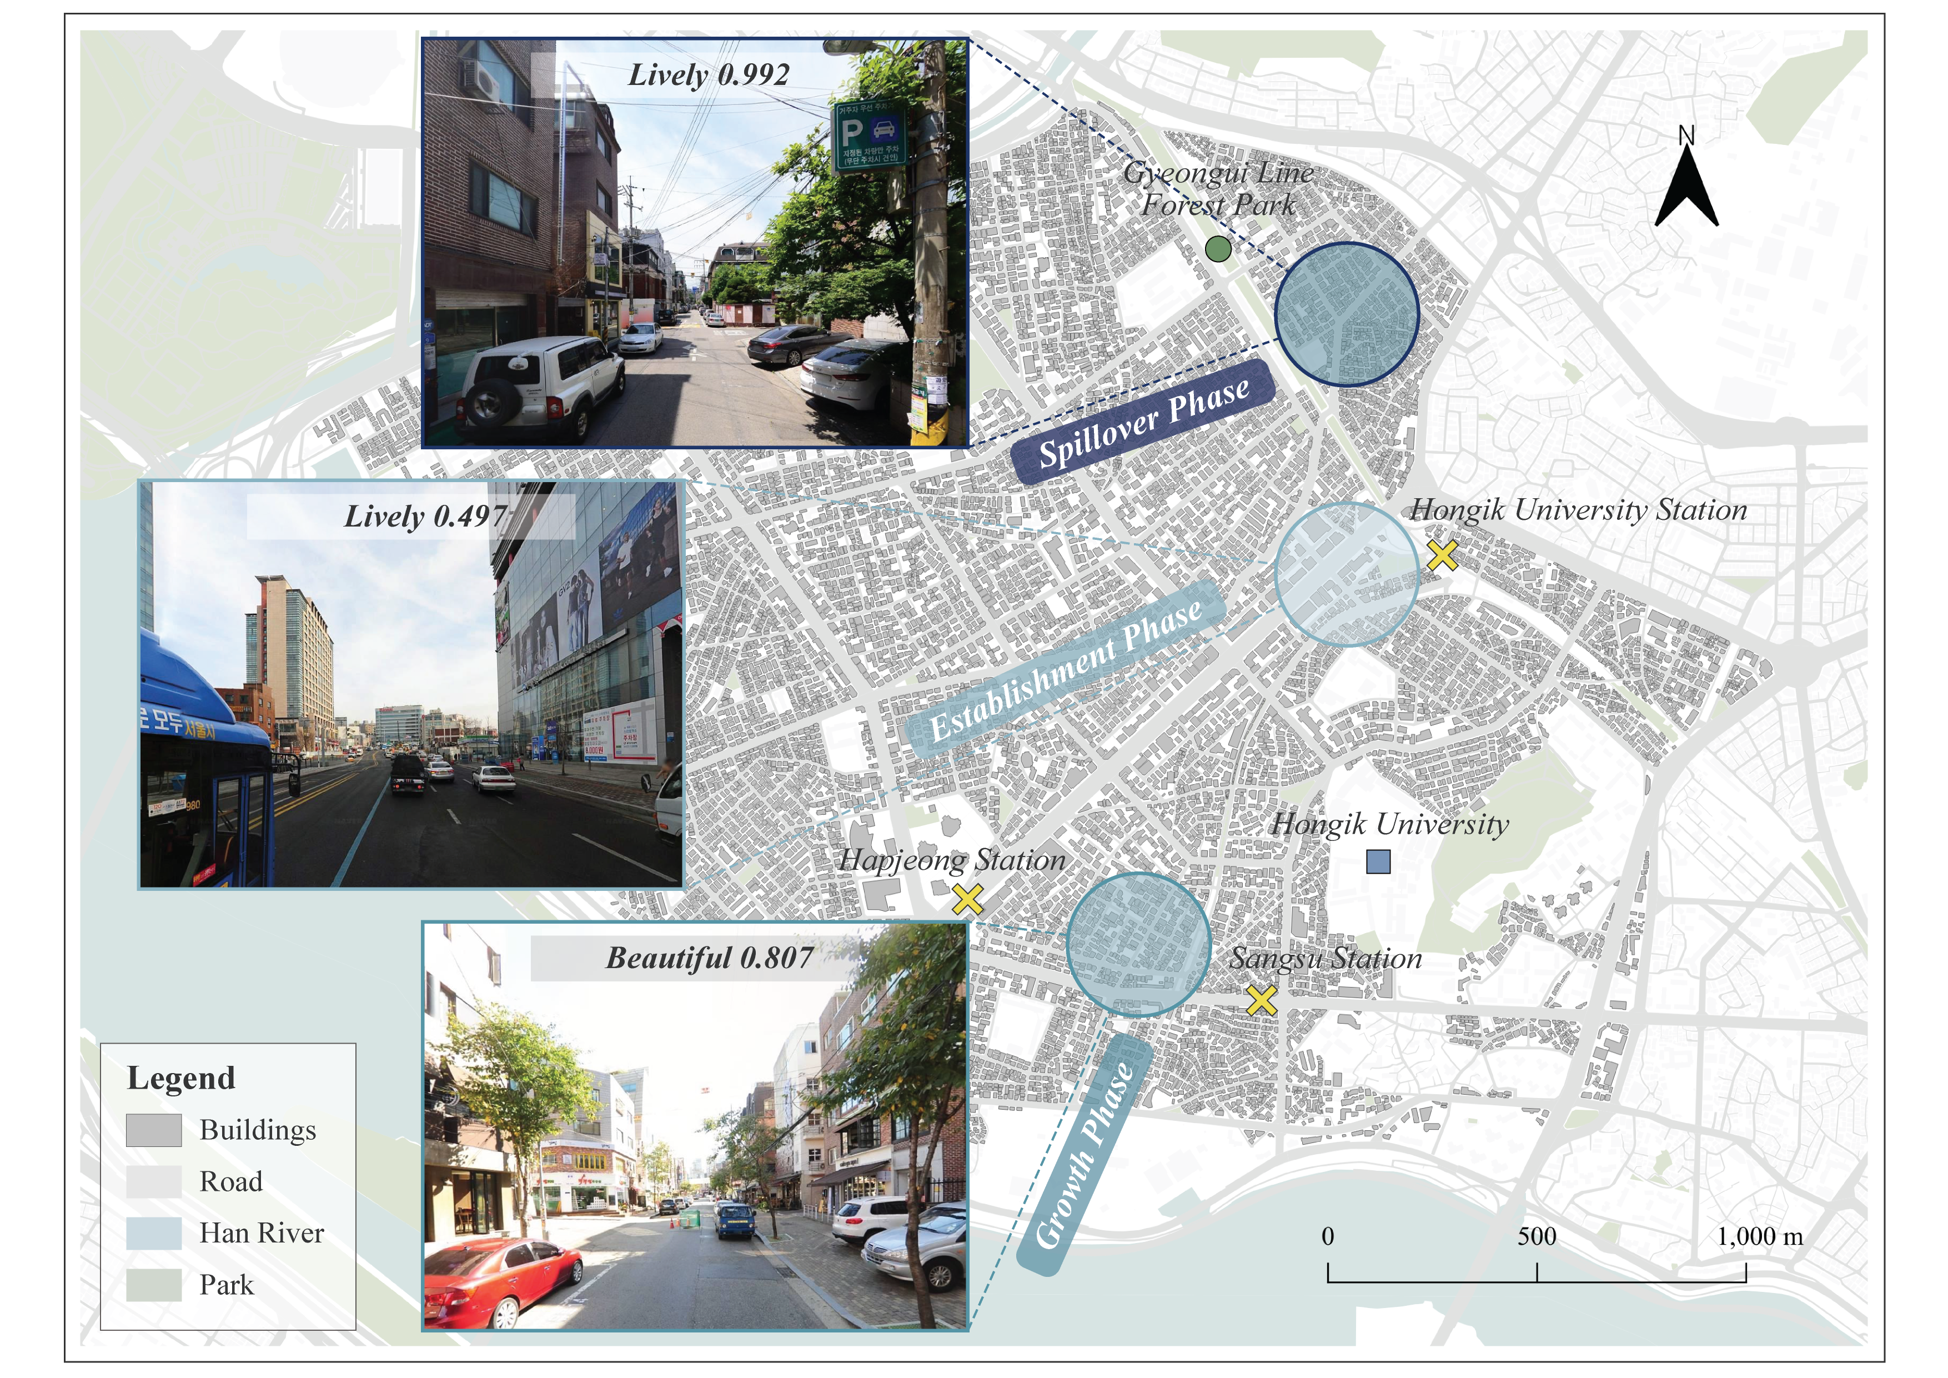
Results
The Spatial Dynamics of Cafés as Everyday Urban Spaces: Exploring Socialscapes through Streetscapes
Discussion
Café location shifts reflect evolves in consumer culture and the influence of streetscape and place perception.
As commercial centres become saturated, cafés shift toward adjacent areas such as alleyways with lower rents—consistent with previous studies on retail expansion (Ley, 1997; Smith, 1979; Zukin, 1987).
This highlights the growing importance of spatial features shaped by consumer experience in café location decisions.

Slide 25
Results
The Spatial Dynamics of Cafés as Everyday Urban Spaces: Exploring Socialscapes through Streetscapes
Discussion
In Growth Phase, cafés concentrated near subway stations and parks. It reflects continued preference for central areas with high transit accessibility and public amenities.
Supports prior studies emphasising the role of public transit as an anchor for pedestrian flow and retail activity (Lee & Kwon, 2015; Wu et al., 2021; Yoshimura et al., 2021)
Highlights how parks attract consumers and generate synergies with surrounding businesses (Sim, 2019)
In Spillover Phase, cafés preferred locations with subway accessibility and narrower street widths. It Indicates a shift away from minimising distance to a fixed destination or prioritising highly walkable central locations.
The relationship between café locations and walkability differs across phases. Café location decisions shift from a focus on transit-based accessibility to a preference for human-scale spaces.

Slide 26
Results
The Spatial Dynamics of Cafés as Everyday Urban Spaces: Exploring Socialscapes through Streetscapes
Discussion
The visual and perceptual quality of streetscapes plays an important role in shaping café location decisions, and this influence differs by phase.
This shift in location—from closed boulevards with limited social interaction to open alleyways that support informal encounters—ultimately contributes to neighbourhood transformation and strengthens the vitality of the broader urban space.
Vibrant and visually appealing streetscapes invite pedestrians, encouraging optional activities (Gehl & Svarre, 2014).
Cafés clustered along pedestrian-friendly and aesthetically pleasing streets, the resulting streetscapes can promote gradual urban growth and enhanced vibrancy (Cox & Streeter, 2019; Jacobs,1961; Kickert & Talen, 2022).
Outdoor cafés that utilise terraces in highly walkable areas, or shops embedded in alleyways that foster active interaction with the street, serve as extensions of public space (Montgomery, 1997; Sim, 2019).
Urban planners should enhance streetscapes and encourage small-scale commercial activity in alley-based retail districts.

Slide 27
Conclusion
The Spatial Dynamics of Cafés as Everyday Urban Spaces: Exploring Socialscapes through Streetscapes
Summary
Café location decisions are shaped by the interaction between urban spatial conditions and consumer preferences.
The importance of location factors has shifted over time.
Accessibility in the Establishment Phase
Walkability in the Growth Phase
Visual and perceptual streetscape qualities in the Spillover Phase
In contemporary urban life, cafés have become key social spaces that support everyday life (Horton & Kraftl, 2013), while streetscapes serve as a medium for memory, experience, and emotional resonance.
Implications
This study re-evaluates the continued relevance of traditional location theories by demonstrating their limitations in explaining the shifting patterns of café locations. It highlights the overlooked connection between café location shifts and streetscape characteristics, emphasising the role of visual and perceptual qualities in shaping retail dynamics.
These insights extend beyond locational shifts to highlight how cafés, as everyday social spaces, contribute to lived experience, sense of place, and urban vibrancy.

Slide 28
References
The Spatial Dynamics of Cafés as Everyday Urban Spaces: Exploring Socialscapes through Streetscapes
Bitner, M.J., 1992. Servicescapes: The impact of physical surroundings on customers and employees. J. Mark. 56, 57–71. https://doi.org/10.1177/002224299205600205.
Casali, Y., Heinimann, H.R., 2019. A topological analysis of growth in the Zurich road network. Comput. Environ. Urban Syst. 75, 244–253. https://doi.org/10.1016/j.compenvurbsys.2019.01.010.
Christaller, W., 1933. Die Zentralen Orte in Süddeutschland. Gustav Fischer, Jena.
Cohen, M.E., Dimick, J.B., Bilimoria, K.Y., Ko, C.Y., Richards, K., Hall, B.L., 2009. Risk adjustment in the American College of Surgeons National Surgical Quality Improvement Program: A comparison of logistic versus hierarchical modeling. J. Am. Coll. Surg. 209, 687–693. https://doi.org/10.1016/j.jamcollsurg.2009.08.020.
Cox, D.A., Streeter, R., 2019. The Importance of Place: Neighborhood Amenities as a Source of Social Connection and Trust.
Gehl, J., Svarre, B., 2013. How to Study Public Life (Vol. 2). Island Press, Washington, District of Columbia. https://doi.org/10.5822/978-1-61091-525-0.
Handy, S.L., Niemeier, D.A., 1997. Measuring accessibility: An exploration of issues and alternatives. Environ. Plan. A. 29, 1175–1194. https://doi.org/10.1068/a291175.
Hillier, B., 1997. Cities as movement economies, in: Intelligent Environments. North-Holland , pp. 295–344. https://doi.org/10.1016/B978-044482332-8/50020-2.
Horton, J., Kraftl, P., 2013. Cultural Geographies: An Introduction. Routledge.
Jacobs, J., 1961. The Death and Life of Great American Cities. Random House, New York.
Kickert, C., Talen, E. (Eds.), 2022. Streetlife: Urban Retail Dynamics and Prospects. University of Toronto Press.
Koo, B.W., Hwang, U., Guhathakurta, S., 2023. Streetscapes as part of servicescapes: Can walkable streetscapes make local businesses more attractive? Comput. Environ. Urban Syst. 106, 102030. https://doi.org/10.1016/j.compenvurbsys.2023.102030.
Lee, H., Kwon, Y., 2016. Commercial Use Expansion patterns in the Cultural Quarter near Hongik University—With special emphasis on a residential district near the Cultural Quarter consisting mainly of detached, low-rise houses. J. Urban Des. Institute Korea. 17, 101–117.
Ley, D., 1997. The New Middle Class and the Remaking of the Central City. Oxford University Press. https://doi.org/10.1093/oso/9780198232926.001.0001.
Lösch, A. (1938). The nature of economic regions. Southern Economic Journal, 71-78.
Montgomery, J., 1997. Café culture and the city: The role of pavement cafés in urban public social life. J. Urban Des. 2, 83–102. https://doi.org/10.1080/13574809708724397.
Sevtsuk, A., 2014. Location and agglomeration: The distribution of retail and food businesses in dense urban environments. J. Plan. Educ. Res. 34, 374–393. https://doi.org/10.1177/0739456X14550401.
Sim, D., 2019. Soft City: Building Density for Everyday Life. Island Press.
Smith, N., 1979. Toward a theory of gentrification a back to the city movement by capital, not people. J. Am. Plann. Assoc. 45, 538–548. https://doi.org/10.1080/01944367908977002.
Wu, M., Pei, T., Wang, W., Guo, S., Song, C., Chen, J., Zhou, C., 2021. Roles of locational factors in the rise and fall of restaurants: A case study of Beijing with POI data. Cities. 113, 103185. https://doi.org/10.1016/j.cities.2021.103185.
Yoshimura, Y., Santi, P., Arias, J.M., Zheng, S., Ratti, C., 2021. Spatial clustering: Influence of urban street networks on retail sales volumes. Environ. Plann. B Urban Anal. City Sci. 48, 1926–1942. https://doi.org/10.1177/2399808320954210.
Yuksel, M., Milne, G.R., Miller, E.G., 2016. Social media as complementary consumption: The relationship between consumer empowerment and social interactions in experiential and informative contexts. J. Con. Mark. 33, 111–123. https://doi.org/10.1108/JCM-04-2015-1396.
Zukin, S., 1987. Gentrification: Culture and capital in the urban core. Annu. Rev. Sociol. 13, 129–147. https://doi.org/10.1146/annurev.so.13.080187.001021.

Slide 29
Thank you!
The Spatial Dynamics of Cafés as Everyday Urban Spaces: Exploring Socialscapes through Streetscapes

