Slide 1
Research on the Construction of City Walk Tourism Routes from the Perspective of Cultural Heritage Conservation: A Case Study of Beiyuanmen Historic and Cultural District in Xi'an
Author’s Name: Qinghang Cheng
Affiliation:Xi'an University of Architecture and Technology
Email:1992389230@qq.com

Slide 2
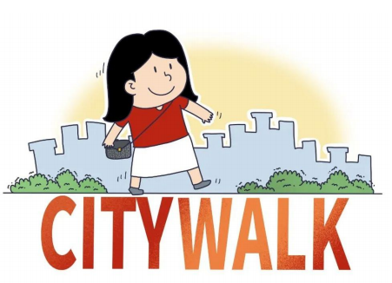
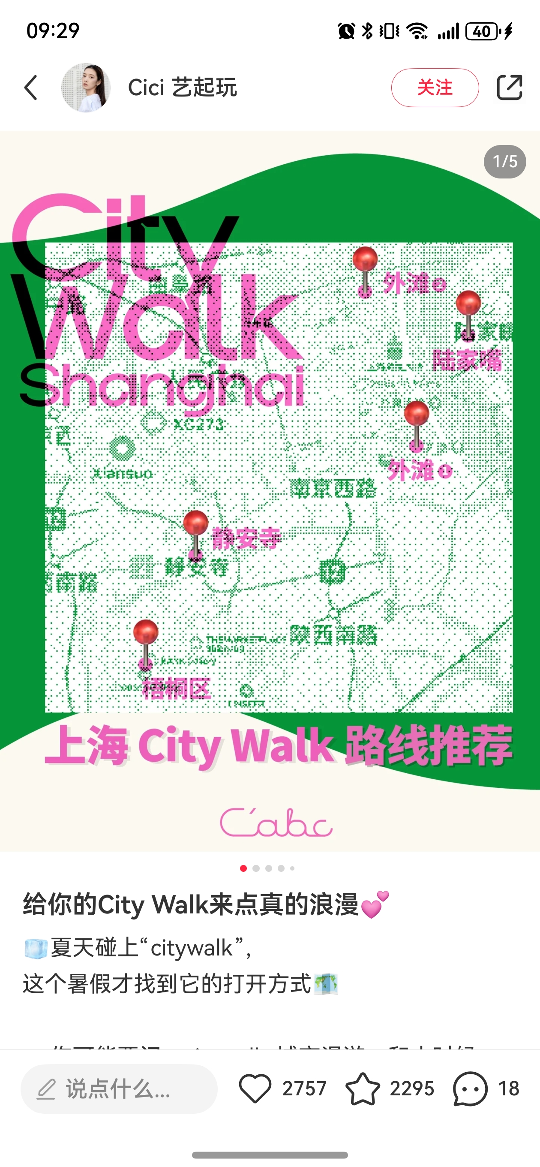
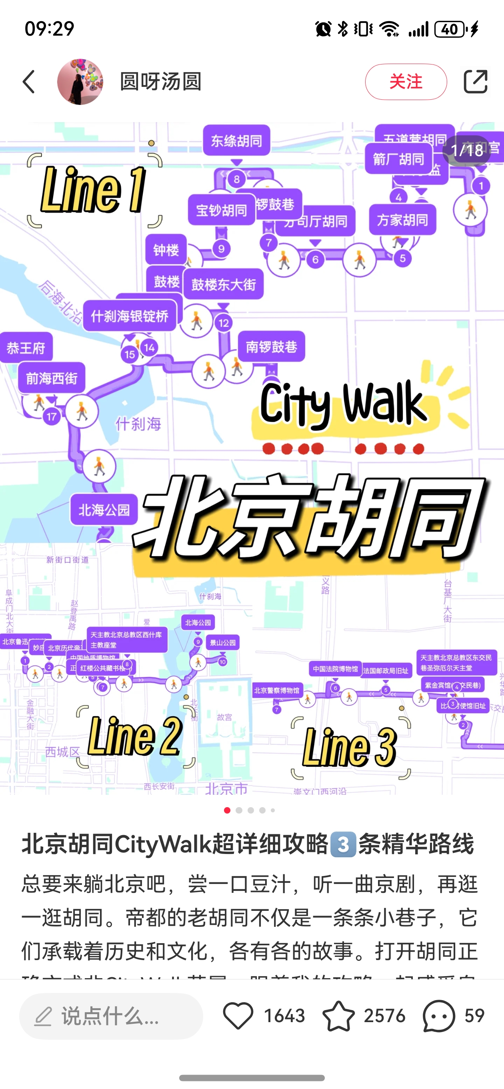
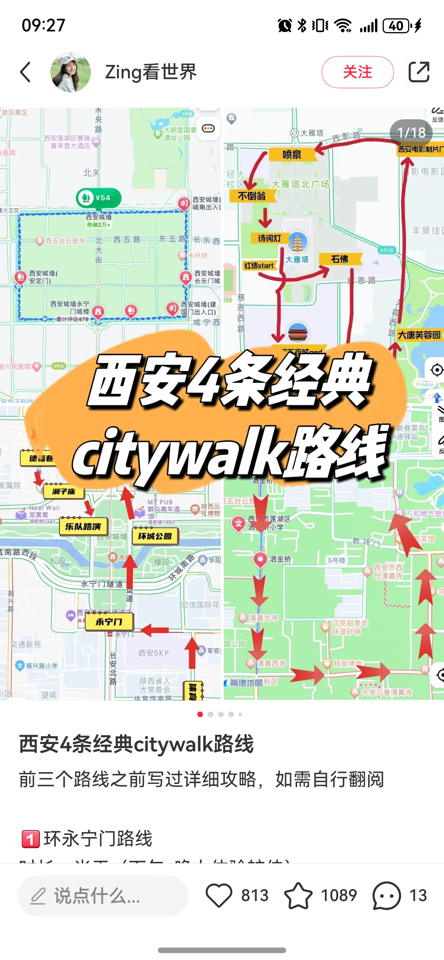
1.Introduction（Research Background）
Within the era of deep integration between culture and tourism and the vigorous development of the experience economy, immersive tourism models epitomised by "City Walk" are rapidly emerging.
Theoretically offers opportunities to revitalise cultural heritage and enhance public understanding of a place's historical stratification and cultural diversity.
This research is grounded in this context, aiming to explore strategies for constructing City Walk tourism routes from the perspective of cultural heritage preservation.

Slide 3
1.Introduction（Problem Statement）
Three principal contradictions exist within the current City Walk routes of Beiyuanmen:The paradox between heritage display and preservation;The contestation for space between tourists and residents;The imbalance between route design and urban form.
The Paradox of Heritage Exhibition and Preservation
Current spatial organisation practices for tourism routes frequently encounter a profound "heritage paradox": to enhance visitor immersion and appeal, route design tends to concentrate and intensively showcase core cultural heritage nodes—such as historic buildings, distinctive sites, and traditional activity points—in high-density sequences. However, this intensive, high-frequency exhibition and utilisation of cultural heritage, when lacking refined regulation and carrying-capacity assessment, readily exceeds both the physical load-bearing thresholds and cultural resilience boundaries of the heritage assets themselves and their environments.
The Spatial Contestation Between Tourists and Residents
The spatial organisation of City Walk routes also acutely instigates a more micro-level and intense spatial contestation within historic districts.
Imbalance Between Route Design and Urban Morphology
The prevailing City Walk route organisation model faces a fundamental structural misalignment: a profound disconnect exists between its premeditated, highly linearised touring logic and the intrinsic, organically complex "courtyard-alley-market" spatial morphology and functional organisation of the Beiyuanmen Historic and Cultural District.

Slide 4
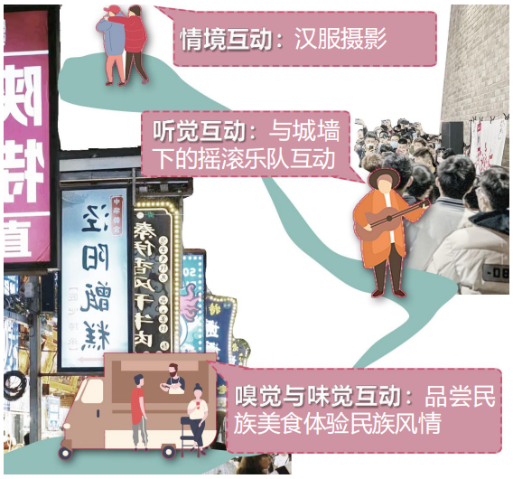
1.Introduction（Research Aims）
This research aims to transcend conventional tourism route planning paradigms. It seeks to move beyond singular efficiency-oriented approaches or static preservation mentalities by constructing a City Walk route system centred on the synergistic trinity of "Heritage Preservation – Tourism Experience – Community Coexistence".
Its fundamental objective is to achieve, within the context of Beiyuanmen—a characteristic high-density, living, dynamic, multi-ethnic historic district—a dynamic equilibrium and long-term mutual reinforcement between:The sustainable safeguarding and transmission of cultural heritage, and The high-quality development of tourism.

Slide 5
2.Literature Review（ Cultural Heritage Preservation and Tourism Utilisation）
The preservation and rescue of cultural heritage constitute a vital component of human civilisation and strategies for sustainable societal development, representing a collective societal obligation.
(ZHENG Xiaoxie)Presently, China faces issues such as constructive damage and tourism-induced degradation in the balance between protecting cultural heritage and its exploitation for tourism purposes .
"cultural routes" and "heritage corridors" emphasise the historical and cultural value of heritage while prioritising balance with economic benefits and socio-environmental value, though operating at larger scales.
scholar ZOU Han proposes the concept of the "heritage trail," a regional linear cultural heritage conservation method applicable to smaller-scale historic areas. This involves planning and constructing tourist routes that link and integrate multiple cultural heritage resources, establishing visitor nodes and providing services.

Slide 6
2.Literature Review（The Spatial Narrative Turn in City Walk）
Spatial narrative, a method that combines a structural system of events arranged along the axis of time and causal logic with a spatial juxtaposition system characterized by coexistence and synchronicity, is described as a 'spatiotemporal complex.'
(Xiao Jing) argues that current cultural heritage protection is increasingly showing a trend towards narrative and cognitive spatiotemporal positioning.
Specific methods:
(Zhuang Xiaoping) developed a 'value cognition depth map' using 'historical richness' and 'time depth' as indicators to quantitatively assess the value of ancient city heritage.
(Li Yuan) identified visual preference as the key factor influencing tourists 'decision-making and proposed a method for simulating pedestrian flow and optimizing tourist routes.
Thus, the spatial narrative shift initiated by City Walk is not merely an innovation in tourism products but a profound transformation in the perception and revitalization of historical districts.

Slide 7
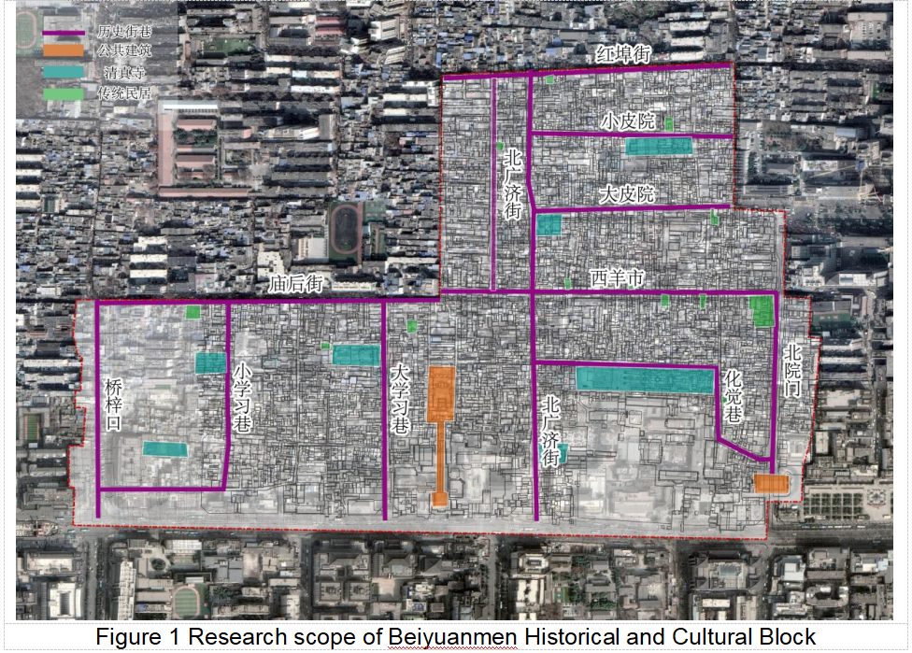
3.Methodology（Research Area）
The Beiyuanmen Historical and Cultural Block, located in the northwest of Mingcheng District, Xi’an, is the area with the highest concentration of Muslim residents in Xi’an. Having experienced development from the Tang, Song, Yuan, Ming and Qing Dynasties to modern times, it preserves still the traditional ‘seven temples and thirteen wards’ layout of the Ming and Qing periods.

Slide 8
3.Methodology（Data Sources）
Spatial data: CAD topographic maps, POI (Points of Interest) data.
Behavioural data: Over 200 travel notes from social media were selected by searching keywords like 'Beiyuanmen' and 'city walk' on Xiaohongshu（red book).
The main purposes for visitors to enter the block are to experience the food, history, Islamic culture and the local atmosphere.

Slide 9
3.Methodology（Technical Framework）
This study applies a progressive technical route of spatial computation - behaviour sensing - semantic mining - intelligent optimisation. By integrating multi - source data and coordinating multiple models, it accurately analyses the spatial genes of the Beiyuanmen block, tourist behaviour patterns, and cultural cognition characteristics.
Firstly, using the depthmapX platform to construct a block axis model and calculate key indicators to precisely identify the disharmonious areas between current paths and the block's natural texture.
Secondly, in ArcGIS10.6 software, based on social media geographical tags and field observation points, applying kernel density estimation to generate tourist spatial aggregation heatmaps.
Then, utilising travel notes published on social media to extract the main subjects tourists focus on, conducting visual - association to identify cultural cognition breakpoints and reveal tourists' perceptual blind spots of the block.
Finally, performing multi - objective constraint optimisation of the historical and cultural block City Walk path.

Slide 10
4.Results（Spatial Form Characteristics）
This study uses axial analysis and segment analysis. Axial analysis assesses the integration and connectivity of the Beiyuanmen Historical and Cultural Block, while segment analysis evaluates the selection of streets within the block.
Integration, a key indicator of space syntax theory, reflects the accessibility of nodes in a spatial system and the closeness of their connections.
Choice, the frequency a space appears on the shortest topological paths, is closely related to traffic potential.
Connectivity, the number of nodes connected to a specific node, indicates the spatial connections.

Slide 11
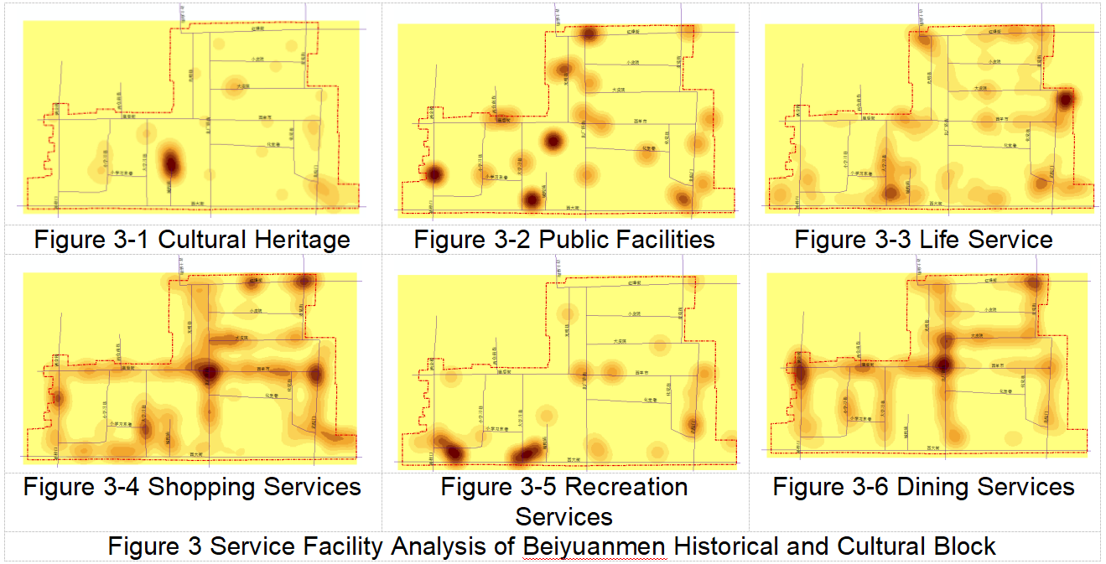
4.Results（Heritage Perception Characteristics）
This study conducted a Kernel Density Analysis of POIs in the Beiyuanmen Historical and Cultural Block, covering cultural heritage, public facilities, daily services, shopping, leisure, and dining services that cater to both residents and tourists.

Slide 12
4.Results（Heritage Perception Characteristics）
The results show that residents' daily and leisure services are mostly marginalised into non - core peripheral areas due to tourism - related space encroachment, with only a few shared public facilities evenly distributed. Tourists' activities mainly focus on historical lanes and cultural heritage sites, leading to a proliferation of shopping and dining services along these streets, which in turn crowds out residents' living spaces.
Specifically, shopping services are concentrated in Beiyuanmen, Xi Yang Market, and North Guangji Street, near the Bell and Drum Towers, attracting tourists who mainly engage in superficial sightseeing. Dining services are mainly found in North Guangji Street, Shajin Bridge, Dapi Courtyard, and Miao Hou Street, which are more integrated into the local community and attract tourists seeking an in - depth experience.

Slide 13
4.Results（Heritage Perception Characteristics）
Secondly, through an analysis of travel notes posted on social media, including a word frequency analysis, it was found that the most frequently mentioned locations by tourists are "Shajin Bridge" and "Beiyuanmen", representing the block's culinary and cultural heritage highlights respectively.

Slide 14
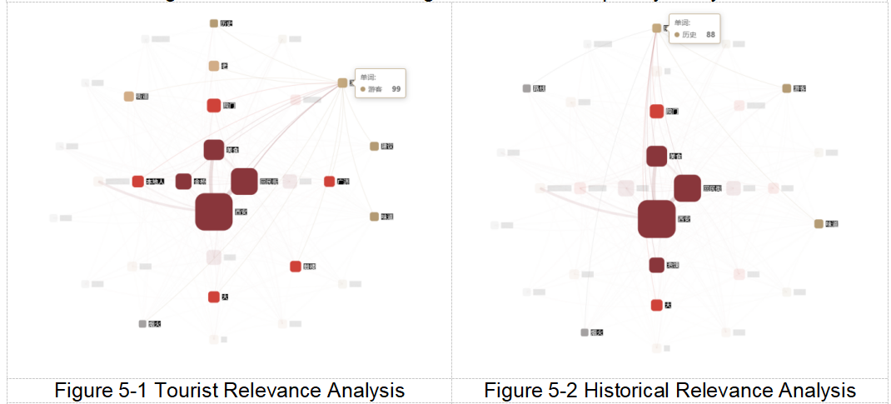
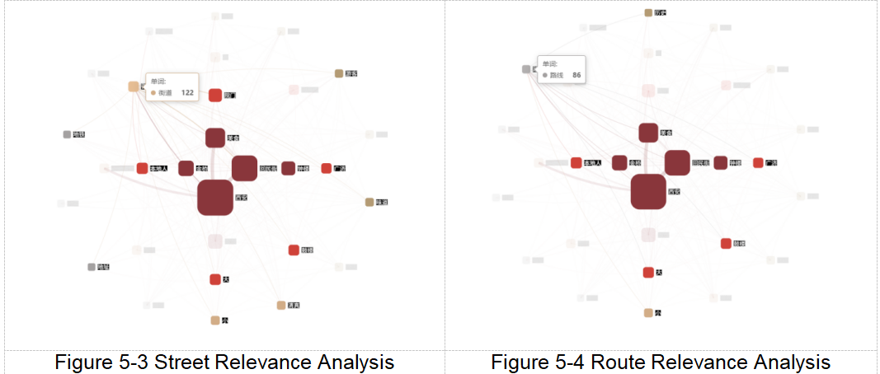
4.Results（Heritage Perception Characteristics）
Several historical lanes and culinary elements are closely watched by tourists. Currently, the tour routes within the Beiyuanmen Historical and Cultural Block are closely related to historical and cultural heritage, historical lanes, and culinary culture.

Slide 15
4.Results（Route Optimisation Plan）
This paper proposes a "double loop" system for the City Walk tourist route in the Beiyuanmen Historical and Cultural Block. The main loop links core heritage sites, while the micro loop offers an in - depth experience within residential courtyards.
The main loop, combining cultural heritage and halal food experiences, starts at the Drum Tower and follows a circular route. It links the “seven temples and thirteen wards” spatial pattern, enhancing the historical block's spatial experience. About 2.5 km long, it takes 2 - 3 hours and covers 90% of core resource spots.
There are two micro loops. One is the community culture experience route on the northeast side. It starts at Guangji Street, goes through Xiao Pi Courtyard, Mai Xiang Street, Beiyuanmen, and the Drum Tower, allowing participation in community activities and experiencing the halal community culture. The other is the halal food culture experience route on the west side. It starts at Guangji Street, goes through Miao Hou Street, Da Mai Market Street, and Shajin Bridge, where tourists can taste the food of century - old shops.

Slide 16
5.Discussion（Balancing Heritage Protection and Display Mechanisms）
As a traditional settlement area in Xi'an Mingcheng District with distinctive local features, The City Walk route aims to balance heritage protection and public display, and resolve the conflict between protection rigidity and utilisation flexibility.
Core protection zones, covering sites like the Gao Family Courtyard and Huajue Alley Mosque, follow the minimal - intervention principle, focusing on static display and cultural interpretation.Style - coordination zones, including Ming and Qing streets like Xi Yang Market, allow moderate commerce but with strict business control, aiming for themed commercial experiences.Update - transition zones involve other general streets, which undergo minor changes to embed cultural spots.
Also, to prevent tourist overcrowding on main streets, themed routes guide visitors to secondary streets. This spatial - temporal narrative reconstruction of cultural understanding eases core zone pressure and activates the block's heritage value.

Slide 17
5.Discussion（Community Participation Implementation Path）
The sustainability of heritage protection and display relies on community residents shifting from "managed objects" to "main participants". Beiyuanmen Block has designed multi - level and practical implementation paths for social participation to establish a real "bottom - up" co - governance mechanism.
Firstly, local residents are recruited as City Walk guides to share their personal memories of the block's evolution, enhancing visitors' cultural experience.
Secondly, intangible cultural heritage workshops are set up. With small scale, appointment - based, and in - depth interaction principles, these workshops avoid performance and commercialisation, aiming to restore historical scenes of value and offer deep cultural exchanges.
Lastly, local shops are certified. Those using traditional crafts and highly rated by visitors and residents are added to the City Walk recommendation list.

Slide 18
6.Conclusion
this study builds an assessable, operable, and promotable City Walk route planning and management paradigm.
First, it resolves the heritage protection - development paradox by suggesting a mechanism.
Second, it reconciles tourist - resident spatial games to safeguard community spatial rights.
Third, it bridges the route - spatial - form gap, creating an embedded network route.
This paradigm serves Beiyuanmen Block's sustainable development and offers theory and practice references for similar global heritage sites, proving protection and development can be dynamically balanced and mutually reinforcing through smart spatial interventions.
However, given the unique spatial forms and routes of historical blocks with different cultural attributes, City Walk planning and management must be tailored to each block's specific characteristics.

Slide 19
Thank you!

