Slide 1
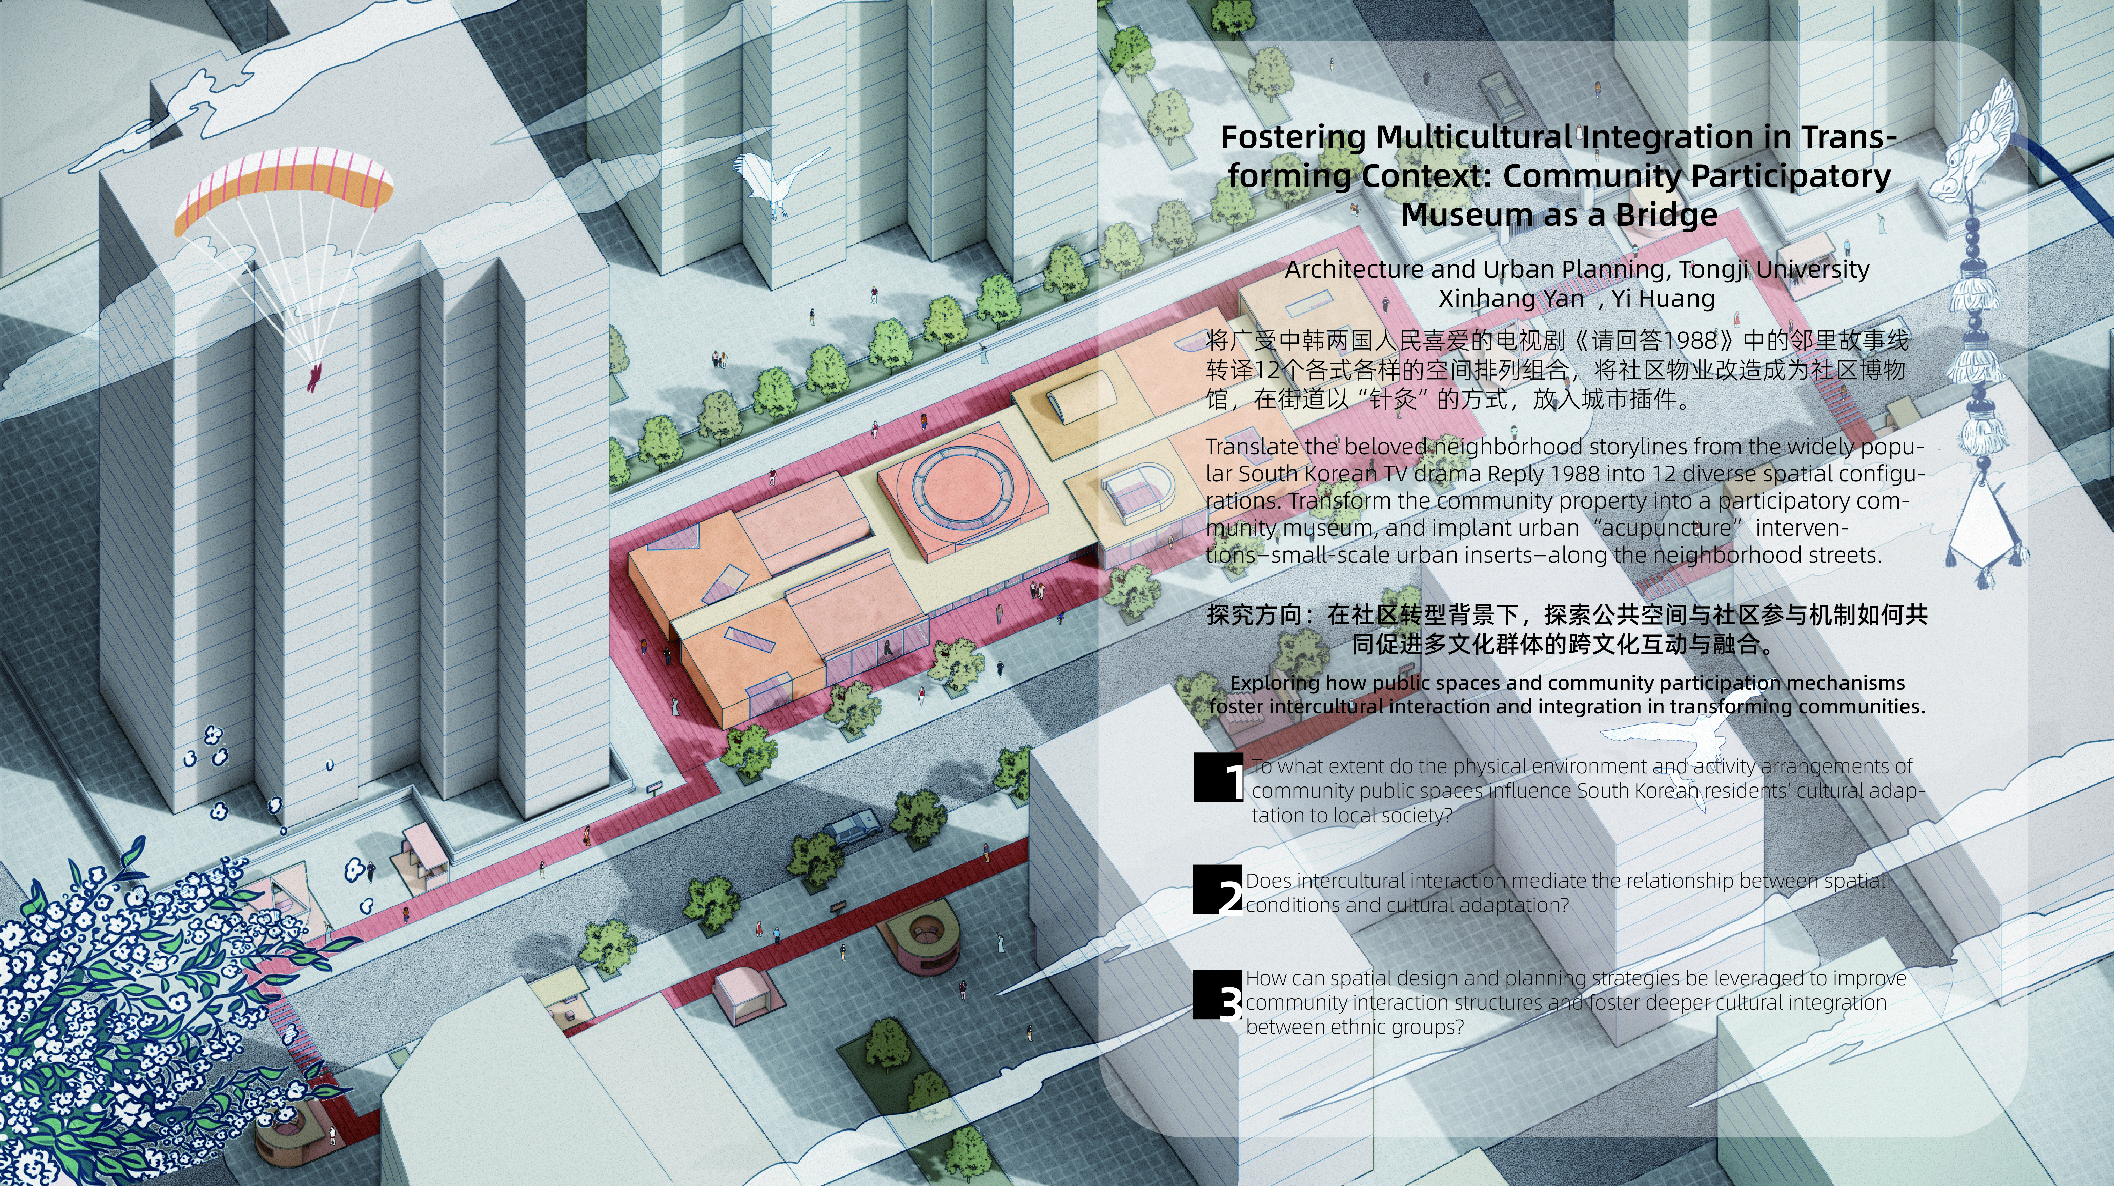
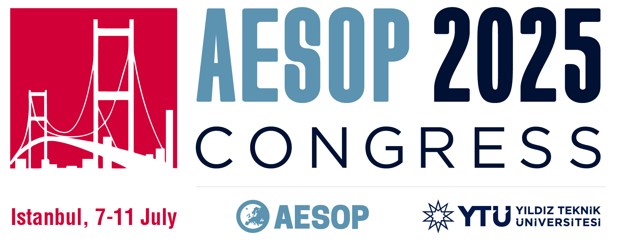
Notes:
Hi everyone, it's a great pleasure to be here today to share and explore this topic with you.My presentation focuses on a transforming mixed residential neighborhood in central Qingdao, China, where a large number of South Korean residents have lived and operated businesses since the 1990s. With the establishment of diplomatic relations between China and South Korea, this area became a key settlement for Korean migrants. Over time, however, it developed into what we call a "parallel adaptation" model: Korean residents maintained their own cultural and commercial networks, with limited engagement with local Chinese residents. While this pattern supported cultural preservation, it also restricted mutual understanding and increased social distance.

Slide 2
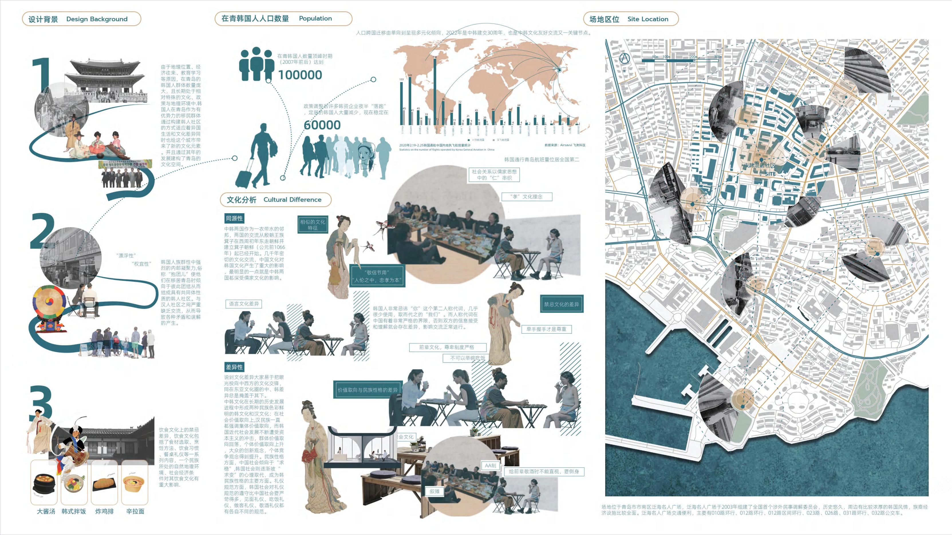
Notes:
Following the 2008 financial crisis, a large number of Korean businesses closed or relocated, triggering economic downturns and aggravating tensions between ethnic groups. In recent years, rising labor costs have further accelerated demographic and cultural transitions in this community.
Today, the neighborhood is at a critical turning point, moving from ethnic separation to social transformation. This situation raises an urgent need for new strategies that can foster deeper cultural integration through shared spaces and participatory initiatives.In this context, we aim to explore the following questions:
To what extent do the physical environment and activity arrangements of community public spaces influence South Korean residents’ cultural adaptation to local society?
Does intercultural interaction mediate the relationship between spatial conditions and cultural adaptation?
How can spatial design and planning strategies be leveraged to improve community interaction structures and foster deeper cultural integration between ethnic groups?

Slide 3
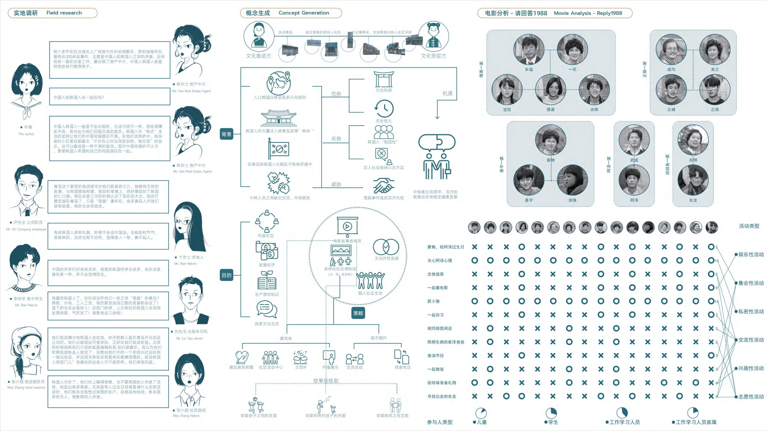
Notes:
This research is grounded in cultural adaptation theory, with particular attention to the transition between parallel adaptation and active cultural integration.
We conceptualize public space not as a passive backdrop, but as a potential social interface, capable of enabling interactions. We also draw on the idea of narrative co-creation, meaning that the use of space generates shared meaning, which in turn influences how people relate to one another.This research is grounded in cultural adaptation theory, with particular attention to the transition between parallel adaptation and active cultural integration.
We conceptualize public space not as a passive backdrop, but as a potential social interface, capable of enabling interactions. We also draw on the idea of narrative co-creation, meaning that the use of space generates shared meaning, which in turn influences how people relate to one another.We adopted a mixed-methods approach including:
A literature review focusing on Korean communities in Qingdao, transnational migration, cultural adaptation, and public space.
GIS spatial analysis to map cultural resources and identify interaction nodes.
Behavioral observations to study how public spaces are used at different times of day.
Questionnaires and structured interviews with both Korean and Chinese residents, to gather their perceptions of the environment, usage experiences, and willingness to interact.
Finally, we used PLS-SEM modeling to examine how physical environments, activity programs, and individual agency influence cultural adaptation through intercultural interaction.

Slide 4
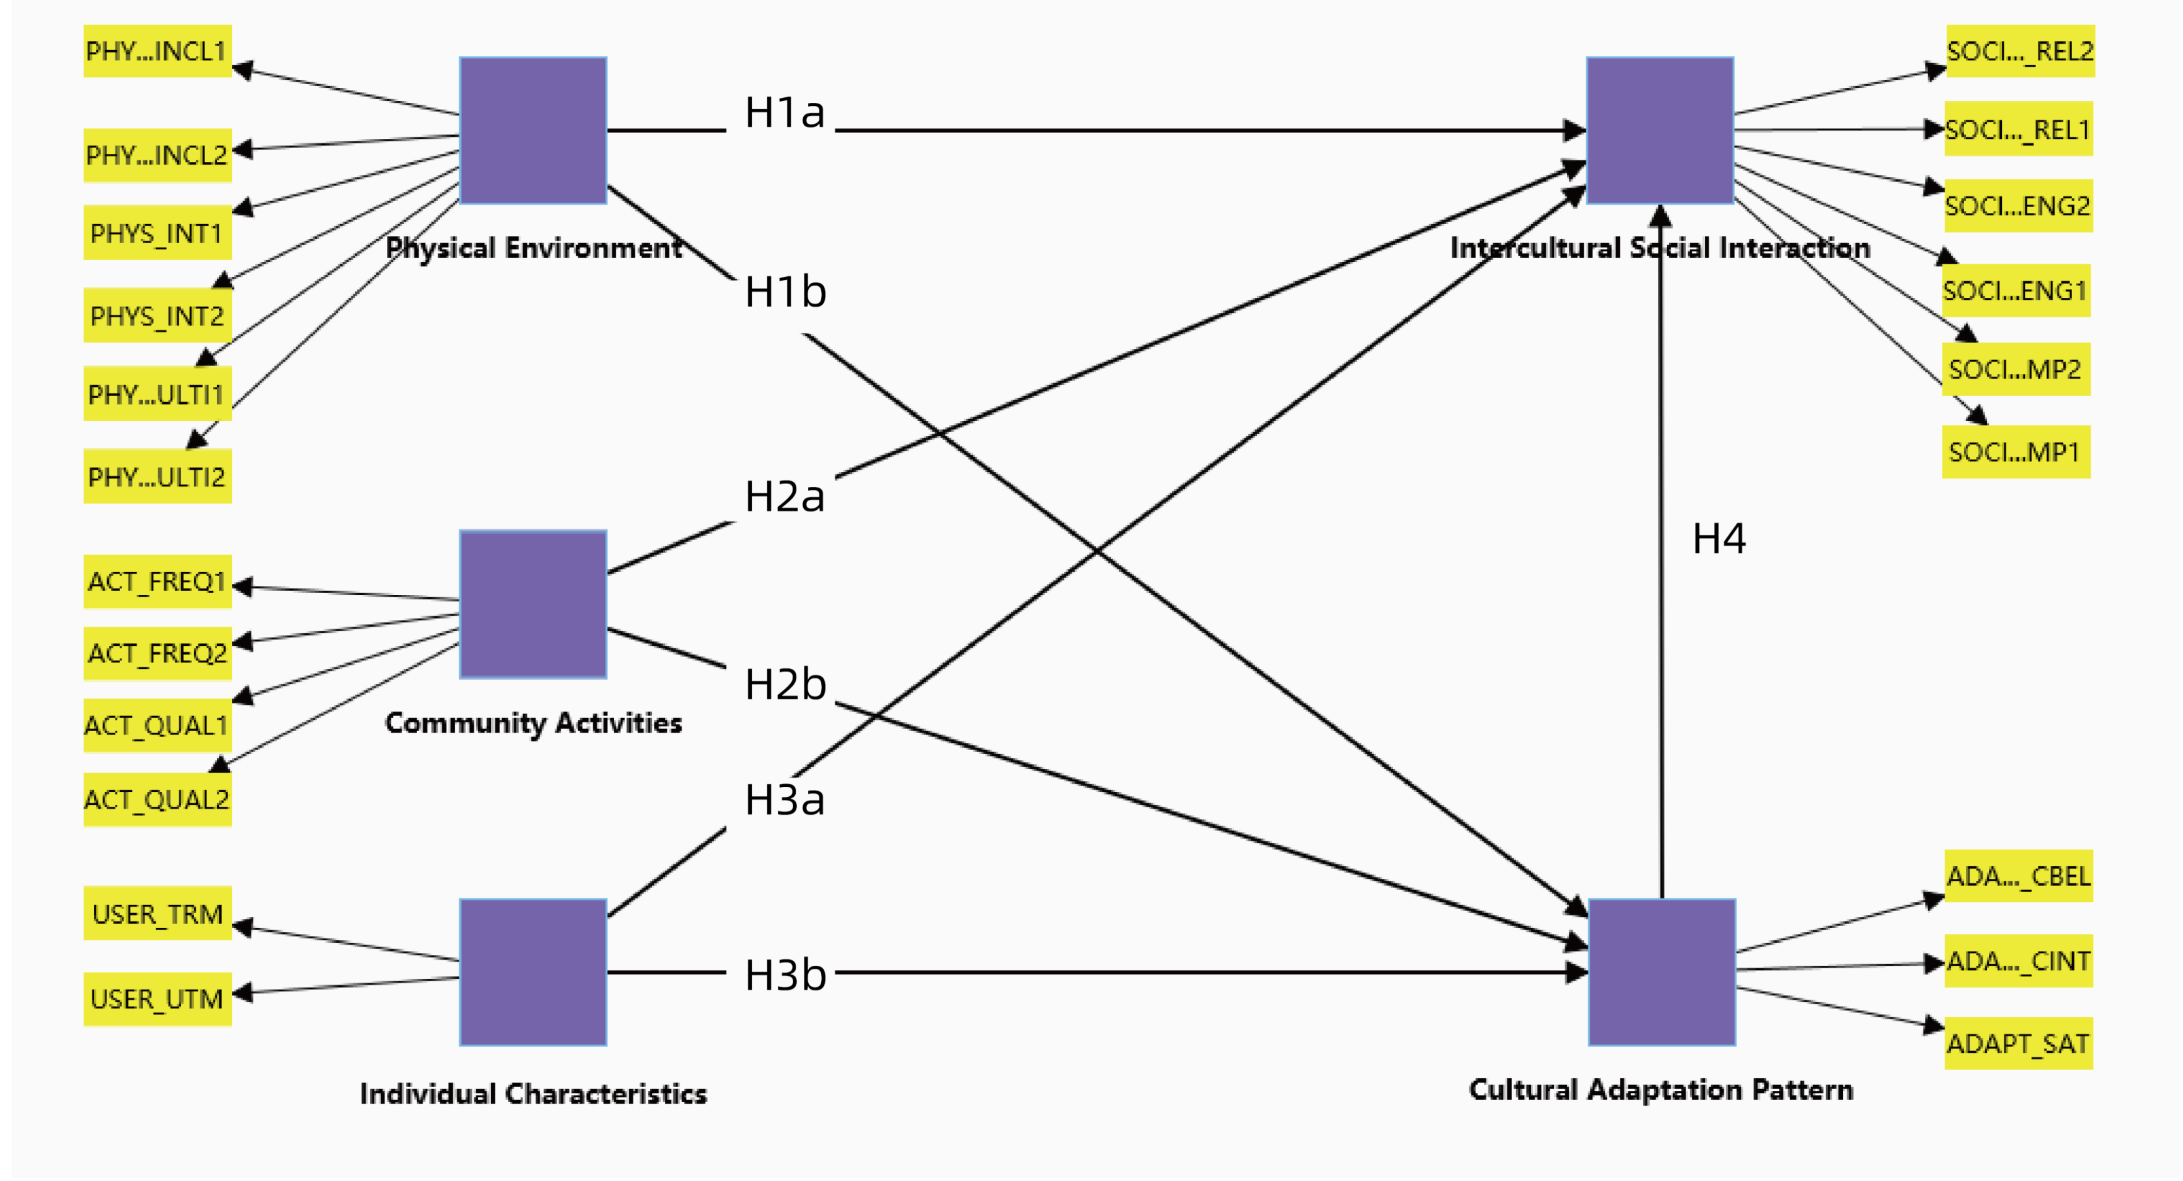
Latent Variable | Rigorous Definition | Observed Variables (Indicators)
Physical Environment | The physical characteristics and design quality of public spaces in residential communities, including their support for social interaction, multifunctional use, and cultural inclusivity. | INT: Spatial interactivity (whether the space facilitates spontaneous interactions among residents) MULTI: Spatial multifunctionality (whether the space supports leisure, socializing, entertainment, and other functions)
Community Activities | Various public cultural and social activities organized for residents, including local festivals and cross-cultural exchange events, with a focus on frequency and interactivity. | FREQ1: Frequency of traditional festival activities (e.g., Spring Festival, Mid-Autumn Festival) FREQ2: Frequency of cross-cultural exchange activities (e.g., Sino-Korean Cultural Festival)
Individual Characteristics | Residents’ participation in community spaces and activities, measured by frequency and duration, reflecting active use and engagement.. | UTM: Weekly participation frequency (number of engagements per week) TRM: Duration per visit (time spent in public spaces or activities per session)
Intercultural Social Interaction | The quality of social interactions between Korean and local residents in a cross-cultural community setting, including breadth of social relationships, sense of companionship, and active engagement. | REL: Degree of social relationships (extent of connections with residents from different cultures) CMP: Sense of companionship (belonging and identification within the community) ENG: Frequency of intercultural interaction (willingness and behavior in actively engaging in exchange activities)
Cultural Adaptation | The degree of cultural integration and sense of belonging among Korean and local residents in the Qingdao community. | CAI: Cultural assimilation (feeling of adapting to local cultural life) CBI: Cultural integration ("I can maintain my own culture while integrating into the local community") AP: Active participation ("I am willing to participate in cultural activities with local residents")
Path | Standardized Coefficient (β) | t-value | p-value | Verification
H1a: Physical Environment→ Intercultural Social Interaction | 0.174 | 1.606 | 0.108 | Reject
H1b: Physical Environment→ Cultural Adaptation Pattern | 0.592 | 8.000 | <0.001 | Accept
H2a:Community Activities→ Intercultural Social Interaction | 0.136 | 1.311 | 0.190 | Reject
H2b: Community Activities→ Cultural Adaptation Pattern | 0.288 | 3.142 | 0.002 | Accept
H3a: Individual Characteristics→ Intercultural Social Interaction | 0.224 | 2.182 | 0.029 | Accept
H3b: Individual Characteristics→ Cultural Adaptation Pattern | -0.045 | 0.411 | 0.681 | Reject
H4: Intercultural Social Interaction→ Cultural Adaptation Pattern | 0.506 | 4.332 | <0.001 | Accept
Notes:
First, space matters. Well-designed, multifunctional, and inclusive public spaces significantly improve the quality of intercultural interactions. These spaces provide comfort, flexibility, and opportunities for spontaneous encounters across ethnic boundaries.
Second, interaction is the key mediator. Our PLS-SEM results show that spatial and programmatic conditions do not directly lead to integration. Instead, they work through stimulating interaction. In other words, design provides the conditions, but it is human behavior—interaction—that truly drives cultural adaptation.
Third, individual differences play an important role. Residents’ openness, language ability, and length of residence all influence the frequency and depth of cross-cultural interactions. This suggests that urban design and community programming should also provide language support, cultural mediators, and low-barrier opportunities to participate.

Slide 5
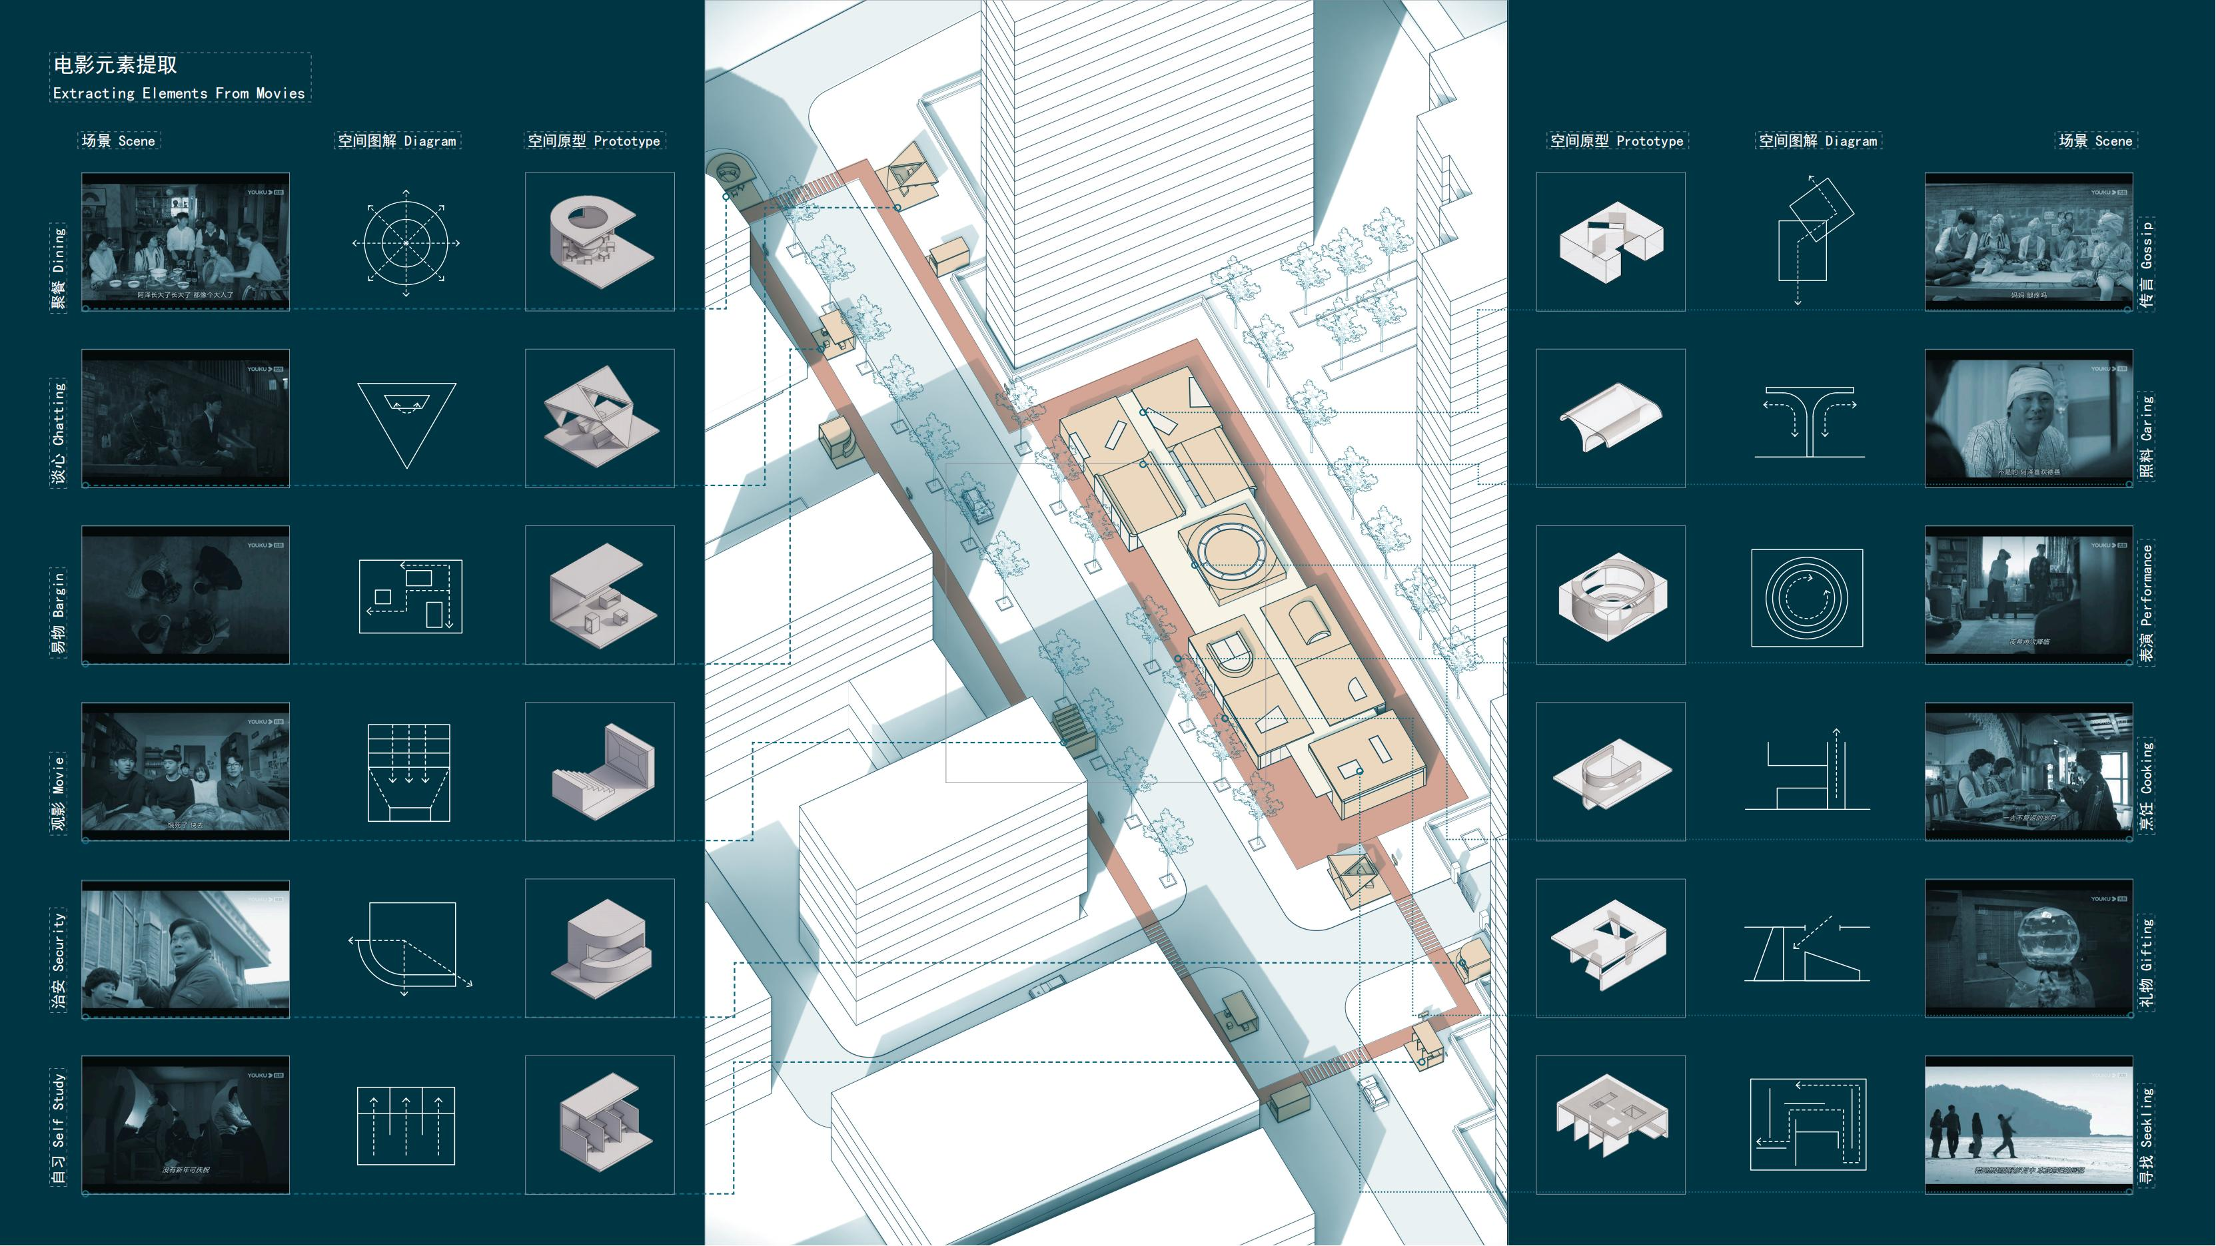
Notes:
Based on these insights, we propose an alternative strategy: a Community Participatory Museum, designed and governed by residents.
We drew inspiration from the popular Korean TV series Reply 1988, using its narrative of neighbourhood warmth and intergenerational trust to imagine 12 multi-functional public spaces, including:
A shared kitchen for cross-cultural food exchanges,
A craft workshop for Korean kimchi and Chinese paper-cutting classes,
A neighbourhood cinema for film screenings and storytelling,
And “urban acupuncture” nodes—such as bilingual signage, interactive street art, and memory walls—to encourage chance encounters and spontaneous conversation.
Together, these elements transform the community into a living museum—a place where cultural memories are preserved, but also co-created through participation and shared experience.

Slide 6
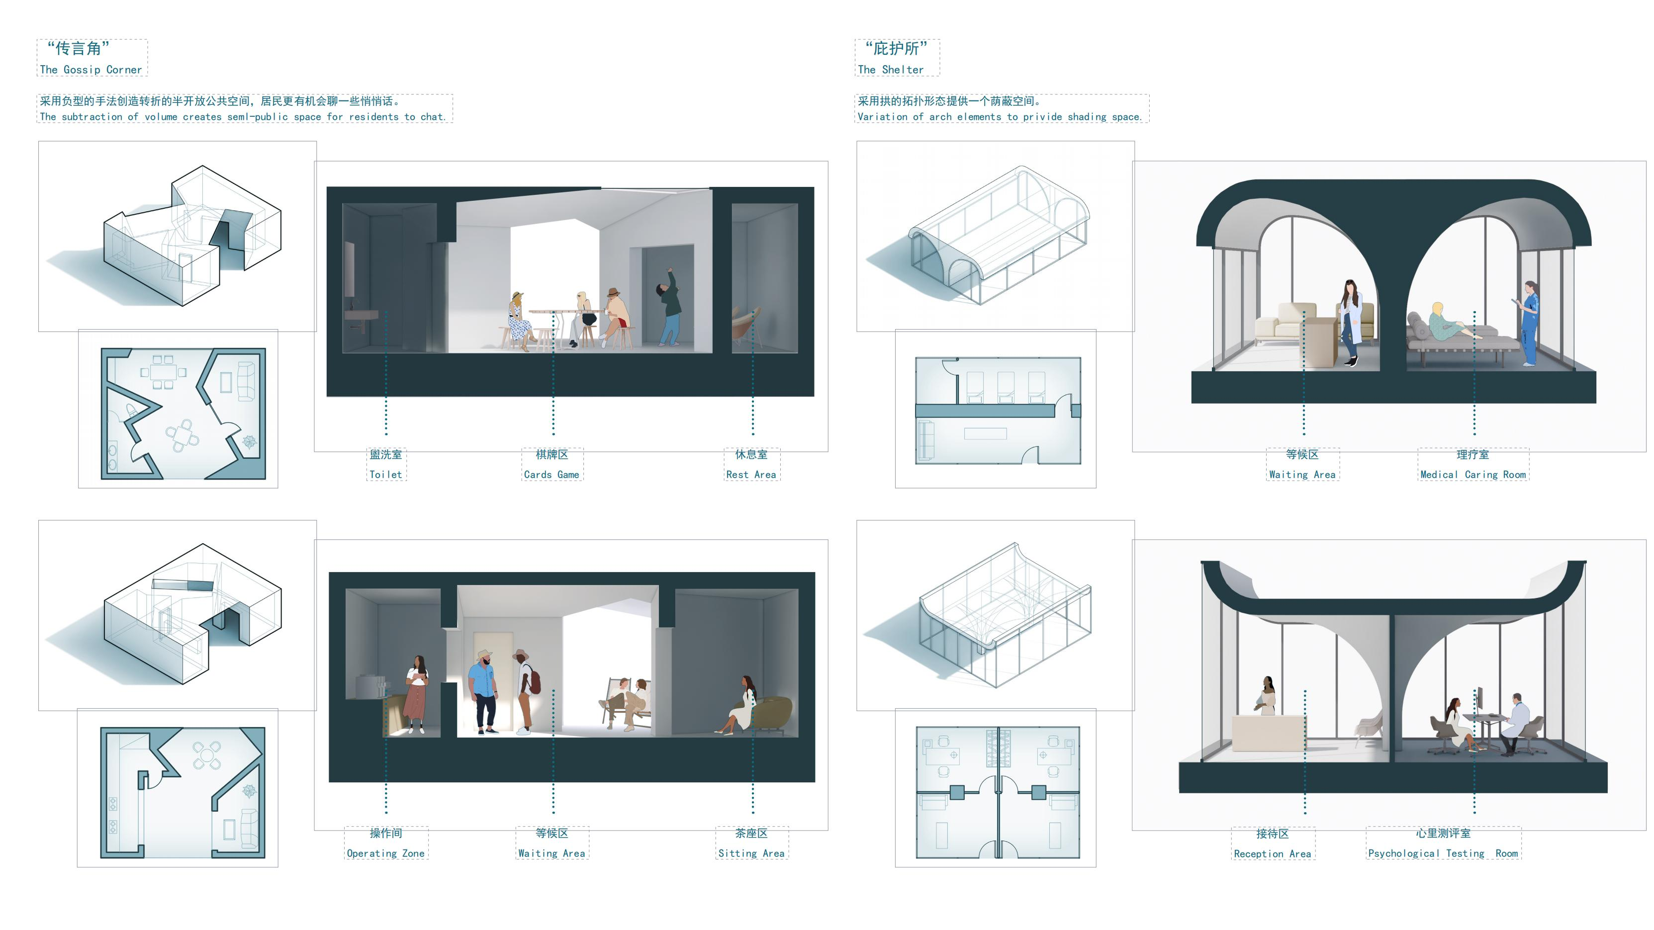

Slide 7
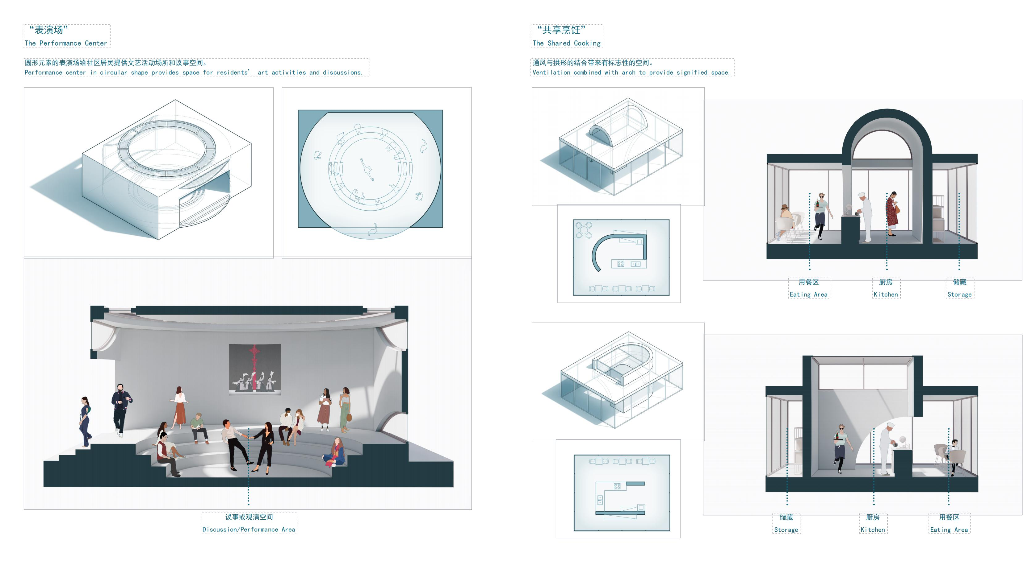

Slide 8
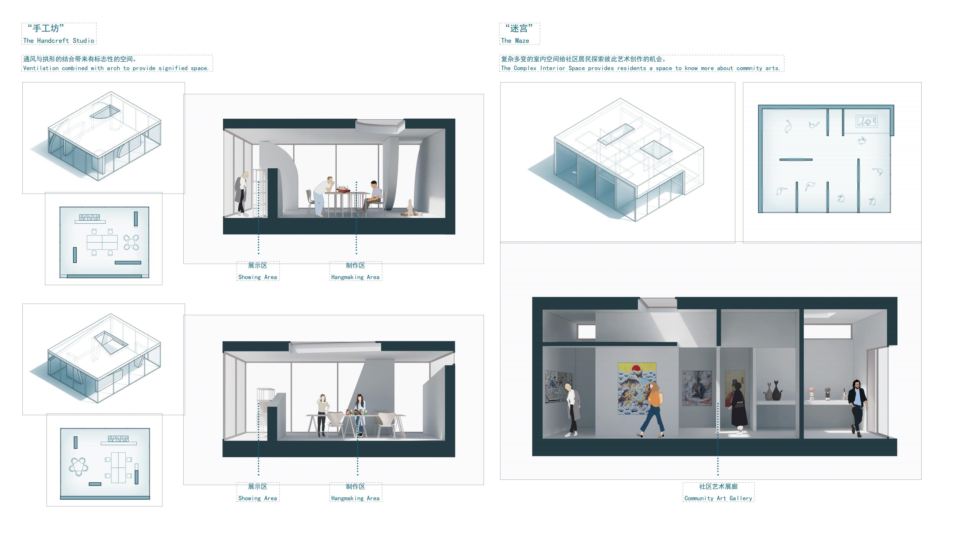

Slide 9
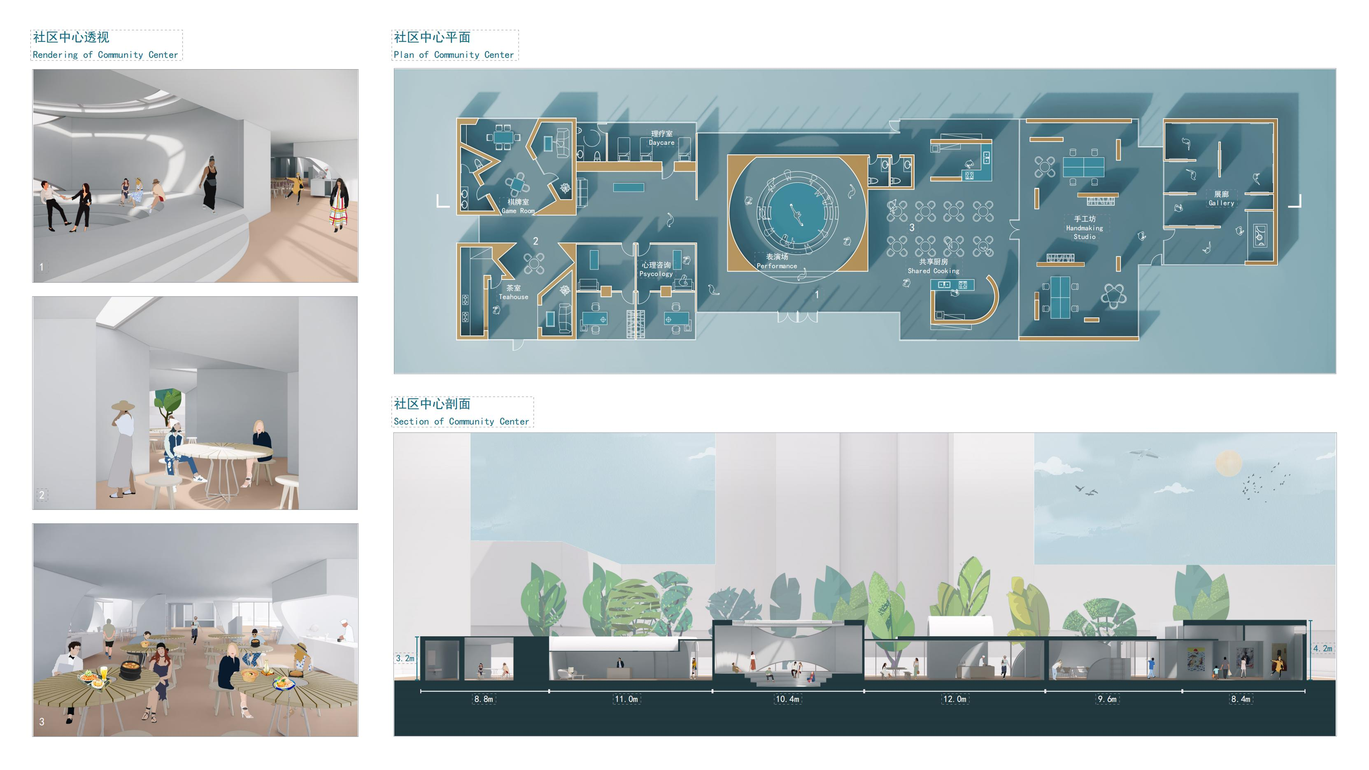

Slide 10
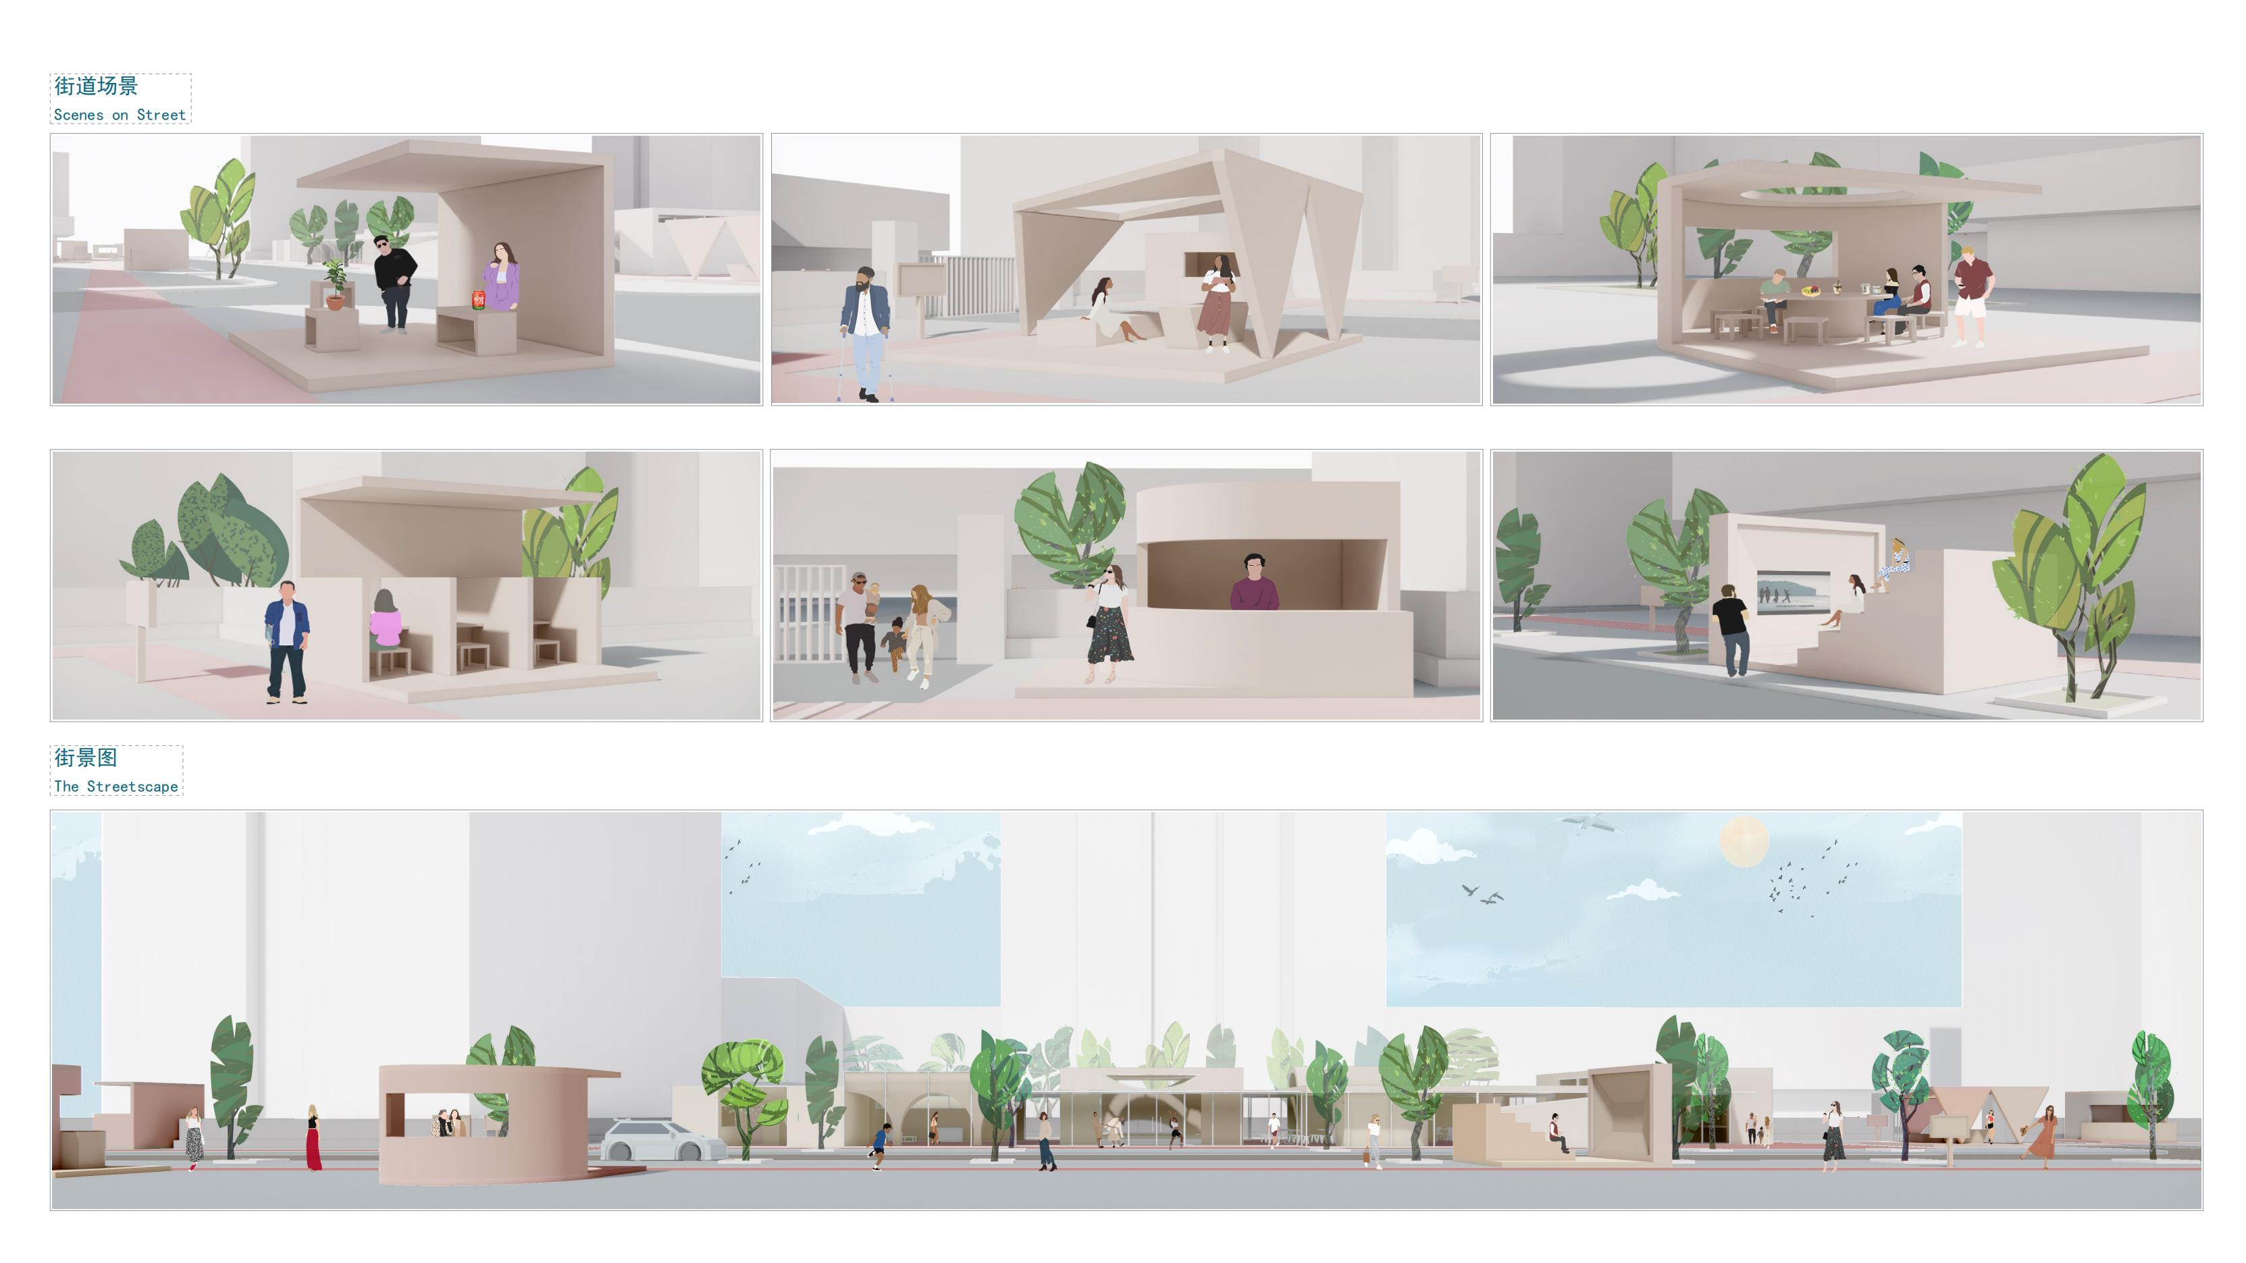

Slide 11
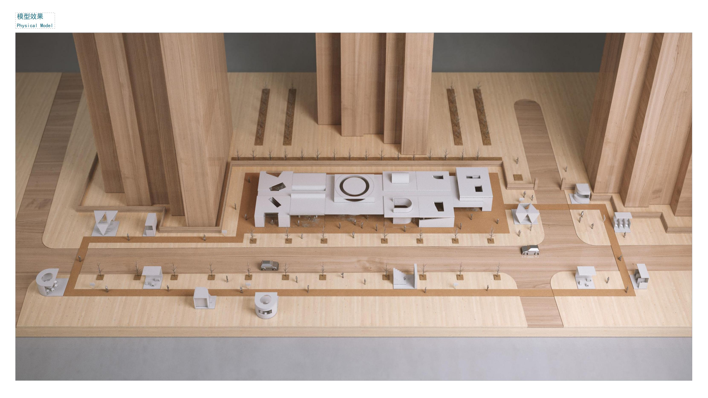
Thank you!
Notes:
n summary, this study demonstrates that public space + community engagement + intercultural interaction can work together to promote genuine cultural integration in transforming neighbourhoods.
From a practical perspective, our approach offers planners concrete strategies to strengthen social cohesion in diverse communities.
From a theoretical perspective, it highlights the importance of treating intercultural interaction as a mediating mechanism—linking space, behaviour, and identity in inclusive urban governance.
Thank you very much for your attention.

