Slide 1
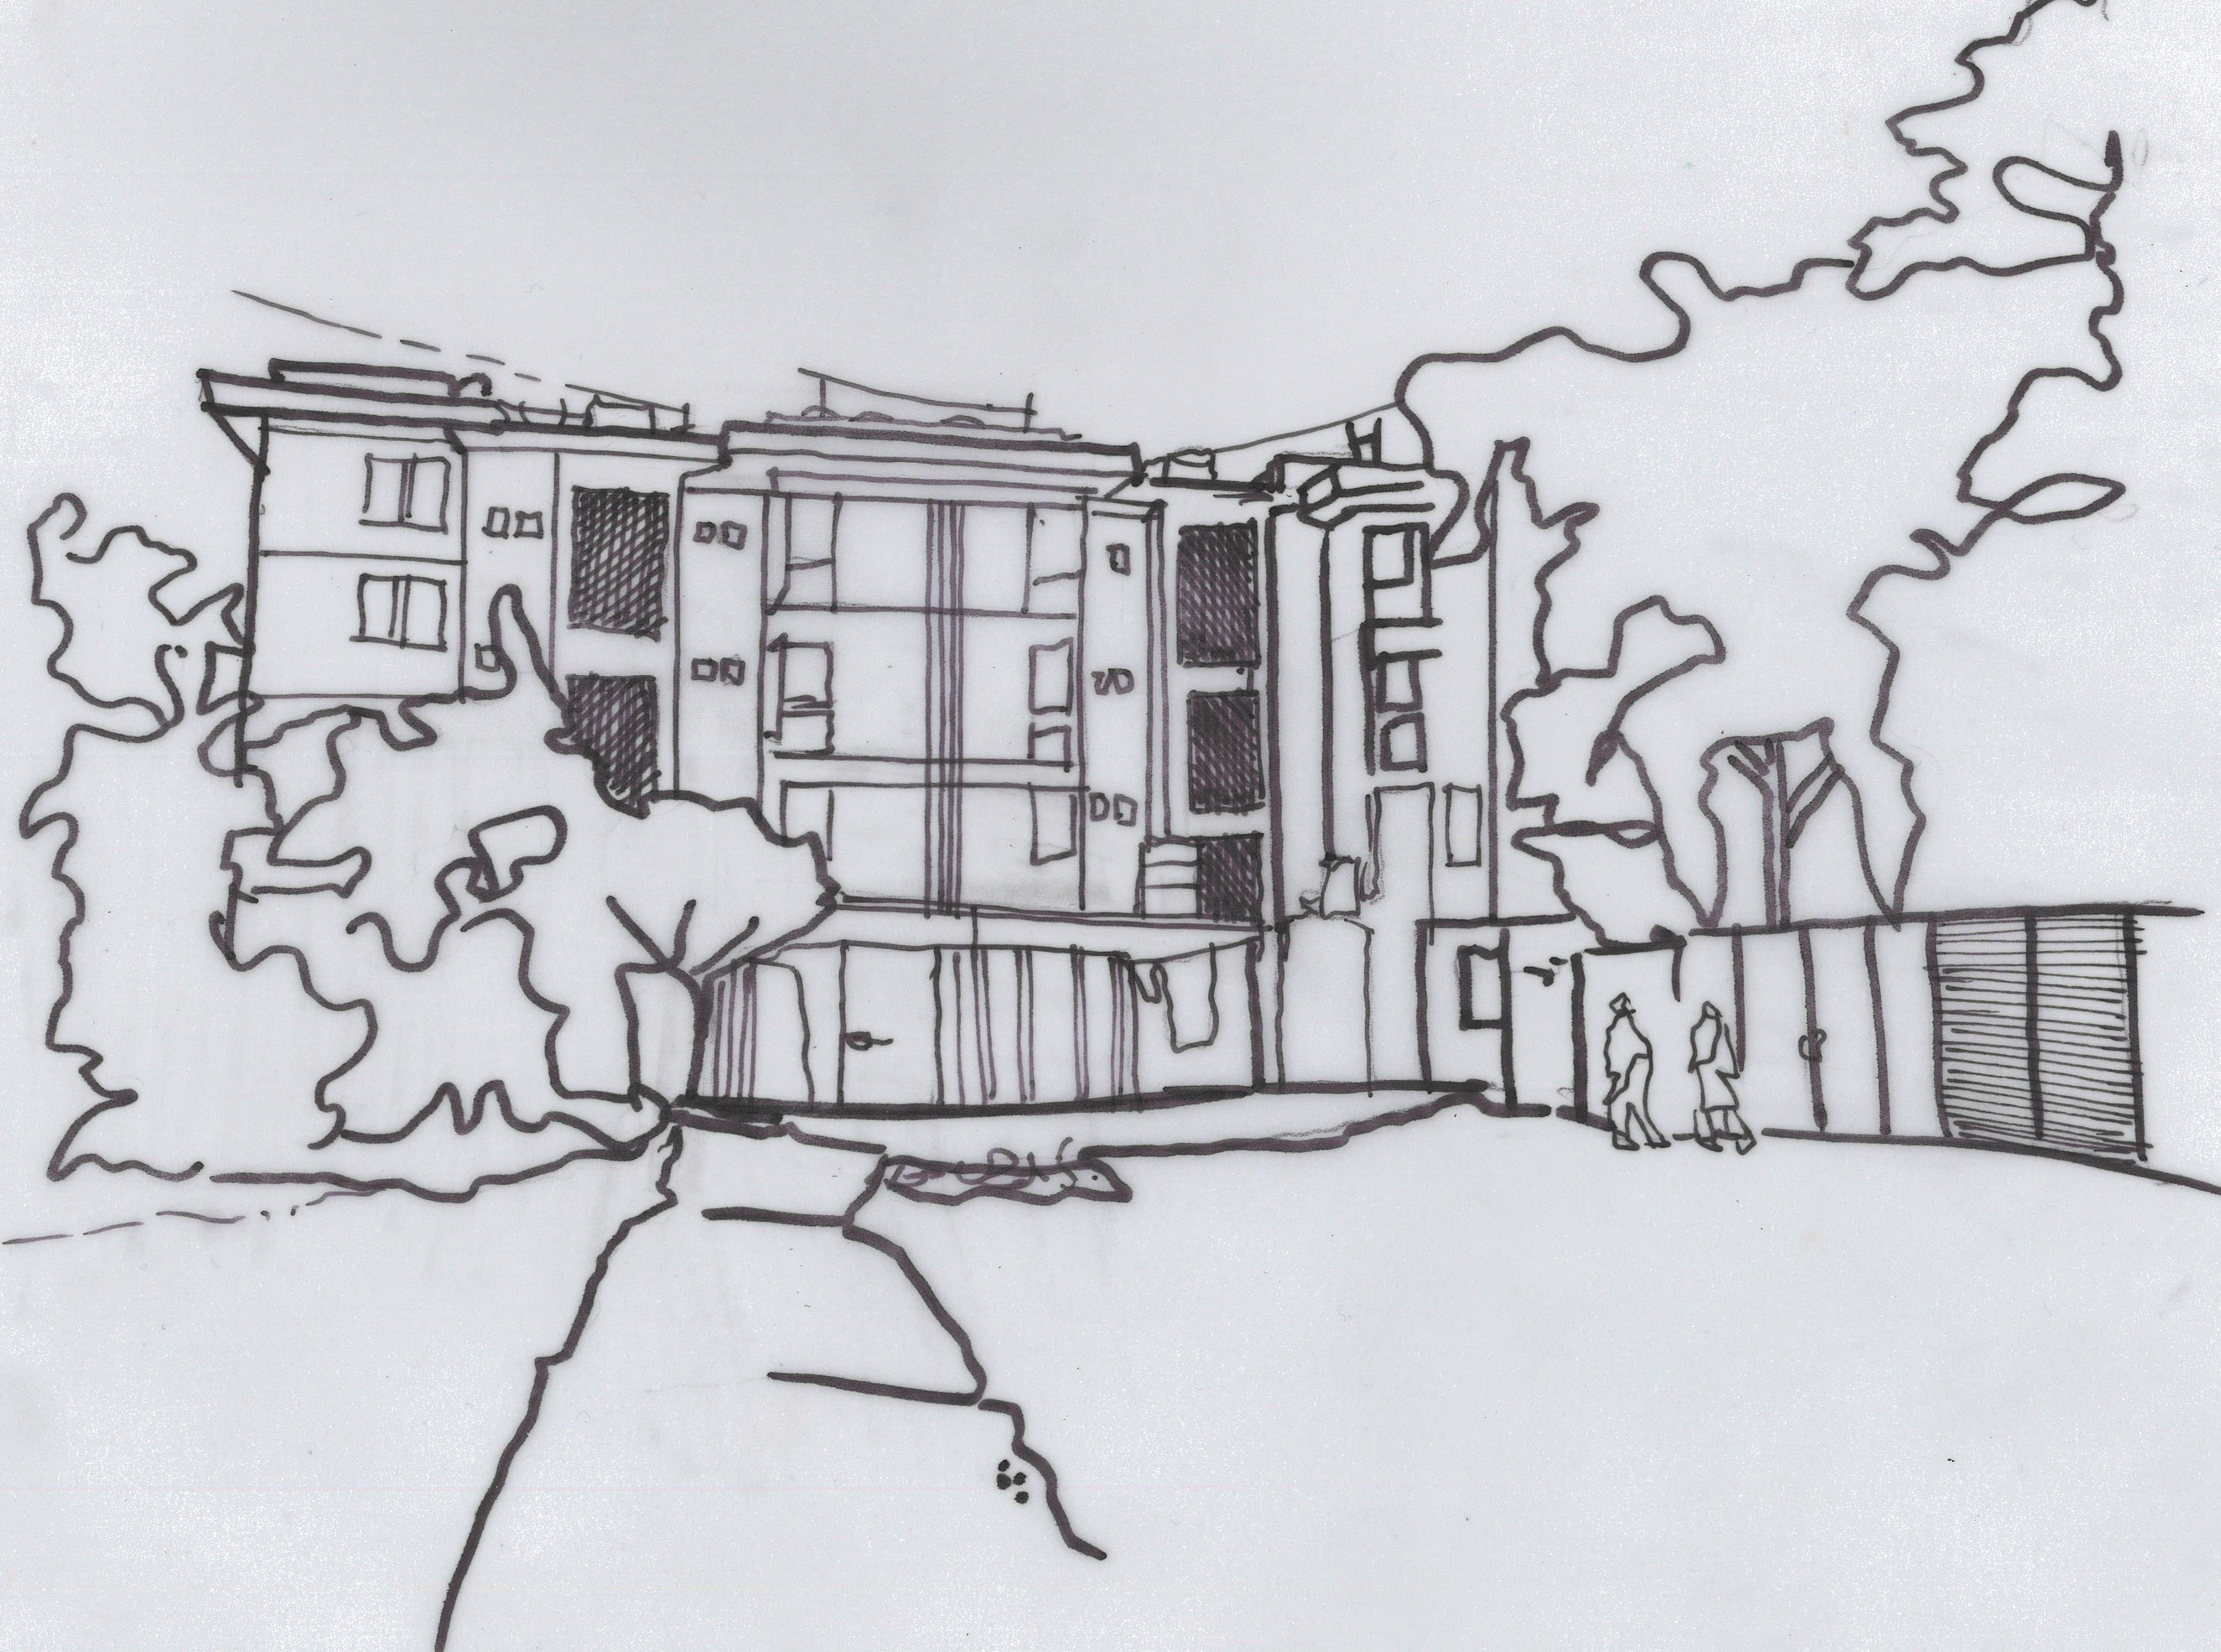
A Critical Ethnographic of Ziddi Feminist Socio-Spatial Practices in a Modern-Mohalla of Islamabad
Author:
Sidra Khokhar

Slide 2
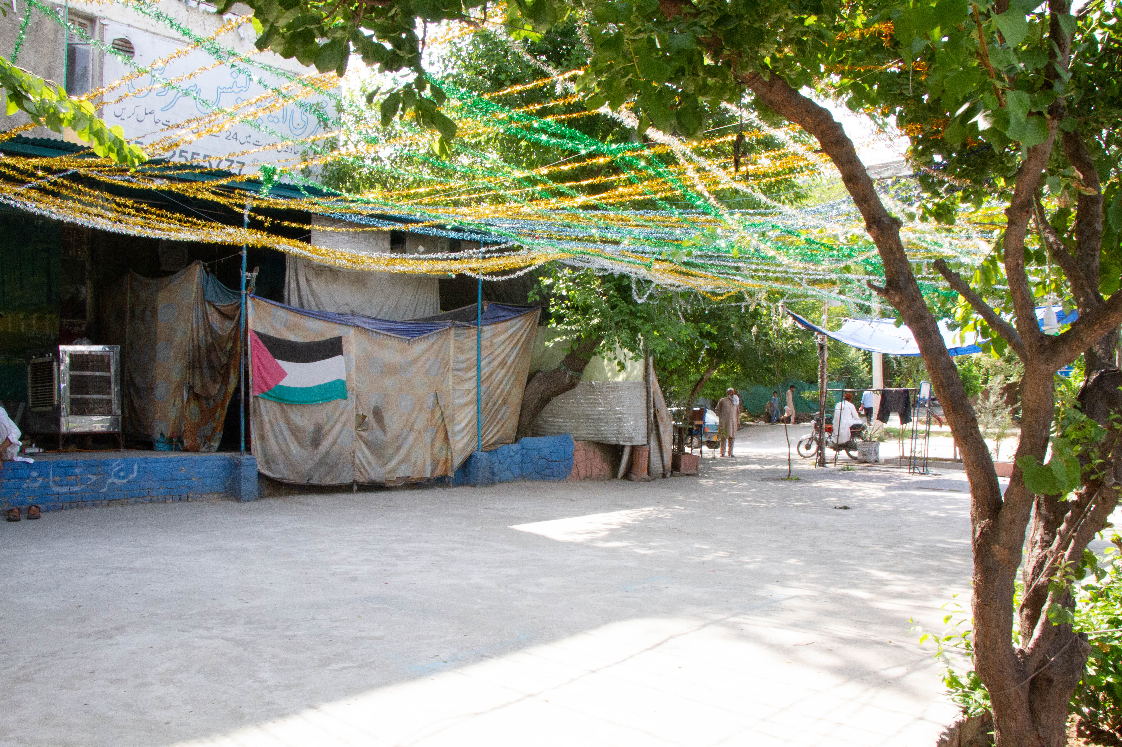
SITUATING THE MOHALLA
Mohalla, which is translated as a ‘neighborhood’, and ‘Ziddi’, meaning stubborn.
Develop a critical historiographical feminist dialogue while conceptualizing the subject of the ‘Modern Mohalla’ in a Government Housing Quarter in sector G-9/2 located in the metropolitan city of Islamabad from the lens of feminist lived experiences and their acts of mohalla-making in a post-independence Pakistan.

Slide 3
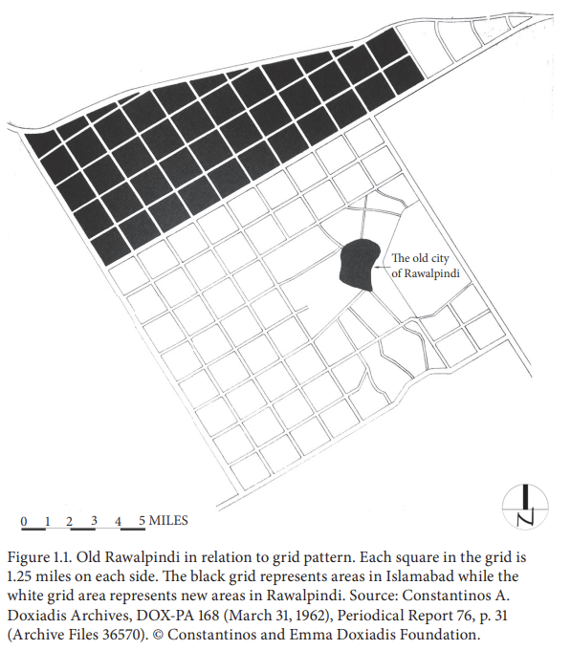
THE HISTORY OF MOHALLAS AND THEIR RITE OF PASSAGE INTO ISLAMABAD
Text : Aptos (pt: min 18pt)
View of Mohalla settlement around main Murree Road in Rawalpindi. Source: Pindi Heritage Tours.

Slide 4
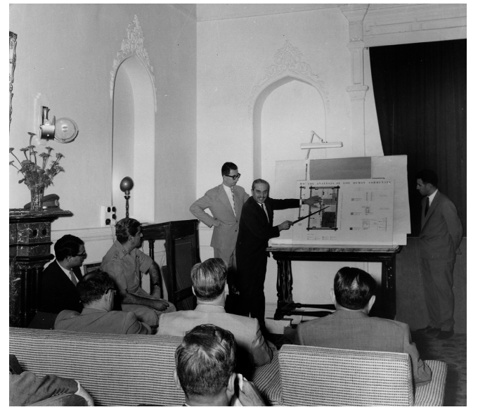
A visual of archived male representation during Islamabad’s design process. The first image shows Doxiadis presenting aspects of his master plan for Islamabad to the Capital Development Authority, Rawalpindi, in May 1961. A lack of female representation in the meeting is observed. 39 Source: CADA: Photographs No. 30917
Archival plan of the site of study from the existing documents left behind by Doxiadis Associates in Islamabad, Pakistan.

Slide 5
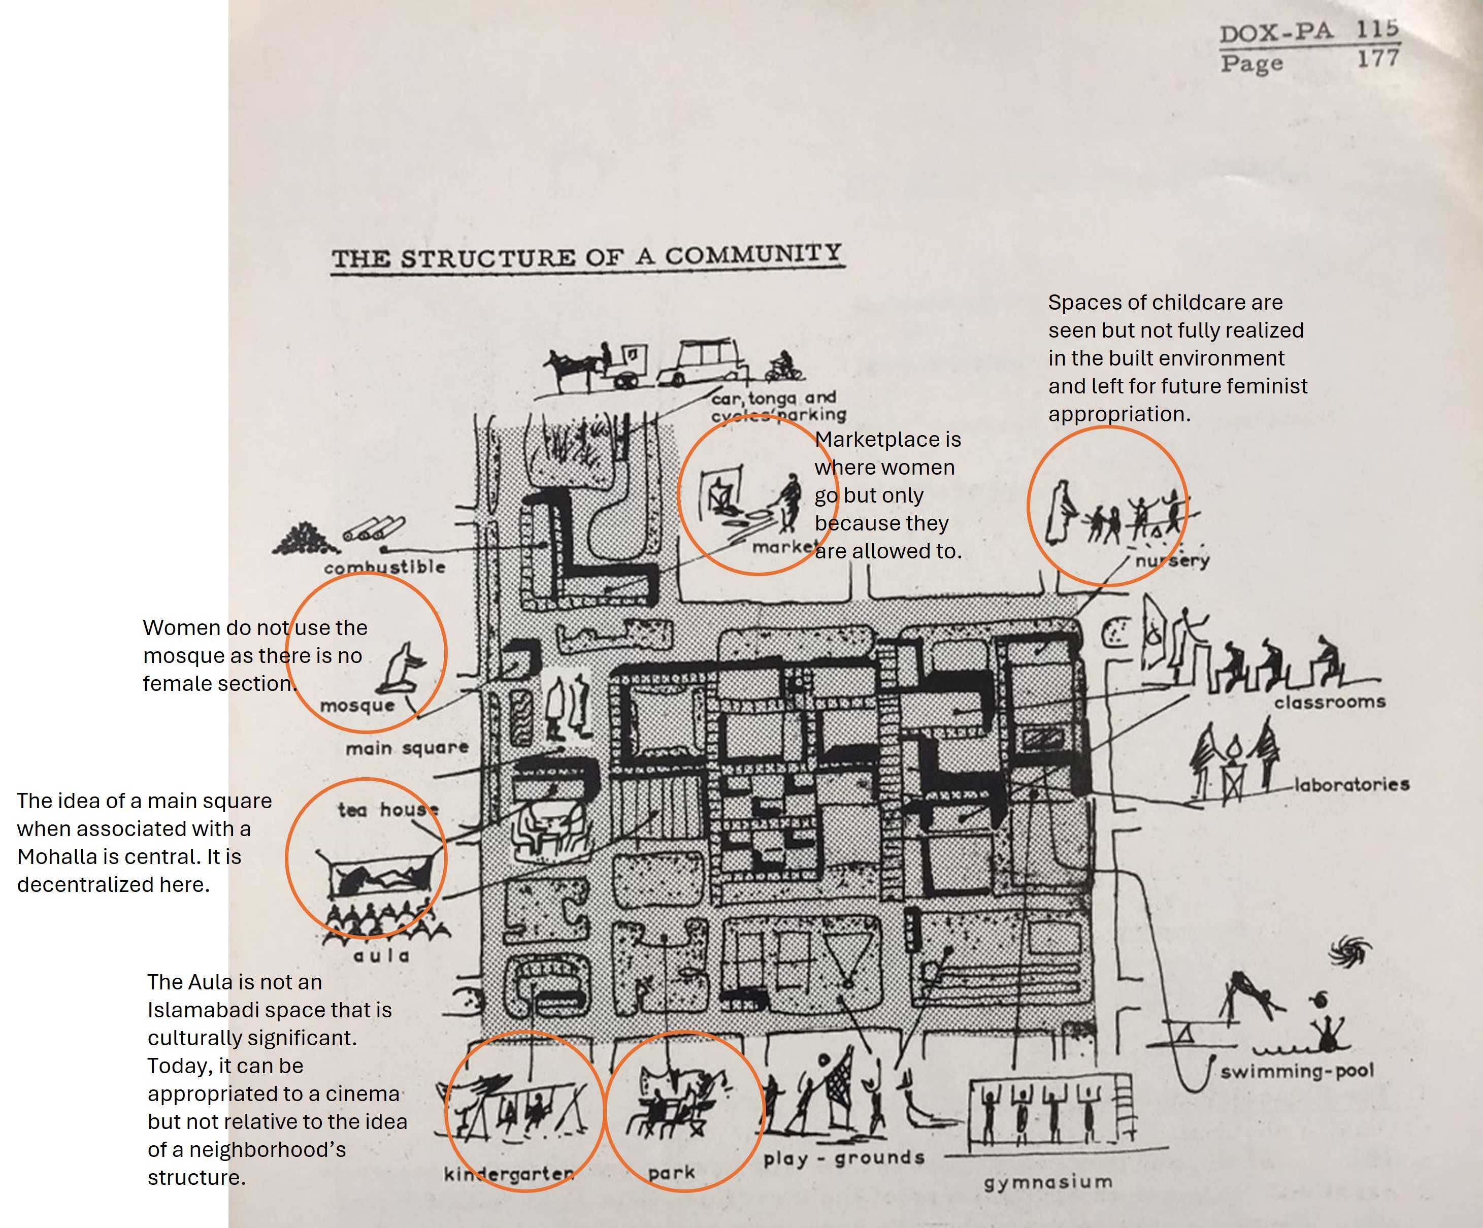
ISLAMABAD AND EKISTICS: HOW DOES EKISTICS FACILITATE FEMINIST MOHALLA MAKING?
The structure of a community illustrated by Doxiadis. Source: Capital Development Authority, Islamabad. Doxiadis and Associates- DOX-PA 115.

Slide 6
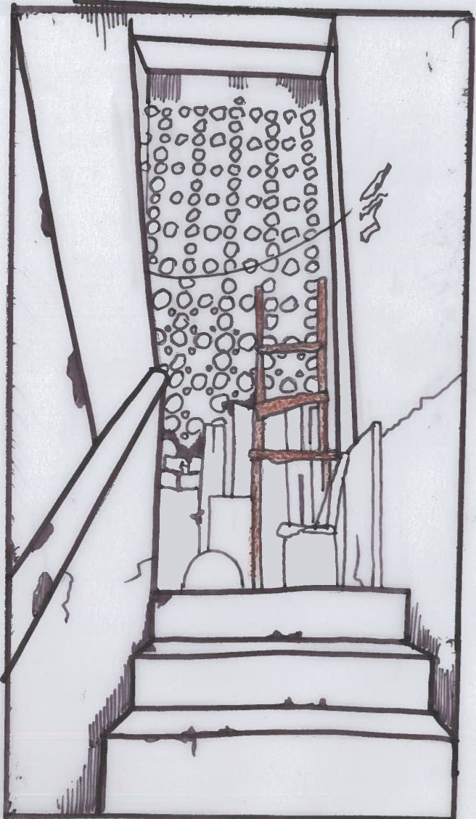
SEAMSTRESSES AND RADICAL ROOFTOPS
LHS: A platform for a ‘stickier’ social practice in the Mohalla. Source: Author
RHS: The women use the stepladder to access the rooftop inside the building block. This stepladder demonstrates
that the roof was not meant to be used in the first place. Source: Author

Slide 7
A Kameez which Umaima has tailored and brought to the interview. Source: Author

Slide 8
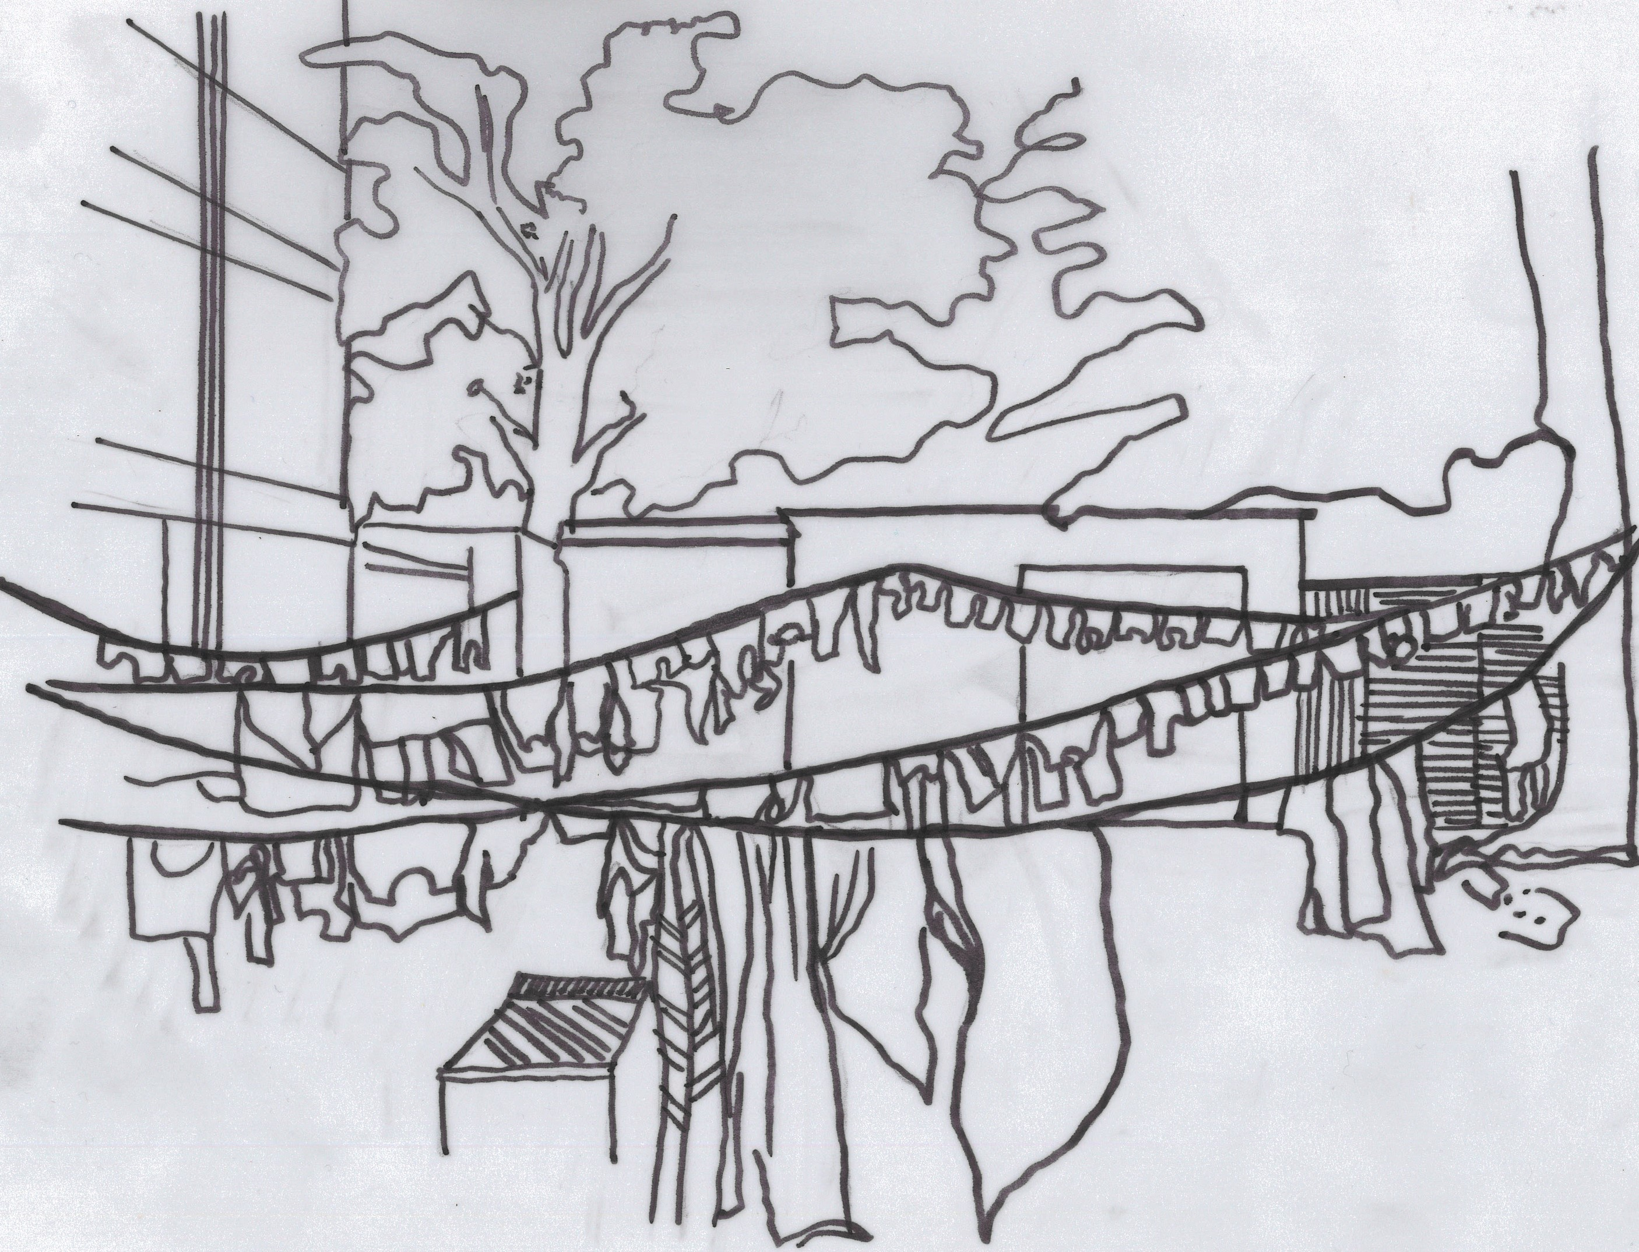
FEMINISED AERIAL OCCUPATION
Drying laundry on ground level (in the courtyard) is a Mohalla-making practice versus the aerial pulley system illustrated on the RHS. Source: Author
The Washing Line Phenomenon of the Modern Mohalla i.e., the pulley system. Source: Author

Slide 9
MOHALLA COURTYARDS TRANSFORMED INTO CHILDREN PLAY AREAS
The transformative nature of the Mohalla courtyard, now a playground, serves as a means of social interaction for the Mohalla mothers. Source: Author

Slide 10
THE MODERN MOHALLA VIA A FEMINIST LENS

Slide 11
Thank you!

