Slide 1
Dr Wendy Jo Mifsud
University of Malta
wendy-jo.mifsud@um.edu.mt
Mr Alexander Farrugia
University of Malta
alexander.farrugia@um.edu.mt
Lived Heritage through the Changing Gaze
A Views and Vistas Analysis for Valletta

Slide 2
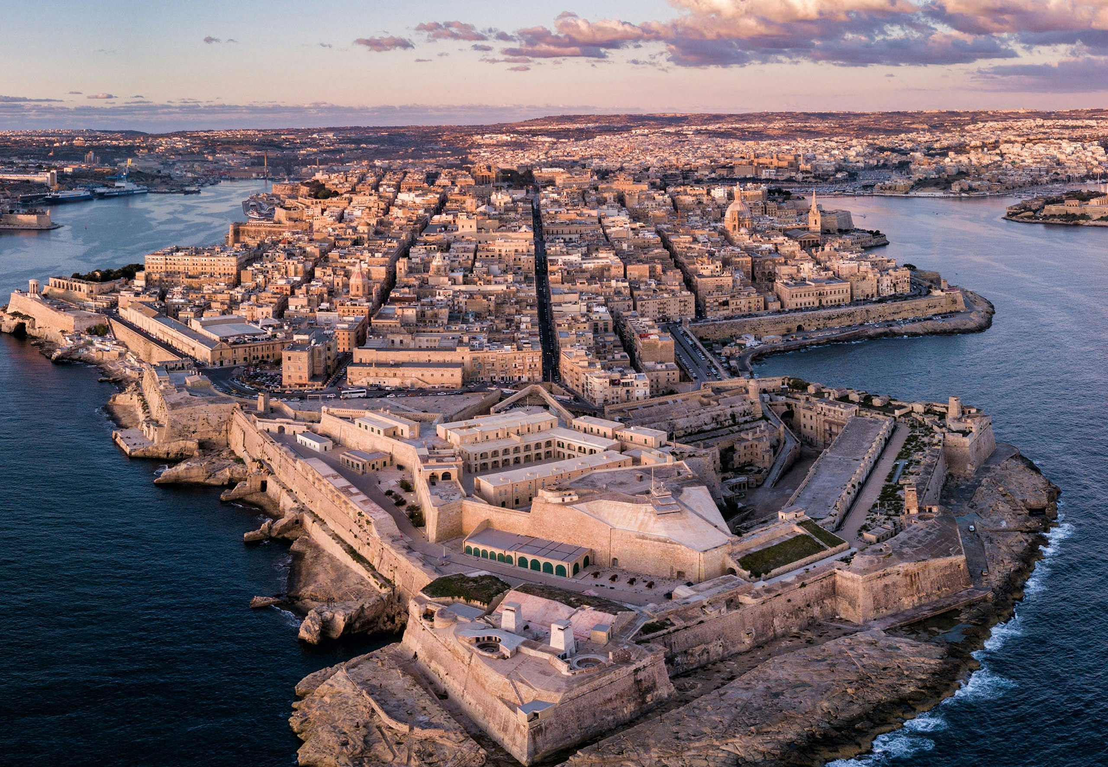
Notes:
Valletta was conceived by the Knights of St. John in the 16th century as a "bulwark of Christendom". It was inaugurated as Malta's capital in 1571 and remains so today.
Our presentation will delve into how different "gazes"—local, touristic, and technical—shape our understanding and appreciation of Valletta's urban landscape.

Slide 3
Gazing as an Informed Action
The Local Gaze: This is shaped by Valletta's symbolic meaning for the Maltese people, which has evolved over time. In the 1980s and 90s, locals often saw Valletta as a "decaying past," preferring modern developments. However, foreign investment and government-led restoration efforts for Valletta's European Capital of Culture 2018 designation led to a renewed appreciation.
The Iconic Gaze: This is driven by how Valletta is marketed to visitors. Iconic views often feature elements not originally part of the Knights' plans, like the Carmelite Church dome and St. Paul's Anglican Pro-Cathedral spire, visible from Marsamxetto Harbour.
The Technical Gaze: This is the expert's view, informed by historical development and balancing the "ideal" city with the "real," lived city. This includes understanding ongoing transformations and managing policy developments.
Notes:
The way we see is not merely a biological act; it's an "educated" and "informed" act, influenced by our expectations and values. This profoundly impacts how we understand space, especially in a historic city like Valletta.

Slide 4
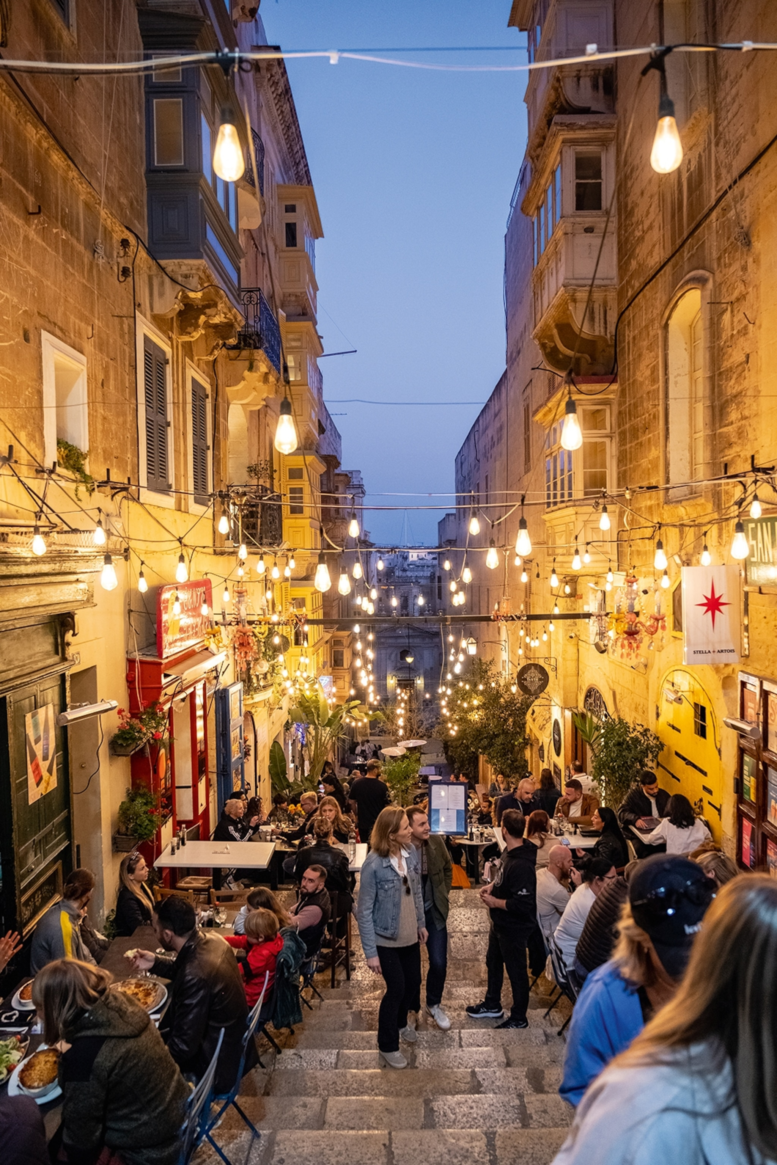
An Ideal City… A Living City…
An Ideal City: Valletta is often referred to as an Ideal City, since it was conceived in the Renaissance as the blueprint for its type and is inscribed on the UNESCO World Heritage List for this reason.
A Living City: There is however tension between preserving an ideal historical view and acknowledging the dynamic, lived experience of the city.
History is not static; it's a continuous process, and the city is not just a physical plan but a human and humanised space with symbolic dimensions.
Notes:
The Valletta community, though small and aging, is increasingly vocal about reclaiming public spaces, particularly for religious and cultural events, as a form of resistance against commercialization.
The gaze of Valletta’s community often focuses within the city walls, on churches, local shops, and informal meeting places that hold historical significance for them. In contrast, the nation’s gaze often views Valletta from the outside, concerned with external impacts rather than internal dynamics.

Slide 5
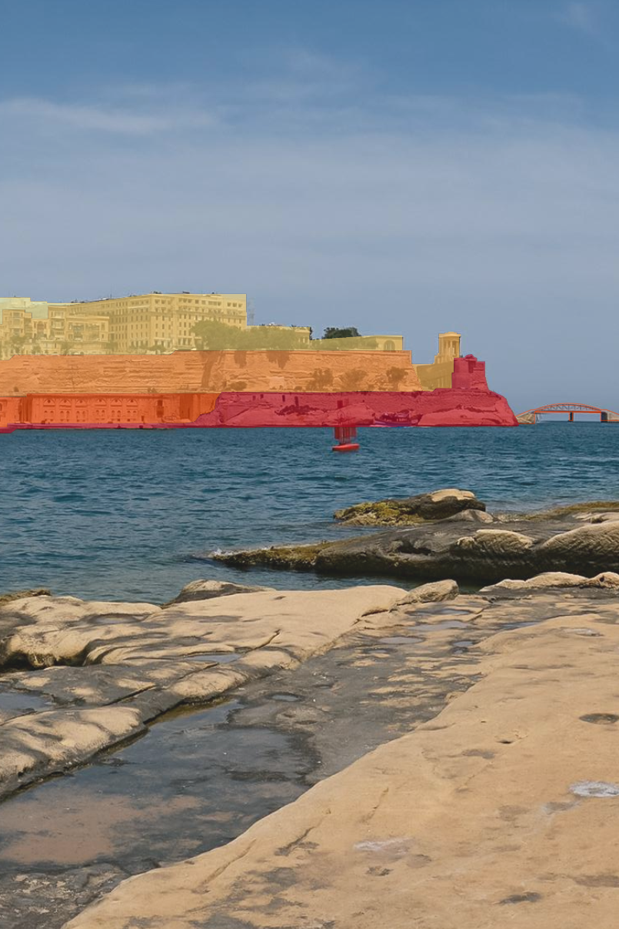
Analysis of Views and Vistas
A seven-point methodology was devised:
Understanding Valletta's Outstanding Universal Value and key view-based indicators.
Defining optimal viewing positions.
Identifying features with visual amenity.
Discussing the visual and symbolic merit of these features.
Summarizing background, middleground, and foreground attributes in daytime and night-time.
Analysing visual compositional characteristics.
Outlining protection measures for visual integrity and delineating a buffer zone for the city.
Notes:
The Views and Vistas Analysis for Valletta, submitted to the World Heritage Committee, involved a meticulous process to understand and protect the city's visual integrity.
We consulted UNESCO's Operational Guidelines for the World Heritage Convention and the Recommendation on the Historic Urban Landscape, which encourages a holistic view of the urban area beyond just the historic centre. Best practices from other Mediterranean World Heritage Cities guided our methodology.
A photographic analysis established a visual baseline, categorizing viewing experiences as Panorama, Contained Prospect, and Linear View, based on "Viewing Places" like High Points, Open Spaces, and Axial Routes. A crucial outcome was the proposal for a buffer zone around Valletta, which provides additional protection given Malta's dense urban context and development pressures.

Slide 6
Guiding Principles
The analysis resulted in guiding principles for protecting views to and from Valletta, addressing:
Foreground views: Focusing on materials, colours, forms, and avoiding jarring elements like large glazed areas or rooftop clutter.
Middleground views: Emphasizing good design for building height and form within the proposed buffer zone, respecting Valletta's grid-iron plan and topography.
Background views: Advocating for sensitive architectural techniques for tall buildings, such as tapering upper levels, drawing inspiration from traditional Maltese skyline elements.
Notes:
Despite strong existing policies, their application is often challenged by development pressure and vested interests. The tension between the "idealized" city and the "lived" city is evident in the debate surrounding modern high-rise developments in Sliema and Gżira. While some see them as symbols of economic success, others view them as a loss of national identity.
However, some argue these differences can represent "two different facades of modern Malta," rooted in history yet moving forward.

Slide 7
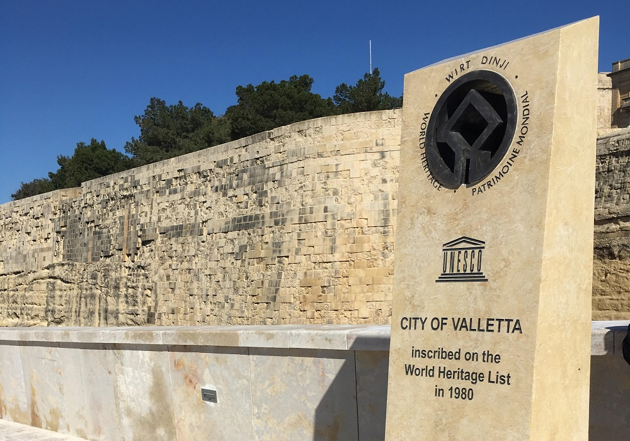
By understanding the "gaze" and the interplay between the city's tangible and intangible values, we can ensure Valletta's visual and symbolic heritage endures for future generations.
Notes:
The Views and Vistas Analysis is a vital part of Valletta's Management Plan, acknowledging the city's dynamic nature and susceptibility to change.

Slide 8
Thank you!

Slide 9
Dr Wendy Jo Mifsud
University of Malta
wendy-jo.mifsud@um.edu.mt
Mr Alexander Farrugia
University of Malta
alexander.farrugia@um.edu.mt
Lived Heritage through the Changing Gaze
A Views and Vistas Analysis for Valletta

