Slide 1

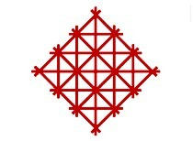


Research on Cultural Adaptation Mechanisms
of the Duku Heritage Corridor Based on
Heritage Ecosystems
Xi’an University of Architecture and Technology
Yanqi Chen, Yunying Ren
T_06 Session Title: Culture, Heritage, and Meaning
537
2025.07.09
Notes:
Good morning, ladies and gentlemen. I am Chen Yanqi from the School of Architecture, Xi'an University of Architecture and Technology, and The topic of my presentation is: Research on Cultural Adaptation Mechanisms of the Duku Heritage Corridor Based on Heritage Ecosystems.

Slide 2
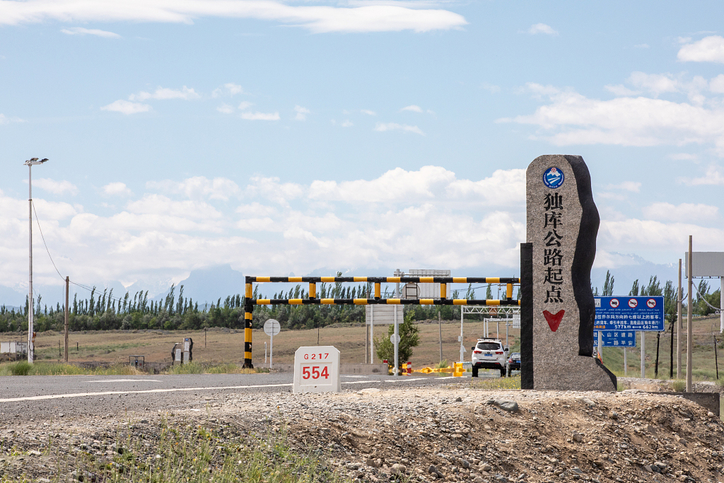


5
Conclusions and Implications
3
Adaptive mechanisms
for the Duku Heritage Corridor
1
Introduction
4
Heritage Ecosystem Utilisation Pathways in the Duku Heritage Corridor
2
Related concepts
Related concepts

Slide 3
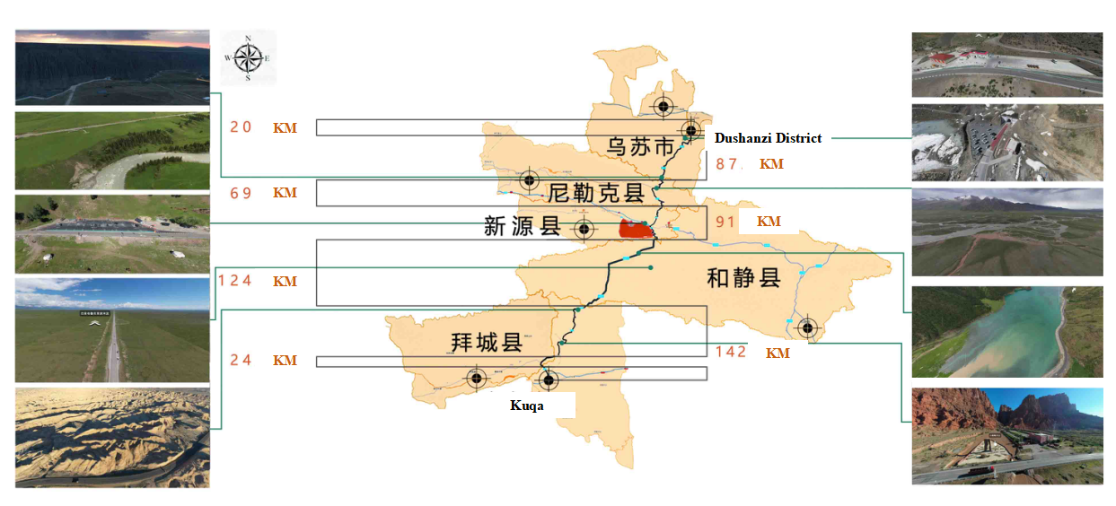
1 Introduction
In 2013, the ‘One Belt, One Road’ programme was launched to give full play to Xinjiang's unique geographical advantages and its role as an important window for opening up to the west, and to create the core area of the Silk Road Economic Belt.
In 2019, in order to promote the vigorous development of ‘transport + tourism’ new industry, in response to the transport to support the development of culture and tourism, culture and tourism to feed the dynamic growth of transport management model.
In 2024, General Secretary Xi Jinping gave important instructions on tourism, stressing the importance of shaping tourism with culture, manifesting culture with tourism, and protecting cultural heritage and ecological resources.
Fig. 1 The Duku Heritage Ecosystem
Lead the whole territory tourism ‘boom’,
but also shoulder the protection and management and show the use of road cultural heritage of the responsibility of the times.
Notes:
The Duku Heritage Corridor is known as “China’s Most Beautiful Highway”,represents the the essence of the Tianshan World Heritage Scenic Byway. The 14th Five-Year cultural development Plan from China's central govemment emphasizes the importance of systematically protecting and utilizing historical and cultural heritage.

Slide 4
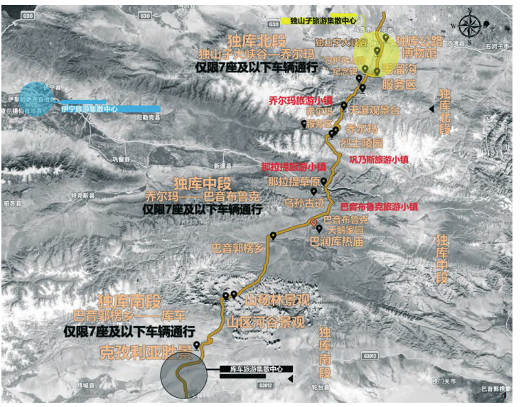
2 Related concepts
2.1 Adaptation of heritage ecosystems
In 2025, the Gunma Declaration introduced the concept of ‘heritage ecosystems’ , which aims to deepen the understanding of heritage by emphasising the interconnections between tangible and intangible, cultural and natural heritage.
· Adaptive heritage ecosystems emphasise the ability to respond to environmental change and the ability of ecosystems to repair and renew themselves.
· Cultural adaptation of heritage ecosystems plays an important role in achieving a balance between cultural heritage and ecosystems by fostering harmony between them.
· Cultural adaptation relies on the subjective status of the heritage-holding community, such as community empowerment.
‘ecological restoration - health restoration -
cultural restoration - economic restoration’
Fig.2 Overview of the location of the study area
Notes:
Cultural adaptability plays an important role in achieving this balance by fostering harmony between cultural heritage and ecosystems. Through the creation of adaptive landscapes, integrating “ecological restoration - health restoration - cultural restoration - economic restoration", it is possible to ensure both preservation and sustainable use of heritage corridors.

Slide 5
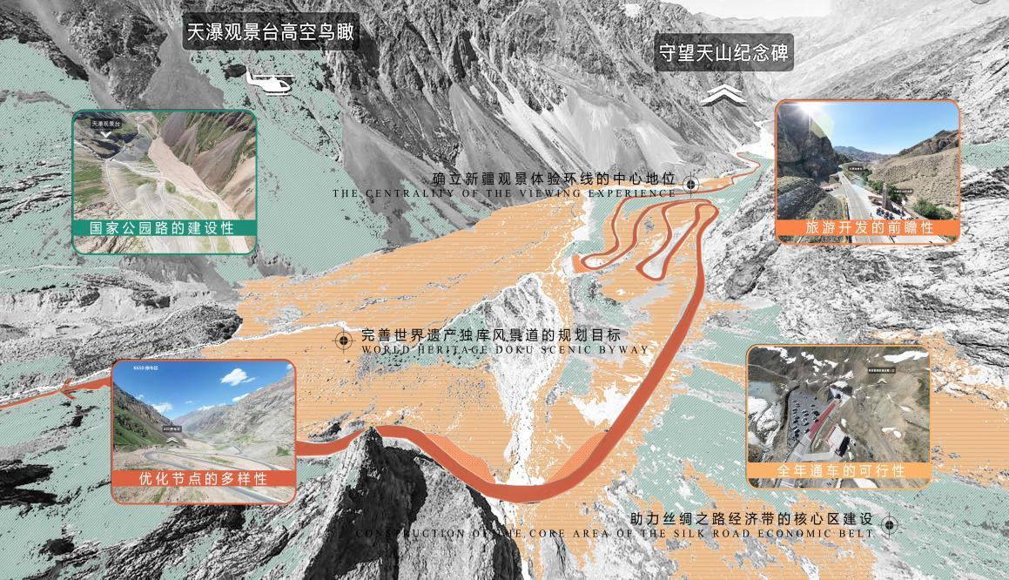
2 Related concepts
2.2 Discriminating between resilience and adaptability
The Duku Highway Cultural Landscape Corridor is a major transport route connecting the north and south of the Tianshan Mountains, and its mode of protection should be resilience and sustainable management. The word ‘resilience’ (resilience), meaning ‘recovery to the original state’ is divided into three dimensions, namely: resistance (Resistance), recovery (Recovery) and evolution (Renewal).
· The study emphasised the necessity of building an integrated management system and a heritage space that is more capable of responding to continuous change.
· Proposed the need to build an integrated management system and a heritage space that is more capable of responding to continuous change.
· As well as to build an integrated management system, and proposes a resilience management model with multidimensional synergistic enhancements .
The main purpose of the project is to assess the cultural landscape of Duku.
Notes:
The main focus is on the adaptation of living conservation, the stabilisation of holistic conservation, and the promotion of regenerative conservation of the Duku cultural landscape corridor.In short, adaptability is about ‘how to change flexibly in order to adapt to new environments’, while resilience is about ‘how to protect and revitalise the core in the face of change’.

Slide 6
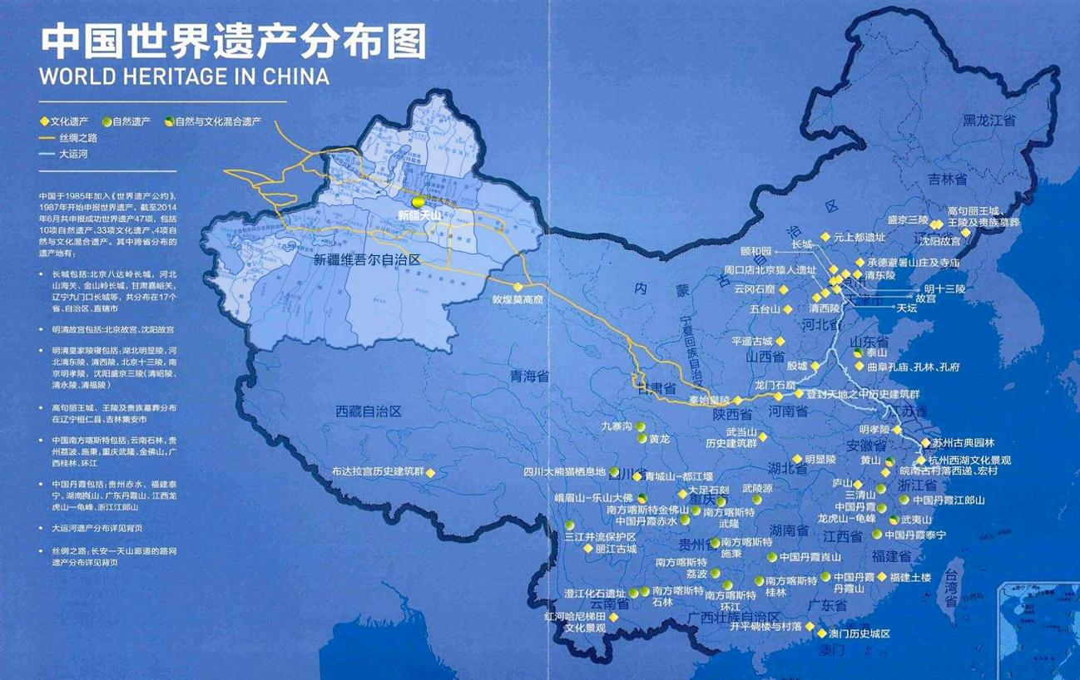
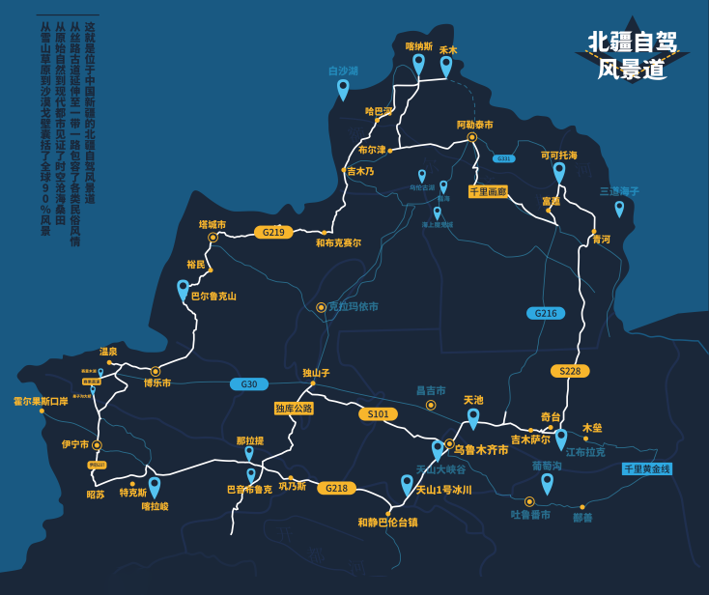
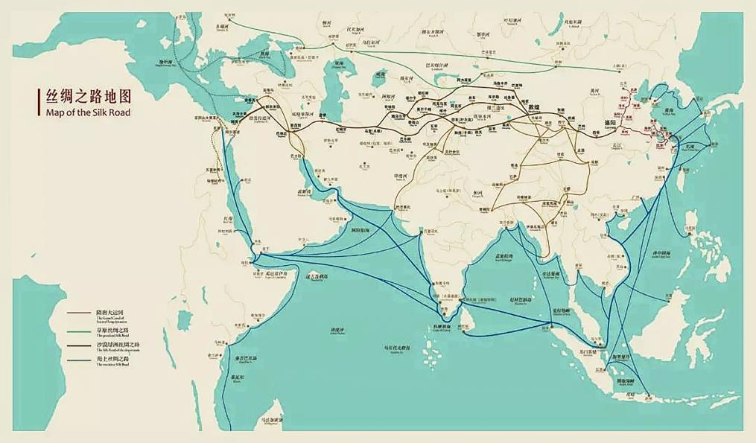
3 Adaptive mechanisms for the Duku Heritage Corridor
3.1 Mechanism for the Integration of Tourism
Reinventing Planning Objectives
Establishing the centre of
the ring road
Promoting core area development
As an important corridor connecting the northern and southern parts of the Tianshan Mountains in Xinjiang, the Duku Heritage Corridor, with its unique geographical location and spectacular natural scenery, has become a typical example of the deep integration of transport and tourism.
It has become a typical representative of promoting the deep integration of transport and tourism.

Slide 7
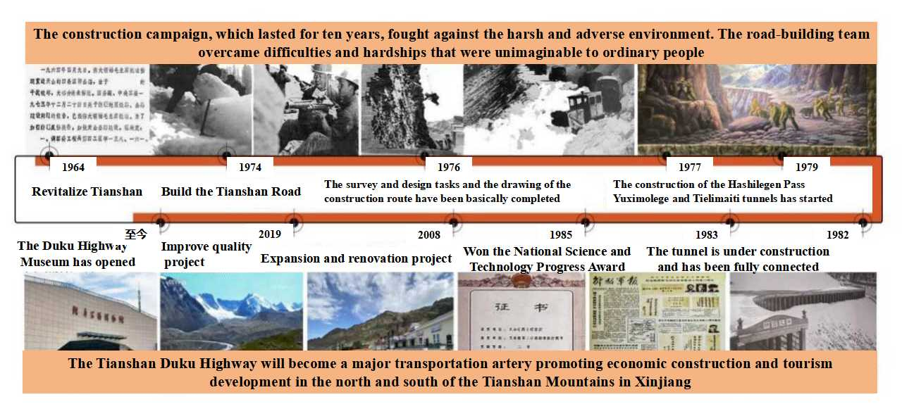
3 Adaptive mechanisms for the Duku Heritage Corridor
3.2 Mechanism of cultural and tourism integration
· Which fully embodies the functional value of guaranteeing ancient social and economic development, contemporary military defence and cultural exchange.
· Mudslides and other causes, and were buried in the Chorma Martyrs' Cemetery along the route, and a Duku Highway Museum was built to commemorate this epic piece of road-building culture.
Fig. 4 History of the Duku Highway
‘minority cultural value + tourism’
‘red cultural value + tourism’
Notes:
In addition, Duku Cultural Landscape Corridor presents the most significant minority cultures as Donggui culture, Guzi culture, monuments, Ovoo, grottoes, murals and other cultural relics witnessing the diversity of roadside culture, while shouldering the responsibility of protecting, managing and demonstrating the use of the roadside cultural relics of the times.

Slide 8
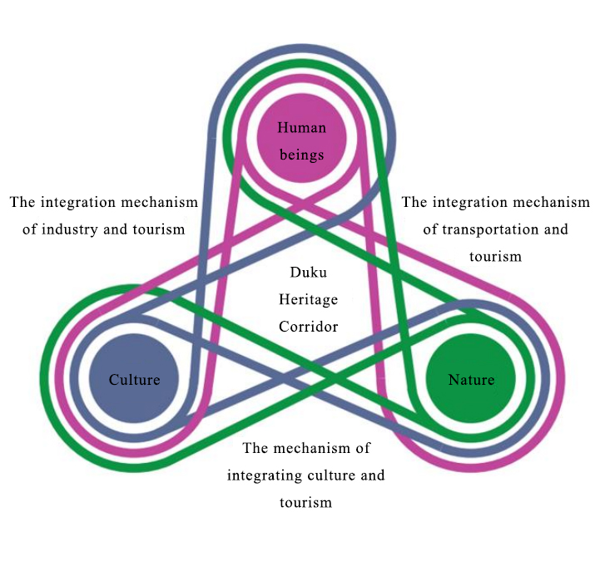
3 Adaptive mechanisms for the Duku Heritage Corridor
3.3 Mechanism of production and tourism integration
The value of industry-tourism integration of the Duku Heritage Corridor lies in the sustainability of resource protection and management along the route, which improves the regeneration of the heritage sites, nature reserves, characteristic landscape nodes and parking spots in the road area, thus enhancing the effectiveness of the production space along the route.
The translation value of its production and tourism integration value consists of the resource utilisation value and the socio-economic value brought by tourism
Which can be broken down into the tourism resource value and the industrial resource value
Fig. 5 Adaptive mechanisms for the Duku Heritage Corridor
Notes:
The Duku Highway to promote the maximisation of socio-economic value, and together to create the ‘Corridor Economy’ of the value of the integration of the industry and tourism.

Slide 9
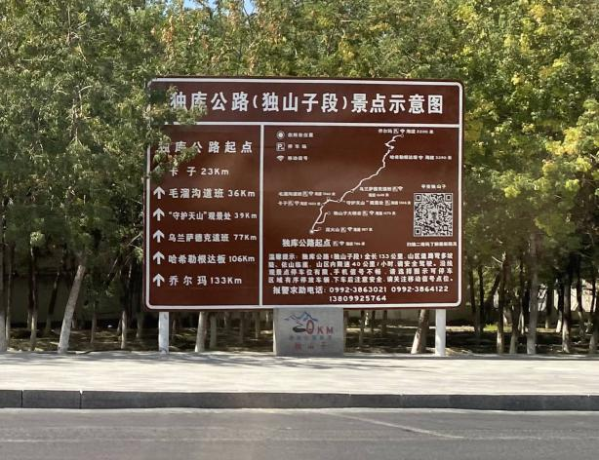
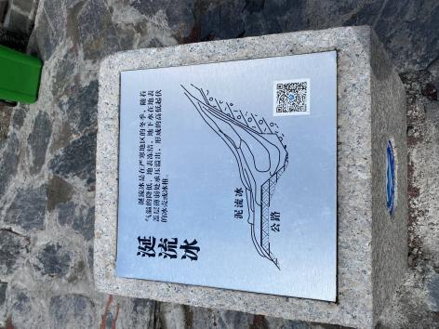
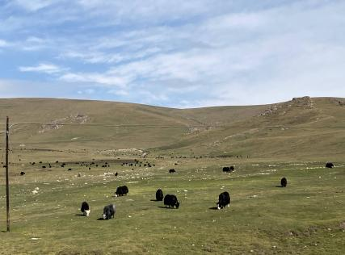
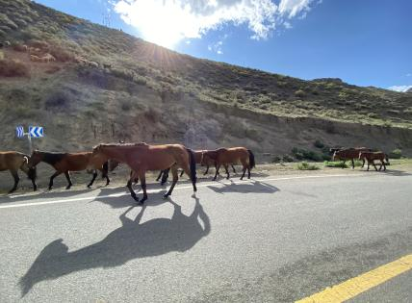
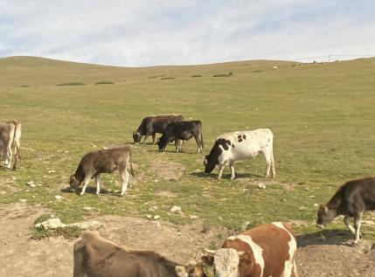
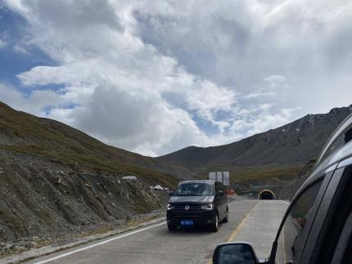
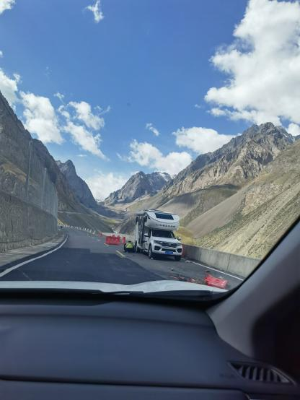

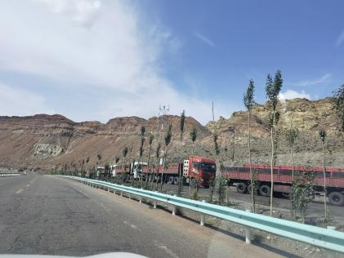
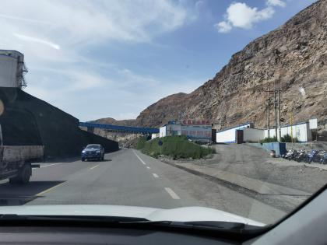
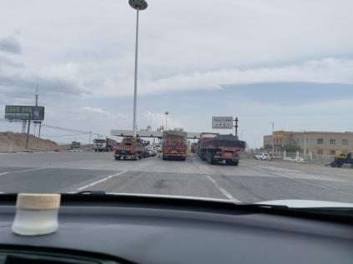
4 Heritage Ecosystem Utilisation Pathways in the Duku Heritage Corridor
4.1 Zoning protection for ecological restoration-healthy recovery
Status-of-access issues
Planning Development Issues
The Duku Heritage Corridor Plan divides the Duku Highway into six regions based on the principles of resource similarity, cultural uniqueness, and regional coordination, including the Kuiduwu Area, the Qorma-Tangbra Area, the Nalati-Gongnaix Area, the Bayinbruk-Bayin Goleng Area, the Dalongchi -Yanshigou Area, and Baicheng County-Kuche County Area.
Problems in the tourism industry
(1) Rational development of regional tourism resources
Ecological and environmental issues
(2) Drive the tourism service industry, catering and accommodation industry, tourism equipment and other industries
Infrastructure issues
(3) Create a favourable atmosphere conducive to private tourism investment
(4) Developing various types of tourism products along the route
Notes:
Through the zoning protection of the Duku scenic area, it forms a regional cycle of development and promotes regional tourism development, and has a positive demonstration and promotion effect on the construction of the Duku National Park Road.

Slide 10
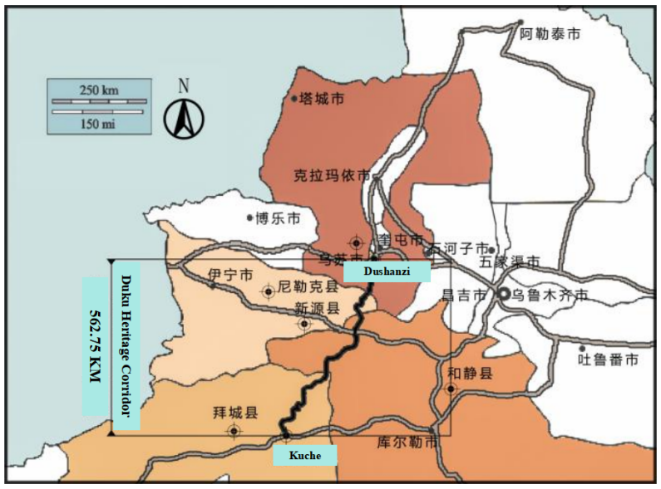
4 Heritage Ecosystem Utilisation Pathways in the Duku Heritage Corridor
4.2 Segmental revitalisation of health restoration and cultural restoration
Through the G217 Dushanzi to Kuqa section of the highway ‘traffic + tourism’ service quality improvement project, a tourism corridor from the icebergs to the grassland is formed, displaying the natural landscape, history and culture and ethnic customs.
because of the Bayinbruk natural cultural heritage along the route, it is recommended to build a world natural heritage scenic road
because of the combination of five scenic spots: the scenic beauty of Tianshan Mountain, the scenic beauty of rivers and lakes, the scenic beauty of the countryside, the scenic beauty of canyons, and the scenic beauty of Yadan, Xinjiang's first tourism highway is proposed
Fig. 6 General road map of the Duku Highway
Notes:
The cultural card of showcasing the regional flavour of the Dukui Highway, and the provision of a smooth, safe, comfortable and beautiful driving environment and infrastructure .

Slide 11
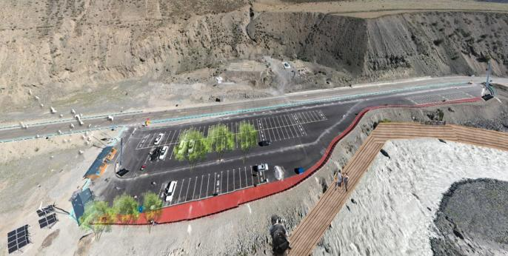
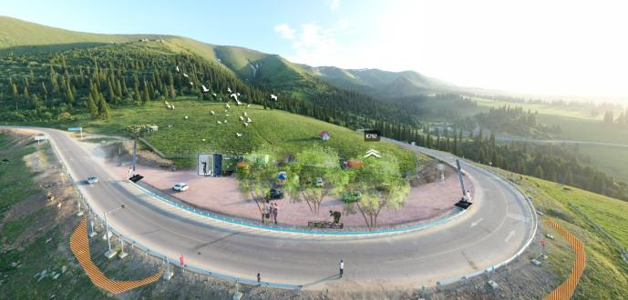
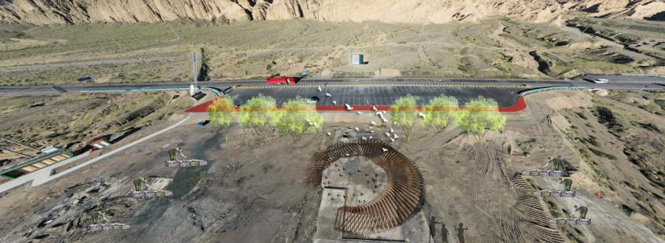
4 Heritage Ecosystem Utilisation Pathways in the Duku Heritage Corridor
4.3 Multi-point enhancement of cultural and economic recovery
In the near future, it mainly improves the safety and accessibility of the Duku Highway, and focuses on the treatment of road diseases that can be implemented at present and have an important impact on the improvement of the access conditions;
it also strengthens the function of tourism services, and improves the sightseeing stops, signage systems, service areas, parking areas and other ancillary service facilities in suitable areas along the route; and it also improves the road appearance and the road environment to beautify the highway tourism environment.
The medium- and long-term goals can be summarised as strengthening itself, promoting integration and leaving interfaces
Notes:
On the basis of guaranteeing the safe passage of highways and upgrading the quality of road surfaces, we will focus on the development of traffic+tourism integration into the industrial system, actively create the form of traffic+tourism industry, and build a high-quality highway for the integration and development of ‘traffic+tourism’.

Slide 12
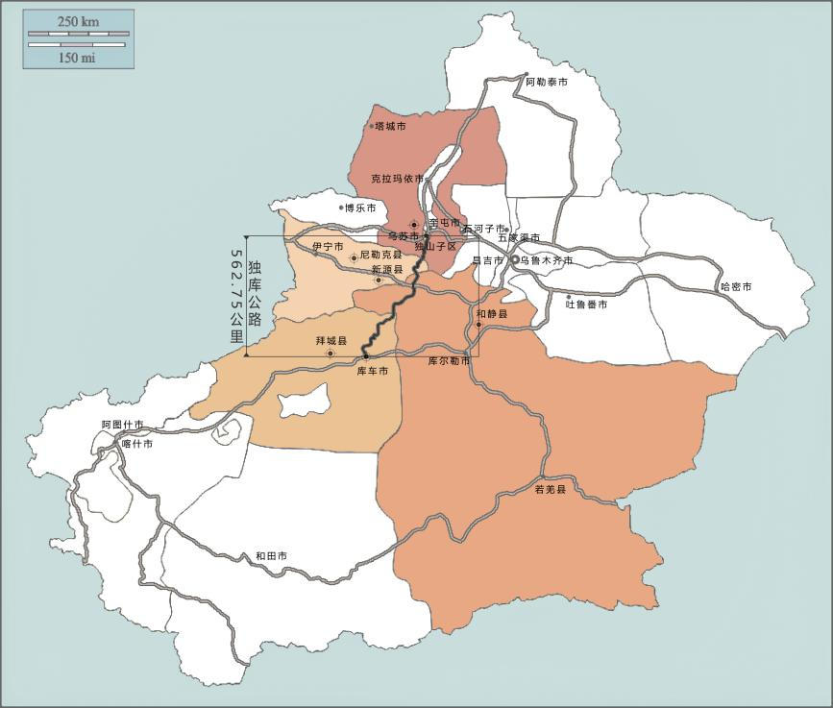
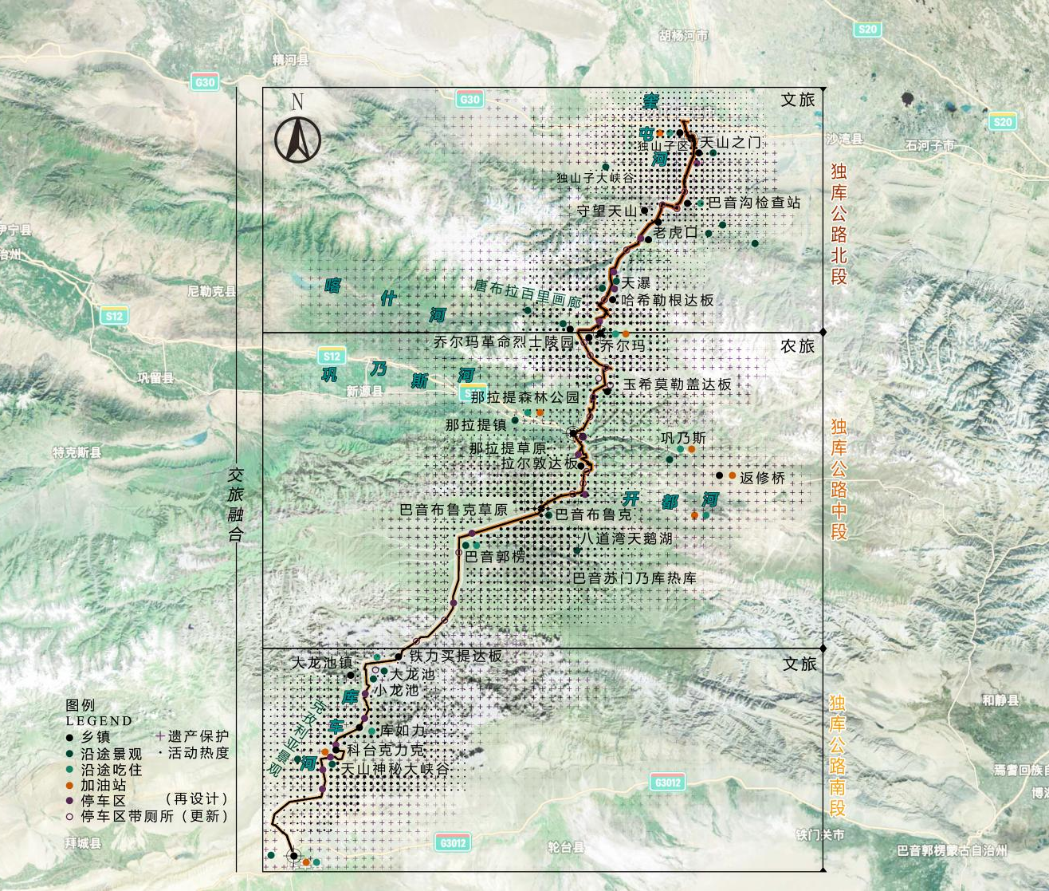
5 Conclusions and Implications
5.1 Rationalisation of thematic mountain landscapes for travelling through the seasons
By building a tourism product system with nature sightseeing, folklore experience, self-driving tourism, cultural heritage tourism, cross-country adventure, leisure and holiday as the main body, it creates ‘China's first national park road’ and becomes a model of China's scenic road development and construction.
One is to make physical conservation more scientific through digital technology and intelligent management, such as better detection of diseases, more accurate identification of roadblocks and deformation of roadbeds, etc.; and the other refers to the fact that we use modern digital intelligence technology to digitise the heritage corridor itself and even the road environment and the view-scope landscape in a complete and holistic manner.
Secondly, through modern digital intelligence technology, we can collect, reconstruct and present the heritage corridor itself and even the road environment and the landscape within the line of sight in a complete and full-fledged way, and save it as ‘data’ permanently.
Notes:
In concrete implementation, it is necessary to combine modern information technology, such as artificial intelligence, big data analysis, cloud computing and other technical means, to achieve effective protection and rational use of heritage corridors.

Slide 13
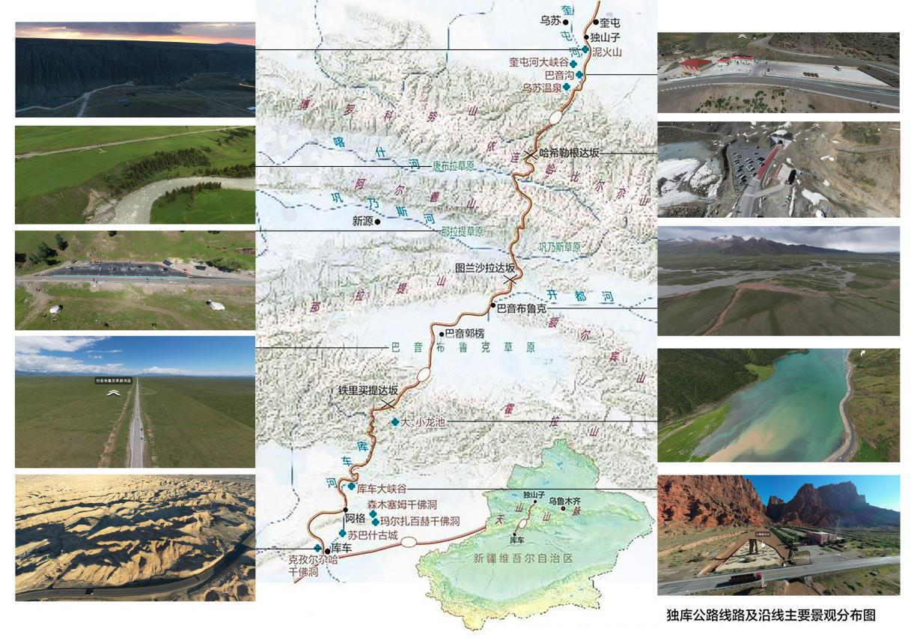
5 Conclusions and Implications
5.2 Systematic cognition of cultural landscape corridors of heritage world heritage sites
The core of the cultural landscape corridor as a world heritage site is to focus on the historical and human resources along the route, and the organisation of traditional festivals and events to bring economic benefits and brand economic benefits.
Using digital twin technology, panoramic 3D modelling and other technologies, the collected data can be transformed into virtual models, providing intuitive and accurate information support for management.
Acquire high-precision images and 3D models of various types of natural-cultural heritage in the heritage corridor and accurately digitally record them, and provide support for the restoration of complex heritage corridor environments through the establishment of high-precision 3D models.
Fig. 7 Duku Highway Route and Main Landscape Distribution Map along the Route
Notes:
To support this analysis, advanced methods such as digital footprint and user-generated content (UGC) from social media are utilized to capture and evaluate public interactions with the heritage corridor.

Slide 14
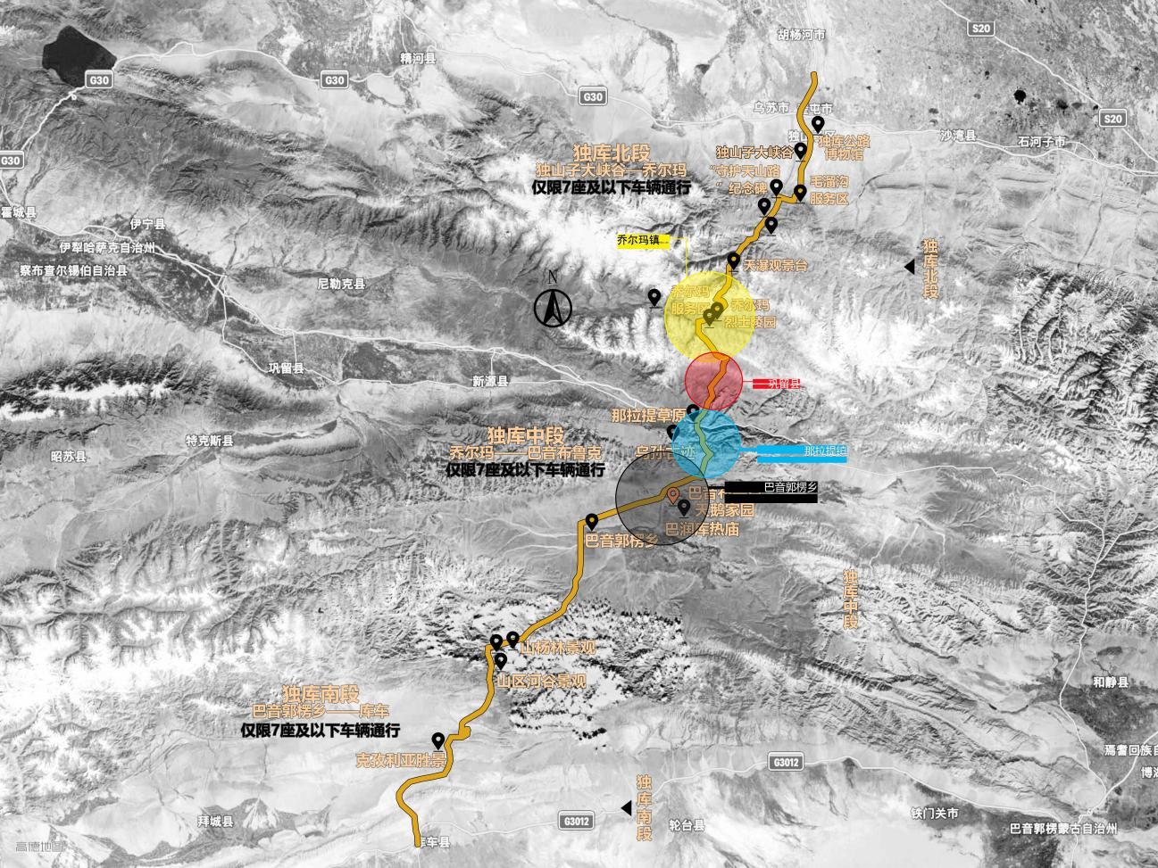
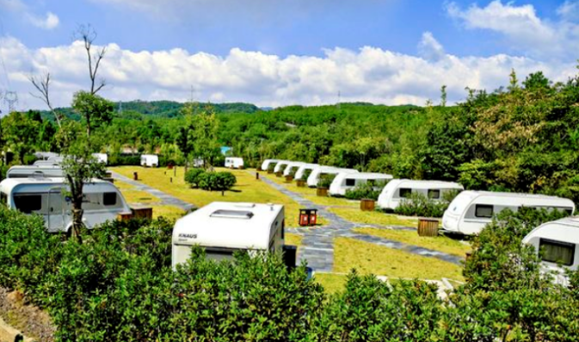
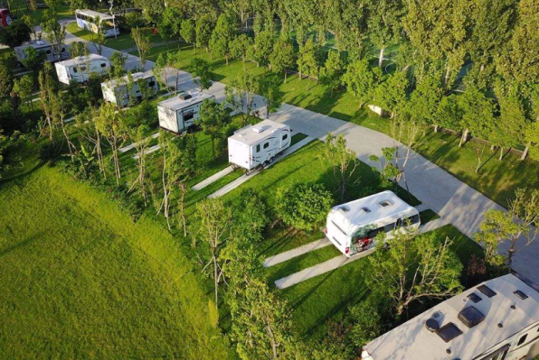
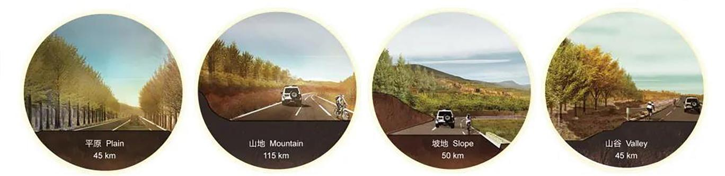
5 Conclusions and Implications
5.3 Digital restoration of exemplary national parkways with Chinese characteristics
Carry out monitoring and big data analysis of important historical and cultural heritage sites, nature reserves, special viewpoints, parking spots, etc. in the road area to monitor the status of the heritage in real time and carry out preventive protection of the heritage corridor.
To comprehensively improve the systematic protection and digital intelligent management level of the Duku Heritage Corridor, gradually realise the digital transformation of the whole road section and the whole network of heritage sites
To form a provincial intelligent heritage corridor system
to promote the development of an intelligent restoration management system of the heritage sites, to let the public understand the importance of digital restoration
To enhance the public's cognition of the multifaceted value of heritage protection and the national Parkway construction participation.
Notes:
In addition to this, VR/AR technology is utilised to provide the public with an immersive experience of touring the heritage corridor, enhancing their knowledge and understanding of the cultural heritage.

Slide 15
Reference
[1]Xinjiang Culture and Tourism Department (2024) Xi Jinping stresses important instructions on tourism work [Online] available at: https://wlt.xinjiang.gov.cn/.
[2]Flink C A, Searns R M (1993) Greenways: a guide to planning design and development. Washington: Island Press.
[3]Zhong Jingqiu, Gao Mengfan, Han Zenglin (2024) Spatial reconstruction of human-land relationship based on ecosystem cultural services . Journal of Geography,79 (07), pp.1682-1699.
[4]FABRIZIO AIMAR (2024) The Resilience of Cultural Landscapes：Perspectives from UNESCO World Heritage Sites. Springer：Berlin.
[5]QUAN Fengmei, TSU Xulu, WANG Shaosen (2022) A study on heritage site protection and planning intervention based on adaptive balance - A case study of Gulangyu Campus of Xiamen College of Arts and Crafts. Planner,38(02), pp.102-107.
[6]Bai Xuelong (2021) Research on Tourism Route Development and Governance Policies of Dokku Highway . Xinjiang University.
[7]CHEN Yanqi,REN Yunying,ZHAO Nina (2024) Study on the protection of multiple values and resilience management model of Duku Highway based on urban historic landscape [J]. Garden, 41 (10), pp.105-113.
[8]CHEN Yining, CHENG Xiang, FAN Mengyu (2023) A study on tourist perception and spatial differentiation in corridor-type tourist destinations - A case study of Dukou Highway. Arid Zone Resources and Environment, 37 (10), pp.199-208.
[9]Zhou Xiang, Tang Yuhang, Su Junji (2023) The Route Selection Method of Heritage Corridors Based on the Perspectives of Historical Urban Landscapes and Digital Footprints: A Case Study of the Historical Urban Area of Nanjing City, China . Landscape Architecture (Chinese and English), 11 (03) pp.11-37.
[10]Liang Jianing, Li Wenzhu, Li Weijian (2023) Application Scenarios and Practical Paths of Urban Landscape Driven by Digital Technology. Landscape Architecture, 30 (07) pp.29-35.

Slide 16
Thank you!
Research on Cultural Adaptation Mechanisms
of the Duku Heritage Corridor Based on
Heritage Ecosystems

