Slide 1
Comprehensive Evaluation of Child-Friendly Public Spaces: Zumrutevler Case as Istanbul's First Permanent Two-Stage Street Transformation
Derya KOÇAŞ
Assoc. Prof. Dr. Elif KISAR KORAMAZ

Slide 2
Contents
Introduction
Children in Public Spaces
Child-Centred Street Transformation
Methodology
Results
Discussion
Conclusion

Slide 3
Introduction
Purpose of the Thesis
Assessment on whether the environments or streets transformed through a phased design approach result in sustainably child-friendly spaces once permanently implemented
Scope of the Thesis
Evaluation of child-centered street transformations, guided by international design frameworks and a phased design approach, to assess their impact on creating sustainable, child-friendly urban spaces across multiple urban scales.
Method of the Thesis Multiscalar evaluation combining international design criteria, spatial analysis, interviews, and observational studies to assess the effectiveness of a two-phase child-friendly street transformation in Istanbul.

Slide 4
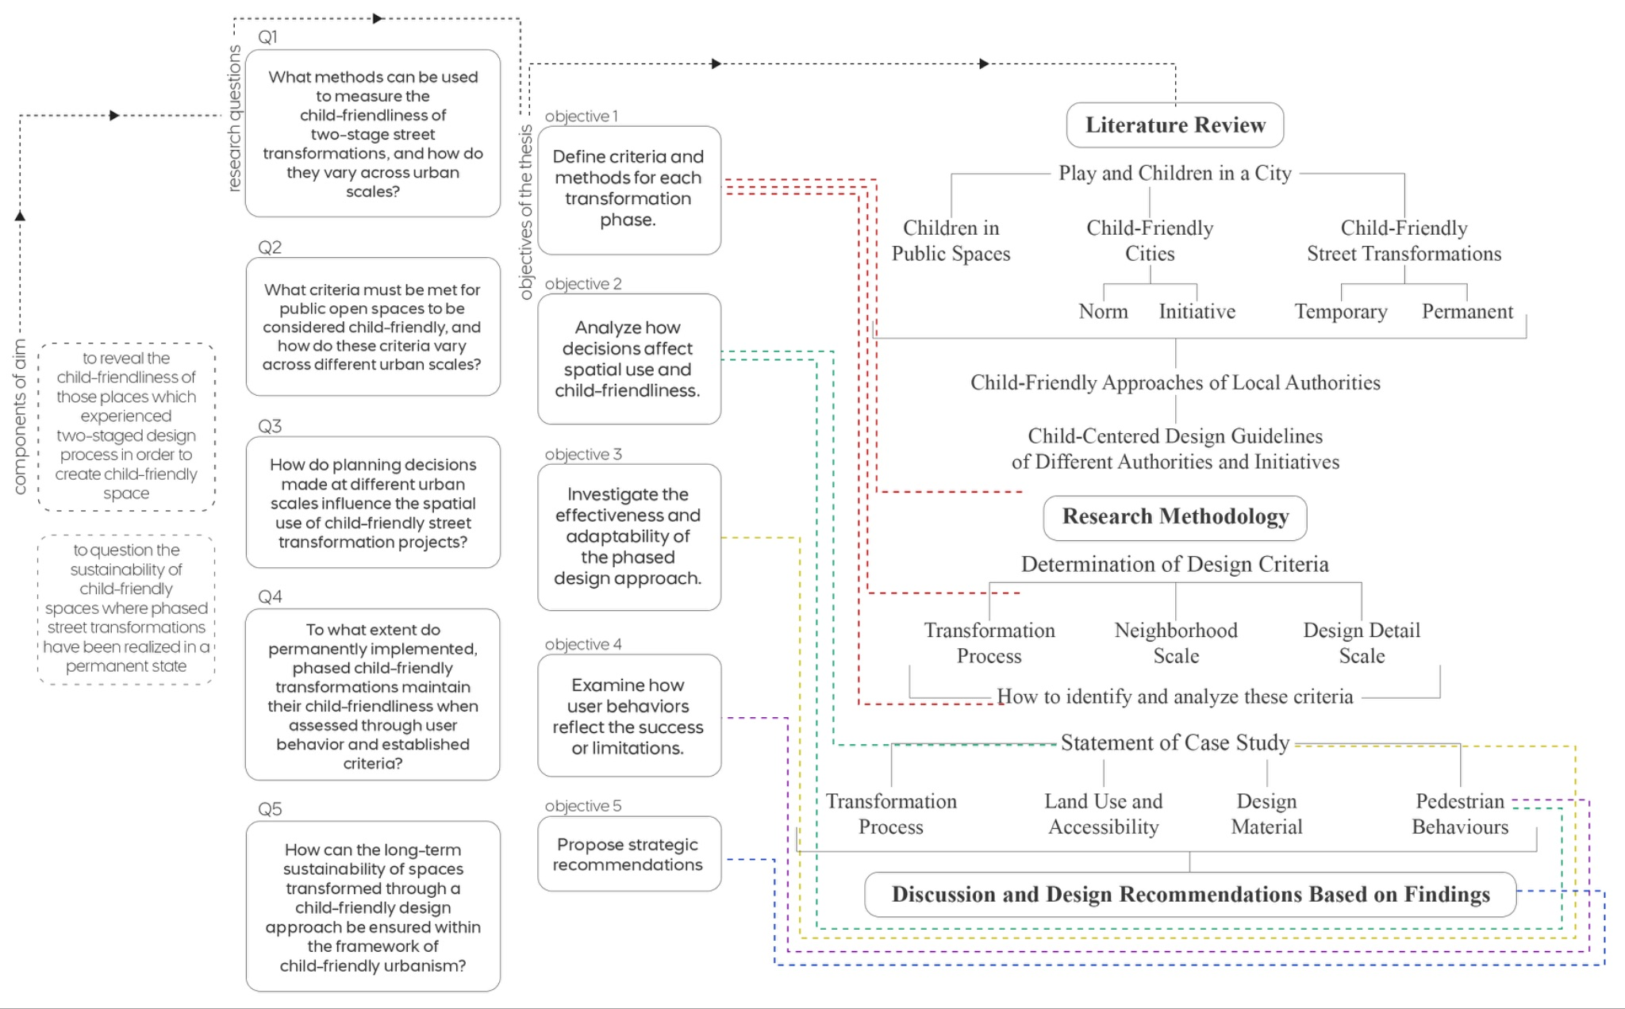

Slide 5
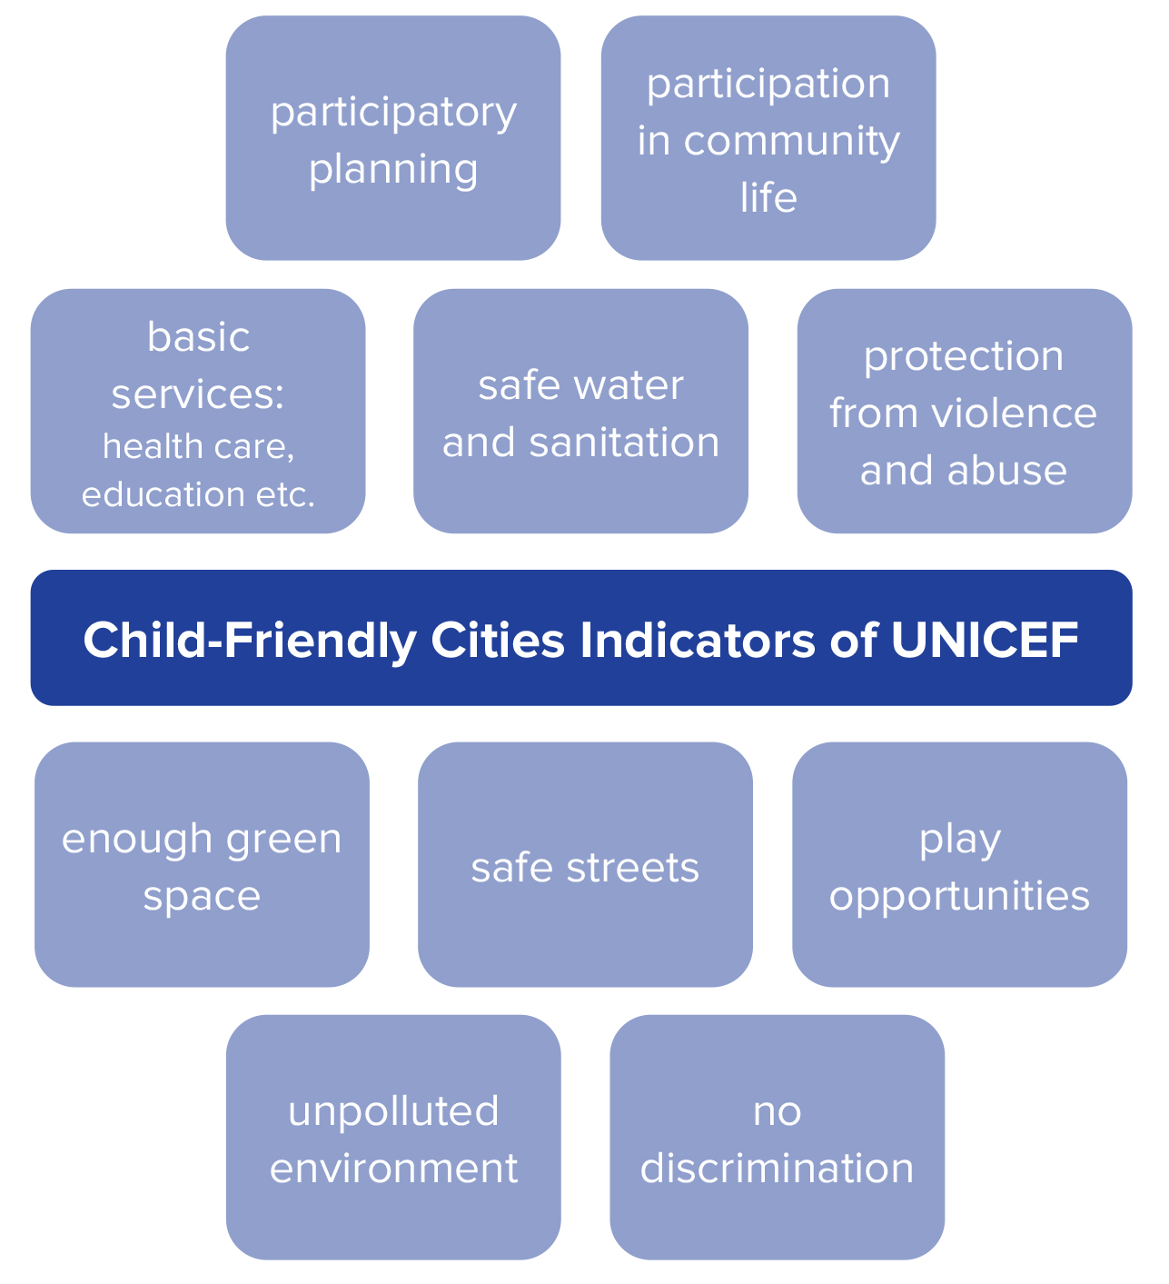
Children in Public Spaces
healthy children, healthy societies
right to play
streets as the first places to experience the city
Child-Friendly Cities
first mentioned in Habitat II in 1996
initiated by UNICEF
supporting municipal governments in implementing children’s rights at the local level based on the UN Convention on the Rights of the Child
SDG - Goal 11 - Sustainable Cities and Communities
Krysiak, N. (2018). Where do the children play: designing child-friendly compact cities. UNICEF (n.d.). Çocuk Dostu Şehirler. Website: https://www.unicef.org/turkiye/çocuk-dostu-şehirler
UNICEF (n.d.). Building a Child Friendly City. Guiding Principles.
UNICEF (2015). Child Friendly City Initiative implementation methodology for the Republic of Kazakhstan. ISBN 978-601-7523-25-1.

Slide 6
Child-Centred Street Transformation
dominance of vehicles on streets
children’s independent mobility
temporary street transformations - play streets
permanent street transformations - two-stage with tactical urbanism

Slide 7
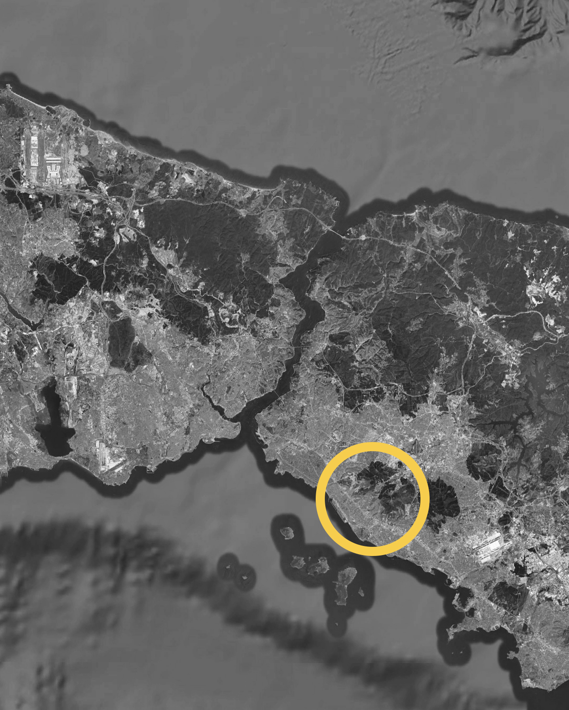
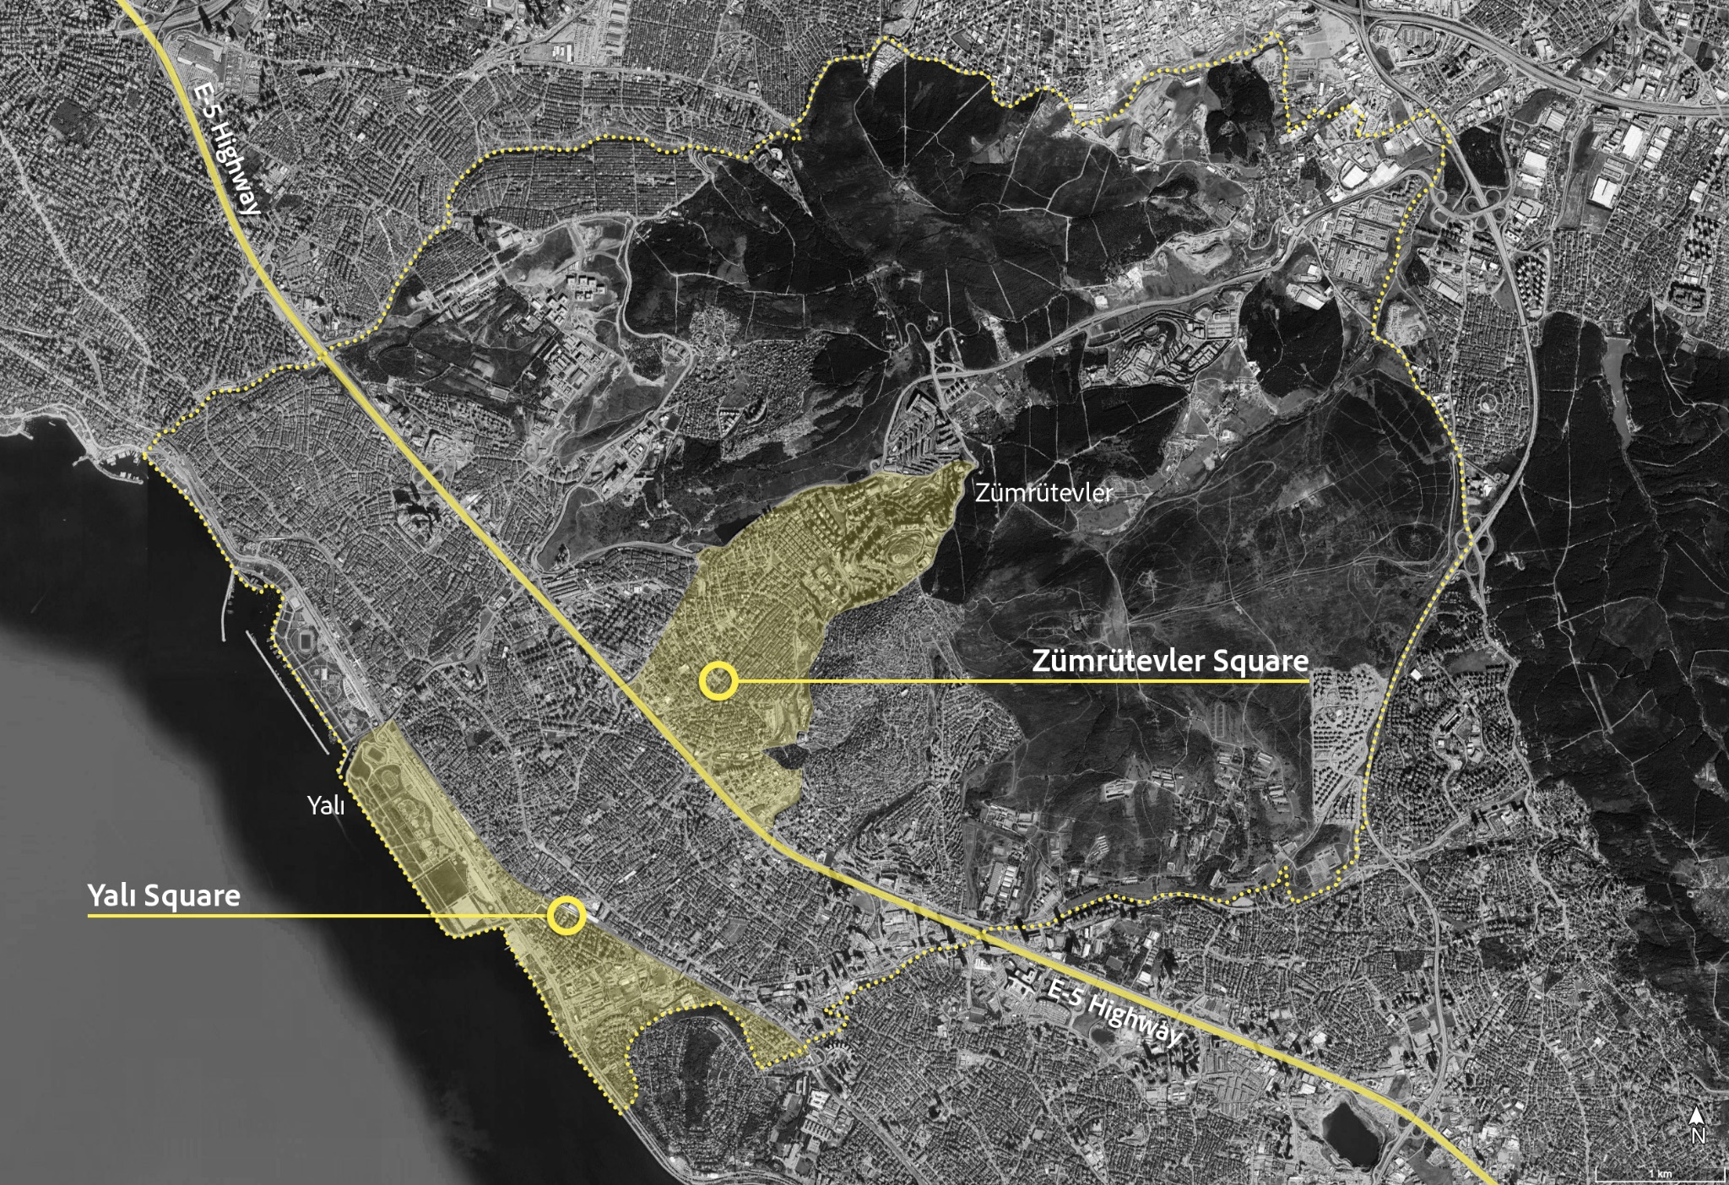
Methodology

Slide 8
Methodology
pre-project
during interim
after implementation

Slide 9
Methodology
Name | Institution | Year | Scope
Designing Streets for Kids | NACTO & GDCI | 2019 | Global
ITCN Design Guidelines | The Ministry of Housing and Urban Affairs, Government of India | 2019 | India
Child-Friendly Cities: Planning and Design Guidelines | Government of Israel | 2023 | Israel
Streets for Walking & Cycling: Designing for Safety, Accessibility, and Comfort in African Cities | UN-Habitat & ITDP | 2015 | Africa
Cities Safer by Design | WRI | 2015 | Global

Slide 10
Methodology
Name | Institution | Year | Scope
Designing Streets for Kids | NACTO & GDCI | 2019 | Global
ITCN Design Guidelines | The Ministry of Housing and Urban Affairs, Government of India | 2019 | India
Child-Friendly Cities: Planning and Design Guidelines | Government of Israel | 2023 | Israel
Streets for Walking & Cycling: Designing for Safety, Accessibility, and Comfort in African Cities | UN-Habitat & ITDP | 2015 | Africa
Cities Safer by Design | WRI | 2015 | Global

Slide 11
Methodology
Three spatial scales of evaluation:
Decision-making process
Neighbourhood scale
Design detail scale
Common criteria consolidated, unique ones retained.
7 decision-making criteria
7 neighbourhood-level criteria
36 design-scale criteria

Slide 12
Methodology
Data Collection Methods:
Document analysis and expert interviews (decision-making)
Mapping and spatial analysis (neighbourhood scale)
Field observation, measurement, pedestrian counts, photography (design scale)
Observation Timing:
January 13, 2025 – 14:35 to 15:15
Targeted school dismissal time to observe real user behavior
Key Metrics:
Accessibility distances (300–600 m)
Pedestrian crossing intervals (50–100 m)
Sidewalk widths, surface quality, seating, play elements
Evaluation Approach:
Scoring system applied at all scales
Combined qualitative and quantitative data for holistic assessment

Slide 13
Results
Two-Phased Implementation Success:
The transformation followed an interim (rehearsal) and permanent phase. The temporary stage allowed evaluation before permanent changes.
Significant Space Reallocation:
1,075 m² of vehicular area converted to pedestrian use; 550 m² became public space, with more green and social areas.
Increased Usage & Mobility:
Post-project data shows a 72% increase in square usage; child presence and elderly use rose dramatically; independent mobility improved by 43%.

Slide 14
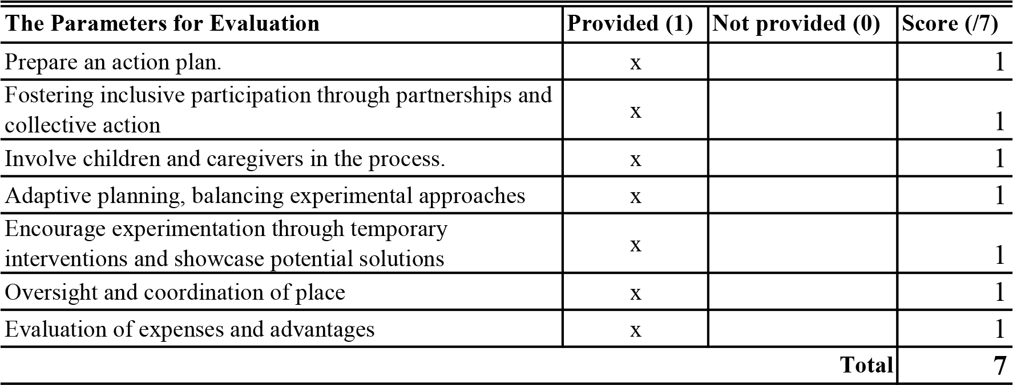
Results

Slide 15
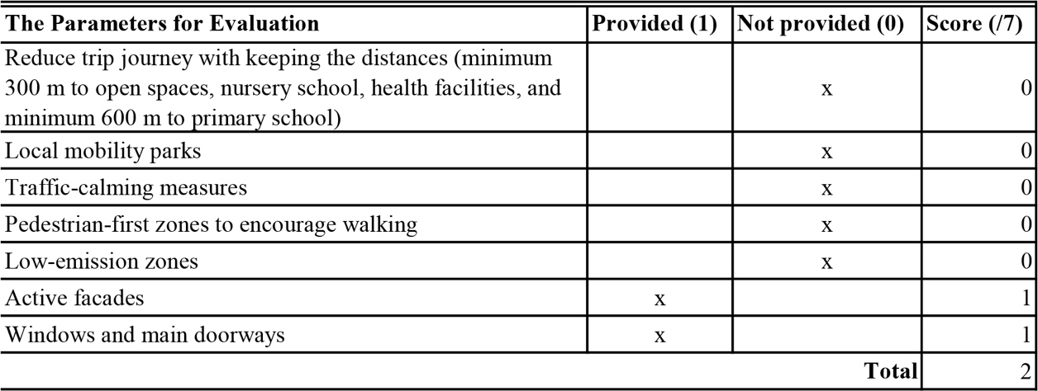
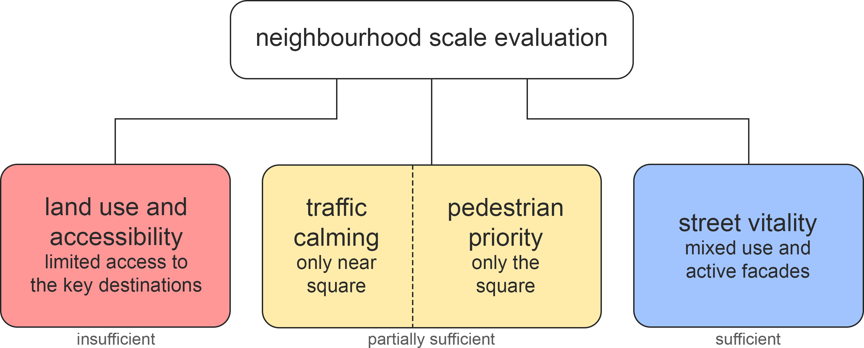
Results
Notes:
Despite project-level success, most surrounding areas lack safe pedestrian access to child-related amenities. Traffic calming is insufficient beyond the square.

Slide 16
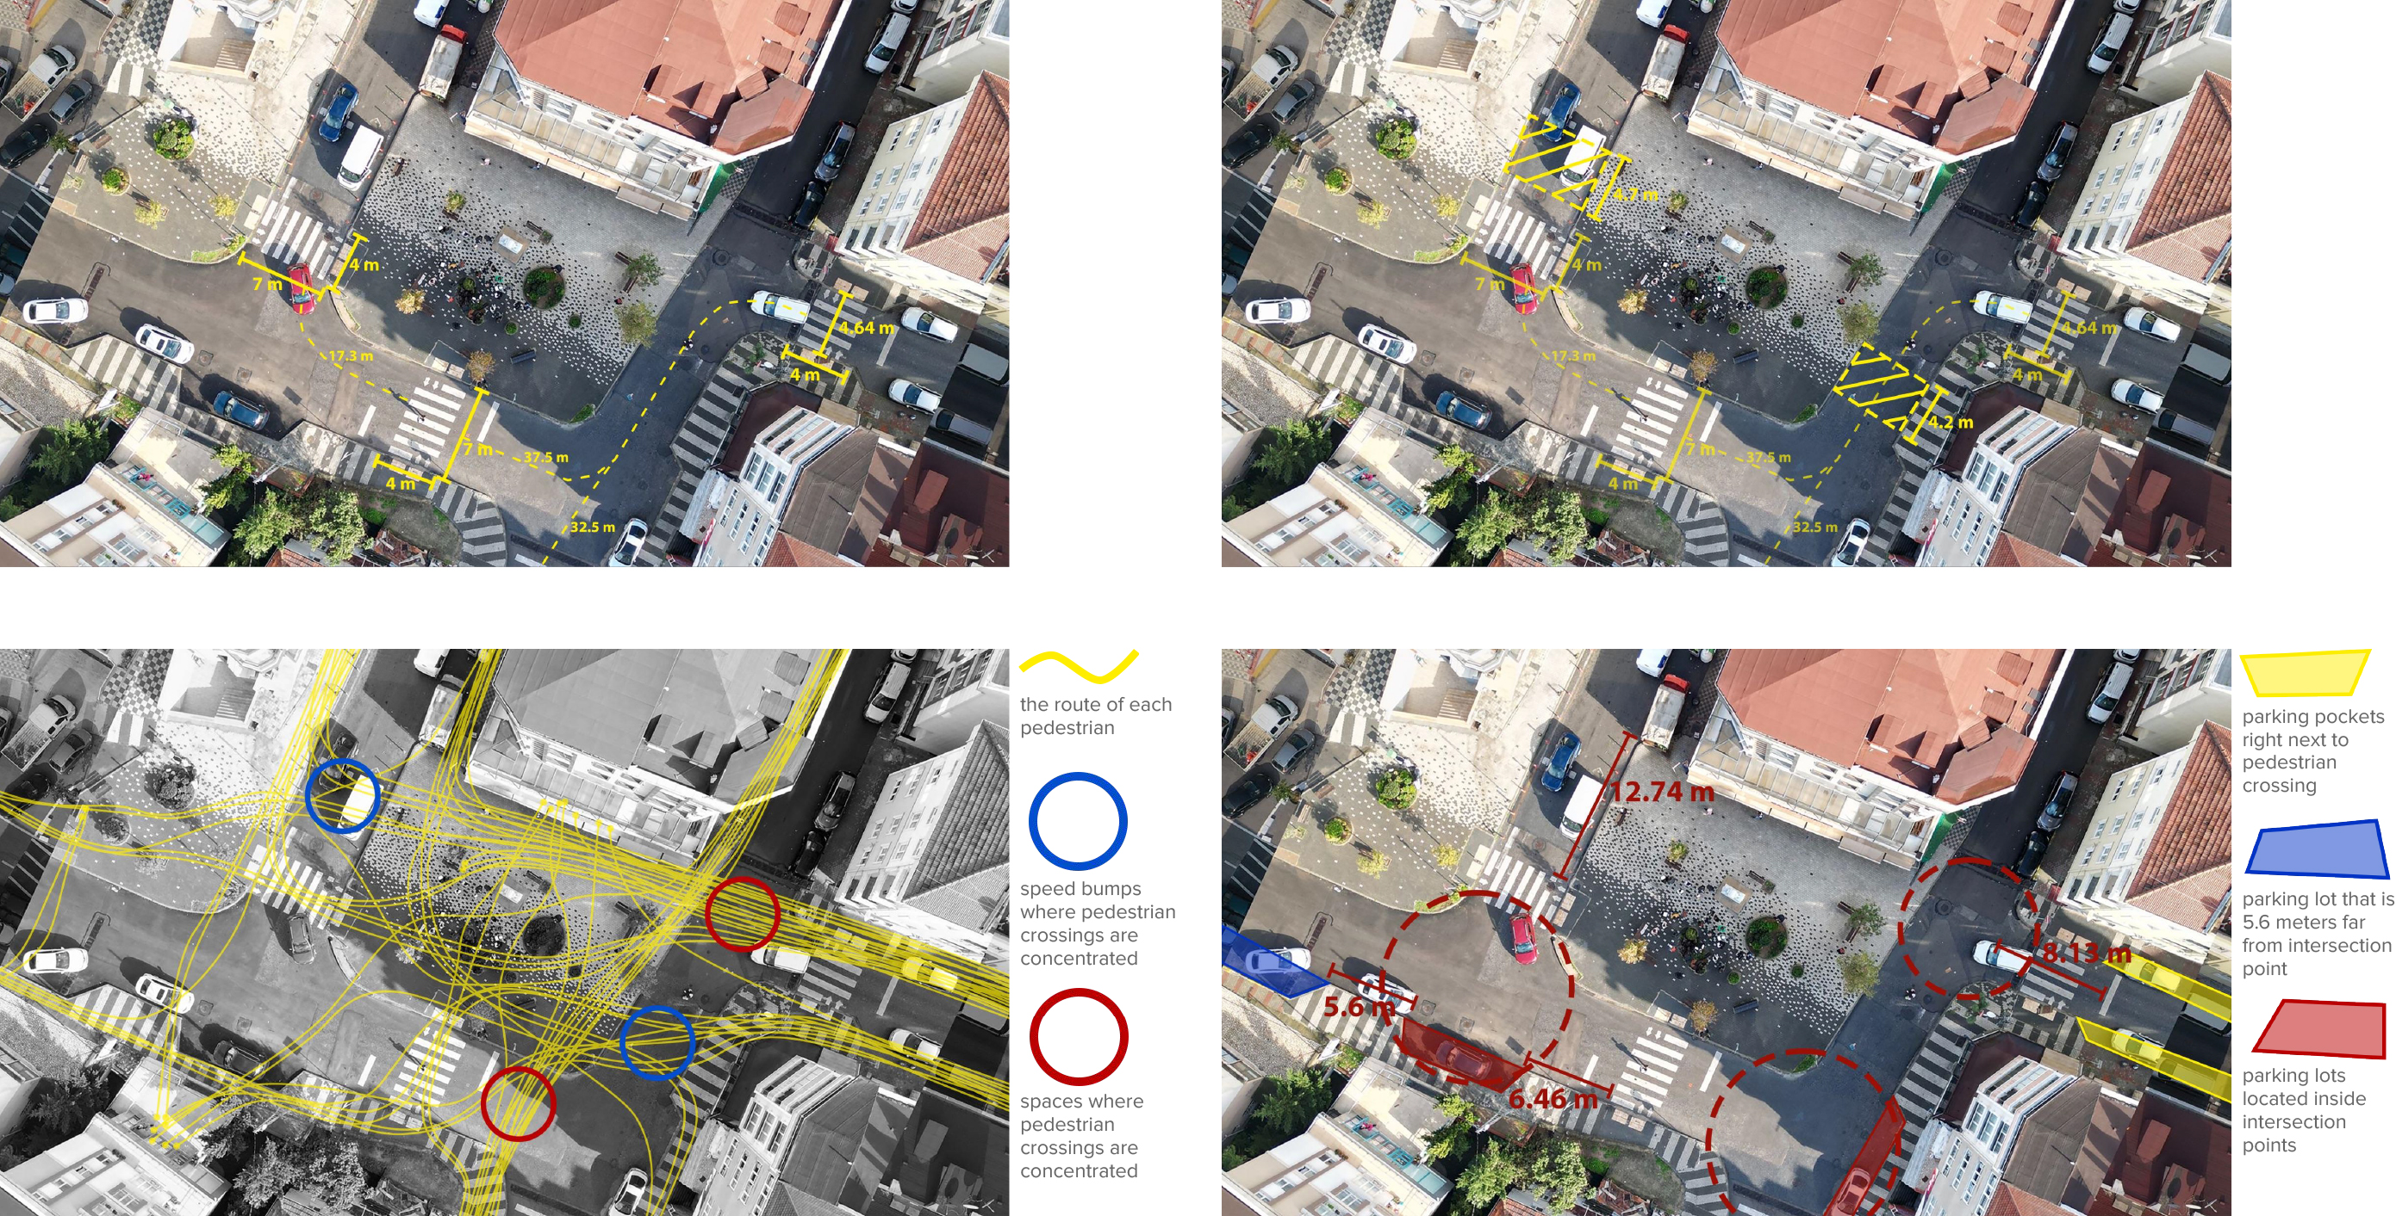
Results
Notes:
While sidewalks and crossings mostly meet technical standards, user behaviour (e.g., informal crossings) reveals safety and usability concerns. Parked vehicles block pedestrian routes and compromise safety; children and caregivers sometimes avoid the square entirely.

Slide 17
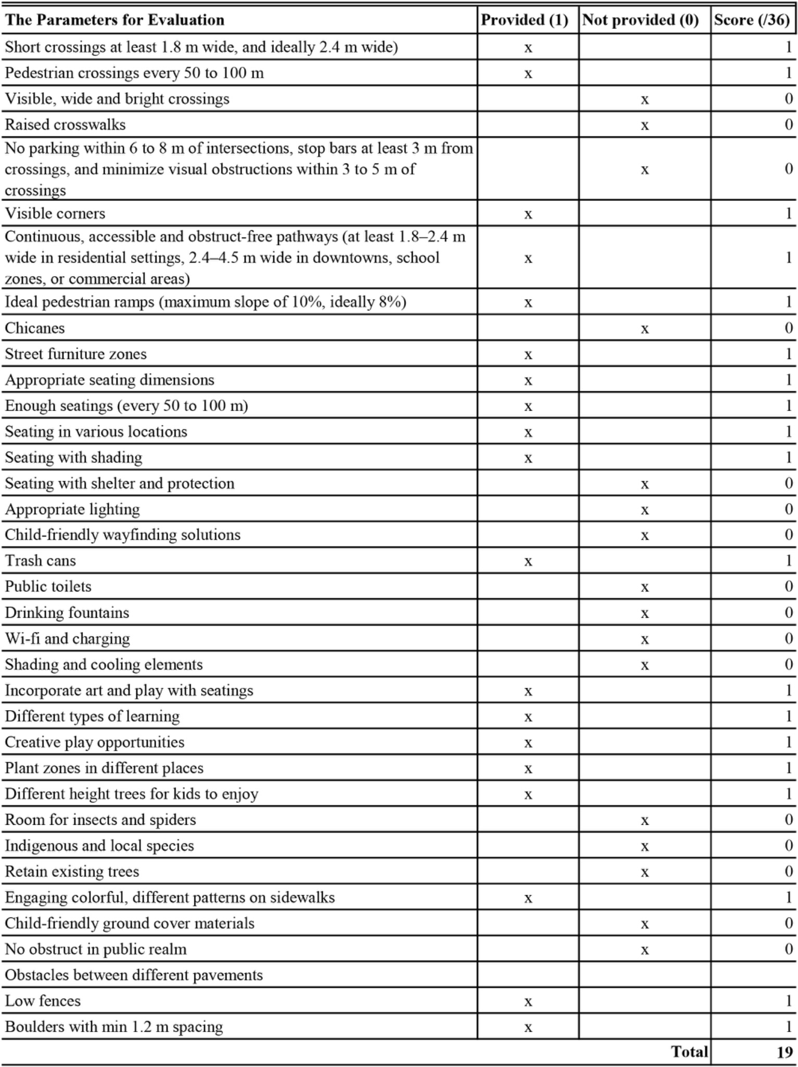
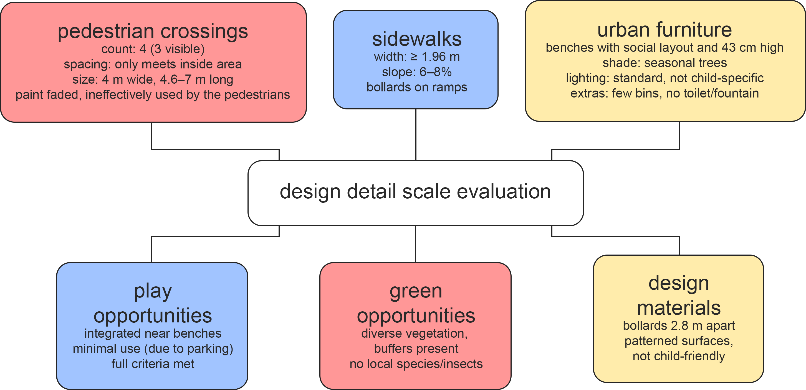
Results

Slide 18
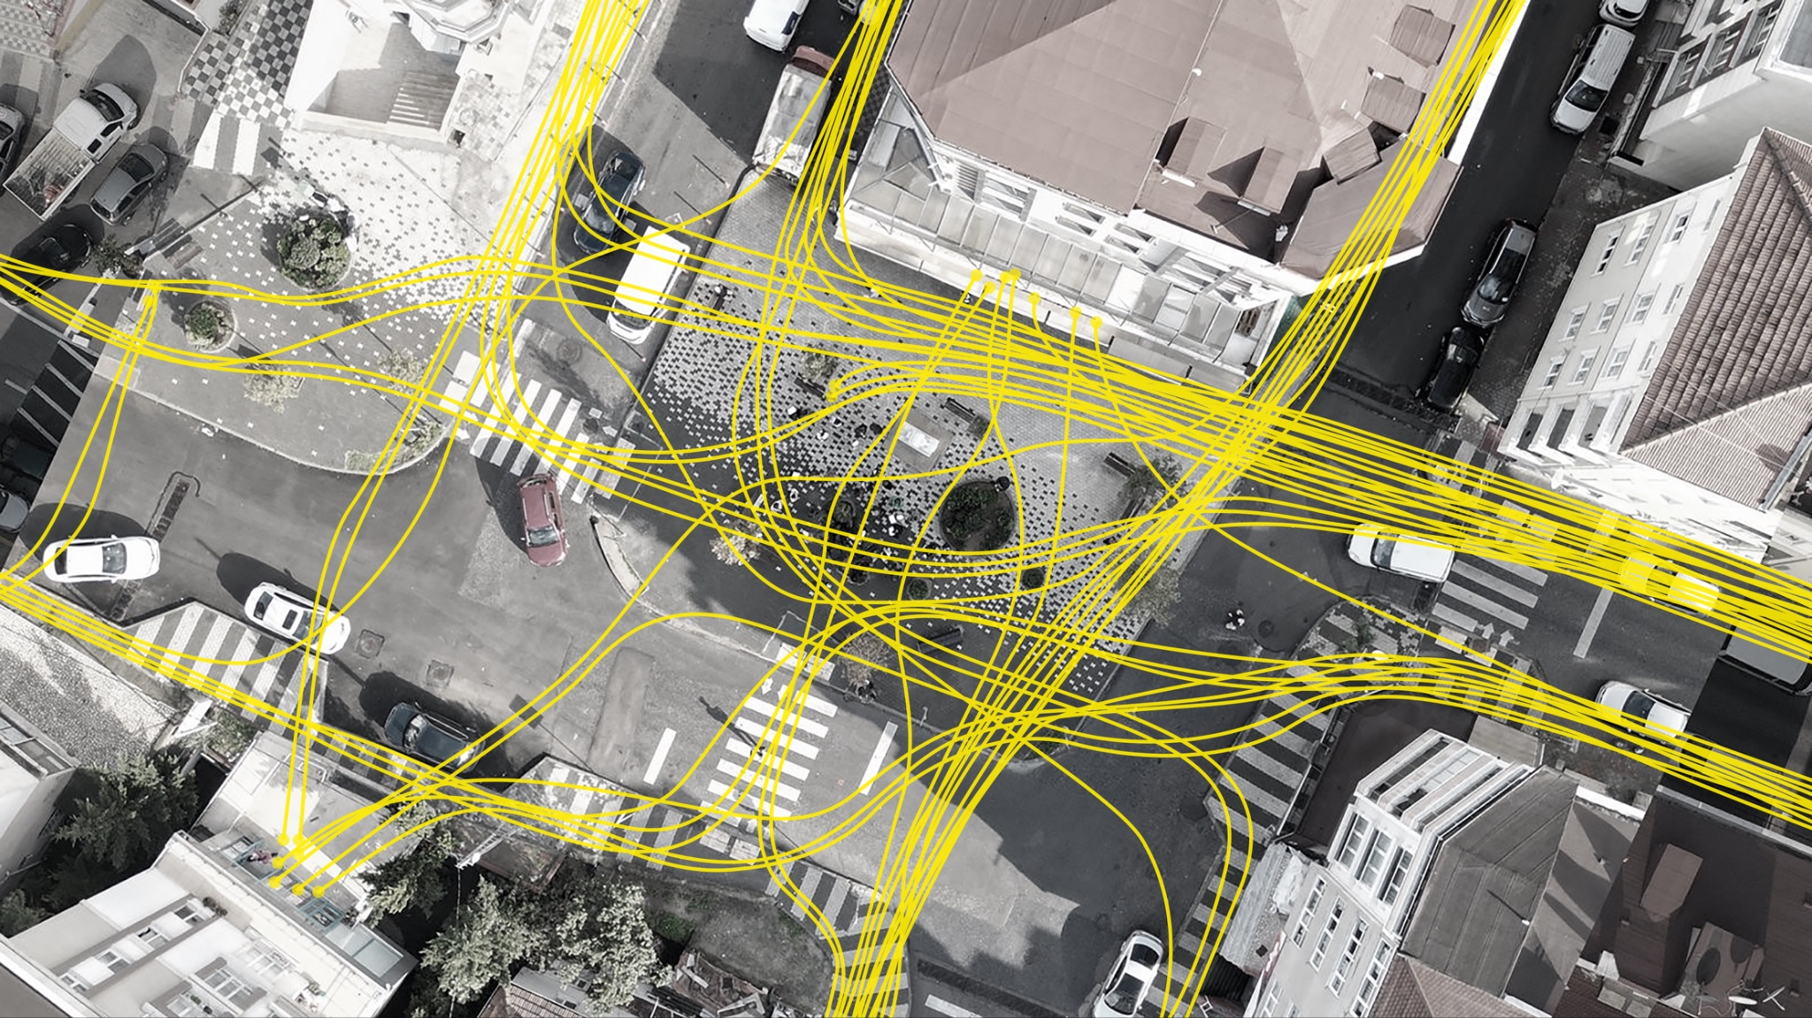
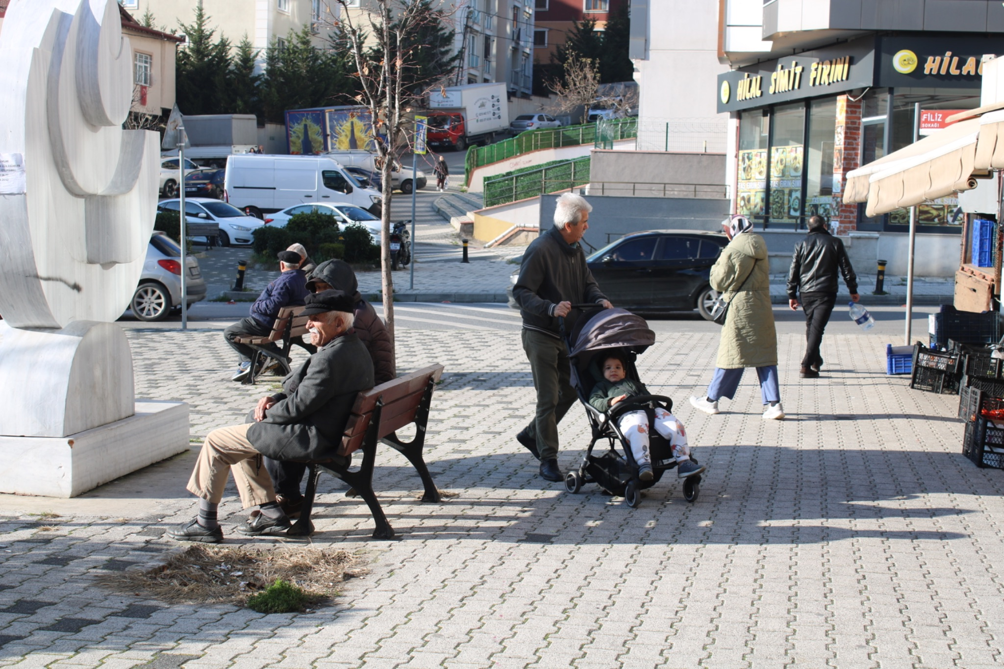
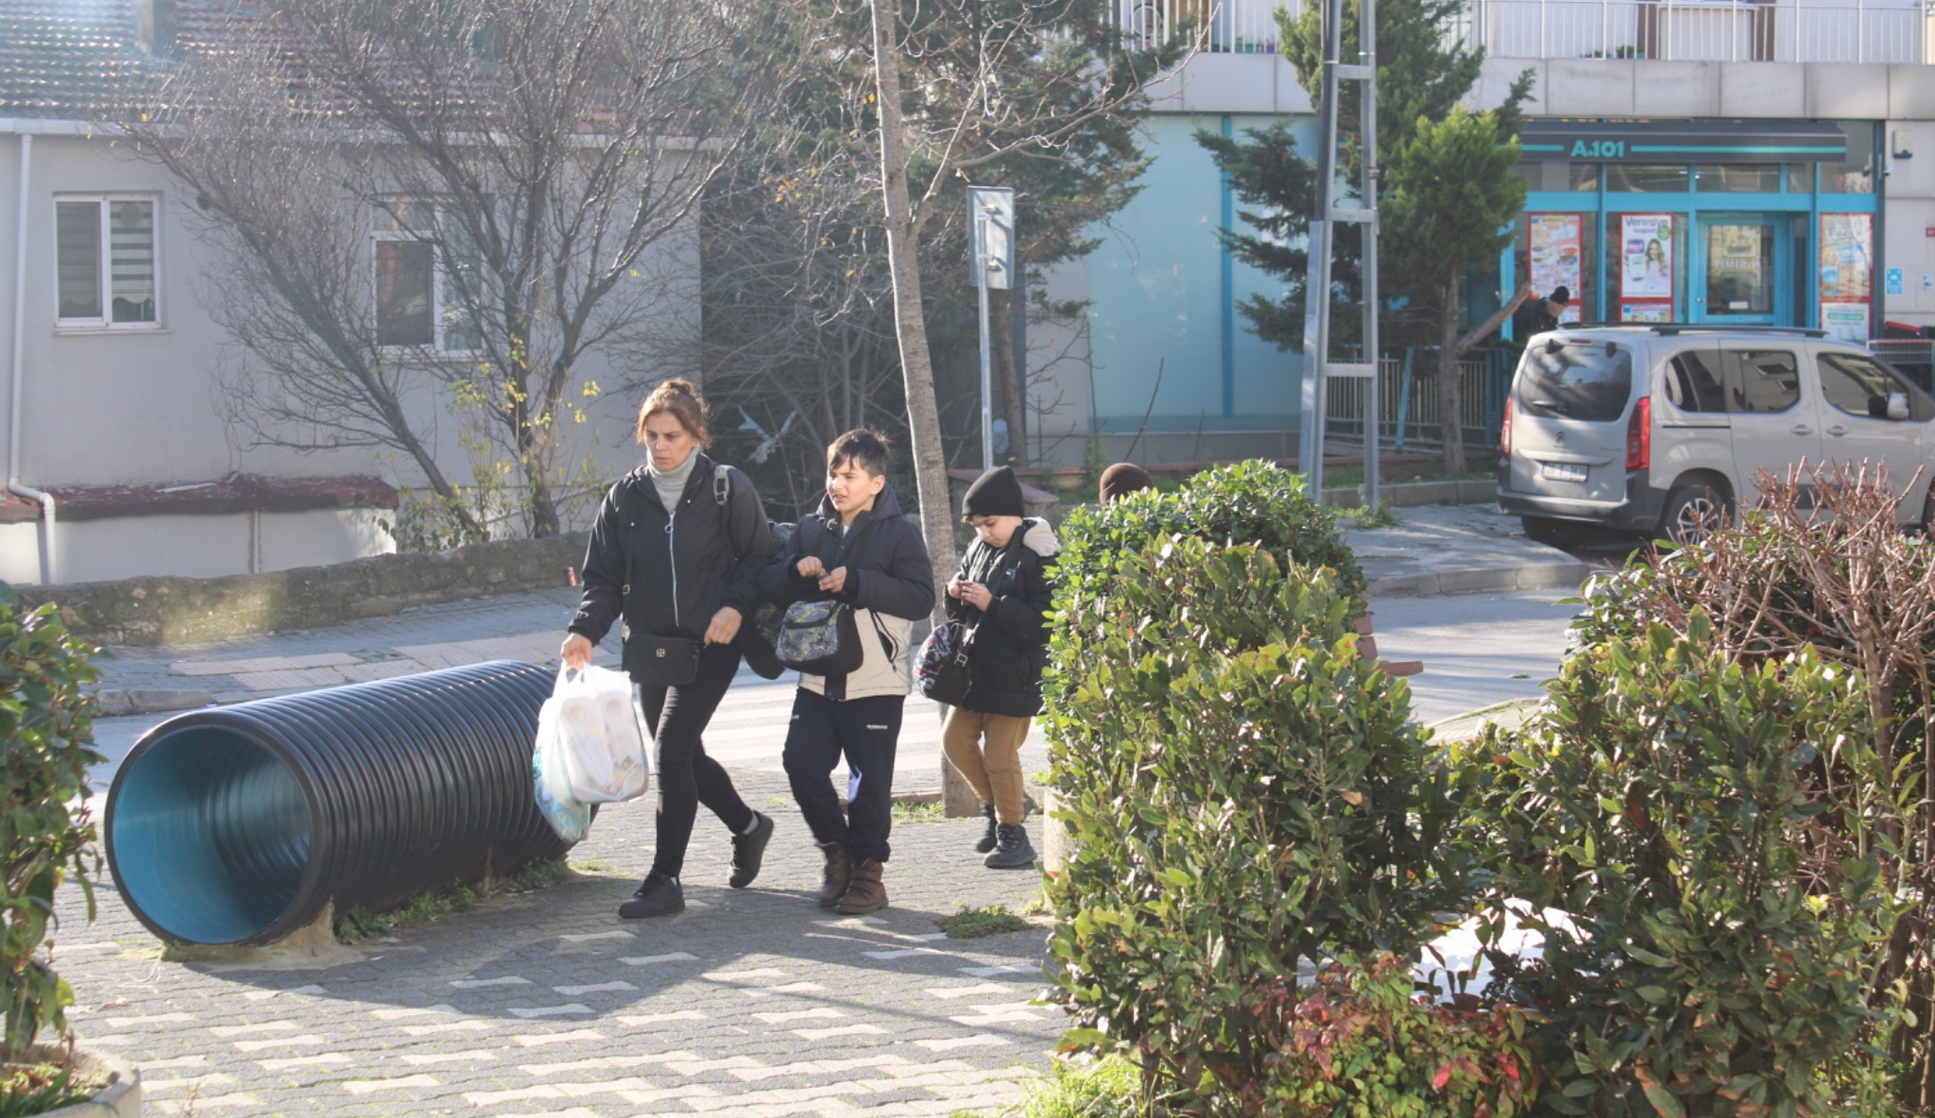
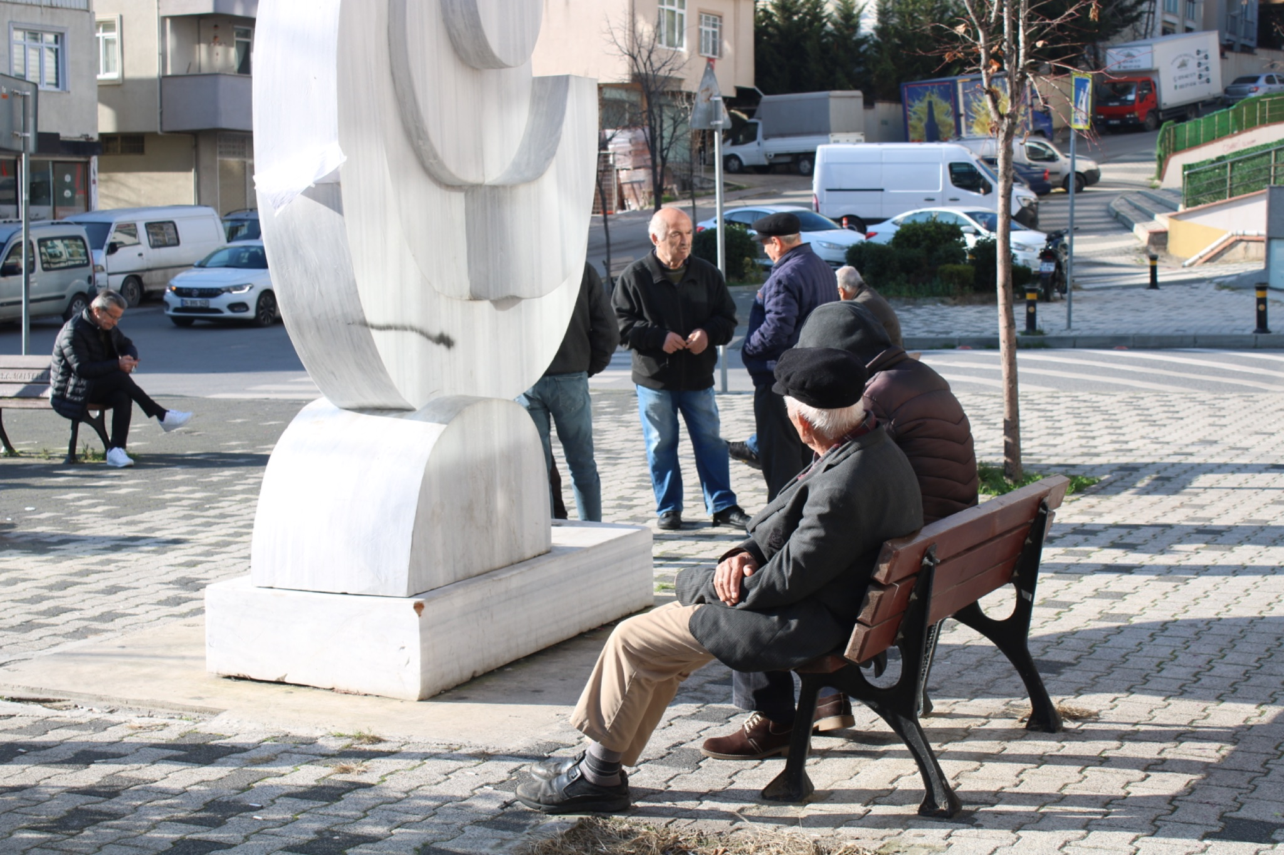
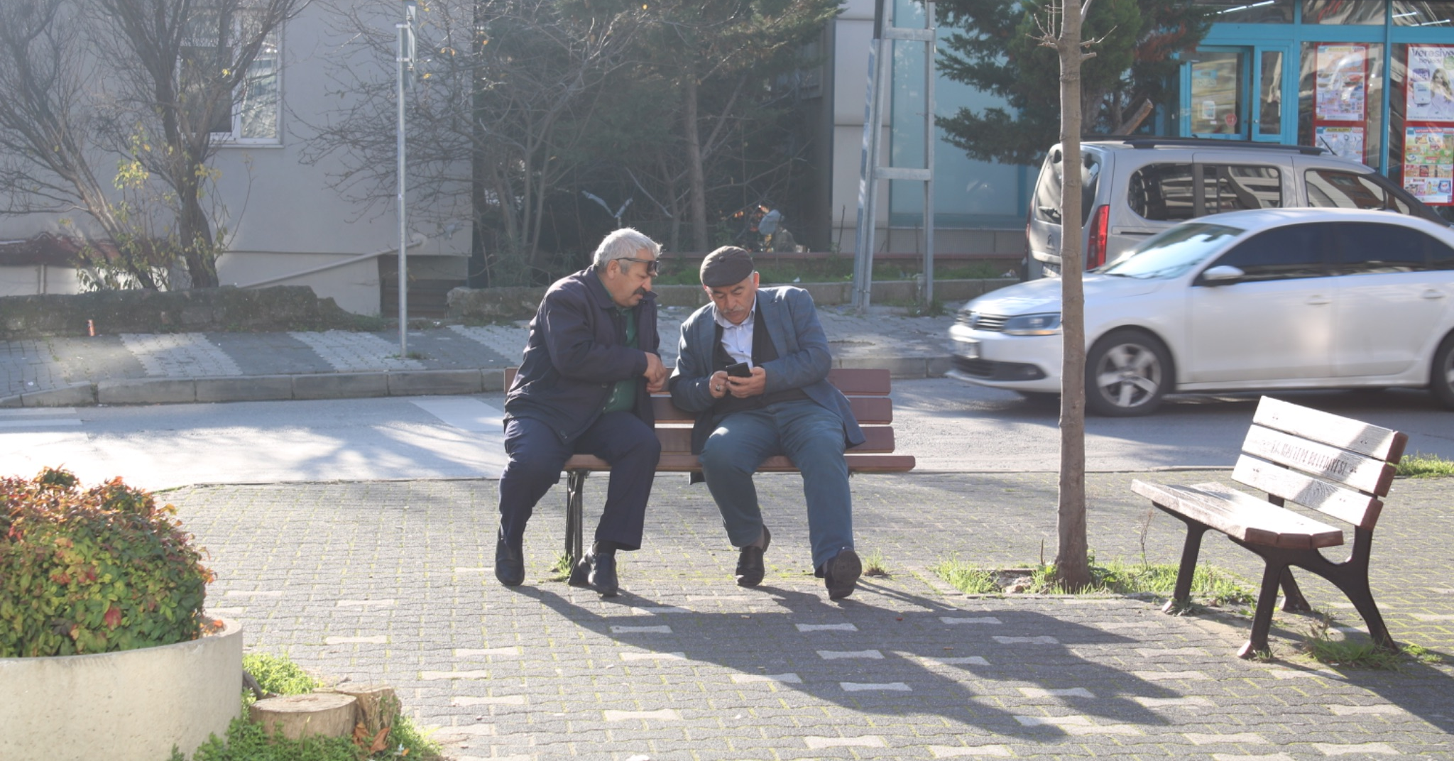
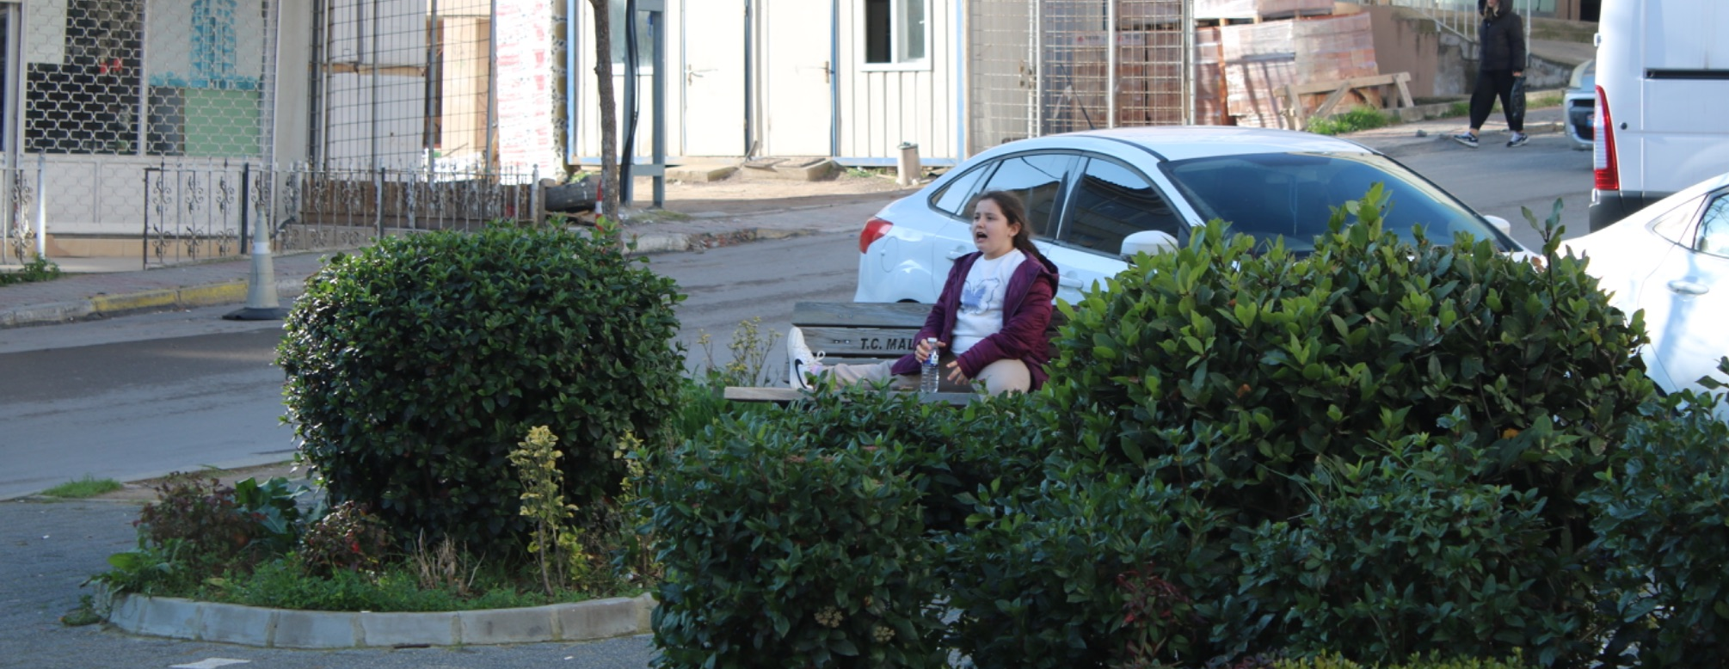
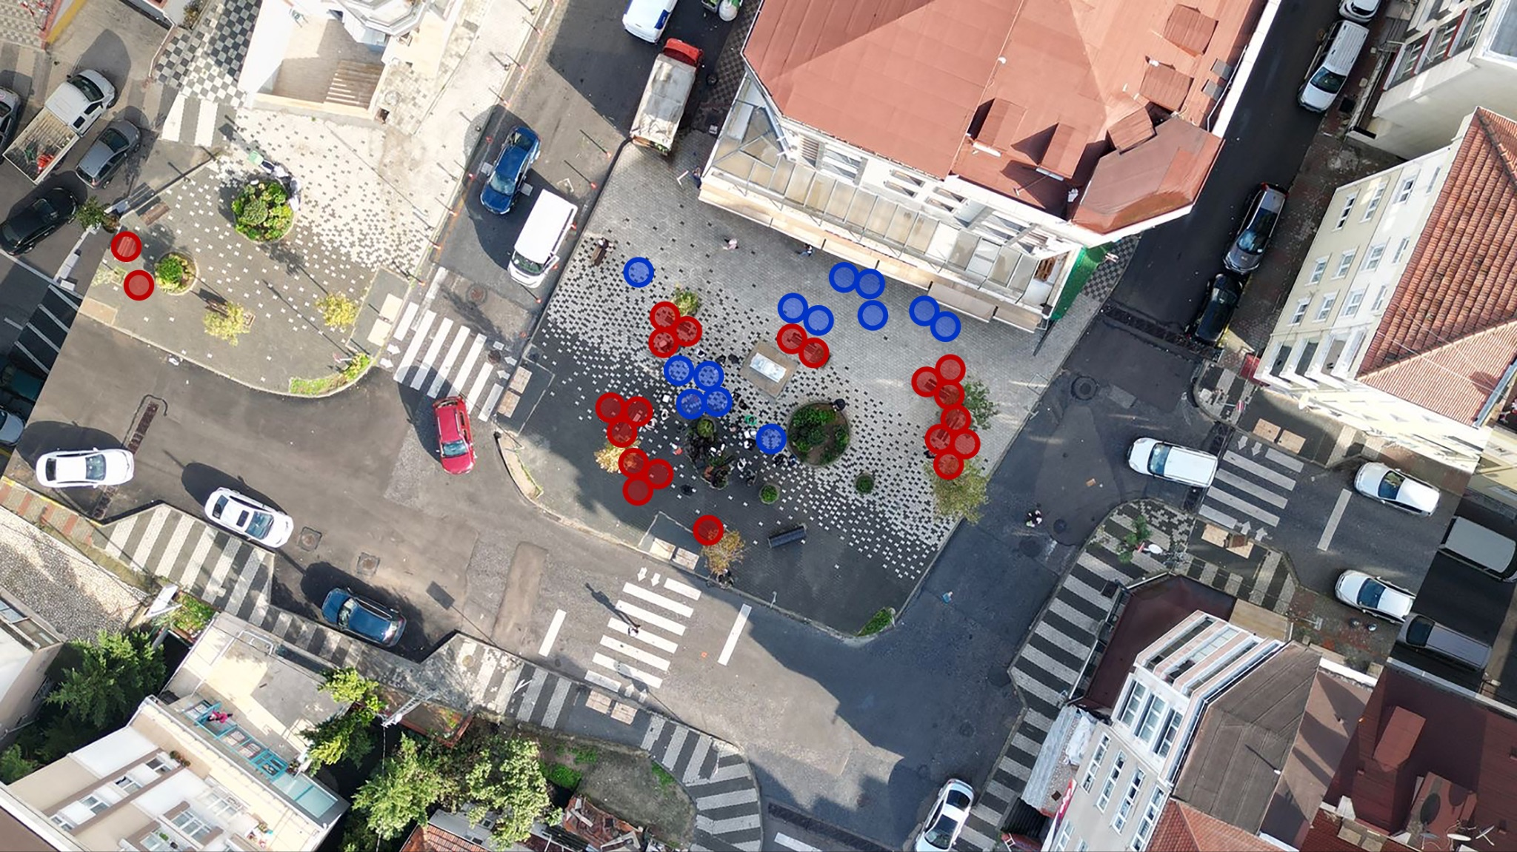
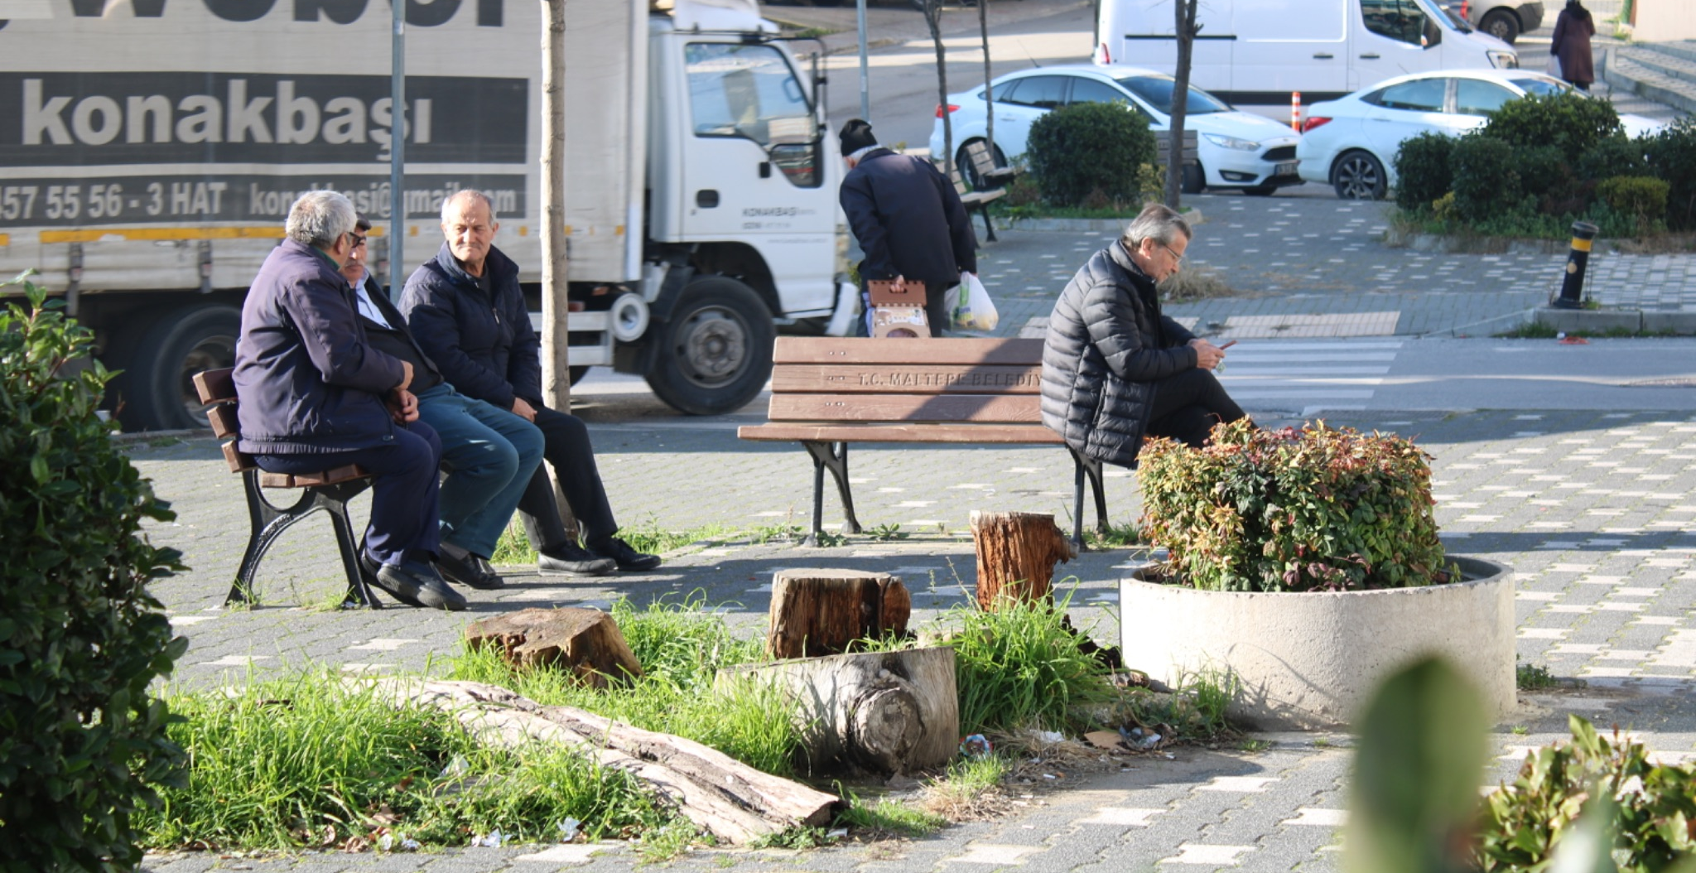
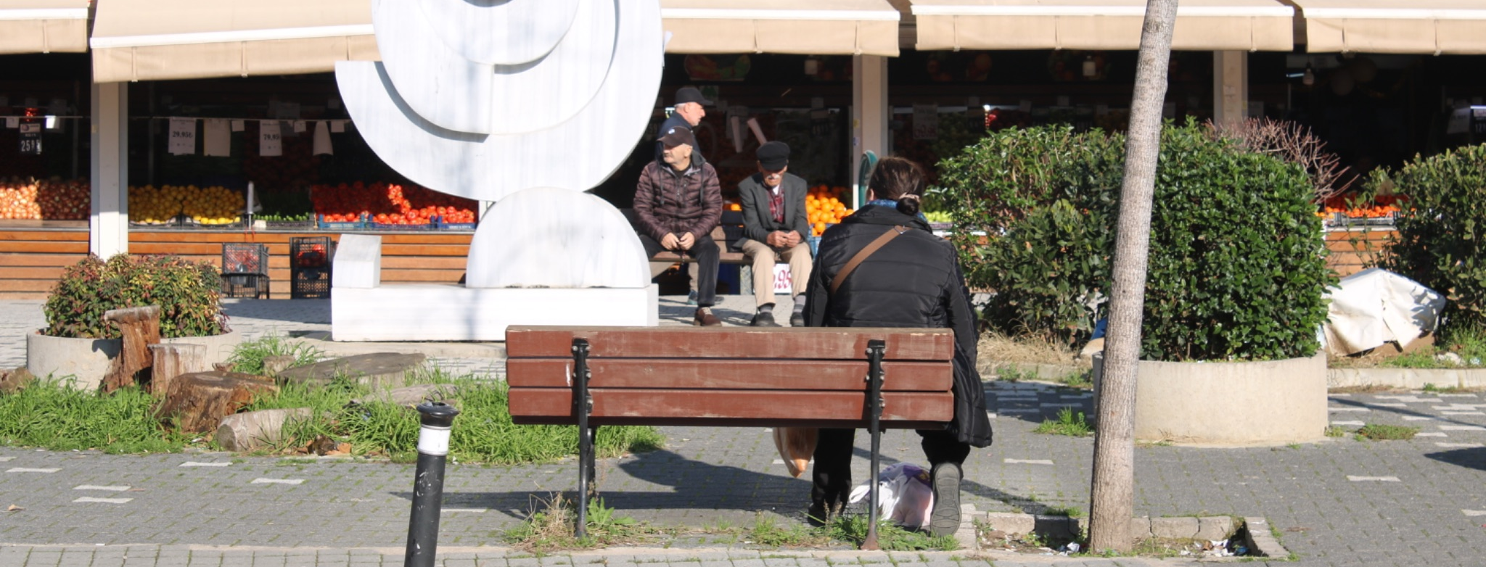
Results
Notes:
Despite intentions for interactive, child-friendly use, the square’s actual function remains passive—failing to encourage active engagement.
Field observations show the space is mainly used as a transit path by caregivers and children—not as a place to stay, rest, or play.

Slide 19
Discussion
Phased, Inclusive Process: The project adopted a flexible, participatory design method with a rehearsal phase, enabling community input and iteration.
Stakeholder Engagement: Despite the absence of a larger-scale directive, the project successfully coordinated multiple actors and involved children and caregivers.
Neighbourhood Disconnect: The square is well-designed locally but lacks integration with wider neighbourhood infrastructure like schools, parks, and calming zones.
Design-Use Mismatch: Design elements met technical criteria, but observed user behaviour did not align with intended play/stay uses—space functions mainly as a transit route.
Vehicle Dominance: Persistent vehicle presence and informal pedestrian routes limit safety and reduce the child-friendliness of the area.
Beyond Technical Standards: Child-friendly design must account for lived experiences, not just technical benchmarks.

Slide 20
Conclusion
Multi-Scale Evaluation is Essential: Understanding child-friendly design effectiveness requires analysis at process, neighbourhood, and detailed design levels.
Rigid Criteria ≠ Universal Success: Some design parameters were hard to implement or maintain; flexible, context-sensitive frameworks are needed.
Low Child Visibility: Despite the child-focused goal, the space was underused by children—mainly serving as a passageway, not a play area.
Governance Challenges: Institutional overlap caused coordination issues, affecting the consistency of implementation.
Missed Rehearsal Opportunity: A second rehearsal phase could have refined the design further—future projects should include iterative testing.
Policy Implication: Zümrütevler offers valuable lessons for scaling child-friendly urbanism: long-term planning, cross-sector collaboration, and adaptability are key.

Slide 21
Conclusion
Further Studies:
A detailed examination of the rehearsal phase will provide a better understanding of the transformation process.
Testing a second rehearsal phase could enhance public engagement and allow more refined, participatory design decisions.
Exploring coordination models between multiple institutions may help overcome administrative barriers in future urban interventions.
Future studies could assess how child-friendly strategies evolve over time, especially under urban pressures such as densification and traffic demands.

Slide 22
References
Apaydın, Y. (2024). Designing Child-Friendly Cities. Urban Design Lab.
Barker, J. (2006). ‘“Are we there yet?”: Exploring aspects of automobility in children’s lives’, PhD thesis, Department of Geography and Earth Sciences, Brunel University, London.
Bernard van Leer Foundation (2019). ITCN Design Guidelines.
Bernard van Leer Foundation (2023). Child-Friendly Cities: Planning and Design Guidelines, Israel.
Bernard van Leer Foundation (2021). An Urban95 Starter Kit, Ideas for Action.
Burgaz, E. (2022). Oyun Sokağı. Bigumigu. https://bigumigu.com/haber/oyunsokagi/
Chawla, L. (1997). Growing up in cities: a report on research under way. Environment and Urbanization, 9(2), 247-252. https://journals.sagepub.com/doi/10.1177/095624789700900212
Clarke, R. (2022). School Streets: Putting Children and the Planet First. A Political Economy Analysis of the Rise of School Streets in Europe and Around the World. Child Health Initiative. 29-30. https://www.fiafoundation.org/media/hr3fmhin/school-streets-reportpages.pdf
Freeman, C., & Tranter, P. (2012). Children and their urban environment: Changing worlds. Routledge.
Gehl Institute (2018). Space to Grow: 10 Principles to Support Families in Cities.
Gill, T. (2007). Can I play out? - Lessons from London Play's home zones project.
Gill, T. (2017). Announcing a new project to build the case for more child-friendly cities. Rethinking Childhood.
Gill, T. (2022). Why Child-Friendly Urban Design Matters. Cities 4 Children. https://cities4children.org/blog/why-child-friendly-urban-designmatters/
Gürdoğan, B., Gürdoğan, S. & Thomsen, G. (2020). Zümrütevler Meydanı Dönüşüm Provası. Superool & Bernard van Leer Foundation.
IMM (2022). Istanbul Play Master Plan. Retrieved from https://yesil.istanbul/haber_istanbul-oyun-master-plani
IMM (2023). Tuzla Valley of Life Interactive Urban Space Project. Street Pedestrianisation Project.
IPA (2024). Araçlardan Çocuklara: Sokakların Dönüşümü. Kent Gündemine Bakış. Nisan 2024.
Istanbul Green (2020, 12 November). Oyun Alanları Olan Bir Kentten Oynanabilir Bir Kente! Retrieved from https://yesil.istanbul/haber_oyun-istanbul
Karsten, L., & Van Vliet, W. (2006). Children in the city: Reclaiming the street. Children, youth and environments, 16(1), 151-167.
Katsavounidou, G. (2023). Child, play, and urban space: a historical overview and a holistic paradigm for child-centered urbanism. Journal of Urbanism: International Research on Placemaking and Urban Sustainability, 16(4), 430-446. https://doi.org/10.1080/17549175.2021.2005120
Kost, C., Mwaura, N., Jani, A. & Van Eyken, C. (2018). Streets for walking & cycling: designing for safety, accessibility, and comfort in African cities. UN-Habitat & ITDP.

Slide 23
References
Krysiak, N. (2018). Where do the children play: designing child-friendly compact cities. Retrieved from cities for play website: https://www.citiesforplay.com/portfoliowhere-do-the-children-play
Krysiak, N. (2020). Designing child-friendly high density neighbourhoods: transforming our cities for the health, wellbeing and happiness of children. Cities for Play.
Krysiak, N. (2021). Cities for Play: Designing streets that prioritise children over cars. Cities for Play.
Lydon M, Bartman D, Woudstra R, et al. (2011). Tactical Urbanism 1: Short-term Action, Long-term Change. Miami: Next Generation of New Urbanists.
Lydon M, Bartman D, Woudstra R, et al. (2012). Tactical Urbanism 2: Short-term Action, Long-term Change. Miami: Next Generation of New Urbanists.
Maltepe Municipality (2022). 2020–2024 stratejik plan: Güncellenmiş versiyon. https://www.maltepe.bel.tr/upload/strateji/2020_2024_Stratejik_Plan.pdf
Maltepe Municipality (2023). 2023 Yılı Sivil Katılım Güçlendirme Eylem Planı.
Moffat, D. (2002). Growing Up in Cities. Places, 15(1). http://escholarship.org/uc/item/4gv825qq
NACTO & GDCI (2019). Designing Streets for Kids.
O’Brien, C. (2003). ‘Transportation that’s actually good for the soul’, National Center for Bicycling and Walking (NCBW) Forum (Canada), vol 54, pp1–13.
Perez-del-Pulgar, C., Anguelovski, I., & Connolly, J. J. (2024). Child-friendly urban practices as emergent place-based neoliberal subjectivation?. Urban Studies, 00420980241235781.
Playing Out (2014). Bristol Library Exhibition - October 2014. Playing Out. https://playingout.net/inspiration/creative-projects/playing-exhibitionbristol-central-library/
Prajapati, S. (2024). Benefits of Prioritizing Child-friendly Urban Design. Newcastle University. Retrieved from https://nclurbandesign.org/child-friendly-urban-design-5/
Sicignano, G. & Caljé, L. (2022). Longread — Milan Before and After: Citywide Placemaking. The City at Eye Level.
Silva, P. (2016). Tactical urbanism: Towards an evolutionary cities’ approach?. Environment and Planning B: Planning and design, 43(6), 1040-1051.
Streetfilms (2024). Paris School Streets: Safe for Children, Safe for Everyone. Open Plans.
Superpool (2020). Zümrütevler Square. Retrieved from https://www.superpool.org/work/zuemruetevler-square
Superpool (2022). Yalı Square and Bike Path. Retrieved from https://www.superpool.org/work/yali-square-and-bike-path
Tranter, P. (2016). Children’s Play in their Local Neighborhoods: Rediscovering the Value of Residential Streets. Play, Recreation, Health and Well Being. 1(1), 211-236. http://dx.doi.org/10.1007/978-981-4585-96-5_37-1
UN-Habitat (2020). Monitoring and Reporting the SDGs: PUBLIC SPACE. United Nations Human Settlement Programme. For a Better Future. UNHabitat.
UNICEF (2015). Child Friendly City Initiative implementation methodology for the Republic of Kazakhstan. ISBN 978-601-7523-25-1.

Slide 24
References
UNICEF (2019). What is the Convention on the Rights of the Child? UNICEF. https://www.unicef.org/tajikistan/what-convention-rights-child
UNICEF (n.d.). Building a Child Friendly City. Guiding Principles. UNICEF. https://www.childfriendlycities.org/building-child-friendly-city
UNICEF (n.d.). Çocuk Dostu Şehirler. UNICEF. https://www.unicef.org/turkiye/çocuk-dostu-şehirler
UNICEF (n.d.). The Convention on the Rights of the Child: The children’s version. UNICEF. https://www.unicef.org/child-rights-convention/conventiontext-childrens-version
Ville de Paris (2023). Plus de 200 « rues aux écoles » dans Paris. Directorate of Roads and Travels.
Welle, B., Li, W., Adriazola-Steil, C., King, R., Obelheiro, M., Sarmiento, C., & Liu, Q. (2015). Cities safer by design. World Resources Institute.
Yassin, H. H. (2019). Livable city: An approach to pedestrianization through tactical urbanism. Alexandria engineering journal, 58(1), 251-259.
Yıldız, D., & Evren, A. (2010). Socioeconomic Status (SES) Scores of Turkish Statistics Students. İstatistik Araştırma Dergisi, 7(2), 87-100.
https://londonplaystreets.org.uk/about/history/ data retrieved 02.11.2024
https://www.restreets.org/case-studies/home-zones data retrieved 17.11.2024
https://www.planetizen.com/node/62934 data retrieved 17.11.2024
https://www.uskudar.bel.tr/tr/main/news/gezgin-oyun-parki-etkinliklerimizin-ilki-ceng/2582 date retrieved 30.12.2024
https://www.birgun.net/haber/sisli-belediyesinden-bizim-sokak-projesi-trafige-kapatilan-sokaklar-cocuklara-acildi-523366 data retrieved 30.12.2024
https://yesil.istanbul/project-detail_cocuklar-tasarladi-ibb-yapti data retrieved 24.12.2024
https://vanleerfoundation.org/about-us/ data retrieved 29.12.2024
https://vanleerfoundation.org/where-we-work/ data retrieved 29.12.2024
https://nacto.org/about/ data retrieved 29.12.2024
https://globaldesigningcities-org.translate.goog/about/?_x_tr_sl=en&_x_tr_tl=tr&_x_tr_hl=tr&_x_tr_pto=tc data retrieved 29.12.2024
https://www.superpool.org/about data retrieved 24.01.2025
https://www.endeksa.com/tr/analiz/turkiye/istanbul/maltepe/demografi data retrieved 05.04.2025
https://pedestriansfirst.itdp.org/about data retrieved 27.04.2025
https://pedestriansfirst.itdp.org data retrieved 24.04.2025
https://www.apa.org/pi/ses/resources/class/measuring-status data retrieved 02.05.2025

Slide 25
Thank you!

