Slide 1
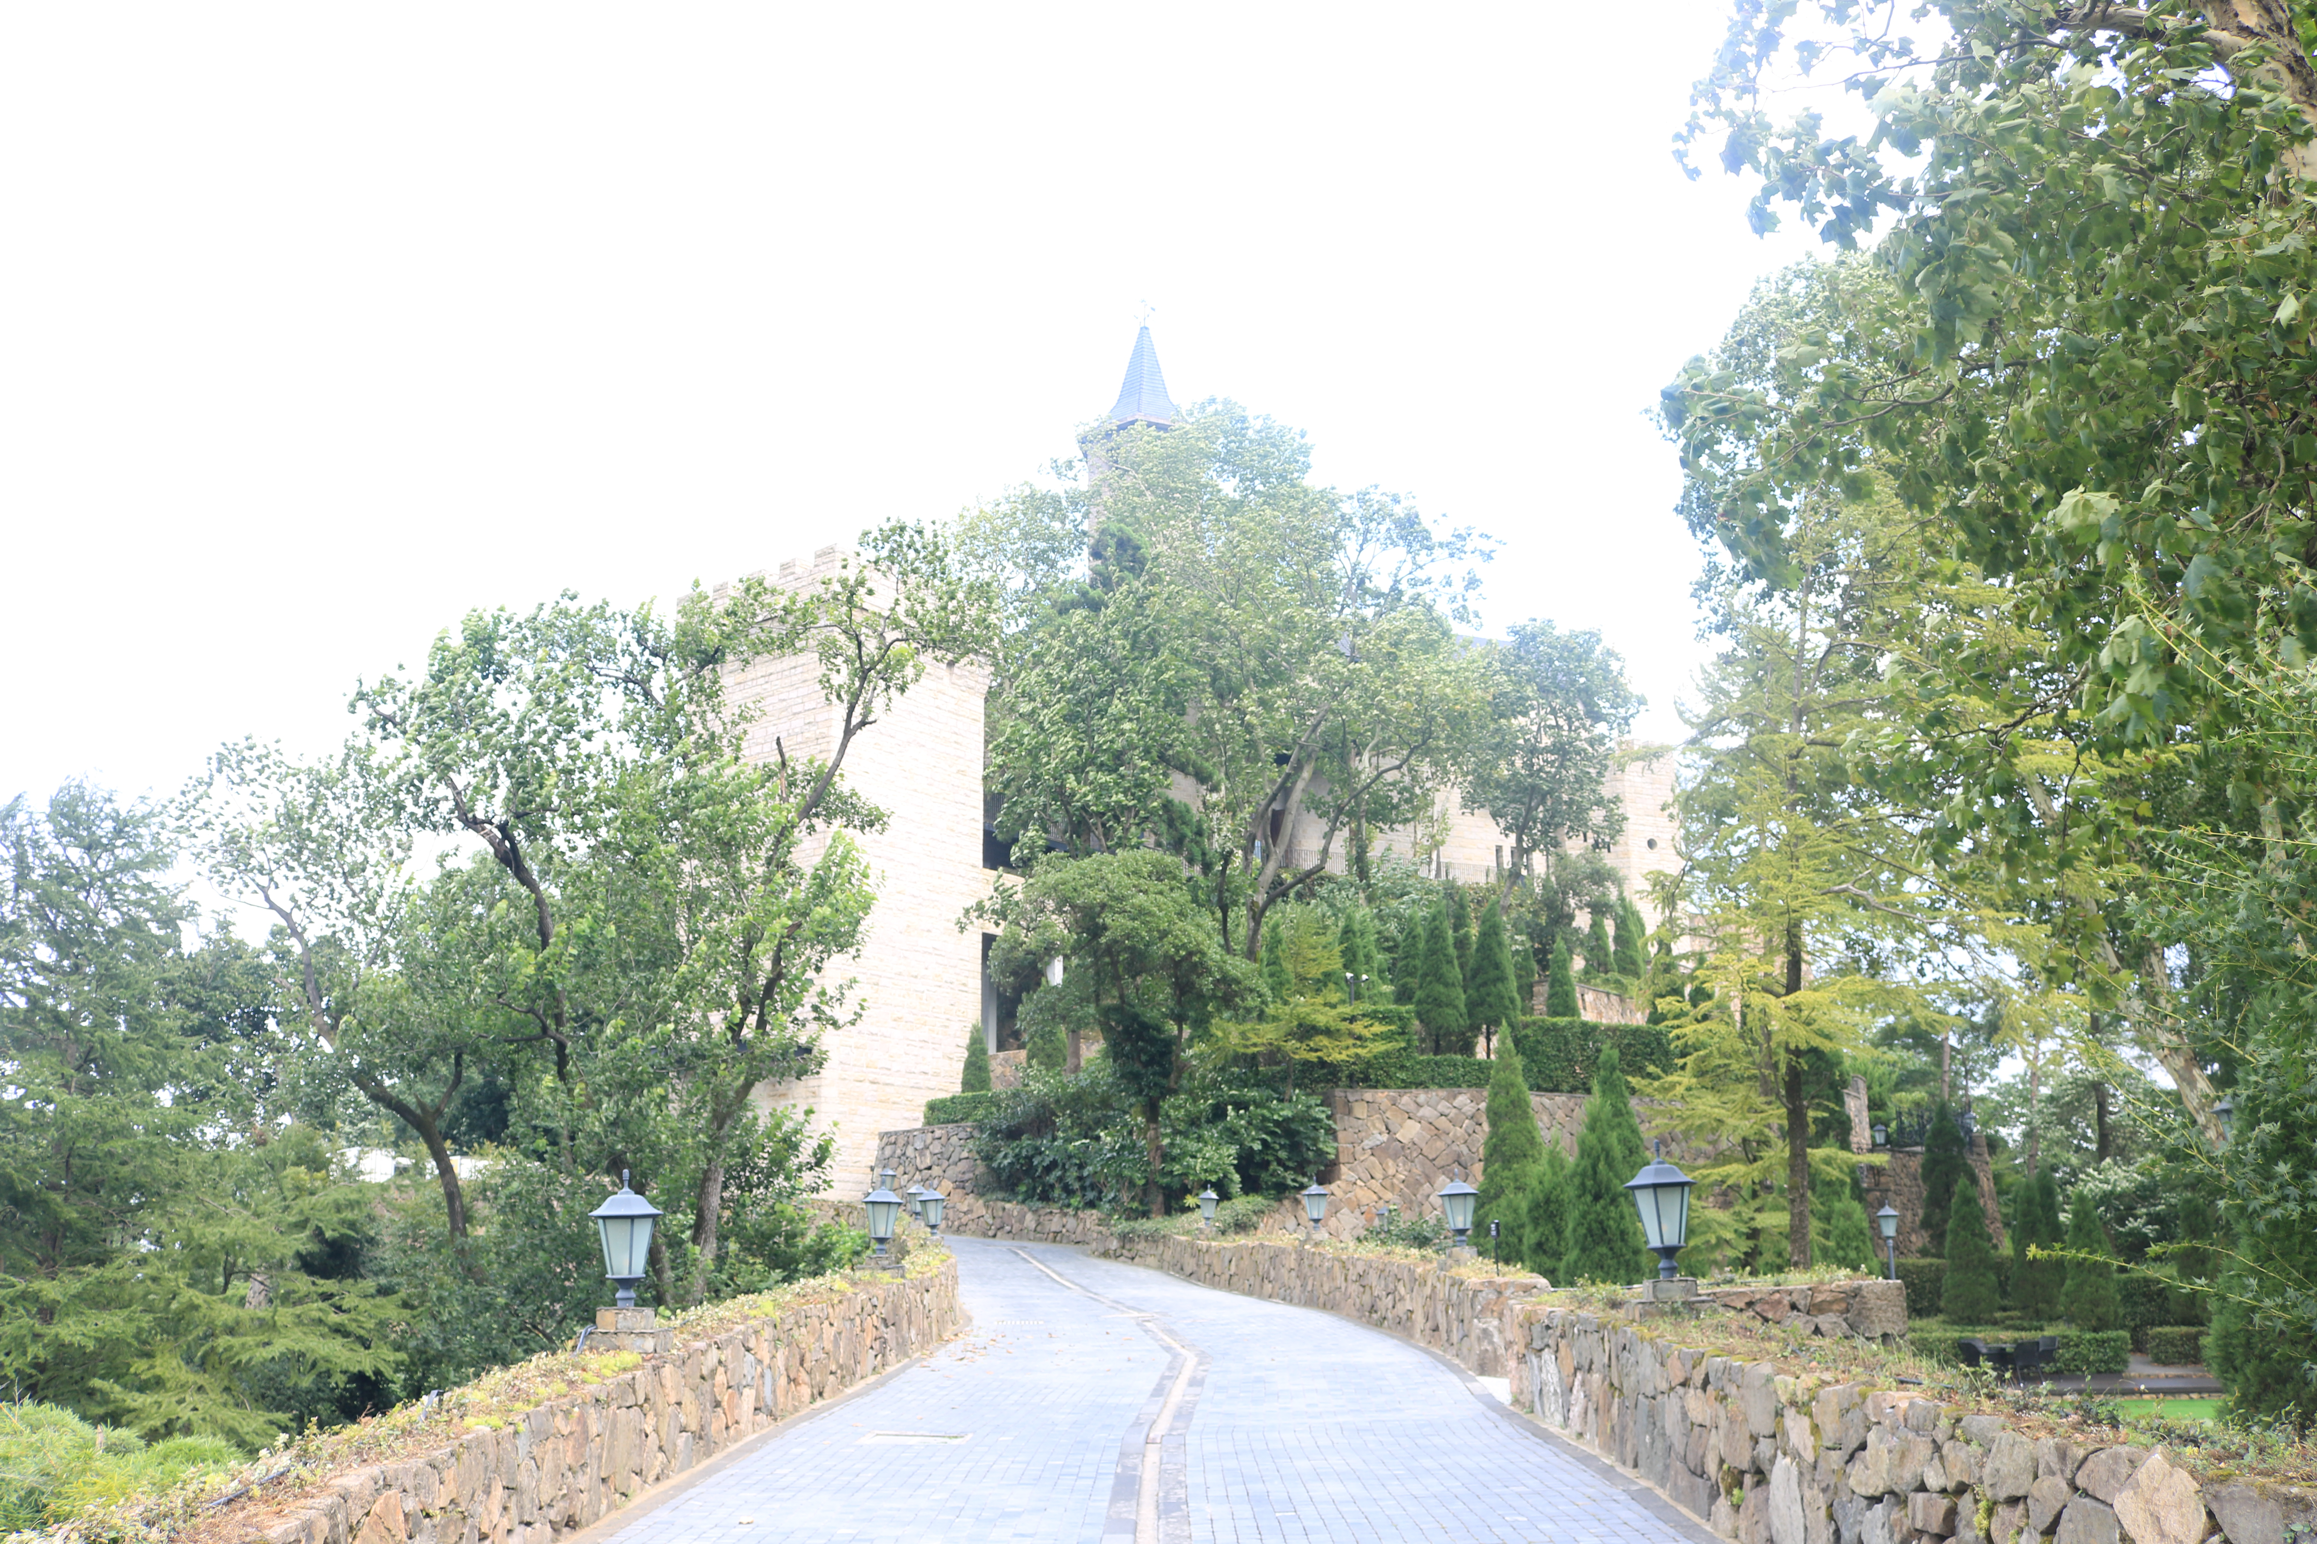
Planetary Gentrification of Rural China: the case of yangjiale
Yifan Song¹, Paulina Maria Neisch²
1 PhD candidate in Architecture and Civil Engineering at the City University of Hong Kong, yifansong4-c@my.cityu.edu.hk;
2 Assistant Professor at the Department of Architecture and Civil Engineering, City University of Hong Kong, pmneisch@cityu.edu.hk;
Pic. 1 LuoXian Castle; Yangjiale BnB
AESOP 2025

Slide 2
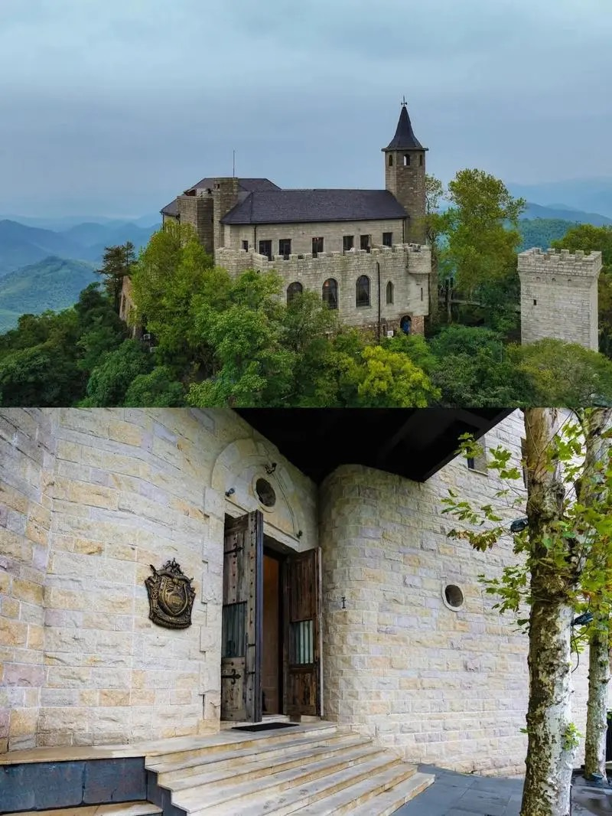
1. BACKGROUND
1.1 Introduction to the Phenomenon of Yangjiale
1890
1). In the Mogan Mountain area in Zhejiang Province, China, due to its superior natural scenery, in 1890, American journalist Forliga’s report attracted a large number of wealthy people from various countries, including Chinese celebrities, to build villas on the Mogan Mountain site.
2). Until modern times, in 2000, Hangzhou TV reporter Xia Yuqing rented cheap local abandoned houses on the mountain at low prices to build a holiday villa "Summer Palace" in order to accompany his children to grow up in nature, which attracted foreigners from the big cities around Mogan Mountain including Shanghai and Hangzhou.
3). In 2007, a South African businessman Gao Tiancheng rented cheap abandoned village houses in the local village in Sanjiuwu on the mountain, and co-designed the holiday villa "Naked Castle" with his wife Ye Kaixin, an architect and designer, which became a huge success commercially. Which marked as the starting point of “Yangjiale”.
4). During the period, a large number of foreigners have built their own villas in the mountains, and their high housing prices and advanced design and operation concepts mark the rise of the rural homestay industry "Yangjiale" created by foreigners in the Moganshan area of Zhejiang Province.
5). With the success of "Yangjiale", it has attracted the input of designers and rural talents from big cities around Moganshan. For example, "Da Le Zhi Ye" was designed by Yang Mohan, a designer in Shanghai who graduated from Shanghai Tongji University, and his team.
2000
2007
Pic.2 "Naked Castle" launched by Gao Tiancheng

Slide 3
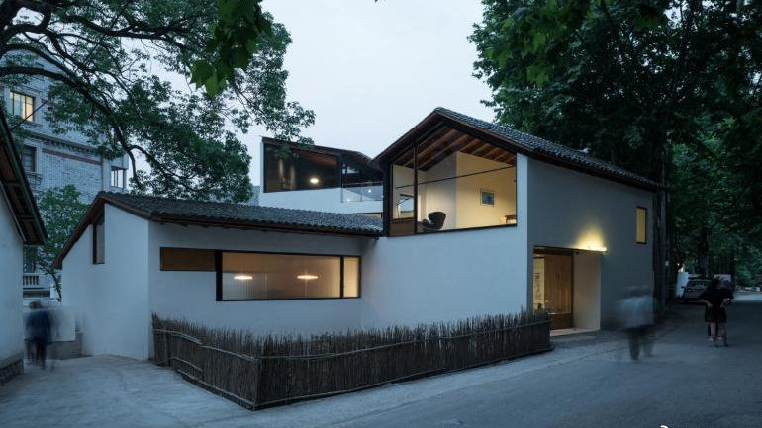
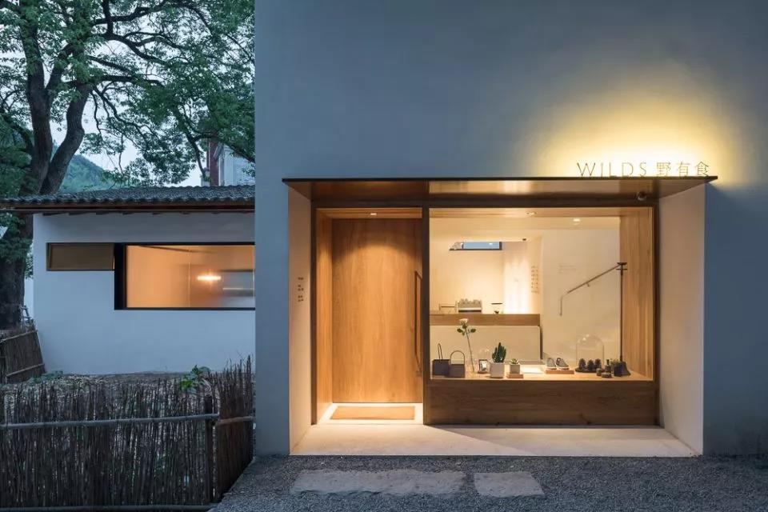
1. BACKGROUND
1.1 Introduction to the Phenomenon of Yangjiale
6). From 2013 to 2015, a large number of middle-class people from Hangzhou and Shanghai returned to their hometowns to rent or convert their own idle farm houses, combined with high-end design and operation, and launched their own homestay industry with a boutique and high-priced pricing method.
7). In this process, local villagers witnessed the success of the "Yangjiale" model and began to rent or convert their homesteads into B&Bs with a sense of design and higher-end operation concepts, such as the library-style B&B "Mogan Mountain Dewlling Picture" launched by local resident Zhu Jindong.
8). In this process, the foreigners who originally created the "Yangjiale" brand began to leave the brand they founded due to the entry of Chinese people, which made the original ecological environment of Moganshan noisy. The entry of Chinese people and villagers made "Yangjiale" enter a period of substantial development from 2016 to 2017. A large number of imitation "Yangjiale" B&Bs independently developed by villagers have appeared in Moganshan, and the "Yangjiale" market has gradually rised with the problem of oversaturated and homogenized. From 2016 to 2017, it entered the "bottleneck period" or "platform period" even though it still attracts nationwide consumers.
2013-2015
2016-2017
Pic.3 “Da Le Zhi Ye” launched byYang Mohan

Slide 4
2. LITERATURE REVIEW
1.2 Main Focus of the Research
1.1 The Combination of Globalization and Localization
1.1.1 McDonaldization, Anti-Mc Donaldization and skunk work
1.2 Cognitive Capitalism Investment and Creative Class Entrepreneurship
1.3 “Yangjiale” and Planetary Gentrification
1.4”Yangjiale” and Rural Touristification
1.5”Yangjiale” and Disneyfication and as a “Positional goods”
1.5.1 Commodification and alternatives
1.6 “Yangjiale” and Platform Economy
1.6.1 “Yangjiale” as a way of Platform Urbanization
1.7 ”Yangjiale” and urban political ecology
The geographical and social phenomena it reveals in the emergence of "Yangjiale" as a star product in the rural transformation of eastern China, the reasons for its occurrence, the development process and the impact
- Based on the existing problems of commoditization and homogenization, what alternative solutions can be proposed
1.3 Theoretical Factors Behind Yangjiale
a manifestation of planetary gentrification.
Mogan Mountain allows the global middle class capital to see the potential of the global rent gap due to its outstanding environmental factors.
regional entrepreneurism spirit brought about by the middle class cognitive capiltilism and culture of first world countries.
The high-end design and operation concepts of “Yangjiale” reflect the role of the global creative class in renewing and transforming rural areas of east Aisa.
It is a regional entrepreneurism brought about by the cultural flow of global middle class and global middle-class coginition.

Slide 5
2. LITERATURE REVIEW
Concept Connection
Mutual promotion
Creative Class(urban) Entrepreneurship
Bring about
Cognitive Capitalism Investment
Platform Urbanization
Commodification
Promote
cause
McDonaldization
Promote
abstract
Mutual promotion
Disneyfication
cause
Globalization
Localization
Platform Economy
Promote
Mutual generation
Mutual generation
“Positional goods”
cause
Creative Class(urban) Entrepreneurship
Promote
cause
Planetary Gentrification
Urban Political Ecology
Result
Pic.4 Theory Relationship Map Source: by author

Slide 6
2. LITERATURE REVIEW
· Theory Relationship
Key Conception
Cause
1.1 The Combination of Globalization and Localization
1.1.1 McDonaldization, Anti-Mc Donaldization and skunk work
1.2 Cognitive Capitalism Investment and Creative Class Entrepreneurship
1.3 “Yangjiale” and Planetary Gentrification
1.4”Yangjiale” and Rural Touristification
1.5”Yangjiale” and Disneyfication and as a “Positional goods”
1.5.1 Commodification and alternatives
1.6 “Yangjiale” and Platform Economy
1.6.1 “Yangjiale” as a way of Platform Urbanization
Globalization
Process
Localization
Process
McDonaldization
Mechanism
Cognitive Capitalism Investment
Driving Force
Creative Class Entrepreneurship
Phenomenon
Planetary Gentrification
Phenomenon
Disneyfication
Driving Force
“Positional goods”
Result
Commodification
Driving Force
Platform Economy
Phenomenon
Platform Urbanization

Slide 7
2. LITERATURE REVIEW
· Planetary Gentrification
Glass's critique has evolved into a global postcolonial challenge to the cognitive violence of Western imperialism, a neoliberal theory of human competition rooted in 19th-century social Darwinism and eugenics.
The author examines global resistance to gentrification by re-examining the value of survival and advocates learning from different contexts in the ongoing challenges brought about by global gentrification (Loretta Liss, Sandra Annuziata, Clara Rivas-Alonso, 2017).
Patrick Rérat interprets the literature on gentrification with spatial capital as the center and expands this concept to a global scale (Patrick Rérat, 2018).
Elvin Wyly argues that the global communication technology revolution, known as “cognitive capitalism” and “borderlessness”, is enabling a multicultural interweaving.(Wyly, 2015).
Cross-border gentrification is a contemporary form of urbanization that narrows the rental gap by attracting high-income immigrants from Nordic and North American countries (Matthew Hayes & Hila Zaban, 2020).
There are many cases of gentrification and regional upgrading in both urban and rural areas of China. However, there are few studies on global gentrification in rural China. This study will focus on the cases of global gentrification in rural areas of developed China, as this represents a clear research gap.

Slide 8
2. LITERATURE REVIEW
· Chinese Neoliberalism
Lu Xinyu (2024) further explores the relationship between collectivism and neoliberalism in rural China in his study Neoliberalism or New Collectivism in Rural China. He argues that Chinese neoliberalism functions as a form of collective capitalism and emphasizes that China faces the challenge of balancing liberal and social democratic demands while ensuring a common minimum standard of living.
Yang Zhan and Xiaoxi Tong (2018) also focus on the manifestation of market neoliberalism among rural migrant populations.
In addition, some scholars have explored the connection between the rise of rural areas as centers of post-carbon transformation and neoliberalism (Marsden, 2016).
However, there is little research analyzing the neoliberal characteristics of rural commercial activities in China.
· Transnationalism
The identities and transnational experiences of students participating in transnational education (Jiang, 2021), and the identity issues faced by transnational migrants who obtain flexible citizenship through education (Yang & He, 2024).
In addition, many studies have explored whether traveling to Africa and accepting infrastructure assistance from other countries represent neocolonial behavior.
However, few studies have explored the issues of transnationalism that emerge in rural China, such as how villagers view foreign entrepreneurs and how their self-identity evolves in this process. In contrast, there is a lack of literature on the potential neocolonial impact of Western entrepreneurial immigrants bringing lifestyle changes to rural eastern China.

Slide 9
3. RESEARCH AIMS & OBJECTIVES
· Research Objectives
Taking Mogan yangjiale as an example, this paper explores the perspective of understanding the phenomenon of Mogan yangjiale and its rural global gentrification process.
The phenomenon of Mogan yangjialelization refers to the influx of a large amount of non-Chinese capital into the Chinese market, which has caused a strong response and has become a benchmark for Chinese homestays, while also promoting changes in the national homestay industry.
Understanding the dynamics and interactions between different stakeholders in the yangjiale ecology.
By studying the interactive ecology between various stakeholders in yangjiale and its yangjialelization process, we can gain a deeper understanding of how these stakeholders interact and influence each other. Their interactions constitute the overall ecological framework of yangjiale, allowing us to understand how different stakeholders are interconnected in the yangjiale interest ecological network.
Investigate the spatial influence of various stakeholders on the development of Mount Mogan yangjiale in the process of rural planetary gentrification.
- This analysis helps us understand how different stakeholders affect the changes in local space during the development of yangjiale Homestay and its transformation into yangjiale Homestay, and gain insight into the role of various stakeholders in the transformation of rural space in the process of planetary gentrification.

Slide 10
4. RESEARCH QUESTIONS
What is the global gentrification process in yangjiale Village?
By examining the gentrification process in yangjiale, this paper provides a deeper understanding of the region itself and the wider global gentrification phenomenon. This will provide a relevant empirical case for the study of global gentrification in the Global South and help to analyze the levels and dynamics of this process in East Asia in more depth.
In the process of rural planetary gentrification, how do different stakeholders interact to shape the social ecology of yangjiale?
By examining the interactive ecological network of yangjiale stakeholders, this paper has a deeper understanding of the formation background, formation process and development context of yangjiale. This will help to more clearly understand the mechanism behind yangjialelization and deepen the comprehensive grasp of this phenomenon.
What are the spatial impacts of these interactions and dynamics in the process of gentrification of rural yangjiale?
By examining the interactions and participation of stakeholders in the process of yangjiale occurrence and yangjialelization, the focus of the study is shifted to the disciplinary context of urban studies.

Slide 11
5. METHODOLOGY
Interview
This study included two semi-structured interviews. The first interview was conducted in the summer of 2023 with 61 participants (N=61), including 19 tourists, 11 villagers, 8 village-level organization staff, 11 BnB owners, 8 small and micro business owners (such as coffee shops and agricultural product owners), 2 Moganshan County Government staff, and 2 operating company employees. The second interview was conducted in the summer of 2024 (N=4) and focused on four BnB owners and managers.
Spatial analysis
Through communication with government departments, we obtained the Moganshan County Master Plan 2021-2035 and the Moganshan County Text Atlas 2006-2020. The analysis focused on comparing the changes in land use planning maps to evaluate the changes in industrial land spatial use in Mount Mogan area during the 15-year development of yangjiale BnB.
Field investigation
This study conducted two field surveys in the summer of 2023 and the summer of 2024 to gain an in-depth understanding of the current status of the local homestay industry, understand the attitudes of local residents and government officials toward the yangjiale homestay industry, and understand the actual situation and business model of local homestays through personal experience.

Slide 12
6. HYPOTHESIS & ARGUEMENT
· Research Hypothesis
Yangjiale, Moganshan, is experiencing a process of rural global gentrification.
This paper hypothesizes whether yangjiale has triggered some form of global gentrification in the region and plans to verify this hypothesis through interviews and research on land use changes.
· Arguement
Mount Mogan yangjiale is a political arena where stakeholders such as indigenous people, tenants, government and electronic platforms are interdependent, reflecting the influence of neoliberalism, neocolonialism, transnationalism and government in the context of eastern China.
It serves as a platform for the expression of multiple rights discourses.
Yangjiale embodies the characteristics of neo-colonialism and rural green gentrification, while creating profits for local villagers and promoting rural green gentrification.
Government-led tourism projects and products launched by large private enterprises are undermining the profitability and development of the localized, grassroots yangjiale homestay model. This situation is closely related to the broader regional upgrading and rural gentrification process.

Slide 13
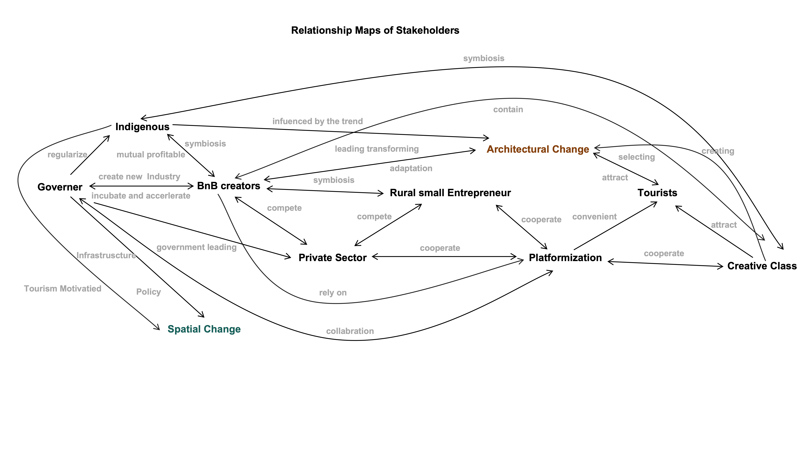
6. HYPOTHESIS & ARGUEMENT
· Arguement
Figure 1. Relationship Map of stakeholders in Mount Mogan Yangjiale on space

Slide 14
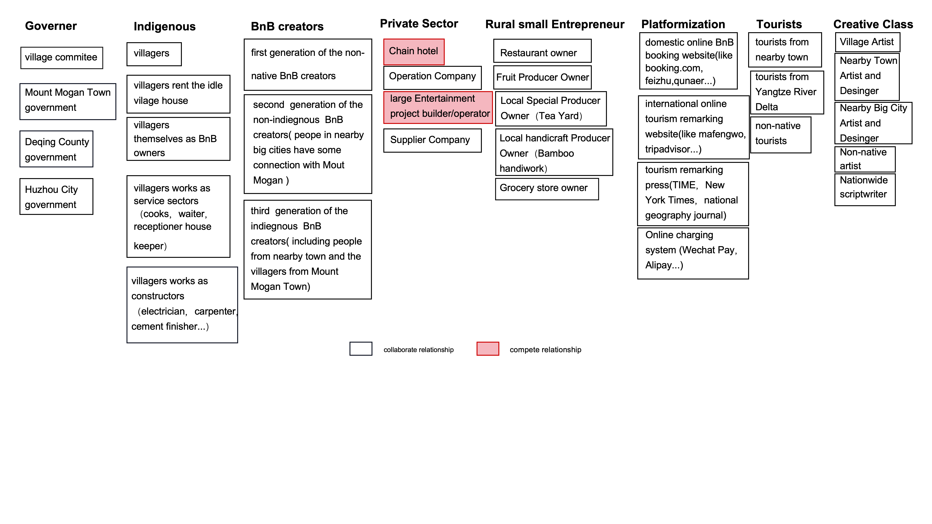
6. HYPOTHESIS & ARGUEMENT
· Arguement
Figure 2. Relationship Map of stakeholders in Mount Mogan yangjiale

Slide 15
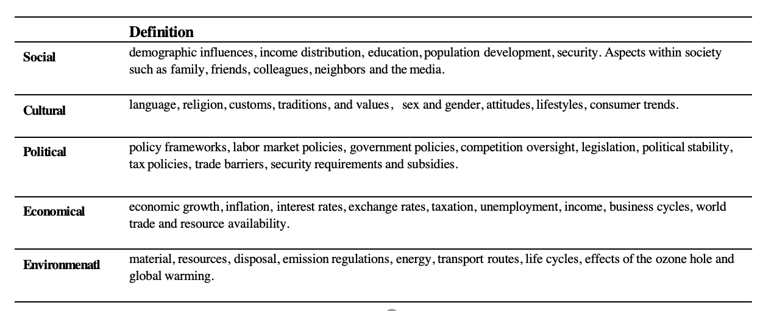
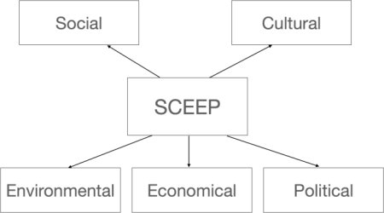
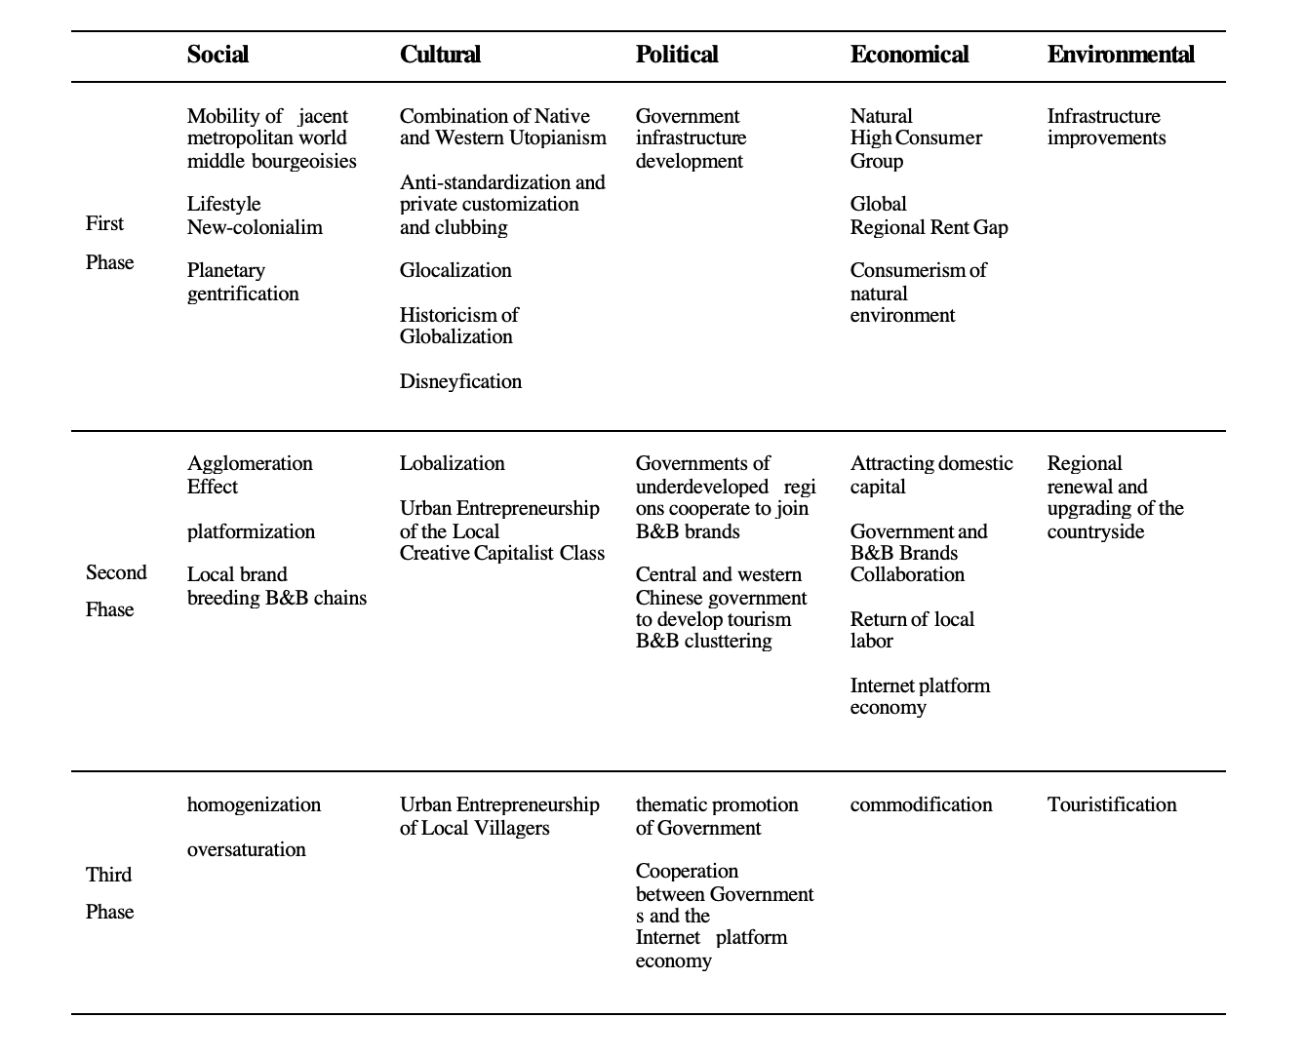
6. KEY FINDINGS
Figure 3. Model of SCEEP
sustainability evaluation model "STEEP" framework
Social, Technology, Environment, Economy, and Politics
replacing the Technology level with Culture.
The process and framework of "Yangjiale" and "Yangjialelization" are evaluated and described from the above dimensions.

Slide 16
6. KEY FINDINGS

Slide 17
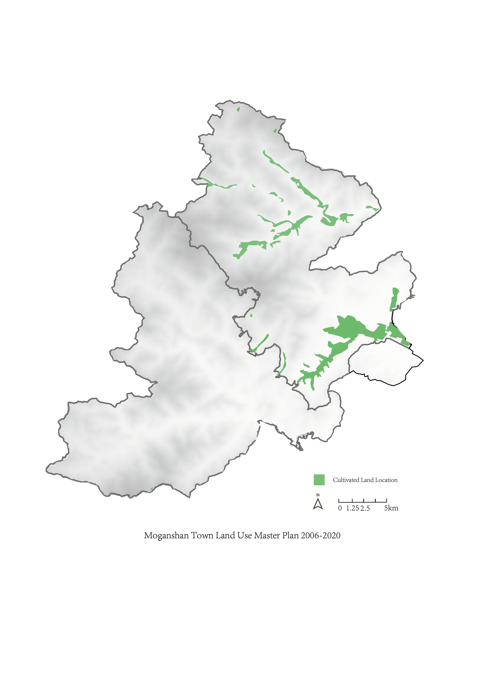
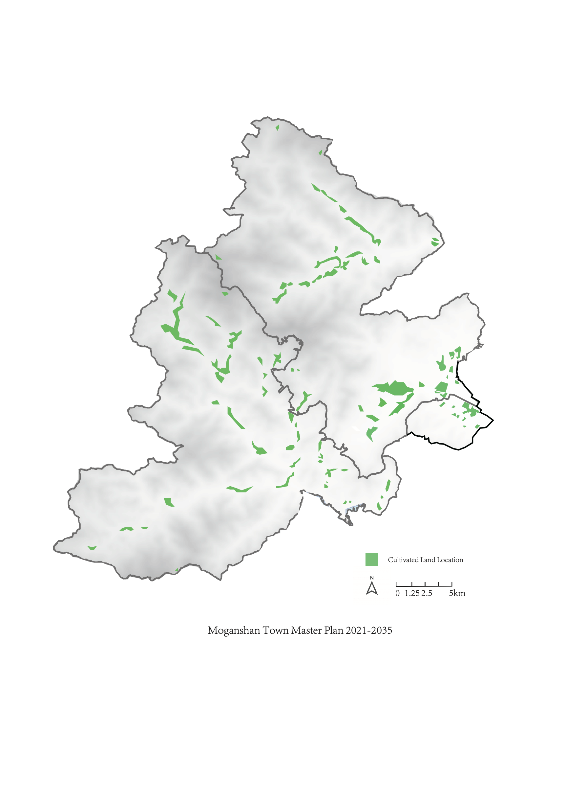
6. KEY FINDINGS
Land Use Transformation of Moganshan Town
permanent agricultural land is dispersed and shrunk
Figure 4. Farmland changing in 15 years’ of Yangjialelization

Slide 18
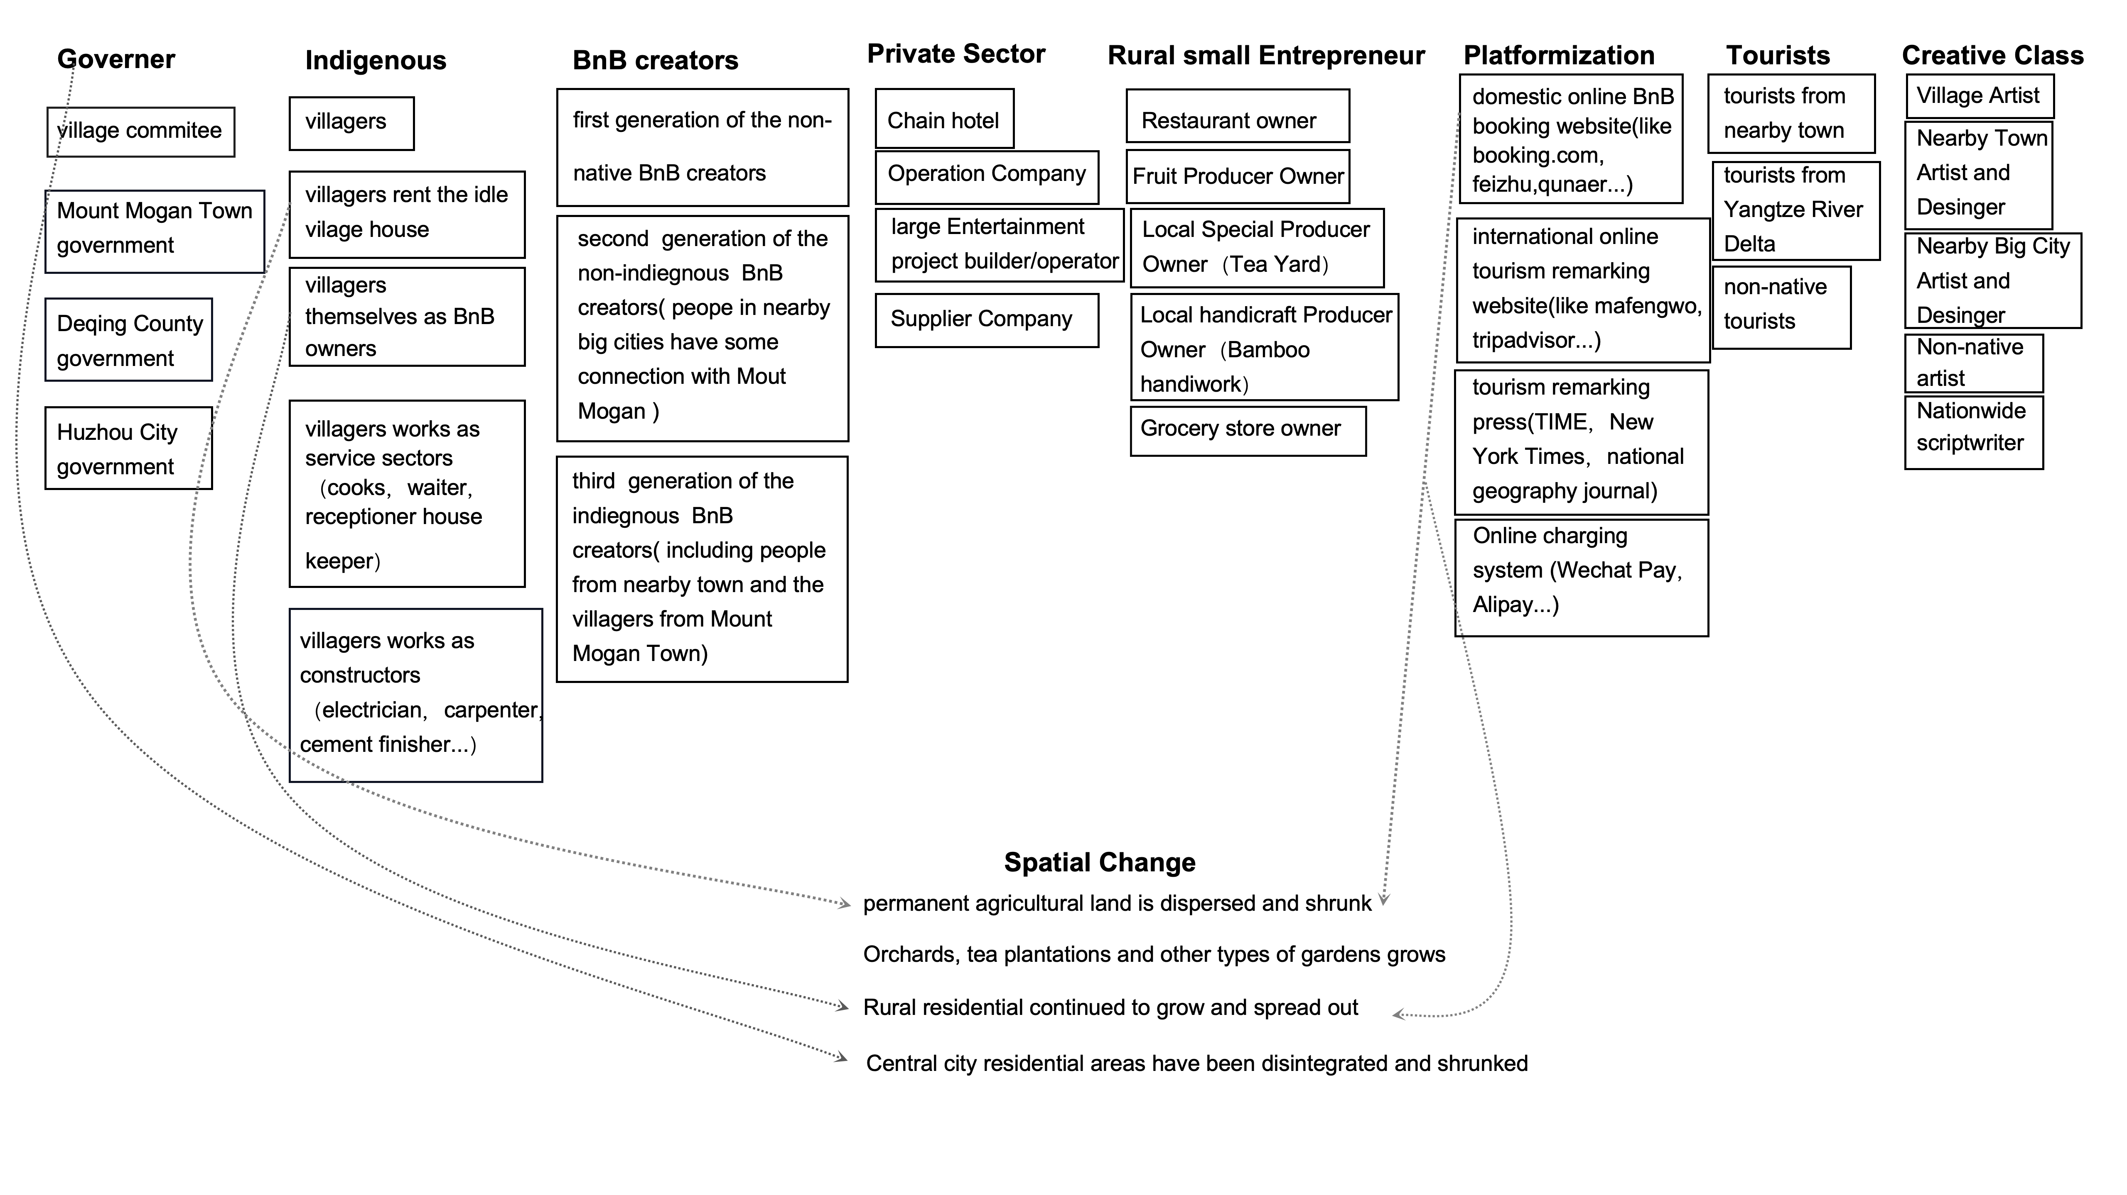
6. KEY FINDINGS
Figure 5. Stakeholders’ influence on space

Slide 19
7. IMPACT & FUTURE DIRECTIONS
- Understanding and studying the Mogan yangjiale BnB industry will help us better understand the implementation of policies such as China's beautiful countryside construction.
By studying the development history of the yangjiale BnB industry, we can have a deeper understanding of the direction and model of China's rural economic development, especially in the Yangtze River Delta region. This study will also help understand China's agricultural policies such as the Beautiful Countryside and the Ten Million Project aimed at promoting rural development and reform.
- Given that the development of yangjiale has benefited from foreign investment, studying this region helps us understand the dynamics of village development and gentrification in the Global South.
- Future research directions include exploring the rural economic development model in Zhejiang Province, examining the identity formation process of the Mount Mogan yangjiale, predicting the overall development trend of the Mount Mogan yangjiale studying the counter-urbanization and rural digital nomadism phenomena in the Mount Mogan yangjiale industry, and examining how Mount Mogan yangjiale can serve as rural spaces to ease the tension between elitism and populism in today's world.

Slide 20
7. ACKNOWLEDGEMENT
This article thanks the Moganshan Homestay Association for its generous support and all the Moganshan County residents who participated in the interviews and surveys. We also thank the village staff and homestay owners who contributed to this survey. Finally, I would like to thank my doctoral supervisor Prof. TALAMINI Gianni for his important guidance on this research and his suggestions on the content of the article, which were of great help in the implementation of this research.

Slide 21
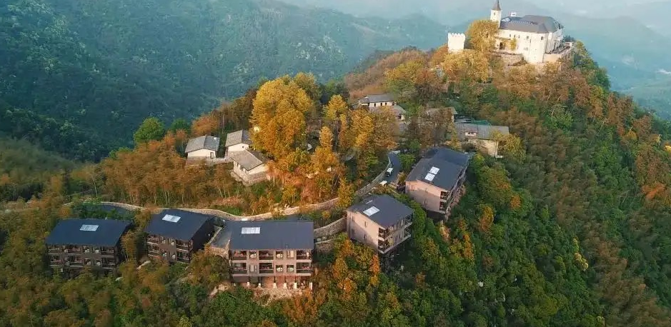
Thank you for listening!

