Slide 1
Producing community
The planning and governance of social infrastructure in Brussels
Jozef Vandermeulen – Vrije Universiteit Brussel – Geography
Notes:
Phd project, in its early stages

Slide 2
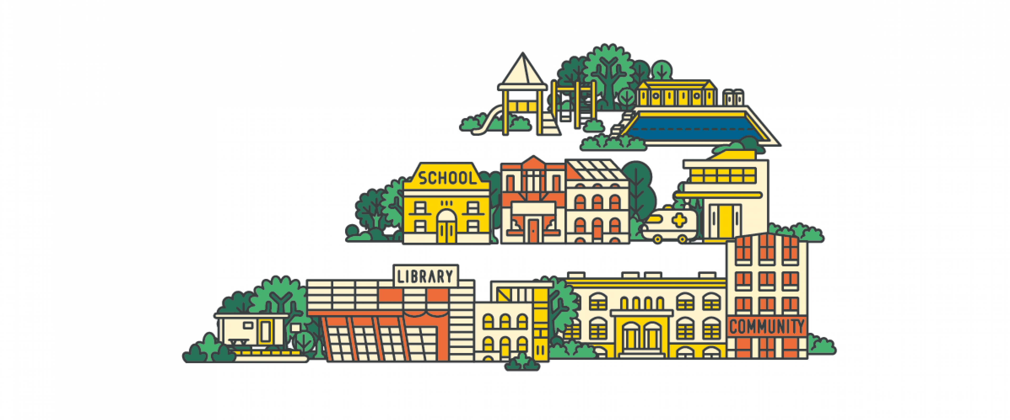
Social infrastructure
Spaces, organisations, networks that enable social interaction, sociality.
Lever to deal with crises
Important to defend and expand
Enneking, G., Custers, G., & Engbersen, G. (2025). The rapid rise of social infrastructure: Mapping the concept through a systematic scoping review. Cities, 158, 105608.
Notes:
Spaces, networks that encourage social interaction, connection, cohesion.
Especially since COVID there’s been an increasingly popular literature about how such social infrastructure is an important lever to deal with the many crises that we’re facing: combatting isolation, political polarization, encourage civic participation or helping in disaster responses by creating a network that take care of each other.
Therefore it is important to defend and expand
I generally agree with this but…

Slide 3
Aims and framework
To complexify very positive “social infrastructure” hype, by expanding on an emerging critical, political-economic approach.
How is social infrastructure produced?
By whom? For whom? Unequal consequences?
To examine how ”communities” are produced through social infrastructures or “community development spaces”.
What constitutes a “community”?
Increasingly relevant issue in contemporary hyperdiverse cities.
Horton, A., & Penny, J. (2023). Towards a Political Economy of Social Infrastructure: Contesting “Anti-Social Infrastructures” in London. Antipode, 55(6), 1711–1734
Notes:
Authors advocating this approach point out that insufficient attention is paid to power relations that are at play in producing and using social infrastructure, as well as to the labour and the governance that is required to make these spaces work.
So they call for more focus on the question of how social infrastructure is produced.
We tend to use “community” a lot, but often without really thinking about what that word means or signifies, and how these communities, sometimes also spatially or through infrastructures.
How can we create cohesion and an “urban community” while accepting difference, and multiple identities at multiple scales?

Slide 4
Why Brussels?
Culturally diverse, multilingual city
>77% non-Belgian origin (in 2024)
Formal Dutch-speaking and French-speaking “communities”
Complex institutional set-up
Regional government
2 “community” administrations
19 municipalities
Active, diverse civil society involved in community building
Closely intertwined with an active welfare state
Carlier et al. (2022). L’espace des infrastructures sociales: Une histoire (bruxelloise) de l’urbanisme de proximité. Académie Royale de Belgique.
Rea, A. (2013). Immigration and diversity. In The Brussels reader. A small world city to become the capital of Europe (pp. 244–266).
Notes:
First: adds new perspective to anglo-saxon dominated literature and also leads to an interesting broad range of types of spaces and involved actor: very state-led, institutional, top-down community creation, bottom-up grassroots intervantions, very corporate/private spaces in that sense, and everything in between
Second: fertile ground to look at processes of how “the social” and “communities” are produced and sustained through social infrastructure
Third: fertile ground for complex governance processes, both advantages and disadvantages of Brussels’s complex, incremental planning style
Non-Belgian origin means either
Foreign nationality (37%)
First or second generation migrant (40,8%)
Third generation migrants and more + native population are “Belgian origin” (22%)

Slide 5
My research: four cases
Applying critical, political-economic approach to four community development spaces
Describe historical evolution of the space: form, function, narrative.
Reconstruct decision-making processes that shaped that evolution.
Key moments
Ownership structures
Actors involved (State? Corporate? Civil society? Citizens?)
Pay particular attention to conceptualisations of the community.
What constitutes a “community”?
Who is and is not included? Why?
At what scale?
Blokland, T. (2017). Community as urban practice. Polity Press Joseph, M. (2002). Against the Romance of Community. University of Minnesota Press.
.
Notes:
I will now give very short overview of these cases, what I find interesting in them and then ending with some initial insights I’ve gained and what open questions that leads me to.

Slide 6
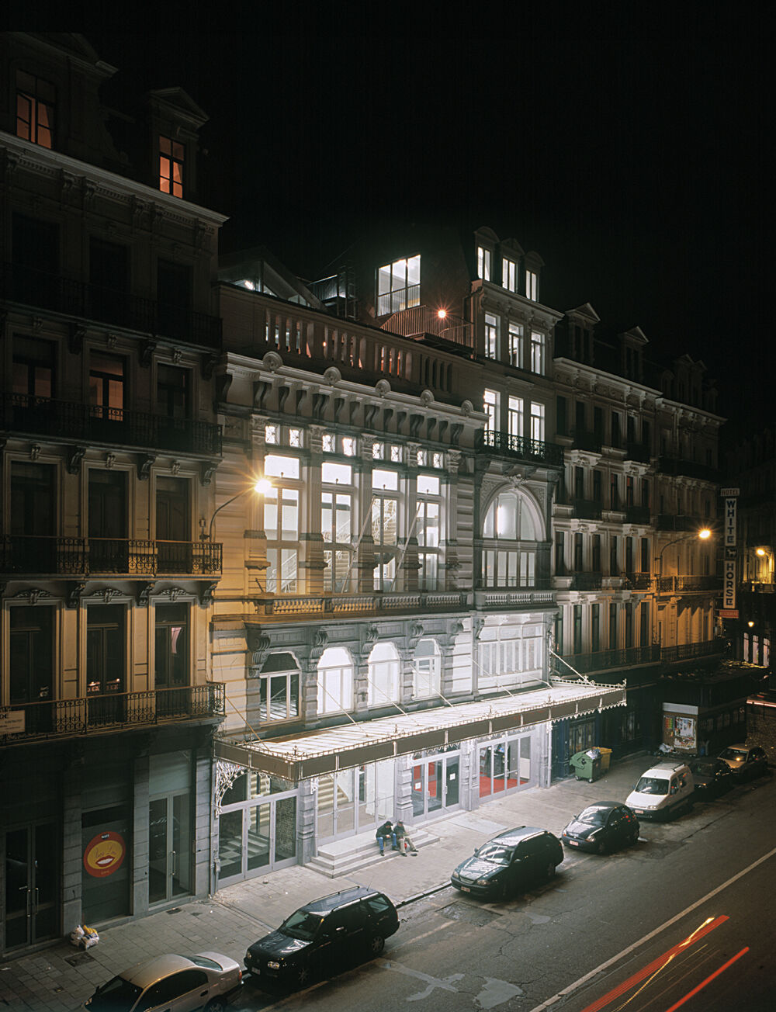
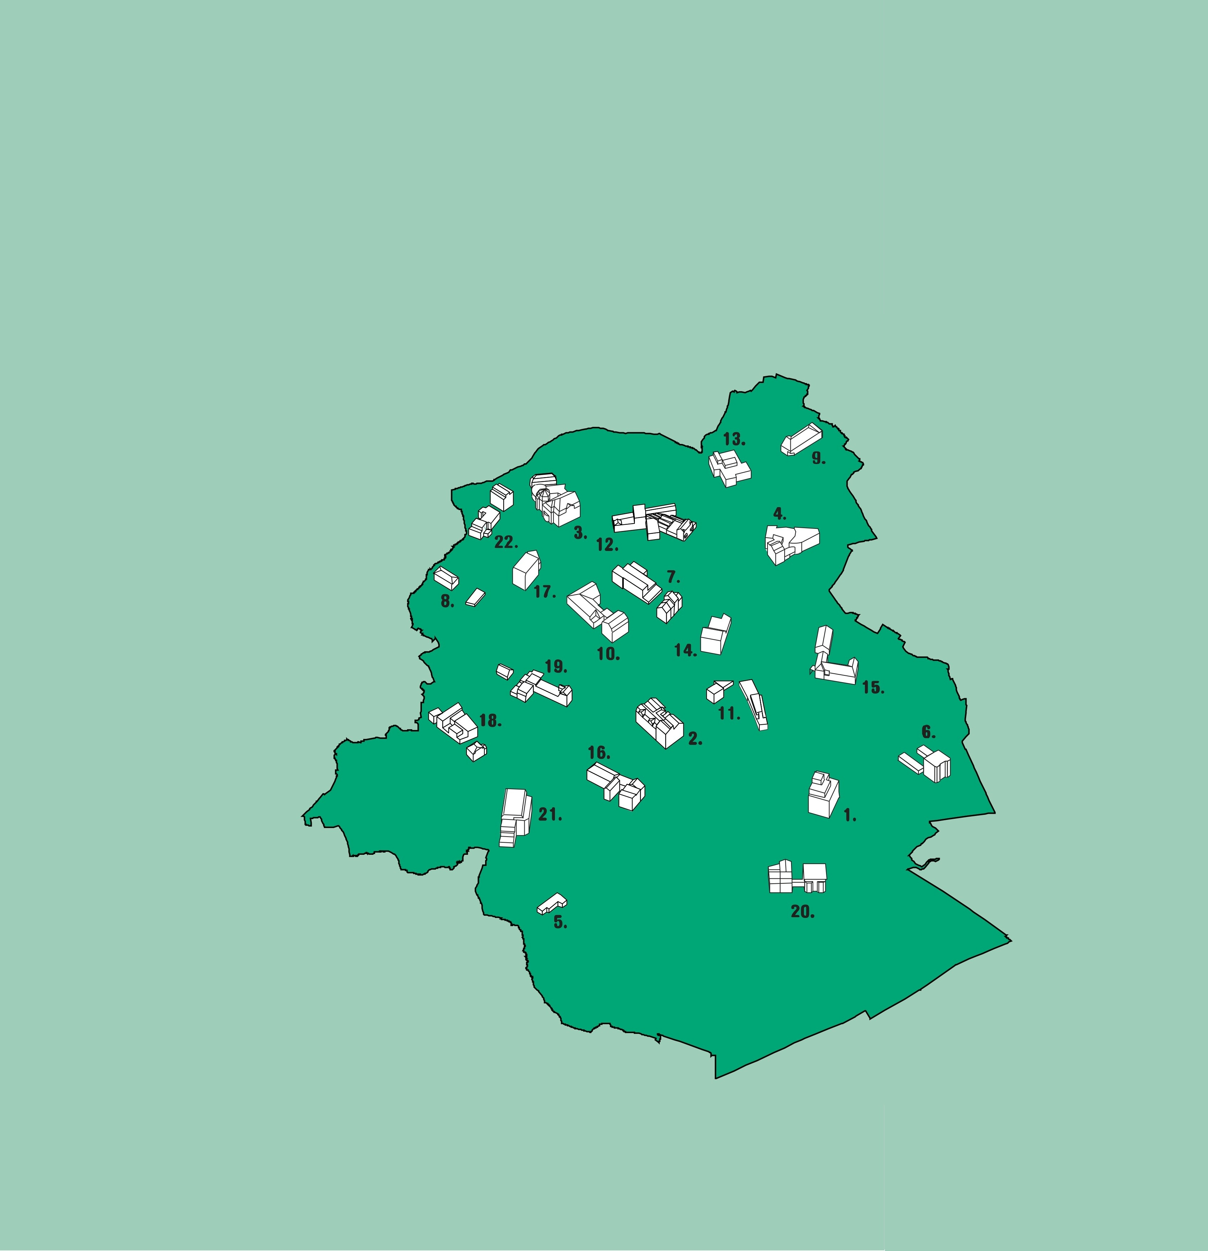
Cases
“Gemeenschapscentra”
22 semi-independent community centres
United in a network funded and governed by Flemish administration
Power struggle between these actors/scales
About governance and language use
“Beursschouwburg”
Theatre with a long history in city centre
Back-and-forth between
focus on role as a cultural centre
focus on space for urban activism
Changing scale of targeted community
Image : Architecture Workroom Brussels
Notes:
Each CC is a separate non-profit with its own board and even its own employees
Flemish administration at the city-scale <-> separate non-profits for each centre in their neighbourhood engaged in struggles over budgets, infrastructure itself, but also about how to deal with the language issue
Power struggle:
Administration wants to combine budgets, collaborate, focus on network-aspect of the centres. Especially infrastructurally
The centres are hesitant, want to keep the last bit of independence they still have (over past decades they’ve become more and more integrated, less and less independent)

Slide 7
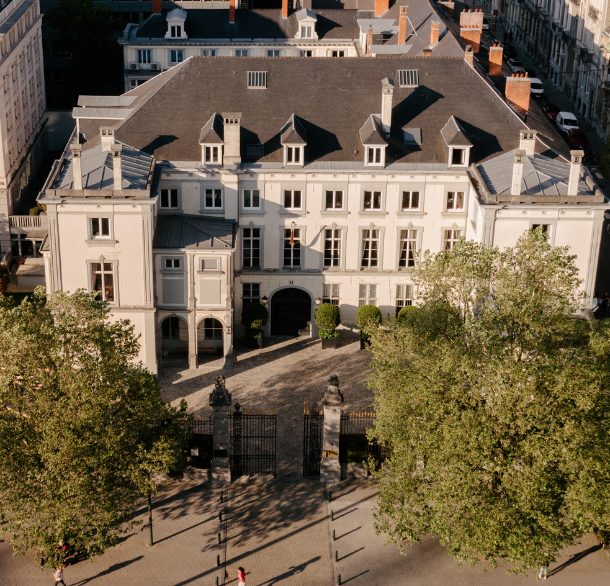
Cases
“Tour & Taxis”
Private development (33 ha) on ex-public land
Regional government closely involved in consultations, zoning, planning,…
Plans for SI have shifted significantly
Supposed to respond to both local needs and appeal to metropolitan audience
“The Merode”
Private social club, opened after COVID.
Aims for diversity in languages, cultures, and disciplines “to build bridges to tackle societal problems”.
But still closed, paying membership
Notes:
multiple rounds of proposals, consultations, zoning, permits,… since 2001
Corporate developer who want to develop a profitable site <-> State which wants a prestigious project with some social services <-> Local inhabitants and associations who …
Different public
already present inhabitants in surrounding areas
new inhabitants in the development
users of office spaces
Regional, national, and international visitors

Slide 8
Initial findings to explore further
Most cases engage with Brussels’ multiplicity of identities and scales.
But public institutions remain fixed in their own scales and a dichotomous view.
How would the planning and governance of social infrastructure change if it adopted a more open approach?
Most cases share a “future-oriented” narrative or goal.
Building a future identity/community.
Changing the future, being engaged, political.
How should community development spaces take up that double role?
My research is missing an informal, (temporary?) civil society-led or citizen-led space, despite these being very present in Brussels.
=> Participatory action research on another case, to dive into these questions?

Slide 9
Thank you
contact me at jozef.vandermeulen@vub.be

