Slide 1
Planners and the moral power of the “unpleasant”
Ángel Aparicio
Universidad Politécnica de Madrid
angel.aparicio@upm.es

Slide 2
Planners and the moral power of the “unpleasant”
Starting point: The unpleasant is a powerful category to spur action in planning, often with a strong moral dimension.
Research question: How do planners make use of the unpleasant to advance their proposals?
The unpleasant as an aesthetic category
The moral and the aesthetic experience in the unpleasant
Planners dealing with the unpleasant: the case of street space
Conclusions

Slide 3
1. The unpleasant as an aesthetic category
OBJECT-FOCUSED AESTHETICS
EXPERIENCE-FOCUSED AESTHETICS
POSITIVENESS (BEAUTY)
NEGATIVE
AESTHETICS
POSITIVENESS OR NEGATIVENESS (UNPLEASANT)
EVERYDAY
AESTHETICS
KANTIAN AESTHETICS
DISINTEREST
AESTHETICS OF ENGAGEMENT
ENGAGEMENT
PRAGMATIC
AESTHETICS
AIMING AT UNIVERSALITY (AGREEMENT)
AIMING AT SHARING (COMMUNICATION)
ENVIRONMENTAL
AESTHETICS
Notes:
The aesthetic experience
Human imagination creates experiences through associations (Dewey).
The aesthetic experience can be generated from everyday experiences
Aesthetic experiences are likely to associate with other human experiences, including moral ones.
There are valuable esthetic experiences that cannot be described as pleasurable (Shusterman)
Based on the concept of the aesthetic experience, it is possible to reflect aesthetically on:
The disgusting, the ugly, the unpleasant (negative aesthetics).
The objects of everyday (everyday aesthetics).
The environment (environmental aesthetics)
Interest and action following an aesthetic experience (aesthetic engagement).
Three features of the Kantian aesthetics: the aesthetic judgement:
Positiveness (focus on beauty and the beautiful object) (versus negative aesthetics)
Disinterest (versus engagement)
Potential to be universally participated (versus a potential to be shared and to engage other people).

Slide 4
1. The unpleasant as an aesthetic category
CATEGORIES | STRUCTURE | Likely reaction / experience | Present in our daily environment?
The Disgusting | Unity, definitude | Visceral response, unmanageable | Occasionally
The Ugly | Amorphousness, disharmony | Disinterest | Occasionally
The Unpleasant | Unity, definitude | Motivating power. Catalyzer for aesthetic action. Manageable size | Usually. Closeness
The unpleasant is morally charged as a sort of disorder in our everyday environment
Notes:
The negative aesthetic categories:
Ugly: Negation of total unity and formal definitude, amorphousness, disharmony… Disinterest rather than engagement (Forsley). Does not form part of our daily environment (like beautiful objects).
The unpleasant: can be beautifully represented in art objects (?). Has motivating power and the modesly of everyday. A catalyser for aesthetic action. Relatively manageable size. Closeness
The disgusting: cannot be beautifully represented in art objects; an imposing nature that cannot be overcome Visceral responses. Unmanageable.
The realm of negative aesthetics (Berleant)
Perceptually distressing, repellent, painful
Elusive to rational criticism.
Settling into vague discomfiture
In the built environment, aesthetic negativeness can just be aesthetic deprivation.
The unpleasant: morally charged as a sort of disorder: Everyday aesthetics (Saito)

Slide 5
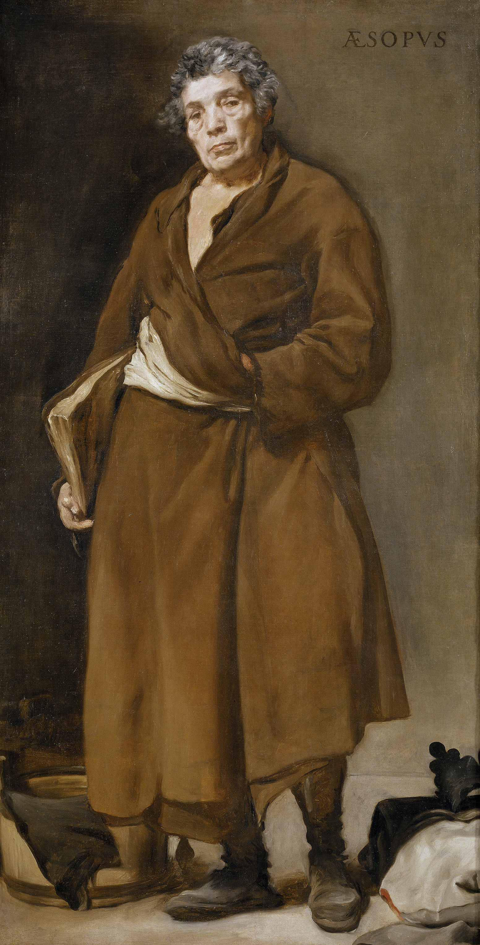
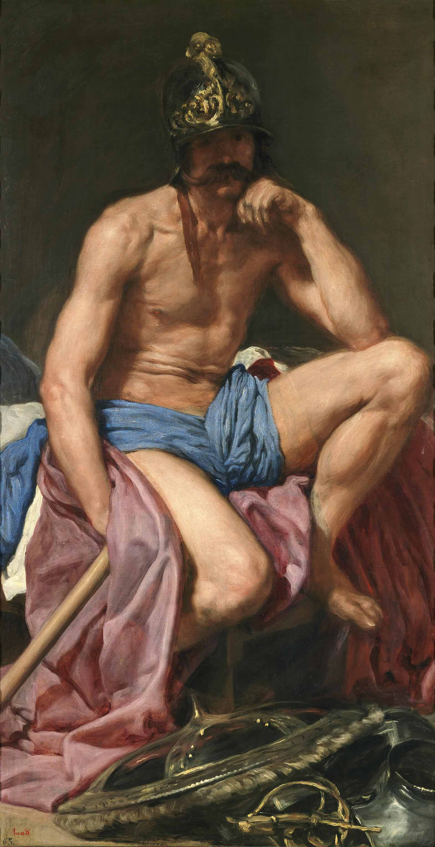
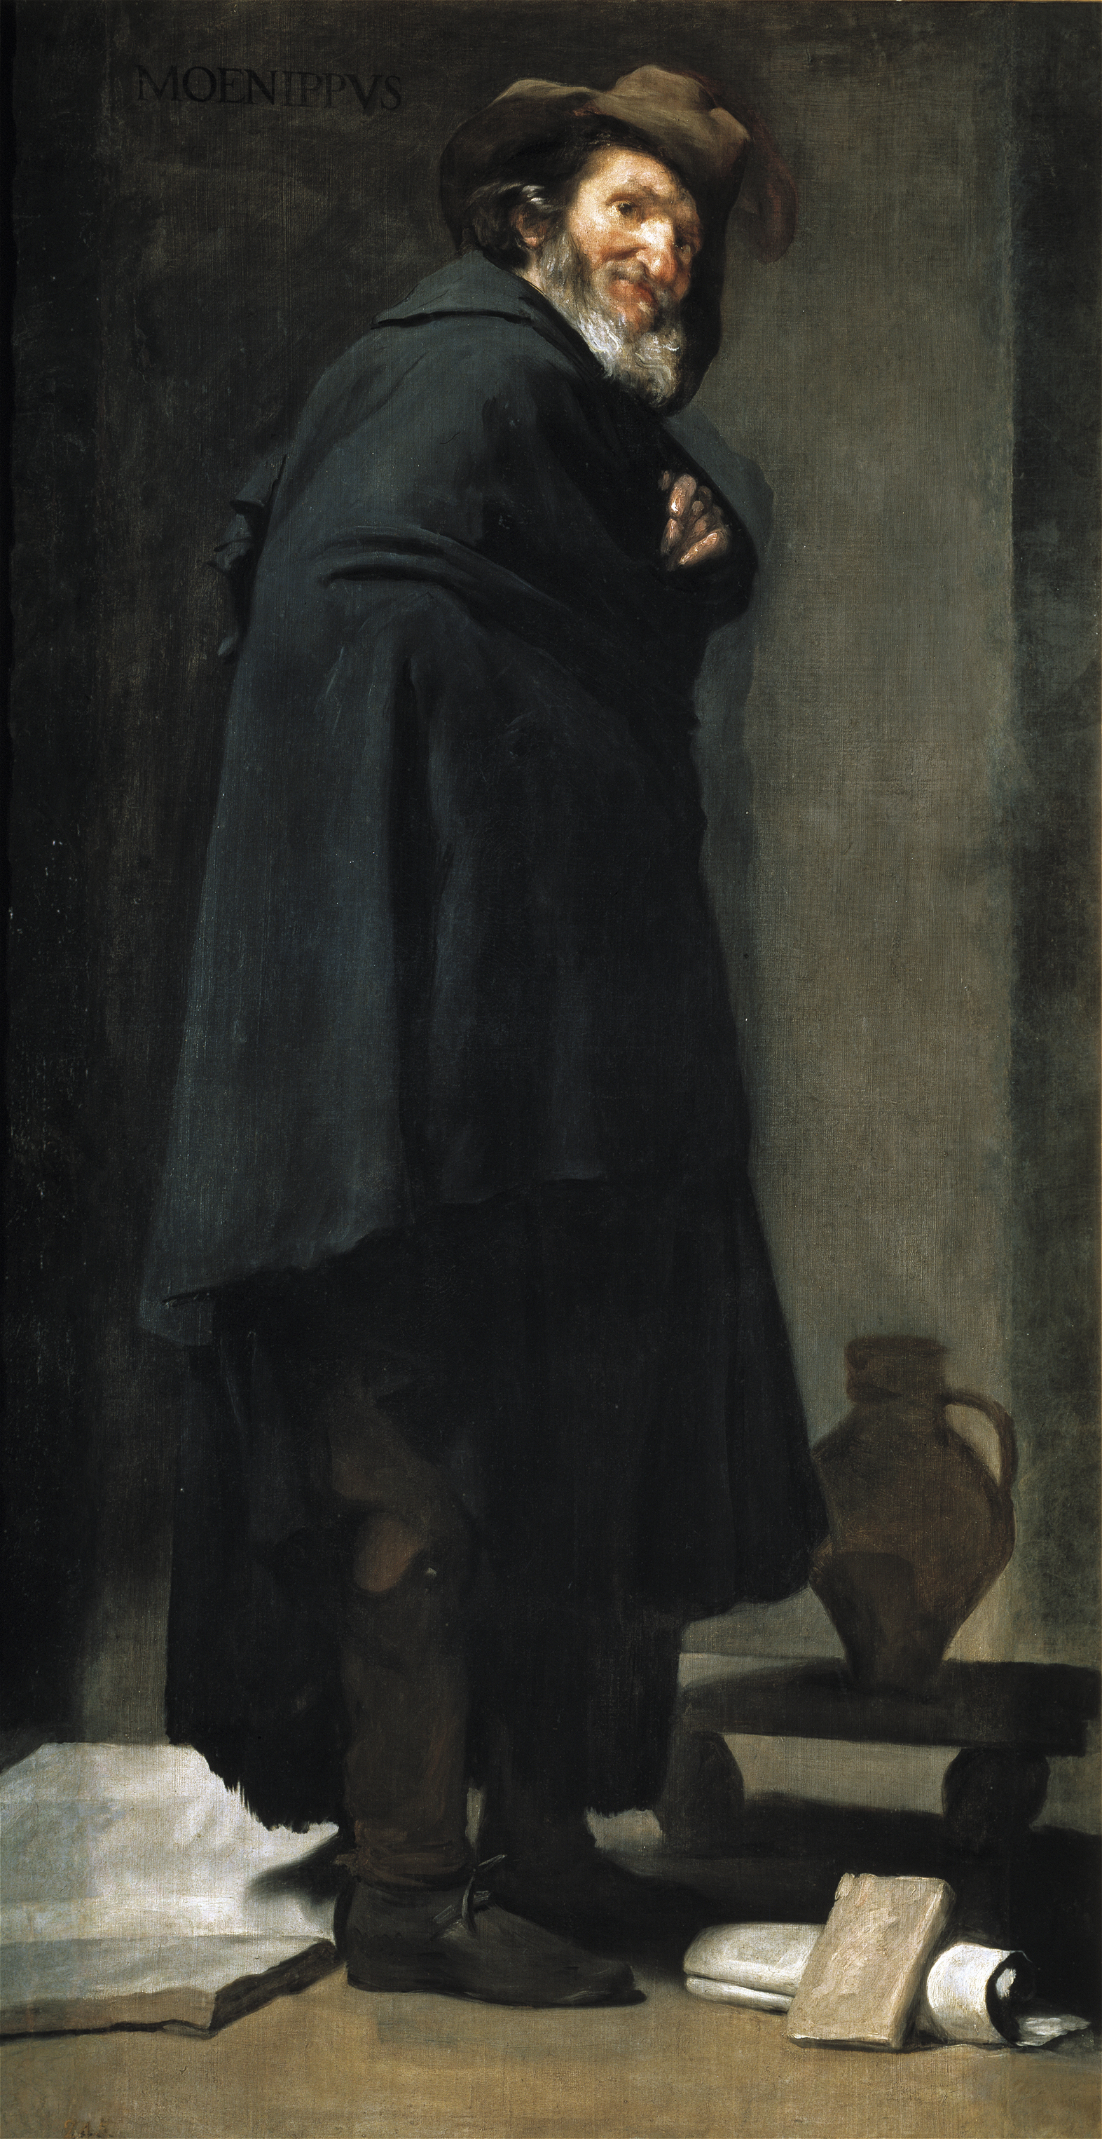
1. The unpleasant as an aesthetic category
Dealing with the unpleasant in high art:
Provocation, half-hidden political criticism, interaction…?
Velazquez, c.a. 1640
AESOP
MARS
MENIPPUS
Notes:
The negative aesthetic categories:
Ugly: Negation of total unity and formal definitude, amorphousness, disharmony… Disinterest rather than engagement (Forsley). Does not form part of our daily environment (like beautiful objects).
The unpleasant: can be beautifully represented in art objects (?). Has motivating power and the modesly of everyday. A catalyser for aesthetic action. Relatively manageable size. Closeness
The disgusting: cannot be beautifully represented in art objects; an imposing nature that cannot be overcome Visceral responses. Unmanageable.
The realm of negative aesthetics (Berleant)
Perceptually distressing, repellent, painful
Elusive to rational criticism.
Settling into vague discomfiture
In the built environment, aesthetic negativeness can just be aesthetic deprivation.
The unpleasant: morally charged as a sort of disorder: Everyday aesthetics (Saito)

Slide 6
2. The moral and the aesthetic experiences in the unpleasant
INSTABILITY
AESTHETIC JUDGEMENT
DISCOMFORT
WILL FOR INDIVIDUAL ACTION
PLANNING
ENGAGEMENT
ETHICAL JUDGEMENT
NEED OF COLLECTIVE ACTION
(LACK OF…) FAMILIARITY, SAFETY, IDENTITY, UNDERSTANDING, MAKING SENSE OF…
POWER RELATIONS, DOMINATION, DISTRIBUTION, RECOGNITION…
Notes:
The Unpleasant arises Discomfort and from that a will for Action.
Such aesthetic discomfort may intertwin with some sort of ethical judgment. In that case, it triggers action in the public sphere. Especially in the built environment.
Intertwining the unpleasant with the morally wrong can be a way to justify planning action
To compare:
The emptiness of aesthetically led planning (touristification, fenced urban developments, commercial spaces): unable to beget collective action. Blunt standardization. The unpleasant here turns into the ugly or the disgusting.
Key traits of everyday aesthetic experience of the built environment: familiarity, safety, identity, understanding, making sense of… The unpleasant here moves to engagement, because it is considered as provisional. Planners can build on this (or manipulate this): INSTABILITY
Car dominance or dominance of certain forms of mobility can be powerful leverages for ethical action.

Slide 7
3. Planners dealing with the unpleasant: The case of street space
What we can look for in these (3) Case Studies in Madrid, Spain:
How the experience of the unpleasant is generated and how it is socialized.
How the aesthetic experience combines with ethical considerations.
Case studies explored through 5 questions:
Unpleasant for whom?
What exactly made this public space aesthetically unpleasant?
Which are the moral considerations associated to the unpleasant? (And how relevant are mobility issues?)
Which are the stakeholders privileged or relegated in the project?
How much does the project cost?

Slide 8
3. Planners dealing with the unpleasant: The case of street space
Arboleda street, Vallecas.
Tactical urbanism highlighting the unpleasant to spur action.
A-5 motorway, Campamento.
Hiding the roots of the unpleasant.
Puerta del Sol square.
Elitist construction of the unpleasant to foster growth.

Slide 9
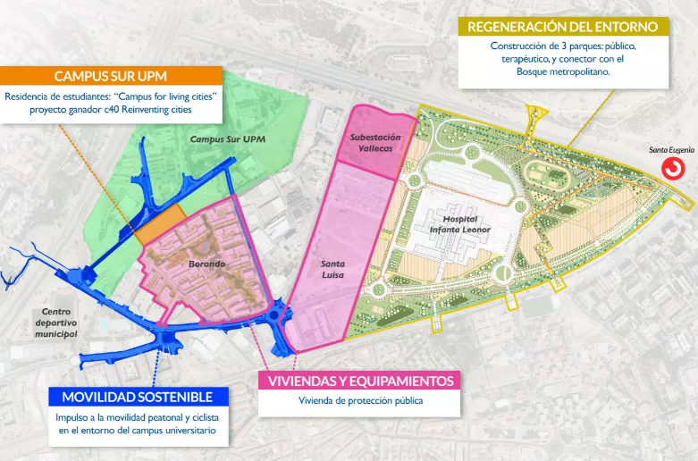
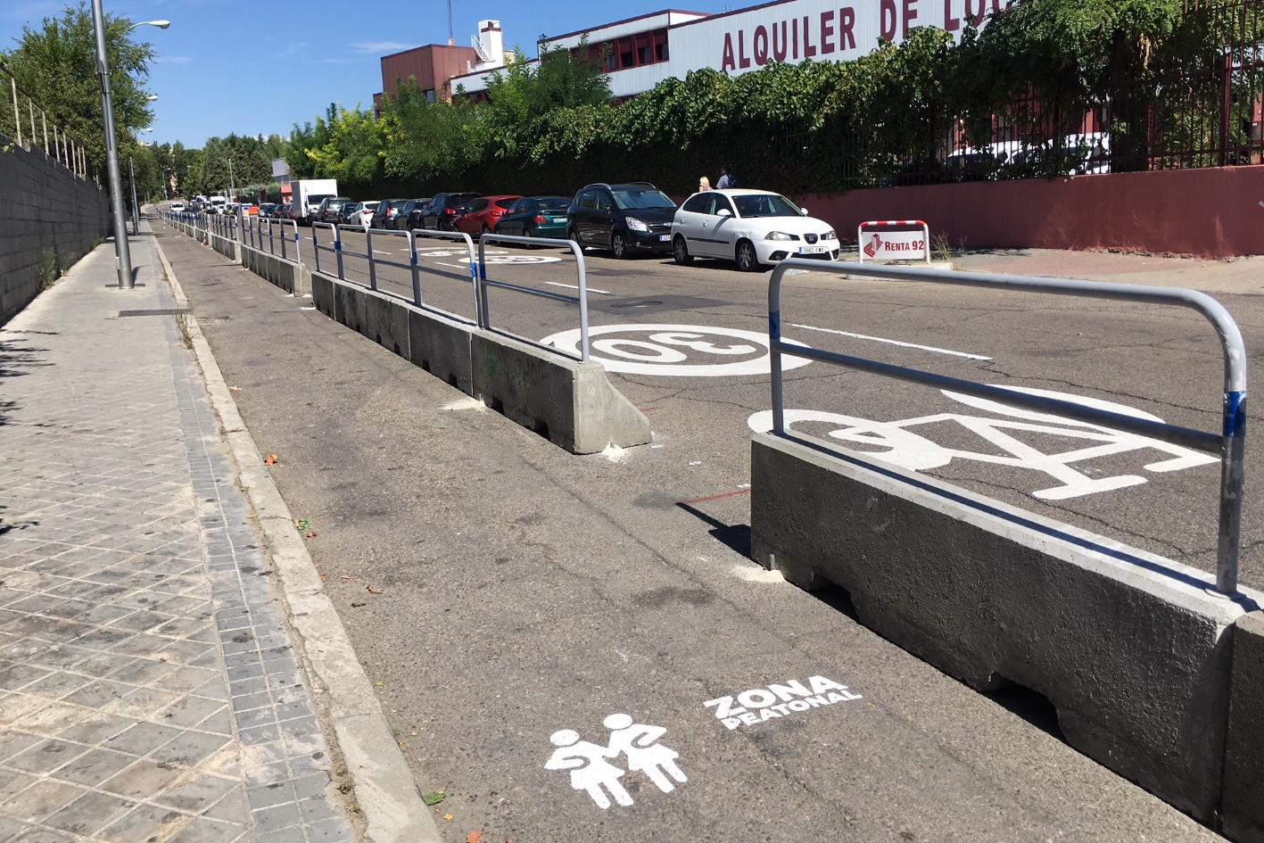
3.1. Arboleda street, Vallecas. The unpleasant as a leverage for change
Main access from Vallecas transport hub to University Campus
Through an industrial site abandoned 20 years ago.
High speeds, car and truck parking, precarious conditions for pedestrians and cyclists.
Tactical action completed in 2018.
Redevelopment plan approved in 2024, including “facilitation of walking and cycling.”

Slide 10
3.1. Arboleda street, Vallecas. The unpleasant as a leverage for change
Unpleasant for whom?
Mostly accepted as natural by daily passers-by
Pointed out initially by sustainable mobility experts and planners.
What exactly make this aesthetically unpleasant?
No-man’s land, dominated by trucks and cars.
Which are the moral considerations associated to the unpleasant? How relevant is mobility?
Unfair distribution of street space
Public inaction in the reallocation of street space
Which are the stakeholders privileged or relegated in the project?
Privileging soft mode users now; future residents later. Relegating cars and remaining industrial activities.
How much does the project cost to the tax-payer?
Tactical intervention: less than € 50,000. Future street space actions with public contribution of €11 million
Planners highlight the unpleasant to spur action in one specific direction.
Power relations are (1) revealed to (2) transform them.
A-5 motorway. Hiding the roots of the unpleasant.
Puerta del Sol square. Elitist construction of the unpleasant to foster development.

Slide 11
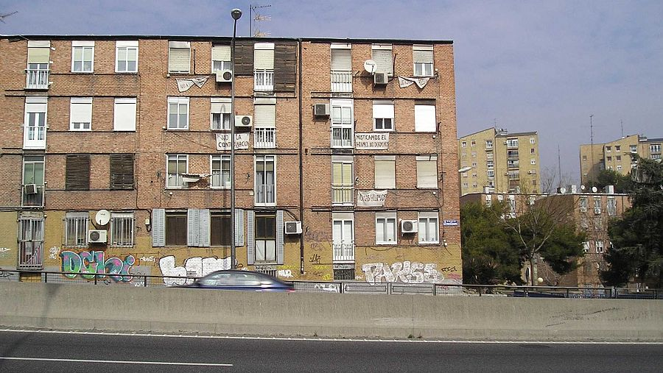
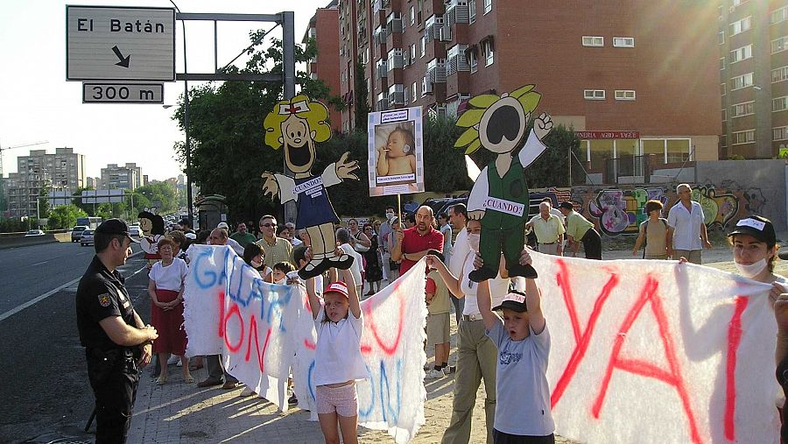
3.2. A-5 motorway. Hiding the roots of the unpleasant
Road initially surrounded by military compounds and agricultural land until mid-XX century.
Agricultural land urbanized with low-quality housing since the 1950s. Population already significant in early 1960s.
Residents fighting in the 1960s for improvement of basic services: water, sanitation, schools, public transport…
Road enlarged as a motorway in 1968.
Military compounds abandoned since the 1980s; redevelopment project unable to kick-off until 2024.
Traffic growth and nuisance becoming an issue to residents, and inaction of public authorities.
Traffic management scheme implemented in 2019 and removed after 4 months, after a new mayor took office.
Construction of a 12-km tunnel announced in 2022. “Green Southwest Boulevard”.
First tunnel section (3 km, €400 million) started at end 2024.

Slide 12
3.2. A-5 motorway. Hiding the roots of the unpleasant
Unpleasant for whom?
Residents; some planners (mainly traffic engineers)
What exactly make this aesthetically unpleasant?
For residents, the motorway becomes a symbol of a larger unpleasant environment.
Low quality of built environment, including underground motorway crossings, motorway layout…
For some planners (traffic engineers), proximity of buildings becomes a threat to the motorway.
Which are the moral considerations associated to the unpleasant? How are power and domination relations understood and transformed? How relevant is mobility?
Conflicting claims of car users and residents for limited urban space.
Which are the stakeholders privileged or relegated in the project?
Apparently, residents and car users are both privileged. In fact the priority is on car users.
How much does the project cost?
More than €400 million, just first stage. Second stage unknown.
Planners consolidate relations of car-dominance through manipulation of the unpleasant by inaction.

Slide 13
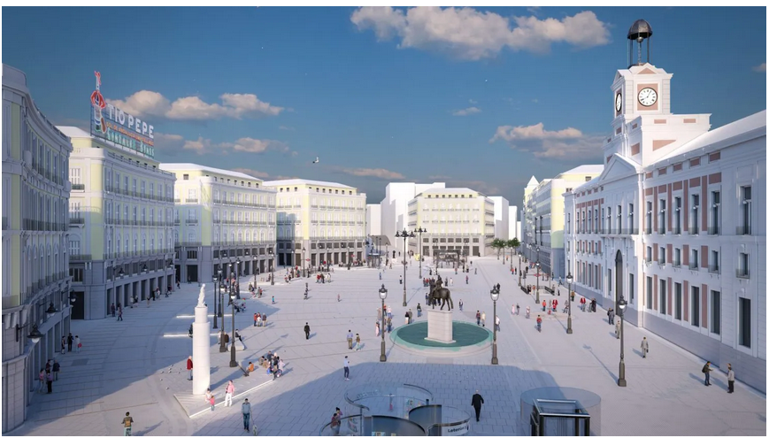
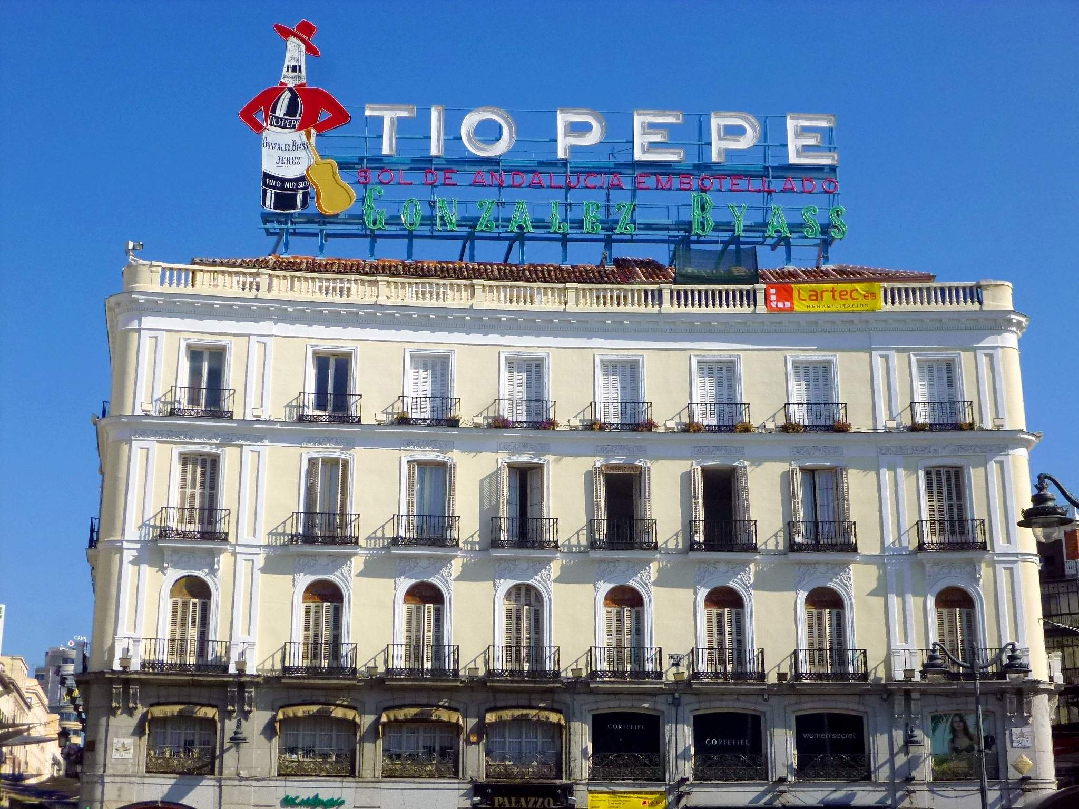
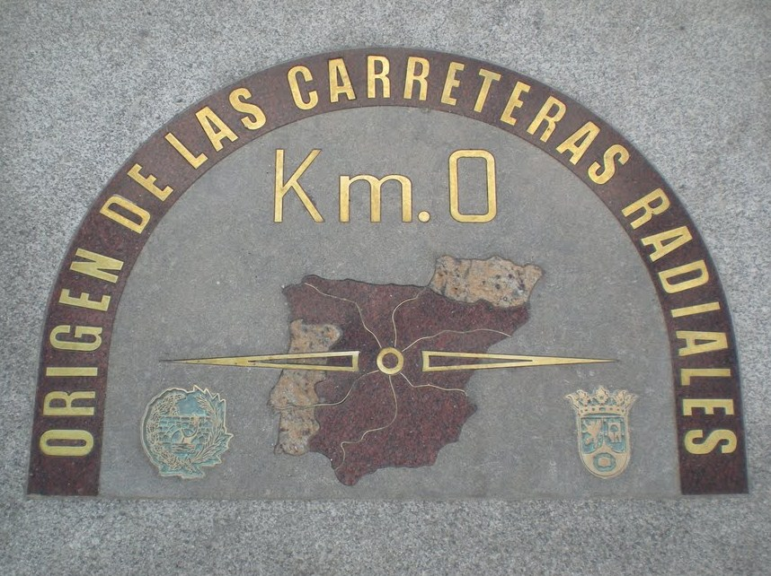
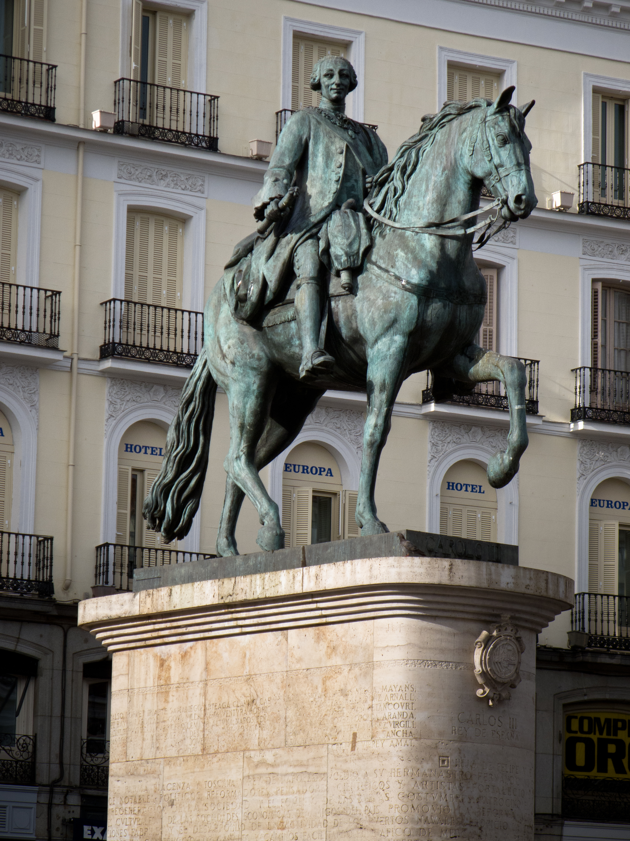
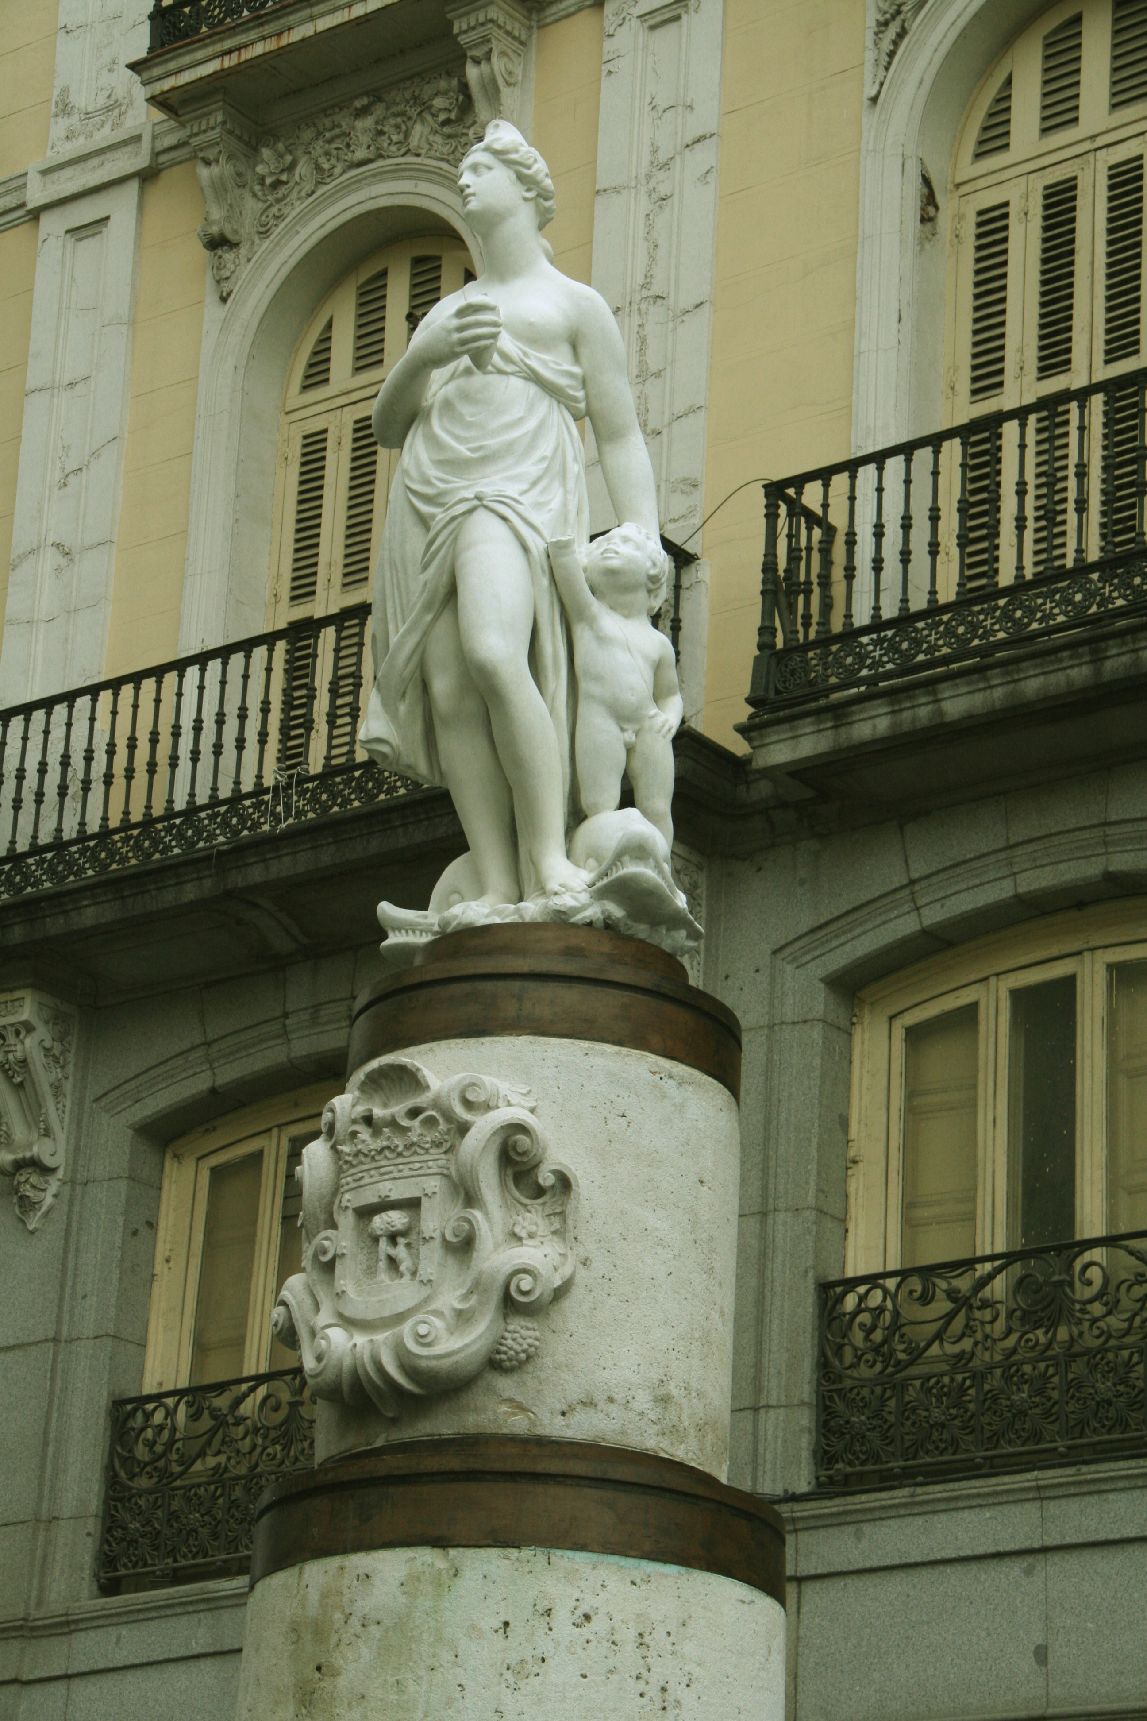
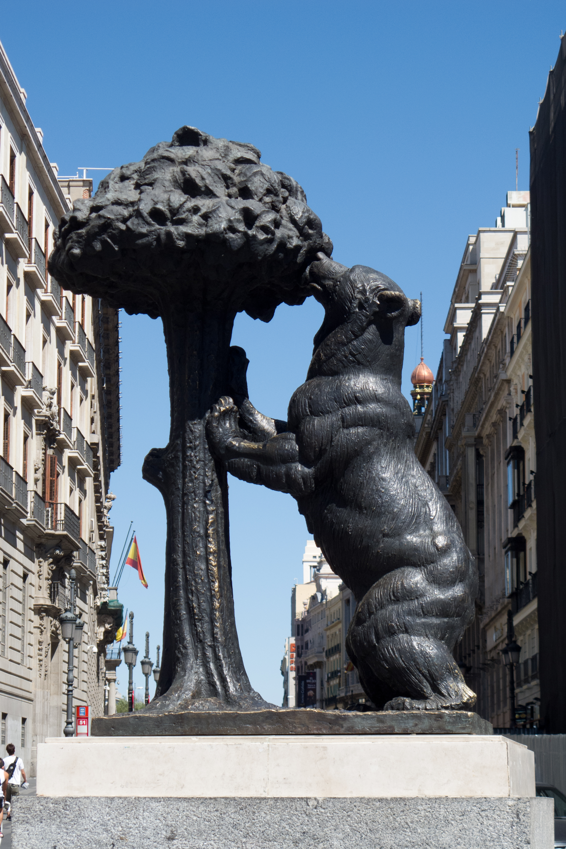
3.3. Puerta del Sol square. Elitist construction of the unpleasant to foster development
A crossroads of up to 11 streets, becoming a square in the XVI century.
Current layout from 1860, followed by multiple reforms.
A magnet for the kitsch: “Tio Pepe” board (1935), Mariblanca (copy of a XVII century statue), Carlos III statue (1994), “Zero Marker” (1950)), the Bear and the Strawberry Tree (1967).
Many rearrangements, including fountains and green space, and accommodation to trams and cars.
2009 rearrangement, including pedestrianization and an underground public transport hub.
2013 competition for a new rearrangement, implemented in 2023.

Slide 14
3.3. Puerta del Sol square. Elitist construction of the unpleasant to foster development
Unpleasant for whom?
Architectural critics
What exactly make this aesthetically unpleasant?
Disorder
Which are the moral considerations associated to the unpleasant? How relevant is mobility?
“Madrid deserves better”. Ambition?
Which are the stakeholders privileged or relegated in the project?
Tourists and occasional visitors and businesses providing services to them vs. daily passers-by and the few remaining residents
How much does the project cost?
€ 12 million.
Unpleasantness may not be generated from everyday experiences, but from elitist narratives created artificially by planners.

Slide 15
4. Wrapping up
The unpleasant as a powerful aesthetic category in planning, spurring action.
When intertwined with ethical judgements, the unpleasant engages collective action.
Such ehtical judgments over the public space and its use may include, in different ways:
The priority provided to everyday experiences.
The assessment of existing relationships of power and domination.
The consideration of what is aesthically unbearable, depending on the location of the public space under consideration.
The intertwining of aesthetic and ethical judgments positions planners in different attitudes:
Advocay. Pointing out to unperceived problems and root drivers, and highlighting the need for action.
Reparation or adaptation. Addressing social claims, without challenging existing power relations and balances.
Formalistic (beautification). Claiming authority to decide over the public space.

Slide 16
Thank you!

