Slide 1
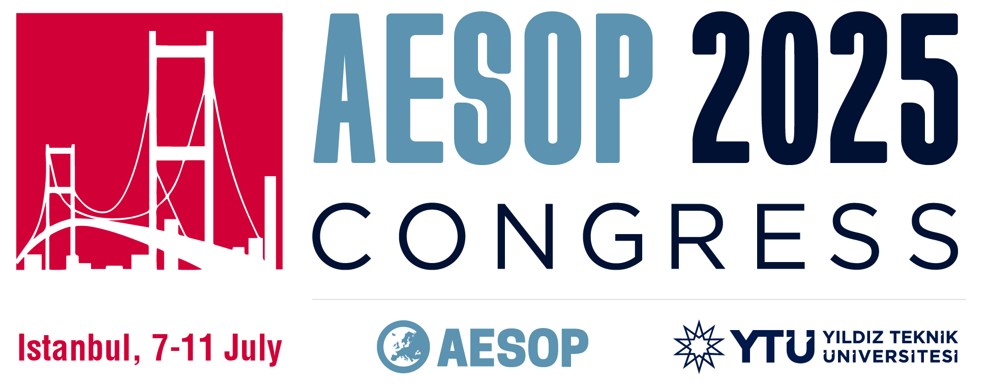
‘A Bibliometric Analysis on the Relationship Between Migration and Urban Design’
Authors: Büşra TİLKİ, Assoc. Prof. Dr. Elif Kısar KORAMAZ

Slide 2
Content
1. Introduction
2. Conceptual Framework
2.1. Migration
2.2. Migration and Urban Design Relationship
3. Method
3.1. Bibliometric Analysis Process
3.2. Bibliometric Analysis Findings
4. Evaluation and Conclusion

Slide 3
1. Introduction
This study aims to analyse how migration is addressed in urban contexts, particularly in terms of urban design, both globally and specifically in Turkey, based on conceptual relationships.
The study uses the bibliometric analysis method to evaluate the relationship between migration and research topics in urban design. The representation of migration in literature and the conceptual links established with urban design will be analysed systematically.
The aim of this analysis is to contribute to the identification of the limits of spatially based academic production on migration, and to highlight gaps in knowledge in this field.

Slide 4
2. Conceptual Framework
Migration
Urban Design
Urbanism
Within the scope of the research, the relationship between the concept of migration and urban planning and urban design is analysed.
The connections between these concepts in the existing literature are examined.

Slide 5
2. Conceptual Framework
2.1. Migration
Migration is a fundamental phenomenon that has transformed social, economic and spatial dynamics throughout history.
Migration refers to the movement of people across state borders or within countries. These population movements are defined as such based on the displacement of people, regardless of the duration, nature or cause of the movement (Perruchoud & Cross).
Migration generally affects both sending and receiving societies by causing social, environmental, economic and political changes (Castles, De Haas & Miller, 2014).

Slide 6
2. Conceptual Framework
2.1. Migration
Since the last quarter of the 20th century, Turkey has been a destination country in the global migration network.
When those who are not included in the official registration system accepted by various international organisations are also taken into account, Turkey is one of the most important migration countries in the world with a number of migrants and refugees approaching 5 million.
Therefore, the issue of migration has become even more critical for a significant number of people.

Slide 7
2. Conceptual Framework
2.2. Migration and Urban Design Relationship
Migration has been an important research topic for many different disciplines. Academic studies on this subject have largely been approached from the perspectives of sociology, economics and political science. This topic has been addressed to a more limited extent in the disciplines of planning and design.
Migration encompasses more than just the physical movement of individuals. It is also a complex process that directly influences the production, use, and transformation of urban areas.

Slide 8
2. Conceptual Framework
2.2. Migration and Urban Design Relationship
The structural characteristics of urban space shape society, while society produces new spatial arrangements.
(Lefebvre, 1974)
In this context, the reflection of migration on urban areas constitutes an important research topic.
society
urban space
Notes:
In line with this conceptual framework, it is important to consider examples that illustrate the relationship between migration and urban design, such as the impact of spatial transformations on social structures.

Slide 9
2. Conceptual Framework
2.2. Migration and Urban Design Relationship
'Comuna 13’;
The 'Comuna 13' project in Medellín, Colombia, is a meaningful example of implementation.
The Comuna 13 project is significant in demonstrating the potential of urban design to transform the social segregation caused by migration, and to encourage social interaction and integration through space (Comunaproject.org, n.d.; Dorene, 2022).

Slide 10
2. Conceptual Framework
'Comuna 13’;
The project aimed to increase accessibility and support social integration through the effective use of urban art in public spaces.

Slide 11
2. Conceptual Framework
As seen in the example of Comuna 13, urban design plays an important role in the spatial and social changes caused by migration.
Therefore, taking into account the phenomenon of migration and the needs of migrants in urban design processes is an important conceptual and practical necessity (Tuohy and Talen, 2017).

Slide 12
3. Method
citation analysis
co-citaton analysis
bibliographic coupling analysis
keyword-cooccurance analysis
social network analysis
content analysis
A bibliometric analysis method was used to examine research topics related to migration in the context of urban planning and design.
It is the numerical analysis of publications produced by individuals or institutions in a specific field, during a specific period, and in a specific region, as well as the relationships between these publications.

Slide 13
3. Method
3.1. Bibliometric Analysis Process
When creating the data set;
Scopus, ULAKBİM TR Index and DergiPark databases were used.
Bibliometric analysis visualisations were performed using the VOSviewer programme.
In searches where the results obtained from the applied filters were insufficient, the relationships between topics were attempted to be conveyed using word clouds.

Slide 14
3. Method
3.2. Bibliometric Analysis Findings
Scopus Database;
Number of publications accessed using the Turkey filter: 25
Used filters | Number of publications
“migration” | 377.216
+"urban studies” | 24.898
+”urban design” | 1.627
Notes:
In the bibliometric search conducted using the Scopus database, a total of 377,216 publications were found as a result of a general search with the keyword ‘migration’. These publications point to a very large body of literature dealing with migration in various aspects. However, when the search scope is narrowed down with the concept of ‘urban studies’, the number of relevant publications decreases to 24,898. This decrease shows that the treatment of migration in the context of urban studies is relatively limited. When the term ‘urban design’ is added to the search, the number of publications is only 1,627. This result reveals that the subject of migration has been the subject of very few studies in urbanism, especially within the framework of urban design.

Slide 15
3. Method
3.2. Bibliometric Analysis Findings
Analyses conducted using Scopus Database;
Keyword analysis
Author-citation analysis
Keyword analysis of publications produced in Turkey
Author-citation analysis of publications produced in Turkey

Slide 16
3. Method
3.2. Bibliometric Analysis Findings
Scopus Database;
Keyword analysis using the Scopus database
(Results obtained using the filters “migration” and “urban design”.)
Notes:
The analysis data shows that the concept of migration is mostly discussed in the literature in relation to topics such as “closed sites” and “segregation in settlements”. However, although less frequently, it is also associated with the concept of “integration”.

Slide 17
3. Method
3.2. Bibliometric Analysis Findings
Scopus Database;
Keyword analysis of publications
produced in Turkey using
Scopus database
(Results obtained using the filters
“migration” and “urban design”.)
Notes:
As a result of the analysis, it is seen that on the one hand, concepts such as ‘urban regeneration’, ‘urban politics’, ‘Ankara’, ‘squatters’ and ‘Islamic neoliberalism’ cluster together; on the other hand, concepts such as ‘urban renewal projects’, ‘squatter rehousing projects’, ‘social space/abstract space’, ‘neoliberalism’ and ‘Islam’ form a second cluster. This structure shows that migration is strongly associated with urban regeneration policies, slum areas, neoliberal urban policies and social spatial production processes in Turkey.
In Turkey, the concept of migration is discussed in relation to urban design within a more limited scope.

Slide 18
3. Method
3.2. Bibliometric Analysis Findings
ULAKBİM TR Index Database;
Publications were filtered using specific keywords in the abstract using the ULAKBİM TR Index database.
Publications began to increase in the 2000s and have seen significant growth in the last five years.
Used filters | Number of publications
“migration” | 3.624
+“urban” | 236
/ + “urbanism” | 5
/ + "city planning” | 1
/ + ”urban planning” | 2
/ + “urban design” | 1
Notes:
According to the filtering results, 3,624 publications were identified with the keyword ‘migration’. If this number is used with the concept of ‘city’, the number of publications decreases to 236. When concepts that narrow the filtering are added, 5 publications were identified with ‘urbanism’, 1 with ‘urban planning’, 2 with ‘urban planning’ and only 1 with ‘urban design’. This finding shows that academic studies produced at the intersection of migration and urban design are quite limited in the Turkish context.

Slide 19
3. Method
3.2. Bibliometric Analysis Findings
ULAKBİM TR Index Database;
This finding shows that academic studies produced
at the intersection of migration and urban design
are quite limited in the Turkish context.
Ulakbim TR index database word cloud
Notes:
In the data set obtained, the scans were evaluated in a more qualified and detailed manner due to the lack of sufficient number of publications on the intersection of migration and urban design. In this framework, the results are visualised and presented through word clouds in order to reveal conceptual trends and thematic relationships more clearly.

Slide 20
3. Method
3.2. Bibliometric Analysis Findings
DergiPark Database;
Publications were filtered using the DergiPark database based on specific keywords in the abstract.
Used filters | Number of publications
“migration” | 6.507
+"urbanism” | 10
/ + “urban planning” | 3
/ + “urban design” | 5
Notes:
DergiPark is a comprehensive database that brings together scientific studies published in Turkish academic journals and provides open access to them in a digital environment. In this study, a search was conducted using keywords identified in the abstract sections of publications in the DergiPark database.
According to this analysis, 6,507 publications were identified using the keyword ‘migration.’ When the keyword “migration” was used in combination with the keyword ‘urban planning,’ the number decreased to 10 publications, while 3 publications were identified using ‘urban planning’ and 5 using ‘urban design.’

Slide 21
3. Method
3.2. Bibliometric Analysis Findings
DergiPark Database;
As a result of the analysis conducted in the DergiPark database, it is observed that the topic of “migration” is used to convey the general situation of today's cities.
Publications produced in Turkey within the scope of urban design have been addressed with the topics of “housing”, “urban transformation” and “slum towns”.
Notes:
Due to the limited amount of data available, the word cloud method was used to highlight conceptual trends and demonstrate which themes stand out in the literature more clearly. Key concepts that stand out in the visualisation include 'urban design', 'heritage area', 'urban open space', 'urban area adequacy', 'urban landscape', and 'Diyarbakır', which refer to spatial and local contexts.

Slide 22
4. Evaluation and Conclusion
The use of Scopus, TR Dizin and DergiPark databases for foreign literature in bibliometric analysis is one of the limitations of the study.
The analysis revealed that the concept of migration is predominantly addressed in the international literature in conjunction with topics such as “closed sites” and “segregation in settlements”. However, it is also associated with the concept of “integration”, albeit with low frequency.
Similarly, in Turkey, migration has been addressed in contexts generally related to “housing”, such as “urban transformation” and “slum formation”. In addition, studies on “adaptation” and “cultural integration” are quite limited.
The examination of the concept of migration in conjunction with urban design has been limited to more restricted topics.
Notes:
In conclusion, the analyses conducted reveal gaps in the literature for future studies. It would be useful to view urban design as a tool for achieving ‘adaptation’ and ‘integration’ in the context of migration and to discuss these issues in relation to public space.

Slide 23
Thank you!

