Slide 1
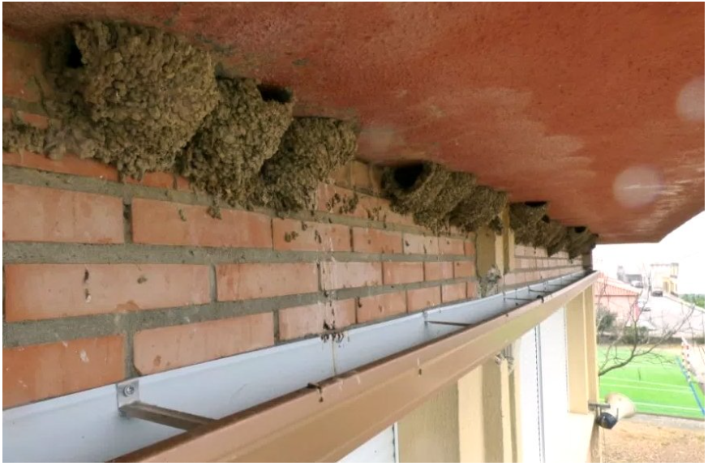
Sociedad Española de Ornitología
Urban Form Shapes Bird Community: Insights from the green capital of Europe 2024

Slide 2
Introduction
In recent decades, there has been worldwide rapid urbanization with significant effects on biodiversity loss.
Cities generally contain a proportion of each of the three principal land cover typologies: green areas, water, and impervious surfaces.
Studies on biodiversity in cities often focus on how the degree of urbanization affects species.
Little is known about how specific urban features-such as building type, age, or façade design-affect different species
Sociedad Española de Ornitología

Slide 3
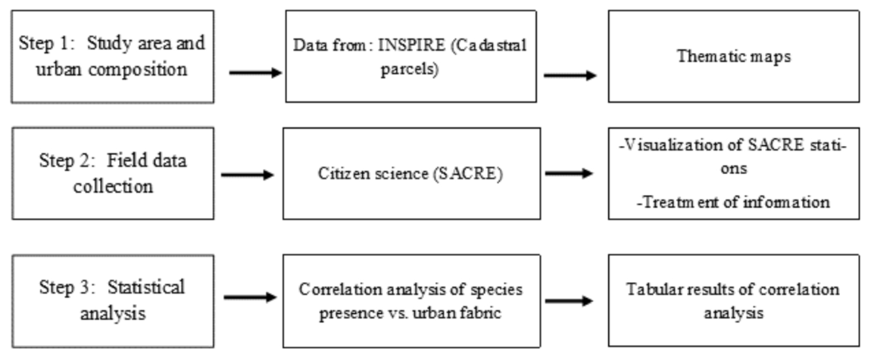
Methodology
Fig. 1. Research methodology.
Sociedad Española de Ornitología

Slide 4
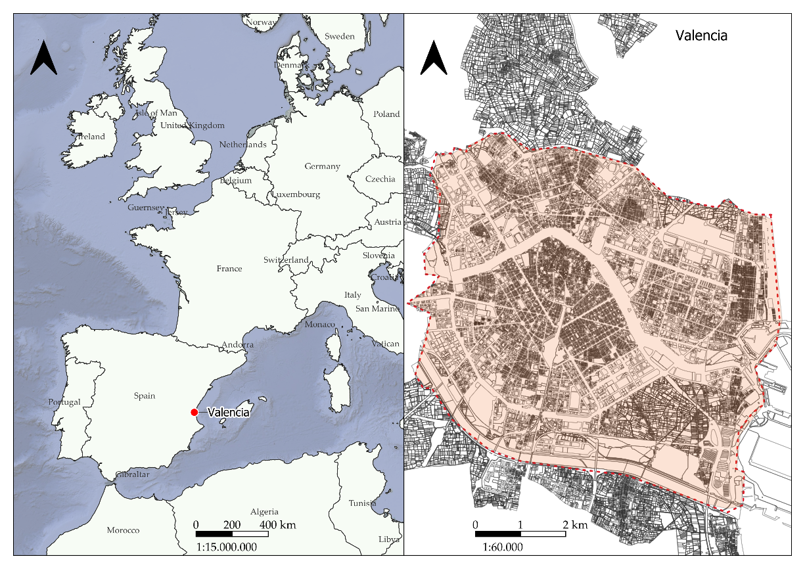
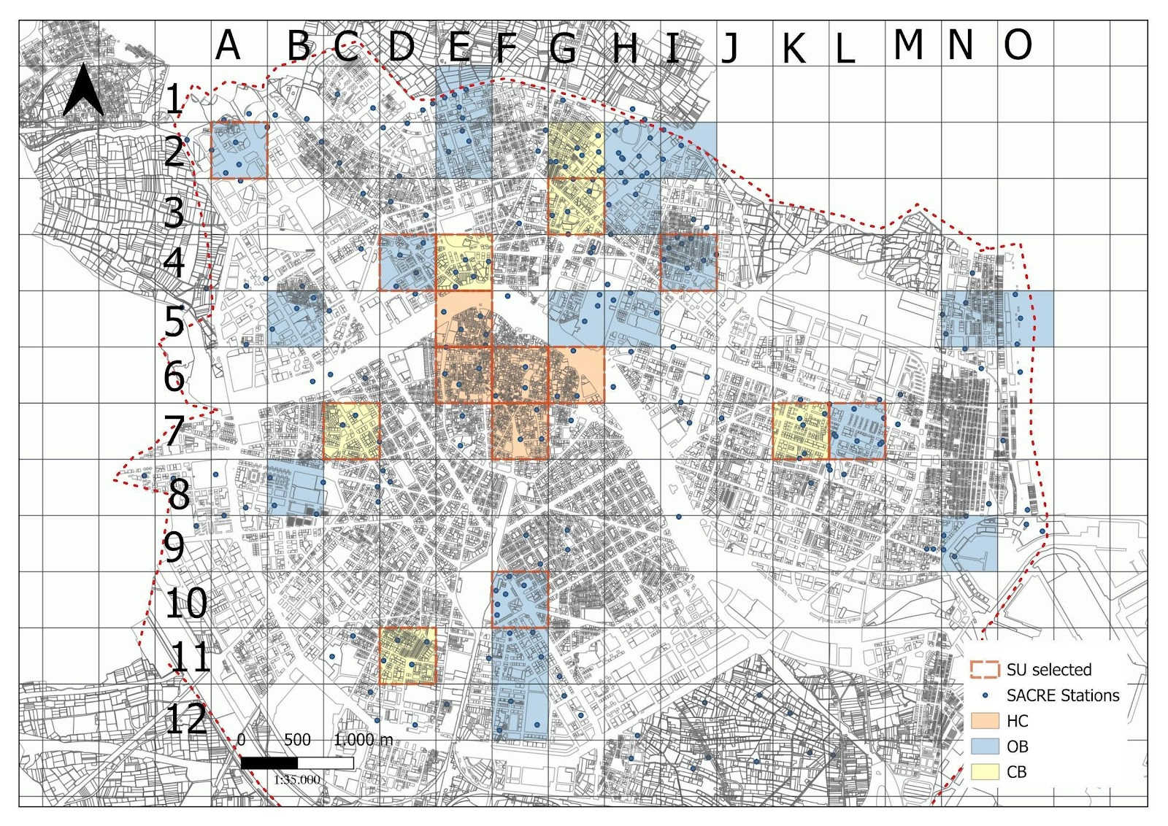
Methodology
Step 1: Establishing the study area and urban composition.
The three urban configurations: historic centre (HC), the open block (OB), and the closed block (CB).
Fig. 2 Location of the city of Valencia and study area. Source: the authors.
Fig. 3. SACRE Stations and selected sampling units. Source: the authors.
Sociedad Española de Ornitología
Sociedad Española de Ornitología

Slide 5
Methodology
Indicators used in the parametrization of individual sampling units.
Environmental indicators
Air quality ICA (web)
Noise level
Predominant height of vegetation
Blue infrastructure
Urban indicators
Total road network (km)
Traffic congestion
Built volume (m³)
Built area (m²)
Built area % (per SU)
Configuration of the space
Roadway width
Street width (building to building; m)
Pedestrian surface (m²)
Pedestrian surface %
Building stock
Building category
Average age
Average number of floors (n)
Zone
Setting
Sociedad Española de Ornitología
Sociedad Española de Ornitología

Slide 6
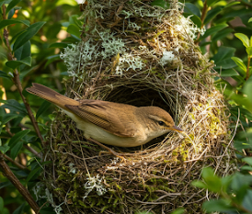
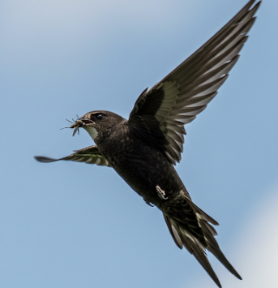
Methodology
Step 2: Data collection
The data were collected within the project SACRE, ‘Monitoring of Common Breeding Birds,’ developed by the Spanish Ornithological Society (SEO/BirdLife). We selected the data from 2019, which provides the highest number of sampling points.
Step 3: Data selection and classification and statistical analysis
The bird species detected were classified according to their nesting and trophic ecology.
Ecology nesting | Trophic ecology
Buildings, tres, bushes, bushes. | Air, bushes, trees and bushes.
Source: AI generated image.
Sociedad Española de Ornitología

Slide 7
Methodology
Step 3: Data selection and classification and statistical analysis
-Generalized Linear Mixed Models (GLMMs) were used in this analysis to identify any differences between the three selected urban configurations in terms of species richness, individual abundance, and diversity.
-For numerical calculations, we used the R library lmer4.
-These GLMMs provide a more detailed representation, including the urban category as a “fixed effect,” while the variability between grids is modelled as a “random effect.”
-To establish whether the differences between urban configurations are statistically significant, the p-values of the t-tests associated with the relevant contrasts were calculated and adjusted using the Tukey method to account for multiple comparisons (three), and p-values smaller than 5% were considered as statistically significant; these calculations were performed by means of the R package R emmeans
Sociedad Española de Ornitología

Slide 8
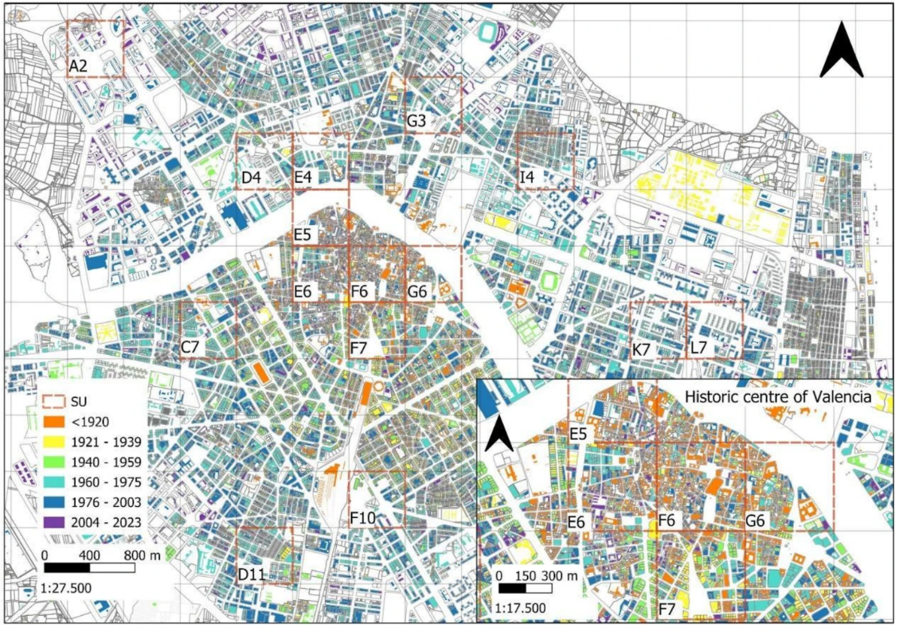
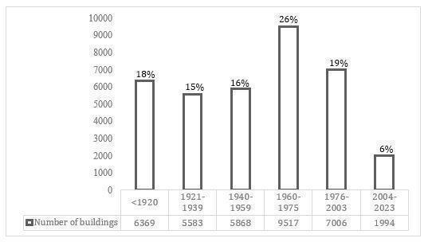
Results
Urban Composition
Fig. 3. Number and percentage of buildings by construction period. Source: the authors.
Sociedad Española de Ornitología

Slide 9
Results
The Shannon Index was 1.04 in HC, 1.25 in OB and 1.48 in CB.
The most abundant species (83%)were the swift, the rock pigeon, the house sparrow and the Eurasian collared dove.
Individuals that feed in the air are more abundant in HC.
Higher numbers of birds using artificial structures are revealed, followed by those that nest in trees.
Fig. 4. Three intersecting circles represent the OB, HC, and CB urban configurations. Species common to all configurations are placed in the central overlap, those shared by two configurations in the pairwise intersections, and species unique to one configuration in the non-overlapping areas. *Species with fewer than two individuals surveyed.
. Source: The authors.
Sociedad Española de Ornitología

Slide 10
Conclusions
The historic centre (HC), due to its age and proximity to urban green areas, indeed presents a higher density of birds, especially those that feed in the air and nest in buildings, such as swifts and house martins. Only 13 of the total 23 species.
However, it is important to note that both species richness and overall diversity are higher in open and closed blocks than in the historical centre.
While some urban areas may exhibit higher diversity than others, the overall trend in urban environments is toward a more uniform and less diverse species composition compared to natural habitats.
These results could be influenced by the inherent constraints of citizen science.
Given the decline of the common swift and its relationship with the lack of suitable nesting sites in modern buildings, SEO/Birdlife is already working to ensure that regulations include the creation of specific nesting spaces.
Sociedad Española de Ornitología

Slide 11
Thank you!
Thanks to the research coauthors, Judit Sabán, Emilio Barba and Juan A. García-Esparza. Antonio Castelló and Anna Valentín from SEO/Birdlife Spain.
Thanks to Marta Canales for the built environment evaluation.
Funding: Universitat Jaume I,PREDOC/2022/027, Ministerio de Ciencia e Innovación, Plan de Recuperación, Transformación y Resiliencia, TED2021-130813B-I00, Generalitat Valenciana,CIAICO/2023/082, ERA-NET Cofund,EU-AEI,PCI2024-155028-2.
Contact: buenano@uji.es
Sociedad Española de Ornitología

Slide 12
Sociedad Española de Ornitología
Urban Form Shapes Bird Community: Insights from the green capital of Europe 2024

